Slide 1
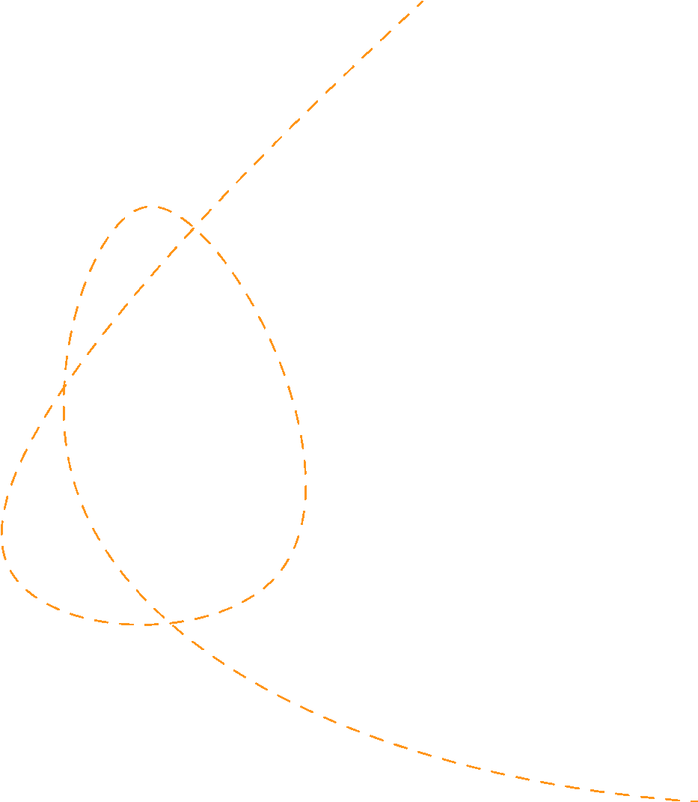





Elasticity of Demand and Supply
Prepared by Dr. Sahar ALBOSAILY
Lecture 04
MTH 112
Business Mathematics

Slide 2
Elasticity of Demand and Supply
At the end of this lecture, you should be able to:
Calculate the coefficient of price elasticity of demand at a point on the demand function
Calculate the coefficient of price elasticity of demand averaged along an arc on the demand function
Calculate the coefficient of price elasticity of supply

Slide 3

Elasticity of Demand, Supply and Income
Elasticity:
The concept of elasticity, denoted by the symbol $ϵ$, as used in economics, is the ratio of the percentage change in the quantity demanded (or supplied) to a percentage change in an economic variable. e.g.: price, income, etc.
Elasticity may be used to predict the responsiveness of demand (and supply) to changes in such economic variables.

Slide 4
Elasticity of Demand and Supply
Price elasticity of demand:
Price elasticity of demand measures the responsiveness (sensitivity) of quantity demanded to changes in the good’s own price. It is also referred to as own-price elasticity. It is represented by the general elasticity formula.
$=\frac{\frac{ΔQ}{Q}100}{\frac{ΔP}{P}100}$
which simplifies to: $ϵ_{d}=\frac{ΔQ}{ΔP}.\frac{P}{Q}$
$ε_{d}$=$\frac{\text{Percentagechangeinquantitydemanded}}{\text{Percentagechangeinprice}}$ =
$$\frac{{\%∆Q}_{d}}{\%∆P}$$

Slide 5
Elasticity of Demand and Supply
Price elasticity of demand:
There are two approaches to measuring price elasticity: Point elasticity and arc elasticity.
Point elasticity measures elasticity at a point on the demand function.
Arc elasticity measures elasticity over an interval on the demand function

Slide 6
Point elasticity of demand
Point elasticity of demand
Given the linear demand function, $P=a-bQ$,
the formula for point elasticity of demand at any point (${P_{0},Q}_{0}$ ) is
$ϵ_{d}=\frac{ΔQ}{ΔP}\frac{P}{Q}$
or
$ϵ_{d}=-\frac{1}{b}\frac{P_{0}}{Q_{0}}$ since slope = $\frac{ΔQ}{ΔP}=-\frac{1}{b}$

Slide 7
Example A(i, ii, iii)
Example:
Given the demand function for computers as $P=2400-0.5Q$.
Determine the coefficient of point elasticity of demand when
$P=1800$,
$P=1200$
$P=600$.
Give a verbal description of each result.

Slide 8
Solution A (i) (1/2)
Solution A (i)
At $P=1800$ the quantity of computers demanded, $Q$, is calculated by substituting $P=1800$ into the demand function:
$$P=2400-0.5Q→1800=2400-0.5Q→0.5Q=600→Q=1200$$
The value of point elasticity of demand at ($P=1800,Q=1200$) is calculated by substituting these values along with $b=0.5$ into formula
$$ϵ_{d}=-\frac{1}{b}\frac{P_{0}}{Q_{0}}$$

Slide 9
Solution A (i) (2/2)
Solution A (i):
$ϵ_{d}=-\frac{1}{b}\frac{P_{0}}{Q_{0}}$
$=-\frac{1}{0.5}\frac{1800}{1200}=-\frac{1800}{600}=-\frac{3}{1}=-3$
The coefficient of point elasticity of demand is $ϵ_{d}=-3$, which indicates that at the price $P=1800$, a 1% increase (decrease) in price will cause a 3% decrease (increase) in the quantity of computers demanded.
Demand is elastic, $|ϵ_{d}|>1$.

Slide 10
Solution A (ii, iii) (1/2)
Solution A (ii) (iii):
The calculations for price elasticity of demand for P= 1200 and P = 600 are carried out in the same way as (i) and are summarized below:
$P_{0}$ 1800 1200 600
Calculate $Q_{0}$ $P_{0}=2400-0.5Q_{0}$
$1800=2400-0.5Q_{0}$ $1200=2400-0.5Q_{0}$ $600=2400-0.5Q_{0}$
$0.5Q_{0}=600$
$Q_{0}=1200$ $Q_{0}=2400$ $Q_{0}=3600$

Slide 11
Solution A (ii, iii) (2/2)
Solution A (ii) (iii):
$P_{0}$ 1800 1200 600
Calculate $ϵ_{d}$ $ϵ_{d}=-\frac{1}{b}\frac{P_{0}}{Q_{0}}$
$=-\frac{1}{0.5}\frac{1800}{1200}$ $=-\frac{1}{0.5}\frac{1200}{2400}$ $=-\frac{1}{0.5}\frac{600}{3600}$
$=-3$ $=-\frac{1200}{1200}=-1$ $=-\frac{1}{3}≈-0.33$Demand Demand is elastic Demand is unit elastic Demand is inelastic
$|ϵ_{d}|>1$ $|ϵ_{d}|=1$ $|ϵ_{d}|<1$

Slide 12
Solution
Notes:
$ϵ_{d}=-1$ indicates that at $P=1200$, a 1% increase (decrease) in price will cause a 1% decrease (increase) in the quantity of computers demanded.
$ϵ_{d}=-0.33$ (correct to 2 decimal places) indicates that at $P=600$, a 1 % increase (decrease) in price will cause a 0.33% decrease (increase) in the quantity of computers demanded.

Slide 13
Example B(i, ii)
Example:(Continued)
Given the demand function for computers as $P=2400-0.5Q.$
If the price of computers increases by 12%, calculate the percentage change in the quantity demanded at P =1800, P = 1200 and P = 600.
  First use the definition of elasticity
Then calculate the exact percentage changes and compare them with the answers in (i).
$ε_{d}$ =$\frac{\text{Percentagechangeinquantitydemanded}}{\text{Percentagechangeinprice}}$
$$\frac{{∆Q}_{d}\left(\%\right)}{∆P\left(\%\right)}$$
=

Slide 14
Solution B (i) (1/4)
Solution B (i):
The definition
(2.13)
                may be re arranged as
$ΔQ(\%)=ΔP(\%)×ϵ_{d}$
$ε_{d}$ =$\frac{\text{Percentagechangeinquantitydemanded}}{\text{Percentagechangeinprice}}$
$$\frac{{∆Q}_{d}\left(\%\right)}{∆P\left(\%\right)}$$
=

Slide 15
Solution B (i) (2/4)
Solution B (i):
At $P=1800$ we have calculated that $ϵ_{d}=-3$. To calculate the percentage change in $Q$, substitute $ϵ_{d}=-3$ and $∆$P = 12% into equation (2.13):
$∆Q$=(12% )( -3 )= -36%
The quantity demanded decreases by 36%, a larger percentage decrease than the 12% price increase. Demand is strongly responsive to price change and this is described as elastic demand.

Slide 16
Solution B (i) (3/4)
Solution B (i):
At $P=1200$ we have calculated that $ϵ_{d}=-1$. To calculate the percentage change in $Q$, substitute $ϵ_{d}=-1$ and $∆$P = 12% into equation (2.13):
$∆Q$=(12% )( -1 )= -12%
The quantity demanded decreases by 12%, a larger percentage decrease than the 12% price increase. This is described as unit elastic demand.

Slide 17
Solution B (i) (4/4)
Solution B (i):
At $P=600$ we have calculated that $ϵ_{d}=-0.33$. To calculate the percentage change in $Q$, substitute $ϵ_{d}=-0.33$ and $∆$P = 12% into equation (2.13):
$∆Q$=(12% )( -0.33 )= -3.96%
The quantity demanded decreases by 3.96%, a smaller percentage decrease than the 12% price increase. So, demand is weakly responsive to price, hence it is described as inelastic demand.

Slide 18
Solution B (ii) (1/2)
Solution B (ii):
The calculation of the exact percentage change in $Q$ requires basic arithmetic. Start by calculating the price which results from an increase of 12% on the initial price
$\text{Increase}P=1800\text{by}12\%→P_{\text{new}}=\frac{112}{100}P=1.12(1800)=2016$

Slide 19
Solution B (i) (2/2)
Solution B (ii):
Then calculate the corresponding values of $Q$ from the equation of the demand function.
When $P=1800,Q=1200$ and when $P=2016,Q=768.$
1800, 1200 2016, 768 $\frac{768-1200}{1200}×100=-36\%$ -3 $ΔQ=-3×12=-36\%$
1200, 2400 1344, 2122 $\frac{2112-2400}{2400}×100=-12\%$ -1 $ΔQ=-1×12=-12\%$
600, 3600 672, 3456 $\frac{3456-3600}{3600}×100=-4\%$ $-\frac{1}{3}$ $ΔQ=-\frac{1}{3}×12=-4\%$
Initial P, Q | New P, Q | Percentage change in Q by direct calculation |  | By formula (2.13)
$$ΔQ(\%)=ΔP(\%)ϵ_{d}$$
$$ϵ_{d}$$

Slide 20
Solution
Comment: The exact value of elasticity, -1/3, not the rounded value, -0.33, was used for accurate results when P = 600. The rounded value of elasticity, -0.33, would give approximately the same answer, -3.96%, as obtained by direct calculation. At prices P = 1800 and P = 1200, no rounding of ed was required; the percentage change in demand was exactly the same, whether calculated directly or calculated by equation (2.13).
In general, the computer firm is not only interested in the percentage change in the price of computers, but also in the percentage change in demand which results from the price changes.

Slide 21
Example C
Example:(Continued)
Given the demand function for computers as $P=2400-0.5Q$.
    C. Graph the demand function, indicating where demand is elastic, unit elastic and inelastic.

Slide 22
Solution C
(c) The graph of the demand function is given in Figure 2.35.
P
Figure 2.35: Variation of price elasticity of demand with price along the demand function $P=2400=0.5Q$
3000
Elastic
Unit elastic
2400
1800
$ε_{d}$=-3
Inelastic
1200
$ε_{d}$=-1
$ε_{d}≈$ -0.33
600
0
Q
0
600
1200
1800
2400
3000
3600
4200
4200

Slide 23
Coefficient of price elasticity of demand
Coefficient of price elasticity of demand
There are three categories of price elasticity: elastic, inelastic and unit elastic.
      Elastic demand $-∞<ϵ_{d}<-1$: demand is strongly responsive to changes in price. that is, the percentage change in demand is greater than the percentage change in price. When $ϵ_{d}→-∞$, demand for the good is perfectly elastic. The demand function is horizontal with slope = 0; that is,
$\frac{ΔP}{ΔQ}=\frac{0}{ΔQ}→\frac{ΔQ}{ΔP}=\frac{ΔQ}{0}=∞(P≠0)$
Note: when $ϵ_{d}<-1,|ϵ_{d}|>1$

Slide 24
Coefficient of price elasticity of demand
Coefficient of price elasticity of demand:
      Inelastic demand $-1<ϵ_{d}<0$: demand is weakly responsive to changes in price. that is, the percentage change in demand is less than the percentage change in price. When $ϵ_{d}=0$, demand for the good is perfectly inelastic. The demand function is vertical with slope =$∞$; that is,
$\frac{ΔP}{ΔQ}=\frac{∞}{1}→\frac{ΔQ}{ΔP}=\frac{1}{∞}=0(Q≠0)$
Note: when $|ϵ_{d}|<1$

Slide 25
Coefficient of price elasticity of demand
Coefficient of price elasticity of demand
      Unit elastic demand $ϵ_{d}=-1$: the percentage change in demand is equal to -1. The numerical scale for the coefficient of price elasticity of demand is shown in Figure 2.36.

Slide 26
Arc price elasticity of demand
Arc price elasticity of demand measures the elasticity of demand over an interval on the demand function. Instead of using the price and quantity at a point as in point elasticity, arc elasticity uses the average of the prices and quantities at the beginning and end of the stated interval:
$ϵ_{d}=\frac{ΔQ}{ΔP}.\frac{\frac{1}{2}[P_{1}+P_{2}]}{\frac{1}{2}[Q_{1}+Q_{2}]}$ = $\frac{ΔQ}{ΔP}.\frac{P_{1}+P_{2}}{Q_{1}+Q_{2}}$
This formula is often referred to as the midpoints elasticity formula or arc-price elasticity
formula.

Slide 27
Arc price elasticity of demand
Note: For linear functions, the arc-price elasticity of demand formula can also be written as
$ϵ_{d}=\frac{ΔQ}{ΔP}.\frac{P_{1}+P_{2}}{Q_{1}+Q_{2}}=-\frac{1}{b}.\frac{P_{1}+P_{2}}{Q_{1}+Q_{2}}\text{since}\frac{ΔQ}{ΔP}=-\frac{1}{b}$

Slide 28
Arc price elasticity of Supply
The same ideas as developed with respect to the price elasticity of demand can be applied to the analysis of the price elasticity of supply at a point on the supply function or averaged along an arc on the supply function. As the supply function is positively sloped, the coefficient of price elasticity of supply will be positive.
The coefficient of price elasticity of supply is given by the formula
$ϵ_{s}=\frac{\text{Percentage change in quantity supplied}}{\text{Percentage change in price}}=\frac{\%ΔQ_{s}}{\%ΔP}=\frac{ΔQ}{ΔP}.\frac{P}{Q}$

Slide 29
Arc price elasticity of Supply
Given the supply function, $P=c+dQ$, slope = $d=ΔP/ΔQ$. Then, $1/d=ΔQ/ΔP$; hence,
the point elasticity of supply formula is
$ϵ_{s}=\frac{1}{d}\frac{P}{Q}$
Note:
$ϵ_{s}>1$: supply is elastic;
$ϵ_{s}<1$: supply is inelastic;
$ϵ_{s}=1$: supply is unit elastic.

Slide 30
price elasticity of Supply Example
Example:
Given the supply function, $P=20+0.5Q$,
Calculate the arc price elasticity of supply when price increases from £40 to £60.
Calculate the percentage change in quantity supplied in response to a price increase of 10% when P=£40.
(i) By using the definition of elastity in equation (2.16).
(ii) Exactly by using ordinary arithmetic.
Comment and explain the difference between (i) and (ii)

Slide 31
price elasticity of Supply Solution
Solution:

Slide 32
price elasticity of Supply Solution
Solution:

Slide 33
price elasticity of Supply Solution
Solution:

Slide 34

price elasticity of Supply Example
Example:
Given the supply function, $P=20+0.5Q$,
Calculate the arc price elasticity of supply when price increases from £40 to £60.
Calculate the percentage change in quantity supplied in response to a price increase of 10% when P=£40.
(i) By using the definition of elastity in equation (2.16).
(ii) Exactly by using ordinary arithmetic.
Comment and explain the difference between (i) and (ii)

Slide 35
price elasticity of Supply Solution
Solution:

Slide 36
price elasticity of Supply Solution
Solution:

Slide 37

price elasticity of Supply Example
Example:
Given the supply function, $P=20+0.5Q$,
Calculate the arc price elasticity of supply when price increases from £40 to £60.
Calculate the percentage change in quantity supplied in response to a price increase of 10% when P=£40.
(i) By using the definition of elastity in equation (2.16).
(ii) Exactly by using ordinary arithmetic.
Comment and explain the difference between (i) and (ii)

Slide 38
price elasticity of Supply Solution
Solution:

Slide 39
price elasticity of Supply Solution
Solution:

Slide 40
price elasticity of Supply Solution
Solution:

Slide 41
Thank you
Thank you ..

