Slide 1

Digital Consumer Behavior
Prepared by Dr. Noha El Aswad
Lecture 10
MKT713_
Master of Digital Marketing

Slide 2
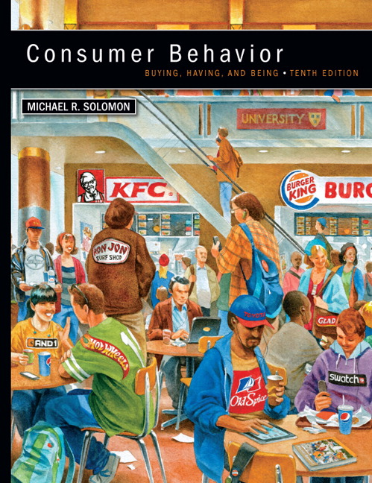

Chapter
02
Buying, Having, Being
CONSUMER BEHAVIOR, 10e
Michael R. Solomon

Slide 3
Chapter
02
Chapter Objectives
When you finish this chapter, you should understand why:
  Ethical business is good business.
  Marketers have an obligation to provide safe and functional products as part of their business activities.
  Consumer behavior impacts directly on major public policy issues that confront our society.
  Consumer behavior can be harmful to individuals and to society

Slide 4
Chapter
02
Lecture Objectives 1/2
When you finish this lecture, you should understand why:
Part 2 Learning objective 4 in chapter 2
  D- Consumer theft and Fraud
  Shrinkage
  Counterfeiting
  Anti-consumption
Case study on chapter 2

Slide 5
Chapter
02
Lecture Objectives 2/2
When you finish this lecture, you should understand why:
Chapter 3
  Perception is a three-stage process that translates raw stimuli into meaning.
  Products and commercial messages often appeal to our senses, but we won’t be influenced by most of them.
  The design of a product today is a key driver of its success or failure.
      Sensation and Perception
      The Process of Perception
      Sensory Systems
      Hedonic Consumption
      Sensory marketing
      The Stages of Perception

Slide 6

Chapter
2
  D- Consumer theft and Fraud 1 /3
Who among us has never received an email offering us fabulous riches if we help to recover a lost fortune from a Nigerian bank account? Of course, the only money changing hands will be yours if you fall for the pitch from a so-called advance-fee fraud artist.

Slide 7
Chapter
2
  D- Consumer theft and Fraud 2 /3
These con men have successfully scammed many victims out of hundreds of millions of dollars. However, a small but intrepid group of “counters-cammers” sometimes give these crooks a taste of their own medicine by pretending to fall for a scam and humiliating the perpetrator.

Slide 8
Chapter
2
  D- Consumer theft and Fraud 3 /3
One common strategy is to trick the con artist into posing for pictures while holding a self-mocking sign and then posting these photos on Internet sites. Both online and offline, fraud is rampant.

Slide 9

Chapter
2
  E- Shrinkage 1 /2
Shrinkage is the industry term for inventory and cash losses from shoplifting and employee theft (it does not refer to the condition George experienced in a famous episode of the Seinfeld TV show).

Slide 10

Chapter
2
  E- Shrinkage 2 /2
This is a massive problem for businesses that gets passed on to consumers in the form of higher prices (about 40 percent of the losses can be attributed to employees rather than shoppers).
Shopping malls spend $6 million annually on security, and a family of four spends about $300 extra per year because of markups to cover shrinkage.

Slide 11
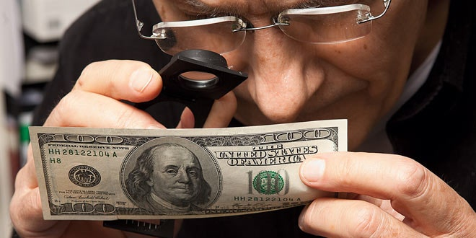
Chapter
2
  F- Counterfeiting
Counterfeiting, where companies or individuals sell fake versions of real products to customers (who may or may not be aware of the switch), accounts for more than $600 billion in global losses annually. Many of us think of counterfeiters as guys who sell faux designer handbags or watches on the street, but in fact the problem is much more widespread— and often deadly. About 200,000 people in China die per year because they ingest fake pharmaceuticals

Slide 12
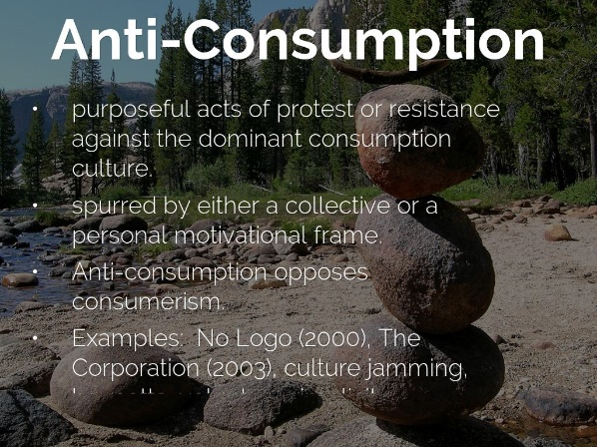
Chapter
2
  G – Anti-consumption 1/2
Some types of destructive consumer behavior are anti-consumption; events in which people deliberately deface or mutilate products and services. Anti-consumption ranges from relatively mild acts like spray-painting graffiti on buildings and subways to serious incidences of product tampering or even the release of computer viruses that can bring large corporations to their knees.

Slide 13
Chapter
2
  G – Anti-consumption 2/2
It can also take the form of political protest in which activists alter or destroy billboards and other advertisements that promote what they feel to be unhealthy or unethical acts.

Slide 14
Chapter
2
Case study 1 /12
child’s life by giving them not only a pair of shoes, but also a safe means to walk to school and avoid diseases that a child could catch walking barefoot. For customers, this knowledge makes the act of buying shoes more than just a purchase. They are able to associate themselves with the company’s social mission.
So far, TOMS has given 35 million pairs of shoes to children in more than 70 countries; it does so by donating shoes to charitable organizations that include the provision of shoes in their community development programs. The shoes are provided according to the type of terrain and season for each community and region. Additionally, TOMS also creates local jobs by manufacturing shoes in countries where they are given.

Slide 15
Chapter
2
Case study 2 /12
Corporate social responsibility at TOMS also focuses on the environmental impact of its products and operations. The shoes are made of sustainable vegan materials and their manufacturing design includes natural hemp, organic cotton, or recycled polyester. Their shoes boxes are made from 80 percent recycled material and are printed with soy ink. Expanding its social mission beyond providing shoes to children in need, TOMS has started other missions, including eye care, clean water, and safer birth. TOMS says that giving is in its DNA, and this is apparent from the fact that it even has a position called Chief Giving Officer. This person is responsible for ensuring that the various charitable missions that TOMS undertakes are carried out properly.

Slide 16
Chapter
2
Case study 3 /12
In 2011, TOMS eyewear was launched, and it has helped restore sight to more than 275,00 people in need. Its eyewear mission operates in 13 countries and provides diagnostic services, medical treatment, vision correction procedures, and prescription glasses with each sale of eyewear. The mission supports sustainable community-based eye care programs and helps in the creation of local professional job opportunities by providing basic eye care training to local health volunteers and teachers.

Slide 17
Chapter
2
Case study 4 /12
The company works on its clean water mission through its coffee roasting division. In 2014, TOMS Roasting Co. was launched, and it has helped provide over 67,000 weeks of safe drinking water in six countries. With each sale of TOMS Roasting Co. Coffee, the company works with its “Giving Partners” to provide one week’s supply of safe water to one person and also works to provide sustainable safe water systems for entire communities. In 2014, working on the same One for One philosophy, TOMS Bag Collection was launched in four countries.

Slide 18
Chapter
2
Case study 5 /12
TOMS Bags works with its Giving Partners to provide training for skilled birth attendants, and with every bag sold, TOMS provides birth kits that help women deliver a baby safely. TOMS draws style and textile inspirations for its bag collection from the locations where it provides shoes, eye care, and water. The entire TOMS bag line communicates a global ethos that reinforces the company’s pledge to make a difference in people’s lives and works toward their well-being.

Slide 19
Chapter
2
Case study 6 /12
The manufacturing units for TOMS shoes are located in Argentina, Ethiopia, and China. The company is conscious of the challenges that come with a global supply network. Their global staff works closely with suppliers and vendors to ensure that TOMS ethical standards are maintained uniformly. Every year, the company ensures that its direct suppliers provide certification that the materials are sourced in conformity with the applicable local labor laws, including laws related to slavery and human trafficking. The company invests in its employees by providing training to them on various business and leadership issues, and it also provides training by third-party experts on labor laws to its supply chain employees.

Slide 20
Chapter
2
Case study 7 /12
Although widely recognized and appreciated, the TOMS One for One charity model has been questioned by some critics on broader and long-term social benefits. The critics argue that there are unintended negative consequences of the One for One charity model that come at the expense of the local businesses in the communities where TOMS carries out its charities. For example, they suggest, for example, that the local business of a small-scale cobbler who makes and sells shoes in a small town is greatly undermined when a truckload of free shoes arrives in their town. When a community gets free shoes, they will not buy shoes available at the local shop, and this will hurt the income of the local business. To make matters worse, if the free shoes are distributed at irregular time periods, the local shoe vendors are not able to plan the demand levels for their shoes.

Slide 21
Chapter
2
Case study 8 /12
Critics further argue that that giving free things fosters a poor self-image among the recipients. The critics do recognize that such a social mission has good intentions, but they contend that it only provides a small and temporary fix and does not actually alleviate poverty from the roots. As the proverb goes, it’s better to teach a hungry person to fish than to just give them a fish to eat. Furthermore, they say that in addition to hindering local businesses, such a model creates dependency and makes the affluent buyers of One for One products complacent about devising other ways to improve poverty and other social issues.

Slide 22
Chapter
2
Case study 9 /12
Similarly, many organizations that support social enterprises and entrepreneurial ventures suggest that the free giving model of charity does not address deeper causes of poverty, and in fact be inhibits long-term solutions. Such models approach poverty with the notion that people are poor because they lack things, and they ignore the reasons behind poverty, like the lack of infrastructure to earn more and make a better living. Social causes should not focus only on giving but should also focus on finding ways through which families can earn and support themselves. Although the TOMS model still predominately revolves around the free-good charity approach, it is worth noting that in some ways TOMS has responded to such criticisms by expanding the scope of its social missions. It diversified its charitable missions by including eye care, safe birth and clean water missions as a way to engage in socially responsible causes that go beyond the free good charities.

Slide 23
Chapter
2
Case study 10 /12
Overall, looking at the popularity of the TOMS model from the consumer point of view, it can be said to be a marketing success.
TOMS understands that more consumers want to buy from companies that incorporate sustainable and responsible business practices that are key elements of its ethos. To communicate its social message and raise awareness of global issues like poverty and blindness, the company holds events like One Day Without Shoes, Style Your Sole, and World Sight Day

Slide 24
Chapter
2
Case study 11 /12
TOMS understands that consumers like tangibility in their charitable actions and good causes. They feel less passionate about a company that says it will spend 10 percent of its profits on research that will help the poor, but if a company says it will give shoes to or will put glasses on a poor child, the consumer will feel a direct connection.

Slide 25
Chapter
2
Case study 12 /12
TOMS’s One for One model has also inspired many other companies to adopted such practices as part of their corporate social responsibility. Once such example is the Canadian company The Meal share, which also works on the “buy one, give one” principle: the non-profit company gives people the choice to feed someone in need every time they eat out. Another company that has meaningfully modified the TOMS charity model is TheNaked Hippie, which works on the basis of “buy one, fund one.” This T-shirt brand invests 100% of its profits in micro loans that help people in developing countries start small business to support themselves and their families.

Slide 26
Chapter
2
(DISCUSSION QUESTIONS) 1/3
CS 2-1 Discuss TOMS’s ethical foundation and its approach to social marketing and corporate social responsibility. Would TOMS have succeeded without its One for One business model?.

Slide 27
Chapter
2
(DISCUSSION QUESTIONS) 2/3
CS 2-2Given the increasing trend toward ethical consumerism or conscientious consumption, discuss how consumers evaluate TOMS’s ethical supply chain and charitable causes as part of their decision making.

Slide 28
Chapter
2
(DISCUSSION QUESTIONS) 3/3
CS 2-3 Considering the viewpoints of the critics regarding TOMS’s charity model, discuss its pros and cons. What type of sustainable charitable causes can TOMS pursue in the future that will attract more customers to its social marketing efforts?

Slide 29
Chapter
3
Chapter 3
Sensation and Perception

Slide 30
Chapter
3
Sensation and Perception
Sensation is the immediate response of our sensory receptors (eyes, ears, nose, mouth, and fingers) to basic stimuli (light, color, sound, odor, and texture).
Perception is the process by which sensations are selected, organized, and interpreted.

Slide 31
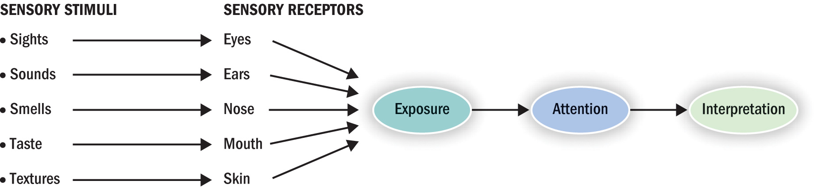
Chapter
3
The Process of Perception
We receive external
stimuli through
our five senses

Slide 32
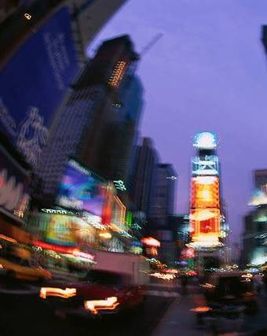
Chapter
3
Sensory Systems
Our world is a symphony of colors, sounds, odors, tastes, etc.
Marketers contribute to the commotion
Advertisements, product packages, radio and TV commercials, billboards provide sensations

Slide 33
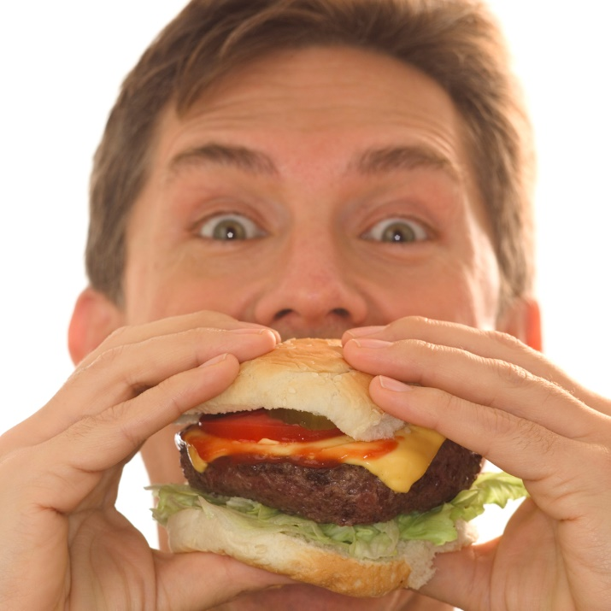
Chapter
3
Hedonic Consumption
Hedonic consumption: multisensory, fantasy, and emotional aspects of consumers’ interactions with products
Marketers use impact of sensations on consumers’ product experiences

Slide 34
Chapter
3
Sensory marketing
Welcome to the new era of sensory marketing, where companies think carefully about the impact of sensations on our product experiences. From hotels to carmakers to brewers, companies recognize that our senses help us decide which products appeal to us—and which ones stand out from a host of similar offerings in the marketplace.
.

Slide 35
Chapter
3
The Stages of Perception
Like computers, we undergo stages of information processing in which we input and store stimuli.
Unlike computers, though, we do not passively process whatever information happens to be present.
In the first place, we notice only a small number of the stimuli in our environment, simply because there are so many different ones out there.
Each individual interprets the meaning of a stimulus in a manner consistent with his or her own unique biases, needs, and experiences.

Slide 36
Chapter
3
Stage 1: Exposure
Exposure occurs when a stimulus comes within range of someone’s sensory receptors
We can concentrate, ignore, or completely miss stimuli.

Slide 37
Chapter
3
Stage 2: Attention
As you sit in a lecture, you might find your mind wandering (yes, even you!). One minute you are concentrating on the professor’s words, and the next you catch yourself daydreaming about the upcoming weekend. Suddenly, you tune back in as you hear your name being spoken. Fortunately, it’s a false alarm—the professor has called on another “victim” who has the same first name. But she’s got your attention now.

Slide 38
Chapter
3
Stage 3: Interpretation
Interpretation: the meaning that we assign to sensory stimuli
  Meaning we assign to stimulus is called schema
  Through priming, certain properties of a stimulus evoke a schema
We interpret sensations to others already in memory
We interpret ambiguous stimuli based on our experiences, expectations, and needs

Slide 39
Chapter
2
Lecture summary
We have been learning:-
  Part 2 Learning objective 4 in chapter 2
    D- Consumer theft and Fraud
    Shrinkage
    Counterfeiting
    Anti-consumption
  Case study on chapter 2
Chapter 3
  Sensation and Perception
  The Process of Perception
  Sensory Systems
  Hedonic Consumption
  Sensory marketing
  The Stages of Perception

Slide 40


