Slide 1



Enterprise Risk Management
PMG 611
Lecture 3
Importance of Effective GRC Practices and Principles
Prepared by
Dr. Eng. Abdullah Jameel Halawany

Slide 2

Lecture
Session Outline
03
Road to Effective GRC Principles
Importance of GRC Governance
Risk Management Component of GRC
GRC and Enterprise Compliance
Importance of Effective GRC Practices and Principles
Introduction
3–2

Slide 3
Lecture
Introduction
03
Importance of Effective GRC Practices and Principles
PMG 611
Enterprise Risk Management
3–3

Slide 4
Lecture
Introduction
03
Enterprise organizations and corporations have faced governance issues since their earliest days.
In past eras, setting the rules for employees and other stakeholders to follow worked with small single proprietorships or in the tightly centralized corporations.
Today’s larger and often multiunit enterprises need broad-based units or functions for setting rules and procedures—they need efficient and effective governance processes.
3–4

Slide 5
Lecture
Introduction
03
Life would be easier for enterprises if they just had to rely on a central leadership to set those governance rules.
Enterprises today of any location or size are faced with ever increasing sets of rules and procedures
  Local Police
  Public Safety Ordinances
  National and International Laws
  Broad professional rules and standards
3–5

Slide 6
Lecture
Introduction
03
On a whole series of levels, an enterprise must comply with these laws and regulations.
Failure to do so can result in a variety of penalties.
Enterprise needs processes to ensure that they are operating incompliance with the appropriate laws and regulations.
An enterprise always faces risks that it will be found in violation of one or another of these multiple laws and regulations.
3–6

Slide 7
Lecture
Introduction
03
There are also risks that their own established governance rules will
  not achieve their desired results or
  may face some outside event beyond their control, such as a major weather event or a fire
There is a need to manage these risks at an overall enterprise level.
ERM has brought all three of these Governance, Risk, and Compliance concerns together into what has been called GRC principles.
3–7

Slide 8
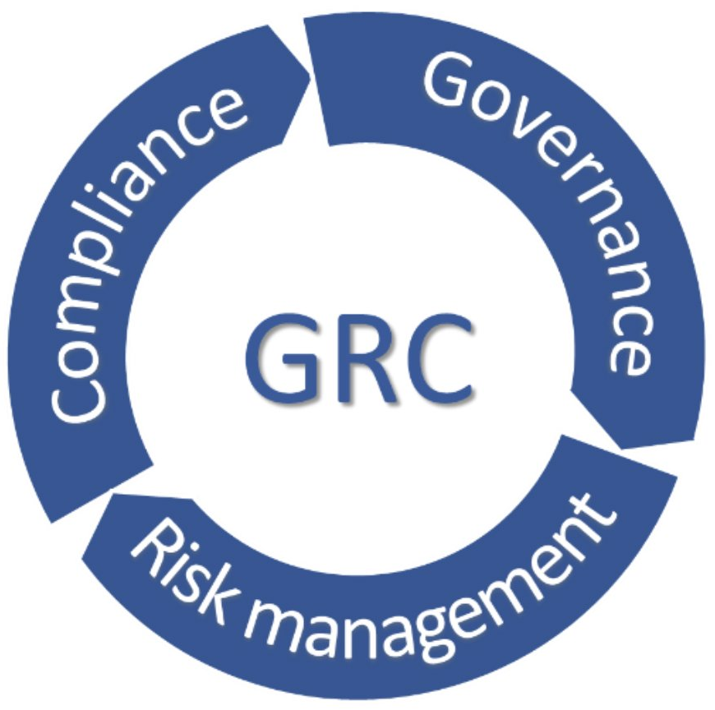
Road to Effective GRC Principles
Lecture
03
Importance of Effective GRC Practices and Principles
PMG 611
Enterprise Risk Management
3–8

Slide 9
Lecture
Road to Effective GRC Principles
03
Business professionals did not even hear about the now increasingly familiar acronym GRC until a few years after SOx.
The Sarbanes-Oxley Act of 2002, often simply called SOX or Sarbox, is U.S. law meant to protect investors from fraudulent accounting activities by corporations.
Sarbanes-Oxley was enacted after several major accounting scandals in the early 2000’s perpetrated by companies such as Enron, Tyco, and WorldCom.
3–9

Slide 10
Lecture
What is SOX Law?
03
The law mandates strict reforms to improve financial disclosures from corporations and prevent accounting fraud.
It also covers issues such as auditor independence, corporate governance, internal control assessment, and enhanced financial disclosure.
The law is named for the two congressmen who drafted it, Paul Sarbanes and Michael Oxley.
The U.S. Securities and Exchange Commission (SEC) administers the act.
3–10

Slide 11
Lecture
G for Governance
03
It means taking care of business, making sure that things are done according to
  Enterprise’s Standards,
  Enterprise’s Regulations,
  Enterprise’s Board of Directors’ Decisions.
It also means setting forth clear stakeholder expectations of what should be done so that everyone is on the same page with regard to how the enterprise is run.
3–11

Slide 12
Lecture
R for Risk
03
It’s pretty clear that certain risks are just not to be taken.
When it comes to business, however, risk becomes a way to help both
  Protect existing asset value
  Create value by strategically expanding an enterprise or adding new products and services.
The concept of risk is even more important than just the ERM. (Lecture 2)
3–12

Slide 13
Lecture
C for Compliance
03
Represents compliance with the many laws and rules affecting businesses and citizens today.
Sometimes, people will also extend that C to include controls.
For example, it means monitoring a factory’s emissions or ensuring that its import and export papers are in order. Or it might just mean establishing effective Internal Accounting Controls.
3–13

Slide 14
Lecture
GRC Concepts
03
All enterprises, and corporations, historically do not think of GRC as a combined set of principles.
GRC is an increasingly recognized term that reflects a new way in which enterprises today are adopting an integrated approach to these aspects of their businesses.
GRC represent core disciplines of governance, risk management, and compliance.
Each of the disciplines consists of the four basic GRC components: strategy, processes, technology, and people.
3–14

Slide 15
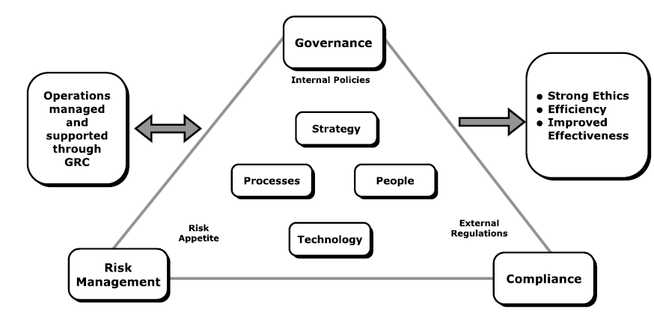
Lecture
GRC Concepts
03
3–15

Slide 16
Lecture
GRC Concepts
03
Internal policies are the key factors supporting governance.
External regulations drive compliance principles.
Enterprise’s risk appetite is a key element of risk management.
Requires management attention and support,
Result in correct ethical behavior, organizational efficiency, and improved effectiveness
3–16

Slide 17
Lecture
GRC Concepts
03
The three GRC principles should be thought of in terms of one continuous and interconnecting flow of concepts.
Neither G, R, or C more important or significant than the others.
3–17

Slide 18
Lecture
Importance of GRC Governance
03
Importance of Effective GRC Practices and Principles
PMG 611
Enterprise Risk Management
3–18

Slide 19
Lecture
Importance of GRC Governance
03
Corporate or enterprise governance is a term that refers broadly to the rules, processes, or laws by which businesses are operated, regulated, and controlled.
The term can refer to
  Internal factors defined by the officers, stockholders, or the charter and basic objectives of a corporation.
  External forces such as consumer groups, clients, and government regulations.
3–19

Slide 20
Lecture
Importance of GRC Governance
03
At enterprise operations level, we can define enterprise governance as
The responsibilities and practices exercised by the board, executive management, and all levels of functional management with the goals of
  Providing strategic direction.
  Ensuring that objectives are achieved.
  Ascertaining that risks are managed appropriately.
  Verifying that the enterprise’s resources are used responsibly.
3–20

Slide 21
Lecture
Importance of GRC Governance
03
Governance really refers to the process of
  Establishing rules and procedures within all levels of an enterprise
  Communicating those rules to appropriate levels of stakeholders
  Monitoring performance against those rules
  Administering rewards and punishments based on the relative performance or compliance with those rules
3–21

Slide 22
Lecture
Importance of GRC Governance
03
A well-defined and enforced set of corporate governance principles provides a structure that works for the benefit of everyone concerned by ensuring that the enterprise adheres to accepted ethical standards and best practices as well as to formal laws.
3–22

Slide 23
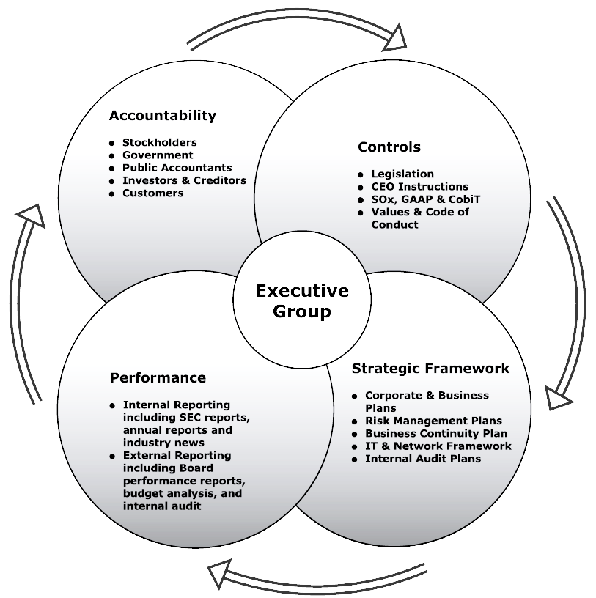
GRC Governance Concepts
3–23

Slide 24
Lecture
Risk Management Component of GRC
03
Importance of Effective GRC Practices and Principles
PMG 611
Enterprise Risk Management
3–24

Slide 25
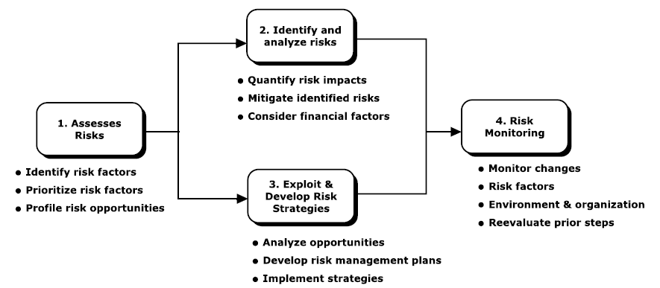
Lecture
Risk Management Component of GRC
03
Risk Management should be part of the overall enterprise culture from the board of directors and very senior officers down through the enterprise.
3–25

Slide 26
Lecture
Risk Management Component of GRC
03
1- Risk assessment and planning.
  Any enterprise faces all levels of risks, whether global issues based on weather or currency threats to weather-related threats at local operations.
  We cannot plan or identify every type of risk that might impact an enterprise, but there should be an ongoing analysis of these various potential risks that may face an enterprise.
3–26

Slide 27
Lecture
Risk Management Component of GRC
03
2- Risk identification and analysis
  There is a need for a more detailed analysis on the likelihood of these risks coming to fruition as well as their potential impacts.
  There is a need to quantify the impacts of the identified risks and to determine mitigation strategies in the event the risk event occurs.
  Mitigation refers to assessing the best way to manage or eliminate an identified risk.
3–27

Slide 28
Lecture
Risk Management Component of GRC
03
3- Exploit and develop risk response strategies.
  Essentially a concept that should be considered in parallel with risk identification, an enterprise should develop plans and strategies to return to normal operations and then recover from the risk event.
  This may include an analysis of risk-related opportunities.
3–28

Slide 29
Lecture
Risk Management Component of GRC
03
4- Risk monitoring.
  Tools and facilities should be in place to monitor for the identified risks possibly occurring.
  Most risk-related monitoring requires a wide series of special reports, established and measurable standards, and a diligent human resources function.
  The idea is to keep ahead and to reenter these prior risk management steps as necessary.
3–29

Slide 30
GRC and Enterprise Compliance
Lecture
03
Importance of Effective GRC Practices and Principles
PMG 611
Enterprise Risk Management
3–30

Slide 31
Lecture
GRC and Enterprise Compliance
03
Compliance is the process of adhering to a set of guidelines or rules established by government agencies, standards groups, or internal corporate policies.
These is applied to all types of business.
Adhering to these compliance-related requirements is a challenge
3–31

Slide 32
Lecture
GRC and Enterprise Compliance
03
Adhering to these compliance-related requirements is a challenge because of
  The frequent introduction of new regulations.
  Vaguely written regulations that require interpretation.
  No consensus on best practices used for compliance.
  Multiple regulations often overlap.
  Constantly changing regulations.
3–32

Slide 33
Lecture
GRC and Enterprise Compliance
03
The Frequent Introduction Of New Regulations
Regulation is a fundamental tool for managing the risks present in society and the economy and can help to reduce the incidence of hazardous events and their severity.
  Examples (New studies, Privacy issues, etc..)
Companies have a challenge to monitor these rules and determine which apply to them.
3–33

Slide 34
Lecture
GRC and Enterprise Compliance
03
Vaguely Written Regulations That Require Interpretation
Some regulations was printed on many thousands of pages, covering issues and rules that the legislators who passed the bill never even read, let alone understood.
Even today, we are still looking at these rules and interpreting what they mean.
Compliance with those types of rules can be difficult.
3–34

Slide 35
Lecture
GRC and Enterprise Compliance
03
No Consensus On Best Practices Used For Compliance
Diverse Regulations: Different industries and regions have varying compliance requirements. This diversity makes it challenging to establish a universal set of best practices.
Evolving Standards: can lead to differing opinions on what constitutes best practices.
Varied Organizational Needs: What works for one company may not be applicable for another, leading to a lack of consensus.
Stakeholder Perspectives: Different stakeholders may prioritize different aspects of compliance, such as cost-effectiveness, risk management, or ethical considerations.
3–35

Slide 36
Lecture
GRC and Enterprise Compliance
03
Multiple Regulations Often Overlap
Governmental units from different geographies may issue rules that cover similar areas but may have different requirements.
Compliance until matters are resolved can be a challenge.
3–36

Slide 37
Lecture
GRC and Enterprise Compliance
03
Constantly Changing Regulations
Regulatory agencies in particular are often constantly changing or reinterpreting their rules, making strict compliance a challenge.
Examples (Ex post evaluation of past approaches)
3–37

Slide 38
Lecture
GRC and Enterprise Compliance
03
Compliance becomes a continuous process, not a one-time project.
Continues to drive business agendas as organizations are being held accountable for meeting the myriad of mandates specific to their markets.
Enterprises might also be required to address cross-industry legislation.
3–38

Slide 39
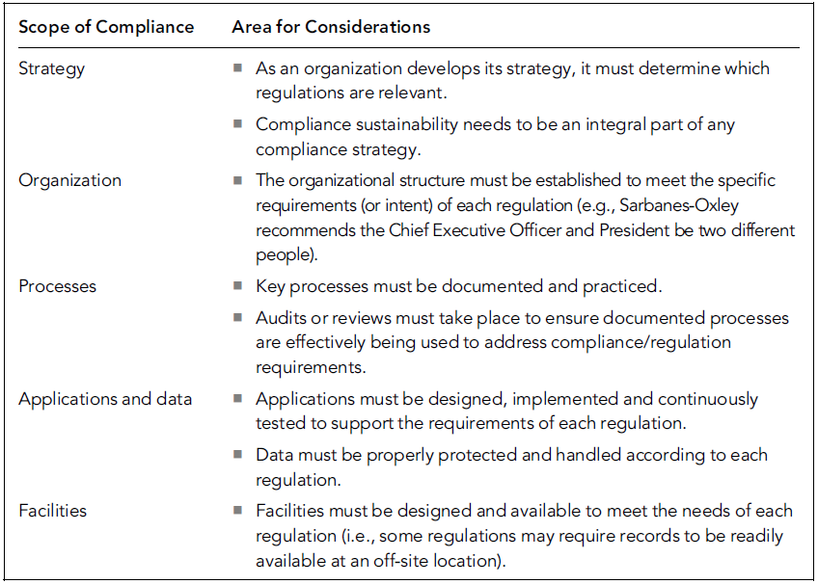
Scope of Compliance Architectures Considerations
The scope of compliance also permeates other aspects of an enterprise.
3–39

Slide 40
Importance of Effective GRC Practices and Principles
Lecture
03
Importance of Effective GRC Practices and Principles
PMG 611
Enterprise Risk Management
3–40

Slide 41
Lecture
03
Importance of Effective GRC Practices and Principles
Corporate Governance has received increased attention because of high-profile scandals involving abuse of corporate power and, in some cases, alleged criminal activity by corporate officers.
An integral part of an effective corporate governance regime includes provisions for civil or criminal prosecution of individuals who conduct unethical or illegal acts in the name of the enterprise.
3–41

Slide 42
Lecture
03
Importance of Effective GRC Practices and Principles
Risk management should create value and be an integral part of organizational processes.
It should be part of decision-making processes and be tailored in a systematic and structured manner to explicitly address the uncertainties an enterprise faces based on the best available information.
In addition, risk management processes should be dynamic, iterative, and responsive to change with the capabilities of continual improvements and enhancements.
3–42

Slide 43
Lecture
03
Importance of Effective GRC Practices and Principles
A consistent approach on the use of compliance driven capabilities and supporting technologies across an enterprise can provide these potential benefits:
  Reduced total cost of ownership.
  Flexibility.
  Competitive advantage.
3–43

Slide 44
Lecture
03
Importance of Effective GRC Practices and Principles
Reduced total cost of ownership.
  For example, many regulations specify document retention requirements, which can be met by a single investment in a content and records management system.
Flexibility.
  By centrally managing compliance initiatives via organization-wide compliance architecture, an enterprise can quickly adapt to these changes.
Competitive advantage.
  Better understand and control their business processes, which allows them to respond more quickly and accurately to external or internal pressures.
3–44

Slide 45
Lecture
Summary
03
Importance of Effective GRC Practices and Principles
PMG 611
Enterprise Risk Management
3–45

Slide 46
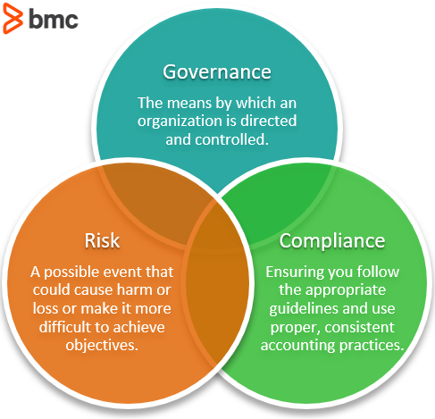
3–46

Slide 47
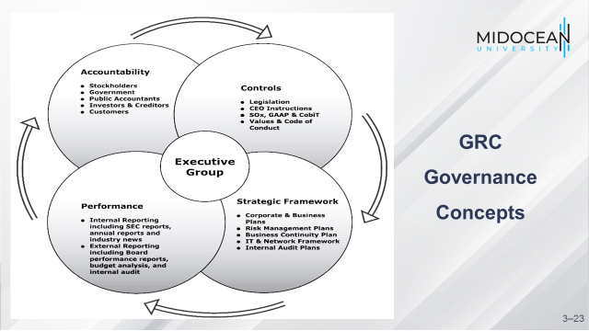
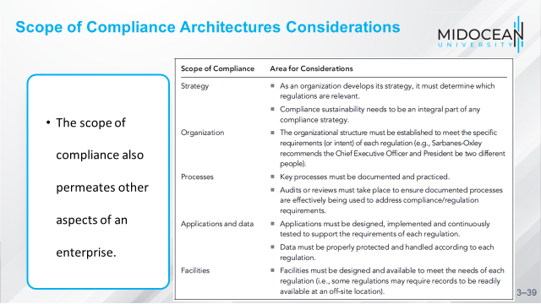
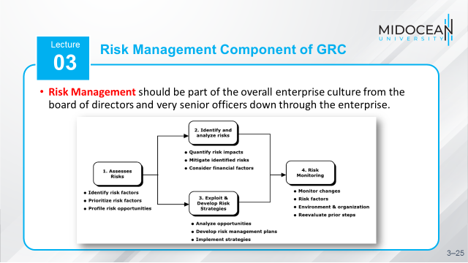
3–47

Slide 48
References
COSO Enterprise Risk Management: Establishing Effective Governance, Risk, and Compliance Processes. Robert R. Moeller.
Implementing Enterprise Risk Management: From Methods To Applications. James Lam.
3-48

Slide 49



Thank You

