Slide 1

CCNA (200-301) Cisco Certified Network Associate
Prepared by Eng. Taghreed Elsayed
Lecture 3
Basic Router Configuration and Verification

Slide 2

Chapter
01
Operating Cisco Routers
What is the Roll Over Cable?
A rollover cable is a network cable that connects a computer terminal to a network router’s console port. It is also referred to as a Cisco console cable and is normally flat and light blue so as to distinguish it from other network cable types. The pin-outs on one end of the cable are reversed from the opposite end, which is how the cable derived its name. Rollover cables are also known as Yost cables or Yost Serial Device Wiring Standard connectors.

Slide 3
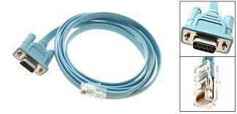
Chapter
01
Operating Cisco Routers
How to Identify a Rollover Cable
A rollover cable is identified by comparing each end of the cable while they are beside each other. The wire that connects the pin on the outside of the plug on the left-hand side is the same color as the wire connecting the pin on the outside of the plug on the right-hand side. If Cisco Systems produced the rollover cable, the first pin will be white on one of the two connectors and pin number 8 will be white on the other.

Slide 4
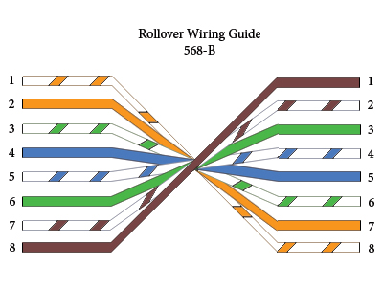
Chapter
01
Operating Cisco Routers
What is the Cisco RJ45 Rollover Cable Pin-out?
The following is the Cisco RJ45 rollover cable pin-out read in five columns:
Router Pin, Router Pin Name, Direction, Workstation Pin, Workstation Pin Name
1 – white-Orange, bi-directional, 8, brown
2 – orange, bi-directional, 7, white-brown
3 – white-green, bi-directional, 6, green
4 – blue, bi-directional, 5, white-blue
5 – white-blue, bi-directional, 4, blue
6 – green, bi-directional, 3, white-green
7 – white-brown, bi-directional, 2, orange
8 – brown, bi-directional, 1, white-orange

Slide 5
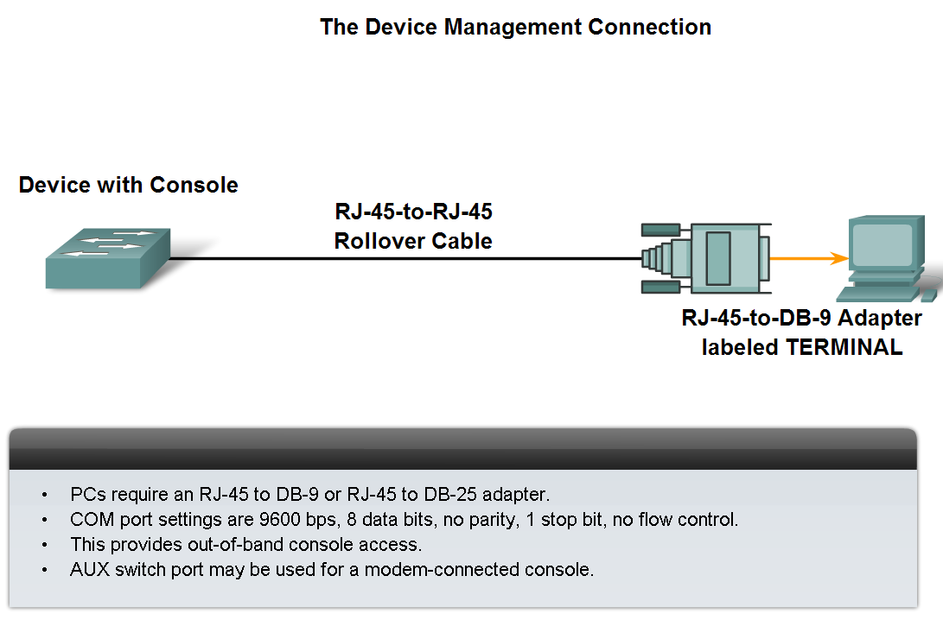
Chapter
01
Operating Cisco Routers
Define the role of device management connections when using Cisco equipment.

Slide 6
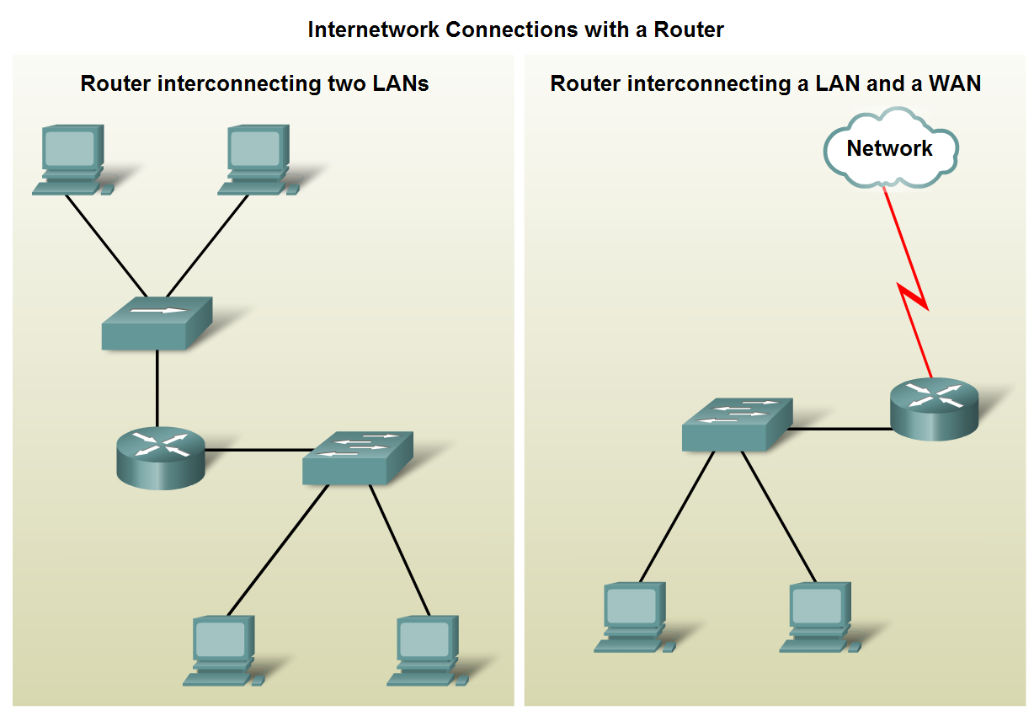
Chapter
01
Operating Cisco Routers
Importance of Network Designs
Given a network requirement, determine the optimum number of sub networks in the larger internetwork.

Slide 7
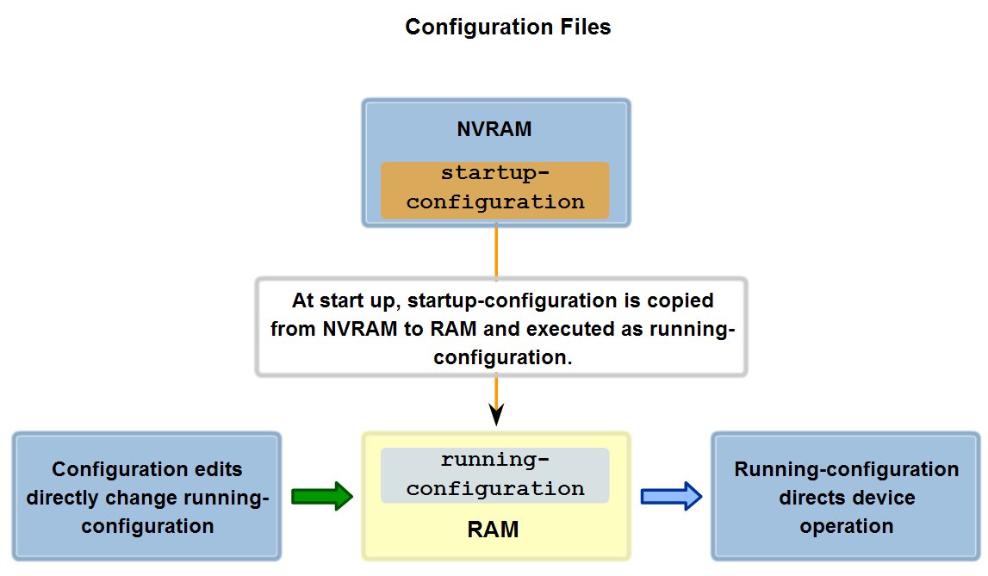
Chapter
01
Operating Cisco Routers
Role of Internetwork Operating System (IOS)
Identify the relationship between IOS
and configuration.

Slide 8
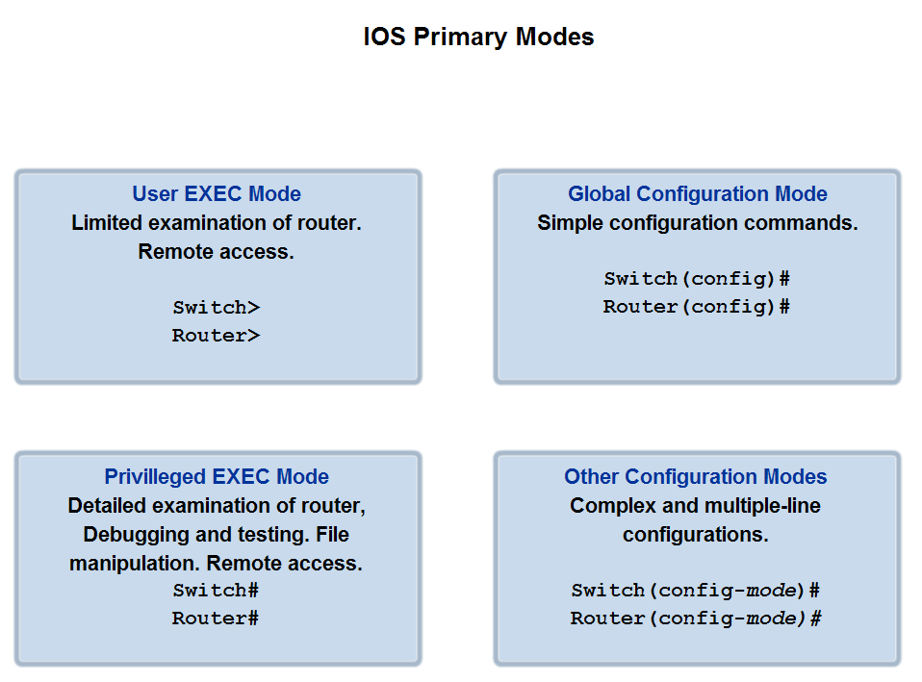
Chapter
01
Operating Cisco Routers
Role of Internetwork Operating System (IOS)
Define the different modes and identify the
mode prompts in the CLI

Slide 9
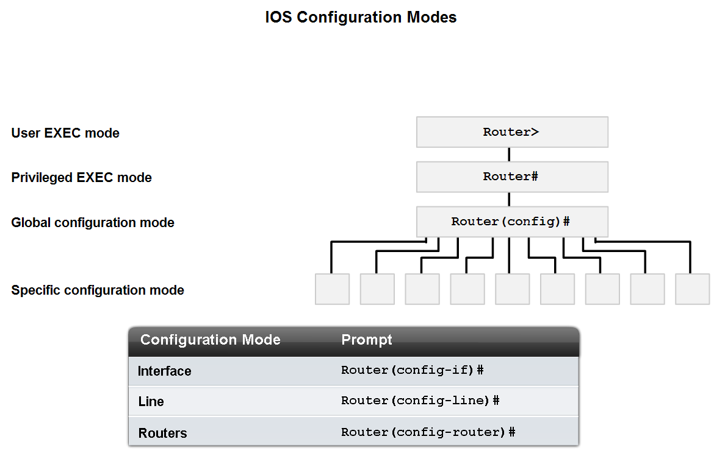
Chapter
01
Operating Cisco Routers
Identify several of the configuration modes, their purpose and their associated prompt

Slide 10
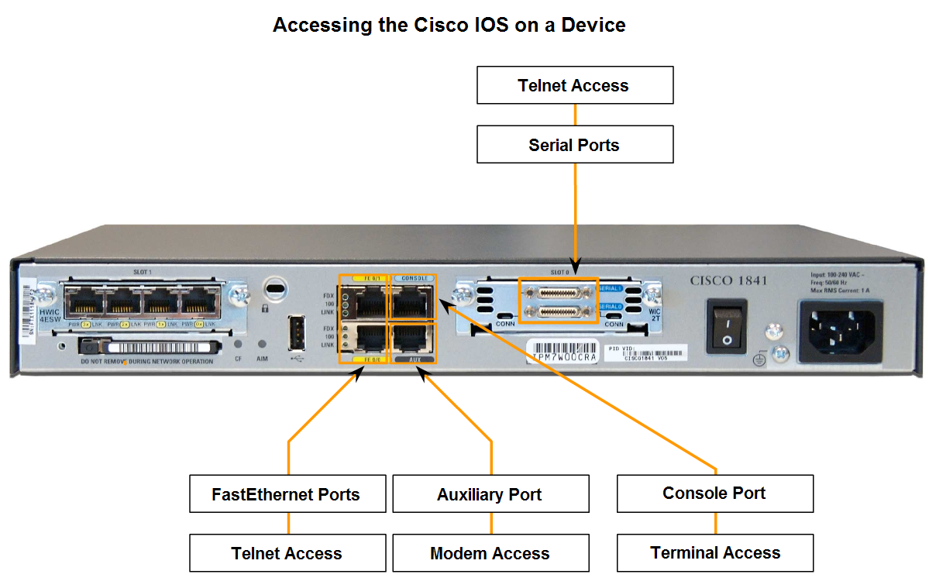
Chapter
01
Operating Cisco Routers
Use the CLI to access various IOS configuration modes on a device

Slide 11
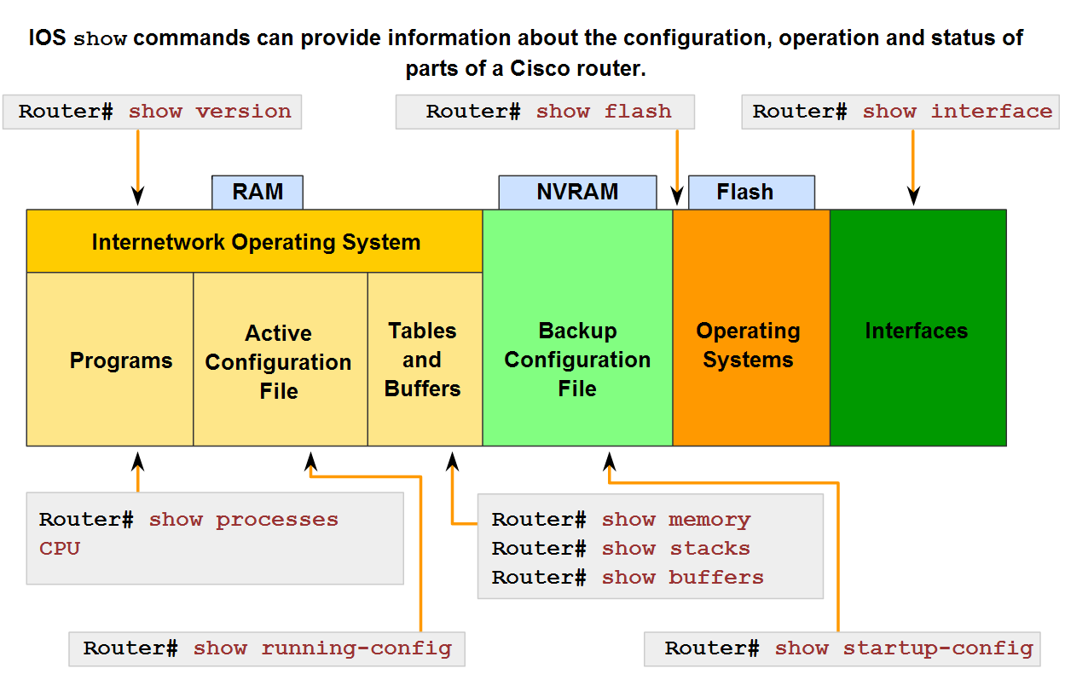
Chapter
01
Operating Cisco Routers
Identify the purpose of the show
command and several of
its variations

Slide 12
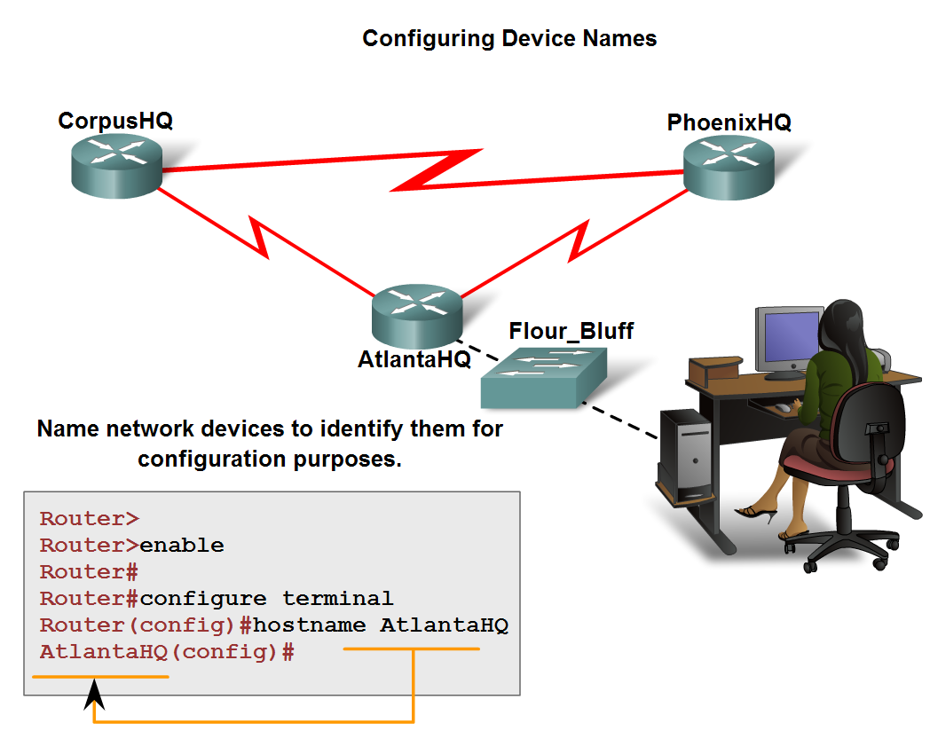
Chapter
01
Operating Cisco Routers
Describe two common approaches to establishing naming conventions

Slide 13
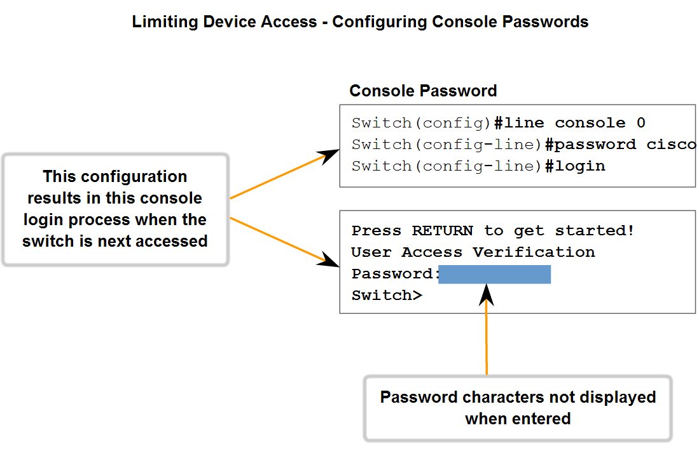
Chapter
01
Operating Cisco Routers
Use Cisco CLI Commands to Perform Basic Router & Switch Configuration and Verification
Describe the role of passwords
in limiting access to device configurations

Slide 14
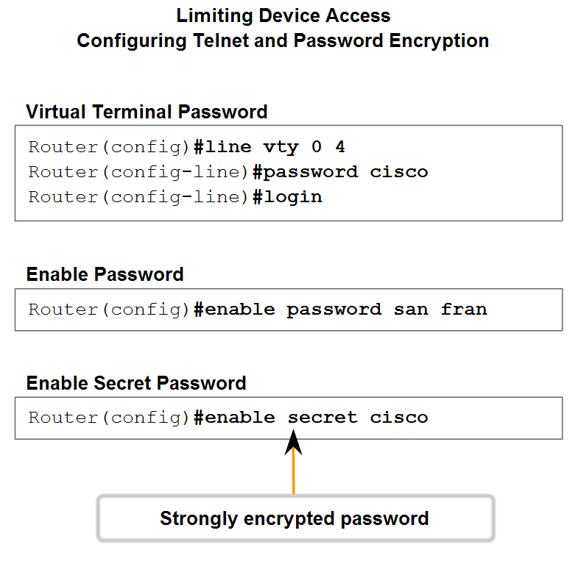
Chapter
01
Operating Cisco Routers
Describe several ways in which access to
a device configuration can be limited

Slide 15
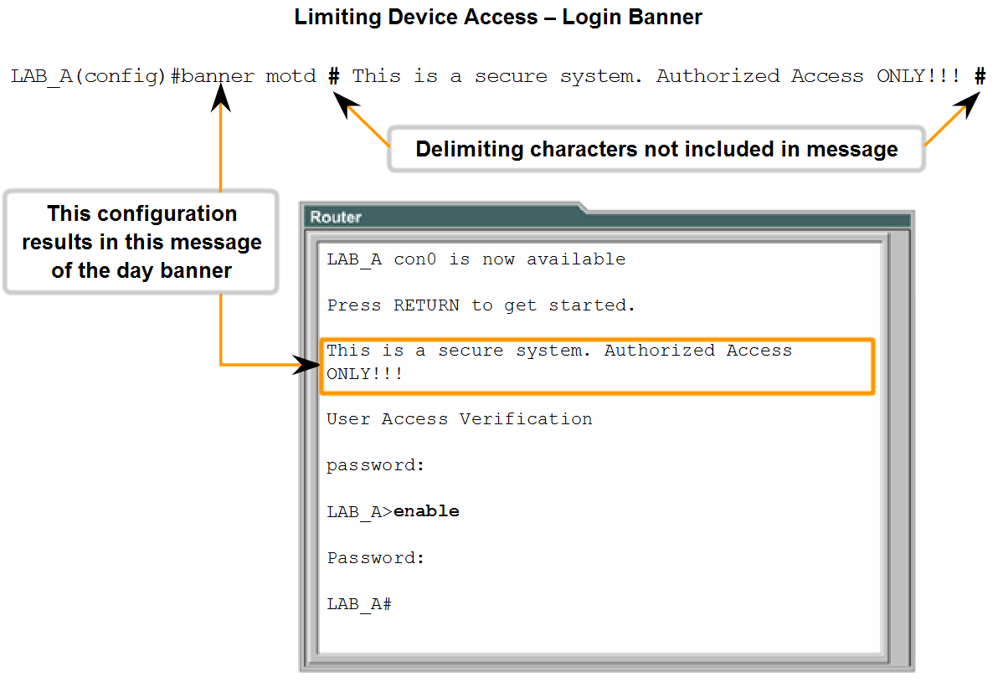
Chapter
01
Operating Cisco Routers
Use the CLI to set passwords and add banners to a device

Slide 16
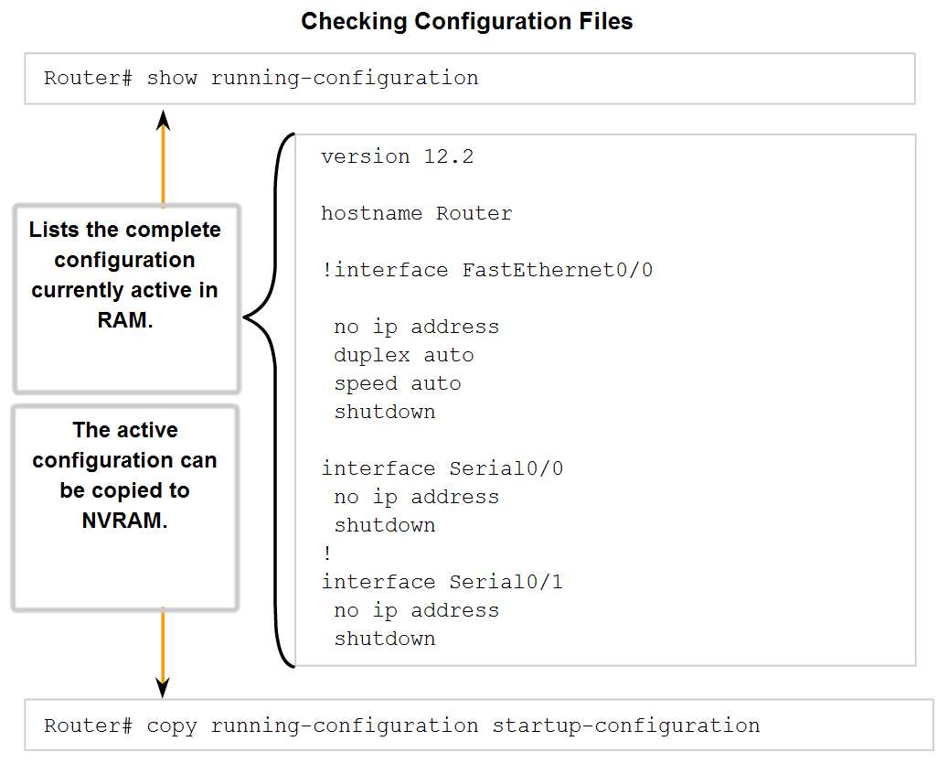
Chapter
01
Operating Cisco Routers
Trace the steps used to examine the startup configuration, make changes to configuration, and replace the startup configuration with the running configuration.

Slide 17
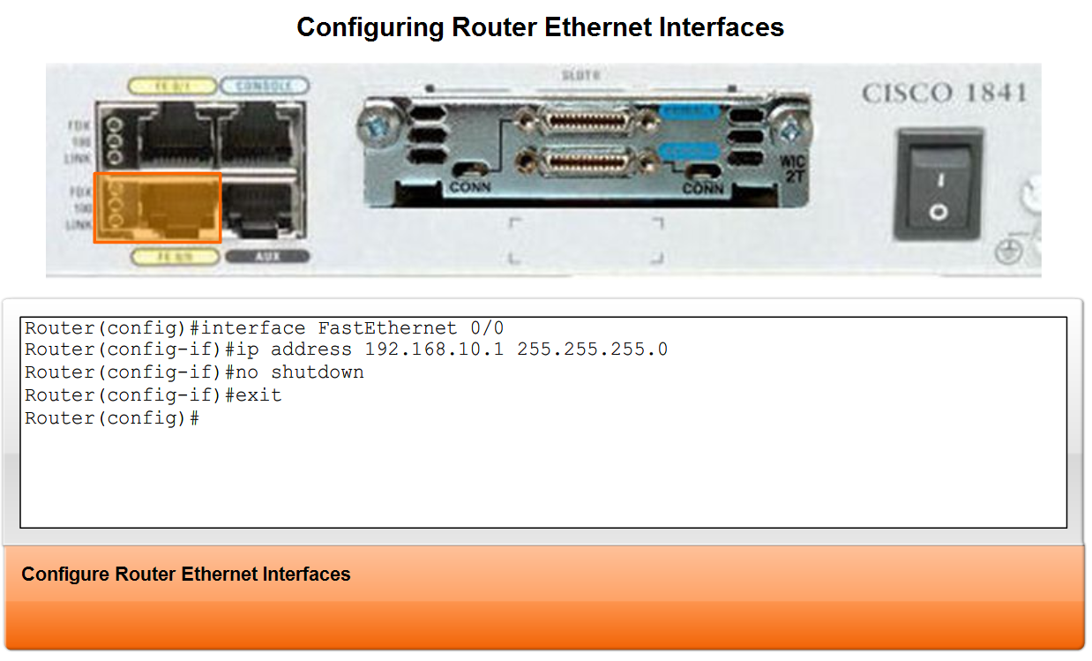
Chapter
01
Operating Cisco Routers

Slide 18
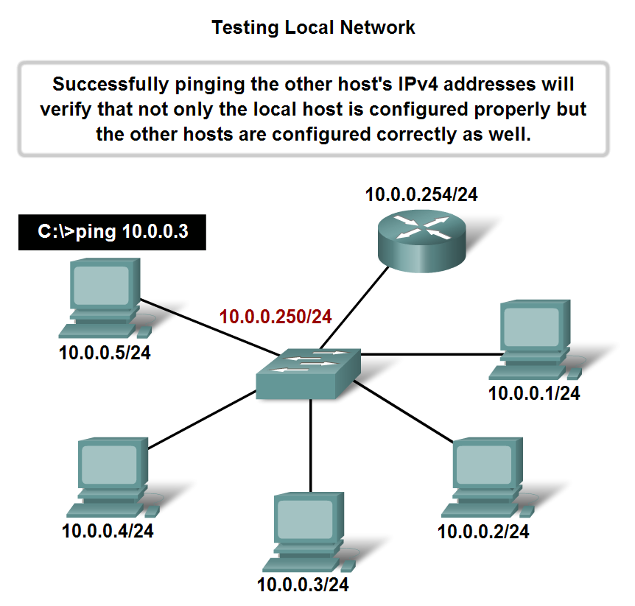
Chapter
01
Operating Cisco Routers
Use the ping command to determine if a host can actively communicate across the local network

Slide 19
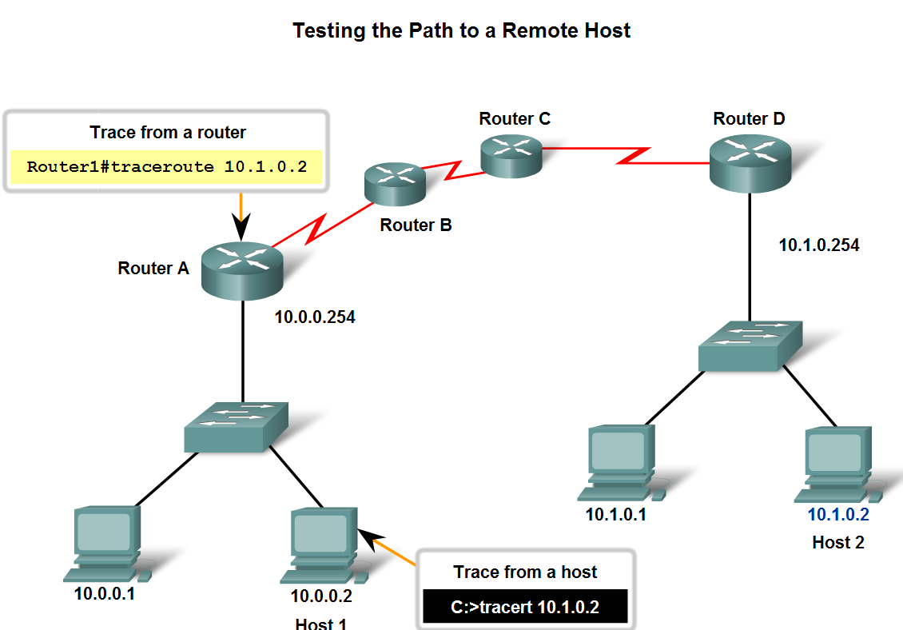
Chapter
01
Operating Cisco Routers
Use the ping command to verify that the
local host can communicate across
the internetwork to a given remote host.

Slide 20

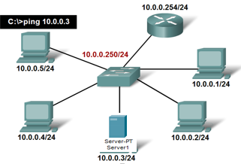
Chapter
01
Operating Cisco Routers
Backup configuration files on server to store it in Tftp server

Slide 21

Chapter
01
Operating Cisco Routers
Backup configuration files :to restore configuration files from Tftp

