Slide 1


Attitudes and
Job Satisfaction
In Decision Making
Prepared by Dr. Ahmad AL-Naimi
Lecture 8

Slide 2


Attitudes
www.midocean.ae

Slide 3
Attitudes
Attitudes are evaluative statements or judgments concerning objects, people, or events.
Three components of an attitude:
Affective
Cognitive
Behavioral
Attitude
The emotional or feeling segment of an attitude
The opinion or belief segment of an attitude
An intention to behave in a certain way toward someone or something
© Pearson Education 2012

Slide 4
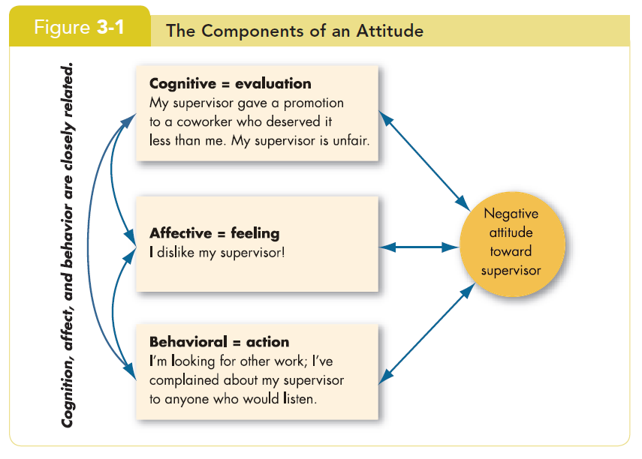
Attitudes
© Pearson Education 2012

Slide 5
Does Behavior Always Follow from Attitudes?
No, the reverse is sometimes true!
Leon Festinger
Cognitive Dissonance is any incompatibility between behavior and attitudes.
  Individuals seek to reduce this uncomfortable gap, or dissonance, to reach stability and consistency.
  Consistency is achieved by changing the attitudes, modifying the behaviors, or through rationalization.
  Desire to reduce dissonance depends on:
    importance of elements;
    degree of individual influence;
    rewards involved in dissonance.

Slide 6
Moderating Variables
The most powerful moderators of the attitude-behavior relationship are:
  importance of the attitude;
  correspondence to behavior;
  accessibility;
  existence of social pressures;
  personal and direct experience of the attitude.
Attitudes
Predict
Behavior
Moderating Variables
© Pearson Education 2012

Slide 7
Predicting Behavior from Attitudes
  Important attitudes have a strong relationship to behavior.
  The closer the match between attitude and behavior, the stronger the relationship:
    Specific attitudes predict specific behavior.
    General attitudes predict general behavior.
  The more frequently expressed an attitude is, the better predictor it is.
  High social pressures reduce the relationship and may cause dissonance.
  Attitudes based on personal experience are stronger predictors.
© Pearson Education 2012

Slide 8
What Are the Major Job Attitudes?
Job satisfaction
  A positive feeling about the job resulting from an evaluation of its characteristics.
Job involvement
  Degree of psychological identification with the job where perceived performance is important to self-worth.
Psychological empowerment
  Belief in the degree of influence over the job, competence, job meaningfulness, and autonomy.

Slide 9
What Are the Major Job Attitudes? (Cont’d)
Organizational Commitment
  Identifying with a particular organization and its goals, while wishing to maintain membership in the organization.
  Three dimensions:
    Affective commitment: emotional attachment to organization.
    Continuance commitment: economic value of staying.
    Normative commitment: moral or ethical obligations.
  Has some relation to performance, especially for new employees.
  Less important now than in past—now perhaps more of occupational commitment, loyalty to profession rather than a given employer.

Slide 10
What Are the Major Job Attitudes? (Cont’d)
Perceived organizational support (POS)
  The degree to which employees believe the organization values their contribution and cares about their well-being.
  Higher when rewards are fair, employees are involved in decision-making, and supervisors are seen as supportive.
  High POS is related to higher OCBs (Organizational citizenship behaviors) and performance.
Employee engagement
  The degree of involvement with, satisfaction with, and enthusiasm for the job.
  Engaged employees are passionate about their work and company.

Slide 11
Are These Job Attitudes Really Distinct?
No: these attitudes are highly related.
Variables may be redundant (measuring the same thing under a different name).
While there is some distinction, there is also a lot of overlap.
Be patient, OB researchers are working on it!

Slide 12
What is Personality?
The dynamic organization within the individual of those psychophysical systems that determine his unique adjustments to his environment.
Gordon Allport.
Personality is the total of ways in which an individual reacts and interacts with others, the measurable traits a person exhibits.
2-12

Slide 13
What is Personality?
Measuring Personality
  Helpful in hiring decisions.
  Most common method: self-reporting surveys.
  Observer-ratings surveys provide an independent assessment of personality—often better predictors.
2-13

Slide 14

Personality Determinants
Heredity
  Factors determined at conception: physical stature, facial attractiveness, gender, temperament, muscle composition and reflexes, energy level, and bio-rhythms.
  This ‘Heredity Approach’ argues that genes are the source of personality.
  Twin studies: raised apart but very similar personalities.
  Parents don’t add much to personality development.
  There is some personality change over long
  time periods.

Slide 15
Personality Traits
Traits are enduring characteristics that describe an individual’s behavior.
  The more consistent the characteristic and the more frequently it happens in diverse situations, the more important the trait.
Two dominant frameworks are used to describe personality:
  Myers-Briggs Type Indicator (MBTI)
  Big Five Model
© Pearson Education 2012

Slide 16
Myers-Briggs Types and Their Uses
Each of the sixteen possible combinations has a name, for instance:
  Visionaries (INTJ) – original, stubborn, and driven.
  Organizers (ESTJ) – realistic, logical, analytical, and business-like.
  Conceptualizer (ENTP) – entrepreneurial, innovative, individualistic, and resourceful.
Research results on the validity of MBTI are mixed.
  MBTI is a good tool for self-awareness and counseling.
  Should not be used as a selection test for job candidates.

Slide 17
The Myers-Briggs Type Indicator
Most widely used instrument in the world.
Participants are classified on four axes to determine one of 16 possible personality types, such as ENTJ.
Extroverted (E)
Introverted (I)
Quiet and
Shy
Sociable and Assertive
Sensing (S)
Intuitive (N)
Unconscious
Processes
Practical and
Orderly
Thinking (T)
Feeling (F)
Uses Values & Emotions
Use Reason
and Logic
Judging (J)
Perceiving (P)
Flexible and Spontaneous
Want Order
& Structure

Slide 18
The Big Five Model of Personality Dimensions
Extroversion
Sociable, gregarious, and assertive
Agreeableness
Good-natured, cooperative, and trusting
Conscientiousness
Emotional Stability
Openness to Experience
Responsible, dependable, persistent, and organized
Calm, self-confident, secure under stress (positive), versus nervous, depressed, and insecure under stress (negative)
Curious, imaginative, artistic, and sensitive

Slide 19
How Do the Big Five Traits Predict Behavior?
Research has shown this to be a better framework.
Certain traits have been shown to strongly relate to higher job performance:
  Highly conscientious people develop more job knowledge, exert greater effort, and have better performance.
  Other Big Five Traits also have implications for work.
    Emotional stability is related to job satisfaction.
    Extroverts tend to be happier in their jobs and have good social skills.
    Open people are more creative and can be good leaders.
    Agreeable people are good in social settings.

Slide 20

The Big Five Traits

Slide 21
Other Personality Traits Relevant to OB
Core Self-Evaluation
  The degree to which people like or dislike themselves.
  Positive self-evaluation leads to higher job performance.
Machiavellianism ( Manipulation)
  A pragmatic, emotionally distant power-player who believes that ends justify the means.
  High Mach's are manipulative, win more often, and persuade more than they are persuaded. Flourish when:
    they have direct interaction;
    they work with minimal rules and regulations;
    their emotions distract others.

Slide 22
Other Personality Traits Relevant to OB (Cont’d)
Narcissism
  A narcissist is an arrogant, entitled, self-important person who needs excessive admiration.
  Less effective in their jobs.
Self-Monitoring
  The ability to adjust behavior to meet external, situational factors.
  High self-monitors conform more and are more likely to become leaders.

Slide 23
Other Personality Traits Relevant to OB (Cont’d)
Risk Taking
  The willingness to take chances.
  May be best to align propensities with job requirements.
  Risk takers make faster decisions with less information.
  Creates positive change in the environment.

Slide 24
Other Personality Traits Relevant to OB (Cont’d)
Type A and B Personalities
  Aggressively involved in a chronic, incessant struggle to achieve more in less time.
    Impatient: always moving, walking, and eating rapidly.
    Strive to think or do two or more things at once.
    Cannot cope with leisure time.
    Obsessed with achievement numbers.
  Quality of the work can be low.
  Type B people are the complete opposite.
Proactive Personality
  Identifies opportunities, shows initiative, acts, and perseveres to completion.

Slide 25
Values
Values are basic convictions on how to conduct yourself or how to live your life that are personally or socially preferable— “How To” live life properly.
Attributes of Values:
Content Attribute—that the mode of conduct or end-state is important.
  Intensity Attribute—just how important that content is.
Value System:
  A person’s values rank-ordered by intensity.
  Tends to be relatively constant and consistent.

Slide 26
Classifying Values – Rokeach Value Survey
Terminal Values
  Desirable end-states of existence; the goals that a person would like to achieve during his or her lifetime.
Instrumental Values
  Preferable modes of behavior or means of achieving one’s terminal values.
People in same occupations or categories tend to hold similar values, but:
  values vary between groups
  value differences make it difficult for groups to negotiate and may create conflict.

Slide 27

Value Differences Between Groups

Slide 28
Linking Personality and Values to the Workplace
Person–Job Fit
Managers are less interested in someone’s ability to do a specific job than in that person’s flexibility.
John Holland’s Personality-Job Fit Theory
  Six personality types.
  Vocational Preference Inventory (VPI).
Key Points of the Model:
  There appear to be intrinsic differences in personality between people.
  There are different types of jobs.
  People in jobs congruent with their personality should be more satisfied and therefore turnover should reduce.

Slide 29

Holland’s Personality Typology & Occupations

Slide 30
Still Linking Personality to the Workplace
Person–Organizational Fit
In addition to matching the individual’s personality to the job, managers are also concerned with Person-Organization Fit.
  The employee’s personality must fit with the organizational culture.
  People are attracted to organizations that match their values.
  Those who match are most likely to be selected.
  Mismatches will result in turnover.
  Can use the Big Five personality types to match to the organizational culture.

Slide 31
Linking Cultures and Behaviors
Hofstede’s Framework: Power Distance
Power Distance is the extent to which a society accepts that power in institutions and organizations is distributed unequally.
  Low distance
    Relatively equal power between those with status/wealth and those without status/wealth
  High distance
    Extremely unequal power distribution between those with status/wealth and those without status/wealth

Slide 32
Linking Cultures and Behaviors
Hofstede’s Framework: Individualism
Individualism
  The degree to which people prefer to act as individuals rather than a member of groups.
Collectivism
  A tight social framework in which people expect others in groups of which they are a part to look after them and protect them.

Slide 33
Linking Cultures and Behaviors
Hofstede’s Framework: Masculinity
Masculinity
  The extent to which society values the work roles of achievement, power, and control, and where assertiveness and materialism are also valued.
Femininity
  The extent to which there is little differentiation between roles for men and women.

Slide 34
Linking Cultures and Behaviors
Hofstede’s Framework: Uncertainty Avoidance
Uncertainty avoidance is the extent to which a society feels threatened by uncertain and ambiguous situations and tries to avoid them.
High Uncertainty Avoidance:
Society does not like ambiguous situations and tries to avoid them.
Low Uncertainty Avoidance:
Society does not mind ambiguous situations and embraces them.

Slide 35
Linking Cultures and Behaviors
Hofstede’s Framework: Time Orientation
Long-term Orientation
  A national culture attribute that emphasizes the future, thrift, and persistence.
Short-term Orientation
  A national culture attribute that emphasizes the present and the here and now.

Slide 36
Job Satisfaction
Job satisfaction is one of the primary job attitudes measured
  Broad term involving a complex individual summation of several discrete job elements.
How to measure it?
  Single global rating (one question/one answer) – Best.
  Summation score (many questions/one average) – OK.
Are people satisfied in their jobs?
  Results depend on how job satisfaction is measured.
  Pay and promotion are the most problematic elements.
  Figures 3-2 and 3-3 show motivation and satisfaction levels in the Arab world.

Slide 37
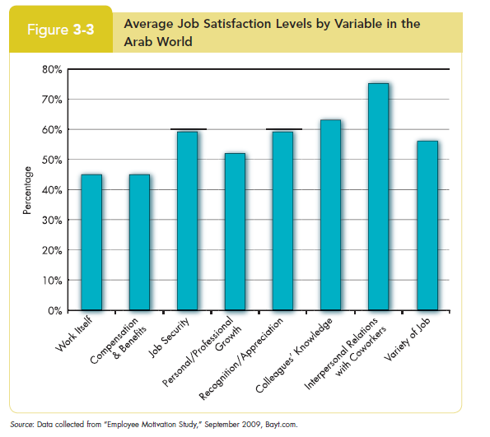
Job Satisfaction

Slide 38
Causes of Job Satisfaction
Pay influences job satisfaction only to a point
  Money may bring happiness, but not necessarily job satisfaction.
Personality can influence job satisfaction
  Negative people are usually not satisfied with their jobs.
  Those with positive core self-evaluation are more satisfied with their jobs.

Slide 39
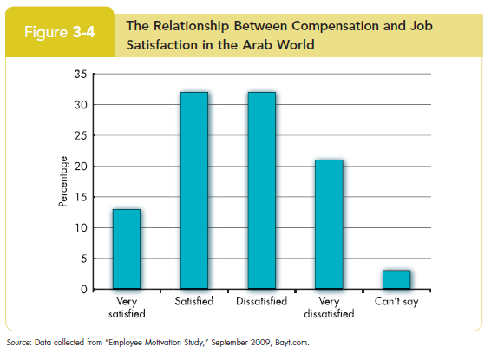
Causes of Job Satisfaction
3-39

Slide 40
Employee Responses to Dissatisfaction
Active
Exit
Neglect
Loyalty
Voice
Behavior directed toward leaving the organization
Active and constructive attempts to improve conditions
Allowing conditions to worsen
Passively waiting for conditions to improve
Destructive
Constructive
Passive

Slide 41
Outcomes of Job Satisfaction
Job performance
  Satisfied workers are more productive AND more productive workers are more satisfied!
  The causality may run both ways.
Organizational citizenship behaviors
  Satisfaction influences OCB through perceptions of fairness.
Customer satisfaction
  Satisfied frontline employees increase customer satisfaction and loyalty.
Absenteeism
  Satisfied employees are moderately less likely to miss work.

Slide 42


Thank You

