Slide 1



Project Governance
PMG 424
Lecture 0
Overview
Prepared by
Dr Hakem Sharari
www.midocean.ae

Slide 2
Session Outline
Academic Agenda
Course Objectives
Course Description
Learning Outcomes
Topics
Conclusion

Slide 3
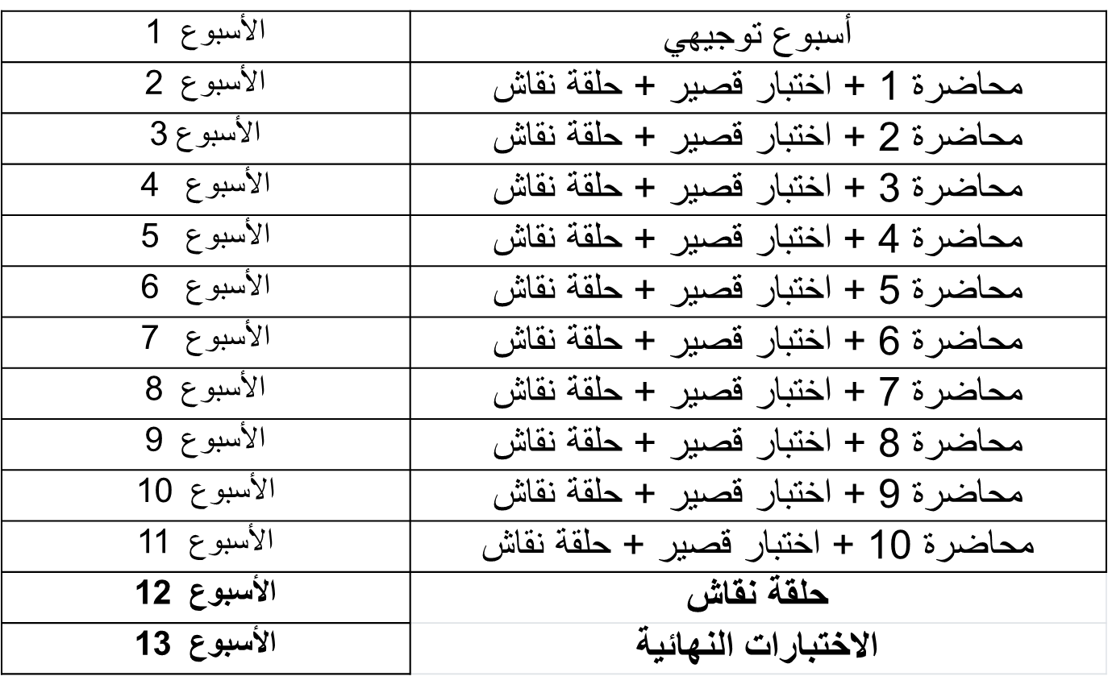
Academic Agenda

Slide 4
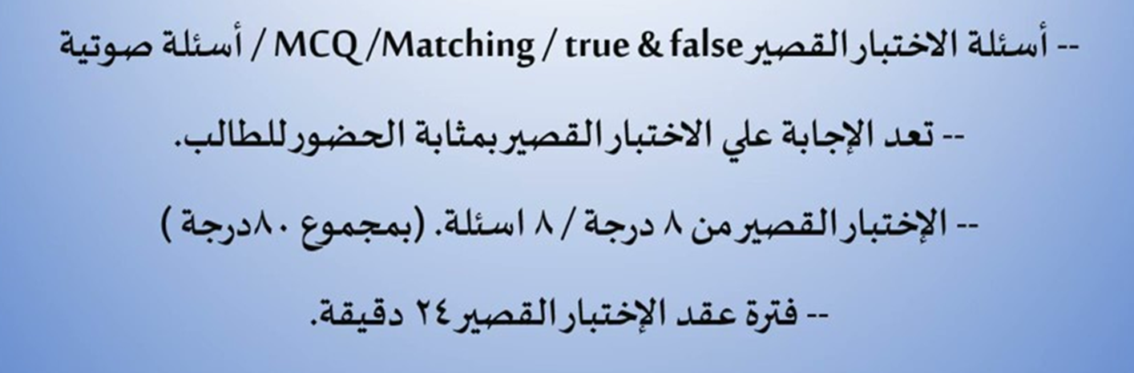
Quizzes & Exams

Slide 5
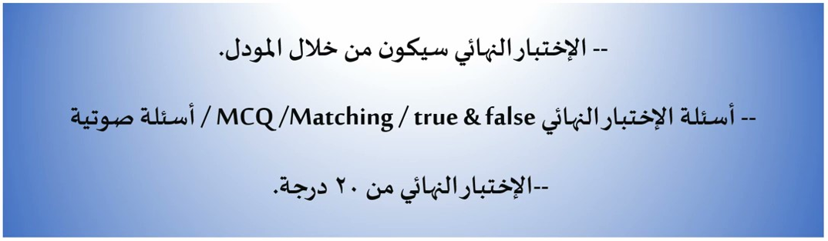
Final Exam

Slide 6
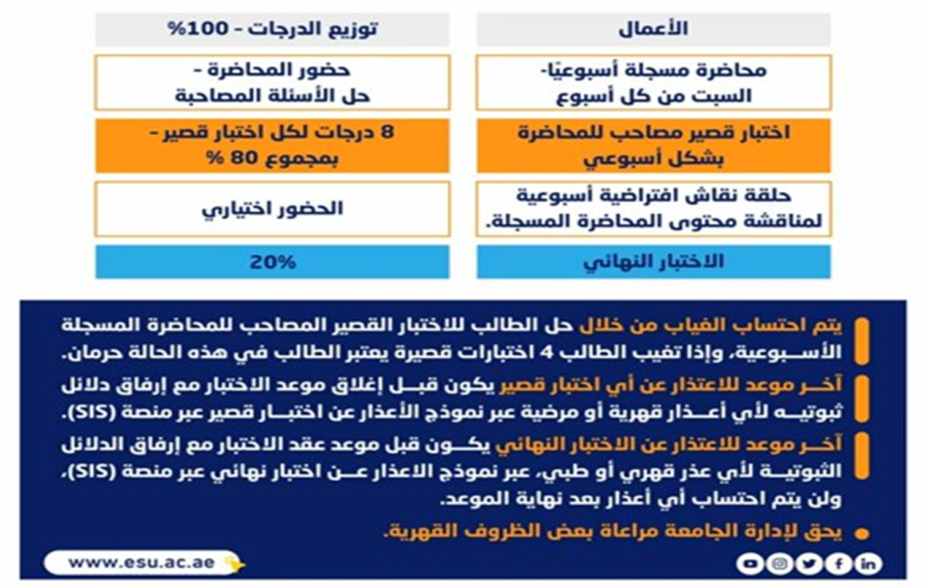
Obligations and Grading

Slide 7

Course Description
Credit Hours: 3 Credit Hours
The materials and reference for this course will be:
The textbook: Project Governance by Ralf Muller
Lecture notes and slides

Slide 8
Online Lecture
Answer your questions/inquiries
Solve different issues/problems
Discuss your opinions with the instructor/classmates
Trigger activities related to previous session topics

Slide 9
Course Objectives
Introducing the principles of project governance
Using governance to establish a good project structure, harmonizes processes and resources, and provides a smooth path to achieve project goals
Applying governance to remove costly inefficiencies that negatively impact smooth running and reduces the risk of conflict
Providing an opportunity to discuss enterprise projects and other megaprojects

Slide 10
Learning Outcomes
Categorize the core issues of project governance within the context of projects and programs
Evaluate and critique the strengths and challenges of various governance structures
Given a large enterprise project, recommend methods and procedures that ensure the project is governed according to best practices
Evaluate how changes to project scope may impact the project’s schedule, cost, and quality, and create a scope document that will produce the desired project outcomes

Slide 11
Course Topics
Definition of governance
Types of governance structures and management scope
Creating governance structures and processes associated with project‐scope management
Creating a transparent and accountable organization with well‐defined. roles and that is based on transparency and accountability
Understanding project ownership versus asset ownership

Slide 12
Course Topics
Understanding project governance structures in large projects, programs, or portfolios
Understanding the roles of governance in decision making, risk management, including opportunity management and threat management, and resource allocation
Verification and validation
Enterprise PM

Slide 13
Areas of Discussion
What is governance
Why do we need governance?
Definitions of governance
Governance theories
Governance of projects and project management as a subset of corporate governance
Paradigms for project and project management governance

Slide 14
Areas of Discussion
Migrating to a project-based organization
Organizational context
How much project management is enough?
Key roles and individuals in the framework

Slide 15
Areas of Discussion
Projects as temporary organizations
Institutions responsible for governance of projects and project management
Institutions for governance of projects
Institutions for governance of project management
Existing standards and guidelines

Slide 16
Areas of Discussion
What is project ownership
What is asset ownership
The difference between project ownership versus asset ownership
Why we need to differentiate between project ownership versus asset ownership
Programs and portfolios as a form of governance
Governance of project portfolios

Slide 17
Areas of Discussion
Governance of programs
Understanding decision-making.
The relationship between decision-making and governance
How governance can help identifying and addressing or managing opportunities and threats
The interlink between governance and resource allocation
Linking governance of projects, programs and portfolios

Slide 18
Areas of Discussion
A model for Governance of Projects, Programs and Portfolios
The future of project governance
Managing projects on a companywide scale
Implementing strategies and processes to streamline and improve the effectiveness of project management on a large scale
Creating a project management department

Slide 19
Conclusion
Definition of governance | Defining governance and why we need it.
Types of Governance Structures | Exploring existing governance theories, paradigms, and structures
Creating Project-focused Governance Structures | Understanding governance in the context and scope of project management
Transparent and Accountable Organizations | Discussing how to create transparent and accountable organizations and the main roles needed
Project Ownership vs Asset Ownership | Differentiating between project ownership and asset ownership
Understanding Project Governance Structures | Understanding governance structures within different scales of projects, programs, and portfolios
Governance, Decisions, Risks, and Resources | Clarifying the interlink between governance and decision-making, risk management, and resource allocation
Verification and Validation | Presenting a model for governance of projects, programs and portfolios, and envisaging the future of project governance
Enterprise PM | Describing how projects on a companywide scale

Slide 20

Reference

