Slide 1
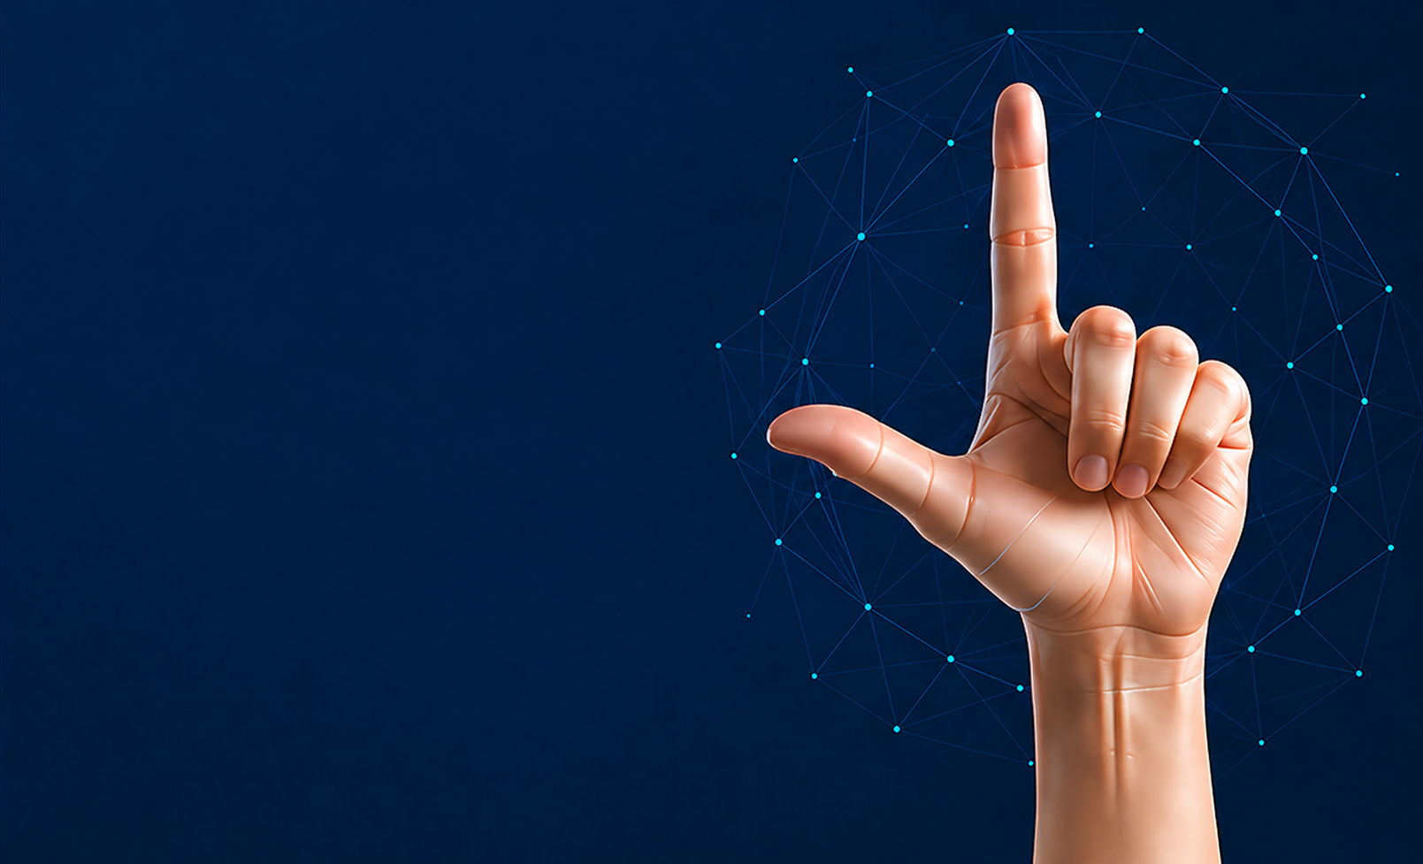

Comparative Study of Deep Learning Models for American Sign Language Fingerspelling Recognition
Master's Thesis Presentation
Prepared By
Anas Alzain ID: 453001724
Mohammed Alqathmi ID: 253001437
Supervisor
Dr. Hager Saleh
College of Informatics
Midocean University Comoros

Slide 2

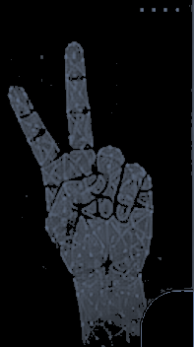
Agenda
01
Research Overview
09
Proposed Hybrid MobileNetV2-Swin Architecture
02
Introduction
10
Experimental Setup and Training Configuration
03
Problem Statement
11
Model Evaluation Metrics
04
Research Gap
12
Performance Comparison and Results Analysis
05
Research Objectives and Contributions
13
Error Analysis and Discussion
06
Dataset and Data Preparation
14
ASL Recognition Application Demonstration
07
Data Augmentation and Preprocessing
15
Conclusion and Future Work
08
Deep Learning Models and Architectures
16
Thank You / Questions & Discussion

Slide 3
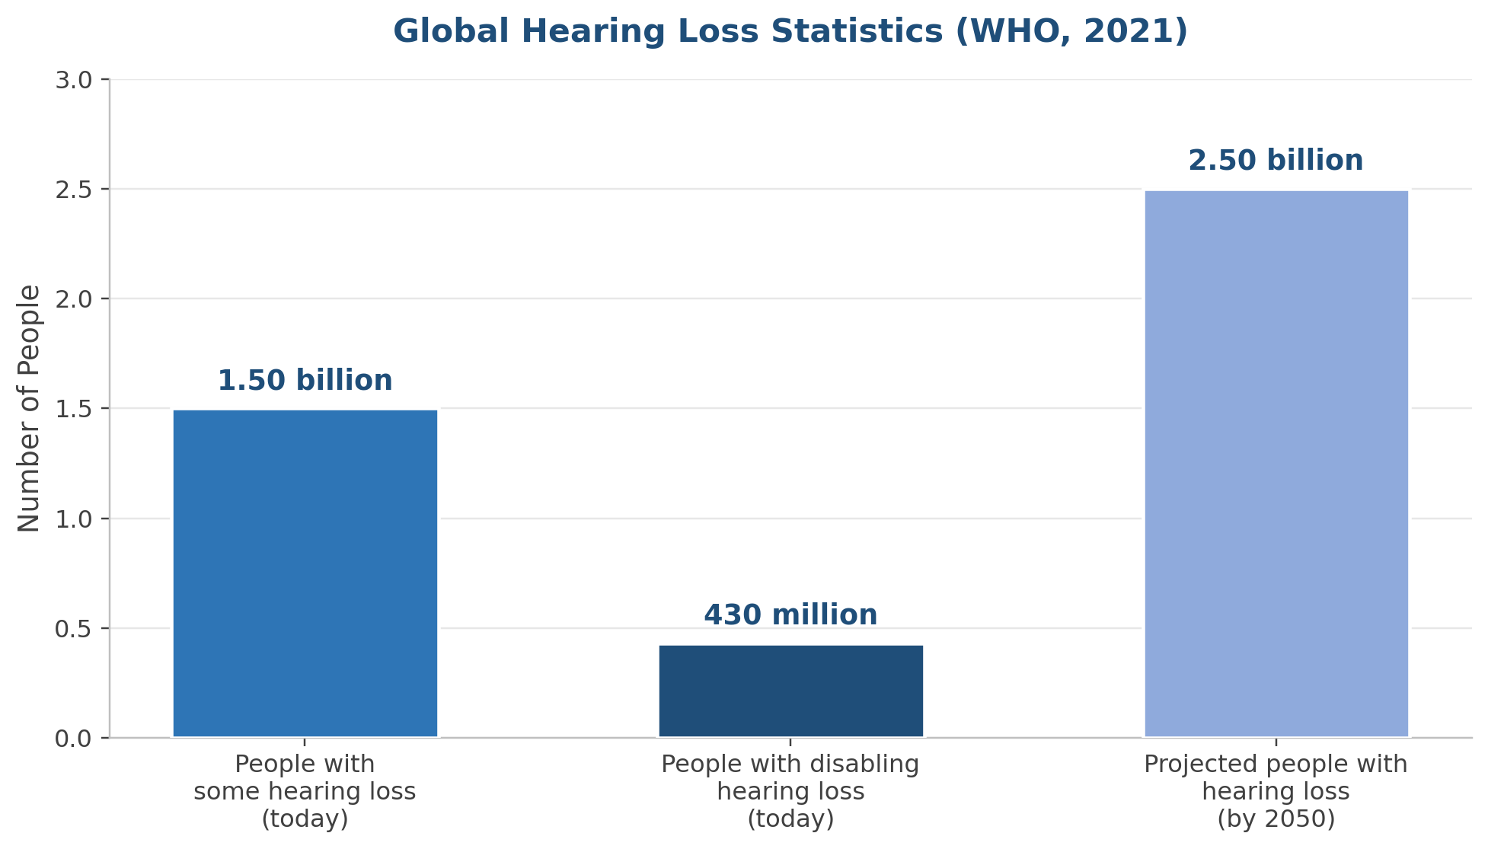

1
Motivation: Breaking the Communication Barrier
Why this matters
1.5B+
430M
people worldwide live with some degree of hearing loss
people require intervention for disabling hearing loss
2050
ASL
projected to reach nearly 2.5B people
fingerspelling is a key building block of communication
Research direction
Use computer vision and deep learning to convert static ASL fingerspelling images into readable letters and words.
A Comparative Study of Deep Learning Models for ASL Fingerspelling Recognition
Notes:
Explain the human problem first. The goal is not just classification; it is reducing communication barriers for Deaf and Mute individuals by converting visual hand gestures into text.

Slide 4
2
Problem Statement & Research Gap
What the literature often does
This thesis addresses
✕
CNN-only comparisons
✓
Unified 6-model benchmark
No direct ViT/Swin/Hybrid benchmark
3 CNNs + ViT + Swin + Hybrid
✕
Accuracy-focused reporting
✓
Deployment-aware evaluation
Limited inference time, size, parameters
Accuracy, F1, time, size, parameters
✕
Single-letter classification
✓
Per-class error analysis
Limited word-level demonstration
Focus on difficult class pairs
✕
Fragmented protocols
✓
Practical Gradio demo
Different datasets, settings, metrics
Word formation + spelling correction
A Comparative Study of Deep Learning Models for ASL Fingerspelling Recognition
Notes:
This slide defines the gap. Emphasize that the study is not merely another model test, but a controlled comparison that also considers practical deployment metrics and a working application.

Slide 5






3
Objectives & Contributions
1
2
3
4
5
Assemble
Prepare a 36-class ASL fingerspelling dataset with a consistent train/validation/test split
Train
Train six deep learning architectures under the same experimental protocol
Evaluate
Evaluate accuracy, precision, recall, F1-score, inference time, and model complexity
Analyze
Analyze per-class errors and model performance differences.
Demonstrate
Demonstrate multi-letter word formation and spelling correction using Gradio.
Main contributions
Novel Hybrid MobileNetV2–Swin model
Fair six-model comparison
Practical assistive workflow
Fuses convolutional and self-attention features.
Same dataset, same split, same GPU.
Recognize letters, build words, correct spelling.

Slide 6








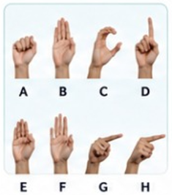
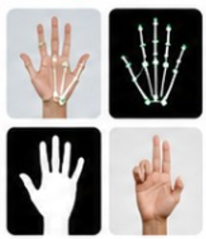
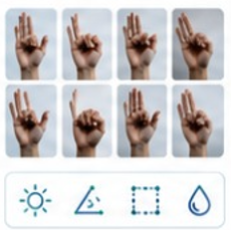
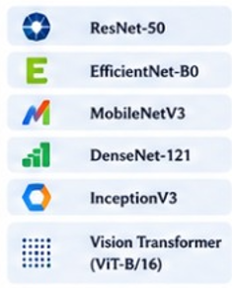
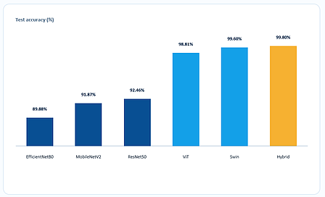
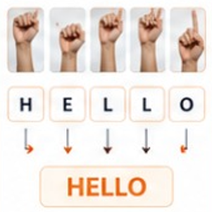

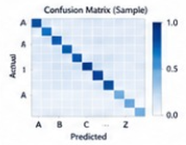





4
ASL Sign Language Recognition - Proposed Methodology Pipeline
1
2
3
4
5
6
7
8
Data
Collection
Data
Preparation
Data Augmentation
& Normalization
Model Training —
Six Architectures
Model
Evaluation
Comparative Analysis
& Selection
Multi-Letter
Word Formation
Automatic Spelling
Correction
Accuracy
Precision
Recognized Output
(Hell0)
Hand
92.6%
91.3%
Recall
F1-Score
HELLO
↓
Crop
91.8%
91.5%
Corrected Output
(HELLO)
•
Collect ASL alphabet hand images/videos
•
Frame extraction (for videos)
•
Sequence modeling for letter recognition
Top Suggestions
•
Hand detection & cropping
•
Rotation, scaling, flipping
1. HELLO
(0.96)
•
Diverse subjects, lighting and backgrounds
•
Compare all six architectures
•
Temporal smoothing
2. HELLO
(0.89)
•
Skin segmentation
•
Brightness & contrast adjustment
•
Transfer learning
3. HELLO
(0.78)
•
Fine-tuning on ASL dataset
Confusion Matrix (Sample)
•
Rank by multiple metrics
•
Word construction from predicted letter sequence
•
Dictionary & language model based correction
•
Balanced classes for all letters (A–Z)
•
Landmark extraction
•
Background variation
•
Accuracy, Precision, Recall, F1-Score
•
Select best-performing model
•
Resize to consistent input size
•
Normalization (pixel scaling & standardization)
•
Adam optimizer
•
Support for continuous signing
•
Edit distance & confidence scoring
•
Early stopping & LR scheduling
•
Confusion matrix
•
ROC-AUC (per class)
•
Improved final text output
Goal: Build an accurate, robust, and real-time ASL sign language recognition system.
Accurate Recognition
Robust Performance
Generalizable Model
Inclusive Communication
Assistive Technology
Real-World Impact
From Letters to Words,
From Recognition to
Reliable Communication.
A Comparative Study of Deep Learning Models for ASL Fingerspelling Recognition
Notes:
This slide defines the gap. Emphasize that the study is not merely another model test, but a controlled comparison that also considers practical deployment metrics and a working application.

Slide 7


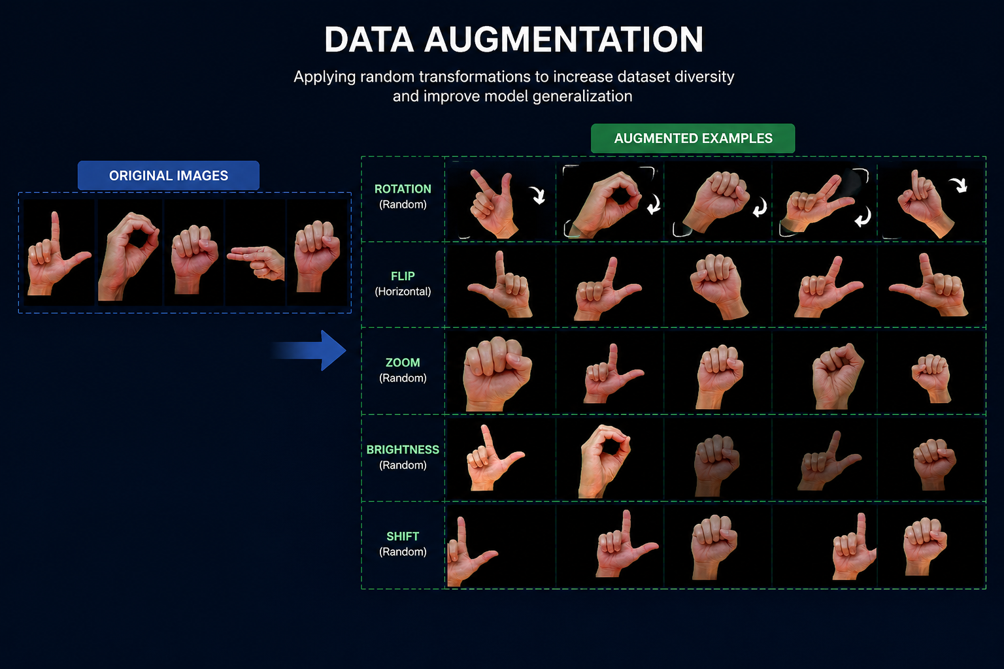
5
Dataset & Preprocessing
Dataset Characteristics: ASL fingerspelling images — 36 classes (Letters A–Z, Numbers 0–9), 2,515 images total.
Dataset Preparation: Image preprocessing & normalization (224×224), data augmentation to improve robustness, and a fixed 70% / 10% / 20% split.
Split | Images | Per Class
Training | 1,760 | ≈ 48.9
Validation | 251 | ≈ 7.0
Testing | 504 | 14 (exact)
Train 70% (1,760)
7
Val 10% (251)
Test 20% (504)
A Comparative Study of Deep Learning Models for ASL Fingerspelling Recognition
Notes:
Explain the dataset: 36 classes, letters a-z and digits 0-9, 2,515 images. Highlight that the test set has 504 images, 14 per class, and was not augmented.

Slide 8






6
Proposed Hybrid MobileNetV2-Swin Architecture
MobileNetV2 Branch
Local convolutional features
1,280-D vector
Feature Concatenation
Classification Head
FC 2048 -> 512
ReLU + Dropout 0.5
Input Image
2,048-D fused vector
36-Class Output
A-Z and 0-9
224 × 224
Swin-Tiny Branch
Shifted-window attention
768-D vector
7
A Comparative Study of Deep Learning Models for ASL Fingerspelling Recognition
Notes:
Explain the dataset: 36 classes, letters a-z and digits 0-9, 2,515 images. Highlight that the test set has 504 images, 14 per class, and was not augmented.

Slide 9
7
Experimental Setup
Image Size
Batch Size
Epochs
224×224
16
Up to 30
Maximum Epochs 30 (Early Stopping Applied)
Learning Rate
Split
GPU
0.0001
70 / 10 / 20
NVIDIA A100
Evaluation metrics
Accuracy • Weighted Precision/Recall/F1 • Macro F1 • Inference time • Model size • Parameter count
A Comparative Study of Deep Learning Models for ASL Fingerspelling Recognition
Notes:
The most important point here is fairness: all six models were evaluated on the same 504-image test set and same GPU with comparable settings.

Slide 10
8
Performance Results: Transformer-Based Models Lead
Test accuracy (%)
99.80%
99.60%
99.80%
Hybrid MobileNetV2–Swin accuracy
98.81%
99.60%
91.87%
92.46%
89.88%
Swin Transformer accuracy
98.81%
EfficientNetB0
MobileNetV2
ResNet50
ViT
Swin
Hybrid
Vision Transformer accuracy
Top tier: Hybrid, Swin, and ViT all exceed 98.8%; CNN baselines remain between 89.9% and 92.5%.
A Comparative Study of Deep Learning Models for ASL Fingerspelling Recognition
Notes:
Do not read every number. Focus on the separation between transformer-based models and CNN baselines. State that the Hybrid model reached the highest accuracy.

Slide 11
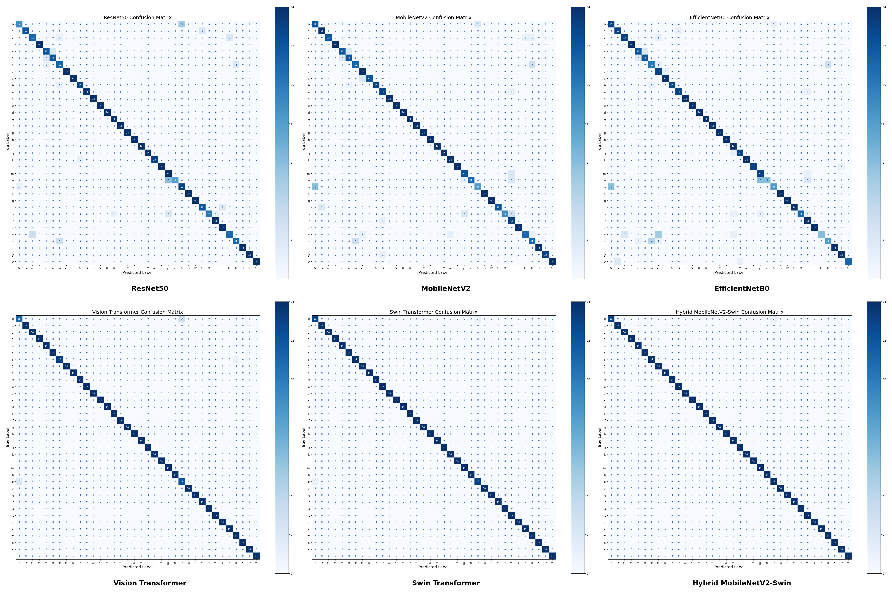
9
Per-Class Error Analysis
DOMINANT CONFUSION
Hybrid
Swin
ViT
CNNs
digit '0' ↔ letter 'o'
1 error
2 errors
6 errors
broader errors
0 → o only
0 ↔ o
mostly 0 / o
m/n/o, u/v/w, 4/5
A Comparative Study of Deep Learning Models for ASL Fingerspelling Recognition
1
Notes:
Do not read every number. Focus on the separation between transformer-based models and CNN baselines. State that the Hybrid model reached the highest accuracy.

Slide 12
10
Accuracy–Speed Trade-off
Swin
Hybrid
Swin
ViT
Fastest + very high accuracy
Accuracy
Hybrid
ResNet
Highest accuracy
MobileNet
EffNet
MobileNetV2
Smallest model
Faster ← Total inference time (s) → Slower
Recommendation: deploy Swin when speed and accuracy both matter; deploy Hybrid when maximum accuracy is the priority.
A Comparative Study of Deep Learning Models for ASL Fingerspelling Recognition
Notes:
This is one of the strongest findings. Explain that Swin was unexpectedly the fastest overall, so the practical recommendation is not simply “choose a CNN for speed.”

Slide 13
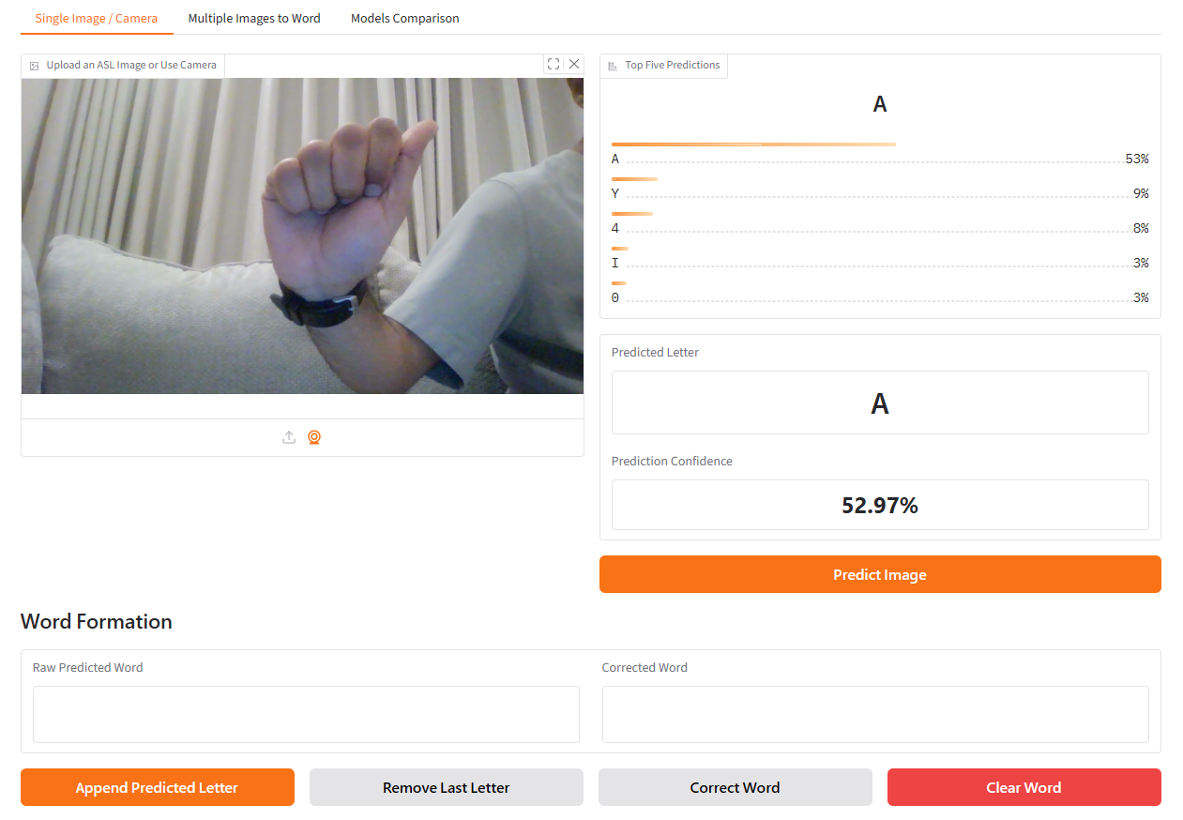
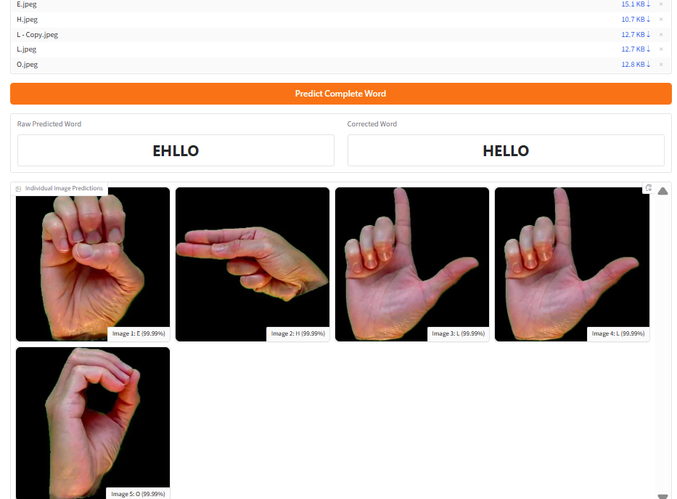
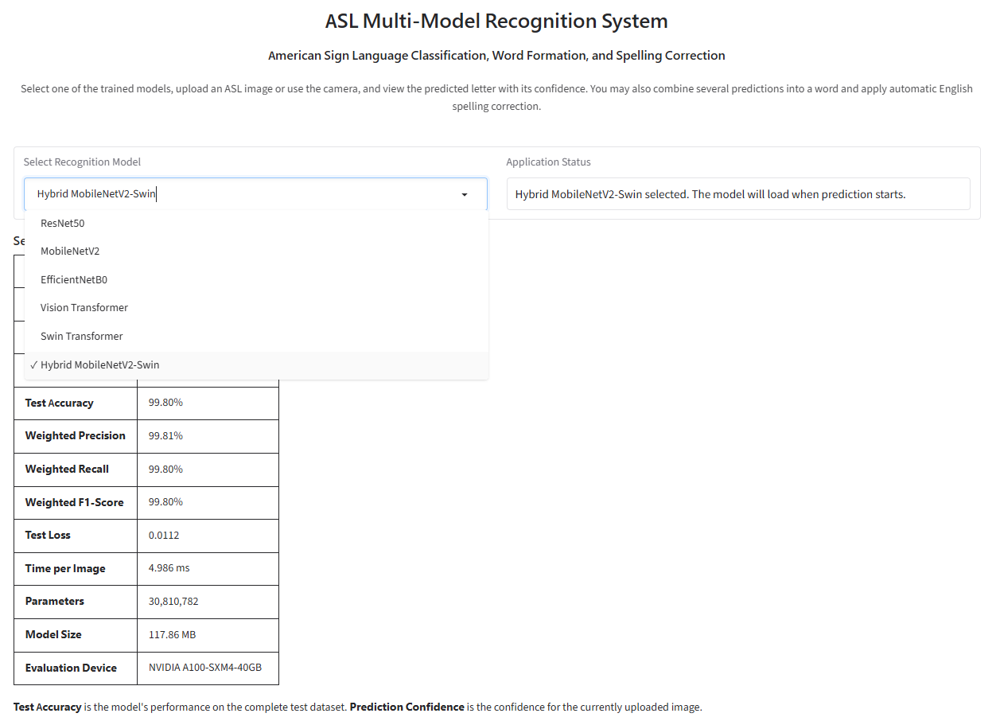
10
Gradio Application: From Letters to Words
Single Image / Camera
Multiple Images to Word
Model Comparison
Predict letter + confidence
Assemble sequence + correct spelling
Compare all six model metrics
Example: EHLLO → HELLO
A Comparative Study of Deep Learning Models for ASL Fingerspelling Recognition
Notes:
Explain that the Gradio app is a demonstration, not the main scientific contribution. It shows how single-letter recognition can support word formation and spelling correction.

Slide 14
11
Conclusion & Future Work
Key conclusions
Hybrid
Swin
Transformers
Gradio
Highest accuracy: 99.80%
Best accuracy–speed balance
Clearly outperform CNN baselines
Shows practical word-level workflow
Future work
Larger & diverse datasets
lighting, backgrounds, skin tones
Dynamic gestures
move beyond static fingerspelling
Compression
distillation and quantization
Video conferencing
real-time integration in remote meetings
A Comparative Study of Deep Learning Models for ASL Fingerspelling Recognition
Notes:
Summarize the study in less than one minute: Hybrid is most accurate, Swin is most practical, and the work can be extended to dynamic gestures and video conferencing.

Slide 15

Thank You
Questions?
A Comparative Study of Deep Learning Models for American Sign Language Fingerspelling Recognition
Mohammed Alqathmi • Anas Alzain
Notes:
Thank the committee and invite questions. Keep this slide on screen during the question period.

