Slide 1


Prepared by Dr. Wesam Ahmed
IT393‎
Business Intelligence
Lecture 3

Slide 2



Descriptive Analytics I:, Statistical Modeling , and Data Analytics
Lecture 3
IT393‎
Business Intelligence
Prepared by
Dr. Wesam Ahmed

Slide 3

01
Learning Objectives:
1.1 Learn about descriptive and inferential statistics
1.2 descriptive and inferential statistics using Excel
1.3 Define business reporting
1.4 The data analytics lifecycle

Slide 4
02
Measures of dispersion (May Also Be called measures of spread) :
FIGURE 2.2 A Simple Taxonomy of Data.
Measures of dispersion are a representation of the numerical spread of a given data set.
To describe this dispersion, a number of statistical measures are developed; the most notable ones are range, variance, and standard deviation .
One of the main reasons why the measures of dispersion/spread of data values are important is the fact
that it gives us a framework within which we can judge the central tendency: gives us the indication of how well the mean (or other centrality measures) represents the sample data. If the dispersion of values in the data set is large, the mean is not deemed to be avery good representation of the data.
For instance, consider a salary dataset: [15k, 18k, 16k, 14k, 15k, 15k, 12k, 17k, 90k, 95k]. The mean is approximately 30.7k, heavily influenced by the two high outliers (90k, 95k). This makes the mean unrepresentative of the typical salary, which lies mostly in the 12k–18k range.

Slide 5
03
Measures of dispersion (May Also Be called measures of spread) :
Understand the Importance of Business Intelligence
It is often perceived as apositive sign to see a small variation within each data sample, as it may indicate homogeneity, similarity, and robustness within the collected data. For instance, ages in a narrow range (e.g., 39–52) indicate similarity and robustness, making the data reliable for analysis.
Range: It is the difference between the largest and the smallest values in a given data set (i.e., variables).
(range = maximum – minimum)
Example: For example, let us consider the following data set:
Sol: The maximum value is 85 and the minimum value is 23. This results in a range of 62. The range can be used to detect any errors when entering data. For example, if you have recorded the age of school children in your study and your range is 7 to 123 years old you know you have made a mistake!
23 | 56 | 45 | 65 | 59 | 55 | 62 | 54 | 85 | 25

Slide 6
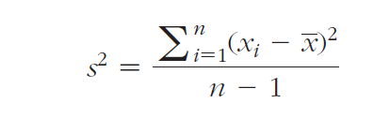
04
Measures of dispersion (May Also Be called measures of spread) :
Understand the Importance of Business Intelligence
Variance: It is a method used to calculate the deviation of all data points in a given data set from the mean as shown in Eq.2.1.
The larger the variance, the more the data are spread out from the mean and the more variability one can observe in the data sample.
Where n is the number of samples, x is the mean of the sample and xi is the ith value in the data set.

Slide 7
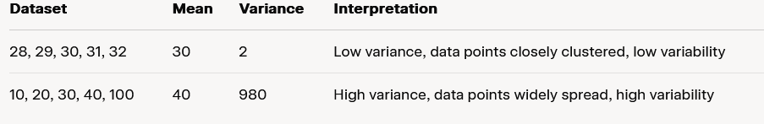
05
Measures of dispersion (May Also Be called measures of spread) :
Understand the Importance of Business Intelligence
Example with Small Variance: Consider the dataset: 28, 29, 30, 31, 32. The mean is 30, and the variance is 2, showing the data points are closely clustered, indicating low variability.
Example with Large Variance: Now, take 10, 20, 30, 40, 100. The mean is 40, and the variance is 980, reflecting high variability due to the outlier (100), showing the data is widely spread.

Slide 8
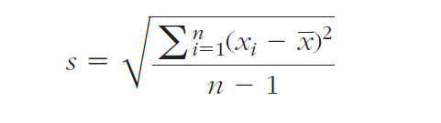
06
Measures of dispersion (May Also Be called measures of spread) :
Understand the Importance of Business Intelligence
Standard Deviation : The standard deviation is also a measure of the spread of values within a set of data.
The standard deviation is calculated by simply taking the square root of the variations.
The following formula shows the calculation of standard deviation from a given sample of data points.

Slide 9
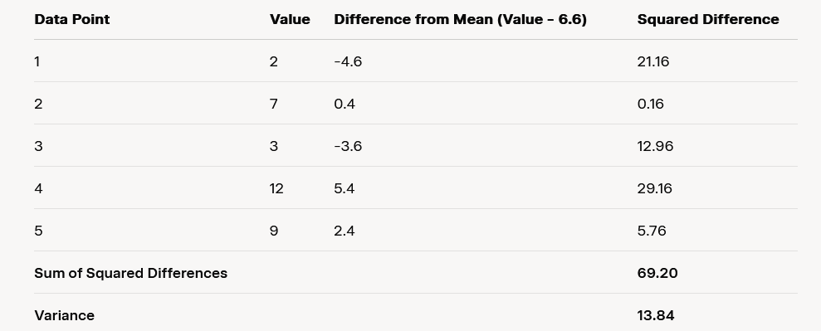
07
Measures of dispersion (May Also Be called measures of spread) :
Understand the Importance of Business Intelligence
Let’s calculate the variance and STD of the following data set:
Standard Deviation = 3.72

Slide 10
How to do analysis regression in Excel with Analysis ToolPak
08
In your Excel, click File > Options.
In the Excel Options dialog box, select Add-ins on the left sidebar, make sure Excel Add-ins is selected in the Manage box, and click Go
In the Add-ins dialog box, tick off Analysis Toolpak, and click OK:
This will add the Data Analysis tools to the Data tab of your Excel ribbon

Slide 11
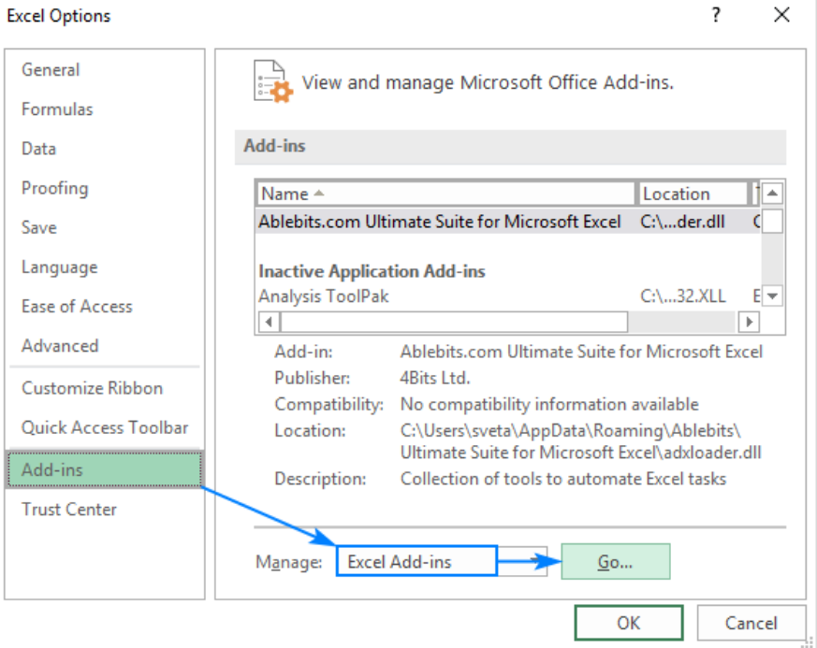
How to do analysis in Excel with Analysis ToolPak
09

Slide 12
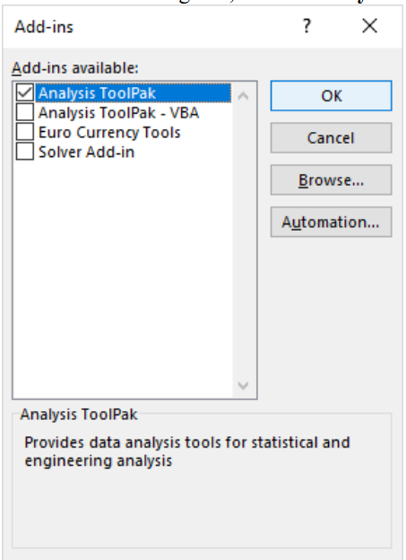
How to do analysis in Excel with Analysis ToolPak
10

Slide 13
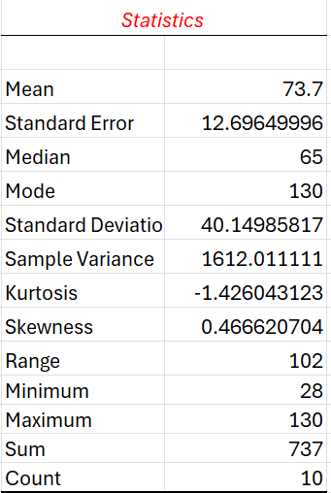
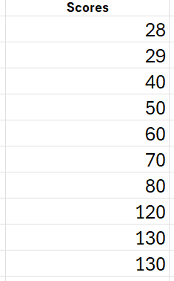
11
Measures of dispersion (May Also Be called measures of spread) :
Understand the Importance of Business Intelligence
Let’s calculate descriptive statistics of the follow data set using Excel:
Go to the Data tab.
Click on Data Analysis in the Analysis group.
In the Data Analysis dialog box, scroll to and select Descriptive Statistics.
Excel Dataset
Statistics of the Dataset

Slide 14
12
Regression Modeling for Inferential Statistics:
Understand the Importance of Business Intelligence
Regression, especially linear regression, is perhaps the most widely known and used analytics technique in statistics. Regression has become the statistical technique for characterization of relationships between explanatory (input) variable(s) and response (output) variable.
Regression aims to capture the functional relationship between and among the characteristics of the real world and describe this relationship with a mathematical model, which may then be used to discover and understand the complexities of reality—explore and explain relationships or forecast future occurrences.
In prediction, regression identifies additive mathematical relationships (in the form of an equation) between one or more explanatory variables and a response variable. Once determined, this equation can be used to forecast the values of the response variable for a given set of values of the explanatory variables.

Slide 15
13
Regression Modeling for Inferential Statistics:
Understand the Importance of Business Intelligence
Simple versus Multiple Regression : If the regression equation is built between one response variable and one explanatory variable, then it is called simple regression.
For instance, the regression equation built to predict/explain the relationship between aheight of a person (explanatory variable) and the weight of a person (response variable) is a good example of simple regression. Multiple regression is the extension of simple regression where the explanatory variables are more than one.
For instance, in the previous example, if we were to include not only the height of the person but also other
personal characteristics (e.g., BMI, gender, ethnicity) to predict the weight of a person, then we would be performing multiple regression analysis. In both cases, the relationship between the response variable and the explanatory variable(s) are linear and additive in nature.

Slide 16
14
Regression Modeling for Inferential Statistics:
Understand the Importance of Business Intelligence
To understand the relationship between two variables, the simplest thing that one can do is to draw a scatter plot, where the y-axis represents the values of the response variable and the x-axis represents the values of the explanatory variable (see Figure 3.1).
A scatter plot would show the changes in the response variable as a function of the changes in the explanatory variable.
In the case shown in Figure 3.1, there seems to be a positive relationship between the two; as the explanatory variable values increase, so does the response variable. Simple regression analysis aims to find a mathematical representation of this relationship.

Slide 17
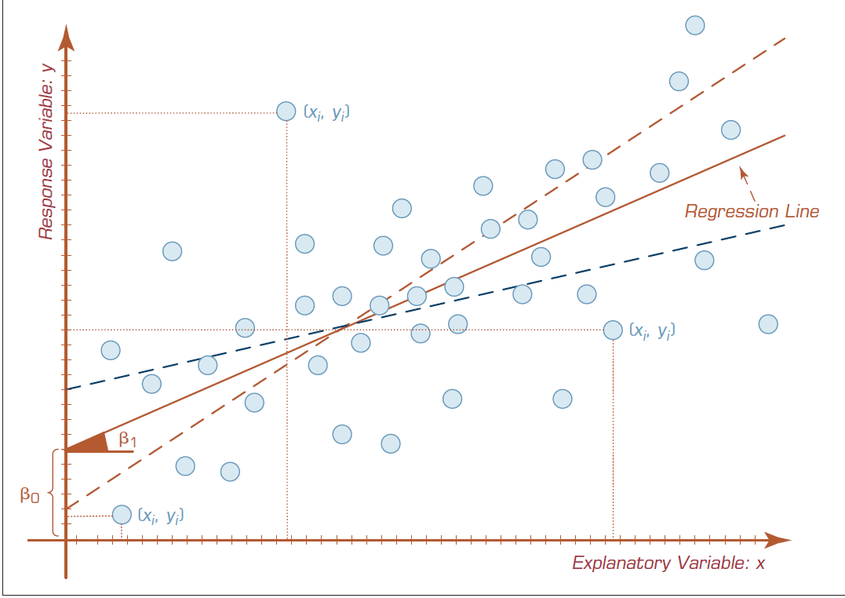
15
Regression Modeling for Inferential Statistics:
Figure 3.1 A Scatter Plot and a Linear Regression Line.

Slide 18
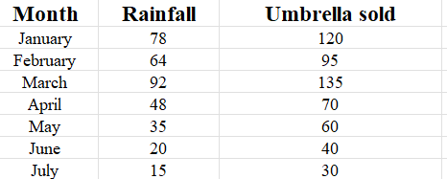
Regression Modeling for Inferential Statistics using Excel:
16
In this example, we are going to do a simple linear regression in Excel. What we have is a list of average monthly rainfall for some months in column B, which is our independent variable (predictor), and the number of umbrellas sold in column C, which is the dependent variable.

Slide 19
Regression Modeling for Inferential Statistics using Excel:
17
If you need to quickly visualize the relationship between the two variables, draw a linear regression chart. That's very easy! Here's how:
Select the two columns with your data, including headers.
On the Inset tab, in the Charts group, click the Scatter chart icon, and select the Scatter thumbnail (the first one):

Slide 20
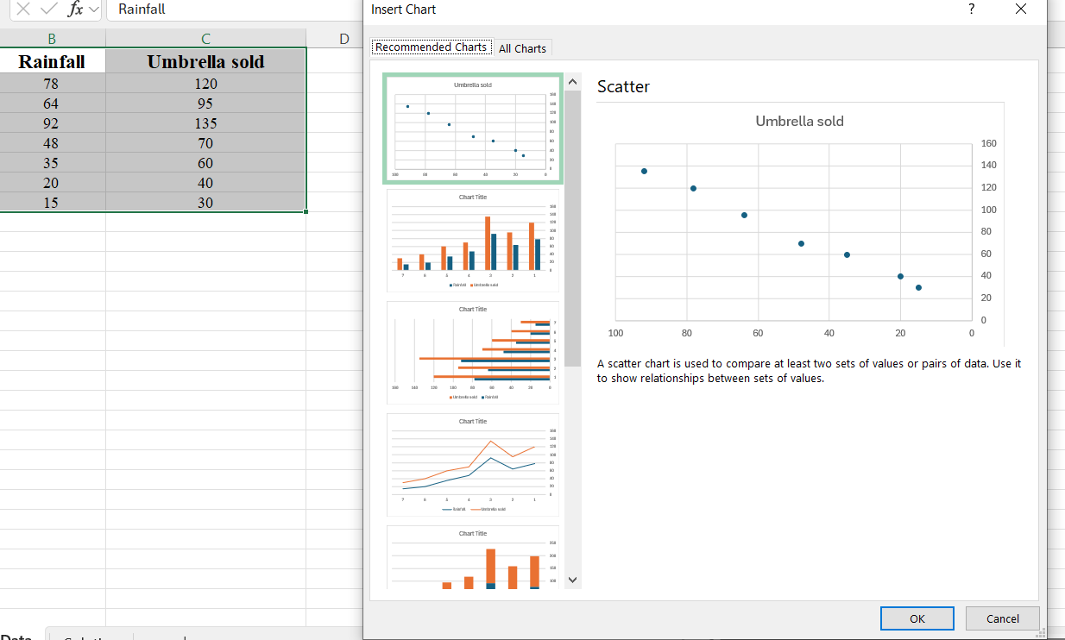
Regression Modeling for Inferential Statistics using Excel:
18

Slide 21
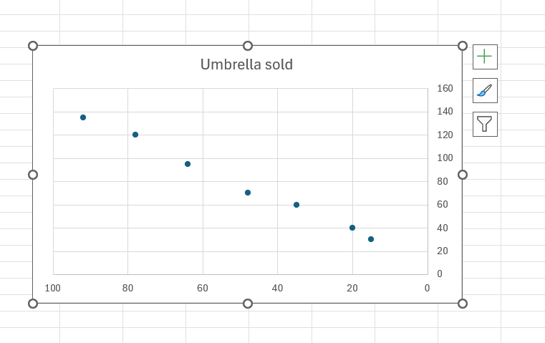
Regression Modeling for Inferential Statistics using Excel:
19
This will insert a scatter plot in your worksheet, which will resemble this one:

Slide 22
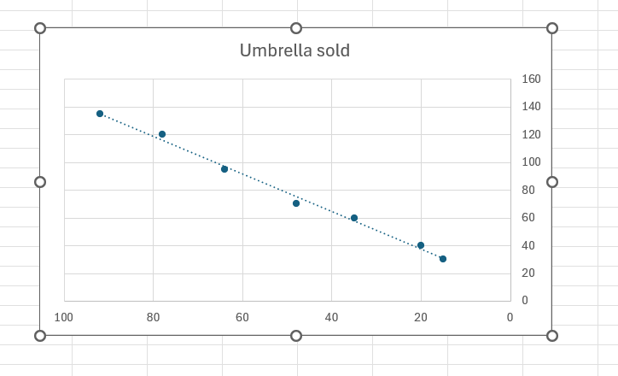
Regression Modeling for Inferential Statistics using Excel:
20
Click OK and observe the regression analysis output created by Excel.
Now, we need to draw the least squares regression line. To have it done, right click on any point and choose Add Trendline… from the context menu.

Slide 23
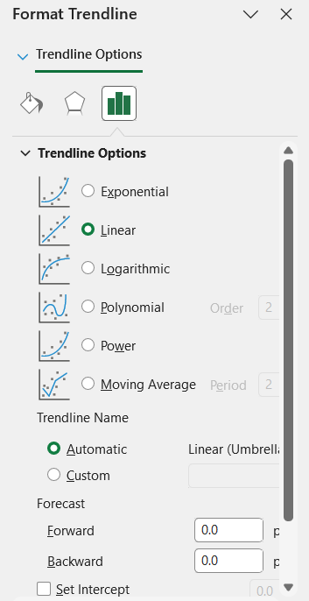
Regression Modeling for Inferential Statistics using Excel:
21
Click OK and observe the regression analysis output created by Excel.
On the right pane, select the Linear trendline shape and, optionally, check Display Equation on Chart to get your regression formula:

Slide 24
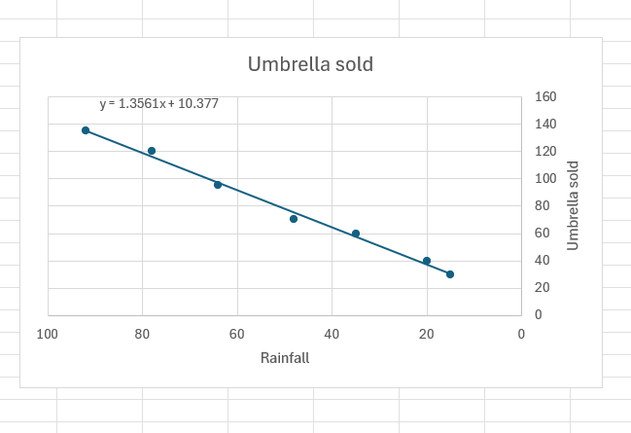
Regression Modeling for Inferential Statistics using Excel:
22
Click OK and observe the regression analysis output created by Excel.
You may want to make a few more improvements:
Drag the equation wherever you see fit.
Add axes titles (Chart Elements button > Axis Titles).

Slide 25
23
Business Reporting:
Click OK and observe the regression analysis output created by Excel.
Decision makers are in need of information to make accurate and timely decisions. Information is essentially the contextualization of data. In addition to statistical means that were explained in the previous section. The information is usually provided to the decision makers in the form of a written report (digital or on paper), although it can also be provided orally.
Simply put, a report is any communication artifact prepared with the specific intention of conveying information in a digestible form to whoever needs it, whenever and wherever they may need it.
It is usually a document that contains information (usually driven from data) organized in a narrative, graphic, and/or tabular form, prepared periodically (recurring) or on an as-needed (ad hoc) basis, referring to specific
time periods, events, occurrences, or subjects.

Slide 26
24
Business Reporting:
Click OK and observe the regression analysis output created by Excel.
Business reports can fulfill many different (but often related) functions. Here are a few of the most prevailing ones:
• To ensure that all departments are functioning properly
• To provide information
• To provide the results of an analysis
Business reporting (also called BI) is an essential part of the larger drive toward improved, evidence-based, optimal managerial decision making. The foundation of these business reports is various sources of data coming from both inside and outside the organization .

Slide 27
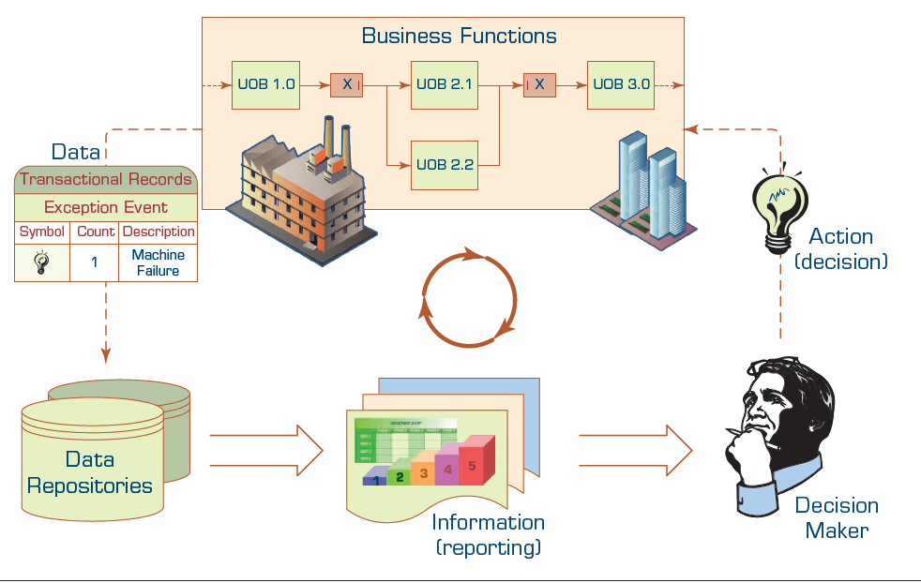
25
Business Reporting:
Click OK and observe the regression analysis output created by Excel.
Figure 3.2 The Role of Information Reporting in Managerial Decision Making.

Slide 28
26
Business Reporting:
Click OK and observe the regression analysis output created by Excel.
Figure 3.2 shows the continuous cycle of data acquisition →information generation → decision making → business process management.
Perhaps the most critical task in this cyclical process is the reporting (i.e., information generation)— converting data from different sources into actionable information.
Key to any successful report are clarity, brevity, completeness, and correctness.

Slide 29
27
Business Reporting:
Click OK and observe the regression analysis output created by Excel.
Even though there are a wide variety of business reports, the ones that are often used for managerial purposes can be grouped into two major categories:
Metric Management Reports: In many organizations, business performance is managed through outcome-oriented metrics. For internal management, they are key performance indicators (KPIs).
KPIs are specific, measurable values that indicate how effectively a company is achieving key business objectives. They are a subset of metrics that matter most for tracking success.
Example KPIs:
Customer Satisfaction Score (CSAT)
Employee Turnover Rate
Net Profit Margin

Slide 30
28
Business Reporting:
Click OK and observe the regression analysis output created by Excel.
Dashboard -Type Reports: A popular idea in business reporting in recent years has been to present a range of different performance indicators on one page, like a dashboard in a car.
Typically, dashboard vendors would provide a set of predefined reports with static elements and fixed structure, but also allow for customization of the dashboard widgets, views, and set targets for various metrics.
It’s common to have color-coded traffic lights defined for performance (red, orange, green) to draw management’s attention to particular areas.

Slide 31
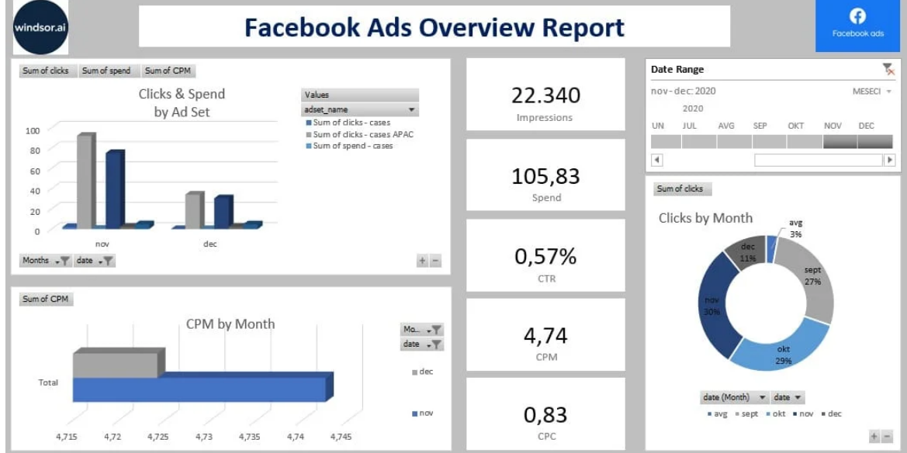
29
Business Reporting:
Click OK and observe the regression analysis output created by Excel.
Figure 3.3:
Example of Dashboard -Type Reports

Slide 32
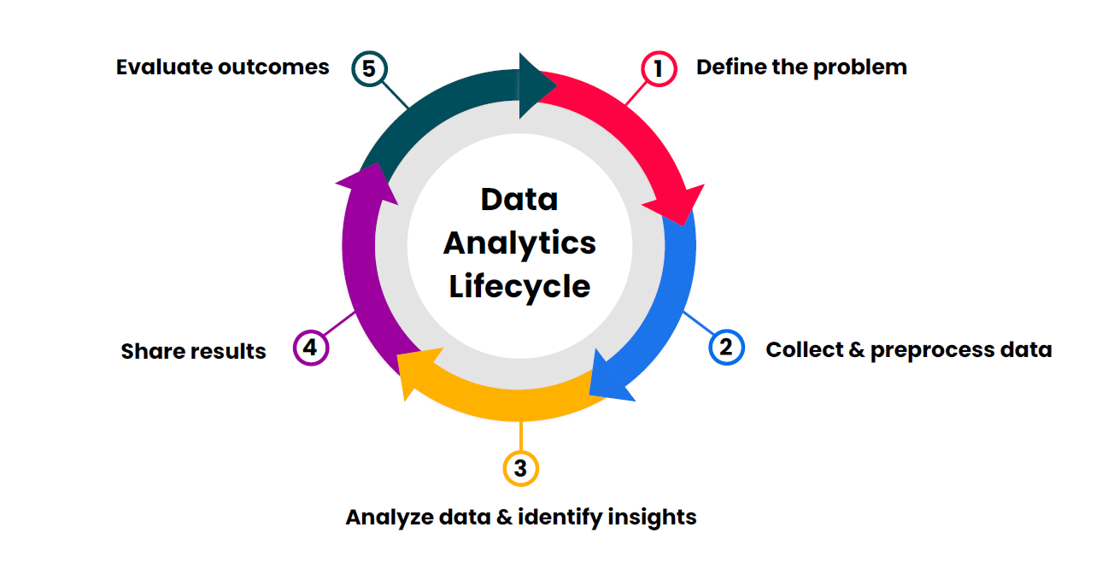
30
The data analytics lifecycle:
Understand the Importance of Business Intelligence
Figure 3.4: The data analytics lifecycle

Slide 33
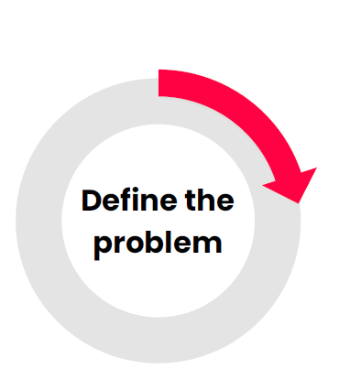
31
The data analytics lifecycle:
Understand the Importance of Business Intelligence
The first phase of the analytics cycle is about understanding the problem that needs to be solved. This includes identifying the business objectives, the available data, and the resources needed to solve the problem.
Key questions:
● What are the business goals?
● What decisions need to be made to achieve those goals?
● Who are the stakeholders making those decisions, and what are their needs?

Slide 34
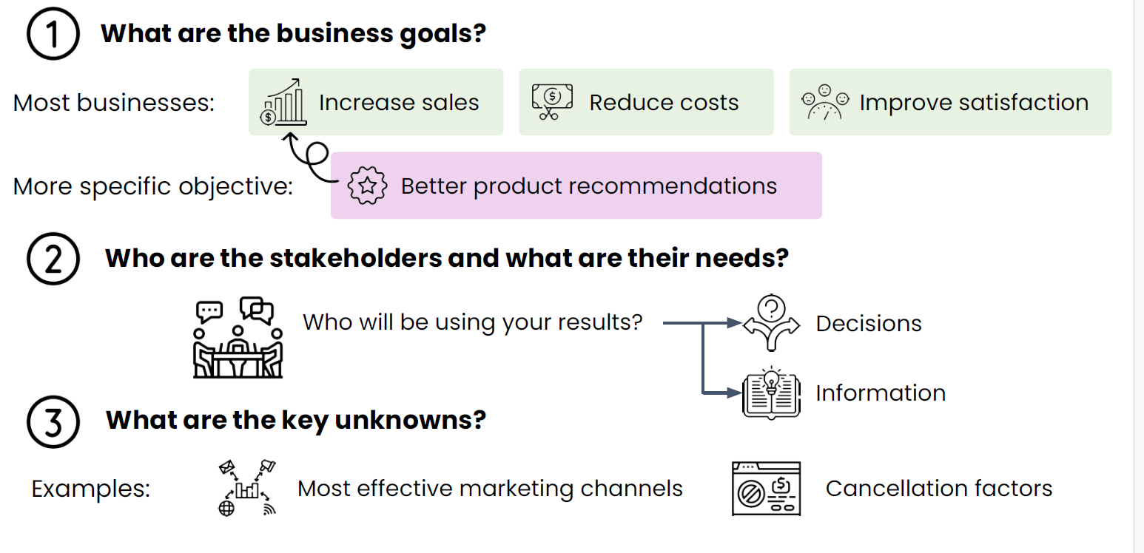
32
The data analytics lifecycle:
Understand the Importance of Business Intelligence

Slide 35
33
The data analytics lifecycle:
Understand the Importance of Business Intelligence
Descriptive Analytics Example:
Let’s look at an example. Let’s say you want to understand your company’s revenue drivers. You perform descriptive analytics on your sales data, answering questions such as:
How many sales were made in the last month? (The count of sales.)
How much is the average transaction value? (The mean sale price.)
How much variation is there between total sales per store? (The standard deviation of total sales by store.)
What were the total sales per day? (A line plot of total sales versus date.)

Slide 36
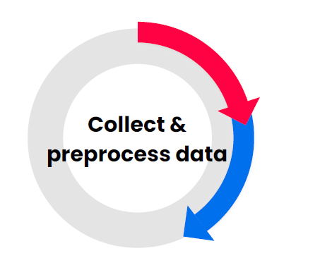
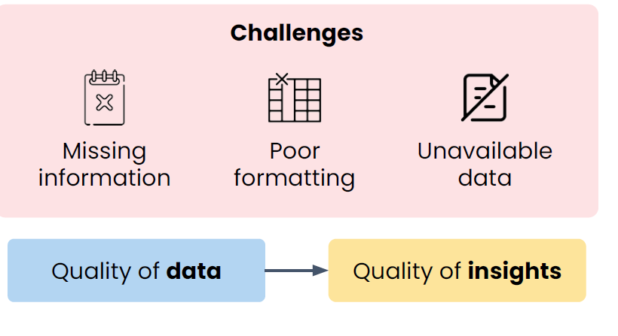
34
The data analytics lifecycle:
Stage 2: Collect & preprocess data
Transform raw data into usable information
Most data requires some transformation

Slide 37
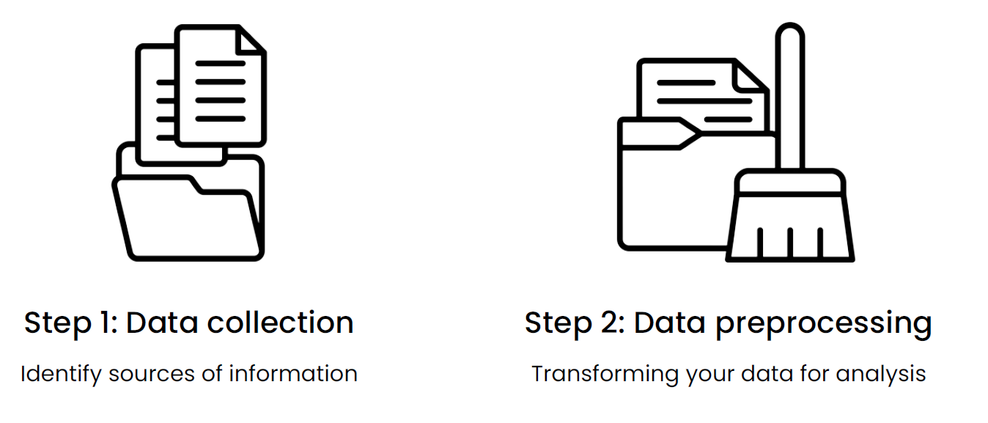
35
The data analytics lifecycle:
Figure 3.4 Stage 2: Collect & preprocess data.

Slide 38
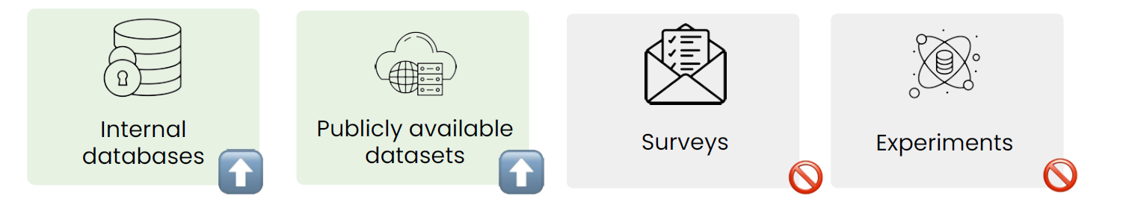
36
The data analytics lifecycle:
Understand the Importance of Business Intelligence
Figure 3.5 Strategies for data collection

Slide 39
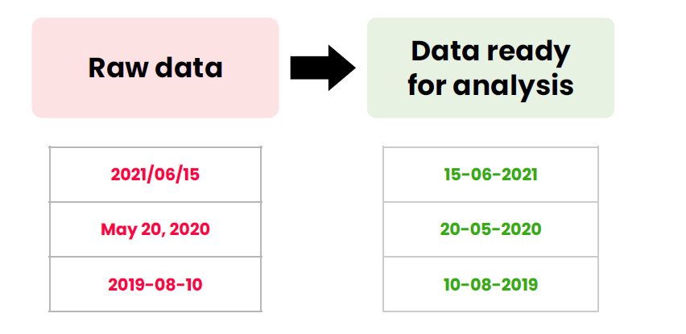
37
The data analytics lifecycle:
Understand the Importance of Business Intelligence
Figure 3.6 Data preprocessing (Formatting)

Slide 40
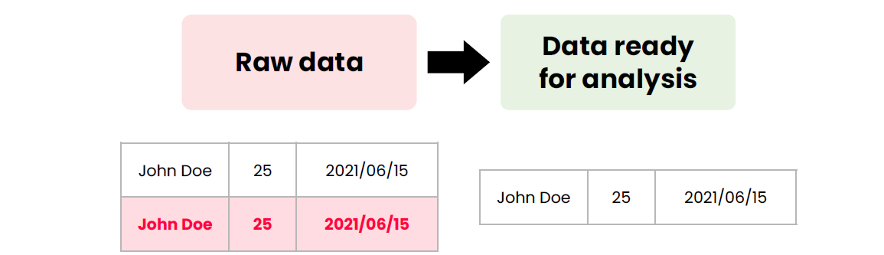
38
The data analytics lifecycle:
Understand the Importance of Business Intelligence
Figure 3.7 Data preprocessing (Cleaning)

Slide 41
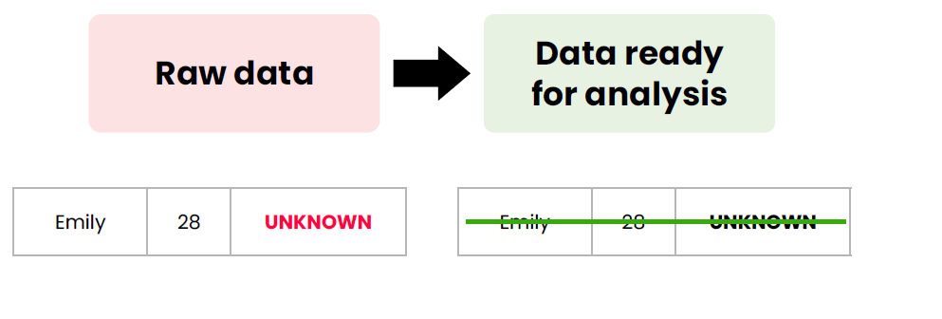
39
The data analytics lifecycle:
Understand the Importance of Business Intelligence
Figure 3.8 Data preprocessing (Handling missing
values)

Slide 42
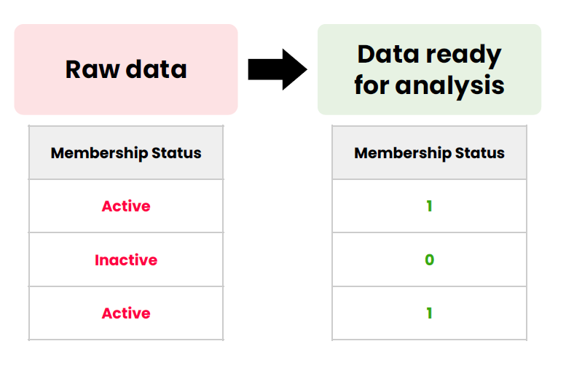
40
The data analytics lifecycle:
Understand the Importance of Business Intelligence
Figure 3.9 Data preprocessing (Transformation)

Slide 43
41
Summary
Descriptive statistics methods can be used to measure central tendency, dispersion, or the shape of a given data set.
Regression, especially linear regression, is perhaps the most widely known and used analytics technique in statistics.
A report is any communication artifact prepared with the specific intention of conveying information in a presentable form.
A business report is a written document that contains information regarding business matters.
The data analytics lifecycle.

Slide 44


Thank You

