Slide 1


Human Resources
Analytics
Prepared by Dr. Samah Abdelfatah
HRM 623
Lecture 01

Slide 2



Disruptive Technology:
The Power to Predict
Chapter
01
Lecture 01
HRM 623
Prepared by
Dr. Samah Abdelfatah

Slide 3

Chapter
MAIN TOPICS
01
Disruptive Technology—What Is Analytics?—Introducing HCM: 21st—The Value of Insight—— The Five Steps of Analytics—Ascending The Value Ladder.

Slide 4

DISRUPTIVE TECHNOLOGY
What do Amazon, Sony, Swatch, and McDonald’s all have in common? The answer is that they are examples of what Harvard professor Clayton Christensen has described as ‘‘disruptive technologies.’’ It is an innovation that creates a new market or serves overlooked customers and eventually challenges established firm.
Chapter
01

Slide 5




DISRUPTIVE TECHNOLOGY (CONT.)
Amazon rewrote book selling, Sony revolutionized the music business, Swatch upset the watch industry forever, and McDonald’s added a totally new dimension to food service.
Today, People Analytics and AI are having a similar disruptive effect on how organizations manage their workforce.
Chapter
01

Slide 6
Chapter
LABOR-MARKET TRANSFORMATIONS
01
Due to global competitiveness, the liquidity crisis, management scandals, and governments intervention, very little has changed within the ‘‘people game.’’
What are we doing concerning Analytics and people ?
There has been no shift in the way we manage people during a time of fundamental renovations in organizational structures, cultures, and workforce compositions.
One year we are worried about where we will find sufficient ‘‘talent’’ and the next we are worried about how we get rid of older workers to free up progression space for younger people. But beyond that, we still treat employees as expenses.

Slide 7
Chapter
LABOR-MARKET TRANSFORMATIONS (CONT.)
01
What are we doing concerning Analytics and people ?
The latest advances in analytic tools are ignored.
HR managers claim to be too busy to change the way they operate, thereby leaving themselves continually behind the curve, adding to operating expenses and claiming that their value is immeasurable
Generative AI tools such as ChatGPT can now automate data preparation, querying, and predictive modeling, removing the “no time to change” excuse.

Slide 8
Chapter
WHAT IS ANALYTICS?
01
To answer the question of what analytics actually is, we go to the meeting of art and science. The arts teach us how to look at the world. The sciences teach us how to do something. When you say analytics, people immediately think of statistics. That is incorrect.

Slide 9
Chapter
WHAT IS ANALYTICS? (CONT.)
01
Analytics is a mental framework, a logical progression first and a set of statistical tools second
Various dictionaries define analytics as the science of analysis, from the Greek word Analutika, including the principles of mathematical analysis.
More formally, HR analytics is the process of measuring the impact of HR metrics on business performance — a discipline increasingly known as people analytics.

Slide 10
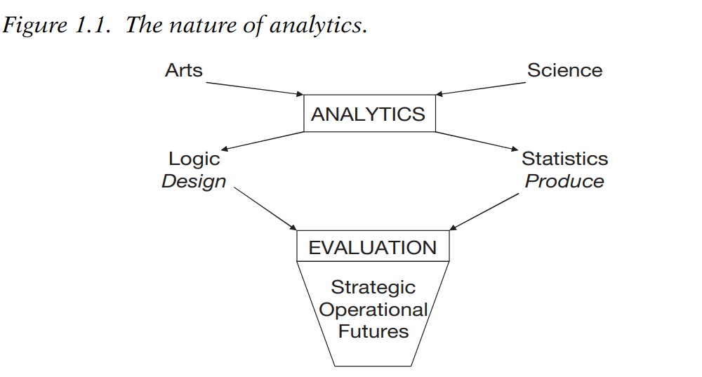
For solving organizational problems, we need a logical structure to parse out the many variables that can affect human performance. Once we have identified those variables, we can employ statistics, as necessary.

Slide 11
Chapter
HCM:21
01
Human Capital Management For The Twenty-first Century HCM, or human capital management, is the framework of logic that is used to gather, organize, and interpret data, and subsequently also knowledge, for the purpose of assessing the probability of upcoming events.

Slide 12
HCM:21
HCM takes the gambling out of decision making. It helps you overcome a reliance on past data and obsolete experience and replace it with insights regarding the future and the tools for influencing it. This is called ‘‘Managing tomorrow, today.’

Slide 13
Chapter
THE VALUE OF INSIGHT
01
Consider how wealthy you would be if you had accumulated a large amount of cash in August 2008, a month before the liquidity crisis slammed the global markets.
If you had made this move at the right time, would you have been lucky or wise? Luck comes in two forms: dumb luck and true luck.

Slide 14
Chapter
THE VALUE OF INSIGHT (CONT.)
01
Most organizations do not rely on dumb luck to save them from market fluctuations. They prepare by buying commodity futures to protect themselves from shortages or cost increases; they buy advertising space a year at a time to obtain volume discounts.
But what do they do in the human capital arena to offset future surprises? In most cases, the answer is nothing.

Slide 15
Chapter
THE VALUE OF INSIGHT (CONT.)
01
Ask most staffing managers what their most cost-effective staffing strategy will be in the coming year or their most fruitful applicant sources.
Or ask the training manager what the most effective method is for bringing the salespeople up to speed on the new product line.
They could not give you an answer based on anything other than ,obsolete experience.

Slide 16
Chapter
THE VALUE OF INSIGHT (CONT.)
01
The chief administrative officer of a major bank said that he spends over $250 million annually on training and yet had no idea if it was effective.
The human resources’ function applies a chaotic approach to service delivery.
It does not have a management model or operating system with predictive capability—that is, until now.

Slide 17
Chapter
HCM:21 MODEL
01
Specifically, the HCM:21 system consists of four phases:
Scanning
Planning
Producing
Predicting
Figure 1.2

Slide 18
Chapter
SCANNING
01
Scanning. All the external market forces and internal organizational factors are listed in terms of how they might affect the organization’s human, structural, and relational capital.
Additionally, the interdependencies and interactions across these three forms of capital are recognized and accounted for. This is the critical, often ignored, point.

Slide 19
Chapter
PLANNING
01
Planning. Workforce planning is reconstituted as capability
development.
The industrial-era, gap-analysis, structure-focused model is replaced with an agile system focused on building sustainable human capability rather than filling positions.
In fact, many of those older positions will be restructured or eliminated.

Slide 20
Chapter
PRODUCING
01
Producing. Human resources services are studied as processes with inputs, throughputs, and outputs.
Statistical analysis is applied to uncover the most cost-effective combination of inputs and throughputs to drive desired outputs.

Slide 21
Chapter
PREDICTING
01
Predicting. A three-point measurement system is designed to include strategic, operational, and leading indicators.
The causal and correlational aspects of the three points are used to tell a comprehensive story.

Slide 22
Chapter
HCM:21
01
In summary, HCM:21 is a model and a methodology for managing human capital, talent, or simply people.
It is distinct and disruptive in that ‘‘people management’’ has always been a loosely connected, out of synch batch of processes for hiring, paying, training, and sustaining talent.

Slide 23
Chapter
HCM:21 Cont.
01
This is why people claim to ‘‘hate’’ HR. As a result, the function is being dismantled through outsourcing and parceling out to finance and operations.
The time clearly is now for HR professionals to face these realities and adopt a future-focused, integrated management model

Slide 24
Chapter
THE LANGUAGE OF METRICS AND ANALYTICS
01
If HR professionals truly want to be part of the business, metrics—and especially predictive analytics—will open the door to that citizenship.
Metrics are the language of organizational management.
Human resources analytics is a communications tool, first and foremost.
It brings together data from disparate sources, such as surveys and operations of different units or levels, to paint a cohesive, actionable picture of current conditions and likely futures

Slide 25
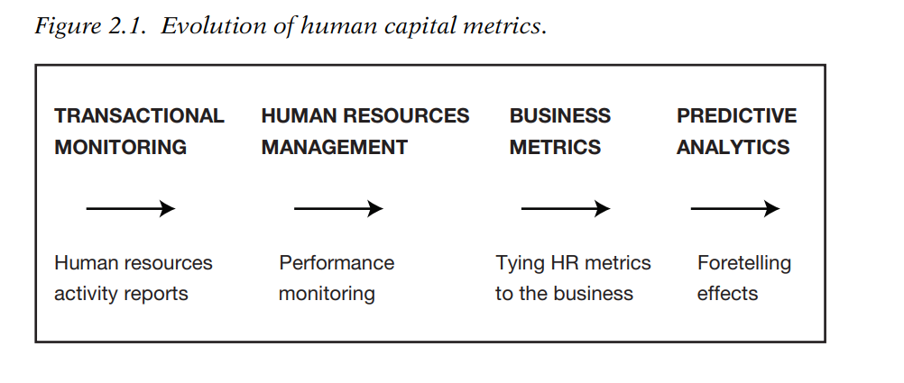
Evolution of Human Capital Metrics
Figure 1.3

Slide 26
Chapter
FIRST STEPS
01
There are five ways to measure anything in business. They are cost, time, quantity, quality, and human reaction.
The central question is: Which is most important to track?
The answer is: It depends.
If we accept that measurement is an activity and activity is expense, it follows that we don’t want to waste our time on metrics of little value.

Slide 27
Chapter
THE FIVE STEPS OF ANALYTICS: Step 1
01
Step 1: Recording our work (i.e., hiring, paying, training, supporting,
and retaining).
If we learn through measurement how efficient our processes are, we can improve them, thus creating value for the organization indirectly by saving money or time, or by increasing the ratio of output to input, or by making an employee or customer happier as the result of a less disturbing process or a better result.

Slide 28
Chapter
THE FIVE STEPS OF ANALYTICS: Step 2
01
Step 2: Relating to our organization’s goals (i.e., quality, innovation, productivity, service [QIPS]).
QIPS encompasses the fundamental goals of any organization.
Targets are set periodically by senior management across these process outcomes and are reviewed on a regular basis.
We want to link the results of our work to its impact on QIPS goals. This shows there is value in our work.

Slide 29
Chapter
THE FIVE STEPS OF ANALYTICS: Step 3
01
Step 3: Comparing our results to others (i.e., benchmarking).
To be effective, benchmarking requires knowledge of the organizations to which we will be compared.
Broad data about a comparative group in an industry or a region have only marginal value because of their great variance within that population.
The more detail we can find, the more the value of the benchmarks.

Slide 30
Chapter
THE FIVE STEPS OF ANALYTICS: Step 4
01
Step 4 : Understanding past behavior and outcomes (i.e., descriptive analytics). This is the first level of true analysis. It looks for and describes relationships among data without giving meaning to the patterns.
From it, we begin to see trends from the past; yet it is risky to extrapolate from the past into the future, considering the volatile, rapidly changing markets of today and likely tomorrow.
Between description and prediction lies diagnostic analytics—moving from what happened to why it happened.

Slide 31
Chapter
THE FIVE STEPS OF ANALYTICS: Step 5
01
Step 5: Predicting future likelihoods
This form of analysis relates what we know to what we don’t know.
It compares what happened yesterday to what will probably happen tomorrow.
Predictive analytics ascribes meaning to the patterns observed in descriptive analysis.

Slide 32
Chapter
THE FIVE STEPS OF ANALYTICS: Example
01
Example : Banks use this method to predict the creditworthiness of borrowers. Insurers use it to predict patterns of illness and mortality. Human resources can apply it to decisions about the expected return on human capital investments in hiring, training, and planning.

Slide 33
Chapter
ASCENDING THE VALUE LADDER
01
As we move from understanding the efficiency of our processes to being able to predict the organizational outcomes for a given human capital investment, we ascend the value ladder. Figure 1.4 shows the relative value of each step.

Slide 34
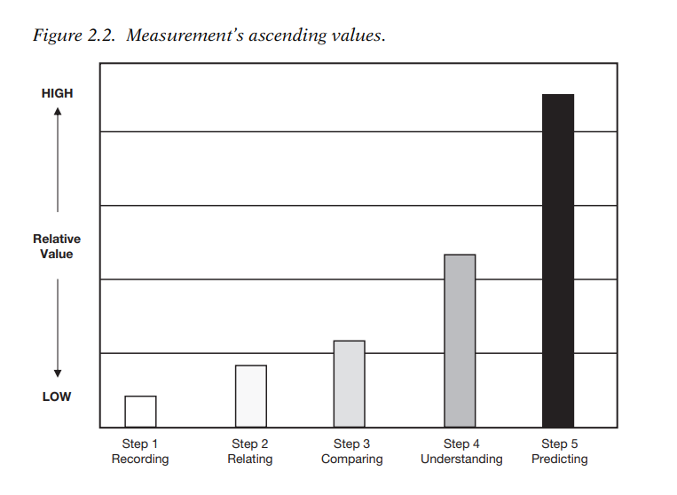
MEASUREMENTS’ ASCENDING VALUE
The Value Ladder
Figure 1.4

Slide 35
Chapter
ASCENDING THE VALUE LADDER
01
When HR is operating in a commercial business, or even a nonprofit organization, it needs to know and be able to explain why, what, and how it is doing what it does.
It is only reasonable that when we ask for resources, we explain what we are going to do with them and the value that we intend to produce as a result.

Slide 36
Chapter
ASCENDING THE VALUE LADDER (CONT.)
01
For example, we upgrade from cost per hire and time to fill requisitions to quality of hires.
If we spend money on training, the questions are:
How relevant is the training?
Are the trainees doing a better job as a result of this experience?

Slide 37
Chapter
ASCENDING THE VALUE LADDER (CONT.)
01
To assume that our work has value without offering any supporting data is arrogant and a dereliction of duty. It is also dangerous.
Why do you think every economic downturn reduces functions such as training? No reported value!

Slide 38
Chapter
ASCENDING THE VALUE LADDER (CONT.)
01
This is happening more as business becomes increasingly competitive—and that is reasonable.
Management is charged with making the best use of the resources provided by shareholder investments.

Slide 39
Chapter
SUMMARY
01
Disruptive Technology — People Analytics and AI are transforming workforce management, just as past innovations disrupted their industries.
What Is Analytics? — A logical framework for interpreting data, not just statistics.
HCM:21 Model — Four phases: Scanning → Planning → Producing → Predicting.
Five Steps of Analytics — Recording → Relating to Goals → Benchmarking → Descriptive → Predictive.
Ascending the Value Ladder — Moving from basic metrics to predictive insight raises HR's strategic value.

Slide 40
References
Fitz-enz, J. (2010). The new HR analytics: Predicting the economic value of your company's human capital investments. AMACOM.
Mukhopadhyay, K. (2023). Human resources analytics for business managers. Cambridge Scholars Publishing.
Patil, R. N., & Hiregoudar, S. S. (2023). Human resource analytics. Himalaya Publishing House.
Sedkaoui, S. (2024). Automated data analytics: Combining human creativity and AI power using ChatGPT. ISTE Ltd/John Wiley & Sons.

Slide 41


Thank You

