Slide 1


Project Quality Management
PMG 354
Lecture 0
Overview
Prepared by
Dr. Ehab Mahmoud
www.midocean.ae

Slide 2
Session Outline
Academic Agenda
Quizzes & Exams
Final Exam
Obligations and Grading
Course Description
Online Lecture
Course Objectives
Learning Outcomes
Course Topics
Areas of Discussion
Reference

Slide 3
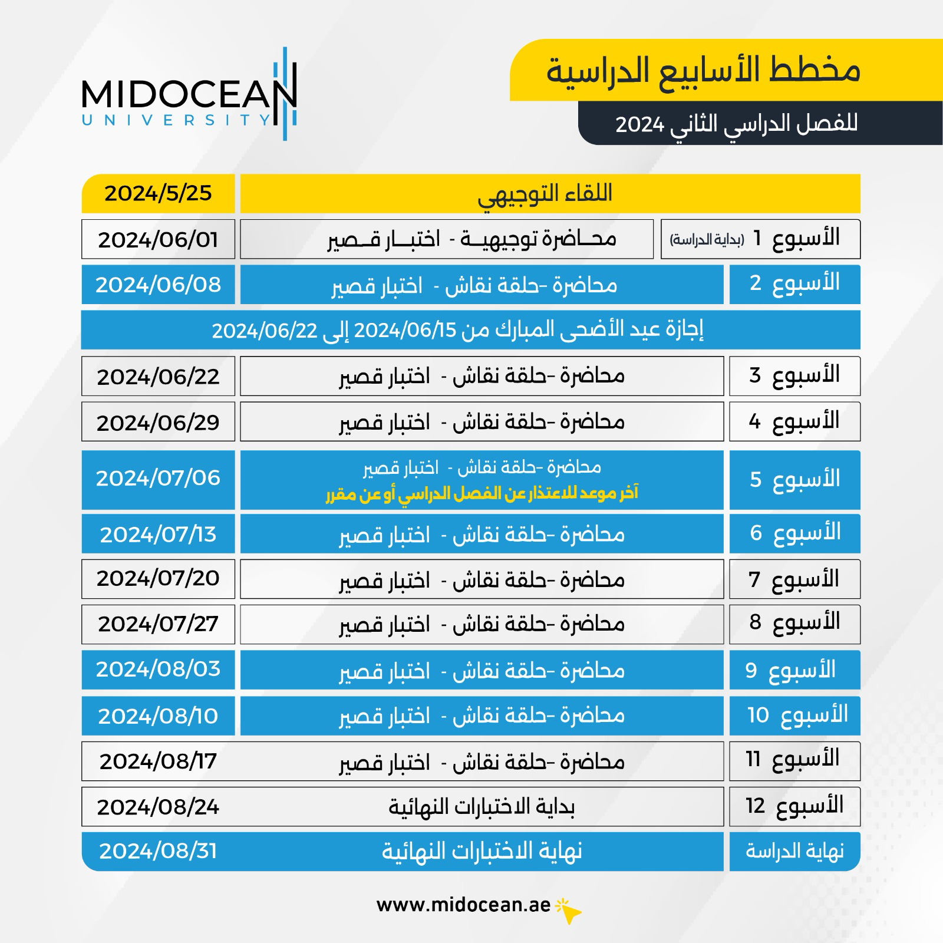
Academic Agenda

Slide 4

Academic Agenda

Slide 5
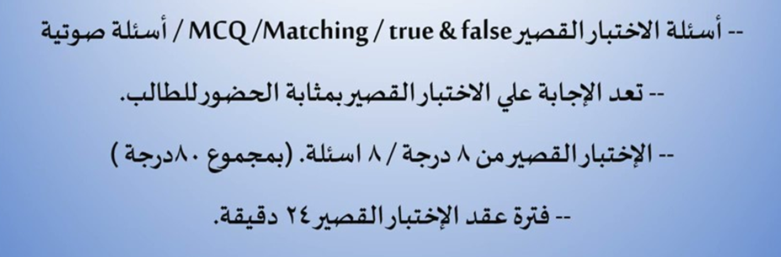
Quizzes & Exams

Slide 6

Final Exam

Slide 7

Course Description
Credit Hours: 3 Credit Hours
The materials and reference for this course will be:
Textbook, Project Quality Management, Second Edition: Why, What and How by Kenneth Rose
Lecture notes and slides

Slide 8
Online Lecture
Answer your questions/inquiries
Solve different issues/problems
Discuss your opinions with the instructor/classmates
Trigger activities related to previous session topics

Slide 9
Course Objectives
Introducing the foundations and concepts of quality in general
Introducing the main tools for quality assurance and quality control of the project
Identifying the main milestones of the project from start to end
Identifying the project charter.
Identifying the main elements of Quality Management plan to make sure the project will deliver the intended outcome.

Slide 10
Learning Outcomes
At the end of this subject, each student will be able to:
Evaluate the core quality processes and explain the role of each process in planning and managing projects.
Given a project scenario with a well‐defined goal and scope, construct a comprehensive quality plan that addresses the stakeholders’ needs.
Apply appropriate quality‐control tools and techniques to a given scenario where improvement is warranted as a result of the project’s quality‐control data.

Slide 11
Course Topics
Quality fundamentals and concepts
Quality auditing
Ishikawa basic seven tools
Statistical quality control – part 1
Statistical quality control – part 2

Slide 12
Course Topics
Project philosophy
Initiating the project
Developing the project schedule – part 1
Developing the project schedule – part 2
Developing a quality management plan

Slide 13
Areas of Discussion
What does Quality mean?
Characteristics of quality
The difference between quality assurance and quality control
The main stages of Audit
What are the common quality control used?
What are the main stages of the project?
How can we create a comprehensive project charter?

Slide 14
Areas of Discussion
What are the responsibilities of project manager?
How can we create the quality management plan to make sure that the project delivers the intended outcome?
Open discussion on what are the main barrier that the project team may face during the execution of project and how can be overcome.

Slide 15

Reference

Slide 16



Thank You

