Slide 1


Managing People and Organizations
Prepared by Dr. Usama Al-Fendi
MGM603
Managing People and Organizations
Lecture 2

Slide 2

Lecture
Outcomes of the chapter:
2
Describe the nature of diversity.
Describe different types of diversity and barriers to inclusion that exist workforce.
Discuss the emergence of globalization and cross-cultural differences and similarities.
Discuss the changing nature of technology and its impact on business.
Discuss emerging perspectives on ethics and corporate governance.
Discuss the key issues in new employment relationships.
www.midocean.ae

Slide 3
Lecture
The Changing Environment of Organizations
2
Real-World Challenge:
Global Diversity at Coca-Cola (case study)
Coca-Cola Company is a global business that operates in a multicultural world both in the workplace and in the marketplace. With over 100,300 global employees, and around a third of them outside of the United States.
The company recognizes that its ability to thrive in a multicultural world is both critical to its financial performance and consistent with its values.
Accordingly, diversity is recognized by Coca-Cola as an important component of their vision for the company in 2020.
www.midocean.ae

Slide 4

www.midocean.ae
Real-World Challenge:
Global Diversity at Coca-Cola (case study)
As Coca-Cola’s Chairman Muhtar Kent said, “The real power of diversity is the incredible synergies that result when different people and cultures come together united behind a common goal of winning and creating shared value. Extraordinary things truly happen”.
Imagine that the company’s leaders ask you for advice on how to build a diverse and inclusive workforce that allows it to leverage the potential of its diverse employees to enhance the company’s performance. After reading this chapter, what would you tell them?
Lecture
2
The Changing Environment of Organizations

Slide 5
Lecture
The Changing Environment of Organizations
2
Introduction:
The environment of all organizations is changing at an unprecedented rate.
In some industries, such as consumer electronics, popular entertainment, and information technology, the speed and magnitude of change are truly breathtaking.
YouTube, for instance, uploads over 400 hours of new video footage every hour. And it’s only been during the last decade or two that smartphone technologies, Facebook, and other forms of social networking have become commonplace.
Hence, to truly understand the behavior of people in organizational settings, it is necessary to understand the changing environment of business.
www.midocean.ae

Slide 6
Lecture
The Changing Environment of Organizations
2
Introduction:
There are at least five of the central environmental forces for change faced by today’s managers: diversity, globalization, technology, ethics and corporate governance, and new employment relationships. An understanding of these forces will then set the stage for our in-depth discussion of contemporary organizational behavior.
www.midocean.ae

Slide 7
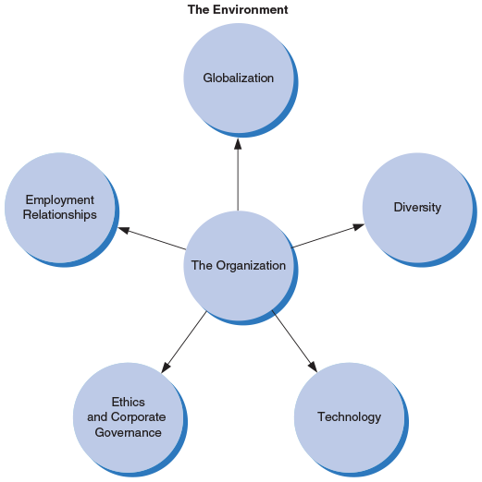
Lecture
The Changing Environment of Organizations
2
Figure 2.1
The changing environment of business presents both opportunities and changes for manages today.
Five important environmental forces are globalization, diversity, technology, ethics and corporate governance, and new employment relationships.
www.midocean.ae

Slide 8

Lecture
Diversity and business:
2
Diversity :
Types of Diversity:
Refers to variety of observable and unobservable similarities and difference among people.
1- Surface-level:
Refers to observable differences in people, including race, age, Ethnicity, physical characteristics, and gender.
Surface-level diversity reflects characteristics that are observable and known about people as soon as you see them.
Consider, for instance, all of the surface-level examples of diversity illustrated in this business meeting. In addition, there are also many forms of deep-level diversity that cannot even be observed
www.midocean.ae

Slide 9
Lecture
2
Diversity and business:
Types of Diversity:
2- Deep-level:
Refers to individual differences that cannot be seen directly, including goals, values, personalities decision making styles, knowledge, skills, abilities, and attitude.
These “invisible” characteristics in others take more time to learn about, but can have stronger effects on group and organizational performance than surface-level characteristics.
3- Separation:
Refers to differences in position or opinion among members reflecting disagreement or opposition – dissimilarity in attitude or value, for example, especially with regard to group goals or processes
www.midocean.ae

Slide 10
Lecture
Diversity and business:
2
Types of Diverse :
4- Variety:
Refers to difference in a certain type of category, including group members’ expertise, knowledge, or functional background.
5- Disparity: Differences in the concentrations of valuable social assets or resources-dissimilarities in rank, pay, decision-making authority, or status, for example.
www.midocean.ae

Slide 11


Lecture
Diversity and business:
2
The two people working in the left photo reflect several examples of surface-level diversity while the two individuals in the right photo would appear to be considerably less diverse. Of course, when we take into account deep-level diversity the two people in the left photo might be more similar than we think, and the two people in the right photo may be more different than we think.
www.midocean.ae

Slide 12
Lecture
Diversity and business:
2
Surface-level Diversity: Observable difference in people including gender, race, age, ethnicity, and physical abilities.
Deep-level diversity: individual differences that cannot be seen directly, including goals, values, personalities, decision making styles, knowledge, and attitudes.
Separation: differences in position or opinion among group members reflecting disagreement or opposition, especially with regard to group goals or processes- dissimilarities in an attitude or value, for example (a type of deep-level diversity).
Variety: differences in a certain type of category, including group members’ expertise, knowledge, or functional background ( a type of deep-level diversity).
Disparity: differences in the concentration of valuable social assets or resources --- including dissimilarities in rank, pay, decision-making authority, or status (a type of deep-level diversity).
www.midocean.ae

Slide 13
Lecture
Diversity and business:
2
Trends of diversity:
The ethnic and cultural mix of the U.S. workforce is changing in fairly predictable ways, with general trends toward greater diversity. The Census Bureau projects that by 2020, the U.S. workforce will consist of 62.3 percent White non-Hispanics, 18.6 percent Hispanics, 12 percent Blacks, and 5.7 percent Asians. Longer-term U.S. demographic projections further highlight the increasingly diverse character of the United States.
The population is projected to become older.
By 2050, the total population is forecasted to grow from 282.1 million in 2000 to 419.9 million , a 49 present increase.
Non-Hispanic Whites are expected to decrease.
Proportion of Blacks, Asians, and Hispanics will increase.
Talent Mangers are forecast to rise globally.
www.midocean.ae

Slide 14

Lecture
Diversity and business:
2
Trends of diversity:
Effective diversity management plays a key role in attracting and retaining talent. By being as inclusive as possible organizations can attract, retain, and capitalize on the abilities of high-talent people, regardless of their age, gender, ethnicity, or religion.
www.midocean.ae

Slide 15
Lecture
2
Diversity and business:
Generational diversity:
Age diversity
May a result in younger managers supervising older workers
Reverse mentoring: pairing a junior employee with a senior employees to transfer technical / computer skills from the joiner to the senior one.
Generations (by birth year)
Seniors: 1922 – 1943
Baby boomers: 1943 – 1963
Generation X: 1964 – 1980
Generation Y/Millennials: 1980-2000
New generation of workers just beginning to enter the workforce, specifically, those born after 2000. Some experts are starting to refer to this group as Generation Z and others are using the term iGen.
Older workers may have better job performance but need monitoring to adopt new technology.
www.midocean.ae

Slide 16
Lecture
Diversity and business:
2
Generational diversity:
Baby boomers’ interest in wellness is changing the fitness programs and wellness benefits many employers provide.
Many Generation Xers are concerned about maintaining balance in their lives, increasing many companies’ interest in work–life balance programs.
Generation Y members are more technologically savvy, the most diverse of any generation, and are considered to be the biggest workplace influence since the baby boomers.
www.midocean.ae

Slide 17
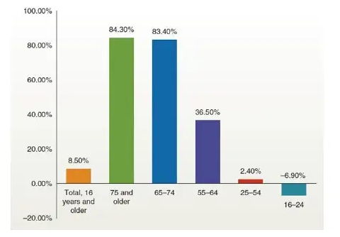
Lecture
Diversity and business:
2
Example: The labor in the United States is getting older. For example, as shown here, between 2006 and 2016 the number of U.S. workers between the ages of the 65 and 74 grew by 83.4 precent. In contrast, the number of workers between the ages 25 and 54 grew only by 2.4 percent.
www.midocean.ae

Slide 18
Lecture
Diversity and business:
2
Diversity Issues for managers
As managers, diversity awareness will enable us to hire, retain, and engage the best talent, which will help to maximize the organization’s performance
The business case for diversity
Diversity also fosters greater creativity and innovation.
Organizational performance increase when employees have appositive attitude toward diversity.
Culturally diverse teams make better decisions over time than homogenous ones.
Women in top management results in more innovation.
Title VII and civil rights act of 1964 prohibits employment discrimination based on race, color, religion, sex, or national origin.
www.midocean.ae

Slide 19
Lecture
Diversity and business:
2
Barriers to Inclusion
The “like me” bias | People prefer to associate with others they perceive to be like themselves.
Stereotypes | A belief about an individual or a group based on the idea that everyone in a particular group will behave the same way or have the same characteristics.
Prejudice | Outright bigotry or intolerance for other groups.
Perceived threat of loss | If some employees perceive a direct threat to their own career opportunities, they may feel that they need to protect their own prospects by impeding diversity efforts.
Ethnocentrism | The belief that one’s own language, native country, and cultural rules and norms are superior to all others.
Unequal access to organizational networks | Women and minorities are often excluded from organizational networks, which can be important to job performance, mentoring opportunities, and being seen as a candidate for promotion.
www.midocean.ae

Slide 20
Lecture
Diversity and business:
2
Managing diversity:
Top management support for diversity and for diversity initiatives.
Reciprocal mentoring: matches senior employees with diverse junior employees to allow both individuals to learn more about different group.
Older adults may benefit from self-paced learning environments and confidence-boosting intervention..
It’s not realistic to claim or to pursue an “I’m totally unbiased” stance with regard to diversity.
www.midocean.ae

Slide 21
Lecture
Globalization and business:
2
Globalizations:
The internationalization of business activities and the shift toward an integrated global economy.
Factors increasing globalizations:
Communication and transportation have improved dramatically over the past several decades. International communication is far easier than it was just a few years ago.
Businesses have expanded internationally to increase their markets.
More and more firms are moving into international markets to control costs, especially to reduce labor costs.
Many organizations have become international in response to competition.
www.midocean.ae

Slide 22
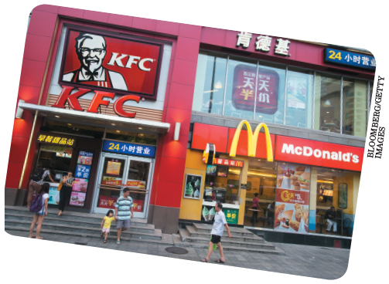
Lecture
Globalization and business:
2
Globalization is a major part of the changing environment of business. Fast food businesses like KFC and McDonald’s, for example, have set up shop around the world. Their challenge is to maintain the identity and appeal that led them to become so recognizable while also adapting to customer tastes and workplace practices in different countries.
www.midocean.ae

Slide 23
Lecture
Globalization and business:
2
Culture: the set of shared values, often taken for granted that help people in a group, organization, or society understand which actions are considered acceptable and which are deemed unacceptable.
Culture competence: the ability to interact effectively with people of different culture.
There are four components of cultural competence
1- Awareness of our own cultural worldview, and of our reactions to people who are different: A security guard who knows that he or she has a tendency to profile teenagers as “troublemakers” is culturally aware of his or her reactions to this group.
www.midocean.ae

Slide 24
Lecture
Globalization and business:
2
2- Our attitude toward cultural differences: This reflects a willingness to honestly understand our beliefs and values about cultural differences
3- Knowledge of different worldviews and cultural practices: Research has found that our values and beliefs about equality may be inconsistent with our behaviors. Many people whose answers on a test indicated that they did not have prejudices did things in cross-cultural situations that did, in fact, reflect prejudice.
4- Cross-cultural skills: This component addresses the importance of practicing cultural competence, including nonverbal communication, to become effective cross-culturally
www.midocean.ae

Slide 25
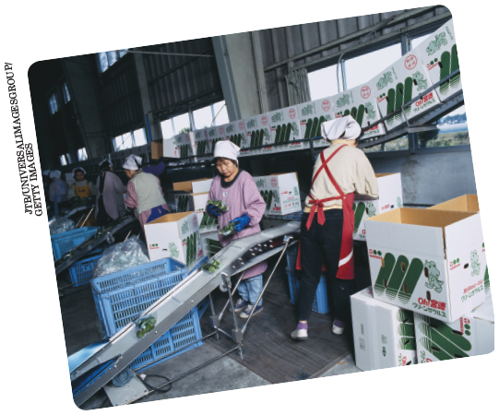
Lecture
Globalization and business:
2
One major reason that businesses move into international markets is to take advantage of lower labor costs. For instance, many firms moved production facilities to Mexico several years ago because of low labor costs. China then became a magnet for business with its own low labor costs. But as wages have started in climb there some businesses are looking at other manufacturing locations such as Vietnam.
www.midocean.ae

Slide 26
Lecture
Globalization and business:
2
Cultural Etiquette Quiz
Successfully managing or conducting business across cultures involves knowing what to say, when to arrive for meetings, what to wear, what gifts are acceptable, and what greeting to give, among many other things. It takes a continued effort to recognize and appreciate the other party’s expectations and business practices. This quiz will give you an idea of how aware you are of the business cultures of other areas of the world.
Which culture often views professional titles as arrogant? Ireland
Where should you not use red ink on your business card because the color red has a negative connotation? Madagascar
In this culture, it may be considered an insult to leave immediately following a meeting, as this may suggest that you are not interested in getting to know the other party. Colombia
4- If you compliment someone in this country on one of his or her personal items, he or she may insist that you accept it as a gift. Bahrain
www.midocean.ae

Slide 27
Lecture
Globalization and business:
2
Cross-Cultural difference and similarities:
General observations: Cultural and national bounders may not coincide.
one major review of the literature on international management reached five basic conclusions.
Behavior in organizational settings does indeed vary across cultures.
Culture itself is one major cause of this variation
although the causes and consequences of behavior within organizational settings remain quite diverse across cultures, organizations and the ways they are structured appear to be growing increasingly similar.
The same individual behaves differently in different cultural settings.
Cultural diversity can be an important source of synergy in enhancing organizational effectiveness.
www.midocean.ae

Slide 28
Lecture
Globalization and business:
2
Global perspective
A global perspective: is distinguished by a willingness to be open to and learn from the alternative systems and meanings of other people and cultures and a capacity to avoid assuming that people everywhere are the same.
A person with a global perspective scans the world from a broad view, always seeking unexpected trends and opportunities.
Understand Yourself:
Self-assessment gives you the opportunity to better understand your global perspective. Place your response on the line to the left of each statement using the scale below, and then follow the scoring instructions and read the interpretation at the end.
www.midocean.ae

Slide 29
Lecture
Technology and business:
2
Technology
refers to the methods used to create products, including both physical goods and intangible services.
Three specific areas of technology worth noting here are:
(1) The shift toward a service-based economy,
(2) The growing use of technology for competitive advantage, and
(3) mushrooming change in information technology
Manufacturing and Service Technologies
Manufacturing: is a form of business that combines and transforms resources into tangible outcomes that are then sold to others.
A service organization: is one that transforms resources into an intangible output and creates time or place utility for its customers.
www.midocean.ae

Slide 30
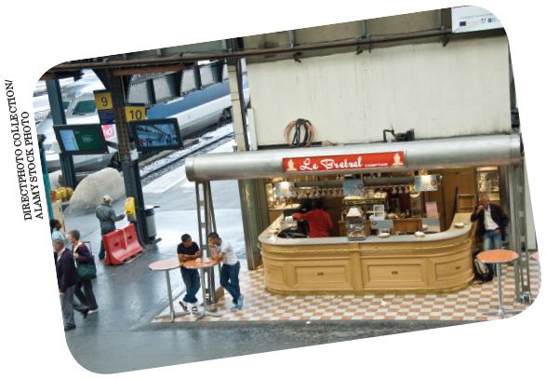
Lecture
Technology and business:
2
Service-oriented businesses need to recruit and train employees to take on a variety of roles as they interface with the business’s customers. Take this cafe in a Paris train station, for example. Employees will be providing food and beverage services to a variety of travelers, including both business people and tourists and who may speak different languages. As a result, those employees will need to be capable of functioning in many different situations.
www.midocean.ae

Slide 31
Lecture
Technology and business:
2
Technology and Competition
Technology is the basis of competition for some firms, especially those whose goals include being the technology leaders in their industries.
Businesses have increasingly found that they can be more competitive if they can systematically decrease cycle times.
Information Technology and Social Media
Breakthroughs in information technology have resulted in leaner organizations, more flexible operations, increased collaboration among employees, more flexible work sites, and improved management processes and systems. On the other hand, they have also resulted in less personal communication, less “down time” for managers and employees, and an increased sense of urgency vis-à-vis decision making and communication—changes that have not necessarily always been beneficial.
www.midocean.ae

Slide 32
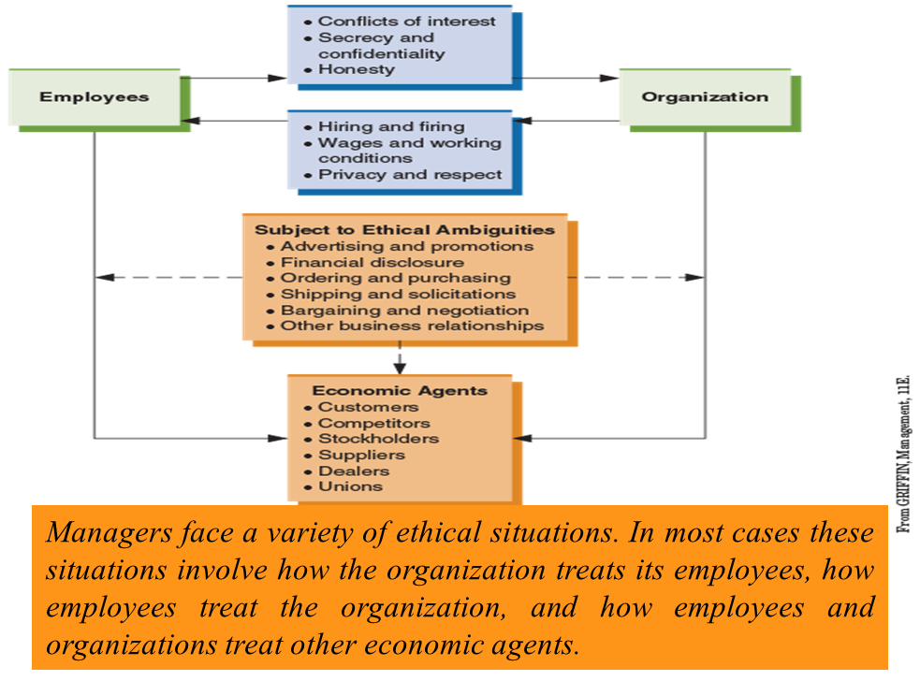
Lecture
Ethics and Corporate Governance:
2
Framing Ethical Issues
illustrates how many ethical situations can be framed. Specifically, most ethical dilemmas faced by managers relate to how the organization treats its employees, how employees treat the organization, and how employees and organizations treat other economic agents.
www.midocean.ae

Slide 33

Lecture
Ethics and Corporate Governance:
2
How an Organization Treats Its Employees
This area includes policies such as hiring and firing, wages and working conditions, and employee privacy and respect.
One important perspective in framing ethical issues is how the organization treats its employees. Take this closed business, for example. If its employees showed up for work one day and found this sign on the door, most people would agree that the business owners did not treat their employees ethically or responsibly by not giving them more advance notice of the impending closure.
www.midocean.ae

Slide 34

Lecture
Ethics and Corporate Governance:
2
How Employees Treat the Organization
Numerous ethical issues also stem from how employees treat the organization, especially in regard to conflicts of interest, secrecy and confidentiality, and honesty.
Another perspective in framing ethical issues is how employees treat the organization. If this employee is taking envelopes for business reasons that is, of course, ethical and appropriate. But if the envelopes are for personal use then most people would see this as unethical.
www.midocean.ae

Slide 35
Lecture
Ethics and Corporate Governance:
2
How Employees and the Organization Treat Other Economic Agents
the primary agents of interest include customers, competitors, stockholders, suppliers, dealers, and unions.
The interactions between the organization and these agents that may be subject to ethical ambiguity include advertising and promotions, financial disclosures, ordering and purchasing, shipping and solicitations, bargaining and negotiation, and other business relationships.
Another area of interest in recent years involves financial reporting by some e-commerce firms.
Ethical Issues in Corporate Governance
the oversight of a public corporation by its board of directors.
The board of a public corporation is expected to ensure that the business is being properly managed and that the decisions made by its senior management are in the best interests of shareholders and other stakeholders.
www.midocean.ae

Slide 36
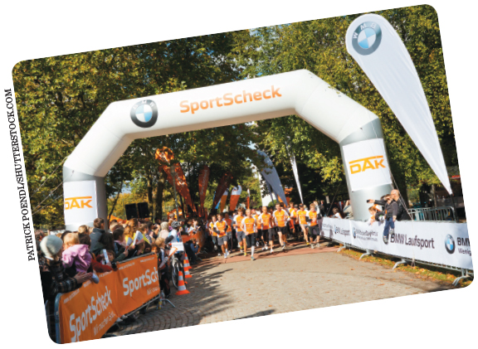
Lecture
Ethics and Corporate Governance:
2
Corporate Social Responsibility
corporate social responsibility often include businesses living and working together for the common good and valuing human dignity. An important part of this is how employers treat their employees.
Corporate social responsibility has become increasingly important in recent years. Some firms actively engage in social responsibility by promoting fitness activities such as fun runs, bicycle races, and so forth.
www.midocean.ae

Slide 37
Lecture
New Employment Relationships:
2
The Management of Knowledge Workers
Many employees add value simply because of what they know. These employees are often referred to as knowledge workers. How well these employees are managed is seen as a major factor in determining which firms will be successful in the future.
Compensation and related policies for knowledge workers must also be specially tailored. For example, in many high-tech organizations, engineers and scientists have the option of entering a technical career path that parallels a management career path. This allows the knowledge worker to continue to carry out specialized work without taking on large management responsibilities, while at the same time offering that worker compensation that is equivalent to that available to management.
www.midocean.ae

Slide 38

Lecture
New Employment Relationships:
2
Outsourcing and Offshoring
Outsourcing is the practice of hiring other firms to do work previously performed by the organization itself. It is an increasingly popular strategy because it helps firms focus on their core activities and avoid getting sidetracked by secondary activities
Offshoring the growing trend toward outsourcing to other countries in order to lower labor costs;
Outsourcing and offshoring have become very popular business practices in recent years. Many companies that use call centers, for instance, have found it to be advantageous to contract with other firms to handle those services for them. To capitalize on this trend, many call center operations in India have sprung up to provide support for other companies. Indian workers such as these are usually fluent in English, can be trained to handle most questions and problems, and work for wages somewhat lower than U.S. counterparts.
www.midocean.ae

Slide 39
Lecture
New Employment Relationships:
2
Temp and Contingent Workers:
A contingent worker: is a person who works for an organization on something other than a permanent or full-time basis. Categories of contingent workers include independent contractors, on-call workers, temporary employees (usually hired through outside agencies), and contract and leased employees. Another category is part-time workers. The financial services giant Citigroup, for example, makes extensive use of part-time sales agents to pursue new clients.
Tiered Workforce:
A tiered workforce: exists when one group of an organization’s workforce has a contractual arrangement with the organization objectively different from that of another group performing the same jobs. For example, during the 2008–2010 recession, Harley-Davidson negotiated a new agreement with its labor union for wages and job security at its large motorcycle factory in York, Pennsylvania.
www.midocean.ae

Slide 40

Lecture
New Employment Relationships:
2
The Changing Nature of Psychological Contracts
Psychological contract: is a person’s overall set of expectations regarding what he or she will contribute to the organization and what the organization will provide in return.
Unlike any other kind of business contract, a psychological contract is not written on paper, nor are all of its terms explicitly negotiated.
A psychological contract is an unwritten agreement about expectations between an organization and its employees. This manager and employee, for example, are finalizing an understanding about how a new project will be managed. The agreement is not written, but both sides understand what they are supposed to do and what they can expect in return.
www.midocean.ae

Slide 41
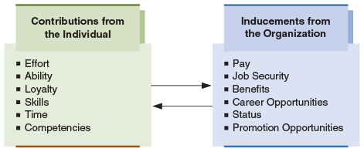
Lecture
New Employment Relationships:
2
The Psychological Contract:
Psychological contracts govern the basic relationship between people and organizations. Individuals contribute such things as effort and loyalty. In turn, organizations offer such inducements as pay and job security.
www.midocean.ae

Slide 42
Lecture
Summary and Application:
2
Diversity is much more than demographics and can reflect combinations of characteristics in addition to a single attribute.
Diversity affects individual and organizational outcomes through processes including social integration, differences in status and power, task conflict, relationship conflict, inclusion, and information processing.
Barriers to inclusion include the “like me” bias, stereotypes, prejudice, perceptions of loss by persons who feel threatened by diversity initiatives, ethnocentrism, and unequal access to organizational networks.
Societal culture reflects language, politics, religion, and values among other things, and societal culture can vary within a single country or across nearby countries.
Globalization is playing a major role in the environment of many firms today. The volume of international trade has grown significantly and continues to grow at a very rapid pace.
www.midocean.ae

Slide 43
Lecture
Summary and Application:
2
One special aspect of business: ethics, corporate governance, has also taken on increased importance.
One special aspect of business ethics, corporate governance, has also taken on increased importance.
A final significant area of organizational change facing organizations today involves new employment relationships.
www.midocean.ae

Slide 44
Lecture
Discussion Questions:
2
Which do you think is more important to team performance: surface-level or deep-level diversity? Why?
How can diversity create a competitive advantage for a firm?
If a subordinate came to you and said that he or she felt the company’s new diversity hiring initiative was unfair and would compromise his or her well-deserved opportunities for advancement, how would you respond?
What can leaders do to be effective when team members are from different cultures and have different expectations about how the leader should behave?
www.midocean.ae

Slide 45
Lecture
Discussion Questions:
2
5. Identify at least three ways in which the globalization of business affects businesses in your community.
6. What roles do changing technologies play in your daily activities?
7. Do you think that concerns regarding ethics will become more or less important in business? Why?
8. What are your personal opinions about international outsourcing in the garment industry? Do you think that lower prices are worth sending U.S. jobs to other countries? Explain your answer.
www.midocean.ae

Slide 46



Thank You

