Slide 1





Critical Thinking
Prepared by Dr. Ahmed Alqarni
Lecture 10
MGM115
Critical Thinking

Slide 2


Lecture 10
Writing Argumentative Essays
Mostly from Critical Thinking, Bassham and others

Slide 3
Lecture 10
Writing Argumentative Essays
This lecture includes:
Before you write
Writing the first draft
After writing the first draft

Slide 4
Lecture 10
Writing a successful argument
Writing takes place in three very broad stages: what you do before you begin the first draft, what you do during the writing of the first draft, and what you do after you have completed the first draft.
Before You Write
Know yourself
Know your audience
Choose and narrow your topic
Write a sentence that expresses your claim
Gather ideas: brainstorm and research
Organize your ideas

Slide 5
Lecture 10
Writing a successful argument
Writing the First Draft
Provide an interesting opening
Include a thesis statement
Develop your body paragraphs
Provide a satisfying conclusion
After the First Draft
Read what you have written and revise
Consider what you have not written and revise
Show your work
Edit your work
Hand it in

Slide 6
Lecture 10
Before You Write
Know yourself
If you want to write about a topic you don’t know very well, take the time to learn as much as you can about it. If you feel strongly about an issue, you should be willing to defend it intelligently and rationally. That doesn’t
mean, of course, that you must know all there is to know about an issue before you begin to formulate your opinion and take your stand or that you must present your case in an absolute or exhaustive manner.

Slide 7
Lecture 10
Before You Write
Know your audience
Some writers present arguments as if the reader were either an enemy or a devoted fan. Neither is usually the case, but let’s suppose for a moment that one or the other is true. Take the first hypothetical reader, our enemy. If our purpose is to be understood and to present a well-reasoned argument in support of our claim, does it make sense to antagonize the person we hope will judge us fairly?
The second hypothetical reader—our loving champion—may agree with everything we say and, at the end of our presentation, tell us that we have presented a beautiful argument, full of truth and well structured, but there is very little to be gained from being evaluated by someone who is predisposed to compliment us.

Slide 8
Lecture 10
Before You Write
Know your audience
Knowing who will be reading your argument will help you decide what tone to use, how sophisticated your word choices can be, how much background you must provide, and how much detail you need to go into. In the business world, even your position in a company or fi rm can dictate how you write your argument or proposal. Are your readers highly skeptical, or are they open to even the riskiest proposals? Do they hate to spend a dime on new ideas, or do they enjoy taking a gamble on costly innovations? Are you in a position of some authority so that your readers must implement your suggestions, or do you have to work hard at proving your case?

Slide 9
Lecture 10
Before You Write
Anticipate Your Readers’ Reactions
On the basis of what you know about your topic and your audience, try to determine how your audience might react to your claim and its defense. When you consider how your audience will react to your claim, you almost automatically begin thinking about their reasons for reacting that way. You begin considering their points of view, their claims, their counterarguments. Predicting what an audience might say in response to your claim will help you to create a stronger argument.

Slide 10
Lecture 10
Before You Write
Anticipate Your Readers’ Reactions
Often you can predict your audience’s reactions by considering how you would feel as a reader. For example, people generally don’t like to be told that they are wrong about something; so, instead of telling your readers that they are wrong, try to discover what values you and they have in common and show that your approach is based on those values, not detrimental to them. If you want to correct what you believe to be dangerous behavior, point out to your readers what you see to be the terrible consequences of continuing to act as they are.

Slide 11
Lecture 10
Before You Write
Anticipate Your Readers’ Reactions
In the absence of information about your readers, or when writing for a general readership, there are a few things you can assume. First, assume that your readers are slightly skeptical, that they do not necessarily agree with everything you say, but that they are open-minded and fair.
Assume that your readers are intelligent, rational, and humane.
if a close-minded, prejudicial audience refuses to listen to you, if you have defended your claim with solid evidence and clear reasoning, you have done your job.

Slide 12
Lecture 10
Before You Write
Choose and Narrow your Topic
it is better to work at developing a focused topic than to leave a large issue undeveloped. And as you improve your writing and arguing skills, you will usually find that you have too much to say even about the most slender of topics.

Slide 13
Lecture 10
Before You Write
Write a sentence that expresses your claim
Once you have decided what you want to write about, formulate a single sentence that presents the central claim of your argument and write it on a blank sheet of paper: “I think . . . ,” “People should . . . ,” “We must . . . ,” “It’s time for . . . ,” “It is true that . . . ,” and so forth. State your claim as forthrightly as you can and be sure that your claim is debatable, something with which someone could disagree.

Slide 14
Lecture 10
Before You Write
Gather Ideas: Brainstorm and Research
Writers generally get their ideas from two sources: their own heads and the
heads of other people, usually other writers.
Some writers do a great deal of reading and research before formulating ideas and approaches for a paper; others record their own thoughts first and then look for additional ideas and support; still others combine the two approaches in a variety of ways. The approach you take will depend on your own habits, your familiarity with the topic, and your need for facts and expert opinion to back you up.

Slide 15
Lecture 10
Before You Write
Gather Ideas: Brainstorm and Research
Brainstorming is a method for generating ideas for a paper. When you brainstorm, allow your ideas to flow freely. Write down whatever occurs to you, and don’t censor any ideas as irrelevant or uninteresting. Don’t worry about being incorrect or even sounding foolish. No one will judge your argument on your brainstorming. It is like a dialogue with yourself. You can always cut ideas after you have listed them.

Slide 16
Lecture 10
Before You Write
Gather Ideas: Brainstorm and Research
First, List Supporting Premises when brainstorming for an argument, list as
many reasons as you can to support your claim
Second List Opposing Premises, write down as many premises as you can think of to oppose your claim. What would someone who disagreed with you say?
Think Critically about Your Claim Are you overgeneralizing in any way? Are there any exceptions to your claim? Are you creating false alternatives?
Think on Paper Now write down what you know or think you know about your topic. In this part of brainstorming, you are simply trying to create and gather ideas from your own mind; in other words, you are thinking on paper

Slide 17
Lecture 10
Before You Write
Gather Ideas: Brainstorm and Research
Methods of Development A very productive method for generating ideas
is to think about the ways we usually develop and detail our communication
with one another:
Narration A narration tells a story in chronological order. Are there any stories
associated with your topic? Do you know of anyone whose experiences would
be worth recounting?
Description A description gives concrete details to paint a verbal picture of a person, place, or thing. There may be in your topic something that can be described

Slide 18
Lecture 10
Before You Write
Gather Ideas: Brainstorm and Research
Methods of Development
Cause Causes are reasons for the occurrence of an event, a decision, an action, and so forth. Look at your topic and ask, “Why did this happen?” “What caused this?
Effect Effects are the results of an event, a decision, an action, and so forth. What
effects are associated with your topic? Ask yourself, “What will happen if . . . ?”
and “What has happened?” “What has the outcome been?
Classification and Division When we classify, we take a large group and break it down into smaller, more manageable, groups. All the students in a college can be grouped by class (freshman, sophomore, junior), major, living status, and so forth.

Slide 19
Lecture 10
Before You Write
Gather Ideas: Brainstorm and Research
Methods of Development
Contrast When we contrast two things, we show them to be dissimilar in important ways. Could you develop your topic through contrasts?
Comparison When we compare two things, we discuss the similarities between them. Is there anything in your topic that calls for a comparison? Can you defend your claim by comparing the situation under study to something similar?
Illustration When we illustrate, we provide examples to help clarify a point
and defend a general comment.
Definition When we defi ne a word, we tell our readers or listeners exactly
what we mean by a word or a concept.

Slide 20
Lecture 10
Before You Write
Organize your Ideas
Organize by Premises In deciding how to organize your argument,
keep in mind that each paragraph in the body of the argument will be
related somehow to your central claim. In most cases, the body paragraph
will present a topic idea that is a premise for the claim made in the thesis.

Slide 21
Lecture 10
Before You Write
Gather Ideas: Brainstorm and Research
Do Some Research The support you seek will generally fall into two broad categories—facts and opinions. You can draw from a wide variety of reliable sources, including experts in the fi eld, statistical abstracts, textbooks, encyclopedias, journals, and reliable Internet sites.
Facts are very useful for supporting an argument. A fact is something that has objective reality; it is not a matter of perception or opinion. Facts include statistical data, reports of observations, and examples of actual occurrences and events.
Unlike facts, opinions can be so subjective that they are sometimes based on nothing more than prejudice or wishful thinking.

Slide 22
Lecture 10
Writing the first draft
Provide an Interesting Opening
You don’t have to begin with your claim, but you can if it is startling, very controversial, or attention-grabbing. Otherwise, start with some background on your topic or show why the issue is an important one. Start with some surprising statistics, an apt quote, a little-known fact, or an interesting story relevant to the topic.

Slide 23
Lecture 10
Writing the first draft
Include a thesis statement
If you haven’t already done so in the opening sentence or two, give a clear, carefully worded statement of your claim (sometimes called a thesis statement )
somewhere in the opening paragraph. You can give your statement in its own sentence or include it as part of a larger sentence. Your thesis statement can also give some idea of how you plan to defend your claim or some idea of how your paper is organized.

Slide 24
Lecture 10
Writing the first draft
Provide a satisfying conclusion
Almost every example of human communication has a beginning, a middle, and an end. You do not want your readers to feel that you have hung up without saying good-bye, which is the purpose of a conclusion. It lets your readers know that the essay is complete, that there are no missing pages, and that you have said what you intended to say.

Slide 25
Lecture 10
After the first draft
Most writers like to set their work aside for a short time before they begin revising or editing. Doing so will help you get some distance from your own words, which can seem too familiar if you read them too soon after writing them. It is easy to miss errors if our minds are filling in what we meant instead of what actually appears on the page.

Slide 26
Lecture 10
After the first draft
Read What you Have Written and Revise
After you have written a draft of your essay and given your brain time to cool, return to your essay and read it again with a critical eye. Don’t look only for clumsy expressions, grammatical problems, meaningless or repetitive sentences,
and the like. Look for the large issues and evaluate your argument from the point of view of someone who disagrees with you. Be honest with yourself; question your evidence. Ask yourself if you are simply repeating what you have heard or what you assume to be true. Check your logic. Put your essay through the same rigorous test you have put other arguments through. Revise your draft to correct any problems.

Slide 27
Lecture 10
After the first draft
Consider What you Have Not Written and Revise
Consider what you have not said. When you look critically at your essay, try to disagree with what you have written by finding a way to reject each of the premises you have offered as support. You don’t have to abandon what you have written; you may simply have to defend it better.

Slide 28
Lecture 10
After the first draft
Show your Work
Show your draft to someone—a friend, a family member, a professor, a tutor in the writing lab—someone who will do you the favor of critically reviewing your essay. Don’t let a friend tell you what you want to hear: “It’s great. Hand it in.” Ask if anything is confusing or undeveloped. Ask your reader to show you where the argument may be weak or unconvincing. Ask if the organization is clear and effective, if the opening paragraph is interesting, and if the conclusion is satisfying. Never hesitate to get advice from a reader. It is not a sign of weakness or insecurity but of strength and intelligence to ask for a critique on a draft. Not even a professional writer considers a piece finished until it has been reviewed by one or more people who can offer advice for improving the writing.

Slide 29
Lecture 10
After the first draft
Edit your Work
When you have revised your argument several times and are happy with the content and organization, look over your sentences very carefully one last time for grammatical mistakes, misused or missing punctuation, misspellings, and typographical errors. And, again, there is no shame in seeking help if you are unsure about things such as comma usage and sentence fragments. Finally, try reading your paper out loud to hear how it sounds. Doing so can sometimes help reveal awkward phrases or repetitive sentence structures.
Hand it in

Slide 30
Lecture 10
5-Paragraph Argumentative Essay
A 5-paragraph essay is basically a formatting style for essay writing. It has the following five parts:
Introduction
In the introductory, the writer introduces the topic and provides a glance at the collected data to support the main argument.
Body paragraph 1
The first body paragraph discusses the first and most important point related to the argument. It starts with a topic sentence and has all the factual data to make the argument convincing.

Slide 31
Lecture 10
5-Paragraph Argumentative Essay
Body paragraph 2
The second body paragraph mentions the second most important element of the argument. A topic sentence is used to start these paragraphs. It gives the idea of the point that will discuss in the following paragraph.
Body paragraph 3
The third paragraph discusses all the miscellaneous points. Also, it uses a transitional sentence at the end to show a relation to the conclusion.
Conclusion
The conclusion of a five-paragraph essay reiterates all the major elements of an argumentative essay. It also restates the thesis statement using a more convincing choice of words.

Slide 32
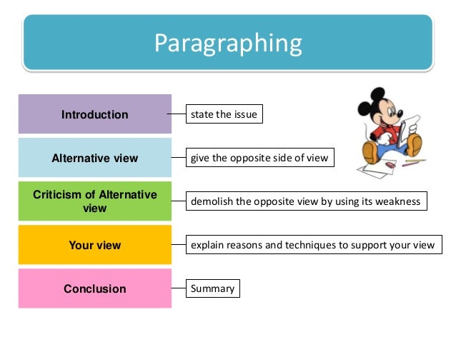
Lecture 10

Slide 33
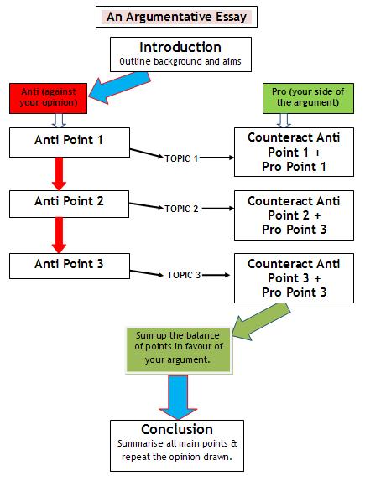
Lecture 10

Slide 34
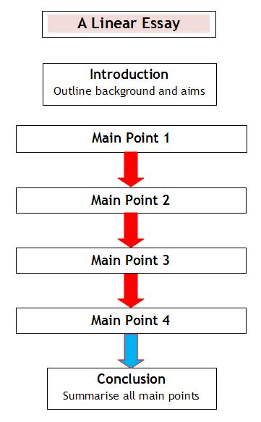
Lecture 10

Slide 35
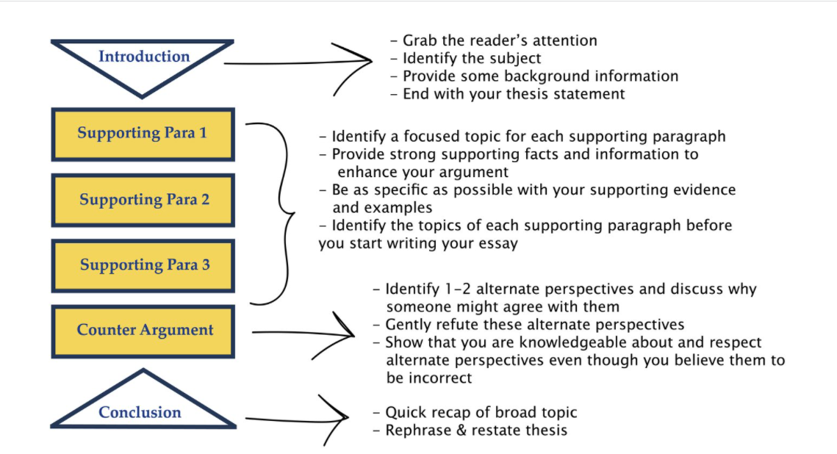
Lecture 10

Slide 36
Lecture 10
Example: paragraph 1: conclusion
Internet does more harm than good. What is your view?
To majority of teenagers and working adults, the Internet has been regarded as one the most innovative achievements of humankind. Since the invention of the internet, its pervasive and life-altering influences can be felt in many aspects of people’s daily lives. While mostly beneficial in areas such as communication, trade and research, the internet has also caused a proliferation of vices such as pornography and hacking. Despite the negativity associated with the internet, I strongly believe that Internet does better than harm.

Slide 37
Lecture 10
Example: paragraph 2: conclusion
Communication all over the world has been considerably improved thanks to the Internet. With the widespread availability of messengers and social networks like Yahoo and Facebook, people can easily communicate irrespective of their geographic locations. Gone are the days when international communication meant a delay of several days to months. Today, interaction through the Internet is not only much cheaper and more convenient than traditional modes of communication, it also has options to allow face to face interaction such as through the use of Skype. Now, family members and businesses can not only have
instantaneous communication, they can also have the added personal touch even if they are in different continents or in any remote part of the world.

Slide 38
Lecture 10
Example: paragraph 3: conclusion
The Internet is one of the key contributors to the global free trade. When the transnational corporations want to open business in the other countries, they first have to contact partners in those countries before officially making a deal. In such case, the Internet certainly does a great job. Furthermore, the internet is instrumental in reducing operation costs for businesses where employees can be easily hired from developing countries and work remotely from their native land. For example, many transnational companies set up call centres in countries like Philippines or India where workers are cheaper to employ. The same benefits are applied to people’s daily lives. With the omnipresence of online shops, many people are able to save their precious time shopping. Instead, they have more time to do other important things such as helping their children do homework or having a short visit to their parents’ house.

Slide 39
Lecture 10
Example: paragraph 4: conclusion
On the other hand, objectors of the Internet argue that it spoils the young generation by spreading pornography and violence, which is considered rampant nowadays. There is no doubt that pornographic websites and violence videos are ubiquitous online, but whether the young are spoilt by it depends on the young themselves. Owing to the continual warning of using the Internet on many cyber education programs, the youths are supposed to know about all the boon and bane effect of surfing webs. Thus, once they have heightened awareness, there is likelihood that they will not be attacked by cyber hackers. Moreover, there is a variety of information for their researches online. Instead of spending hours of
flipping over hundreds of books in the libraries, one may easily obtain necessary
documentation within a second of mouse click.

Slide 40
Lecture 10
Example: paragraph 5: conclusion
Similar to any other technological inventions, the Internet has both pros and cons;
nonetheless, its benefits far outweigh its harms. With recent upgrading Internet security software and substantial improvements on its use, I am firmly convinced the Internet is more a blessing than a curse.

Slide 41
Lecture 10
Thank you

