Slide 1


Cybersecurity
Concepts
Prepared by Dr. Diaa Salama
FNT625
Simplified Advanced Encryption Standard (S_AES) , RSA
Lecture 9

Slide 2




Cybersecurity
Concepts
Lecture 9
FNT625
Simplified Advanced Encryption Standard (S_AES) ,
RSA
Prepared by
Dr. Diaa Salama
www.midocean.ae

Slide 3





Slide 4

Lecture
Lets Start the Eighth Lecture
09
Simplified Advanced Encryption Standard (S_AES) , RSA
www.midocean.ae

Slide 5


Simplified Advanced Encryption Standard (S_AES)
RSA
www.midocean.ae

Slide 6
Simplified Advanced Encryption Standard S_AES
RSA
www.midocean.ae

Slide 7
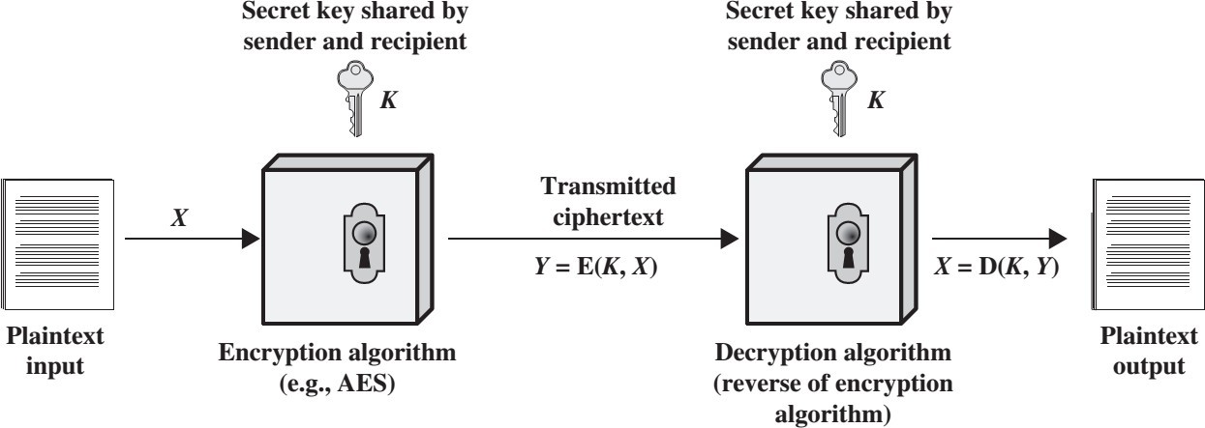
Cryptography and Network Security
Lecture
09
www.midocean.ae

Slide 8
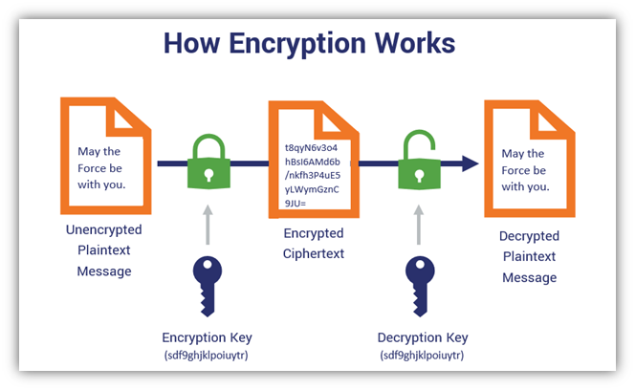
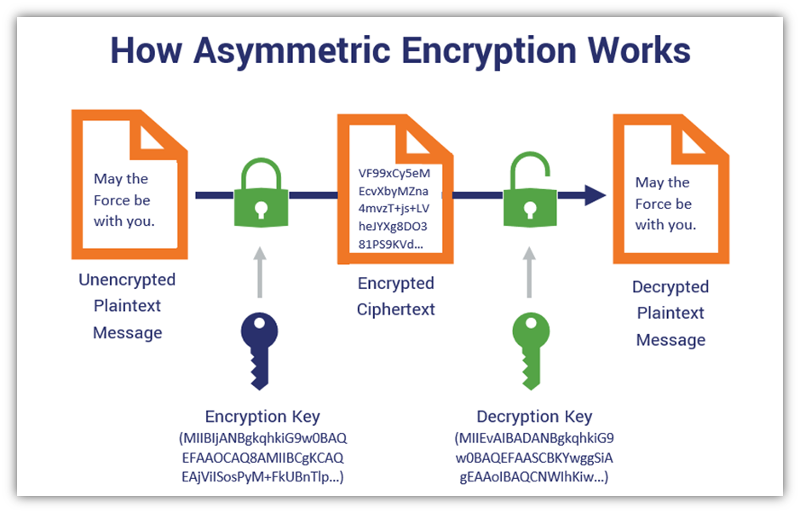
Lecture
09
Cryptographic Algorithms
Symmetric Encryption Algorithm | Asymmetric Encryption Algorithm
www.midocean.ae

Slide 9
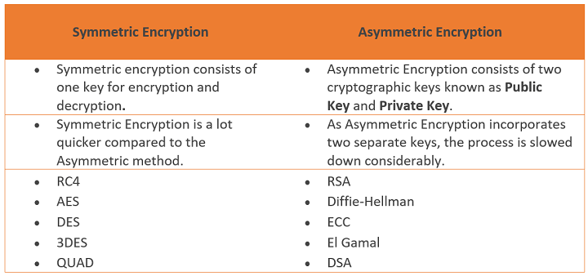
Lecture
09
Cryptographic Algorithms
www.midocean.ae

Slide 10
Stream Cipher and Block Cipher
Lecture
09
Stream cipher is one that encrypts a digital data stream one bit or one byte at a time.
Block cipher is one in which a block of plaintext is treated as a whole and used to produce a ciphertext block of equal length.
www.midocean.ae

Slide 11
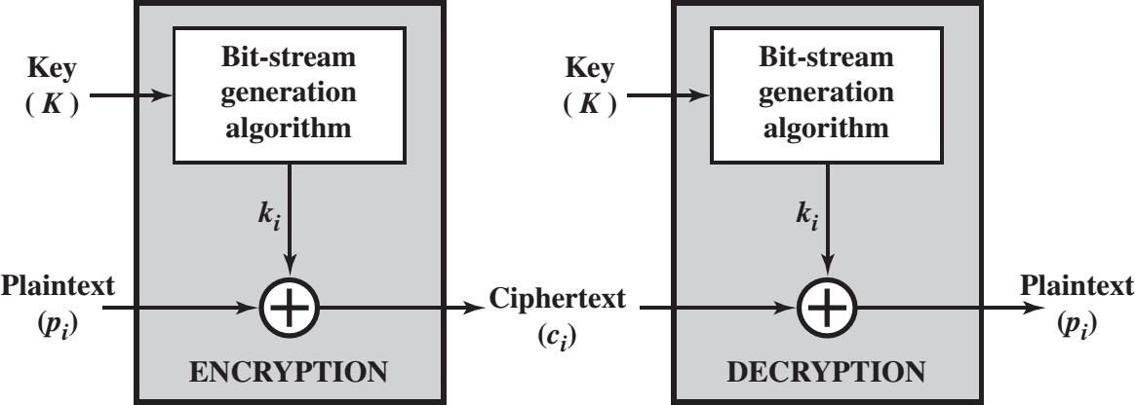
Stream Cipher
Lecture
09
www.midocean.ae

Slide 12


www.midocean.ae

Slide 13
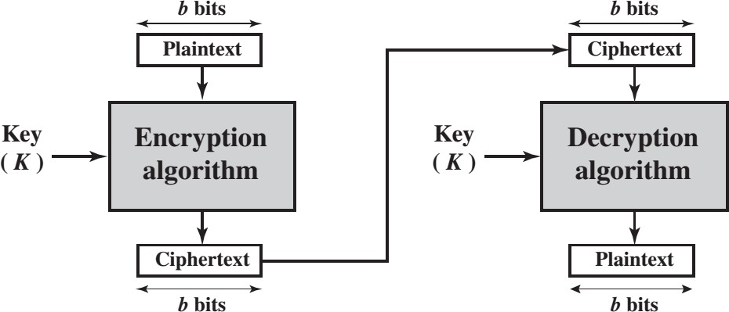
Block Cipher
Lecture
09
www.midocean.ae

Slide 14
Lecture
09
Origin of AES
1999: NIST indicates that DES should be replaced as a standard
  have theoretical attacks that can break it
  have demonstrated exhaustive key search attacks
Triple-DES should be used before a new standard is approved
  3DES has 168-bit key: brute-force attack is infeasible
  Same engine as for DES is running – software/hardware can be reused
  Confident that no effective attack exists: DES has been around for a long time
  As far as security is concerned, 3DES is ideal to replace DES
Drawbacks of 3DES
  Relatively slow software implementations – DES was designed for 1970’s hardware
  DES and 3DES use 64-bit blocks: for efficiency and security, larger blocks should be used
www.midocean.ae

Slide 15
Lecture
09
Requirements for the new standard
Private key symmetric block cipher
128-bit data, 128/192/256-bit keys
Stronger and faster than 3DES
Active life of 20-30 years (+ archival use)
Provide full specification and design details
Both C and Java implementations
NIST have released all submissions & unclassified analyses
www.midocean.ae

Slide 16
Lecture
09
Rijndael
Processes data as 4 groups of 4 bytes – 128-bit block
Input block copied into State array, modified at each stage of encryption or decryption and copied to the output matrix after the final round
has 9/11/13 rounds (depending on which variant is used) in which State
undergoes:
  byte substitution (one S-box used on every byte)
  shift rows: a simple permutation
  mix columns: substitution using arithmetic in GF(2⁸)
  add round key (XOR State with the round key)
initial XOR of the plaintext with a round key
There is an incomplete last round (the 10th/12th/14th)
Note: all operations can be combined into XOR and table lookups - hence very fast and efficient
www.midocean.ae

Slide 17
Table 6.1 A E S Parameters
Key Size (words/bytes/bits) | 4/16/128 | 6/24/192 | 8/32/256
Plaintext Block Size (words/bytes/bits) | 4/16/128 | 4/16/128 | 4/16/128
Number of Rounds | 10 | 12 | 14
Round Key Size (words/bytes/bits) | 4/16/128 | 4/16/128 | 4/16/128
Expanded Key Size (words/bytes) | 44/176 | 52/208 | 60/240
Notes:
The cipher consists of N rounds, where the number of rounds depends on the key length: 10 rounds for a 16-byte key, 12 rounds for a 24-byte key, and 14 rounds for a 32-byte key (Table 6.1). The first N - 1 rounds consist of four distinct transformation functions: SubBytes, ShiftRows, MixColumns, and AddRoundKey, which are described subsequently. The final round contains only three transformations, and
there is a initial single transformation (AddRoundKey) before the first round, which can be considered Round 0. Each transformation takes one or more 4 * 4 matrices as input and produces a 4 * 4 matrix as output. Figure 6.1 shows that the output of each round is a 4 * 4 matrix, with the output of the final round being the ciphertext. Also, the key expansion function generates N + 1 round keys, each of which is a distinct 4 * 4 matrix. Each round key serves as one of the inputs to the AddRoundKey transformation in each round.

Slide 18
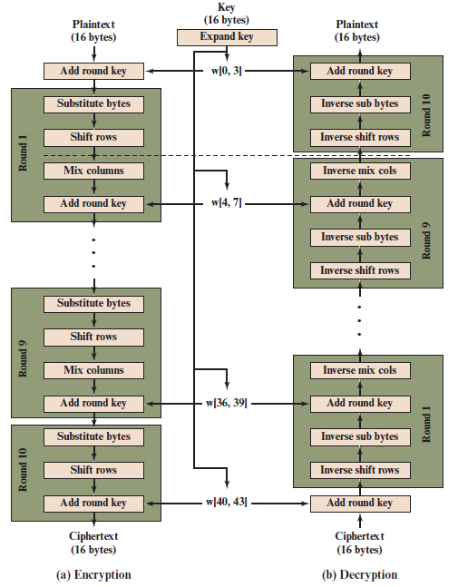
Lecture
09
Rijndael
Figure 6.3 A E S Encryption and Decryption
www.midocean.ae

Slide 19
Advanced Encryption Standard
Simplified Advanced Encryption Standard (AES)
www.midocean.ae

Slide 20








Simplified Advanced Encryption Standard
S-AES Encryption and Decryption S-AES Key Generation
S-AES Encryption
S-AES Decryption
www.midocean.ae

Slide 21
Simplified Advanced Encryption Standard
S-AES Encryption and Decryption
S-AES Key Generation S-AES Encryption
S-AES Decryption
www.midocean.ae

Slide 22
Simplified Advanced Encryption Standard
S-AES Encryption and Decryption
S-AES Key Generation
S-AES Encryption S-AES Decryption
www.midocean.ae

Slide 23













S-AES Encryption and Decryption
16-bit Plain text
16-bit Key
16-bit Plain text
Add Round Key
^{𝒘}𝟎,𝟏
Add Round Key
Nibble Substitution
Expand Key
Inverse Nibble Substitution
Shift Row
Round 1
Round 2
Inverse Shift Row
Mix Columns
Inverse Mix Columns
Add Round Key
^{𝒘}𝟐,𝟑
Add Round Key
Nibble Substitution
Expand Key
Inverse Nibble Substitution
Shift Row
Round 2
Round 1
Inverse Shift Row
Add Round Key
^{𝒘}𝟒,𝟓
Add Round Key
16-bit Cipher text
16-bit Cipher text

Slide 24
S-AES Encryption Example
16-bit Plaintext, P= D7 28
=1101 0111 0010 1000
16-bit Key, K= 4A F5
=0100 1010 1111 0101
www.midocean.ae

Slide 25
Simplified Advanced Encryption Standard
S-AES Encryption and Decryption
S-AES Key Generation
S-AES Encryption
S-AES Decryption
www.midocean.ae

Slide 26
16-bit Key
S-AES Key Generation
^{𝒘}𝟎,𝟏
Expand Key
^{𝒘}𝟐,𝟑
Expand Key
^{𝒘}𝟒,𝟓
www.midocean.ae

Slide 27
16-bit Key
S-AES Key Generation
^{𝒘}𝟎,𝟏
Expand Key
^{𝒘}𝟐,𝟑
Expand Key
^{𝒘}𝟒,𝟓
www.midocean.ae

Slide 28
S-AES Key Generation
K= 4A F5
= 0100 1010 1111 0101
The input key, K, is split into 2 words, w0 and w1:
w0 = 0100 1010
w1 = 1111 0101
www.midocean.ae

Slide 29
16-bit Key
S-AES Key Generation
^{𝒘}𝟎,𝟏
Expand Key
^{𝒘}𝟐,𝟑
Expand Key
^{𝒘}𝟒,𝟓
www.midocean.ae

Slide 30
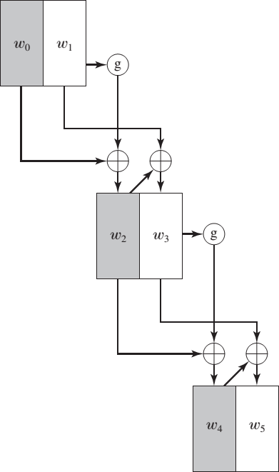
S-AES Key Generation
S-AES Key Expansion
www.midocean.ae

Slide 31
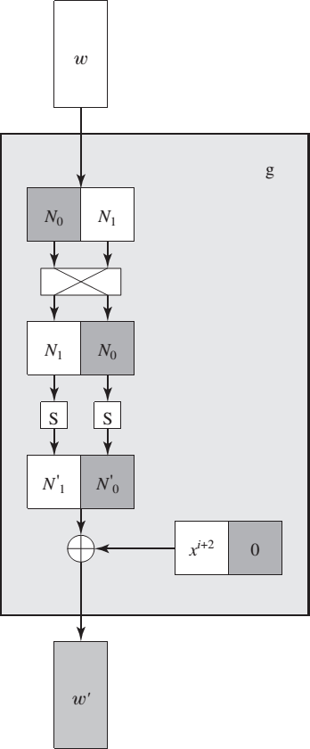
S-AES Key Generation
Function g

Slide 32
16-bit Key
S-AES Key Generation
^{𝒘}𝟎,𝟏
Expand Key
^{𝒘}𝟐,𝟑
Expand Key
^{𝒘}𝟒,𝟓
www.midocean.ae

Slide 33
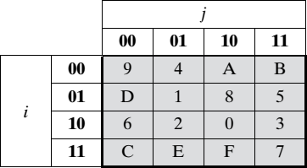
w0 = 0100 1010, w1 = 1111 0101
S-AES Key Generation
w2 = w0 ⊕ Rcon(1) ⊕ SubNib( RotNib(w1))
RotNib() is “rotate the nibbles”, which is equivalent to swapping the nibbles , Rcon is a round constant
SubNib() is “apply S-Box substitution on nibbles using encryption S-Box”
RotNib(w1) = 0101 1111
SubNib(0101 1111) = 0001 0111
Rcon(1) = 10000000
S-Box
www.midocean.ae

Slide 34
S-AES Key Generation
w0 = 0100 1010, w1 = 1111 0101
w2 = w0 ⊕ Rcon(1) ⊕ SubNib( RotNib(w1))
= 0100 1010 ⊕ 1000 0000 ⊕ 0001 0111
= 0100 1010 ⊕ 1001 0111=1101 1101
w2 =1101 1101
w3 = w2 ⊕ w1 = 1101 1101 ⊕ 1111 0101= 0010 1000
w3 = 0010 1000
www.midocean.ae

Slide 35
16-bit Key
S-AES Key Generation
^{𝒘}𝟎,𝟏
Expand Key
^{𝒘}𝟐,𝟑
Expand Key
^{𝒘}𝟒,𝟓
www.midocean.ae

Slide 36
w2 = 1101 1101, w3 = 0010 1000
S-AES Key Generation
w4 = w2 ⊕ Rcon(2) ⊕ SubNib( RotNib(w3) )
= 1101 1101 ⊕ 0011 0000 ⊕ SubNib( 1000 0010 )
= 1101 1101 ⊕ 0011 0000 ⊕ 0110 1010
= 1101 1101 ⊕ 0101 1010
= 1000 0111
w5 = w4 ⊕ w3
= 1000 0111 ⊕ 0010 1000
= 1010 1111
S-Box
www.midocean.ae

Slide 37
16-bit Key
S-AES Key Generation
^{𝒘}𝟎,𝟏
Expand Key
^{𝒘}𝟐,𝟑
Expand Key
^{𝒘}𝟒,𝟓
www.midocean.ae

Slide 38
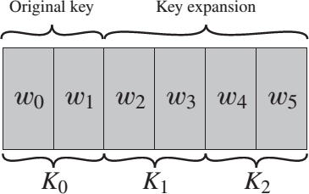
S-AES Key Generation
Key
Key0 = w0w1
= 0100 1010 1111 0101
Key1 = w2w3
= 1101 1101 0010 1000
Key2 = w4w5
= 1000 0111 1010 1111
www.midocean.ae

Slide 39
Simplified Advanced Encryption Standard
S-AES Encryption and Decryption S-AES Key Generation
S-AES Encryption
S-AES Decryption
www.midocean.ae

Slide 40
S-AES Encryption
16-bit Plain text
16-bit Key
Add Round Key
^{𝒘}𝟎,𝟏
Nibble Substitution
Expand Key
Shift Row
Round 1
Mix Columns
Add Round Key
^{𝒘}𝟐,𝟑
Nibble Substitution
Expand Key
Shift Row
Round 2
Add Round Key
^{𝒘}𝟒,𝟓
16-bit Cipher text
www.midocean.ae

Slide 41
S-AES Encryption
Assume: P= 1101 0111 0010 1000
Key0 = w0w1
= 0100 1010 1111 0101
Key1 = w2w3
= 1101 1101 0010 1000
Key2 = w4w5
= 1000 0111 1010 1111
www.midocean.ae

Slide 42
S-AES Encryption
16-bit Plain text
16-bit Key
Add Round Key
^{𝒘}𝟎,𝟏
Nibble Substitution
Expand Key
Shift Row
Round 1
Mix Columns
Add Round Key
^{𝒘}𝟐,𝟑
Nibble Substitution
Expand Key
Shift Row
Round 2
Add Round Key
^{𝒘}𝟒,𝟓
16-bit Cipher text
www.midocean.ae

Slide 43
S-AES Encryption
Round 0
P= 1101 0111 0010 1000
Key0 = 0100 1010 1111 0101
R0= P ⊕ Key0
= 1101 0111 0010 1000 ⊕
0100 1010 1111 0101
= 1001 1101 1101 1101
www.midocean.ae

Slide 44
S-AES Encryption
16-bit Plain text
16-bit Key
Add Round Key
^{𝒘}𝟎,𝟏
Nibble Substitution
Expand Key
Shift Row
Round 1
Mix Columns
Add Round Key
^{𝒘}𝟐,𝟑
Nibble Substitution
Expand Key
Shift Row
Round 2
Add Round Key
^{𝒘}𝟒,𝟓
16-bit Cipher text
www.midocean.ae

Slide 45
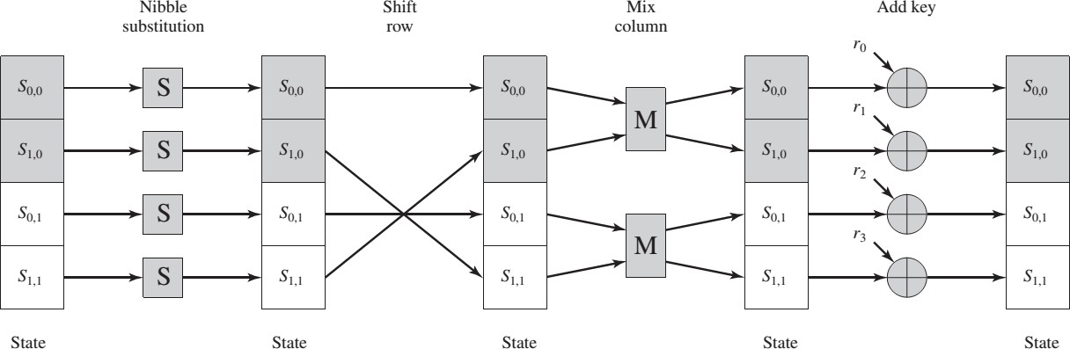
S-AES Encryption
S-AES Encryption Round
www.midocean.ae

Slide 46
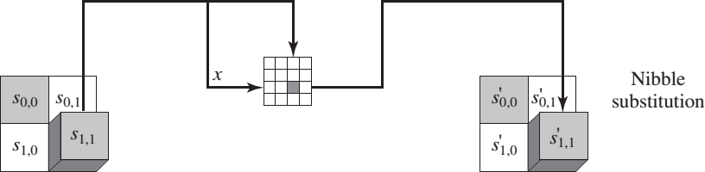
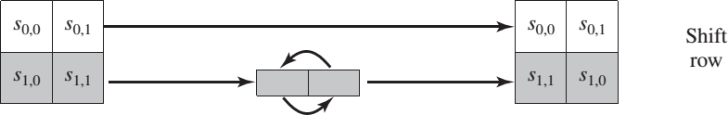
S-AES Encryption
S-AES Transformation (Substitution and Shift row)
www.midocean.ae

Slide 47
S-AES Encryption
16-bit Plain text
16-bit Key
Add Round Key
^{𝒘}𝟎,𝟏
Nibble Substitution
Expand Key
Shift Row
Round 1
Mix Columns
Add Round Key
^{𝒘}𝟐,𝟑
Nibble Substitution
Expand Key
Shift Row
Round 2
Add Round Key
^{𝒘}𝟒,𝟓
16-bit Cipher text
www.midocean.ae

Slide 48
S-AES Encryption
Round 1
1) Nibble Substitution :
SubNib(1001 1101 1101 1101)= 0010 1110 1110 1110
2) Shift Row:
S-Box
Swap 2nd nibble and 4th nibble
ShRow(0010 1110 1110 1110)
= 0010 1110 1110 1110
www.midocean.ae

Slide 49
Key Generation
S-AES Encryption Round
www.midocean.ae

Slide 50
S-AES Encryption
16-bit Plain text
16-bit Key
Add Round Key
^{𝒘}𝟎,𝟏
Nibble Substitution
Expand Key
Shift Row
Round 1
Mix Columns
Add Round Key
^{𝒘}𝟐,𝟑
Nibble Substitution
Expand Key
Shift Row
Round 2
Add Round Key
^{𝒘}𝟒,𝟓
16-bit Cipher text
www.midocean.ae

Slide 51
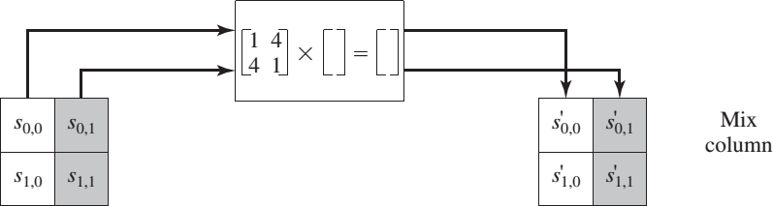
S-AES Encryption
S-AES Transformation (Mix Column)
www.midocean.ae

Slide 52
S-AES Encryption
Mix Column Table
* | 1 | 2 | 3 | 4 | 5 | 6 | 7 | 8 | 9 | A | B | C | D | E | F
2 | 2 | 4 | 6 | 8 | A | C | E | 3 | 1 | 7 | 5 | B | 9 | F | D
4 | 4 | 8 | C | 3 | 7 | B | F | 6 | 2 | E | A | 5 | 1 | D | 9
9 | 9 | 1 | 8 | 2 | B | 3 | A | 4 | D | 5 | C | 6 | F | 7 | E
www.midocean.ae

Slide 53

S-AES Encryption
Round 1
3) Mix Columns:
* | 1 | 2 | 3 | 4 | 5 | 6 | 7 | 8 | 9 | A | B | C | D | E | F
2 | 2 | 4 | 6 | 8 | A | C | E | 3 | 1 | 7 | 5 | B | 9 | F | D
4 | 4 | 8 | C | 3 | 7 | B | F | 6 | 2 | E | A | 5 | 1 | D | 9
9 | 9 | 1 | 8 | 2 | B | 3 | A | 4 | D | 5 | C | 6 | F | 7 | E
0010 1110
1110 1110
1 4
4 1
MixCol (0010 1110 1110 1110) =
∗
=
2 E
E E
1 4
4 1
(2∗1⊕E∗4) (2∗4⊕E∗1)
(E∗1⊕E∗4) (E∗4⊕E∗1)
❑ =
∗
=
www.midocean.ae

Slide 54
(1110⊕1101) (1101⊕1110)
S-AES Encryption
_{ =} (2⊕D)
(E⊕D)
(D⊕E)
(0010⊕1101) (1000⊕1110)
=
(8⊕E)
(0010⊕1101) (1000⊕1110)
(1110⊕1101) (1101⊕1110)
1111 0011
0110 0011
❑
=
= 1111 0110 0011 0011
www.midocean.ae

Slide 55
S-AES Encryption
16-bit Plain text
16-bit Key
Add Round Key
^{𝒘}𝟎,𝟏
Nibble Substitution
Expand Key
Shift Row
Round 1
Mix Columns
Add Round Key
^{𝒘}𝟐,𝟑
Nibble Substitution
Expand Key
Shift Row
Round 2
Add Round Key
^{𝒘}𝟒,𝟓
16-bit Cipher text
www.midocean.ae

Slide 56
S-AES Encryption
Round 1
4) Add round Key1
Key1 = 1101 1101 0010 1000
R1= Key1 ⊕ MixCol(ShRow(SubNib(R0)))
= 1101 1101 0010 1000 ⊕ 1111 0110 0011 0011
= 0010 1011 0001 1011
www.midocean.ae

Slide 57
S-AES Encryption
16-bit Plain text
16-bit Key
Add Round Key
^{𝒘}𝟎,𝟏
Nibble Substitution
Expand Key
Shift Row
Round 1
Mix Columns
Add Round Key
^{𝒘}𝟐,𝟑
Nibble Substitution
Expand Key
Shift Row
Round 2
Add Round Key
^{𝒘}𝟒,𝟓
16-bit Cipher text
Simplified Advanced Encryption Standard
www.midocean.ae

Slide 58
S-AES Encryption
16-bit Plain text
16-bit Key
Add Round Key
^{𝒘}𝟎,𝟏
Nibble Substitution
Expand Key
Shift Row
Round 1
Mix Columns
Add Round Key
^{𝒘}𝟐,𝟑
Nibble Substitution
Expand Key
Shift Row
Round 2
Add Round Key
^{𝒘}𝟒,𝟓
16-bit Cipher text
Simplified Advanced Encryption Standard
www.midocean.ae

Slide 59
S-AES Encryption
S-AES Transformation (Substitution and Shift row)
www.midocean.ae

Slide 60
S-AES Encryption
Round 2
1) Nibble Substitution :
SubNib(0010 1011 0001 1011)= 1010 0011 0100 0011
2) Shift Row:
Swap 2nd nibble and 4th nibble
ShRow(1010 0011 0100 0011)
= 1010 0011 0100 0011
S-Box
www.midocean.ae

Slide 61
S-AES Encryption
16-bit Plain text
16-bit Key
Add Round Key
^{𝒘}𝟎,𝟏
Nibble Substitution
Expand Key
Shift Row
Round 1
Mix Columns
Add Round Key
^{𝒘}𝟐,𝟑
Nibble Substitution
Expand Key
Shift Row
Round 2
Add Round Key
^{𝒘}𝟒,𝟓
16-bit Cipher text
www.midocean.ae

Slide 62
S-AES Encryption
Round 2
4) Add round Key2
Key2 = 1000 0111 1010 1111
R2= Key2 ⊕ ShRow(SubNib(R1))
= 1000 0111 1010 1111 ⊕ 1010 0011 0100 0011
= 0010 0100 1110 1100
Ciphertext = 0010 0100 1110 1100
www.midocean.ae

Slide 63
Simplified Advanced Encryption Standard
S-AES Encryption and Decryption S-AES Key Generation
S-AES Encryption
S-AES Decryption
www.midocean.ae

Slide 64

S-AES Encryption and Decryption
16-bit Plain text
16-bit Key
16-bit Plain text
Add Round Key
^{𝒘}𝟎,𝟏
Add Round Key
Nibble Substitution
Expand Key
Inverse Nibble Substitution
Shift Row
Round 1
Round 2
Inverse Shift Row
Mix Columns
Inverse Mix Columns
Add Round Key
^{𝒘}𝟐,𝟑
Add Round Key
Nibble Substitution
Expand Key
Inverse Nibble Substitution
Shift Row
Round 2
Round 1
Inverse Shift Row
Add Round Key
^{𝒘}𝟒,𝟓
Add Round Key
16-bit Cipher text
16-bit Cipher text
www.midocean.ae

Slide 65

S-AES Decryption
16-bit Key
16-bit Plain text
^{𝒘}𝟎,𝟏
Add Round Key
Expand Key
Inverse Nibble Substitution
Round 2
Inverse Shift Row
Inverse Mix Columns
^{𝒘}𝟐,𝟑
Add Round Key
Expand Key
Inverse Nibble Substitution
Round 1
Inverse Shift Row
^{𝒘}𝟒,𝟓
Add Round Key
16-bit Cipher text
www.midocean.ae

Slide 66
S-AES Decryption
Assume: C= 0010 0100 1110 1100
Key0 = w0w1
= 0100 1010 1111 0101
Key1 = w2w3
= 1101 1101 0010 1000
Key2 = w4w5
= 1000 0111 1010 1111
www.midocean.ae

Slide 67

S-AES Decryption
16-bit Key
16-bit Plain text
^{𝒘}𝟎,𝟏
Add Round Key
Expand Key
Inverse Nibble Substitution
Round 2
Inverse Shift Row
Inverse Mix Columns
^{𝒘}𝟐,𝟑
Add Round Key
Expand Key
Inverse Nibble Substitution
Round 1
Inverse Shift Row
^{𝒘}𝟒,𝟓
Add Round Key
16-bit Cipher text

Slide 68
S-AES Decryption
Key2 = w4w5
= 1000 0111 1010 1111
C= 0010 0100 1110 1100
R0= C ⊕ Key2 = 0010 0100 1110 1100 ⊕ 1000 0111 1010
1111
❑ =1010 0011 0100 0011
www.midocean.ae

Slide 69

S-AES Decryption
16-bit Key
16-bit Plain text
^{𝒘}𝟎,𝟏
Add Round Key
Expand Key
Inverse Nibble Substitution
Round 2
Inverse Shift Row
Inverse Mix Columns
^{𝒘}𝟐,𝟑
Add Round Key
Expand Key
Inverse Nibble Substitution
Round 1
Inverse Shift Row
^{𝒘}𝟒,𝟓
Add Round Key
16-bit Cipher text
www.midocean.ae

Slide 70
S-AES Decryption
16-bit Key
16-bit Plain text
^{𝒘}𝟎,𝟏
Add Round Key
Expand Key
Inverse Nibble Substitution
Round 2
Inverse Shift Row
Inverse Mix Columns
^{𝒘}𝟐,𝟑
Add Round Key
Expand Key
Inverse Nibble Substitution
Round 1
Inverse Shift Row
^{𝒘}𝟒,𝟓
Add Round Key
16-bit Cipher text

Slide 71
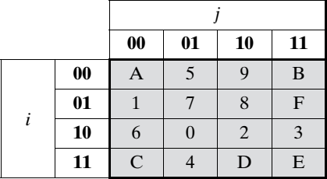
Round 1
1) Inverse Shift Row
IShRow(R0)=IShRow(1010 0011 0100 0011)=
= 1010 0011 0100 0011
2) Inverse Nibble Sub
ISubNib( 1010 0011 0100 0011 )=
= 0010 1011 0001 1011
Inv S-Box
www.midocean.ae

Slide 72

S-AES Decryption
16-bit Key
16-bit Plain text
^{𝒘}𝟎,𝟏
Add Round Key
Expand Key
Inverse Nibble Substitution
Round 2
Inverse Shift Row
Inverse Mix Columns
^{𝒘}𝟐,𝟑
Add Round Key
Expand Key
Inverse Nibble Substitution
Round 1
Inverse Shift Row
^{𝒘}𝟒,𝟓
Add Round Key
16-bit Cipher text

Slide 73
S-AES Decryption
3) Add Round 1 Key
0010 1011 0001 1011 ⊕ Key1
= 0010 1011 0001 1011 ⊕ 1101 1101 0010 1000
=1111 0110 0011 0011
www.midocean.ae

Slide 74
S-AES Decryption
16-bit Key
16-bit Plain text
^{𝒘}𝟎,𝟏
Add Round Key
Expand Key
Inverse Nibble Substitution
Round 2
Inverse Shift Row
Inverse Mix Columns
^{𝒘}𝟐,𝟑
Add Round Key
Expand Key
Inverse Nibble Substitution
Round 1
Inverse Shift Row
^{𝒘}𝟒,𝟓
Add Round Key
16-bit Cipher text

Slide 75
S-AES Decryption
Round 1
4) Inverse Mix Columns :
1111 0011
0110 0011
9 2
2 9
MixCol (1111 0110 0011 0011) =
∗
=
F 3
6 3
𝟗 𝟐
𝟐 𝟗
(F∗9⊕6∗2) (F∗2⊕6∗9)
(3∗9⊕3∗2) (3∗2⊕3∗9)
❑ =
∗
=
₌ (E⊕C)
(8⊕6)
(6⊕8)
❑
* | 1 | 2 | 3 | 4 | 5 | 6 | 7 | 8 | 9 | A | B | C | D | E | F
2 | 2 | 4 | 6 | 8 | A | C | E | 3 | 1 | 7 | 5 | B | 9 | F | D
4 | 4 | 8 | C | 3 | 7 | B | F | 6 | 2 | E | A | 5 | 1 | D | 9
9 | 9 | 1 | 8 | 2 | B | 3 | A | 4 | D | 5 | C | 6 | F | 7 | E
(D⊕3)
(1110⊕1100)
(1101⊕0011)
(1000⊕0110)
(0110⊕1000)
❑ =

Slide 76
S-AES Decryption
(1110⊕1100) (1101⊕0011)
(1000⊕0110) (0110⊕1000)
0010 1110
1110 1110
❑
=
R1 = 0010 1110 1110 1110
www.midocean.ae

Slide 77
S-AES Decryption
16-bit Key
16-bit Plain text
^{𝒘}𝟎,𝟏
Add Round Key
Expand Key
Inverse Nibble Substitution
Round 2
Inverse Shift Row
Inverse Mix Columns
^{𝒘}𝟐,𝟑
Add Round Key
Expand Key
Inverse Nibble Substitution
Round 1
Inverse Shift Row
^{𝒘}𝟒,𝟓
Add Round Key
16-bit Cipher text

Slide 78
S-AES Decryption
16-bit Key
16-bit Plain text
^{𝒘}𝟎,𝟏
Add Round Key
Expand Key
Inverse Nibble Substitution
Round 2
Inverse Shift Row
Inverse Mix Columns
^{𝒘}𝟐,𝟑
Add Round Key
Expand Key
Inverse Nibble Substitution
Round 1
Inverse Shift Row
^{𝒘}𝟒,𝟓
Add Round Key
16-bit Cipher text

Slide 79
S-AES Decryption
Round 2
1) Inverse Shift Row
IShRow(R1)=IShRow(0010 1110 1110 1110)=
= 0010 1110 1110 1110
2) Inverse Nibble Sub
ISubNib( 0010 1110 1110 1110 )=
= 1001 1101 1101 1101
Inv S-Box
www.midocean.ae

Slide 80
S-AES Decryption
16-bit Key
16-bit Plain text
^{𝒘}𝟎,𝟏
Add Round Key
Expand Key
Inverse Nibble Substitution
Round 2
Inverse Shift Row
Inverse Mix Columns
^{𝒘}𝟐,𝟑
Add Round Key
Expand Key
Inverse Nibble Substitution
Round 1
Inverse Shift Row
^{𝒘}𝟒,𝟓
Add Round Key
16-bit Cipher text

Slide 81
S-AES Decryption
3) Add Round 2 Key
R2= 1001 1101 1101 1101 ⊕ Key0
= 1001 1101 1101 1101 ⊕ 0100 1010 1111 0101
=1101 0111 0010 1000
Plaintext = 1101 0111 0010 1000 = D7 28
www.midocean.ae

Slide 82

Simplified Advanced Encryption Standard S_AES
RSA
www.midocean.ae

Slide 83






RSA
RSA Key generation RSA Encryption RSA Decryption
A Real World Example
RSA Security
www.midocean.ae

Slide 84
RSA
RSA Key generation RSA Encryption RSA Decryption
A Real World Example
RSA Security
www.midocean.ae

Slide 85
Lecture
09
RSA
  RSA is one of the first practical public-key cryptosystems and is widely used for secure data transmission.
  RSA is made of the initial letters of the surnames of Ron Rivest, Adi Shamir, and Leonard Adleman, who first publicly described the algorithm in 1977
www.midocean.ae

Slide 86

RSA
RSA is Asymmetric Encryption
Two separate keys which are not shared
Encryption Key
Decryption Key
Encrypt
Decrypt
$1000
%3f7&4
$1000
www.midocean.ae

Slide 87
RSA
RSA Key generation RSA Encryption RSA Decryption
A Real World Example RSA Security
www.midocean.ae

Slide 88
Lecture
09
RSA Key Generation
  1) Choose two distinct prime numbers 𝒑 and 𝒒
  2) Compute 𝒏 = 𝑝 ∗ 𝑞
  3) Compute Z= (p - 1) * (q - 1)
  4) Choose e such that 1 < e < Z and e and n are prime.
  5) Compute a value for d such that (d * e) % Z = 1
      Public key is (e, n)
      Private key is (d, n)
www.midocean.ae

Slide 89
Lecture
09
RSA Key Generation Example
  Choose p = 3 and q = 11
  Compute n = p * q = 3 * 11 = 33
  Compute φ(n) = (p - 1) * (q - 1) = 2 * 10 = 20
  Choose e such that 1 < e < φ(n) and e and n are prime. Let e = 7
  Compute a value for d such that (d * e) % φ(n) = 1. One solution is d = 3 [(3 * 7) % 20 = 1]
  Public key is (e, n) => (7, 33)
  Private key is (d, n) => (3, 33)
www.midocean.ae

Slide 90
RSA
RSA Key generation RSA Encryption RSA Decryption
A Real World Example RSA Security
www.midocean.ae

Slide 91
Lecture
09
RSA Encryption
  m = plaintext
  Public key is (e, n)
  C= Ciphertext
  𝐶 = 𝑚^{𝑒} % 𝑛
www.midocean.ae

Slide 92
Lecture
09
RSA Encryption Example
  m = 2
  Public key is (e, n) => (7, 33)
  C = 2 ⁷% 33 = 29
www.midocean.ae

Slide 93
RSA
RSA Key generation RSA Encryption RSA Decryption
A Real World Example RSA Security
www.midocean.ae

Slide 94
Lecture
09
RSA Decryption
  C= Ciphertext
  m = plaintext
  Private key is (d, n)
  𝑚 = 𝐶^{𝑑} % 𝑛
www.midocean.ae

Slide 95
Lecture
09
RSA Decryption Example
  C= 29
  Private key is (d, n) => (3, 33)
  𝑚 = 𝐶³ % 33 = 2
www.midocean.ae

Slide 96
Lecture
09
RSA another Example
  Select two prime numbers, p = 17 and q = 11.
  Calculate n = pq = 17 * 11 = 187.
  Calculate Z = (p - 1)(q - 1) = 16 * 10 = 160.
  Select e such that e is relatively prime to
  Z = 160 and less than Z; we choose e = 7.
  Determine d such that d.e (mod 160) = 1 and d < 160. The correct value is d = 23, because 23 * 7 = 161 = (1 * 160) + 1
  Public Key= {7, 187} and Private Key = {23, 187}
www.midocean.ae

Slide 97
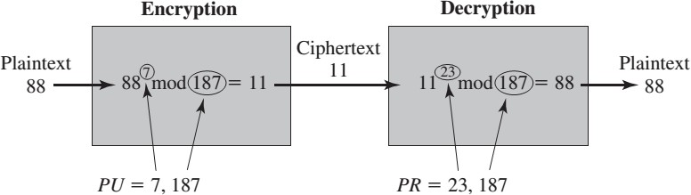
RSA another Example
www.midocean.ae

Slide 98
RSA
RSA Key generation RSA Encryption RSA Decryption
A Real World Example RSA Security
www.midocean.ae

Slide 99
Lecture
09
RSA another Example
  lets encrypt the message "attack at dawn“
  Convert the message into a numeric format. Each letter is represented by an ASCII character.
  "attack at dawn" becomes 1976620216402300889624482718775150
www.midocean.ae

Slide 100
Real World Example
p=
12131072439211271897323671531612440428472427633701410
92563454931230196437304208561932419736532241686654101
7057361365214171711713797974299334871062829803541
q=
12027524255478748885956220793734512128733387803682075
43365389998395517985098879789986914690080913161115334
6817050832096022160146366346391812470987105415233
www.midocean.ae

Slide 101

n=1459067680075833232301869393490706352924018723753571643995818
Real World Example
7101987343879900535893836957140267014980212181808629246742282815
7022922076746906543401224889672472407926969987100581290103199317
8587536637108623576565105078837142971156373427889114635351027120
32765166518411726859837988672111837205085526346618740053
Z=14590676800758332323018693934907063529240187237535716439958
1871019873438799005358938369571402670149802121818086292467422828
1570229220767469065434012248896483138112322799663173013977778523
6530154784827347887129722205858745715289160645926971811926897116
3555070802643999529549644116811947516513938184296683521280
www.midocean.ae

Slide 102
e= 65537
Real World Example
d=89489425009274444368228545921773093919669586065884 25744549785445648767483962981839093494197326287961679
79706089172836798754993315741611138540888132754881105
88247193077582527278437906504015680623423550067240042
46666565423238350292221549362328947213886644581878912
7946123407807725702626644091036502372545139713
www.midocean.ae

Slide 103
Encryption: C= 1976620216402300889624482718775150 ^e % n
Real World Example
C=
35052111338673026690212423937053328511880760811579981
62064280234668581062310985023594304908097338624111378
40407947041939782153784997654130836464387847409523069
32534945195080183861574225226218879827232453912820596
88644037753608246568175007441745915148540744586251102
3472235560823053497791518928820272257787786
www.midocean.ae

Slide 104
A Real World Example
Decryption: P= 35052111338673026690212423937053328511880760811579981620642 80234668581062310985023594304908097338624111378404079470419 39782153784997654130836464387847409523069325349451950801838 61574225226218879827232453912820596886440377536082465681750 07441745915148540744586251102347223556082305349779151892882 0272257787786 ^d % n
P= 1976620216402300889624482718775150 (which is our plaintext "attack at dawn")
www.midocean.ae

Slide 105
RSA
RSA Key generation RSA Encryption RSA Decryption
A Real World Example RSA Security
www.midocean.ae

Slide 106
Lecture
09
RSA Security
  Two approaches to attacking RSA:
  brute force key search (infeasible given size of numbers)
  mathematical attacks (based on difficulty of computing Z, by factoring modulus N)
www.midocean.ae

Slide 107



Thank You

