Slide 1


Natural Language
Processing (AI615)
Prepared by Dr. Ashraf Elsayed
Lecture 2

Slide 2



Basic Text Processing
Lecture 2
Prepared by
Dr. Ashraf Elsayed
www.midocean.ae

Slide 3
The objectives of this lecture is to:
Understand Basic Test Processing
Define and explain the basic concepts of Byte Pair Encoding
Understand Word Normalization, Lemmatization and Stemming
Understand the Minimum Edit Distance
www.midocean.ae

Slide 4
Basic Text Processing
www.midocean.ae

Slide 5
Basic Text Processing
Byte Pair Encoding
www.midocean.ae

Slide 6
Another option for text tokenization
Instead of
white-space segmentation
single-character segmentation
Use the data to tell us how to tokenize.
Subword tokenization (because tokens can be parts of words as well as whole words)
www.midocean.ae

Slide 7
Subword tokenization
Three common algorithms:
  Byte-Pair Encoding (BPE) (Sennrich et al., 2016)
  Unigram language modeling tokenization (Kudo, 2018)
  WordPiece (Schuster and Nakajima, 2012)
All have 2 parts:
  A token learner that takes a raw training corpus and induces a vocabulary (a set of tokens).
  A token segmenter that takes a raw test sentence and tokenizes it according to that vocabulary
www.midocean.ae

Slide 8
Byte Pair Encoding (BPE) token learner
Let vocabulary be the set of all individual characters
= {A, B, C, D,…, a, b, c, d….}
Repeat:
  Choose the two symbols that are most frequently adjacent in the training corpus (say 'A', 'B')
  Add a new merged symbol 'AB' to the vocabulary
  Replace every adjacent 'A' 'B' in the corpus with 'AB'.
Until k merges have been done.
www.midocean.ae

Slide 9
BPE token learner algorithm
www.midocean.ae

Slide 10
Byte Pair Encoding (BPE) Addendum
Most subword algorithms are run inside space-separated tokens.
So we commonly first add a special end-of-word symbol '__' before space in training corpus
Next, separate into letters.
www.midocean.ae

Slide 11
BPE token learner
Original (very fascinating🙄) corpus:
low low low low low lowest lowest newer newer newer newer newer newer wider wider wider new new
Add end-of-word tokens, resulting in this vocabulary:
representation
www.midocean.ae

Slide 12
BPE token learner
Merge e r to er
www.midocean.ae

Slide 13
BPE
Merge er _ to er_
www.midocean.ae

Slide 14
BPE
Merge n e to ne
www.midocean.ae

Slide 15
BPE
The next merges are:
www.midocean.ae

Slide 16
BPE token segmenter algorithm
On the test data, run each merge learned from the training data:
  Greedily
  In the order we learned them
  (test frequencies don't play a role)
So: merge every e r to er, then merge er _ to er_, etc.
Result:
  Test set "n e w e r _" would be tokenized as a full word
  Test set "l o w e r _" would be two tokens: "low er_"
www.midocean.ae

Slide 17
Properties of BPE tokens
Usually include frequent words
And frequent subwords
Which are often morphemes like -est or –er
A morpheme is the smallest meaning-bearing unit of a language
unlikeliest has 3 morphemes un-, likely, and -est
www.midocean.ae

Slide 18
Basic Text Processing
Word Normalization, Lemmatization and Stemming
www.midocean.ae

Slide 19
Word Normalization
Putting words/tokens in a standard format
    U.S.A. or USA
    uhhuh or uh-huh
    Fed or fed
    am, is, be, are
www.midocean.ae

Slide 20
Case folding
Applications like IR: reduce all letters to lower case
  Since users tend to use lower case
  Possible exception: upper case in mid-sentence?
    e.g., General Motors
    Fed vs. fed
    SAIL vs. sail
For sentiment analysis, MT, Information extraction
  Case is helpful (US versus us is important)
www.midocean.ae

Slide 21
Lemmatization
Represent all words as their lemma, their shared root
= dictionary headword form:
  am, are, is → be
  car, cars, car's, cars' → car
  Spanish quiero (‘I want’), quieres (‘you want’)
      → querer ‘want'
  He is reading detective stories
      → He be read detective story
www.midocean.ae

Slide 22
Lemmatization is done by Morphological Parsing
Morphemes:
  The small meaningful units that make up words
  Stems: The core meaning-bearing units
  Affixes: Parts that adhere to stems, often with grammatical functions
Morphological Parsers:
  Ex: Parse cats into two morphemes cat and s
www.midocean.ae

Slide 23
Stemming (simplified form of lemmatization)
Reduce terms to stems, chopping off affixes crudely
Thi wa not the map we found in Billi Bone s chest but an accur copi complet in all thing name and height and sound with the singl except of the red cross and the written note
.
This was not the map we found in Billy Bones’s chest, but an accurate copy, complete in all things-names and heights and soundings-with the single exception of the red crosses and the written notes.
Increasing Recall at the expense of Precision
www.midocean.ae

Slide 24
Porter Stemmer
Based on a series of rewrite rules run in series
  A cascade, in which output of each pass fed to next pass
Some sample rules:
www.midocean.ae

Slide 25
Dealing with complex morphology is necessary for many languages
  e.g., the Turkish word:
  Uygarlastiramadiklarimizdanmissinizcasina
  `(behaving) as if you are among those whom we could not civilize’
  Uygar `civilized’ + las `become’
    + tir `cause’ + ama `not able’
    + dik `past’ + lar ‘plural’
    + imiz ‘p1pl’ + dan ‘abl’
    + mis ‘past’ + siniz ‘2pl’ + casina ‘as if’
Complex Morphology
Definitely require a richer morphological parsing algorithms
www.midocean.ae

Slide 26
Sentence Segmentation
!, ? mostly unambiguous but period “.” is very ambiguous
  Sentence boundary
  Abbreviations like Inc. or Dr.
  Numbers like .02% or 4.3
Common algorithm: Tokenize first: use rules or ML to classify a period as either (a) part of the word or (b) a sentence-boundary.
  An abbreviation dictionary can help
Sentence segmentation can then often be done by rules based on this tokenization.
www.midocean.ae

Slide 27
Computational Linguistics
Minimum Edit Distance
www.midocean.ae

Slide 28
Definition of Minimum Edit Distance
www.midocean.ae

Slide 29
How similar are two strings?
Spell correction
  The user typed “graffe”
  Which is closest?
    graf
    graft
    grail
    giraffe
Computational Biology
  Align two sequences of nucleotides
  Resulting alignment:
AGGCTATCACCTGACCTCCAGGCCGATGCCC
TAGCTATCACGACCGCGGTCGATTTGCCCGAC
-AGGCTATCACCTGACCTCCAGGCCGA--TGCCC---
TAG-CTATCAC--GACCGC--GGTCGATTTGCCCGAC
Also for Machine Translation, Information Extraction, Speech Recognition
www.midocean.ae

Slide 30
Edit Distance
The minimum edit distance between two strings
Is the minimum number of editing operations
  Insertion
  Deletion
  Substitution
Needed to transform one into the other
www.midocean.ae

Slide 31

Minimum Edit Distance
Two strings and their alignment:
www.midocean.ae

Slide 32
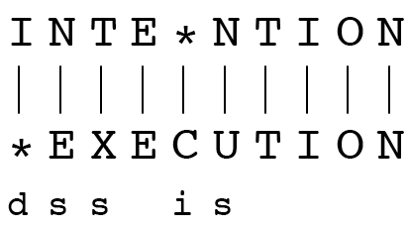
Minimum Edit Distance
If each operation has cost of 1
  Distance between these is 5
If substitutions cost 2 (Levenshtein)
  Distance between them is 8
www.midocean.ae

Slide 33
Alignment in Computational Biology
Given a sequence of bases
An alignment:
Given two sequences, align each letter to a letter or gap
AGGCTATCACCTGACCTCCAGGCCGATGCCC
TAGCTATCACGACCGCGGTCGATTTGCCCGAC
-AGGCTATCACCTGACCTCCAGGCCGA--TGCCC---
TAG-CTATCAC--GACCGC--GGTCGATTTGCCCGAC
www.midocean.ae

Slide 34
Other uses of Edit Distance in NLP
Evaluating Machine Translation and speech recognition
R Spokesman confirms senior government adviser was shot
H Spokesman said the senior adviser was shot dead
S I D I
Named Entity Extraction and Entity Co-reference
  IBM Inc. announced today
  IBM profits
  Stanford President John Hennessy announced yesterday
  for Stanford University President John Hennessy
www.midocean.ae

Slide 35
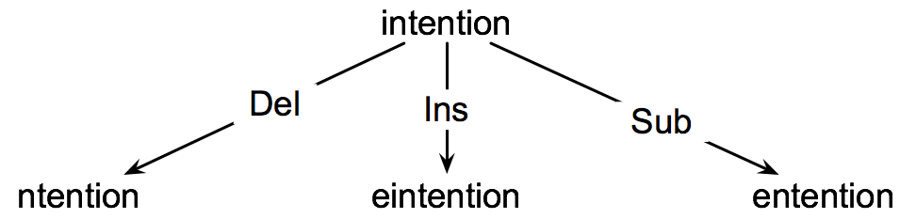
How to find the Min Edit Distance?
Searching for a path (sequence of edits) from the start string to the final string:
  Initial state: the word we’re transforming
  Operators: insert, delete, substitute
  Goal state: the word we’re trying to get to
  Path cost: what we want to minimize: the number of edits
www.midocean.ae

Slide 36
Minimum Edit as Search
But the space of all edit sequences is huge!
  We can’t afford to navigate naïvely
  Lots of distinct paths ends up at the same state.
    We don’t have to keep track of all of them
    Just the shortest path to each of those revisited states.
www.midocean.ae

Slide 37
Defining Min Edit Distance
For two strings
  X of length n
  Y of length m
We define D(i,j)
  the edit distance between X[1..i] and Y[1..j]
    i.e., the first i characters of X and the first j characters of Y
  The edit distance between X and Y is thus D(n,m)
www.midocean.ae

Slide 38
Minimum Edit Distance
Computing Minimum Edit Distance
www.midocean.ae

Slide 39
Dynamic Programming for
Minimum Edit Distance
Dynamic programming: A tabular computation of D(n,m)
Solving problems by combining solutions to subproblems.
Bottom-up
  We compute D(i,j) for small i,j
  And compute larger D(i,j) based on previously computed smaller values
  i.e., compute D(i,j) for all i (0 < i < n) and j (0 < j < m)
www.midocean.ae

Slide 40
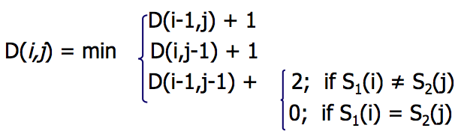
Defining Min Edit Distance (Levenshtein)
Initialization
  D(i,0) = i
  D(0,j) = j
Recurrence Relation:
  For each i = 1…M
  For each j = 1…N
Termination:
  D(N,M) is distance
www.midocean.ae

Slide 41
The Edit Distance Table
N | 9
O | 8
I | 7
T | 6
N | 5
E | 4
T | 3
N | 2
I | 1
# | 0 | 1 | 2 | 3 | 4 | 5 | 6 | 7 | 8 | 9
Src/Tar | # | E | X | E | C | U | T | I | O | N
www.midocean.ae

Slide 42
The Edit Distance Table
Del-cost(source[i])
Ins-cost(target[j])
N | 9
O | 8
I | 7
T | 6
N | 5
E | 4
T | 3
N | 2
I | 1
# | 0 | 1 | 2 | 3 | 4 | 5 | 6 | 7 | 8 | 9
Src/Tar | # | E | X | E | C | U | T | I | O | N
i
www.midocean.ae
j

Slide 43
Edit Distance
N | 9
O | 8
I | 7
T | 6
N | 5
E | 4
T | 3
N | 2
I | 1
# | 0 | 1 | 2 | 3 | 4 | 5 | 6 | 7 | 8 | 9
 | # | E | X | E | C | U | T | I | O | N
www.midocean.ae

Slide 44
The Edit Distance Table
N | 9 | 8 | 9 | 10 | 11 | 12 | 11 | 10 | 9 | 8
O | 8 | 7 | 8 | 9 | 10 | 11 | 10 | 9 | 8 | 9
I | 7 | 6 | 7 | 8 | 9 | 10 | 9 | 8 | 9 | 10
T | 6 | 5 | 6 | 7 | 8 | 9 | 8 | 9 | 10 | 11
N | 5 | 4 | 5 | 6 | 7 | 8 | 9 | 10 | 11 | 10
E | 4 | 3 | 4 | 5 | 6 | 7 | 8 | 9 | 10 | 9
T | 3 | 4 | 5 | 6 | 7 | 8 | 7 | 8 | 9 | 8
N | 2 | 3 | 4 | 5 | 6 | 7 | 8 | 7 | 8 | 7
I | 1 | 2 | 3 | 4 | 5 | 6 | 7 | 6 | 7 | 8
# | 0 | 1 | 2 | 3 | 4 | 5 | 6 | 7 | 8 | 9
 | # | E | X | E | C | U | T | I | O | N
www.midocean.ae

Slide 45
Minimum Edit Distance
Backtrace for Computing Alignments
www.midocean.ae

Slide 46
Computing alignments
Edit distance isn’t sufficient
  We often need to align each character of the two strings to each other
We do this by keeping a “backtrace”
Every time we enter a cell, remember where we came from
When we reach the end,
  Trace back the path from the upper right corner to read off the alignment
www.midocean.ae

Slide 47
Edit Distance
N | 9
O | 8
I | 7
T | 6
N | 5
E | 4
T | 3
N | 2
I | 1
# | 0 | 1 | 2 | 3 | 4 | 5 | 6 | 7 | 8 | 9
 | # | E | X | E | C | U | T | I | O | N
www.midocean.ae

Slide 48
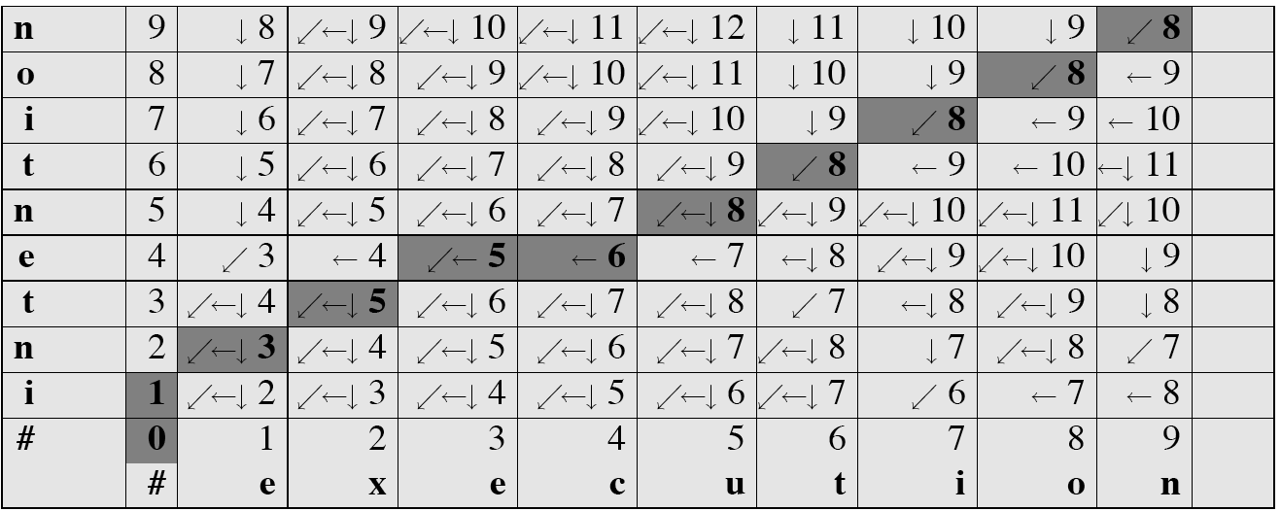
MinEdit with Backtrace
www.midocean.ae

Slide 49
Adding Backtrace to Minimum Edit Distance
Base conditions: Termination:
  D(i,0) = i D(0,j) = j D(N,M) is distance
Recurrence Relation:
  For each i = 1…M
  For each j = 1…N
  D(i-1,j) + 1
  D(i,j)= min D(i,j-1) + 1
  D(i-1,j-1) + 2; if X(i) ≠ Y(j)
  0; if X(i) = Y(j)
  LEFT
  ptr(i,j)= DOWN
  DIAG
deletion
insertion
substitution
insertion
deletion
substitution
www.midocean.ae

Slide 50
The Distance Matrix
Every non-decreasing path
from (0,0) to (M, N)
corresponds to
an alignment
of the two sequences
x₀ …………………… x_{N}
An optimal alignment is composed of optimal subalignments
y₀ ……………………………… y_{M}
www.midocean.ae

Slide 51
Result of Backtrace
Two strings and their alignment:
www.midocean.ae

Slide 52
Performance
Time:
  O(nm)
Space:
  O(nm)
Backtrace
  O(n+m)
www.midocean.ae

Slide 53


Thank You

