Slide 1




Research Methodology in Computer Science (AI800)
Lecture 8
Ethical issues in Conducting Research
Prepared by
Dr. Mohammed Anbar
www.midocean.ae

Slide 2

Outlines
Learning Outcomes
What is Research Ethics?
Why Research Ethics?
Research Ethics Types
Objectives of Research Ethics
Ethical considerations in the research process
Ethical Issues in Research
What is Plagiarism?
Legal Incorporation of Another's Work
Tips to Incorporation of Another's Work
Inadvertent & Deliberate Plagiarism
Why do students plagiarize?
Un-Ethical Research Conduct
Components of Ethical Research
Principles of Ethical Research
Ethical Principle in Research and Publication
Ethical Decision-Making
www.midocean.ae

Slide 3
Learning Outcomes
To understand the importance of ethical considerations in research.
To identify common ethical issues that may arise in the research process.
To discuss the potential consequences of unethical research practices.
To explore guidelines and regulations for ethical research conduct.
To analyze case studies to apply ethical principles in research scenarios.
To reflect on personal values and biases that may influence research ethics.
To engage in discussions on controversial topics related to research ethics.
To develop strategies for addressing and resolving ethical dilemmas
www.midocean.ae

Slide 4
What is Research Ethics?
Research Ethics refers to the moral principles and guidelines that govern the conduct of research.
Research Ethics involves ensuring that research is conducted in an ethical manner, with respect for the rights and welfare of participants, integrity in data collection and analysis, and transparency in reporting findings.
Research Ethics includes considerations such as obtaining informed consent, protecting privacy and confidentiality, minimizing potential harm, and addressing conflicts of interest.
www.midocean.ae

Slide 5
What is Research Ethics? (cont.)
“Greek ethos ‘character’ is the systematic study of value concepts—good, bad, right, wrong and the general principles that justify applying these concepts”.
“Ethics is the disciplined study or morality….and morality asks the question…what should one’s behavior be”.
Joan E. Sieber Planning Ethically Responsible Research, p. 3
Jeff Cooper Albany Medical Center, Ethical Decision Making, 2001, p. 1
www.midocean.ae

Slide 6
Why Research Ethics?
Ethics in research is important for the following reasons:
Scientific Integrity:
  The validity and integrity of the research process are upheld by research ethics.
Compliance:
  Legal and regulatory standards are adhered to in accordance with ethical norms.
Ethical Decision-Making:
  Researchers use ethics to help them navigate difficult moral conundrums.
Cooperation and Reputation:
  Researchers and organizations with a strong ethical code are better able to collaborate with one another.
Credibility and Trustworthiness:
  Research findings that adhere to ethical standards are more credible and reliable.
www.midocean.ae

Slide 7
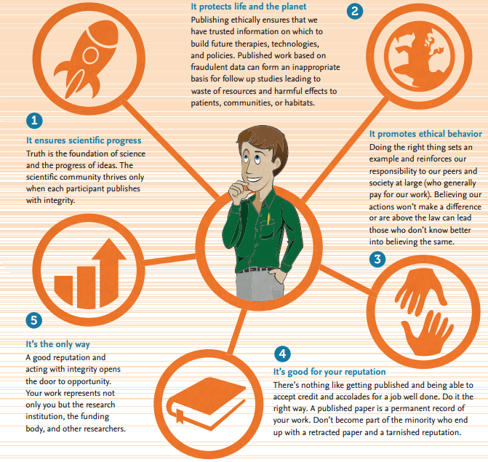
Why Research Ethics? (cont. )
Source: Elsevier, Ethics in Research and Publication.
www.midocean.ae

Slide 8
Research Ethics Types
Descriptive Ethics :
  Focuses on describing and understanding how individuals or groups behave when faced with ethical dilemmas.
  It involves studying moral principles, values, and beliefs that guide human actions.
Prescriptive Ethics : Also known as normative ethics
  Explores how people ought to behave based on certain ethical theories or principles.
  Seeks to provide guidelines for decision-making and prescribing morally acceptable courses of action in various situations.
www.midocean.ae

Slide 9
Research Ethics Types(Cont…)
Meta Ethics:
  A branch of philosophy that explores the nature of ethical concepts and moral judgments.
  It focuses on understanding the underlying principles and the meaning of ethical language, rather than directly addressing specific moral issues or providing guidance on what is right or wrong
Applied Ethics:
  The ethical principles and guidelines that are specific to domains or disciplines, such as business, biomedical research, engineering ethics, and many more.
  Address unique ethical considerations and challenges that may arise within each domain, considering the potential impact on stakeholders, participants, and society .
www.midocean.ae

Slide 10
Objectives of Research Ethics
Ensure the protection and well-being of research participants, promote scientific integrity, and maintain public trust in the research process.
  Protection of Participants: protect study participants' rights and well-being by minimizing risks, obtaining informed permission, and putting in place suitable protections.
  Scientific Integrity: supporting objective data collection, analysis, and reporting, discouraging fraud, and fostering study reproducibility, research ethics preserves the validity and integrity of the research process.
  Social Responsibility: make sure that the work is done in a way that helps people or the community at large.
www.midocean.ae

Slide 11
Objectives of Research Ethics(cont…)
Aim to prevent any harm or exploitation of vulnerable populations, ensure informed consent and voluntary participation, and uphold the principles of fairness, transparency, and accountability in conducting research.
Seek to address potential conflicts of interest, maintain confidentiality and privacy of participants' data, and encourage responsible dissemination of research findings.
www.midocean.ae

Slide 12
Ethical considerations in the research process
Conceptualization and design
  scientific merit, identify risks and ways to mitigate the risks.
When participants are recruited
  the process of informed consent, right to privacy.
During the intervention or measurement procedure to which participants are subjected
  management of risk.
In the release of results obtained
  protection of confidentiality and anonymity.
After the release of results
  ensure that participants and communities involved in the research benefit.
www.midocean.ae

Slide 13
Ethical Issues in Research
Validity
Research techniques should be in line with the goals of the study and the research questions.
Sampling
Samples must be impartial, rationally supported, and in line with the study plan.
Confidentiality
It is important to safeguard and maintain participant names and data.
Vulnerable populations
When include vulnerable populations in research, more caution should be used.
Informed Consent
All information on the study's possible hazards and benefits should be provided to participants.
Plagiarism
Researchers must not pass off someone else's work as their own or claim originality for work they have done in many formats.
Fabrication
It is immoral to manipulate or change the results of research.
Falsification
To fake their findings, scientists shouldn't alter their data or leave out important details.
www.midocean.ae

Slide 14

What is Plagiarism?
Plagiarism refers to the act of using someone else's work or ideas without giving them proper credit.
Plagiarism involves copying and presenting someone else's work as your own
  Written
  Visual (Images and Videos).
  audio content.
Plagiarism is considered unethical and can have serious consequences in academic and professional settings.
Plagiarism
www.midocean.ae

Slide 15
Legal Incorporation of Another's Work
Legal incorporation of another's work refers to the process of using someone else's work in your own without infringing on their copyright.
Legal incorporation done through :
  Summarizing involves condensing the main ideas of the original work into a shorter version.
  Paraphrasing involves restating the original ideas in your own words.
  Direct quotations involve using the exact words of the original author, enclosed in quotation marks. It is important to properly cite and give credit.
www.midocean.ae

Slide 16
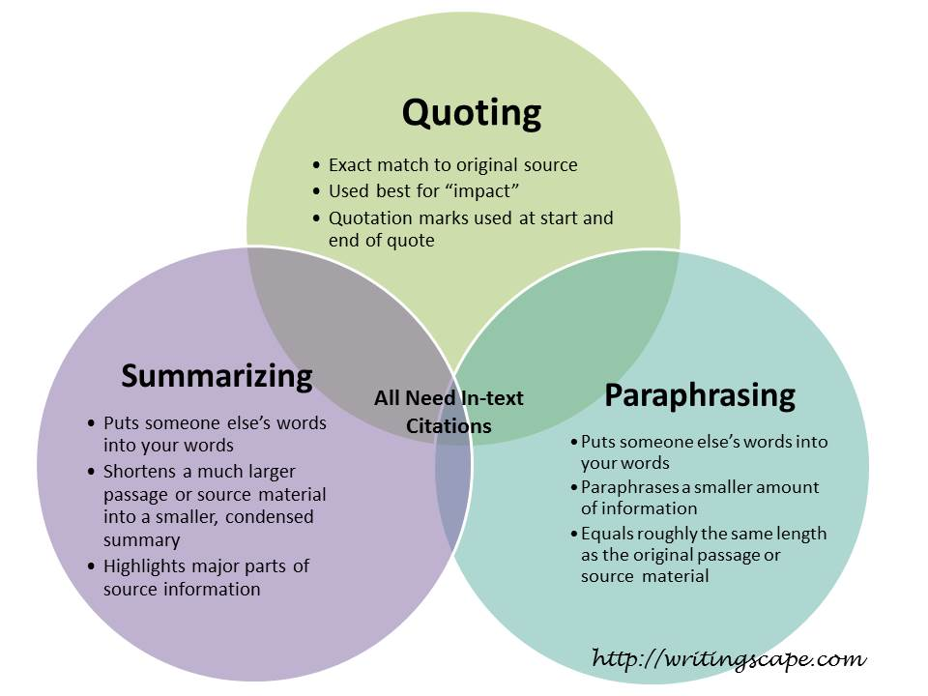
Legal Incorporation of Another's Work (cont. )
www.midocean.ae

Slide 17
Tips to Incorporation of Another's Work
Always give proper credit and attribution to the original author or creator of the work you are incorporating.
  Including citations, references, or acknowledgments in your own work.
Understand and follow the guidelines and regulations regarding copyright laws and fair use when incorporating another person's work.
  Ensure that you are not infringing on someone else's intellectual property rights.
Seek permission from the original author or copyright holder if you plan to use a substantial amount of their work.
www.midocean.ae

Slide 18


Inadvertent & Deliberate Plagiarism
Inadvertent plagiarism refers to the unintentional act of using someone else's work without proper citation or acknowledgment.
Inadvertent plagiarism often occurs when a person fails to properly paraphrase or quote sources, leading to the mistaken belief that
the work is their own.
Deliberate plagiarism involves intentionally copying or
stealing someone else's work and presenting it as one's own,
which is a serious ethical violation in academic and
professional settings.
www.midocean.ae

Slide 19
Why do students plagiarize?
Pressure to achieve high grades
Lack of time management skills
Lack of preparation
Lack of understanding the assignment.
lack of confidence in their own abilities or a fear of failure.
Availability of online resources and the ease of copying and pasting information.
www.midocean.ae

Slide 20
Un-Ethical Research Conduct
Deception (issues of full disclosure)
Lack of objectivity and integrity in the design and conduct of research
Fabrication or falsification of data
Not following the appropriate ascription of authorship to a publication
Conducting research that does not have a scientific base (ill-formed problem statement)
Not respecting the right to: privacy, anonymity and confidentiality, and vulnerable groups
Not having due consideration for the environment
www.midocean.ae

Slide 21
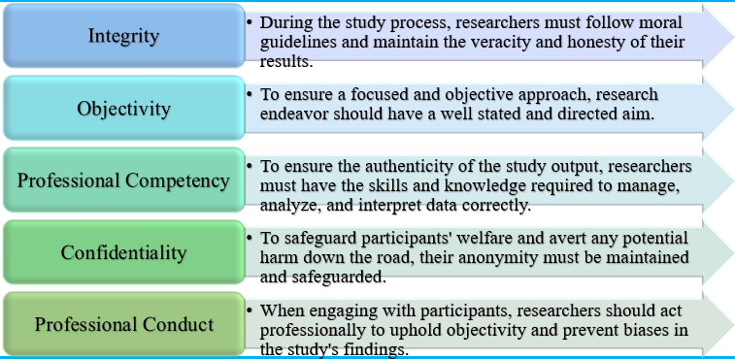
Components of Ethical Research
www.midocean.ae

Slide 22
Ethical Principle in Research and Publication
Authorship
There are three kinds of authorship that are not acceptable:
"Ghost" writers, who make significant contributions but go unrecognized (often sponsored by businesses).
"Guest" writers, named to assist improve publishing prospects but contributing nothing of note.
"Gift" writers, whose involvement stems only from a loose connection to a research project.
www.midocean.ae

Slide 23
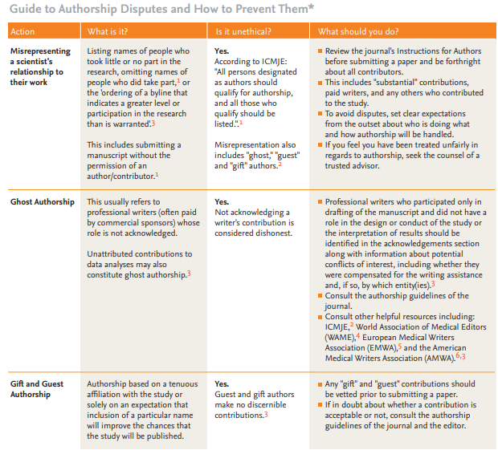
Ethical Principle in Research and Publication (cont.)
Source: Elsevier, Ethics in Research and Publication.
www.midocean.ae

Slide 24
References
1. Committee on Publication Ethics (COPE). Committee on Publication Ethics (COPE). How to handle authorship disputes: a
guide for new researchers. 2003. Available at: publicationethics.org/files/2003pdf12.pdf. Accessed on June 17, 2017.
2. International Committee of Medical Journal Editors. Uniform Requirements for Manuscripts Submitted to Biomedical
Journals: Ethical Considerations in the Conduct and Reporting of Research: Authorship and Contributorship. Available at:
icmje.org/recommendations/browse/roles-and-responsibilities/defining-the-role-of-authors-and-contributors.html. Accessed
on June 17, 2017.
3. Scott-Lichter D and the Editorial Policy Committee, Council of Science Editors. CSE’s White Paper on Promoting Integrity in
Scientific Journal Publications, 2012 Update. 3rd Revised Edition. Wheat Ridge, CO: 2012. Available at: councilscienceeditors.
org/wp-content/uploads/entire_whitepaper.pdf. Accessed on June 17, 2017.
4. World Association of Medical Editors (WAME) policy statement on ghost writing initiated by commercial companies.
Available at: wame.org/policy-statements#Ghost Writing - ghost. Accessed on June 17, 2017.
5. Jacobs A, Wager E. European Medical Writers Association (EMWA) Guidelines on the role of medical writers in developing
peer-reviewed publications. Curr Med Res Opin. 2005;21:317-321. Available at: emwa.org/Mum/EMWAguidelines.pdf. Accessed
on June 17, 2017.
6. AMWA-EMWA-ISMPP Joint Position Statement on the Role of Professional Medical Writers. Available at: c.ymcdn.com/sites/
www.amwa.org/resource/resmgr/about_amwa/JointPositionStatement.Profe.pdf. Accessed on June 17, 2017.
www.midocean.ae

Slide 25
Ethical Principle in Research and Publication
Competing Interest
Academic rivalry, intellectual enthusiasm, and interpersonal interactions can all lead to competing interests. One example of this situation might involve a researcher who own:
A family member employed by the organization whose merchandise the investigator is assessing.
A self-serving interest in the research findings (e.g., possible career progress or promotion based on outcomes).
Personal convictions that directly contradict the subject of the research
www.midocean.ae

Slide 26
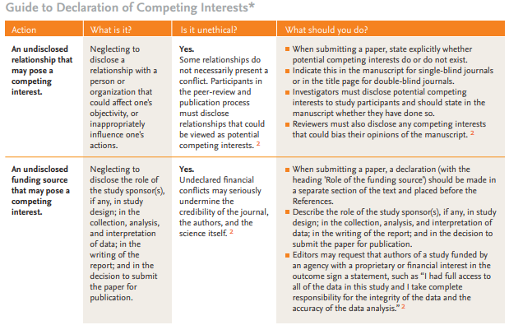
Ethical Principle in Research and Publication
Source: Elsevier, Ethics in Research and Publication.
www.midocean.ae

Slide 27
References
1. Office of Research Integrity U.S. Department of Health and Human Services. A brief overview on Conflict of Interests. Available at: ori.hhs.gov/plagiarism-35. Accessed on June 17, 2017.
2. International Committee of Medical Journal Editors. Uniform Requirements for Manuscripts Submitted to BiomedicalJournals: Ethical Considerations in the Conduct and Reporting of Research: Conflicts of Interest. Available at: icmje.org/conflicts-of-interest/. Accessed on June 17, 2017.
3. Committee on Publication Ethics (COPE). Principles of Transparency and Best Practice in Scholarly Publishing, Version 2, 2015. Available at: publicationethics.org/resources/guidelines/. Accessed on June 17, 2017.
www.midocean.ae

Slide 28
Ethical Principle in Research and Publication
Simultaneously Submission
“A person submits a paper to different publications at the same time, which can result in more than one journal publishing that particular paper.”
“Duplicate/multiple publication occurs when two or more papers, without full cross reference, share essentially the same hypotheses, data, discussion points, and/or conclusions. This can occur in varying degrees: literal duplication, partial but substantial duplication, or even duplication by paraphrasing.”
www.midocean.ae

Slide 29
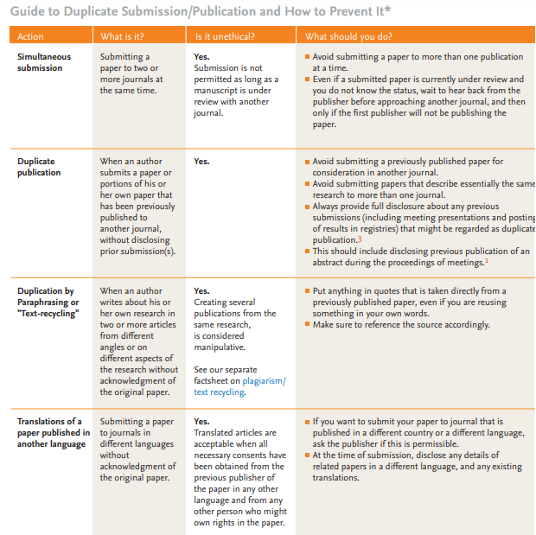
Ethical Principle in Research and Publication
Source: Elsevier, Ethics in Research and Publication.
www.midocean.ae

Slide 30
References
1. Principles of Transparency and Best Practice in Scholarly Publishing, Version 2, 2015. Committee on Publication Ethics (COPE). Accessed on Nov 5, 2023.
2. Elsevier Publishing Ethics policies: Duties of Authors. Available at: elsevier.com/publishingethics. Accessed on Nov 5, 2023.
3. International Committee of Medical Journal Editors. Uniform Requirements for Manuscripts Submitted to Biomedical Journals: Publishing and Editorial Issues Related to Publication in Biomedical Journals: OverlappingPublications. Available at: http://www.icmje.org/recommendations/browse/publishing-and-editorial-issues/overlapping-publications.html. Accessed on
Nov 5, 2023.
www.midocean.ae

Slide 31
Ethical Principle in Research and Publication
Salami slicing
The “slicing” of research that would form one meaningful paper into several different papers is called "salami publication" or "salami slicing".
Unlike duplicate publication, which involves reporting the exact same data in two or more publications, salami slicing involves breaking up or segmenting a large study into two or more publications.
The breaking up of a complex study containing multiple dependent measures into separate smaller publications can have serious negative consequences for the integrity of the scientific database
1. Elsevier, Ethics in Research and Publication.
2.Office of Research Integrity. Salami Slicing (i.e., data fragmentation). Available at: ori.hhs.gov/plagiarism-16. Accessed on April 19, 2022.
www.midocean.ae

Slide 32
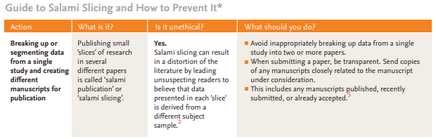
Ethical Principle in Research and Publication
Source: Elsevier, Ethics in Research and Publication.
www.midocean.ae

Slide 33
References
1. Abraham P (2000). Duplicate and salami publications. Journal of Postgraduate Medicine, 46: 67.
2. Office of Research Integrity. Salami Slicing (i.e., data fragmentation). Available at: ori.hhs.gov/plagiarism-16. Accessed on
June 17, 2017.
3. Committee on Publication Ethics (COPE) (2005). Cases: Salami publication. Available at: publicationethics.org/search/site/
salami. Accessed on June 17, 2017.
4. Angell M, Relman AS. Redundant publication. N Engl J Med 1989; 320:1212-1214
5. Kassirer JP, Angell M. Redundant publication: a reminder. N Engl J Med 1995; 333:449-450
www.midocean.ae

Slide 34
Ethical Principle in Research and Publication
Research Fraud
“Research fraud is publishing data or conclusions that were not generated by experiments or observations, but by invention or data manipulation.
There are two kinds in research and scientific publishing:
Fabrication. Making up research data and results and recording or reporting them.
Falsification. Manipulating research materials, images, data, equipment, or processes.
Falsification includes changing or omitting data or results in such a way that the research is not accurately represented. A person might fabricate data to make it fit with the desired result of a study”.
1. Elsevier, Ethics in Research and Publication.
2.Office of Research Integrity. Salami Slicing (i.e., data fragmentation). Available at: ori.hhs.gov/plagiarism-16. Accessed on Nov 5, 2023.
www.midocean.ae

Slide 35
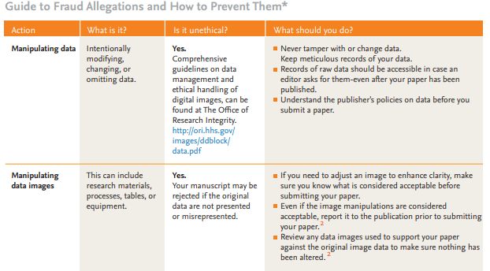
Ethical Principle in Research and Publication
Source: Elsevier, Ethics in Research and Publication.
www.midocean.ae

Slide 36
References
1. Office of Research Integrity U.S. Department of Health and Human Services. Definition of Research Misconduct. Available at: ori.hhs.gov/definition-misconduct. Accessed on June 17, 2017.
2. Scott-Lichter D and the Editorial Policy Committee, Council of Science Editors. CSE’s White Paper on Promoting Integrity in Scientific Journal Publications, 2012 Update. 3rd Revised Edition. Wheat Ridge, CO: 2012. Available at: http://www.councilscienceeditors.org/resource-library/editorial-policies/white-paper-on-publication-ethics/acknowledgments/.Accessed on June 17, 2017.
3. Elsevier. Publishing Ethics Policies: Duties for Authors. Available at: elsevier.com/publishingethics. Accessed on June 17, 2017.
4. Office of Research Integrity U.S. Department of Health and Human Services. Guidelines for Responsible Data Management in Scientific Research. Available at: ori.hhs.gov/images/ddblock/data.pdf. Accessed on June 17, 2017.
5. Rossner M, Yamada K. What’s In a Picture: The Temptation of Image Manipulation Journal Cell Biology 2004. Available at: http://jcb.rupress.org/content/166/1/11. Accessed on June 17, 2017.
www.midocean.ae

Slide 37
Guidelines and Regulations for Ethical Research
Guidelines provide a framework for researchers to follow, ensuring that their work is conducted with integrity and respect for the rights of individuals.
Guidelines outline the principles of informed consent, confidentiality, and voluntary participation.
Guidelines emphasize the importance of minimizing any potential harm or discomfort to participants and require researchers to obtain approval from ethics committees before conducting their studies.
By adhering to these guidelines and regulations, researchers can maintain the integrity and credibility of their work while upholding ethical standards in the field of research.
www.midocean.ae

Slide 38
References
L.H Edwards, Legal Writing Process, Analysis and Organization (2nd ed. 1999) p.10
Joan E. Sieber Planning Ethically Responsible Research, p. 3
Jeff Cooper Albany Medical Center, Ethical Decision Making, 2001, p. 1
Elsevier, Ethics in Research and Publication.
Office of Research Integrity. Salami Slicing (i.e., data fragmentation). Available at: ori.hhs.gov/plagiarism-16. Accessed on April 19, 2022.
www.midocean.ae

Slide 39



Thank You

Slide 40
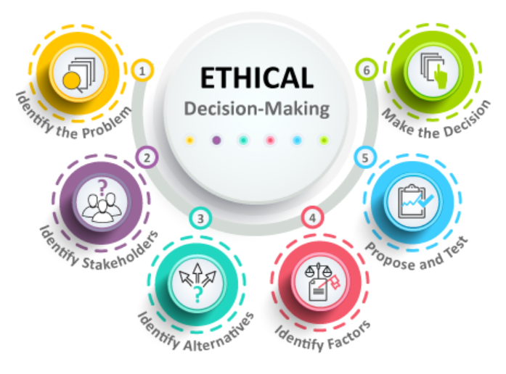
Ethical Decision-Making
Deductive or principle-based reasoning:
  Start with an ethical theory
  Continue with a specific principle
  Develop rules
  Make judgments
Inductive or case-based reasoning
  Decisions made – precedent
  Look to decisions and combine to make a judgment
  Judgments reflect on rules
  Rules reflect on our principles
  Principles reflect to the ethical theory
www.midocean.ae

Slide 41
Principles of Ethical Research
Respect for Autonomy
To provide research participants the freedom to decide whether to participate in the study, researchers must uphold their rights to autonomy.
Beneficence
To minimize damage and maximize benefits, researchers should put participants' welfare and well-being first.
Justice
To conduct ethical research, participants must be chosen fairly and equally.
Fidelity & Responsibility
Scholars must be aware of their responsibilities and take an active role in sharing their discoveries to advance society at large.
Participant Recruitment
Logic and justification should underpin the selection process, with criteria considering the decision to pick a certain participant above others.
To act morally.
To take no unwarranted risks.
It entails considering how rewards and liabilities of research are distributed across various groups.
www.midocean.ae

