Slide 1


Procurement and Supply Chain Management
Prepared by Dr. Tarek Mohamed
MGM 431
Orientation Show

Slide 2


Procurement and Supply Chain Management
Orientation Show
MGM 431
Prepared by
Dr. Tarek Mohamed
www.midocean.km

Slide 3

Course Agenda
Chapter
01
1-Introduction about the professor of the course.
2-Introduction to the course.
3-Primary goal of this course.
4-Learning outcomes.
5-Learning resources.
6-Units of course contents.
7-Assessment method.
8-Academic calendar.
www.midocean.km

Slide 4
Who Am I ?
Dr.Tarek Mohamed
Adjunct Professor at Post-Graduate Studies and Research Department - Faculty of Commerce -Cairo University
Doctorate degree in Business Administration- (Major Supply Chain)-Cairo University.
Master degree in Business Administration- Arab Academy for Science & Technology and Maritime Transport .
Executive Management Diploma- The American University in Cairo.
Supply chain consultant & certified trainer in manufacturing and service fields.
Professional consultant of applying Value Chain framework analysis at manufacturing companies.
www.midocean.km

Slide 5
How to reach me ?
By Email : tarek.mohamed @ midocean.edu.km
Pls include "Procurement and Supply Chain Management ” in the subject line.
Via Moodle messages.
Vimeo Meeting.
Discussion time on Tuesday (9-10 PM ) Every Week.
www.midocean.km

Slide 6
Primary Goal of this Course
To outline the key features of supply chain management.
To understand the role of logistics and supply chain management.
To understand how procurement adds value.
To examine sourcing and the management of suppliers.
To understand the negotiation skills, practice and business benefits
To appreciate the issues involved in contract & tendering management.
To consider world-class procurement to enhance business performance and sustainability.
www.midocean.km

Slide 7
Learning Outcomes
At the end of the course, the students will be able to :
Evaluate the role of supply‐chain management and identify the impact of tangible and intangible components of supply chains.
Construct a procurement management plan to ensure the effective integration of supply‐chain components throughout the project life cycle.
Critique the issues associated with a given project supply chain and recommend appropriate adjustments to the project to account for these issues.
Construct a procurement management plan that reflects the company’s procurement needs.
Analyze different types of contracts and the risks associated with each type of contract and determine contract incentives.
Evaluate and recommend best practices for vendor management and contract‐procurement monitoring.
www.midocean.km

Slide 8
Learning Resources
Credit Hours: 3 Credit Hours.
Required Textbook :
Procurement and Supply Chain Management; Tenth Edition; by Kenneth Lysons & Brian Farrington.
Essential References :
The main material and reference for each course will be the textbook mentioned in the course specifications,lecture notes and slides are additional resources that are prepared by the professor.
www.midocean.km

Slide 9
Units of Course Contents
Course Unit | No.of.Weeks | Contact Hours
Lecture 1- Introduction to supply chain management. | 1st | 3
Lecture 2- Understanding logistics and supply chains. | 2nd | 3
Lecture 3- The scope and influence of procurement. | 3rd | 3
Lecture 4- Foundational knowledge of procurement. | 4th | 3
Lecture 5- Procurement Systems. | 5th | 3
Lecture 6- Sourcing and the management of suppliers. | 6th | 3
Lecture 7- Negotiation skills, practice and business benefits | 7th | 3
Lecture 8 -Tender management. | 8th | 3
Lecture 9 - Contract management. | 9th | 3
Lecture 10 -World-class procurement to enhance business performance and sustainability. | 10th | 3
www.midocean.km

Slide 10
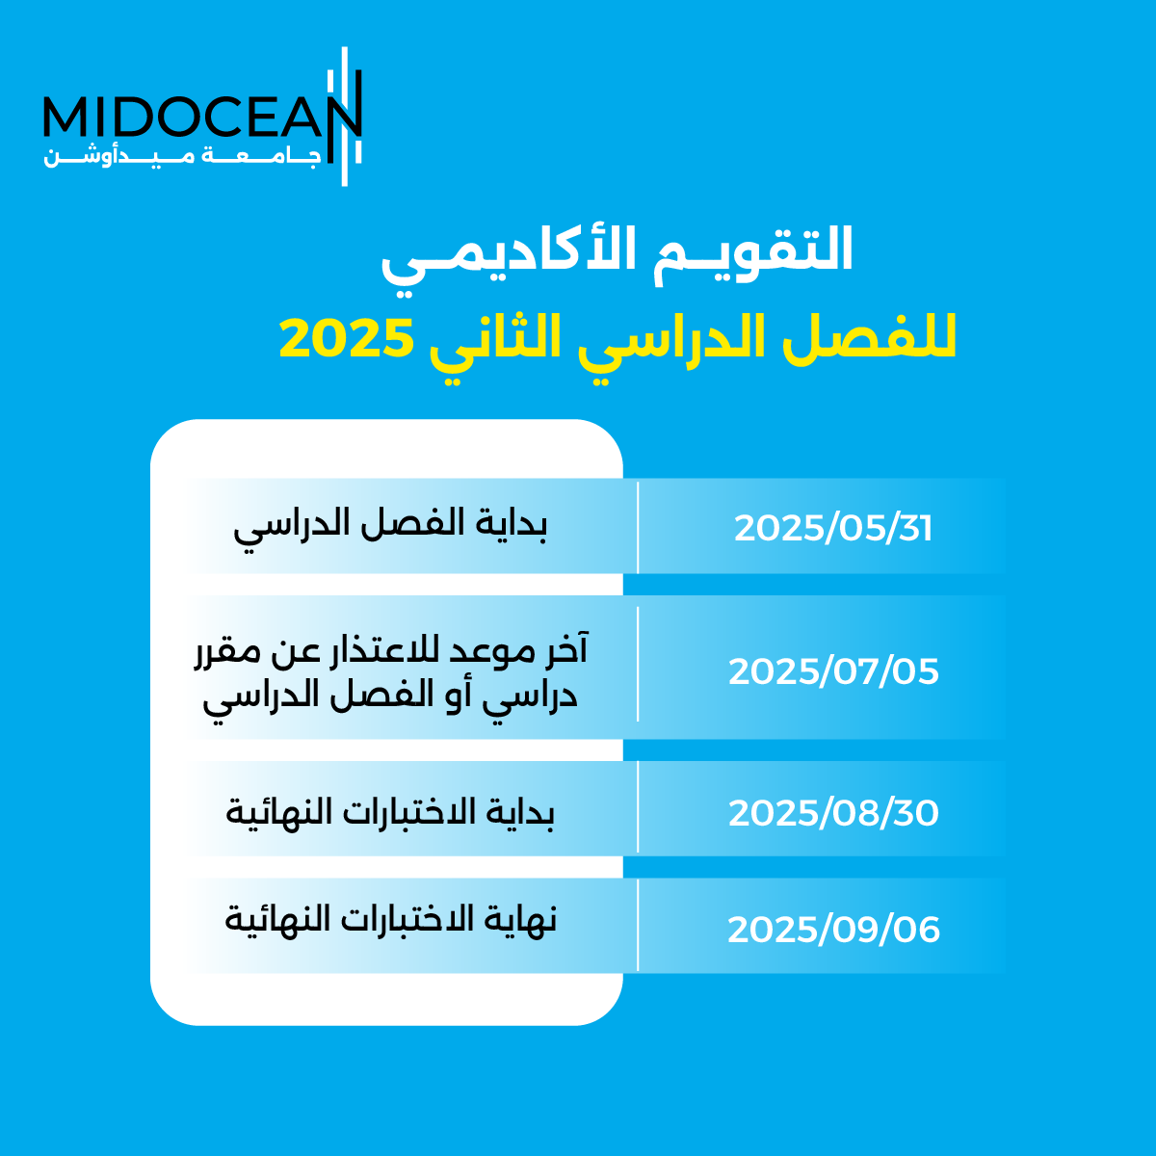
01
www.midocean.km

Slide 11
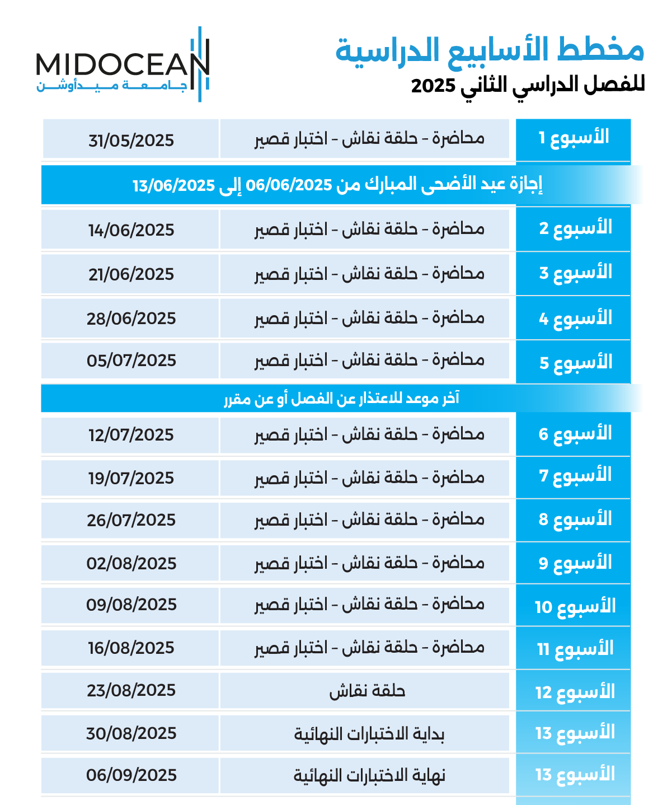
01
www.midocean.km

Slide 12
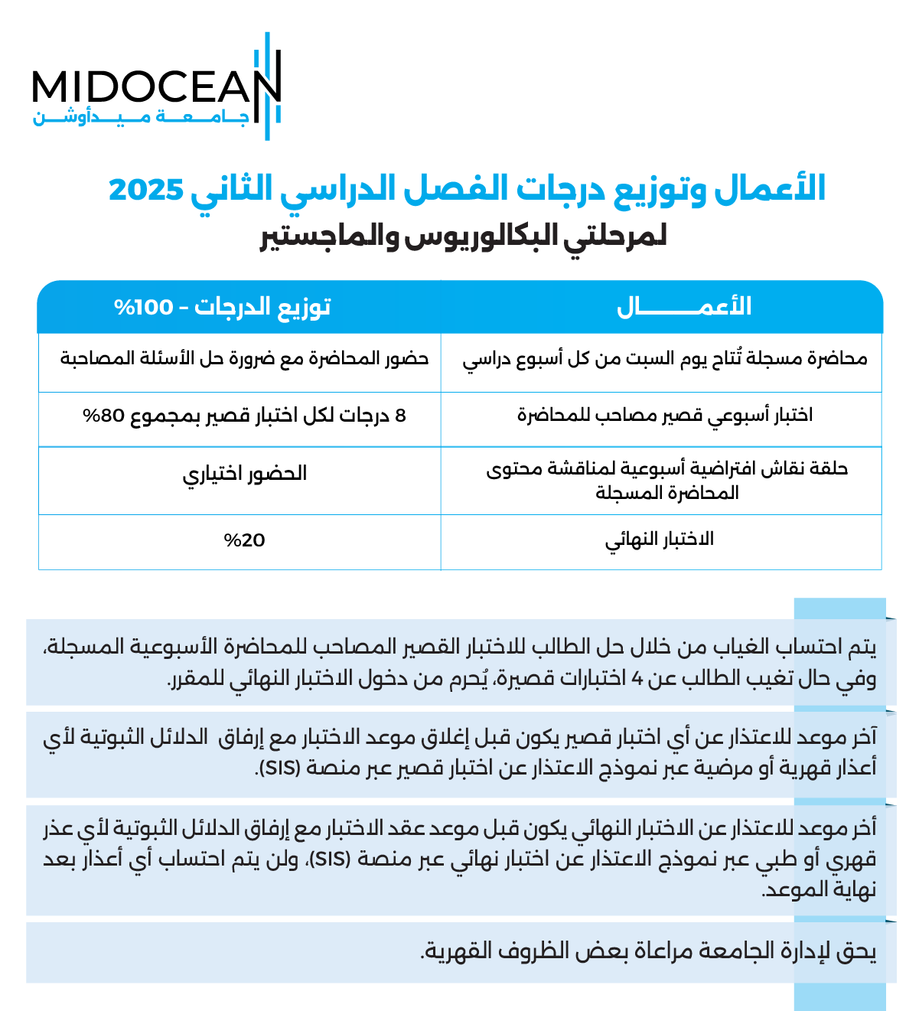
Chapter
01
www.midocean.km

Slide 13


Thank You

