Slide 1



Enterprise Risk Management
PMG 611
Lecture 2
Risk Management Fundamentals
Prepared by
Dr. Eng. Abdullah Jameel Halawany

Slide 2

Lecture
Session Outline
02
What Is Risk
Risk in a Business Context
Risk Management Phases
Summary
2–2

Slide 3
Lecture
What Is Risk
02
Risk Management Fundamentals
PMG 611
Enterprise Risk Management
2–3

Slide 4
Lecture
What Is Risk - Dictionary Definition
02
“(Exposure to) the possibility of loss, injury, or other adverse or unwelcome circumstance; a chance or situation involving such a possibility.”
“the possibility of something bad happening”.
2–4

Slide 5
Lecture
What Is Risk
02
The term risk is generally used to refer to a situation where the outcome is uncertain and there is a possibility of loss.
The loss is random in nature.
It occurs by chance and may happen to anybody and any property.
2–5

Slide 6
Lecture
What Is Risk
02
The word evokes elements of chance, uncertainty, threat, danger, and hazard.
These connotations include the possibility of loss, injury, or some other negative event.
It would be natural to assume that one should simply minimize risks or avoid them altogether.
In fact, risk managers have applied this negative definition for many years.
Risk was simply a barrier to business objectives, and the object of risk management was to limit it.
2–6

Slide 7
Lecture
Definitions from different industries and standards
02
An ongoing or upcoming concern that has a significant probability of adversely affecting the success of major milestones. “Rational Unified Process 2000”
A probability or threat of damage, injury, loss, or any other negative occurrence that is caused by external or internal vulnerabilities, and that may be avoided through preemptive action. “Business Dictionary”
A possible event that could cause harm, loss, or affect the ability to achieve objectives. “ITIL”
2–7

Slide 8
Lecture
Risk in a Business Context
02
Risk Management Fundamentals
PMG 611
Enterprise Risk Management
2–8

Slide 9
Lecture
Risk in a Business Context
02
Risk has an upside as well as a downside.
Without risk there would be no opportunity for return.
A proper definition of risk, then, should recognize both:
  its cause (a variable or uncertain factor)
  its effect (positive and negative deviation from an expected outcome).
2–9

Slide 10
Lecture
Pure and Speculative Risk
02
 | Pure Risk | Speculative Risk
Meaning | Pure risk is the risk which involves only the possibility of loss or no loss. | Speculative risk involves both the possibility of gain as well as possibility of loss.
Possibility of Profits/ Loss | Occurrence of this risk may result in loss only and no gains. | Occurrence of this risk may result in possibility of both gain as well as loss.
Risk Coverage | Insurance services provides coverage of such risks. | such risks cannot be covered under insurance provisions.
2–10

Slide 11
Lecture
Risk in a Business Context
02
“Risk is a variable that can cause deviation from an expected outcome, and as such may affect the achievement of business objectives and the performance of the overall organization.”
To understand this definition, we need to clarify seven key fundamental concepts.
It is important not to confuse any of these with risk itself.
2-11

Slide 12
Lecture
Seven Key Fundamental Concepts
02
1. Exposure
2. Volatility
3. Probability
4. Severity
5. Time Horizon
6. Correlation
7. Capital
2-12

Slide 13
Lecture
1. Exposure
02
Risk exposure is the maximum amount of economic damage resulting from an event.
This damage can take the form of financial and/or reputational loss.
All other factors being equal, the risk associated with that event will increase as the exposure increases.
Exposure measurement is a hard science for some risks—those which result in direct financial loss such as credit and market risk—but is more qualitative for others, such as operational and compliance risk.
2-13

Slide 14
Lecture
2. Volatility
02
Volatility is a measure of uncertainty, the variability in potential outcomes.
More specifically, volatility is the magnitude of the upside or downside of the risk taken.
Generally, the greater the volatility, the greater the risk.
2-14

Slide 15
Lecture
3. Probability
02
The more likely an event.
In other words, the greater its probability—the greater the risk it presents.
Take the case of a modern data center.
Among potential risks are cyberattack and fire, with the probability of the latter considerably lower than that of the former.
2-15

Slide 16
Lecture
4. Severity
02
Whereas exposure is defined in terms of the worst that could possibly happen, severity, by contrast, is the amount of damage that is likely to be suffered.
The greater the severity, the greater the risk.
Severity is the partner to probability.
If we know how likely an event is to happen, and how much we are likely to suffer as a consequence, we have a pretty good idea of the risk we are running.
2-16

Slide 17
Lecture
5. Time Horizon
02
Time horizon refers to the duration of risk exposure or how long it would take to reverse the effects of a decision or event.
The longer an exposure’s duration, the greater its risk.
For example
  Extending a one-year loan is less risky than extending a 10-year loan to the same borrower.
  A fire that burns a computer center to the ground will leave a company exposed until backup facilities come online
2-17

Slide 18
Lecture
6. Correlation
02
Correlation refers to how risks in a business are related to one another.
If two risks behave similarly—that is, they increase for the same reasons or by the same amount—they are considered highly correlated.
The greater the correlation, the greater the risk.
Examples
  include loans to a particular industry, investments in the same asset class, or operations within the same building.
  use of redundant systems
2-18

Slide 19
Lecture
7. Capital
02
Companies hold capital for two primary reasons: The first is to meet cash requirements such as investments and expenses, and the second is to cover unexpected losses arising from risk exposures. Called Economic Capital.
Human Capital (management talent, experience, and track record)
Liquidity Reserves relative to a company’s risk profile.
The combination represents the “Risk Capacity” of the company.
2-19

Slide 20
Lecture
Risk Management Phases
02
Risk Management Fundamentals
PMG 611
Enterprise Risk Management
2–20

Slide 21
Lecture
Risk Management Phases
02
Risk management encompasses the identification, analysis, and response to risk factors that form part of the life of a business.
Effective risk management means attempting to control, as much as possible, future outcomes by acting proactively rather than reactively.
Therefore, effective risk management offers the potential to reduce both the possibility of a risk occurring and its potential impact.
2-21

Slide 22
(1) Risk Identification
(2) Risk Assessments
(3) Risk prioritization and Response Planning
(4) Risk Monitoring
2-22

Slide 23
Lecture
(1) Risk Identification
02
Management should endeavor to identify all possible risks that may impact the success of their enterprise.
The risk identification process requires a studied, deliberate approach to looking at potential risks in each area of operations and then identifying the more significant risk areas that may impact each operation in a reasonable time period.
2-23

Slide 24
Lecture
(1) Risk Identification
02
The idea is not to just list every possible risk but to identify those that might impact operations, with some level of probability, within a reasonable time period.
A good approach is to identify people at all levels of the enterprise who would be asked to serve as risk assessors.
Brainstorming is often a good approach to get a group with different backgrounds to focus on some subject.
2-24

Slide 25
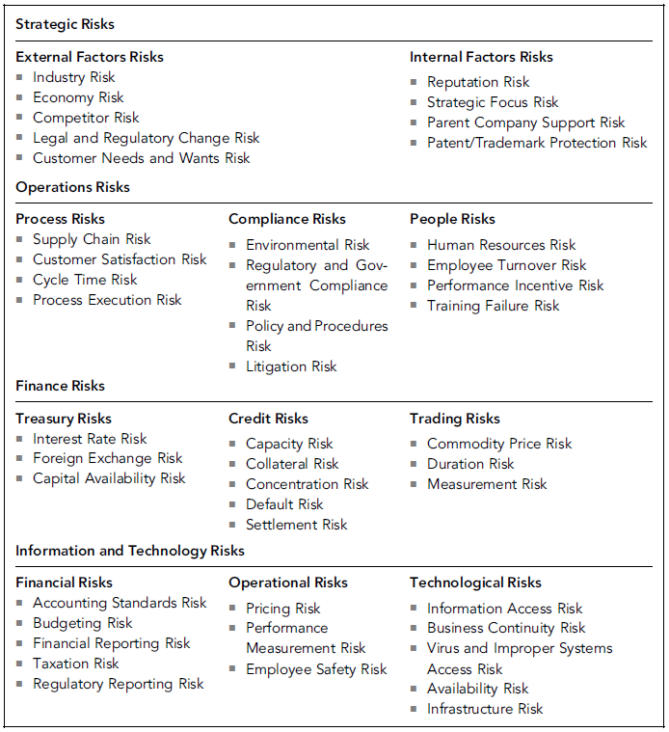
Lecture
(1) Risk Identification
02
Sample Types of Enterprise Business Risks
2-25

Slide 26
Lecture
(1) Risk Identification
02
The ERM team should analyze each of these brainstorm-session identified risks in a bit more detail asking such questions as:
  Is the risk common across the overall enterprise or is it unique to just one business group?
  Will the enterprise face this risk because of internal events within the company or through external events?
  Are the risks related? That is, will one risk cause another to occur?
The idea is to gain a strong understanding of the nature of the and then to highlight those risks that can be considered to be core/major risks.
2-26

Slide 27
Lecture
(2) Risk Assessments
02
Qualitative Assessments
  a relatively quick best-guess qualitative assessment to some detailed
Quantitative Assessments
  mathematical quantitative approaches
The whole idea here is to help management to better decide which of a series of potentially risky events should give the most to worry about.
2-27

Slide 28
Lecture
(2) Risk Assessments
02
In both Qualitative and Quantitative Assessments, we need to determine for each risk:
Likelihood / Probability
  What is the likelihood of this risk occurring over the time period?
Significance / Impact / Consequence / Severity
  What is the significance of the risk, in terms of cost to the enterprise?
2-28

Slide 29
Lecture
(2) Risk Assessments - Qualitative Assessments
02
What is the likelihood of this risk occurring over the next one-year period?
Using a score of 1 to 9, assign a best-guess single-digit score as follows:
  Score 1 if you see almost no chance of that risk happening during the period.
  Score 9 if you feel the event will almost certainly happen during the period.
  Score 2 through 8 depending on how you feel the likelihood will fall between these two ranges.
What is the significance of the risk, in terms of cost to the enterprise?
  1-to-9 scale,
  Scoring ranges should be set depending on the financial significance of the risk to the enterprise.
2-29

Slide 30
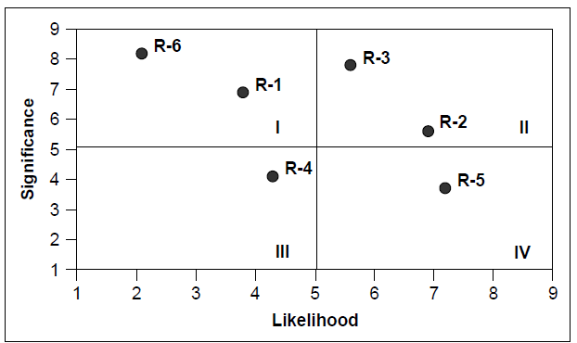
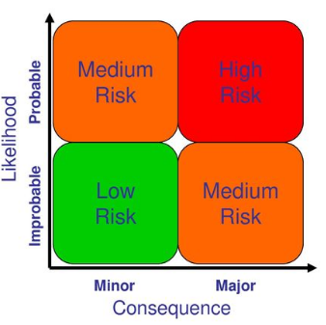
Risk# | Likelihood | Significance
R-1 | 3.75 | 7
R-2 | 7 | 5.5
R-3 | 3.75 | 7.5
R-4 | 4.25 | 4
R-5 | 7.25 | 3.5
R-6 | 5.75 | 7.75
Risk Assessment Analysis Chart
2-30

Slide 31
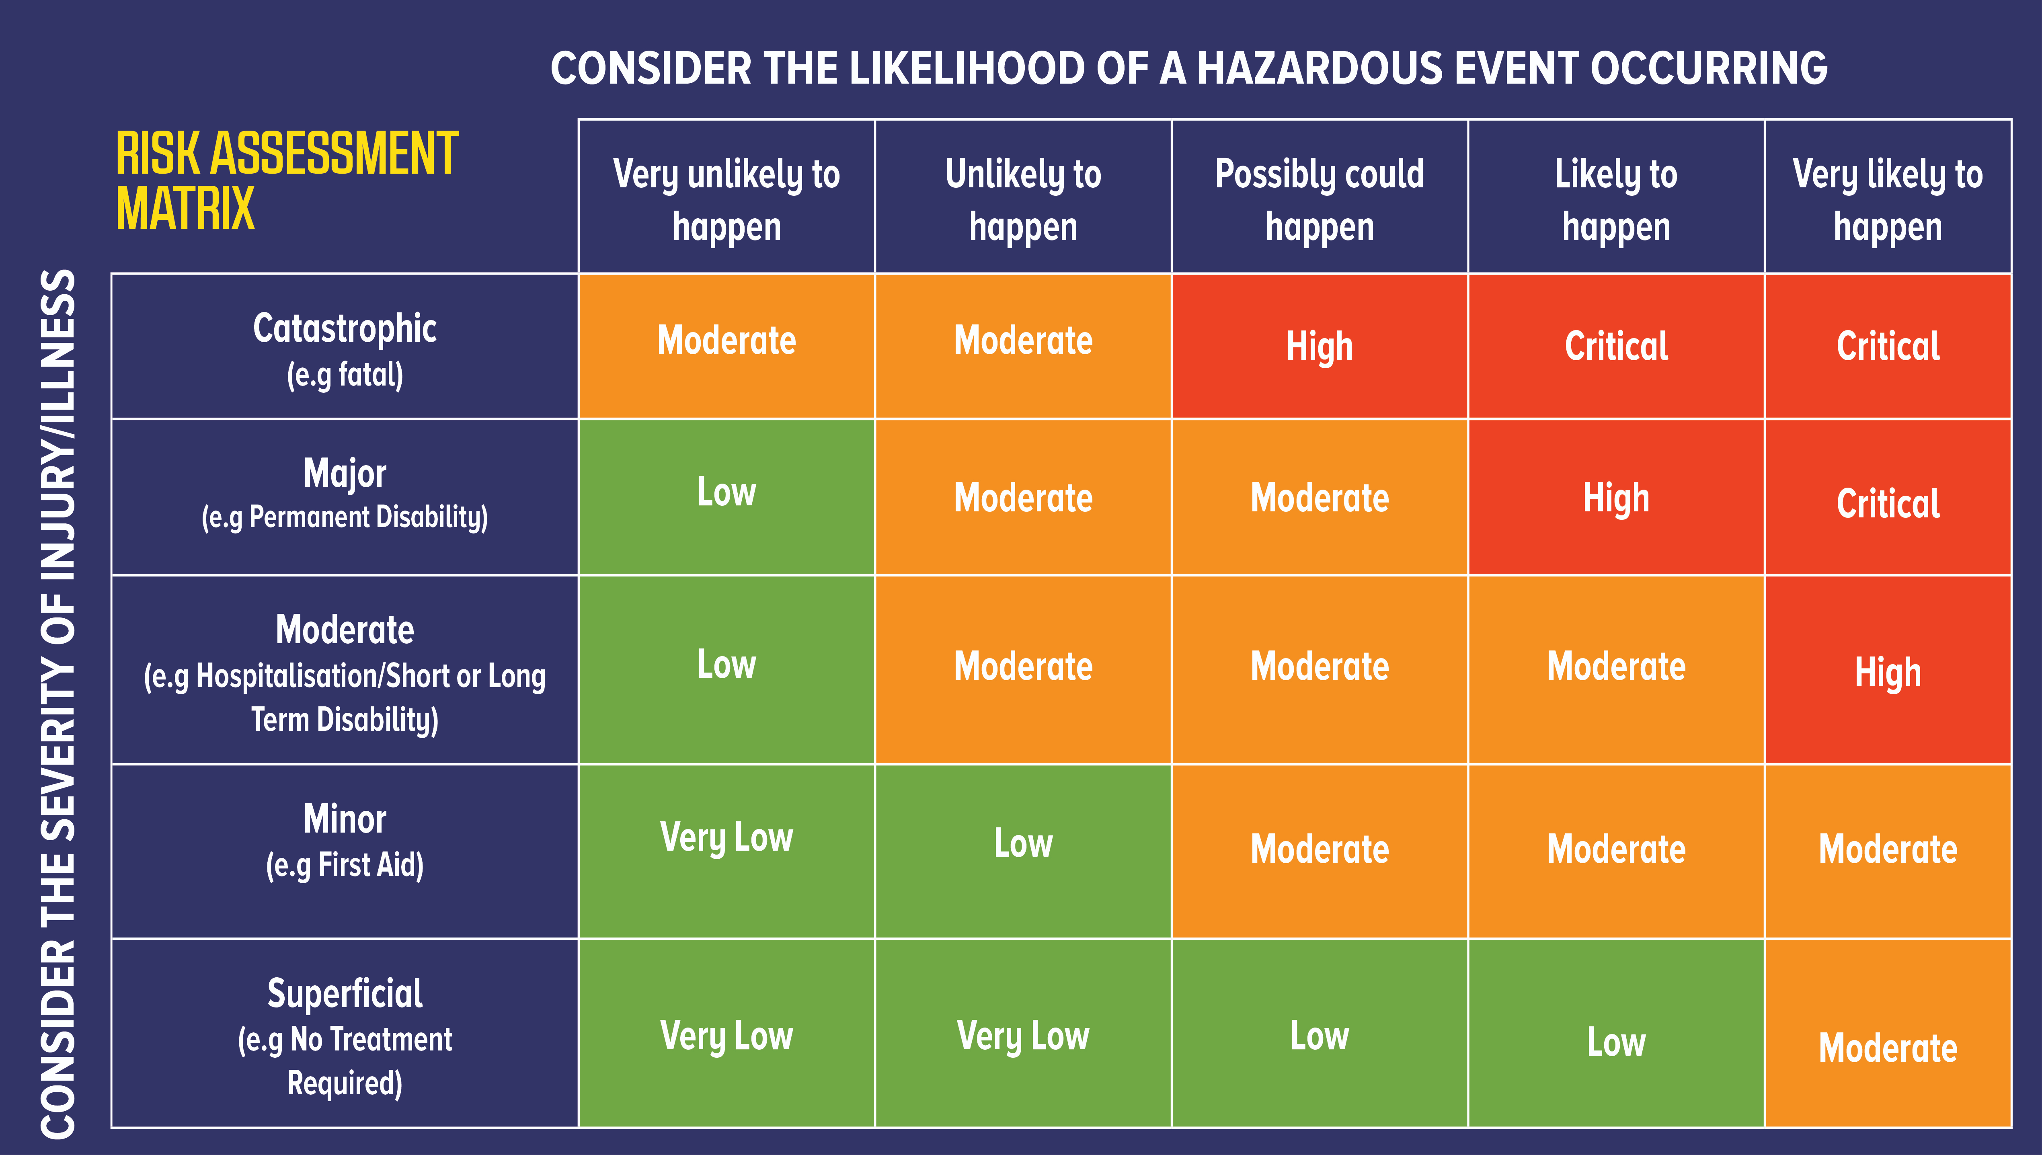
Lecture
02
(2) Risk Assessments - Qualitative Assessments
2-31

Slide 32
Lecture
02
(2) Risk Assessments - Quantitative Assessments
The assessment teams should think of the individual risk likelihoods and occurrences in terms of two-digit probabilities ranging from almost 0.00 to 0.99.
Risks essentially never have a zero chance or 100 percent chance of occurring.
2-32

Slide 33
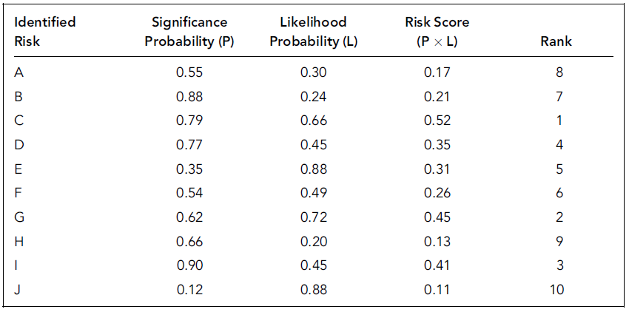
Lecture
02
(2) Risk Assessments - Quantitative Assessments
Risk-Ranking Chart Example
2-33

Slide 34
Lecture
(2) Risk Assessments
02
When estimating occurrences and likelihoods, the ERM team should take care to assure that all estimates are made over the same period of time.
Usually, a one-year interval or at least until the end of the next fiscal year is a reasonable interval of time.
There is typically not enough information to make reasonably accurate estimates much beyond those periods.
2-34

Slide 35
Lecture
Qualitative Vs. Quantitative Assessments
02
A quantitative risk management methodology is best suited for a detailed look at comparing risks. (more costly)
A qualitative risk assessment is quick best-guess based more so on subjectivity and the knowledge of the assessor. (less costly)
You can combine the two methodologies to enhance an existing risk assessment.
Start with qualitative method to determine the top risks list and then use quantitative method to carry more detailed look at risks in this list.
2-35

Slide 36

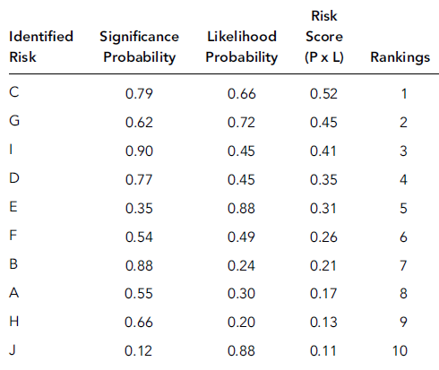
Lecture
02
(3) Risk Prioritization and Response Planning
Risk Prioritization / Risk Ranking
  A typical enterprise that goes through a risk assessment process will end up with a very long list of potential risks.
  A next step is to find risk rankings and identify the most significant risks across the entity reviewed.
2-36

Slide 37
Lecture
02
(3) Risk Prioritization and Response Planning
Response Planning
  process requires significant management input and support to recognize the various alternative risk responses and to have action plans in place to satisfy the appropriate responses.
Cost Impact (Exposure)
  Cost of risk is the cost of managing risk and incurring losses due to risk.
  It can be forecast for a future period.
2-37

Slide 38
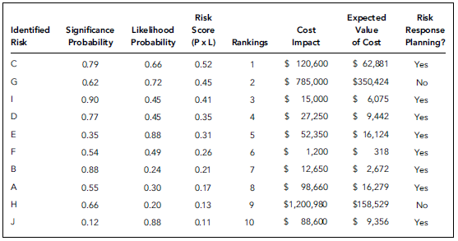
Lecture
02
(3) Risk Prioritization and Response Planning
Risk-Ranking Response-Planning Example
2-38

Slide 39
Lecture
02
(3) Risk Prioritization and Response Planning
Risk C has a high likelihood and significance as well as a fairly high expected cost to correct. This is the type of risk that management should identify as a candidate for corrective actions.
Risk G has a relatively high cost to implement. This may be the type of risk where management decides to accept the risk or to develop some other form of remediation plan.
2-39

Slide 40
Lecture
(4) Risk Monitoring
02
Keep track of the identified risks, including the watch list.
Monitor trigger conditions for contingencies
Monitor residual risks and identify new risks arising.
Determine if risk responses have been implemented as planned.
Determine if risk exposure has changed from its prior state, with analysis of trends.
2-40

Slide 41
Lecture
Summary
02
Risk Management Fundamentals
PMG 611
Enterprise Risk Management
2–41

Slide 42
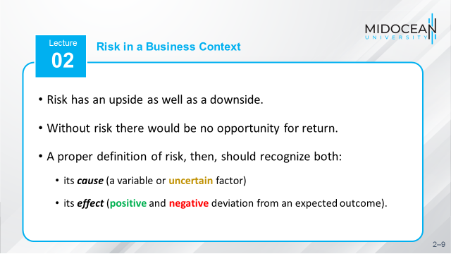
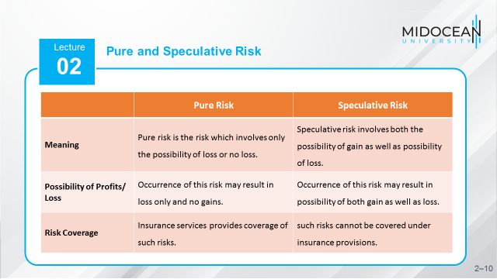
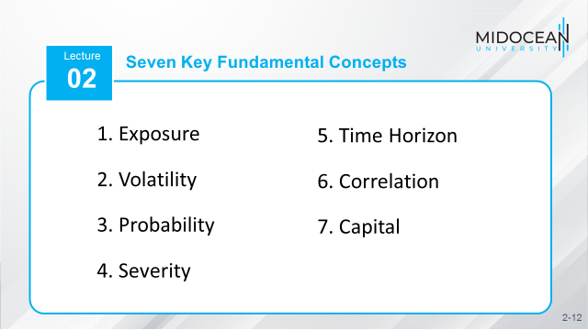
2-42

Slide 43
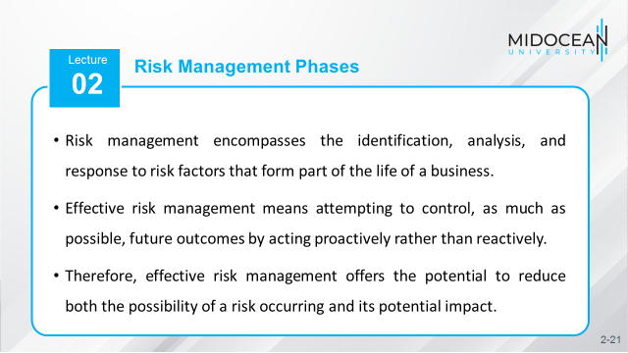
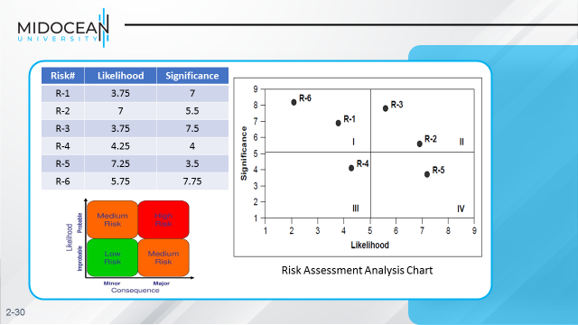
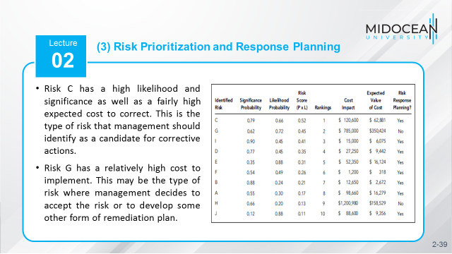
2-43

Slide 44
References
COSO Enterprise Risk Management: Establishing Effective Governance, Risk, and Compliance Processes. Robert R. Moeller.
Implementing Enterprise Risk Management: From Methods To Applications. James Lam.
1-44

Slide 45



Thank You

