Slide 1


Procurement and Supply Chain
Prepared by Dr. Tarek Mohamed
MGM 431
Lecture 7

Slide 2


Negotiation skills, practice and business benefits
Lecture 7
MGM 431
Prepared by
Dr. Tarek Mohamed

Slide 3

Course Agenda
Chapter
Understand the meaning of negotiation.
Negotiation” as an executive tool-buyer perspective.
Understanding the different issues of negotiation.
Explaining the key negotiation vocabulary.
Describe the good and bad time for negotiation.
The different steps in negotiation a contract.
Discussing the strategic approach to negotiation.

Slide 4
“Negotiation” Defined
Negotiation is a process by which two or more parties, linked by mutual dependence but with some apparent conflict, seek to achieve a better outcome through a jointly agreed-upon.
Back-and-forth communication to reach an agreement, when some interests are shared and some are opposed.

Slide 5
“NEGOTIATION” AS AN EXECUTIVE TOOL

Slide 6
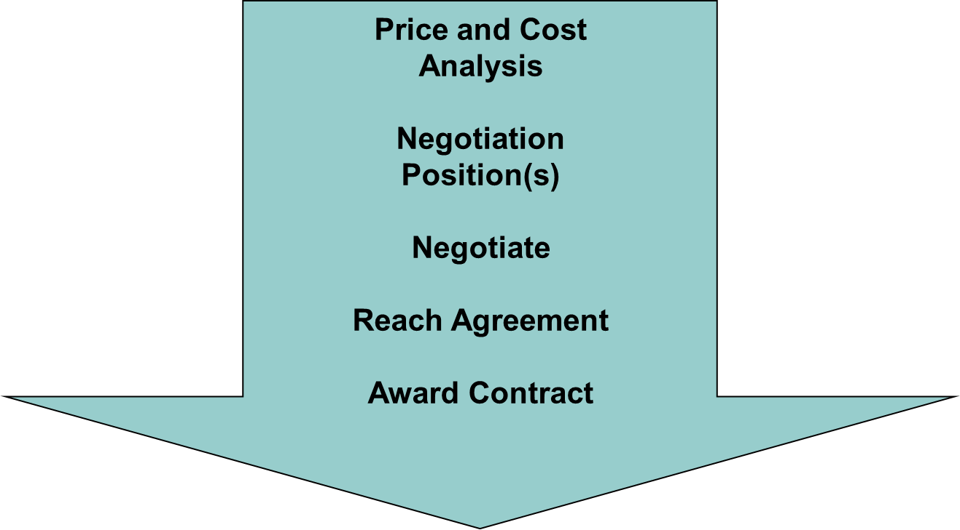
“NEGOTIATION” AS AN EXECUTIVE TOOL-BUYER PERSPECTIVE

Slide 7
Issues of Negotiation
External Negotiation:
  Supplier agreements
  Customer contracts
  Purchase of property or equipment
Internal Negotiation:
  Budgets, resource allocation
  Work schedules
  Work sharing on projects or reports
  Decisions with conflicting priorities
  Interpersonal problems and conflicts

Slide 8
Why are Negotiations
Increasingly Important in Business?
-Structural changes in organizations
  New authority relationship ⇒ broader range of relationships
  Skills in negotiation, decision making, problem-solving important
-Increasing use of teams in organizations
-New relationships between organizations
  Partnerships, alliances, old-new economy partners
-Globalization
  Cross-cultural relationships
  Relationships conducted through technology
-Technological advances
  People more accessible; more people accessible

Slide 9
Key Negotiation Vocabulary
Non-negotiable points: These issues are necessary and cannot be subjected to negotiations (for example, providing more favorable financing than permitted by organization policy).
Concession items: These issues are relatively low in importance but may be considered by the other party to be extremely valuable. Typically, providing these concessions to the other party may result in concessions from the other party.
Avoidance issues: These are issues that the negotiator does not want to discuss during negotiations because they may represent weak points in the negotiator’s position.
Bargaining issues: These are issues where the negotiator may be willing to engage in meaningful give-and-take to achieve a fair and reasonable price.

Slide 10
Key Negotiation Vocabulary
Objective position: This position represents the best estimate of a fair and reasonable price, which is the pre-negotiation objective.
Minimum position: This position represents the lowest buyer value for a fair and reasonable price and highest seller value for a fair and reasonable price and should be usually be used by the buyer as the first counteroffer to an offer. Any lower price would represent an unreasonable price.
Maximum position: This position represents the highest buyer price considered (by the buyer) to be fair and reasonable and lowest seller price considered (by the seller) to be fair and reasonable. The buyer should base this on market research or cost analysis, subject to the availability of funds.

Slide 11
Key Negotiation Vocabulary
BATNA: The “Best Alternative to a Negotiated Agreement”. This may be an alternative Buyer (for the seller) or an alternative Seller (for the buyer). It may also be NO AGREEMENT AT ALL.
Walk-Out Price (WOP): This is sometimes called Reservation Price or Required Price (RP). This is normally the Buyer’s maximum and the Seller’s minimum. When a party cannot negotiate a more favorable price than its “WOP”, the negotiation is normally considered ineffective and the party which has reached its “WOP” should normally terminate the negotiation.
Zone of Potential Agreement (ZOPA): When there is an overlap between the Buyer’s maximum and the Seller’s minimum, there is a good chance the parties will be able to reach an agreement somewhere within this overlap or “ZOPA”. When there is no overlap between the two, the negotiation cannot succeed unless one or both of the parties moves its “WOP”. Empirical evidence shows that most negotiations end up somewhere in the original “ZOPA” and somewhere near the midpoint of the Seller’s Maximum and the Buyer’s Minimum (typically opening) price.

Slide 12
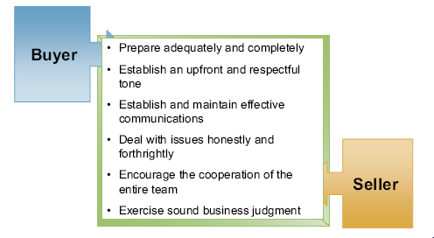
Buyer and Seller Success Factors

Slide 13
When Is It a Good Time to Negotiate??
(Buyer’s Perspective)
When you are making a purchase for a new item.
When the potential rewards in the long run are higher than accepting the original offer.
When you have been giving or expect to give an ever-increasing amount of business to a supplier but are still getting the same high-volume price.
When new untried suppliers are trying to obtain business and are giving you rather attractive bids and your existing supplier is performing very well.

Slide 14
When Is It a Good Time to Negotiate??
(Buyer’s Perspective)
When you are in no hurry to place an order but know you will need the material or service in the future.
When it is a buyers’ market and it has been over a year since you discussed your on-going purchases with an existing supplier.
When the news media reports that prices for the products/services you purchase are doing down but you have received no reduction from your supplier.

Slide 15
When Is It a Good Time to Negotiate??
(Buyer’s Perspective)
When you are well informed about the product, the company you are going to deal with, and know the state of the marketplace.
When the supplier is in a hurry to make an agreement with someone quickly.
When the supplier announces a general increase or a supplier tells you he must increase prices.
When you are trying out a new contract type or contracting procedure that may be unfamiliar to your suppliers.

Slide 16
When Is It a Bad Time to Negotiate??
(Buyer’s Perspective)
When you need the product or service immediately.
When you are in a hurry or have a limited amount of time to spend.
When it is a seller's market and it has been over a year since you discussed your on-going purchases with an existing supplier.
When the news media reports that prices are going up, but you have received no hint of any increase from your supplier.
When you don’t have enough facts.

Slide 17
When Is It a Bad Time to Negotiate??
(Buyer’s Perspective)
When you don’t know the product/service you are buying.
When you don’t know anything about the company you are going to deal with.
When you don’t know conditions in the marketplace.
When you are tired, under stress, or emotionally upset.
When you don’t know the limitations of authority of the people you are dealing with.

Slide 18
When Is It a Bad Time to Negotiate??
(Buyer’s Perspective)
When you don’t know your own authority to make concessions.
When the supplier knows your business is failing, or that your company is near bankruptcy.
When you have not received adequate education and training on negotiation strategy, tactics, and procedures.

Slide 19
When is Negotiation Needed?(Buyer’s Perspective)
The lowest quotation appears to be unreasonable as to price.
The buyer is contracting a large number of items at one time.
The item/service has a high mark-up or profit factor.
The buyer does a large volume of business with the supplier.
There are alternative ways of furnishing the product or service.
The low bidder has taken exception to the specifications or delivery conditions.
There are agreement terms and conditions that buyer and supplier cannot agree to.
The quotation can be made more advantageous to the buyer through negotiation.
The delivery time needs to be improved.

Slide 20
When is Negotiation Needed?
(Buyer’s Perspective)
Whenever the Buyer (and Supplier) wish to arrive at a “QUALITY CONTRACT”.

Slide 21
When is “Negotiation” Or “Bargaining "Used?
BARGAINING?
  An “informal” process, often involving “Haggling” over price.
  NEGOTIATION?
  More “formal” process that occurs when parties are trying to find
  A mutually acceptable solution to a complex conflict.

Slide 22
Characteristics of a “Negotiation "Situation
Intrapersonal, Interpersonal, Intragroup, or Intergroup process
Conflict of Interest between two or more parties
Parties negotiate because they think they can use some form of influence to get a better deal than by simply taking what the other side offers
Parties prefer to search for agreement rather than “fight”
When we negotiate, WE EXPECT GIVE AND TAKE!
Tangibles (price) v. Intangibles (Need to look “good”, desire to “book” more business, save “face”, setting precedent for future, etc.)

Slide 23
What Issues Are Negotiated?
Intangibles may be as or more important than tangibles
Division of tangibles
The substance of the deal
  Rate / price / volume
  Terms: Delivery date, etc.
  Features / quality
  Wording of agreements
  Specific settlements
Resolutions of intangibles
Emotional / psychological factors
  “Winning”
  Beating the other person
  Standing by principles
  Maintaining precedent
  Saving face, looking good to my constituency
  Being fair

Slide 24
Steps in Negotiating Contract
( Buyer's Perspective )
Planning/Preparation
Organization
Fact-finding
Objectives
Pre-Negotiation Review
Negotiation Conference(s)
Documentation

Slide 25
Steps in Negotiating a Contract
(Buyer’s Perspective)
Planning/Preparation
The first step of planning or preparation is probably the most important.
Includes the processes of price and cost analysis, the development of the buyer’s preliminary negotiation position(s) based upon those analyses and planning the strategy and tactics for the impending negotiation conference(s).
One important product of this step is the agenda for negotiation,

Slide 26
Steps in Negotiating a Contract
(Buyer’s Perspective)
Organization
The second step is organizing the buyer’s team and establishing the ground rules to be followed by the various members of the team.
The buyer will generally want his technical representative and his cost person to attend the more complex negotiation sessions.

Slide 27
Steps in Negotiating a Contract
(Buyer’s Perspective)
Fact-Finding
Can be done in two major ways.
1.The best way is to go over the proposal with the supplier team in advance of the negotiation conference in order to understand their problems and approaches and to know where to look in greater depth. Such preliminary discussions are not meant to end in an agreement on anything, since such agreements should be reserved to the negotiation conference.
2.The other way is to use the first part of the negotiation conference for
fact-finding, essentially making the negotiation a two-stage affair.

Slide 28
Steps in Negotiating a Contract
(Buyer’s Perspective)
Objectives
After the facts are known and the issues relating to those facts are resolved, the buyer team must identify those issues which still remain and formulate positions on those issues.
The buyer is reevaluating his/her position prepared in the planning step.
The buyer should think of a range of positions, all the way from the maximum price he/she is willing to pay to the rock bottom position he/she would like to pay assuming everything goes right in the negotiation. Somewhere in the middle would be what the buyer really expects to pay (target or objective position).

Slide 29
Steps in Negotiating a Contract
(Buyer’s Perspective)
Pre-negotiation Review
Most buyers have to seek higher level approval for their negotiation positions.
This higher-level approval will require him/her to document the basis for his positions, including the documentation of the price and/or cost analysis performed.

Slide 30
Steps in Negotiating a Contract
(Buyer’s Perspective)
Negotiation Conferences
In the negotiation conference(s), the buyer team brings to the “table” its planned strategy and tactics as well as its plan for achieving its cost and profit positions.
This lecture covers this process in some detail and from different perspectives.

Slide 31
Steps in Negotiating a Contract
(Buyer’s Perspective)
Documentation
The buyer prepares a negotiation memorandum.
The negotiation memorandum tells the story of the negotiation and justifies the final price and other final agreements to management.

Slide 32
Recommended Format for
Negotiation Memorandum
Summary comparisons reflecting the cost and profit/fee elements according to the in-house estimate, according to the supplier's cost proposal, as a result of the buyer’s pre-negotiation cost and price analysis, and as a result of negotiation.
Discussion of reasons for differences between pre-negotiation and final negotiated positions on all issues negotiated.
Identification of final cost data and the degree to which the data was relied upon.
Identification of supplemental information and data obtained during negotiation and evaluation of the information/data which shows how the information/data supports the price and other terms negotiated.
Attachments should include all documents submitted and used during the negotiation.

Slide 33
The Two Major Negotiation Strategies

Slide 34
Goals-The Objectives That Drive a Negotiation Strategy
Simultaneous Development of Goals & Frames.
Direct Effects of Goals on Choice of Strategy
  Wishes are not goals
  Our goals are often linked to other’s goals
  There are limits/boundaries to what goals can be
  Effective goals must be specific

Slide 35
Strategy-The Overall Plan To Achieve One’s Goals
Strategic Options--Vehicles for Achieving Goals.
Alternative Situational Strategies
Avoidance: The No engagement Strategy
Competition/Dominance/Forcing (Win-Lose)
Collaboration/Integrating (Win-Win)
Compromising
Accommodation/Obliging

Slide 36
Negotiation Goals & Strategy
Negotiation Goals
  Short-term or long-term
  Tangible or intangible issues
  Compatible or incompatible
Negotiation Strategy
  Be Collaborative
    Long-term goals
    Tangibles & intangibles
    Some compatibility of goals
  Be Competitive
    Short-term deal
    Emphasis on tangibles
    Zero-sum game

Slide 37
Strategic Approach to Negotiation:
PLANNING
The Need for Planning--Do your “homework”!
  Defining the Issues
  Assembling Issues & Defining the Bargaining Mix
  Defining your Interests--Why do we “want” it?
  Consulting with Others
    Constituencies
    Other side

Slide 38
Strategic Approach to Negotiation:
PLANNING
The Need for Planning--Do your “homework”!
  Assessing the Other’s Priorities
  Knowing your Limits
  Setting Targets
    Where to start--Optimistic, Realistic, or Pessimistic
    Anticipation of “Packaging” among Issues/Objectives
    Understanding of Trade-Offs and “Throwaways”

Slide 39
Strategic Approach to Negotiation:
PLANNING
The Need for Planning--Do your “homework”!
  Developing Supporting Argument--Research
  Analyzing the Other Party
    Resources, Interests, Needs
    Objectives
    Reputation & Style
    Other Party’s Alternatives
    Other Party’s Authority
    Other Party’s Strategy & Tactics

Slide 40
Strategic Approach to Negotiation:
PLANNING
Step 1: Brainstorm your alternatives
Step 2: Find your Best Alternative to Negotiated Agreement (BATNA)
Step 3: Try to improve your BATNA
Step 4: Determine your Walk-out-Price (W-o-P) Sometimes referred to as Required or Reservation Price (RP)
Step 5: Simulate step 1 to 4 from the other’s perspective
Step 6: Calculate Zone of Possible Agreement (ZOPA)

Slide 41
Develop your BATNA
BATNA: What you will do if the negotiation fails.
It’s the alternative with which you compare any potential deal.
When developing your BATNA:
Invent a wide range of alternatives.
Improve on some of the most promising ones.
Select, tentatively, the best alternative.
Consider the other side’s BATNA

Slide 42
AI and Negotiation Skills
Negotiation Skill | How AI Contributes
Preparation | Analyzes historical negotiations, market prices, and competitors.
Communication | Suggests persuasive language and identifies emotional tone.
Decision making | Evaluates multiple negotiation scenarios and outcomes.
Problem solving | Recommends win-win alternatives based on available data.
Risk assessment | Predicts potential negotiation risks and likely responses.
Cultural awareness | Provides guidance on cross-cultural negotiation practices.

Slide 43
AI and Negotiation Skills
AI and Negotiation Practice
AI changes how negotiations are conducted in real business environments.
Before Negotiation
Market intelligence gathering
Price benchmarking
Supplier evaluation
Contract analysis
BATNA (Best Alternative to a Negotiated Agreement) assessment

Slide 44
AI and Negotiation Skills
During Negotiation
Real-time recommendations
Sentiment and emotion analysis
Speech and language assistance
Automatic note-taking
Live translation for international negotiations
After Negotiation
Contract review
Performance monitoring
Lessons learned analysis
Negotiation outcome evaluation

Slide 45
Summary of Learning Objectives
Understand the meaning of negotiation.
Negotiation” as an executive tool-buyer perspective.
Understanding the different issues of negotiation.
Explaining the key negotiation vocabulary.
Describe the good and bad time for negotiation.
The different steps in negotiation a contract.
Discussing the strategic approach to negotiation.

Slide 46
Essential Reference
Lysons, K., & Farrington, B. (2020). Procurement and supply chain management. Pearson UK.
Chopra, S., & Meindl, P. (2016). Global Edition. Pearson Education Limited.
Morris, P. W., & Pinto, J. K. (Eds.). (2007). The Wiley guide to project technology, supply chain, and procurement management (Vol. 4). John Wiley & Sons.
Schwalbe, K. (2015). Information technology project management. Cengage Learning.
Supply Chain Council

Slide 47

Thank You

