Slide 1

Lecture 3
Leadership Methods & Theories

Slide 2

Last Lecture, we leaned about
Lec.3
Are you a Leader?
How to Be a Leader?
Developing a Vision
Understanding People's Needs
Influencing People
Communication
  Definition
    Elements of Communication

Slide 3
Today’s Lecture we will Know about
Types of Leadership
Methods of leadership
Theories of Leadership
  1. The Great Man Theory
  2. Trait Theories of Leadership
  3. Behavioral Theories of Leadership
  4.Transactional & Transformational Theories
  5.Contingency theory of leadership
  6. Neo-Charismatic Theories
  New Leaders Take Note & Traps
  Leading Effectively: The 70-20-10 Rule
  Self-Assessment
    Do You Have Charismatic Tendencies?
Lec.3

Slide 4
Lec.3
Introduction & Learning Outcomes
Learn about the types, methods, and different theories of leadership, understand its results and apply examples.
Learn about new leaders' advices and traps, and how they can use some rules to lead effectively.

Slide 5

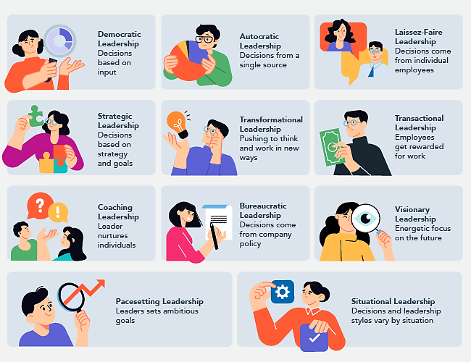
Lec.3
Types of Leadership

Slide 6

Lec.3
Methods of Leadership

Slide 7
Lec.3
Methods of leadership
Pure exercise of power. "My way or the highway." If you don't do what the leader demands, no matter how unreasonable, you're gone. The leader's decisions are not open to question or discussion, and no one else gets to make decisions.
Political scheming. The leader plays people off against one another, creates factions within the organization, cultivates "allies" and isolates "enemies," and builds up (through favors or overlooking poor performance) personal debt which can be cashed in when needed, in order to manipulate people and events as he wishes.

Slide 8
Lec.3
Methods of leadership
Using relationships. The leader develops strong positive relationships with all or most of the people in the organization, and uses these relationships to steer people in particular directions. People do what they're asked because of their relationships with the leader, rather than for reasons connected to the tasks themselves.
Setting an example. The leader may or may not demand or request particular behavior or actions, but the leader will demonstrate them, and expect or imply that others will follow.

Slide 9
Lec.3
Methods of leadership
Persuasion. The leader convinces people through argument, reasoning, selling techniques, or other persuasive methods that what the leader wants is, in fact, the best course, or in line with what they want to do.
Sharing power. Some leaders choose to exercise at least some leadership through the other stakeholders in the organization. In this situation they may give up some personal power in return for what they see as more ownership of decisions, goals, and the organization itself by those involved in the decision-making process.

Slide 10
Lec.3
Methods of leadership
Charisma. Some leaders are charismatic enough to simply pull others along by the power of their personalities alone. They may, in fact, advocate and accomplish wonderful things, but they do it through people's loyalty to and awe of them.
Involving followers in the goal. The leader gets others to buy into the vision for the organization, and to make it their own. The leader may accomplish this through charisma, through the force of the belief in power and rightness of the vision, or through the nature of the vision itself.

Slide 11
Lec.3
Methods of leadership
Various combinations of these and other methods.
  The combination of the leader's and organization's conception of leadership and the leader's way of leading does much to define leadership style. In addition, the characteristics of the leadership are almost always reflected in the relationships within and among the staff, participants, Board, and others related to the organization, as well as in its policies, procedures, and program.

Slide 12
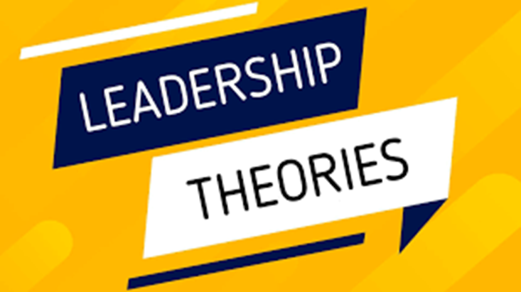
Lec.3

Slide 13
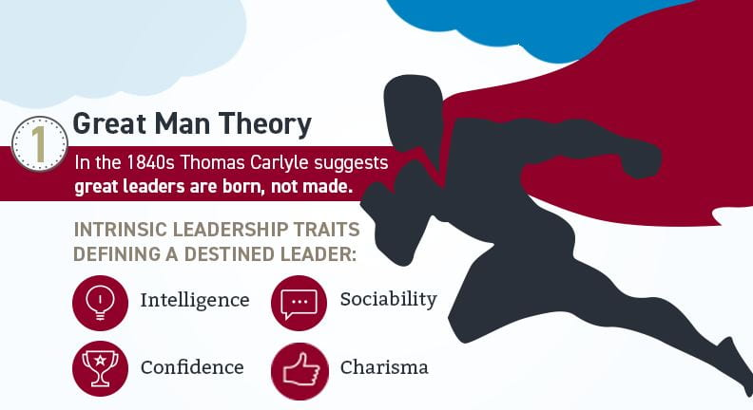
Lec.3
1. The Great Man Theory
One of the first theories on leadership makes the assumption that these qualities are inherent, which indicates that leaders are born, not created, and cannot be learned. This hypothesis asserts that a leader has certain innate human characteristics, such as:
    Glamour
    Decisive
    Wisdom
    Daring
    Assertiveness
    Appeal

Slide 14
Lec.3
1. The Great Man Theory
This viewpoint emphasizes the fact that individuals cannot be taught to be effective leaders. It's a quality that either you have, or you don't. These abilities come naturally; thus, you cannot learn them or receive training in them.
In addition, the idea holds that these leadership qualities are constant over time and apply to all organizations, regardless of the setting in which these leaders are employed. The idea that exceptional leaders emerge when they are required is another tenet of this leadership ideology.

Slide 15
Lec.3
2. Trait Theories of Leadership
Theories that sought personality, social, physical or intellectual traits and differentiated leaders from non-leaders.
Leaders tend to be described as: confident, iron-willed, determined & decisive (Margaret Thatcher, Mandella, Sadat). Whom else??
Other terms used include: Charismatic, Enthusiastic & Courageous
Research failed to show consistent attributes that differentiated LEADERS from NON LEADERS
However, research was successful in identifying traits that were CONSISTENTLY ASSOCIATED WITH LEADERS.

Slide 16
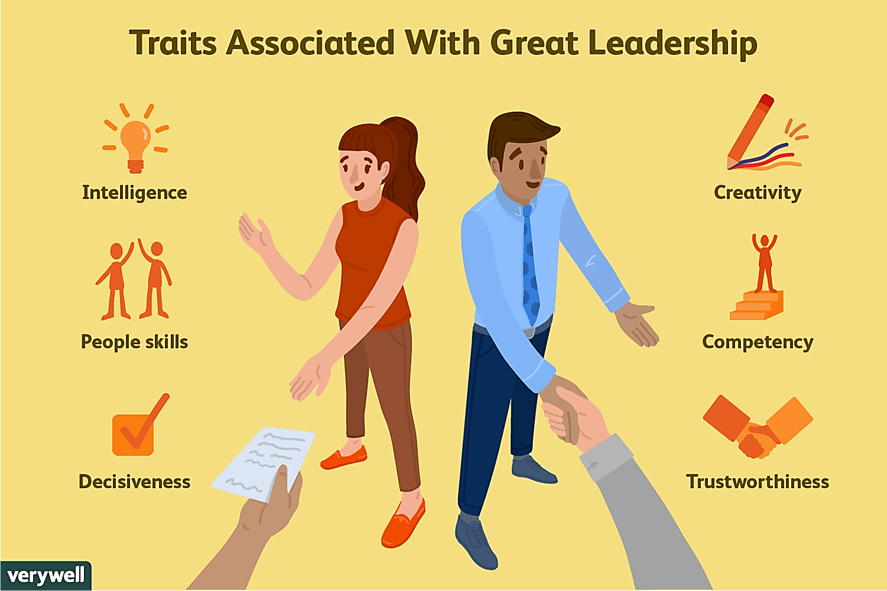
Lec.3
2. Trait Theories of Leadership
6 Traits in which LEADERS Differ from Non-Leaders:
  Ambition & Energy
  The Desire to Lead
  Honesty & Integrity
  Self-Confidence
  Intelligence
  Job-Relevant Knowledge
  High self-monitors (high flexibility in adjusting their behavior in different situations)

Slide 17
Lec.3
2. Trait Theories of Leadership
Personality
  Verbal facility
  Honesty
  Initiative
  Aggressive
  Self-confident
  Ambitious
  Originality
  Sociability
  Adaptability
Intelligence
  More intelligent than non-leaders
  Scholarship
  Knowledge
  Being able to get things done
  Physical
  Doesn‘t seem to be correlated

Slide 18
Lec.3
2. Leadership Traits from the Follower’s Perspective
A somewhat different approach to identifying leadership characteristics was based on the opinions of individuals who were both followers and leaders. This study collected the views of many thousands of individuals from business and government, participating in university executive development programs (Kouzes and Posner, 2002).
When asked ‘What do you look for and admire in your leader?’, there was considerable consensus among these individuals in that they reported that leaders need to be: 1. honest; 2. forward looking; 3. inspiring; 4. competent; 5. fair minded; 6. supportive; 7. broad minded; 8. intelligent.

Slide 19
Lec.3
2. Leadership Traits in Summary
Research into leadership traits has revealed that the more of the traits that individuals possess, the more effective their leadership.
A more practical approach, however, is to recognize that some broad leadership characteristics are relatively central, and although not absolutely required in all cases, will tend to correlate positively with effectiveness in leading others.

Slide 20
Lec.3
3. Behavioral Theories of Leadership
This type of leadership theory focuses on a leader’s actions and behavior, with very little emphasis on their qualities and traits.
According to behavioral leadership theory, an effective leader has many acquired skills. In addition to it, the theory also considers that an individual can learn skills to become a good leader.
So, theories proposing that specific behaviors differentiate leaders from non-leaders.
If so, we could train non-leaders to become leaders.
These theories had some success in identifying consistent relationships between Leadership & Group Performance.

Slide 21
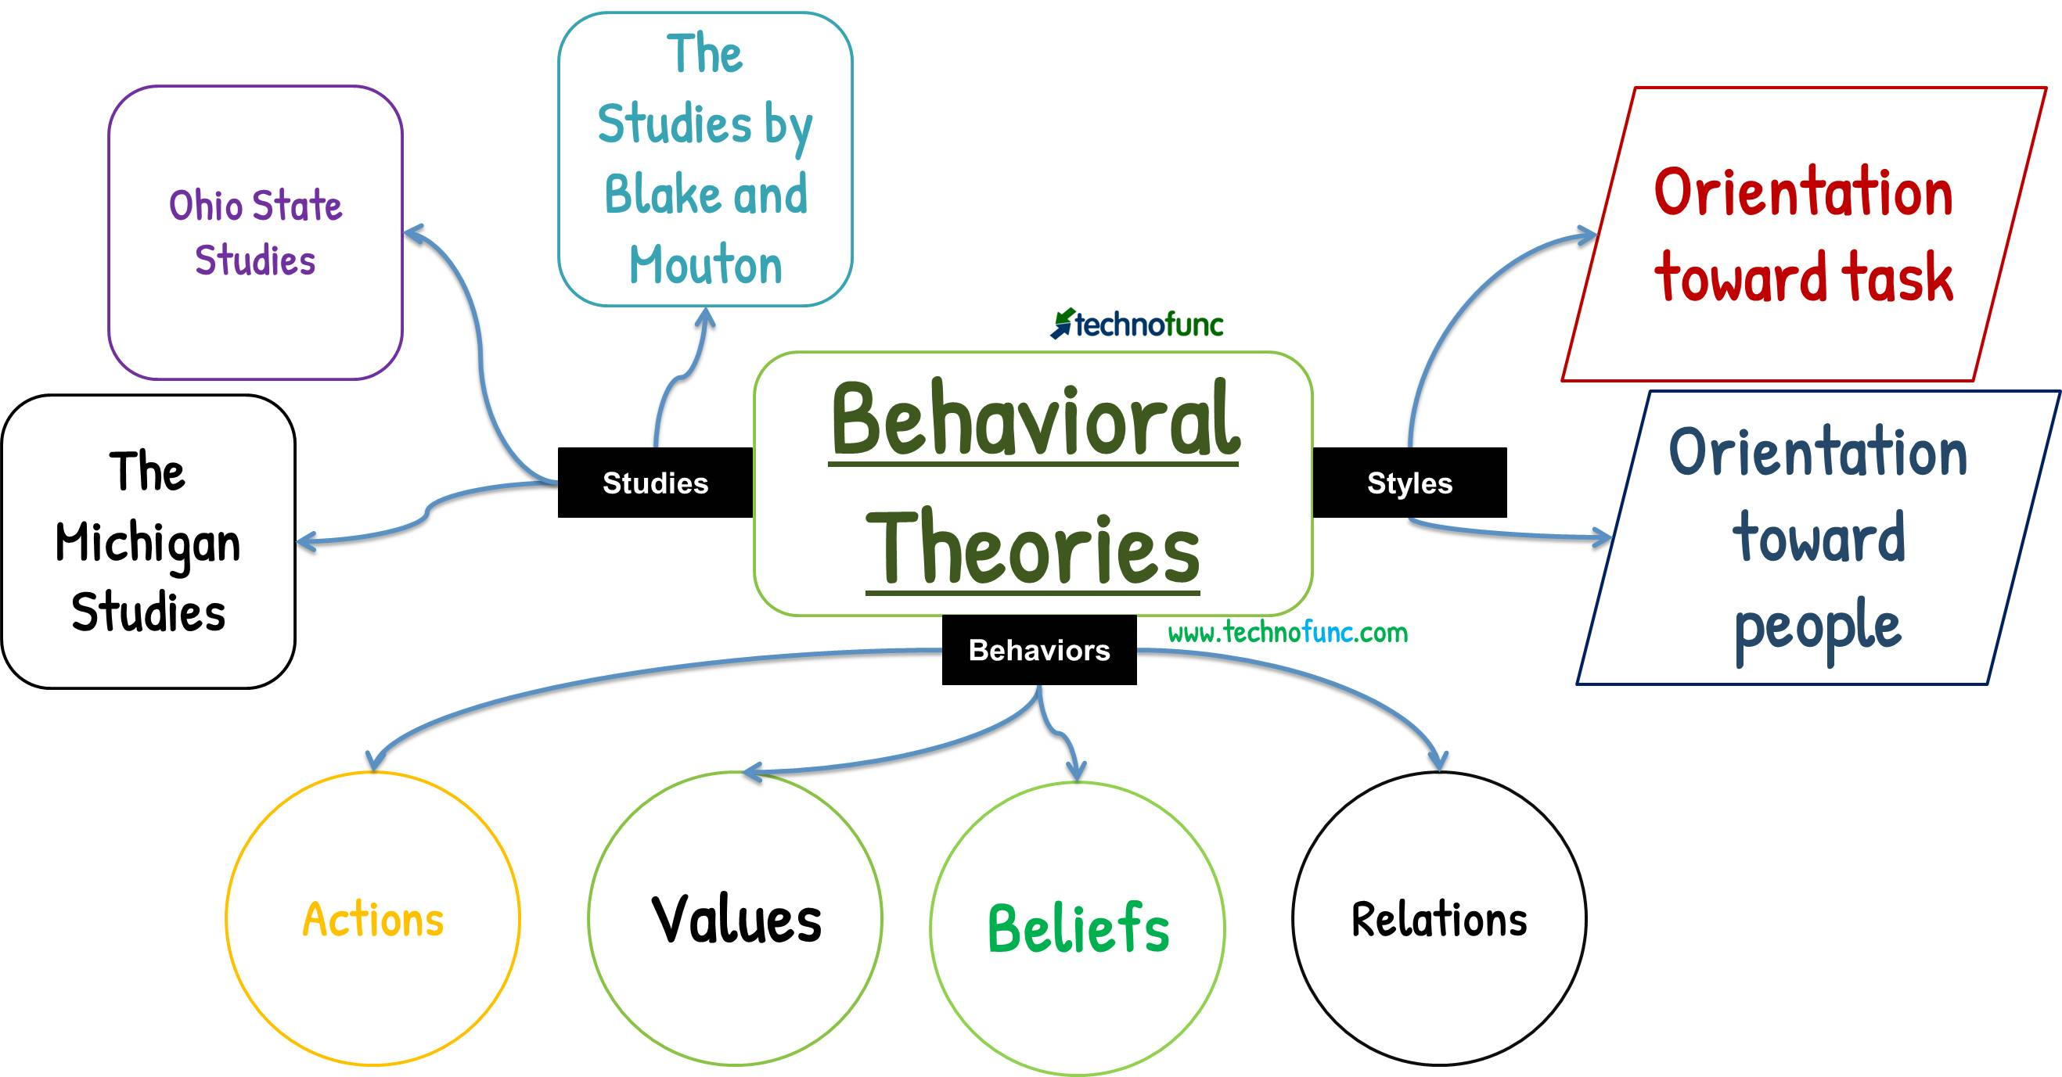
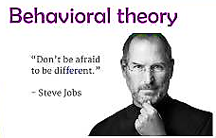

Lec.3
3. Behavioral Theories of Leadership

Slide 22
Lec.3
4.Transactional & Transformational Theories
      A different view, popularized by James MacGregor Burns, contrasts two styles of leadership: transactional and transformational.
Transactional Leader: One who guides or motivates their followers in the direction of established goals by clarifying role and task requirements.
  Transactional leadership views leadership as based on transactions between leader and followers. Thus rewards, punishments, exchanges (economic, emotional, physical) and other such "transactions" are the basis of leadership.
    An organization leads by paying you and telling you what you need to do; you respond by doing what you need to do efficiently and well, and the organization will prosper.

Slide 23
Lec.3
4.Transactional & Transformational Theories
Transformational Leader: One who inspires followers to transcend (go beyond) their own self-interests for the good of the organization, provide personal consideration and intellectual stimulation, and who possess charisma (heroic or extraordinary leadership abilities observed by the followers).
  Transformational leadership sees a true leader as one who can distill the values and hopes and needs of followers into a vision and then encourage and empower followers to pursue that vision.
  A transactional leader thinks of improvement or development as doing the same thing better: an organization that reaches more people, a company that makes more money.
  A transformational leader thinks about changing the world, even if only on a small scale.

Slide 24
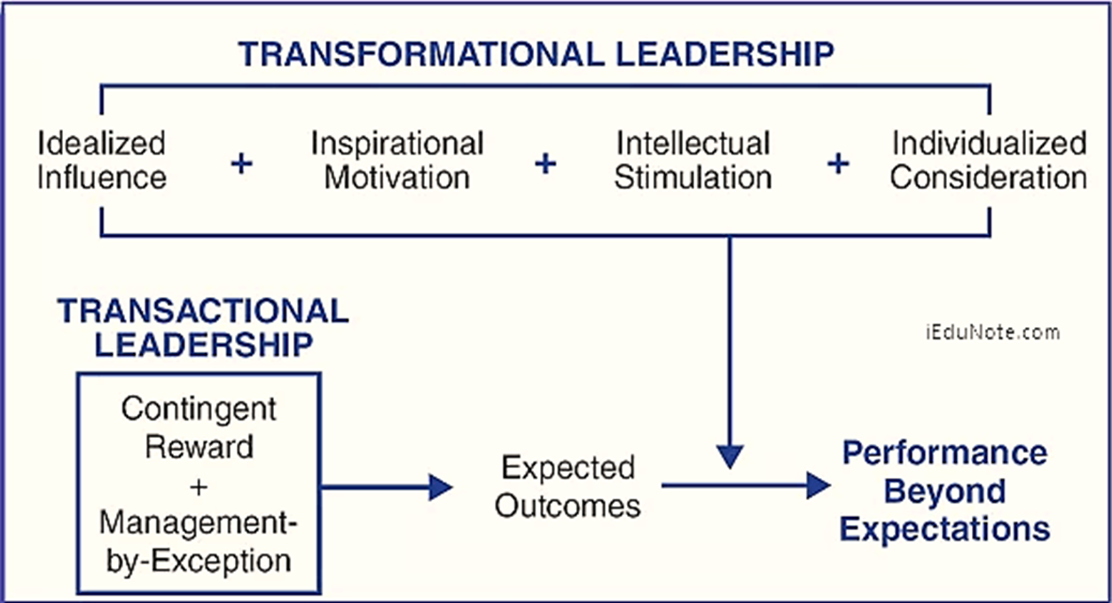
Lec.3
4.Transactional & Transformational Theories

Slide 25
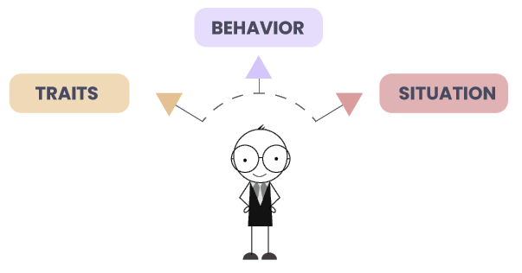
Lec.3
5.Contingency theory of leadership
Often called the situational leadership theory, it is one of the versatile leadership theories that suggest that different leadership styles suit different situations. In these types of leadership theories, leaders must adapt their leadership style depending on their situation, which increases innovation and effectiveness.
The leadership theory helps leaders become versatile and adapt to different situations easily. It makes their transition from one phase to another easy and also gives them the skills and knowledge required to tackle difficult situations.

Slide 26
Lec.3
5.Contingency theory of leadership
According to the contingency hypothesis, there is no one right way to run an organization. Determining the optimal strategy for leading an organization to achieve depends on both internal and external considerations. The right candidate should fit the correct scenario, according to the contingency theory.
The management strategy that will help the organization achieve its objectives in a particular situation is decided by the leader.
According to this view, situations determine whether or not leaders are effective. No matter how successful a leader is, the idea explains, difficult situations will always arise. It emphasizes that the leaders are aware that the conditions in combination with their abilities have a role in their achievement.

Slide 27
Lec.3
5.Contingency theory of leadership
The following elements influence the leadership style, based on contingency theory:
    Management approach
    Work speed
    Organizational policies and culture
    Employee spirit
    Employees' level of maturity
    Relationship between coworkers or members of a team
    Organizational objectives
    Environment and routine at work

Slide 28

Lec.3
5.Contingency theory of leadership
Leadership theories that stress symbolism, emotional appeal and extraordinary follower commitment
They include:
    Charismatic Leadership
    Transformational & Transactional
    Visionary Leadership
Key Characteristics of Charismatic Leaders
Vision & Articulation (expressed as an idealized goal that proposes a better future than status quo & in understandable terms to others)
Personal Risk
Environmental Sensitivity (realistic assessment of environmental constraints & resources to bring about change)
Sensitivity to Follower Needs & Feelings
Unconventional Behavior (novel & counter to norms)

Slide 29
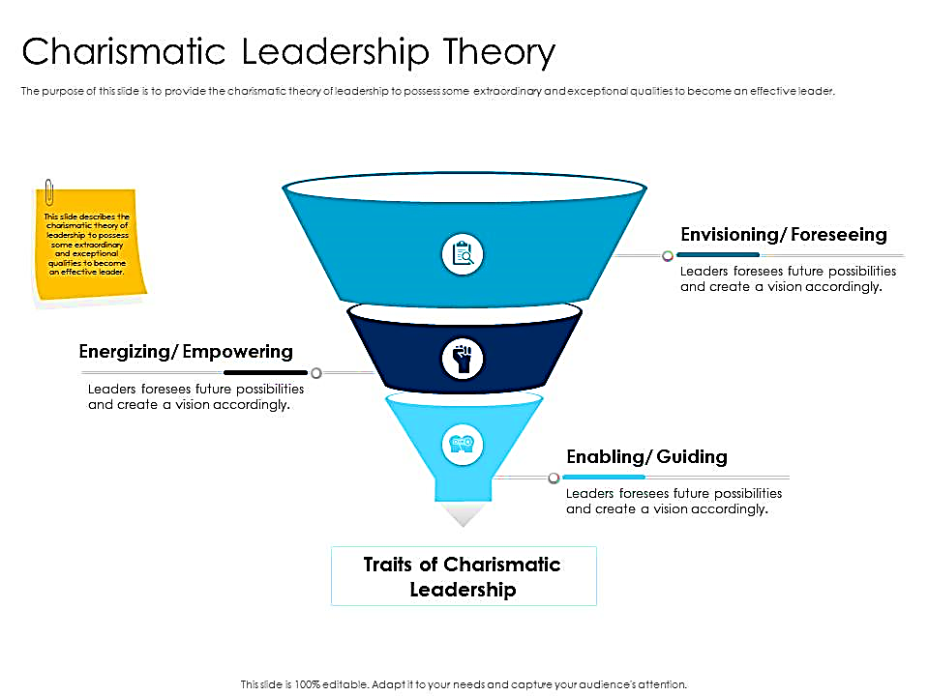
Lec.3
6. Neo-Charismatic Theories
3Es: Envisioning, Energizing, Enabling
“Vision, Passion, and Care”
The Charismatic Leader
Charismatic leaders may affect an organization and the individuals they lead in a strong, positive way.
However, this leadership style can also lead to dangerous situations if used in the wrong manner.
Charismatic leadership is defined by three behavioral dimensions: envisioning (communication about vision), energizing (communication about passion), and enabling (communication about care and support).
1
2
3

Slide 30

Lec.3
6. Neo-Charismatic Theories
The Pros and Cons of Being a Charismatic Leader
Pros
  Extremely motivating and encouraging
  Fosters a sense of friendship, cooperation, and community
  Makes subordinates followers feel noticed and appreciated
  Builds momentum for sustainable change
Cons
Can cause leaders to concentrate on themselves rather than their followers
Can encourage self-centered behaviors
Often seen as superficial or presumptuous

Slide 31
Lec.3
6. Neo-Charismatic Theories
Visionary Leadership
Ability to create and articulate a realistic, credible, attractive vision of the future for an organization or department that grows out of and improves upon the present (status quo).
Visions: are inspirational, value-centered, unique, challenging, but attainable, with superior imagery & articulation, offer a view of the future, fit the times & circumstances and can make an organization ―”stand above the crowd”

Slide 32
Lec.3
6. Neo-Charismatic Theories
Visionary Leadership
Visionary Leaders Have 3 Common Qualities:
  Ability to explain vision
  Express vision thru his/her behavior
  Extend vision to different leadership contexts so as to be applied in different situations, e.g. in various departments of marketing, sales, accounting, HR, and in all geographic locations of the company

Slide 33
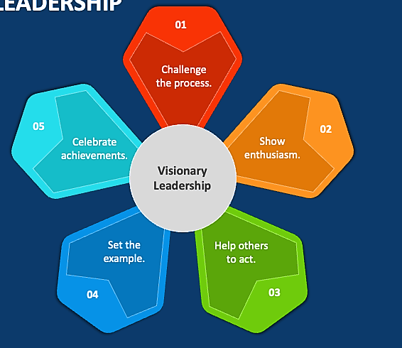
Lec.3
6. Neo-Charismatic Theories
Five Principles Of Visionary Leadership
Challenge the Process - Be a pioneer - encourage innovation and support people with ideas.
Be Enthusiastic - Inspire others through personal enthusiasm to share in a common vision.
Help Others to Act - Be a team player and support the efforts and talents of others.
Set the Example - Provide a consistent role model of how others can and should act.
Celebrate Achievements - Bring emotion into the workplace and rally "hearts" as well as "minds."

Slide 34
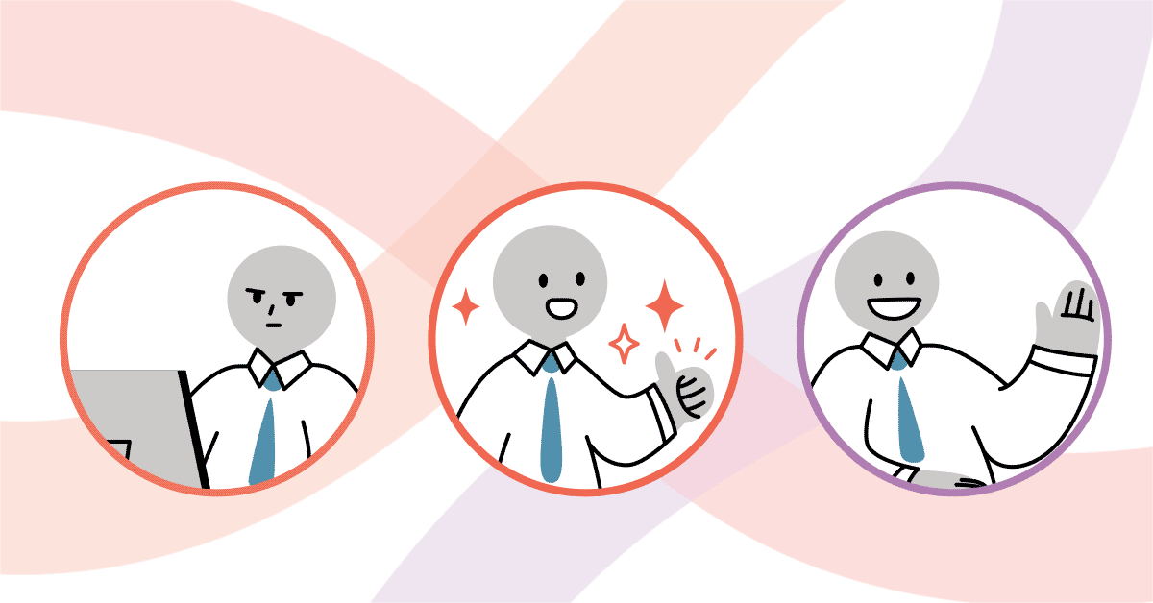
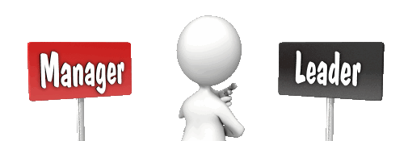
Lec.3
New Leaders

Slide 35

Lec.3
New Leaders Take Note
General Advice
  Take advantage of the transition period
  Get advice and counsel
  Show empathy to predecessor
  Learn leadership
  Challenges
  Need knowledge quickly
  Establish new relationships
  Expectations
  Personal equilibrium

Slide 36
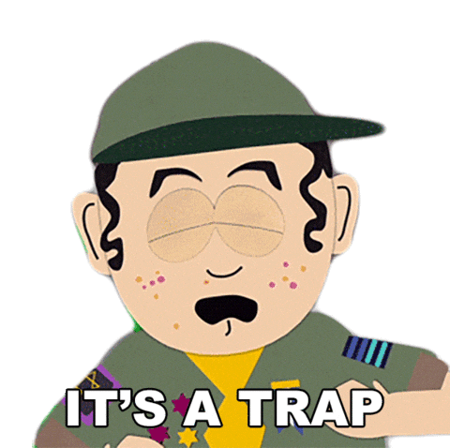
Lec.3
New Leaders Take Note
Not learning quickly
Isolation
Know-it-all
Keeping existing team
Ignoring Potential Problems
Taking the Easy Path
Ignoring Feedback, You Don't Like

Slide 37

Basic Principles
Lec.3
Have 2-3 years to make measurable financial and cultural progress
Come in knowing current strategy, goals, and challenges. Form hypothesis on operating priorities
Balance intense focus on priorities with flexibility on implementation….
Decide about new organization architecture
Build personal credibility and momentum
Earn right to transform entity
Remember there is no ―″one‶ way to manage a transition

Slide 38

Lec.3
Leading Effectively
The 70-20-10 Rule

Slide 39
Leading Effectively
The 70-20-10 Rule for Leadership Development
Lec.3
The 70-20-10 rule emerged from over 30 years of Lessons of Experience research
According to the 70-20-10 rule, leaders learn and grow from 3 types of experience, following a ratio of:
    70% challenging experiences and assignments
    20% developmental relationships
    10% coursework and training
The underlying assumption of the 70-20-10 rule is that leadership can be learned that leaders are made, not born.
A leader’s ability and willingness to learn from experience
is the foundation for leading with impact.

Slide 40
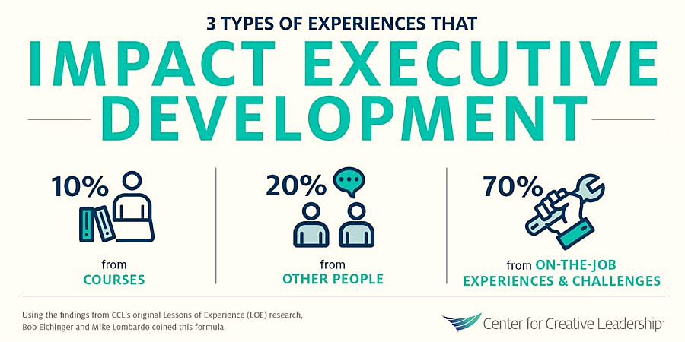
Leading Effectively
The 70-20-10 Rule for Leadership Development
Lec.3
The 70-20-10 rule reveals that individuals tend to learn 70% of their knowledge from challenging experiences and assignments, 20% from developmental relationships, and 10% from coursework and training.
Skilled training specialists can help an organization establish a shared knowledge base and align its members with respect to a common leadership vision and the 70-20-10 rule.

Slide 41

Lec.3
Leadership Self-Assessment
Do You Have Charismatic Tendencies?

Slide 42
Leadership Self-Assessment
Do You Have Charismatic Tendencies?
Lec.3
Instructions: To investigate your charismatic tendencies, answer the questions below. This quiz devised by Prof. Jay Conger, a leadership expert at the USC school of business. If your present situation doesn't apply to the question, imagine how you would react if placed in the situation.

Slide 43
Leadership Self-Assessment
Do You Have Charismatic Tendencies?
Lec.3
Questions
    1. I worry most about
        a. my current competitors.
        b. my future competitors.
    2. I'm most at ease thinking in
        a. generalities
        b. specifics.
    3. I tend to focus on
      a. our missed opportunities.
      b. opportunities we've seized.

Slide 44
Leadership Self-Assessment
Do You Have Charismatic Tendencies?
Lec.3
Questions
    4. I prefer to
        a. promote traditions that made us great.
        b. create new traditions.
    5. I like to communicate an ideas via
        a. a written report.
        b. a one-page chart.
    6. I tend to ask,
        a. "How can we do this better?"
        b. "Why are we doing this?"

Slide 45
Leadership Self-Assessment
Do You Have Charismatic Tendencies?
Lec.3
Questions
    7. I believe
        a. there's always a way to minimize risk.
        b. some risks are too great.
    8. When I disagree with my boss, I typically
        a. coax him/her nicely to alter his/her view.
        b. bluntly tell him/her, "You're wrong."
    9. I tend to sway people by using
        a. emotion.
        b. logic.
        10. I think this quiz is
        a. ridiculous.
        b. fascinating.

Slide 46
Leadership Self-Assessment
Do You Have Charismatic Tendencies?
Lec.3
10 Questions
Scoring and interpretation:
Answers:
1. b; 2. a; 3. a; 4. b; 5. b;
6. b, 7. a; 8. b; 9. a; 10. b
If you responded this way to 4 or fewer questions, you probably don't have much charisma.
7 or more? You ooze it!

Slide 47
Conclusion
We learned about
Types of Leadership
Methods of leadership
Theories of Leadership
  1. The Great Man Theory
  2. Trait Theories of Leadership
  3. Behavioral Theories of Leadership
  4.Transactional & Transformational Theories
  5.Contingency theory of leadership
  6. Neo-Charismatic Theories
  New Leaders Take Note & Traps
  Leading Effectively: The 70-20-10 Rule
  Self-Assessment
    Do You Have Charismatic Tendencies?
Lec.3

Slide 48


Lec.3
References
Bli-Group-Wp. (2011). Leadership Course material. Amideast Egypt. Business Intelligence, Training & Consulting, http://bli-group.com/
Jaiswal, S. (2022, November 30). Leadership theories for every manager in 2022: Leadership: Emeritus India. Emeritus. Retrieved February 11, 2023, from https://emeritus.org/in/learn/leadership-theories-for-every-manager-in-2022/
Simplilearn. (2023, January 18). 10 major leadership theories every manager should master in 2023. Simplilearn.com. Retrieved February 11, 2023, from https://www.simplilearn.com/top-leadership-theories-every-manager-should-know-article
Carter, L. (2022, August 11). Charismatic leadership is the most powerful way to lead. louiscarter.com. Retrieved February 15, 2023, from https://louiscarter.com/charismatic-leadership-style/
Rita Men, L., April Yue, C., & Liu, Y. (2020, May). ‘Vision, Passion, and Care:’ The Impact of Charismatic Executive Leadership Communication on Employee Trust and Support for Organizational Change. UF College of Journalism and Communications. Retrieved February 15, 2023, from https://www.jou.ufl.edu/insights/vision-passion-and-care-the-impact-of-charismatic-executive-leadership-communication-on-employee-trust-and-support-for-organizational-change/
Robbins, S. P., Coulter, M. K., & DeCenzo, D. A. (2011, August). Fundamentals of Management . Fundamentals Of
Leading. Retrieved February 15, 2023, from https://arslanhelpyoucom.files.wordpress.com/2016/05/ch-02-management-functions.ppt

Slide 49



Thank You

