Slide 1



Influence and Negotiation Skills
Introduction to Influence & Negotiation skills
Prepared by:
Dr. Bothaina Mahmoud Fouad
College of
Entrepreneurship and Innovation
Code: ENT623
Lecture 1

Slide 2

Lec. 1 Overview
The main points:
To share some defining and key concepts of negotiation and influencing
To highlight some different between negotiation and influencing skills
To have awareness about the importance of these skills.

Slide 3
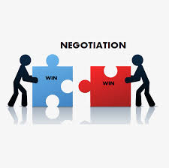
Everyone negotiates on a daily basis (Samina & Vinta, 2010, p. 26)

Slide 4
Personal lives;
Who makes dinner, who drinks/drives, holiday destinations…
At work;
employees in organisations negotiate and influence vertically & horizontally with colleagues, partners, customers, clients and internal teams.
Negotiation and Influencing are skills, not a profession we can learn it through experience and training.
Vital personally and for organizations

Slide 5

Influencing skills are your abilities to encourage and persuade others to adopt your ideas.
The skill to influence others can be beneficial for leaders to motivate people and make their teams more productive.

Slide 6
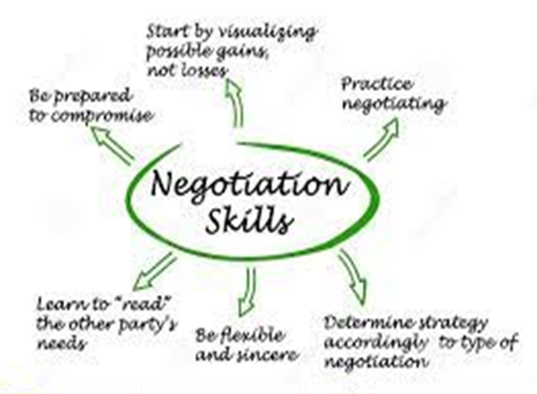
Negotiation skills are inherent qualities that help two or more parties agree to a common logical solution.
Other definition:
is a process of communication in which the parties aim to send a message to the other side and influence each other.

Slide 7
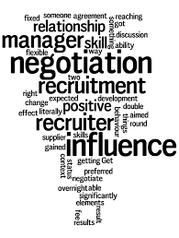
What is the relationship between influence and negotiation?
Negotiation is the act of coming to a mutual agreement
influence occurs when an individual has an effect on his or her opponent during the act of negotiation

Slide 8
Common elements of Negotiation and Influencing
More than one party is involved
Both parties have shared interests (they are therefore committed to an extent) but there are also opposed interests
The parties are prepared to be flexible
Participants have the ability and authority to make decisions

Slide 9
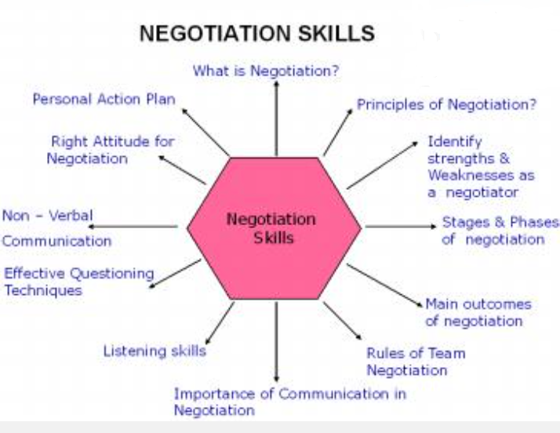
Negotiating Skills

Slide 10
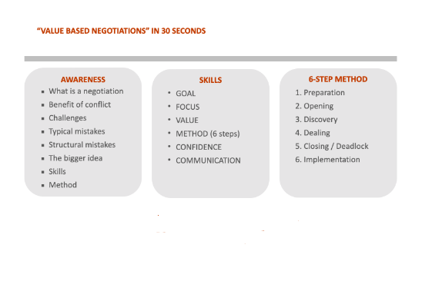

Slide 11
Why many people avoid even fear negotiation??
Because they may lack the simple skills, techniques, and experience to prepare and succeed at negotiation

Slide 12
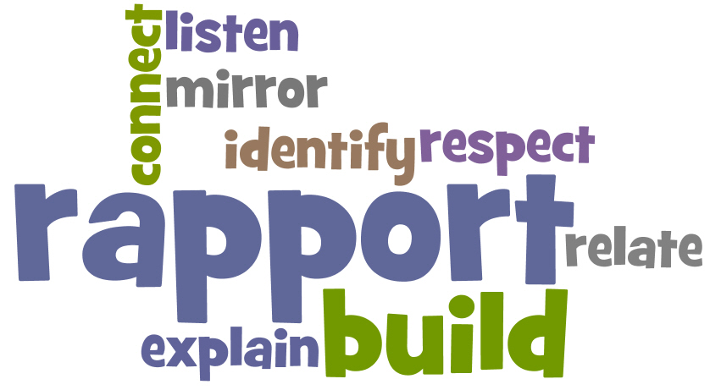
  ‘Always get to know the other party. Never negotiate with a stranger.’

Slide 13

How important a skill is negotiation??
Negotiation Is the pre- eminent form of decision making in personal and professional life
William Ury
one of the world's best-known experts on negotiation and mediation
co-founder of Harvard's Program on Negotiation

Slide 14

the importance of negotiation in entrepreneurship?
Negotiating effectively can give clients, employees and employers a positive impression rooted in respect. By dealing with problems fairly, forming strong bonds with clients and securing mutually beneficial deals, more people will want to work with you because of your ability and value your insights.

Slide 15
Important aspects of negotiations
Is everywhere
Is a process
Entails a relationships
Various ways with their own risks and rewards
To do or not do something has value for us

Slide 16
Some Basic assumptions we need to keep in mind
We can try to negotiate everything
Negotiation is a skill
Negotiation is not a magic pill
There is no “ best “ way to negotiate
It depends on strategy and implementation

Slide 17
The common elements in negotiation situations
Two or more parties
Ability of decision making
Common elements
Independence
Common goals
flexibility

Slide 18
Basic types of negotiation ( 3Ds)
Deal Making
Purchase of something ( new home, new car…etc)
Decision Making
Parties in a zoning case
Dispute resolution
Litigation over property rights
While the three have subtle differences, all are forms of negotiations

Slide 19
One of the most important tips to be effective negotiators
Before you first meet parties with whom you are negotiating, take time to gather pertinent information.
Focus on all dimensions: people, problem, and process — for your side and the other side. (See the chart “Preparing for the 3 Dimensions,” below, for details.)
Preparation for the 3 Dimensions
https://www.fm-magazine.com/news/2022/oct/negotiation-skills-finance-leaders.html

Slide 20
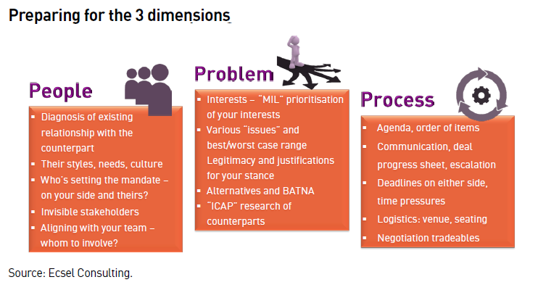

Slide 21
Advantages of Negotiation
Finding mutually beneficial solutions
Negotiation can help parties find solutions that benefit everyone involved, leading to more harmonious relationships and improved outcomes
Enhancing communication skills
Through negotiation, individuals can improve their communication skills, including active listening, persuasion, and conflict resolution.
Resolving conflicts:
Negotiation can help resolve disputes by finding common ground and reducing tension between parties.
Successful negotiation can establish strong relationships built on trust, respect, and mutual understanding.
Building relationships
https://www.risely.me/understanding-persuasion-and-negotiation/

Slide 22
Disadvantages of Negotiation
Time-consuming
Negotiation can be a time-consuming process, as it requires both parties to communicate effectively, listen to each other, and find common ground.
Risk of failure
Negotiation can fail if parties cannot find common ground or if one party is unwilling to compromise, leading to a breakdown in communication and further conflicts.
Power imbalance
Negotiation can be unfair if one party holds more power than the other, leading to an unequal outcome that favors the stronger party.
Negotiation can be emotionally stressful, especially if parties have a history of conflict or if the negotiation involves high-stakes decisions
Emotional stress
https://www.risely.me/understanding-persuasion-and-negotiation/

Slide 23
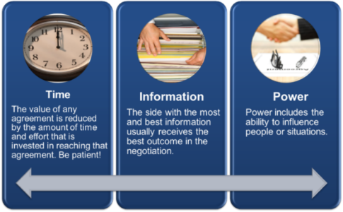
3 Key elements for Negotiation
There are three critical elements in any negotiation:
Time,
Information
Power.

Slide 24
1. Time
We often focus on getting through negotiation and to win our position in the quickest way possible. However, the value of any negotiated agreement is reduced by the amount of time and effort that is invested in reaching that agreement. Be patient!

Slide 25
2. Information
The most successful negotiation takes prep work. The side with the most and best information usually receives the best outcome in the negotiation

Slide 26
3. Power
Power includes the ability to influence people or situations. Without our ability to influence, our negotiation will not be successful. Research suggests that there are generally five to seven types of power: Positional power, reward power, coercive power, referent power, informational power, expert power, and personal power. We often must use our own personal power to influence the other parties in negotiation

Slide 27
What is the role of the negotiator
A negotiator is a person who either comes to an agreement with someone else, or one who helps other people reach such an agreement. When two people cannot see eye to eye, it's time to bring in a negotiator. When two businesses are merging, they can use the help of a negotiator to work out details of the plan.

Slide 28
Differences between negotiators
Interests
Judgments about the future
Risk tolerance
Time preferences

Slide 29
1. Differences in interests
Negotiators seldom value all items in the negotiation equally
Eg; An employer may prefer a bonus on sales knowing the cost will only last while an employee works in sales.
An employee may prefer a higher starting salary as it would be fixed.
Which would you prefer?

Slide 30
2. Differences in judgments about the future
Is a run down property in a great area an investment
or
a potential drain on hard earned money?

Slide 31
3.Differences in risk tolerance
A young family with two children is less likely to risk taking on a large loan than double income baby boomers with adult offspring who no longer live at home

Slide 32
4.Differences in time preference
A sales person may want to make the sale to receive an end of the month bonus but a buyer may be thinking of upgrading a TV sometime in the next 6 months.

Slide 33
Case Study and role model

Slide 34
أشهر عملية تفاوض في التاريخ
صلح الحديبية

Slide 35
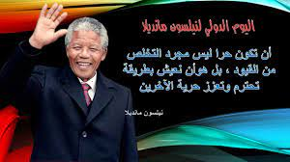
Nelson Mandela will certainly be remembered as one of the best negotiators in history. And the greatest negotiator of the twentieth century
Robert H. Mnookin
Harvard Law School professor and Program on Negotiation Chairman
In his Book “ Bargaining with the Devil, When to Negotiate, When to Fight ”

Slide 36
Qualities of Nelson Mandela as an Extraordinary Leader
He was a man of peace.
He had a powerful presence and disarmed enemies with his smile.
He showed the world what forgiveness looks like.
He was positive, thinking about what could be.
He was a visionary and could see the big picture.
He was focused on goals and a mission beyond himself.
He had remarkable endurance.
He showed grit and determination.
He was humble.
He was full of hope, not hate.
He was patient.
https://www.skipprichard.com/11-leadership-qualities-of-nelson-mandela/

Slide 37
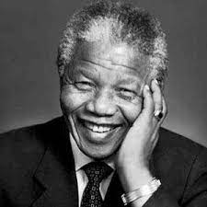
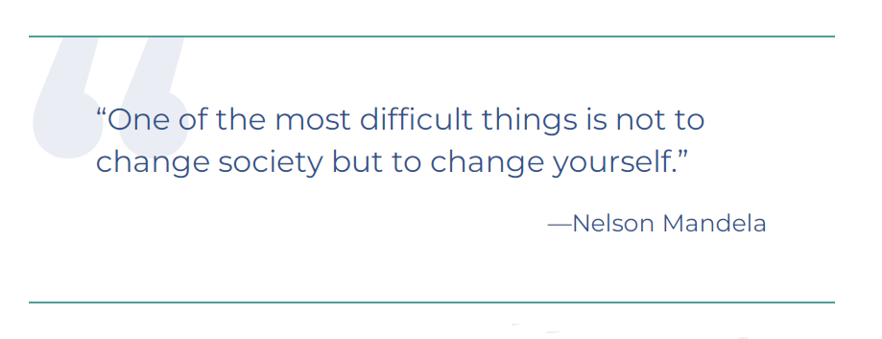
Mandela’s Quotes
"ليس أفضل من أن تكون ذلك القائد الذي يقف في الخلف ويضع الآخرين في المقدمة وقت الاحتفال بالانتصار، بينما تقفز لأول الصف وقت الخطر".

Slide 38

2. The Microsoft-Nokia Deal
Microsoft made the surprising announcement that it was purchasing Finnish mobile handset maker Nokia for $7.2 billion, a merger aimed at building Microsoft’s mobile and smartphone offerings.
the merger between the two companies (two different identities) faced even more complexity in negotiation.
You can watch: https://prezi.com/a9mu0bsscf4n/nokia-microsoft-case-study/

Slide 39
Conclusion of Lec.1
increasing your awareness of what negotiations are and its benefits

Slide 40
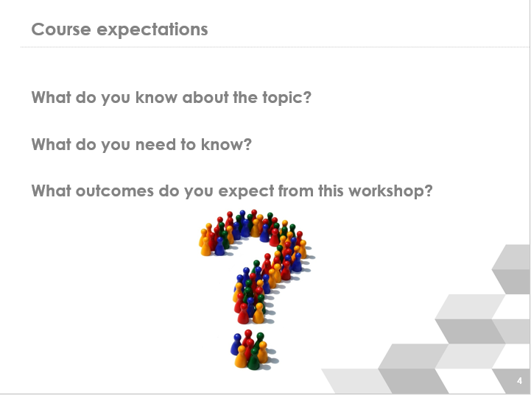

Slide 41



Thank You

