Slide 1


Managing People and Organizations
Prepared by Dr. Usama Al-Fendi
MGM603
Managing People and Organizations
Lecture 7

Slide 2

Lecture
Outcomes of the chapter:
7
After studying this chapter, you should be able to:
Identify and describe different approaches to job design and relate each to motivation.
Discuss employee participation, empowerment, and flexible work arrangements and identify how they can impact motivation.
Describe the goal-setting theory of motivation and discuss broader perspectives on goal setting.
Discuss performance management and its role in motivation.
Describe how organizations use various kinds of rewards to motivate employees.

Slide 3
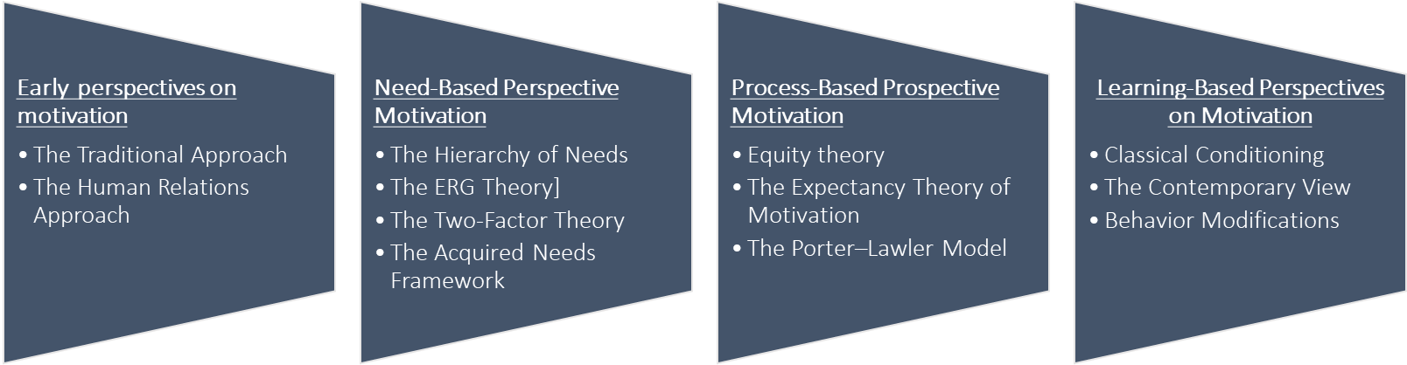
Lecture
Motivating Behavior with Work and Rewards
7
Chapter 5 summery:
Chapter 5 introduced the following :
Nature of motivation , The importance of motivations, and motivation framework.
Different types of perspective motivations as following :

Slide 4
Lecture
Motivating Behavior with Work and Rewards
7
Real-World Challenge
Orchestrating Outcomes:
Reviewing a concert by the Orpheus Chamber Orchestra, New York Times music critic Vivien Schweitzer wrote that the orchestra played Robert Schumann’s Symphony No. 2 “with remarkable coordination”;

Slide 5
Lecture
Motivating Behavior with Work and Rewards
7
”; the “balance among strings, winds, and brass,” she added, “was impressively well proportioned.” Was Schweitzer, as we sometimes say, damning with faint praise? Isn’t a symphony, which means “harmony of sounds,” supposed to be played with remarkable coordination? Aren’t the various sections of the orchestra supposed to be well balanced? Had the conductor, whose job is to ensure a consummate performance of the music, achieved little more than coordination and balance? Actually, New York-based Orpheus doesn’t play with a conductor, and Schweitzer was remarking on the fact that the orchestra had “bravely—and successfully—attempted” such a complex work without the artistic and managerial leadership of someone who directs rehearsals and stands at a podium waiving an authoritative baton.

Slide 6
Lecture
Motivating Behavior with Work and Rewards
7
Real-World Challenge
Orchestrating Outcomes:
Orpheus holds to the principle that its product—the music performed for audiences—is of the highest quality when its workers—the musicians—are highly satisfied with their jobs. All professional orchestra musicians, of course, are highly trained and skilled, but make no mistake about it: A lot of them are not very happy workers.

Slide 7
Lecture
Motivating Behavior with Work and Rewards
7
Real-World Challenge
Orchestrating Outcomes:
An organizational psychologist at Harvard surveyed workers in thirteen different occupational categories, including orchestra players, to determine relative levels of job motivation and satisfaction. On the one hand, musicians ranked at the top in motivation, “fueled by their own pride and professionalism,” according to this study. But when it came to general satisfaction with their jobs, orchestra players ranked seventh (just below federal prison guards and slightly above beer sales and delivery teams).

Slide 8
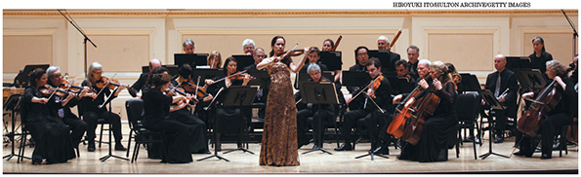
Lecture
Motivating Behavior with Work and Rewards
7
Real-World Challenge
Orchestrating Outcomes:

Slide 9
Lecture
Motivating Behavior with Work and Rewards
7
Sequence of Chapter 6:
Chapter 5 described a variety of perspectives on motivation, a manager might still need to translate that theory into operational terms.
managers may need to take certain steps to translate the potential for motivation directed at enhanced performance into real motivation and enhanced performance.
Chapter 6 presents the more common methods used to enhance performance.
The chapter covers six methods: job design, employee participation and empowerment, flexible work arrangements, goal setting, performance management, and organizational rewards.

Slide 10
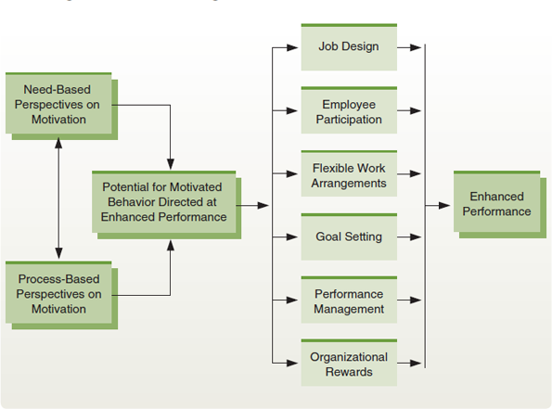
Lecture
Motivating Behavior with Work and Rewards
7
Figure 6.1 Enhancing Performance in Organizations
Managers can use a variety of methods to enhance performance in organizations. The need- and process- based perspectives on motivation explain some of the factors involved in increasing the potential for motivated behavior directed at enhanced performance. Managers can then use such means as goal setting, job design, flexible work arrangements, performance management, rewards, and organizational behavior motivation to help translate this potential into actual enhanced performance.

Slide 11
Lecture
Motivating Behavior with Work and Rewards
7
1. Job Design in Organizations:
Job Design: | Defined as How organizations define and structure jobs When work design is addressed at the individual level, it is most commonly referred to as job design The first widespread model of how individual work should be designed was job specialization. For example, a worker who applies safety decals to a piece of equipment as that equipment moves down an assembly line is performing a specialized job.

Slide 12
Lecture
Motivating Behavior with Work and Rewards
7
1. Job Design in Organizations: (job specialization)
Job specialization: | Breaking jobs down into small component tasks and standardizing them across all workers doing those jobs Frederick Taylor, the chief proponent of job specialization, argued that jobs should be scientifically studied, broken down into small component tasks, and then standardized across all workers doing those jobs Taylor’s view grew from the historical writings about division of labor advocated by Scottish economist Adam Smith. Specialization paved the way for large-scale assembly lines and was at least partly responsible for the dramatic gains in output U.S. industry achieved for several decades in the early 1900s.

Slide 13
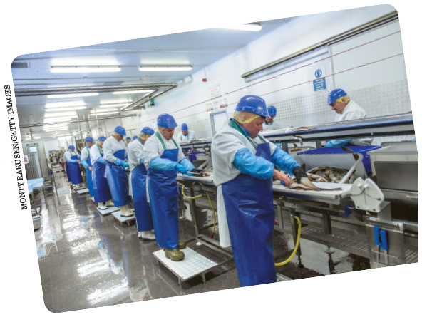
Lecture
Motivating Behavior with Work and Rewards
7
1. Job Design in Organizations: (job specialization)
Job specialization involves carefully studying jobs, breaking those jobs down into small component tasks, and then standardizing how those tasks should be performed across all workers performing the jobs. These workers are following standard procedures in how they perform their specialized jobs.

Slide 14
Lecture
Motivating Behavior with Work and Rewards
7
1. Job Design in Organizations: (job specialization)
Job specialization: | On the surface, job specialization appears to be a rational and efficient way to structure jobs. The jobs in many factories, for instance, are highly specialized and are often designed to maximize productivity. In practice, however, performing those jobs can cause problems, foremost among them the extreme monotony of highly specialized tasks.

Slide 15
Lecture
Motivating Behavior with Work and Rewards
7
1. Job Design in Organizations: (job specialization)
Job specialization: | Ex. Consider the job of assembling toasters. A person who does the entire assembly may find the job complex and challenging, albeit inefficient. If the job is specialized so that the worker simply inserts a heating coil into the toaster as it passes along on an assembly line, the process may be efficient, but it is unlikely to interest or challenge the worker. may be less motivated to work hard and more inclined to do poor-quality work or to complain about the job.

Slide 16
Lecture
Motivating Behavior with Work and Rewards
7
1. Job Design in Organizations: (job Rotations)
Basic Alternatives to Job Specialization
Job Rotations: | Systematically moving workers from one job to another in an attempt to minimize monotony and boredom When job rotation is introduced, the tasks themselves stay the same. However, the workers who perform them are systematically rotated across the various tasks. if a rotation cycle takes workers through the same old jobs, the workers simply experience several routine and boring jobs instead of just one. Although a worker may begin each job shift with a bit of renewed interest, the effect usually is short-lived. Rotation may also decrease efficiency.

Slide 17
Lecture
Motivating Behavior with Work and Rewards
7
1. Job Design in Organizations: (job Rotations)
Basic Alternatives to Job Specialization
Job Rotations: | For example, it sacrifices the proficiency and expertise that grow from specialization. At the same time, job rotation is an effective training technique because a worker rotated through a variety of related jobs acquires a larger set of job skills.

Slide 18

Lecture
Motivating Behavior with Work and Rewards
7
1. Job Design in Organizations: (job Rotations)
Basic Alternatives to Job Specialization
Job rotation involves systematically shifting workers from one job to another. While job rotation was intended to sustain motivation and interest, it really does little to address the problems of monotony and boredom created by job specialization. The TSA rotates airport screeners regularly, in an effort to keep them focused on their jobs.

Slide 19
Lecture
Motivating Behavior with Work and Rewards
7
1. Job Design in Organizations: (Job Enrichment)
Basic Alternatives to Job Specialization
Job Enrichment: | Entails giving workers more tasks to perform and more control over how to perform them Job enrichment is based on the two-factor theory of motivation, That theory contends that employees can be motivated by positive job-related experiences such as feelings of achievement, responsibility, and recognition. To achieve these, job enrichment relies on vertical job loading—not only adding more tasks to a job, as in horizontal loading, but also giving the employee more control over those tasks

Slide 20
Lecture
Motivating Behavior with Work and Rewards
7
1. Job Design in Organizations: (Job Enrichment)
Basic Alternatives to Job Specialization
 | For example; AT&T utilized job enrichment in a group of eight people who were responsible for preparing service orders. Managers believed turnover in the group was too high and performance too low. Analysis revealed several deficiencies in the work. The group worked in relative isolation, and any service representative could ask them to prepare work orders. As a result, they had little client contact or responsibility, and they received scant feedback on their job performance. The job enrichment program focused on creating a process team.

Slide 21
Lecture
Motivating Behavior with Work and Rewards
7
1. Job Design in Organizations: (Job Enrichment)
Basic Alternatives to Job Specialization
 | Each member of the team was paired with a service representative, and the tasks were restructured: Ten discrete steps were replaced with three more complex ones. In addition, the group members began to get specific feedback on performance, and their job titles were changed to reflect their greater responsibility and status. Because of these changes, the number of orders delivered on time increased from 27 percent to 90 percent, accuracy improved, and turnover decreased significantly.

Slide 22

Lecture
Motivating Behavior with Work and Rewards
7
1. Job Design in Organizations: (Job Enrichment)
Basic Alternatives to Job Specialization
Job enrichment involves both giving workers more tasks to perform and more control over how to perform them. This clothing designer, for example, gets to select fabrics, develop new designs, and then tailor the designs into new clothing.

Slide 23
Lecture
Motivating Behavior with Work and Rewards
7
1. Job Design in Organizations: (Job Enrichment)
Basic Alternatives to Job Specialization
 | At the same time, we should note that many job enrichment programs have failed. Some companies have found job enrichment to be cost ineffective, and others believe that it simply did not produce the expected results Ex. Several programs at Prudential Insurance, for example, were abandoned because managers believed they were benefiting neither employees nor the firm.

Slide 24
Lecture
Motivating Behavior with Work and Rewards
7
1. Job Design in Organizations: (Job Enrichment)
Basic Alternatives to Job Specialization
 | Some of the criticism is associated with flaws in the two-factor theory of motivation on which job enrichment is based. Because of these and other problems, job enrichment is not as popular as it was a few years ago. The efforts of managers and academic theorists ultimately have led to more complex and sophisticated viewpoints. Many of these advances are evident in the job characteristics theory,

Slide 25
Lecture
Motivating Behavior with Work and Rewards
7
1. Job Design in Organizations: (Job Characteristics Theory)
Job Characteristics Theory | The job characteristics theory focuses on the specific motivational properties of jobs. Uses five motivational properties of tasks and three critical psychological states to improve outcomes was developed by Hackman and Oldham The three critical psychological states are:

Slide 26
Lecture
Motivating Behavior with Work and Rewards
7
1. Job Design in Organizations: (Job Characteristics Theory)
Job Characteristics Theory | Experienced meaningfulness of the work: the degree to which the individual experiences the job as generally meaningful, valuable, and worthwhile Experienced responsibility for work outcomes: the degree to which individuals feel personally accountable and responsible for the results of their work Knowledge of results: the degree to which individuals continuously understand how effectively they are performing the job environment.

Slide 27
Lecture
Motivating Behavior with Work and Rewards
7
1. Job Design in Organizations: (Job Characteristics Theory)
Job Characteristics Theory | Hackman and Oldham suggest that the three critical psychological states are triggered by the following five characteristics of the job, or core job dimensions: Skill variety: the degree to which the job requires a variety of activities that involve different skills and talents Task identity: the degree to which the job requires completion of a “whole” and an identifiable piece of work; that is, the extent to which a job has a beginning and an end with a tangible outcome

Slide 28
Lecture
Motivating Behavior with Work and Rewards
7
1. Job Design in Organizations: (Job Characteristics Theory)
Job Characteristics Theory | 3 . Task significance: the degree to which the job affects the lives or work of other people, both in the immediate organization and in the external environment 4. Autonomy: the degree to which the job allows the individual substantial freedom, independence, and discretion to schedule the work and determine the procedures for carrying it out 5. Feedback: the degree to which the job activities give the individual direct and clear information about the effectiveness of his or her performance

Slide 29
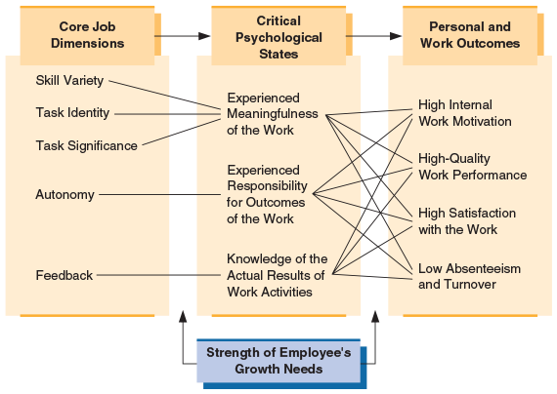
Lecture
Motivating Behavior with Work and Rewards
7
1. Job Design in Organizations: (Job Characteristics Theory)
The Job Characteristics Theory
The job characteristics theory is an important contemporary model of how to design jobs. By using five core job characteristics, managers can enhance three critical psychological states. These states, in turn, can improve a variety of personal and work outcomes. Individual differences also affect how the job characteristics affect people.

Slide 30
Lecture
Motivating Behavior with Work and Rewards
7
2. Employee Participation and Empowerment
Participation: Empowerment: | Participations defined as; Entails giving employees a voice in making decisions about their own work Empowerment is the process of enabling workers to set their own work goals, make decisions, and solve problems within their sphere of responsibility and authority

Slide 31
Lecture
Motivating Behavior with Work and Rewards
7
2. Employee Participation and Empowerment
 | Thus, empowerment is a somewhat broader concept that promotes participation in a wide variety of areas, including but not limited to work itself, work context, and work environment The role of participation and empowerment in motivation can be expressed in terms of both the need-based perspectives and the expectancy theory discussed in Chapter 5. Employees who participate in decision making may be more committed to executing decisions properly.

Slide 32
Lecture
Motivating Behavior with Work and Rewards
7
2. Employee Participation and Empowerment
Participation & Empowerment | Furthermore, successfully making a decision, executing it, and then seeing the positive consequences can help satisfy one’s need for achievement, provide recognition and responsibility, and enhance self-esteem. Simply being asked to participate in organizational decision making may also enhance an employee’s self-esteem. In addition, participation should help clarify expectancies (as a component of expectancy theory, as discussed in Chapter 5). That is, by participating in decision making, employees may better understand the linkage (expectancy) between their performance and the rewards they want most.

Slide 33

Lecture
Motivating Behavior with Work and Rewards
7
2. Employee Participation and Empowerment
Participation and involvement are often used to promote worker motivation. This executive, for example, is consulting with one of his employees on how best to solve a problem.

Slide 34
Lecture
Motivating Behavior with Work and Rewards
7
2. Employee Participation and Empowerment: (Areas of Employee Participation)
Areas of Employee Participation | At one level, employees can participate in addressing questions and making decisions about their own jobs. Instead of just telling them how to do their jobs, for example, managers can ask employees to make their own decisions about how to do them. Based on their own expertise and experience with their tasks, workers might be able to improve their own productivity. In many situations, they might also be well qualified to make decisions about what materials to use, which tools to use, and so forth

Slide 35
Lecture
Motivating Behavior with Work and Rewards
7
2. Employee Participation and Empowerment: (Areas of Employee Participation)
Areas of Employee Participation | Ex. Chaparral Steel, a small steel producer near Dallas, allows its workers considerable autonomy in how they perform their jobs. For example, when the firm needed a new rolling mill lathe, it budgeted $1 million for its purchase and then put the purchase decision in the hands of an operating machinist. This machinist, in turn, investigated various options, visited other mills in Japan and Europe, and then recommended an alternative piece of machinery costing less than half of the budgeted amount. The firm also helped pioneer an innovative concept called “open-book management”; any employee at Chaparral can see any company document, record, or other piece of information at any time and for any reason.

Slide 36
Lecture
Motivating Behavior with Work and Rewards
7
2. Employee Participation and Empowerment: (Areas of Employee Participation)
Areas of Employee Participation | It might also help to let workers make decisions about administrative matters, such as work schedules. If jobs are relatively independent of one another, employees might decide when to change shifts, take breaks, go to lunch, and so forth. A workgroup or team might also be able to schedule vacations and days off for all of its members. Furthermore, employees are getting increasing opportunities to participate in broader issues of product quality. Involvement of this type has become a hallmark of successful Japanese and other international firms, and many U.S. companies have followed suit.

Slide 37
Lecture
Motivating Behavior with Work and Rewards
7
2. Employee Participation and Empowerment:
(Approaches to Participation and Empowerment)
Approaches to Participation and Empowerment | One method some firms use to empower their workers is the use of work teams. This method grew out of early attempts to use what Japanese firms call “quality circles.” A quality circle is a group of employees who voluntarily meet regularly to identify and propose solutions to problems related to quality. Quality circles quickly evolved into a broader and more comprehensive array of work groups, now generally called “work teams.” These teams are collections of employees empowered to plan, organize, direct, and control their own work

Slide 38
Lecture
Motivating Behavior with Work and Rewards
7
2. Employee Participation and Empowerment:
(Approaches to Participation and Empowerment)
Approaches to Participation and Empowerment | The other method some organizations use to facilitate employee involvement is to change their overall method of organizing. The basic pattern is for an organization to eliminate layers from its hierarchy, thereby becoming much more decentralized. Power, responsibility, and authority are delegated as far down the organization as possible, so control of work is squarely in the hands of those who actually do it.

Slide 39
Lecture
Motivating Behavior with Work and Rewards
7
2. Employee Participation and Empowerment:
(Approaches to Participation and Empowerment)
Approaches to Participation and Empowerment | Technology also helps organizations empower workers by making better and timelier information available to everyone in the organization Increased responsibility does not motivate everyone. Practical ways to empower others include: Articulating a clear vision and goal Fostering personal mastery experiences to enhance self-efficacy and build skills Modeling successful behaviors

Slide 40
Lecture
Motivating Behavior with Work and Rewards
7
2. Employee Participation and Empowerment:
(Approaches to Participation and Empowerment)
Approaches to Participation and Empowerment | 4. Sending positive messages and arousing positive emotions in employees 5. Connecting employees with the outcomes of their work and giving them feedback 6. Building employee confidence by showing competence, honesty, and fairness

Slide 41
Lecture
Motivating Behavior with Work and Rewards
7
3- Flexible Work Arrangements: (Variable Work Schedules)
Variable Work Schedules | Although the exact starting and ending times vary, most companies in many countries have used a well-defined work schedule. But such a schedule makes it difficult for workers to attend to routine personal business—going to the bank, seeing a doctor or dentist for a checkup, having a parent–teacher conference, getting an automobile serviced, and so forth. Employees locked into this work schedule may find it necessary to take a sick or vacation day to handle these activities.

Slide 42
Lecture
Motivating Behavior with Work and Rewards
7
3- Flexible Work Arrangements: (Variable Work Schedules)
Variable Work Schedules | On a more psychological level, some people may feel so powerless and constrained by their job schedules that they grow resentful and frustrated. To help counter these problems, one alternative some businesses use is a compressed work schedule

Slide 43
Lecture
Motivating Behavior with Work and Rewards
7
3- Flexible Work Arrangements: (Variable Work Schedules)
a compressed work schedule | A compressed work schedule: Work schedule in which employees work a full forty-hour week in fewer than the traditional five days a special form of compressed work schedule is job sharing. Job sharing: Two or more part-time employees sharing one full-time job Job sharing may be desirable for people who only want to work part-time or when job markets are tight

Slide 44
Lecture
Motivating Behavior with Work and Rewards
7
3- Flexible Work Arrangements: (Variable Work Schedules)
a compressed work schedule | Ex. Perhaps the simplest job-sharing arrangement to visualize is that of a receptionist. To share this job, one worker would staff the receptionist’s desk from, say, 8:00 a.m. to noon each day; the office might close from noon to 1:00 p.m., and a second worker would staff the desk from 1:00 p.m. in the afternoon until 5:00 p.m. To the casual observer or visitor to the office, the fact that two people serve in one job is essentially irrelevant.

Slide 45
Lecture
Motivating Behavior with Work and Rewards
7
3- Flexible Work Arrangements: (Extended Work Schedules )
Extended Work Schedules | Defined as; Work schedule that requires relatively long periods of work followed by relatively long periods of paid time off These schedules are most often used when the cost of transitioning from one worker to another is high and there are efficiencies associated with having a small workforce.

Slide 46
Lecture
Motivating Behavior with Work and Rewards
7
3- Flexible Work Arrangements: (Extended Work Schedules )
Extended Work Schedules | Ex. Other work settings that are conducive to this kind of extended work schedule include offshore petroleum-drilling platforms, transoceanic cargo ships, research labs in distant settings such as the South Pole, and movie crews filming in remote locations. While the specific number of hours and days and the amount of vacation time vary, most of these job settings are characterized by long periods of work followed by an extended vacation plus premium pay. Offshore drilling platform workers at ExxonMobil, for instance, generally work every day for five weeks and then have two weeks off.

Slide 47

Lecture
Motivating Behavior with Work and Rewards
7
3- Flexible Work Arrangements: (Extended Work Schedules )
Some organizations find it useful to use extended work hours--work schedules with relatively long periods of work followed by relatively long periods of paid time off. Firms that operate offshore drilling platforms like this one, for example, shuttle workers back-and-forth between the work site and shore by helicopter. Workers on the platform may work ten or even twelve hours a day, every day, for several weeks straight. They then get an extended period of time off.

Slide 48
Lecture
Motivating Behavior with Work and Rewards
7
3- Flexible Work Arrangements: (Flexible Work Schedules)
Flexible Work Schedules | Give employees more personal control over the hours they work each day The workday is broken down into two categories: flexible time and core time. All employees must be at their workstations during core time, but they can choose their own schedules during flexible time The major advantage of this approach, as already noted, is that workers get to tailor their workday to fit their personal needs.

Slide 49
Lecture
Motivating Behavior with Work and Rewards
7
3- Flexible Work Arrangements: (Flexible Work Schedules)
Flexible Work Schedules | Ex. Organizations that have used the flexible work schedule method for arranging work include Sun Microsystems, KPMG, Best Buy, Price water house Coopers, and some offices in the U.S. government. In 2014, approximately 81 percent of employers in the United States allowed some employees a degree of flexibility in when they began and ended their workdays

Slide 50
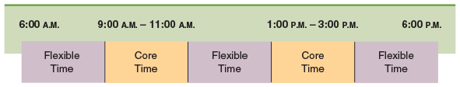
Lecture
Motivating Behavior with Work and Rewards
7
3- Flexible Work Arrangements: (Flexible Work Schedules)
Flexible Work Schedules
Flexible work schedules are an important new work arrangement used in some organizations today. All employees must be at work during “core time.” In the hypothetical example shown here, core time is from 9 to 11 a.m. and 1 to 3 p.m. The other time, then, is flexible—employees can come and go as they please during this time, as long as the total time spent at work meets organizational expectations

Slide 51
Lecture
Motivating Behavior with Work and Rewards
7
3- Flexible Work Arrangements: (Alternative Workplaces)
Telecommuting | Work arrangement in which employees spend part of their time working off-site Telecommuting—allowing employees to spend part of their time working off-site, usually at home. By using email, Internet-based tools, and other technology, employees can maintain close contact with their coworkers and do as much work at home as they could in their offices. The increased power and sophistication of modern communication technology—video chat and instant messaging, among others—is making telecommuting easier and easier

Slide 52
Lecture
Motivating Behavior with Work and Rewards
7
3- Flexible Work Arrangements: (Alternative Workplaces)
Telecommuting | Some employees also feel that they get more work done by staying at home because they are less likely to be interrupted. Organizations may benefit for several reasons as well: they can reduce absenteeism and turnover since employees will need to take less “formal” time off, and they can save on facilities such as parking spaces because fewer people will be at work on any given day.

Slide 53

Lecture
Motivating Behavior with Work and Rewards
7
3- Flexible Work Arrangements: (Alternative Workplaces)
Many employers today offer flexible work schedules and the freedom for employees to work at alternative work locations. This individual, for example, is working from his home office. Of course, not all jobs are amenable to these arrangements, and even for those that are employees are still expected to meet all of the responsibilities of their jobs.

Slide 54
Lecture
Motivating Behavior with Work and Rewards
7
Summary and Application
Managers seek to enhance employee performance by capitalizing on the potential for motivated behavior to improve performance. Methods often used to translate motivation into performance involve work design, participation and empowerment, alternative work arrangements, performance management, goal setting, and rewards.
The essence of work design is how organizations define and structure jobs. Historically, there was a general trend toward increasingly specialized jobs, but more recently, the movement has consistently been away from extreme specialization. Two early alternatives to specialization were job rotation and job enlargement.
Job enrichment approaches stimulated considerable interest in job design. The job characteristics theory grew from early work on job enrichment.

Slide 55
Lecture
Motivating Behavior with Work and Rewards
7
Summary and Application
Employee involvement using participative management and empowerment can help improve employee motivation in many business settings. New management practices such as the use of various kinds of work teams and of flatter, more decentralized methods of organizing are intended to empower employees throughout the organization.
Organizations that want to empower their employees need to understand a variety of issues as they go about promotion participation.
Flexible work arrangements are commonly used today to enhance motivated job performance. Among the more popular alternative arrangements are compressed workweeks, flexible work schedules, extended work schedules, job sharing, and telecommuting.

Slide 56


Thank You

