Slide 1


Effective Training
Phase 2
Training Design
Prepared by Dr. Injy Nashaat
Lecture 4

Slide 2


Training Design
www.midocean.ae

Slide 3
The Design Phase
Training design: is the process of creating a blueprint for the development of training to deal with performance gaps caused by KSA deficiencies.
An effective design will help to ensure the methods, tools, and approaches you decide to use, will maximize trainee interest in the training, and motivate trainees to learn the KSAs required.
The focus of a successful design is not just learning the KSAs, but, more importantly, getting trainees to want to use the KSAs and thus improve job performance.

Slide 4
The Design Phase
Thus, the design must motivate the trainee to learn the KSAs by demonstrating that the learning has value to the trainee learning required is achievable.
In summary, the design phase creates the guidelines that need to be followed in "development" when creating the content, delivery process, and materials to be used for the training.

Slide 5
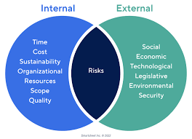
“Organizational Constraints:
In a perfect world, it would be possible to develop the perfect training program for every training need identified. Reality prevails, however, and you must consider the constraints when designing the training.
Organizational constraints are often identified in the needs analysis, provided by upper management, or surface in other ways.
Notes:
In your teams identify Constraints that might alter the design of training and describe how the training design might be altered.
Constraints include: budget, time, characteristics of trainees
CLICK MOUSE
What are the constraints you need to pay attention to in your project for this class?
Facility
equipment
21/2 hr time constraint
financial resources
different trainee jobs and employers

Slide 6
Some of the more important constraints that could be faced are:
  The amount of time that can be allocated for the training
  The number of trainees that can be trained at the same time (e.g., impact on production)
  Scheduling of the training (regular hours or overtime)
  Voluntary or mandatory training
  The location of the training (centralized or dispersed)
  Identification of a sufficient number of qualified personnel to be involved
  Financial, physical, and technology resources available.

Slide 7
Types of Costs in Training Programs
Development Costs(Ex :Trainer and manager time)
Direct Costs (Ex. Salaries, facilities, coffee etc.)
Indirect Costs (preparation time)
Overhead Costs (recruitment, shared technology..etc)
Participant Compensation (employees attending the training)
Evaluation Costs (Evaluator’s time)

Slide 8
Developing objectives
The term training objectives refers to all the objectives that are developed for the training program. There are generally four types of training objectives: reaction, learning, transfer of training, and organizational outcome. These represent the levels at which the training's effectiveness can be evaluated.
Reaction objectives refer to how trainees should feel about the training and their learning environment.
Learning objectives describe the KSAs that trainees are expected to acquire throughout the training program and the ways that learning will be demonstrated.

Slide 9
Developing objectives
Transfer of training objectives describes the changes in job behaviour that are expected to occur because of applying the KSAs gained in training to the trainee's job.
Organizational outcome objectives describe the outcomes that the organization can expect from the changes in the trainees' job behaviour because of the learning.

Slide 10
Why Use Objectives?
It takes time, effort, and careful thought … So, why bother?
  Guides the development of training
  Focuses attention of trainers & trainees
  Enhances transfer of knowledge
  Reduces anxiety related to the unknown

Slide 11
Writing a Learning Objective

Slide 12

A good objective has three components:
1. Desired outcome: What behaviour should be expected to occur?
  Must be worded clearly. Anyone reading the objective should be able to understand what the learner will be required to do to demonstrate that she learned the KSA.

Slide 13

2. Conditions: Under what conditions is the outcome expected to happen
  (Ex: the need for a specific tool to demonstrate learning outcome).

Slide 14
3. Standards: What criteria signify that the outcome is acceptable?
  Standards are the criteria for success. Three potential standards are ( accuracy, quality, and speed).
accuracy
quality
speed

Slide 15
1st, State The Purpose of Training
The Purpose Statement is a general description of what the training is intended to accomplish. Objectives follow from this.
It should be written to inform the participants.
It should NOT be stated as formally as a learning objective.
Example of a Purpose Statement
This training module is intended to provide participants with the competencies required to construct learning objectives in their proper form.

Slide 16
What do Learning Objectives tell you?
They answer the question,
“What will the trainee be required to do to show that the KSAs have been learned?”

Slide 17
How are Learning Objectives constructed?
  Learning Objectives describe:
  the type of behavior that will demonstrate learning has occurred,
  the conditions under which the behavior must be performed, and
  the standards (criteria) that will signify that a sufficient level of learning has occurred.

Slide 18
Behavior
Clearly Describe Expected Behavior
  Describe the specific behavior that demonstrates that the trainee has learned the targeted K, S, A
  Ask yourself:
  Is the wording clear and unmistakable?
  Will someone unfamiliar with the training know what to look for?

Slide 19
Describing behavior isn’t enough
Behavior: The trainee will ask questions that require the applicant to describe his/her past behavior as it relates to the job requirements for the open position.
You also need to describe the conditions under which the behavior occurs:
When? Any aids available? What is the context? And so on…

Slide 20
Conditions
  Conditions specify when and under what conditions the behavior must occur, including:
  What assistance will be available
  What barriers the trainee will face
  Anything in the situation that will affect performance.

Slide 21
Conditions
Example from selection interviewing training
After the completion of training, using notes developed from the Camp, et al. Strategic Interviewing text, the trainee, when conducting a job interview, will ask questions that require the applicant to describe his/her past behavior as it relates to the job requirements for the open position.

Slide 22
Describing Behavior & Conditions still isn’t enough
You also need standards for the level of performance required, such as: speed, accuracy, quality etc.
Standards identify the level of performance that will signify satisfactory learning has occurred.
  Typically, these are in the form of an accuracy, a quality and or a speed component
  However, other standards can exist. It depends on the KSAs to be developed.

Slide 23
Standards
Example from selection interviewing training
  After the completion of training, using notes developed from the Camp, et al. Strategic Interviewing text, the trainee will ask questions during a 60 minute job interview that require the applicant to describe his/her past behavior as it relates to all the key job requirements for the open position. In addition, the questions will adhere to all EEO laws and regulations. On average, two expert observers will rate the interviewer as an 8 or higher on the 10 point rating scale.

Slide 24
Summary of the Key Components of Objectives
Behavior should include a “doing” verb and describe the behavior that will show that learning has occurred.
Conditions should include all factors that will influence performance.
Standards should describe the definitions of success (e.g., accuracy, quality and speed)

Slide 25
Writing an objective for Attitude
Sometimes attitudes, in addition to knowledge and skills, are the focus of training.
How do you write a learning objective for an attitude?
  When the goal of training is attitude change, the focus of training activities is to provide the trainees with information that contradicts inappropriate attitudes and supports more appropriate attitudes. Thus, training does not focus on changing attitudes specifically, but rather on providing new knowledge.
  This new knowledge might consist of alternative views and information related to attitudes.
  Therefore, learning objectives for attitude change should focus on acquisition of the relevant information rather than on the resulting attitude change.

Slide 26
Writing an objective for Attitude
  Consider training that is attempting to improve attitudes toward teamwork in a group of trainees who all scored below the midpoint on a TNA teamwork awareness survey.
  In this case, the learning objective might read as follows: At the end of training, trainees will demonstrate an increased awareness of the positive aspects of teamwork (new knowledge) as demonstrated by a 50 percent improvement on the team awareness survey.
  Recall that the reason we want to affect an attitude is to influence behaviour.
  In this example, we want trainees to have positive attitudes so that once they are back in the workplace, they will participate fully in team meetings and provide input.
  (The transfer of training objective in this case might be "Eight weeks after completing training, the participants will have attended all team meetings and, using the skills taught, provide ideas and suggestions in those meetings.“)

Slide 27
FACILITATION OF LEARNING: FOCUS ON THE TRAINEE
Recall that a person's performance depends on their motivation, competencies, and the environment (P = M x KSA x E).
Many aspects of each of these factors that will make it easier or more difficult for the trainee to achieve the learning objectives. You first need to understand the potential differences that may exist among your trainees.
Differences in Learning Styles:
  Sensing Versus Intuitive Learners.
  Visual Versus Verbal Learners.
  Sequential Versus Global Learners.
  Active Versus Reflective Learners.

Slide 28
Differences in Learning Styles:
Sensing Versus Intuitive Learners
Your preference for one style or the other may be strong, moderate, or mild. Everybody is sensing sometimes and intuitive sometimes. To be effective as a learner and problem solver, you need to be able to function both ways
Sensing learners don't like training that doesn't connect closely to practical application, tend to like learning facts, and prefer solving problems by well-established methods. They dislike complications and surprises. They are good at memorizing and are patient with details. They like hands-on learning opportunities. Sensors are more likely than intuitors to resent being tested on material that has not been explicitly covered in training.

Slide 29
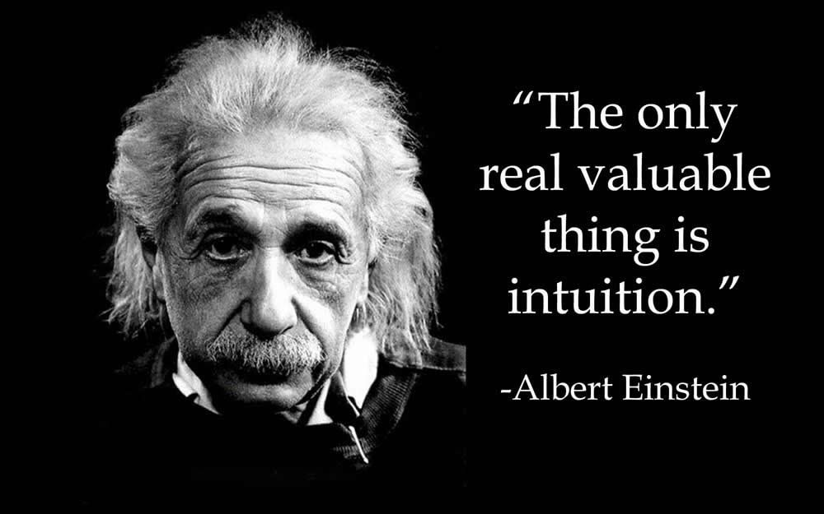
Intuitive learners often prefer discovering possibilities and relationships, like innovation, and dislike repetition. They seem to be better at grasping new concepts and are often more comfortable than sensors with abstractions and mathematical formulations. lntuitors don't like "plug-and-chug" courses that involve a lot of memorization and routine calculations.

Slide 30

Differences in Learning Styles:
How Can Trainers Help Sensors?
Sensors remember and understand information best if they can see how it connects to the real world.
If you are training in an area where most of the material is abstract and theoretical, you may have difficulty. You can be helpful by providing specific examples of concepts and procedures and how they apply in practice.

Slide 31
How Can Trainers Help Intuitors?
If your training requires primarily memorization and plugging in formulas, you may have trouble with these trainees.
Provide interpretations or theories that link the facts or ask these trainees to find the connections. You should also create incentives for memorizing details and correct solutions (reinforcing the trainee for checking her completed solutions). Some type of competition (either among a group or individual improvement) might work well when the content of the training doesn't match the intuitor's preferred approach.

Slide 32
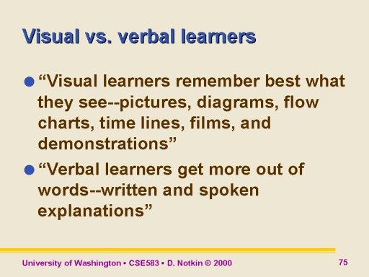
Differences in Learning Styles:
2. Visual Versus Verbal Learners
Visual learners remember best what they see- pictures, diagrams, flowcharts, time lines, films, and demonstrations.
Verbal learners get more out of words- written and spoken explanations. Everyone learns more when information is presented both visually and verbally.

Slide 33
How Can Trainers Help Visual Learners?
The simple answer is to find diagrams, sketches, schematics, photographs, flow charts, or any other visual representation of course material that is predominantly visual. Even showing a short video of someone else presenting the material will help the visual learner. Prepare a concept map showing key points, enclosing them in boxes or circles, and drawing lines with arrows between concepts to show connections.
How Can Trainers Help Verbal Leaners?
Have trainees write summaries or outlines of course material in their own words. Put trainees into groups where they can gain understanding of material by hearing others explain the concepts. Trainees learn more when they actively participate in the learning process

Slide 34
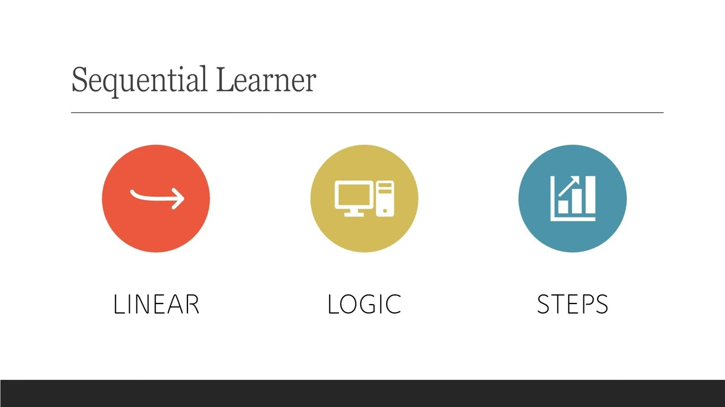
Differences in Learning Styles:
3. Sequential Versus Global Learners:
Sequential learners tend to gain understanding in linear steps, with each step following logically from the previous one. They are able to absorb and use material even though they do not understand the big picture, but the material has to be presented in a logical order.

Slide 35

• Global learners are not able to absorb the details until they understand the big picture. Even then, they may not be great with the details. They tend to learn in large jumps, absorbing material almost randomly without seeing connections, and then suddenly "getting it." They tend to be able to solve complex problems quickly or put things together in novel ways once they have grasped the big picture, but they may have difficulty explaining how they did it.

Slide 36
Differences in Learning Styles:
How Can Trainers Help Sequential Learners?
  One useful technique here is to provide trainees with a copy of the lecture material with blank spaces in place of key terms and definitions. Ask trainees to fill out the blanks as the training progresses. At the end of the module, as a review, go through the blank spaces and ask the trainees to tell you what should be in the space.

Slide 37
How Can Trainers Help Global Leaners?
  Before beginning each module, indicate how that mod ule fits into the overall purpose of the training. Follow this up with how the module fits into the world of the trainees. As indicated earlier, one way to do this is to get the trainees to make the connection between the new topic and things they already know. This helps the global learner to put the new topic into a familiar context and see the connections.

Slide 38
Differences in Learning Styles:
4. Active Versus Reflective Learners
Active learners tend to retain and understand information best by doing something active with it-discussing or applying it or explaining it to others. These trainees want to try it out and see how it works because that's how they most effectively process the new information (e.g., symbolic coding, cognitive organization, and symbolic rehearsal). Because they process information externally, these trainees like working in groups.

Slide 39
Reflective learners prefer to think about the new information before applying it. They are more comfortable processing the new information internally, before using it externally. These trainees prefer working alone so that they can complete their internal processing of the information. Sitting through lectures without any activity except taking notes is hard for both learning types, but particularly hard for active learners.

Slide 40
Differences in Learning Styles:
How Can Trainers Help Active Leaners?
Create time for group discussion or problem-solving activities as part of the training. If training requires work outside the classroom, have the trainees work in teams.
How Can Trainers Help Reflective Learners?
Before moving to group activities, have the trainees engage in individual thinking. At the end of each module, ask trainees questions about the content. Also, ask them to think of possible applications. It will also help this type of learner if you allow some time at the end of the module for them to write down a summary of the material in their own words.

Slide 41


Thank You

