Slide 1


Project Risk Management
Prepared by Dr. Usama Al-Fendi
PMG 510
Project Risk Management
Lecture 10

Slide 2

Lecture
Lecture Organization
10
Sustainable Development and Sustainable Finance (ESG Model).
www.midocean.ae

Slide 3
Lecture
Lecture Organization
10
ESG and its main Pillars.
Sustainable Development (UNDP).
Sustainable Finance (Banking System).
Environmental Footprint.
Social Footprint.
www.midocean.ae

Slide 4
Lecture
Understanding ESG: Main Concepts and Pillars
10
Environmental Pillar
Climate change and carbon emissions.
Energy efficiency and renewable energy use.
Water Scarcity
Waste management and resource conservation.
Biodiversity and pollution control.
Transition risk vs. physical risk.
www.midocean.ae

Slide 5
Lecture
Understanding ESG: Main Concepts and Pillars
10
Social Pillar
Labor standards and employee well-being.
Diversity, equity, and inclusion (DEI).
Human rights and community relations.
Health and safety standards.
Supply chain labor and social responsibility.
www.midocean.ae

Slide 6
Lecture
Understanding ESG: Main Concepts and Pillars
10
Governance Pillar
Board structure, accountability, and transparency.
Ethical conduct and anti-corruption frameworks.
Executive compensation linked to ESG performance.
Risk culture and internal controls.
Shareholder rights and disclosure practices.
www.midocean.ae

Slide 7
Lecture
Sustainable Development
10
What Sustainable development
Sustainable development is a comprehensive socio-economic term adopted by the United Nations. The UN has outlined a global roadmap for environmental, social, and economic development, with its primary goal being to improve living conditions for every member of society.
It also aims to develop production methods and tools and manage them in ways that do not lead to the depletion of the Earth's natural resources.
www.midocean.ae

Slide 8
Lecture
Sustainable Development
10
What Sustainable development
This ensures we do not overburden the planet or deprive future generations of these resources, "meeting the needs of the present without compromising the ability of future generations to meet their own needs“, and without excessively using the remaining natural resources on our planet.
www.midocean.ae

Slide 9
Lecture
Sustainable Development
10
What Sustainable development
It is development that takes into account social and environmental dimensions alongside economic dimensions to ensure the optimal use of available resources to meet the needs of individuals while preserving the rights of future generations.
It is development that meets the needs of the present without compromising the ability of future generations to meet their own needs.
www.midocean.ae

Slide 10
Lecture
Sustainable Development
10
Dimensions of Sustainable development
Sustainable economic growth (The economic dimension).
Sustainable social development (The social dimension).
Sustainable protection of the environment and natural resource wealth (The environmental dimension).
www.midocean.ae

Slide 11
Lecture
Sustainable Development
10
Objectives of Sustainable development (UNDP)
No Poverty
Zero Hunger
Good Health and Well-being
Quality Education
Gender Equality
Clean Water and Sanitation
Affordable and Clean Energy
Decent Work and Economic Growth
www.midocean.ae

Slide 12
Lecture
Sustainable Development
10
Objectives of Sustainable development (UNDP)
Industry, Innovation and Infrastructure
Reduced Inequalities
Sustainable Cities and Communities
Responsible Consumption and Production
Climate Action
Life Below Water
Life on Land
Peace, Justice and Strong Institutions
Partnerships for the Goals
www.midocean.ae

Slide 13
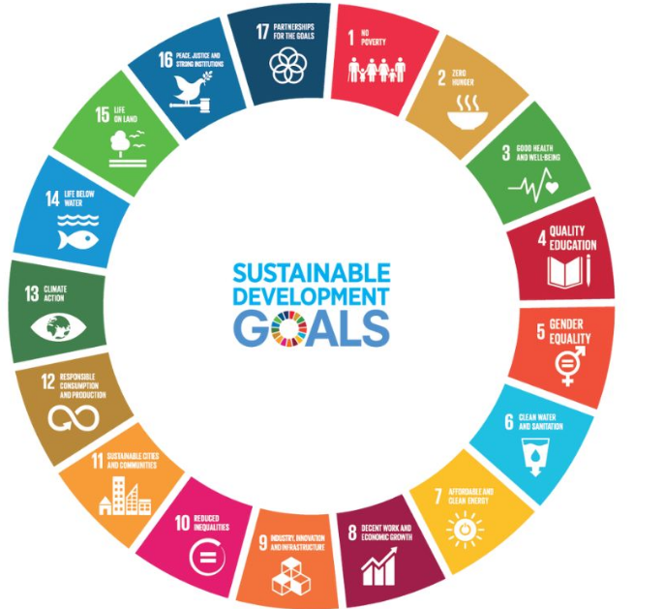
Lecture
Sustainable Development
10
www.midocean.ae

Slide 14
Elements of Sustainable Finance: Environmental–Social–Governance (ESG)
Lecture
10
Environmental Element: Factors related to the environment, such as climate change, gas and carbon emissions, air and water pollution, water scarcity, and global warming.
Social Element: Factors with a social impact, such as providing employment opportunities, improving working conditions (including health, safety, and workers' rights), and the impact on communities surrounding the relevant projects, etc.
Governance Element: Factors related to how the institution is managed, such as the independence and composition of the board of directors, shareholder rights, and transparency.
www.midocean.ae

Slide 15
Sustainable Finance
Lecture
10
Sustainable finance is the process of making investment decisions that consider environmental, social, and governance (ESG) factors alongside financial returns. It directs capital towards sustainable economic activities and projects that contribute to long-term social and environmental well-being, such as renewable energy and social impact initiatives.
www.midocean.ae

Slide 16
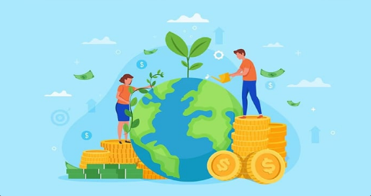
Sustainable Finance
Lecture
10
www.midocean.ae

Slide 17
The Role of banks in Sustainable Finance
Lecture
10
Banks act as crucial catalysts in sustainable finance by directing capital toward environmentally and socially responsible projects, such as renewable energy, clean technology, and social infrastructure.
They achieve this by offering sustainable financial products like green loans and bonds, integrating ESG criteria into risk management and investment strategies, and financing supply chains to support sustainable practices. By doing so, they influence business practices, drive innovation, and help achieve long-term environmental and social goals while managing their own financial stability.
www.midocean.ae

Slide 18
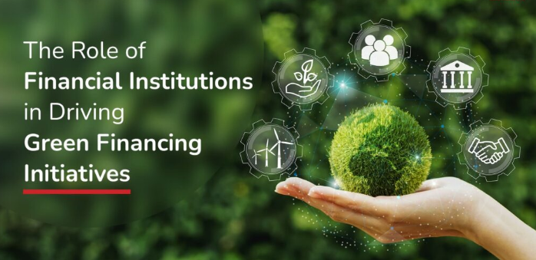
The Role of banks in Sustainable Finance
Lecture
10
www.midocean.ae

Slide 19
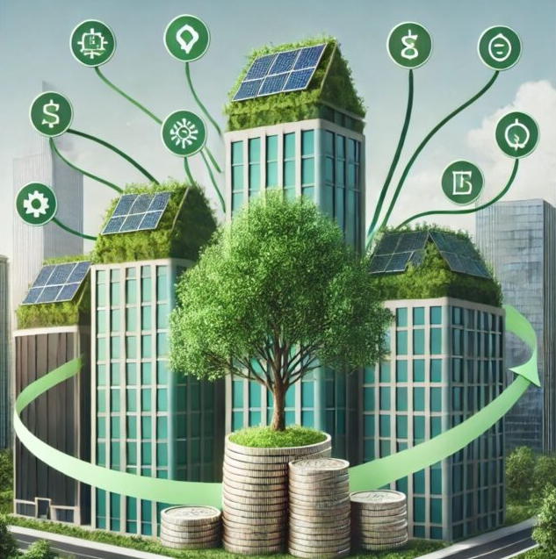
Green Financing
Lecture
10
Green finance and sustainable finance are types of financial activities that support the transition to a low-carbon, sustainable economy while addressing global challenges we face today, such as climate change and emerging environmental and sustainability risks.
www.midocean.ae

Slide 20
Green Financing
Lecture
10
Green finance involves financing projects and initiatives that have positive environmental impacts such as reducing greenhouse gas emissions and promoting renewable energy.
On the other hand, sustainable finance integrates environmental, social, and governance (ESG) factors into investment decisions to promote long-term economic growth, social outcomes, and environmental sustainability.
Both green finance and sustainable finance aim to drive positive change by mobilizing capital towards activities that promote sustainability and reduce negative environmental impacts.
www.midocean.ae

Slide 21
Examples of green finance initiatives
Lecture
10
Renewable energy and energy efficiency
Pollution prevention and control
Biodiversity conservation
Circular economy initiatives
Sustainable use of natural resources and land
www.midocean.ae

Slide 22
Examples of green finance initiatives
Lecture
10
Renewable energy and energy efficiency
Green financing is a pivotal mechanism that directs capital towards projects supporting renewable energy development and energy efficiency improvements to foster a sustainable, low-carbon economy. This financial flow, which includes instruments like green bonds and green loans, helps bridge the significant investment gap needed for the global energy transition.
www.midocean.ae

Slide 23
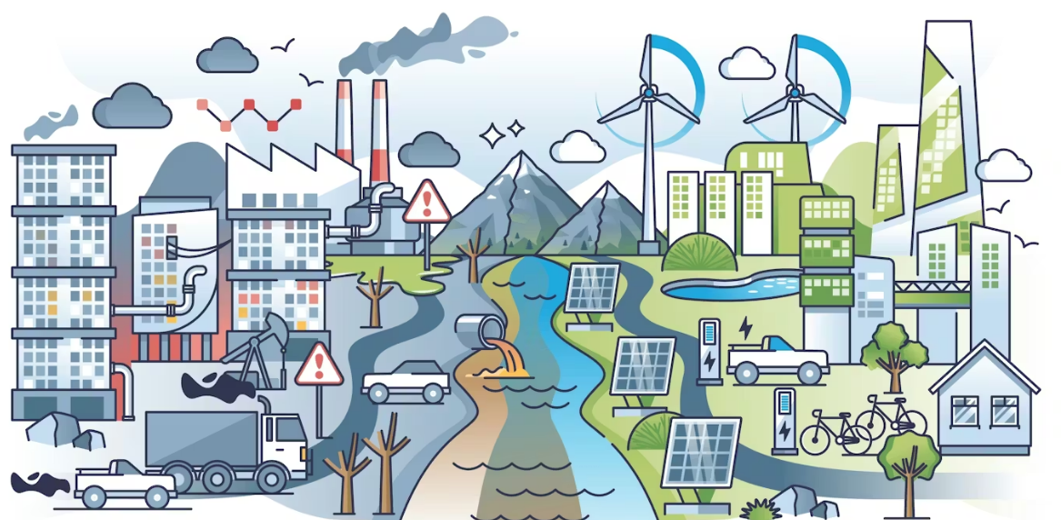
Examples of green finance initiatives
Lecture
10
www.midocean.ae

Slide 24
Examples of green finance initiatives
Lecture
10
Pollution prevention and control
Green financing is a key mechanism for driving pollution prevention and control by redirecting capital towards environmentally friendly projects and away from highly polluting industries. It achieves this through a combination of market-based incentives, financial instruments, and regulatory frameworks.
www.midocean.ae

Slide 25
Examples of green finance initiatives
Lecture
10
Pollution prevention and control
Financial Constraints on Polluters: Financial institutions, guided by green credit policies, impose stricter loan conditions, higher interest rates, or outright "vetoes" on financing for highly polluting and energy-intensive enterprises. This increases their operational and financing costs, forcing them to adopt cleaner practices or exit the market.
www.midocean.ae

Slide 26
Examples of green finance initiatives
Lecture
10
Pollution prevention and control
Incentivizing Green Investment: Green finance provides low-cost, long-term capital, subsidies, and risk compensation for green projects, making them more financially attractive.
www.midocean.ae

Slide 27

Examples of green finance initiatives
Lecture
10
www.midocean.ae

Slide 28
Examples of green finance initiatives
Lecture
10
Biodiversity conservation
Green financing is a crucial mechanism for funding biodiversity conservation, yet current investment levels are insufficient to bridge the substantial annual financing gap, estimated at over $700 billion. It works by directing capital towards nature-positive projects and away from harmful activities, using a range of instruments and policies.
www.midocean.ae

Slide 29
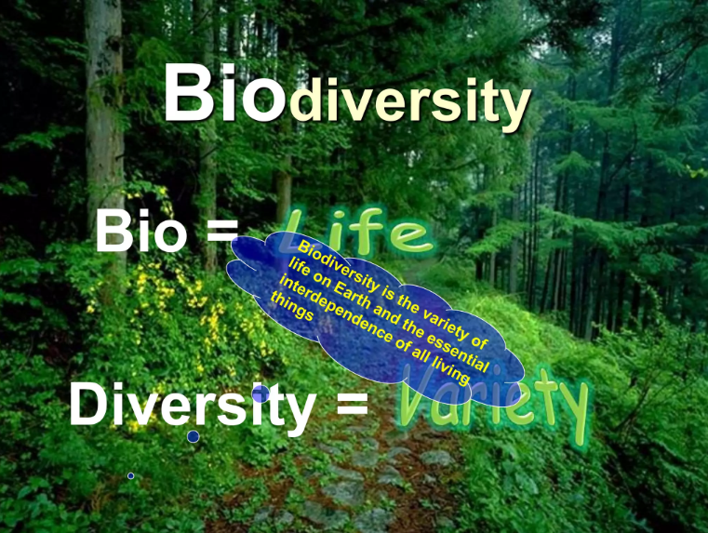
Examples of green finance initiatives
Lecture
10
www.midocean.ae

Slide 30
Examples of green finance initiatives
Lecture
10
Circular economy initiatives
Green financing significantly promotes the circular economy (CE) through various initiatives, including targeted financial products, supportive policies, and investments in innovative business models. These efforts aim to shift from a linear "take-make-waste" model to a restorative system that eliminates waste and keeps resources in use for longer.
www.midocean.ae

Slide 31
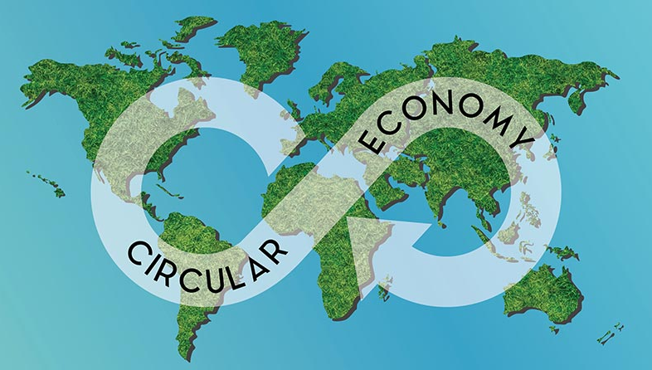
Examples of green finance initiatives
Lecture
10
www.midocean.ae

Slide 32
Examples of green finance initiatives
Lecture
10
Sustainable use of natural resources and land
Green financing promotes the sustainable use of natural resources and land by channeling capital towards environmentally friendly projects, integrating environmental risks into financial decisions, and incentivizing the adoption of sustainable practices and technologies.
www.midocean.ae

Slide 33
Importance of Sustainable Finance - At the Central Bank Level
Lecture
10
Supporting financial and banking stability by integrating environmental, social, and governance (ESG) elements, which has had a positive impact on corporate performance and risk reduction. Consequently, this provides financing for those companies at a lower risk level, positively reflecting on the stability of the financial system.
Enhancing investment opportunities and injecting foreign currency by attracting a new segment of investors targeting sustainable finance, in addition to direct foreign investment in the banking sector and the national economy.
www.midocean.ae

Slide 34
Importance of Sustainable Finance - At the Central Bank Level
Lecture
10
Promoting the issuance of green bonds amid the increasing spread of environmental and social investment.
The potential to establish green banks, which are a type of specialized bank that helps secure low-cost capital financing for clean and renewable energy projects and projects generally aimed at improving environmental quality with suitable terms and conditions.
Supporting the state's efforts in achieving the Sustainable Development Goals (SDGs), which sustainable finance directly contributes to.
www.midocean.ae

Slide 35
Importance of Sustainable Finance - At the Central Bank Level
Lecture
10
Offering new and innovative financial solutions and banking products, and opening new fields and markets for financing, which contributes to achieving more profits.
Adopting sustainable finance concepts reduces the chances of default, thus preserving the quality of the bank's portfolio.
Positively contributing to community development and preserving the surrounding environment, and improving the banks' reputation locally and internationally.
Reducing environmental and social risks.
www.midocean.ae

Slide 36
Does Sustainable Finance Necessarily Affect Bank Profitability?
Lecture
10
Implementing sustainable finance in banks does not necessarily negatively impact bank profitability or lead to stopping the financing of specific projects or industries. Instead, it will lead to offering innovative financial solutions and achieving more profits by opening new markets and fields and reducing environmental and social risks.
www.midocean.ae

Slide 37
The Difference Between Sustainable Finance and Social Responsibility
Lecture
10
Sustainable Finance is a specific and established banking approach applied according to international standards concerning the method and approach of lending, investment, and reducing associated risks.
www.midocean.ae

Slide 38
The Difference Between Sustainable Finance and Social Responsibility
Lecture
10
Social Responsibility, on the other hand, differs from sustainable finance as it stems from each institution's vision of its role in the surrounding community, and this vision changes according to the circumstances of each institution. It is also related to efforts and initiatives implemented during specific periods and cannot be relied upon in the long term as plans to achieve the desired development. However, it can be said that corporate social responsibility efforts contribute in the short term to achieving some of the Sustainable Development Goals.
www.midocean.ae

Slide 39
Risks Resulting from Neglecting Sustainable Finance Elements
Lecture
10
Physical Risks:
The consequences resulting from environmental risks and climate change—which threaten many industries and can disrupt global supply chains, such as droughts, floods, hurricanes, and rising carbon levels—may affect financial stability through their impact on other sectors like agriculture, energy, tourism, etc.
This may have a long-term impact on inflation rates due to, for example, decreased agricultural production and subsequent increases in food commodity prices. It also involves risks to macroeconomic sustainability and stability, thus requiring the intervention of regulatory authorities.
www.midocean.ae

Slide 40
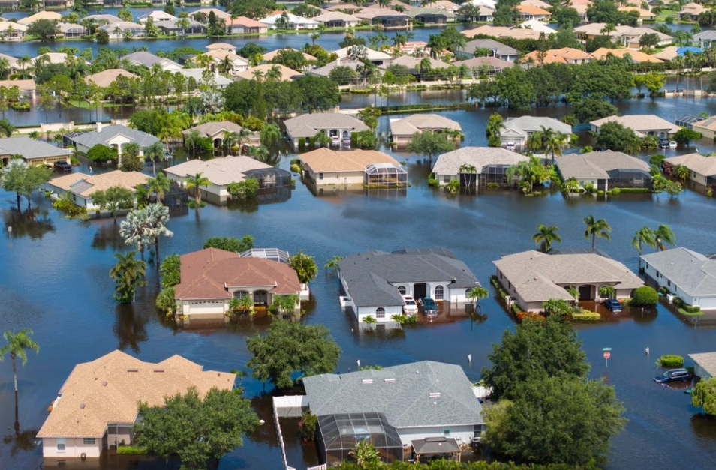
Risks Resulting from Neglecting Sustainable Finance Elements
Lecture
10
www.midocean.ae

Slide 41
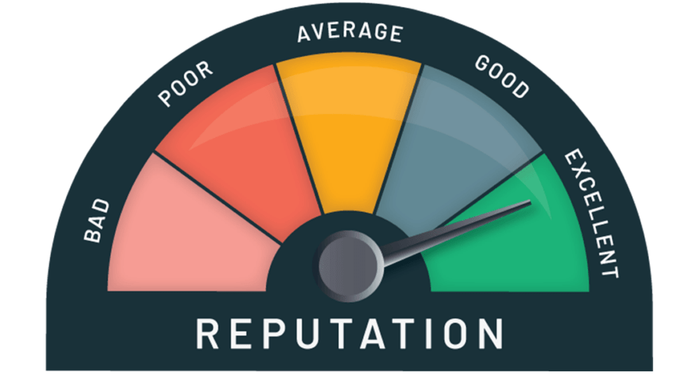
Risks Resulting from Neglecting Sustainable Finance Elements
Lecture
10
Reputational Risks:
Risks resulting from banks focusing solely on profit-making, without regard for the environmental or social risks associated with the bank's activity, or financing clients or projects that do not meet sustainability elements and have negative environmental or social impacts.
www.midocean.ae

Slide 42
Risks Resulting from Neglecting Sustainable Finance Elements
Lecture
10
Credit Risks:
Risks resulting from the possibility of clients failing to repay credit facilities due to reasons such as:
Disregard for sustainable finance elements and their actual exposure to related physical losses.
Incurring fines or compensation for affected parties who have suffered negative social or environmental impacts, which may subsequently affect the value of their collateral or assets.
www.midocean.ae

Slide 43
Risks Resulting from Neglecting Sustainable Finance Elements
Lecture
10
Environmental Risks:
Risks resulting from operations carried out by financial institutions that negatively impact the environment, such as energy use, paper consumption, fuel consumption, and waste disposal.
Although the direct impact of the energy, waste, and paper used by financial institutions on the environment is relatively low compared to many other sectors, their overall environmental impact cannot be ignored.
This also highlights the importance of using financing institutions as a tool for change in this direction for the institutions causing this damage.
www.midocean.ae

Slide 44
Risks Resulting from Neglecting Sustainable Finance Elements
Lecture
10
Social Risks:
Risks resulting from a lack of attention to social dimensions, where efforts should be made to promote a culture of respecting and protecting human rights in general and the rights of workers in projects to be financed.
Additionally, ensuring justice and fairness, providing equal opportunities for individuals, contributing to their growth and development, and ensuring the maintenance of a healthy and safe work environment.
www.midocean.ae

Slide 45
Risks Resulting from Neglecting Sustainable Finance Elements
Lecture
10
Legal Risks:
Involve the legal obligations that banks and/or companies may incur, including, but not limited to, paying fines and compensation to affected parties who have suffered negative social or environmental impacts.
www.midocean.ae

Slide 46
Challenges Associated with Implementing Sustainable Finance
Lecture
10
Transition risks arise from the rapid shift to environmentally friendly industries and a "low-carbon economy.“
Although this transition positively contributes to the environment, it may result in the need to quickly redirect investments away from industries and an economy that does not consider the environmental dimension, known as the "carbon economy."
This could affect entire sectors within the current economic system and thus eliminate billions in potential investments.
www.midocean.ae

Slide 47
Pillars of Sustainable Finance in the Bank
Lecture
10
Commercial Banking Pillars (Banking activities that indirectly motivate sustainability practices in the other institutions).
Operational Pillars (banking own operations that directly affect the sustainability).
Sustainable Finance Initiatives
www.midocean.ae

Slide 48
Pillars of Sustainable Finance in the Bank
Lecture
10
Commercial Banking Pillars:
Promoting Inclusive Growth: Sustainable development through sustainable finance aims to create long-term value by ensuring economic growth, while promoting social, environmental, and governance considerations. This is achieved through the following pillars:
www.midocean.ae

Slide 49
Pillars of Sustainable Finance in the Bank
Lecture
10
Commercial Banking Pillars:
Environmental and Social Risk Management: Understanding and addressing environmental and social risks and evolving non-traditional risks in the investment portfolio, in addition to emerging systemic risks, and integrating the Environmental and Social Risk Management (ESRM) framework into its business operations.
www.midocean.ae

Slide 50
Pillars of Sustainable Finance in the Bank
Lecture
10
Commercial Banking Pillars:
Climate-Related Risks: Establishing a robust framework for risk management practices in the bank, which ensures the bank's understanding of these practices and ensures the bank is well protected against potential negative impacts caused by climate change and climate-related risks.
Examples are project that have high emissions and high carbon footprint.
www.midocean.ae

Slide 51
Pillars of Sustainable Finance in the Bank
Lecture
10
Commercial Banking Pillars:
Sustainable Lending: The need to understand the environmental, social, and corporate governance (ESG) risks associated with different industries, clients, and projects by assessing their sustainability as part of the sustainable lending assessment process, to avoid and mitigate any negative impact on the environment and/or society and fulfill obligations to national and international standards. Examples are financing environmentally friendly product like EV cars and solar pannels.
www.midocean.ae

Slide 52
Pillars of Sustainable Finance in the Bank
Lecture
10
Commercial Banking Pillars:
Sustainable Investment: By assessing the environmental, social, and governance (ESG) risks and opportunities associated with the bank's investment practices, to avoid and mitigate any negative impact on the environment and/or society and fulfill obligations to national and international standards..
www.midocean.ae

Slide 53
Pillars of Sustainable Finance in the Bank
Lecture
10
Commercial Banking Pillars:
Sustainable Programs and Products: Developing products and programs for clients that contribute to addressing environmental or social challenges, such as promoting financial inclusion and/or mitigating the effects of climate change.
www.midocean.ae

Slide 54
Pillars of Sustainable Finance in the Bank
Lecture
10
Commercial Banking Pillars:
Financing for Small and Medium Enterprises (SMEs): Supporting the growth of SMEs and entrepreneurs, and committing to serving unbanked and/or underbanked community segments by facilitating access to finance and financial products and services with a close focus on empowering women and youth. Investing in digital capabilities and relying on proximity to customers to create value for unbanked and deprived communities. This can support the Socialpillar in ESG.
www.midocean.ae

Slide 55
Pillars of Sustainable Finance in the Bank
Lecture
10
Operational Pillars:
Environmental Footprint: Measuring, reducing, and improving the bank's environmental footprint, and striving to meet high safety standards and reduce the environmental impact of its buildings by regulating its emissions and ensuring the safe removal and management of its waste.
Examples are using energy saving AC systems and water saving facilities.
www.midocean.ae

Slide 56
Pillars of Sustainable Finance in the Bank
Lecture
10
Operational Pillars:
Social Footprint: Contributing to human capital development through business operations such as promoting gender equality, fair working conditions, talent management and development, diversity and inclusion, and social engagement.
Not tolerating or neglecting discrimination or any form of harassment based on gender, age, disability, race, or religious belief. Conducting social and environmental risk assessment in its supply chain management and encouraging local suppliers in its procurement process.
www.midocean.ae

Slide 57
Pillars of Sustainable Finance in the Bank
Lecture
10
Sustainable Finance Initiatives:
Making a positive contribution to the broader community by investing in and sponsoring initiatives and projects that have a positive impact on the environment and society on a large scale
www.midocean.ae

Slide 58
Pillars of Sustainable Finance in the Bank
Lecture
10
Sustainable Finance Initiatives:
Making a positive contribution to the broader community by investing in and sponsoring initiatives and projects that have a positive impact on the environment and society on a large scale
www.midocean.ae

Slide 59



Thank You

