Slide 1

PMG 506
Advanced Project Management
LECTURE 6
March 06, 2021
Everyone’s Smart
University
Initial project coordination and the project Charter

Slide 2

PMG506 Advanced Project Management (APM)
Introduction:
Lecture 1 Introduction to APM and Initial Project Strategy
Lecture 2 Project Quality Management
Project planning
Lecture 6 Initial project coordination and the project Charter
Lecture 7 Starting the project plan: The WBS
Lecture 8 Project risk management
Lecture 9 Budgeting, Estimating costs and risks
Project Initiation:
Lecture 3 Project Communication and team Management
Lecture 4 Managing conflicts and the art of communication
Lecture 5 Strategic Management and project selection
Project Execution
Lecture 10 Monitoring and information systems
Lecture 11 Project Control
Lecture 12 Project Auditing
Lecture 13 Project termination

Slide 3

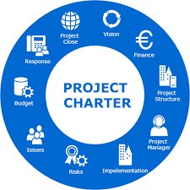
Learning Outcomes
By the end of this lecture, you will be able to:
Describe how strategic planning should influence projects undertaken by an organization.
Discuss the project launch meeting
Describe the importance, use, and design of a project charter.
Understand how to identify project benefits and prepare a project charter.

Slide 4

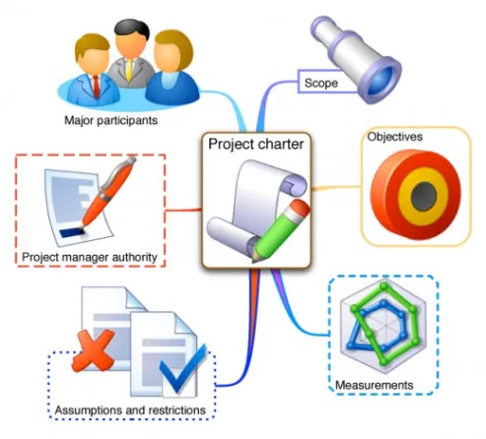
Plan the work…
…work the plan

Slide 5

Introduction
Project Managers say, or are told, that :
planning “takes too much time”.
“customers don’t know what they want”.
“if we commit, we will be held accountable”.
and several similar weak excuses.

Slide 6
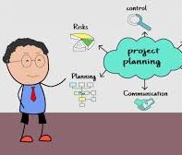
Cont. Introduction
The more time you spend planning, the less time you’ll need to spend on implementation.
there is a great deal of research supporting the view that careful planning is solidly associated with project success—and none, to our knowledge, supporting the opposite position.
On the other hand, sensible planners do not kill the plan with over analysis

Slide 7

Why Project Planning?
Thus far, we have dealt with initiating a project. Now we are ready to begin the process of planning the work of the project in such a way that it may be translated into “hard work” that leads to a successful completion of the project.
There are several reasons why we must use considerable care when planning projects. The primary purpose of planning, of course, is to establish a set of directions in sufficient detail to tell the project team exactly
What must be done?
When it must be done?
What resources will be required to produce the deliverables of the project successfully?
When each resource will be needed?

Slide 8
INITIAL PROJECT COORDINATION AND THE PROJECT PLAN
The project plan will include a complete set of schedules together with the associated resources and personnel needed to perform all the tasks required to complete the project.
It is crucial that the project’s objectives be clearly tied to the overall mission, goals, and strategy of the organization, such as might be reflected in the project portfolio process.
It is also vital that a senior manager call and be present at the project launch meeting, an initial coordinating meeting, as a visible symbol of top management’s commitment to the project

Slide 9


The project launch meeting
1.Scope & objectives:
The individual leading the launch meeting is first to define the scope of the project.
The success of the project launch meeting is dependent on the existence of a well-defined set of objectives.
Unless all parties to the planning process have a clear understanding of precisely what it is the project is expected to deliver, planning is sure to be inadequate or misguided.
The precise nature of the scope statement depends on the nature of the project itself, and because of this, it reflects the fact that all projects are, to some extent, unique.

Slide 10

The project launch meeting
2. What is needed:
At the launch meeting, the project is discussed in sufficient detail that potential contributors. develop a general understanding of what is needed.
If the project is one of many similar projects, the meeting will be short and routine, a sort of “touching base” with other interested units.
If the project is unique in most of its aspects, extensive discussion may be required.

Slide 11

The project launch meeting
3. Major risks
It is useful to review the major risks facing the project during the launch meeting.
The known risks will be those identified during the project selection process. These focus largely on the market reaction to a new process/product, the technical feasibility of an innovation, and like matters.
The risk management plan for the project must be started at the launch meeting so that further risk identification can be extended to include the technology of the process/product, the project’s schedule, resource base, and a myriad of other risks facing the project but not identifiable until the project plan has begun to take form.
The formulation of the project’s risk management group and the initial risk management plan that the group develops during the process of planning the project.

Slide 12
Expectations for the project launch meeting
It is important not to allow plans, schedules, and budgets to go beyond the most aggregated level.
Whatever the process, the outcome must be that:
Technical scope is established.
(2) Basic areas of performance responsibility are accepted by the participants.
(3) Any tentative delivery dates or budgets set by the parent organization are clearly noted.
(4) a risk management group is created.
(5) Each individual/unit accepting responsibility for a portion of the project should agree to deliver, by the next project meeting.

Slide 13
If the project is to deliver a product/service to an outside clients?
When the project is to deliver a product/service to an outside client, the fundamental planning process is unchanged except for the fact that the project’s scope cannot be altered without the client’s permission.
A common “planning” problem in these cases is that marketing has promised deliverables that engineering may not know how to produce on a schedule that manufacturing may be unable to meet.
This sort of problem usually results when the various functional areas are not involved in the planning process at the time the original proposal is made to the potential client. We cannot ignore the importance of a carefully determined set of deliverables, accepted by both project team and client.

Slide 14
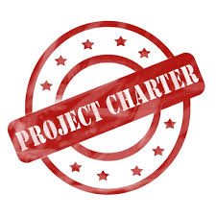
What is a Project Charter in Project Management?
A project charter is a formal, typically short document that describes your project in its entirety — including what the objectives are, how it will be carried out, and who the stakeholders are. It is a crucial ingredient in planning out the project because it is used throughout the project lifecycle.
The PMBOK® Guide, defines a project charter as “a document issued by the project initiator or sponsor that formally authorizes the existence of a project and provides the project manager with the authority to apply organizational resources to project activities. The key word in this definition is “authority.” It authorizes both the project and the project manager.

Slide 15

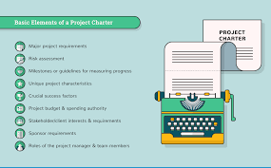
Project Charter Elements
The process of developing the project charter varies from organization to organization, but any project charter must contain the following elements:
1. Overview
2. Objectives or Scope
3. General Approach
4. Contractual Aspects
5. Schedules
6. Resources
7. Personnel
8. Risk Management Plans
9. Evaluation Methods

Slide 16
Project Charter Elements
1. Overview: This is a short summary of the objectives and scope of the project. It is directed to top management and contains a statement of the goals of the project, a brief explanation of their relationship to the firm’s objectives, a description of the managerial structure that will be used for the project, and a list of the major milestones in the project schedule

Slide 17
Project Charter Elements
2. Objectives or Scope: This contains a more detailed statement of the general goals noted in the overview section. The statement should include profit and competitive aims as well as technical goals.
3. General Approach: This section describes both the managerial and the technical approaches to the work. The technical discussion describes the relationship of the project to available technologies. For example, it might note that this project is an extension of work done by the company for an earlier project. The subsection on the managerial approach takes note of any deviation from routine procedure—for instance, the use of subcontractors for some parts of the work.

Slide 18
Project Charter Elements
4. Contractual Aspects: This critical section of the plan includes a complete list and description of all reporting requirements, customer-supplied resources, liaison arrangements, advisory committees, project review and cancellation procedures, proprietary requirements, any specific management agreements (e.g., use of subcontractors), as well as the technical deliverables and their specifications, delivery schedules, and a specific procedure for changing any of the above. (Project change orders will be discussed in Chapter 11.) Completeness is a necessity in this section. If in doubt about whether an item should be included or not, the wise planner will include it.

Slide 19
Project Charter Elements
5. Schedules: This section outlines the various schedules and lists all milestone events. Each task is listed, and the estimated time for each task should be obtained from those who will do the work. The projected baseline schedule is constructed from these inputs. The responsible person or department head should sign off on the final, agreed on schedule.

Slide 20
Project Charter Elements
6. Resources: There are two primary aspects to this section. The first is the budget. Both capital and expense requirements are detailed by task, which makes this a project budget. One-time costs are separated from recurring project costs. Second, cost monitoring and control procedures should be described.
In addition to the usual routine elements, the monitoring and control procedures must be designed to cover special resource requirements for the project, such as special machines, test equipment, laboratory usage or construction, logistics, field facilities, and special materials.

Slide 21
Project Charter Elements
7. Personnel This section lists the expected personnel requirements of the project. Special skills, types of training needed, possible recruiting problems, legal or policy restrictions on work force composition, and any other special requirements, such as security clearances, should be noted here. (This reference to “security” includes the need to protect trade secrets and research targets from competitors as well as the need to protect the national security.) It is helpful to time-phase personnel needs to the project schedule. This makes clear when the various types of contributors are needed and in what numbers. These projections are an important element of the budget, so the personnel, schedule, and resources sections can be cross-checked with one another to ensure consistency.

Slide 22
Project Charter Elements
8. Risk Management Plans
This covers potential problems as well as potential lucky breaks that could affect the project.
Sometimes it is difficult to convince planners to make a serious attempt to anticipate potential difficulties or benefits. One or more issues such as subcontractor default, unexpected technical breakthroughs, new markets for our technology, tight deadlines and budgets, and sudden moves by a competitor are certain to occur—the only uncertainties are which, when, and their impact.
The timing of these disasters and benefits is not random. There are times in the life of every project when progress depends on subcontractors, the weather, or timely technical successes.
Plans to deal with favorable or unfavorable contingencies should be developed early in the project’s life. Some PMs avoid dealing with risk because “Trying to list everything that can go wrong gets everyone in a negative state of mind. I want my people to be positive!”
In high-risk projects better project planning improved success on four measures: schedule overrun, cost overrun, technical performance, and customer satisfaction.
They conclude that improving the project plan is a more effective risk management approach than using the usual risk management tools.

Slide 23
Project Charter Elements
9. Evaluation Methods Every project should be evaluated against standards and by methods established at the project’s inception, allowing for both the direct and ancillary goals of the project. This section contains a brief description of the procedure to be followed in monitoring, collecting, storing, and evaluating the history of the project

Slide 24

Remember!
These are the elements that constitute the project charter and are the basis for a more detailed planning of the budgets, schedules, work plan, and general management of the project.
Once this basic plan is fully developed and approved, it is disseminated to all interested parties.
this formal planning process is required for relatively large projects that cannot be classified as “routine” for the organization.
The time, effort, and cost of the planning process we have described is not justified for routine projects.
for example, most plant or machine maintenance projects. Admittedly, no two routine maintenance projects are identical, but they do tend to be quite similar. It is useful to have a complete plan for such projects, but it is meant to serve as a template that can easily be modified to fit the specific maintenance project at hand. The template also can serve as a benchmark in a continuous improvement program.

Slide 25

Learning Summary and Evaluation 1
The main idea I have learnt?
A new word I have learnt today is? It means……
How could I apply these ideas towards my course studies and career aspiration?

Slide 26

1. What is a project charter?
A project charter is a formal, typically short document that describes your project in its entirety — including what the objectives are, how it will be carried out, and who the stakeholders are. It is a crucial ingredient in planning out the project because it is used throughout the project lifecycle.
2. What are the main elements of the project charter?
1. Overview
6. Resources
2. Objectives or Scope
7. Personnel
3. General Approach
8. Risk Management Plans
4. Contractual Aspects
9. Evaluation Methods
5. Schedules

Slide 27
Learning Check
Can you work out where you would put the following project’s charter elements?
Schedules
Evaluation methods
The risk management plan
1. This section of the project charter contains a brief description of the procedure to be followed in monitoring, collecting, storing, and evaluating the history of the project.
2. In this section of the project each task is listed, and the estimated time for each task should be obtained from those who will do the work.
3. This section of the project charter covers potential problems as well as potential lucky breaks that could affect the project.
How many did you get right?

Slide 28
Project Planning in Action
Example:
Project plans are usually constructed by listing the sequence of activities required to carry the project from start to completion. This is not only a natural way to think about a project; it also helps the planner decide the necessary sequence of things—a necessary consideration for determining the project schedule and duration. In a fascinating paper, The following example describes the planning process used at a telecommunications firm.

Slide 29
Using a planning process oriented around the life-cycle events common for software and hardware product developers, they divide the project into nine segments:
• Concept evaluation
• Requirement's identification
• Design
• Implementation
• Test
• Integration
• Validation
• Customer test and evaluation
• Operations and maintenance

Slide 30
Each segment is made up of activities and milestones (significant events). As the project passes through each of the segments, it is subjected to a series of “quality gates” (also known as “phase gates,” “toll gates,” etc.) that must be successfully passed before proceeding to the next segment.
Note that the planning process must pass through the quality gates as must the physical output of the project itself.
For example, the requirements identification segment must meet the appropriate quality standards before the design segment can be started, just as design must be approved before implementation can begin.

Slide 31


Tips for writing a Project Management Charter

Slide 32
1. Rely on insights from your team. Don’t feel like you need to work out all this information on your own. Pull together some of your project team members to pick their brains about goals, milestones, and more. Gathering their insights will help you pull together a far more accurate project charter.

Slide 33
2. Keep it short and straightforward. It’s tempting to get lost in the weeds. But, keep in mind that your project charter is supposed to be a high-level overview of your project and not a breakdown that covers every last detail. Each section of your charter shouldn’t require more than a sentence or two. Additionally, charts and bulleted lists will help you present the information in an organized and digestible way.

Slide 34
3. Create a template. After you realize how helpful a project charter is, you’ll undoubtedly want one for all your team’s projects. Don’t waste time reinventing the wheel repeatedly. Create a simple template that you can copy and use for your project charters. Not only will it eliminate some manual effort, but it will also ensure that you don’t miss any elements.

Slide 35

Change order
The various parts of the project plan, including the risk management plan, are then scrutinized by the group and combined into a composite project plan.
The composite plan, still not completely firm, is approved by each participating group, by the project manager, and then by senior organizational management.
Each subsequent approval hardens the plan somewhat, and when senior management has endorsed it, any further changes in the project’s scope must be made by processing a formal change order.
If the project is not large or complex, informal written memoranda can substitute for the change order.
The main point is that no significant changes in the project are made, without written notice, following top management’s approval. The definition of “significant” depends on the specific situation and the people involved.

Slide 36
Project Charter example 1
Imagine that you and your team are putting together a webinar to generate some new leads. Here’s what a super simple project charter could look like.
Company XYZ Project Charter
Project Name: “Building a Positive Company Culture” Webinar
Project Description: A one-hour webinar featuring insights from three employee engagement experts.
Business Case: Supports our company wide goals of:
1. Increasing sales by 28% this quarter
2. Establishing Company XYZ as a thought leader in the employee engagement space

Slide 37
Project Deliverables:
1. Landing page for webinar signups
2. One-hour webinar
3. Webinar recording for continued lead generation
Project Benefits:
1. Boosted reputation
2. Lead generation
3. Resource we can continue to promote
Project Risks:
1. Technical difficulties
2. This is our first webinar, and the team lacks this expertise
Project Budget:
Not to exceed $3,000

Slide 38
Project Milestones:
Landing page launched: October 15, 2020
Slides completed: October 26, 2020
Live webinar: November 4, 2020
Project Team Members:
Project Manager: Thai V.
Designer: Greta K.
Webinar Participant/Expert: Jason B.
Webinar Participant/Expert: Safiya M.
Webinar Participant/Expert: Rachel C.
Webinar Host: Tom S.
Social Media Coordinator: Ander B.
Email Marketing Coordinator: Nancy R.

Slide 39
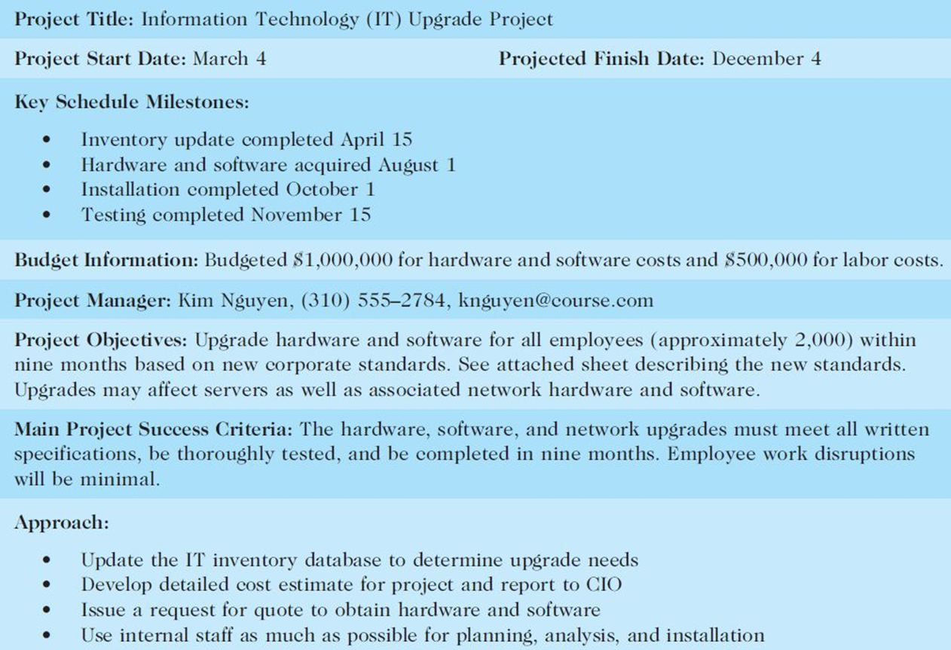

Slide 40
< TITLE>
<date>
<ponsor>
CONTEXT / ISSUES What is the issue and why is it important to tackle now? What is the purpose, the business reason for choosing this project? What are the anticipated benefits to customers and staff from the project? What performance measure needs to improve? What process/program/customer data do you have regarding the problem (time, cost, quality )? Show facts and processes visually using charts, graphs, maps, etc. When did the problem start? Where is the problem occurring? What is the extent or magnitude of the problem?
GOALS What specific, measurable , attainable, relevant, time-bound results do you want or need to accomplish? Show visually how much, by when, and with what impact.
SCOPE (IN BOUNDS) What is the first step and last step in the process? What is the program and geographic area? NOTE: Be mindful of what you can realistically accomplish with available resources and time. | SCOPE (OUT OF BOUNDS) What is off the table due to resources? What are the givens or assumptions for the project?
Customers/Stakeholders Who is the end-user customer? Who are other stakeholders who have a role or interest in the success of the process? | Team Members Team Leader: Team Members:
CUSTOMER REQUIREMENTS (CTQ) What do customers/stakeholders expect and require from the process? What are their critical to quality (CTQ) requirements? What legal requirements (laws, rules) govern the process?
VISION OF SUCCESS What outcomes or results do you want to see? What does success look like for our customer? What does success look like for other stakeholders (staff, partners)?
PROJECT MILESTONES & SCHEDULE
RESOURCES Time commitment for a 4 day Kaizen, excluding time to implement changes: Sponsor (6-10 hrs.); Team Leader (40 hrs.); Team Members (32 hrs.); Facilitator (40-50 hrs.) External Resources: Equipment: Materials:
Project Milestones | Owner | Proposed Date | Actual Date
1. Set project scope and goals (prepare Project Charter, engage team, collect data) | Sponsor/Team Leader, Facilitator
2. Understand the current situation | Facilitator/ Team
3. Analyze the current situation (root causes) | Facilitator/ Team
4. Define a vision of success | Facilitator/ Team
5. Generate, evaluate and select improvements | Team/ Sponsor
6. Implement changes and make adjustments | Team Leader/ Staff
7. Measure performance | Sponsor/Team Leader
8. Document standard work and lessons learned | Team
9. Sustain improvement | Team Leader/Process Owner
Notes:
An A3 Project Charter is a visual tool for communicating critical project information on one page. It helps ensure all parties working on the project are clear about what they need to accomplish and their role in the project.
Typical CI Project Benefits:
Improved quality and timeliness of services
Improved productivity and reduced service costs
Redeploy staff resources to higher priority areas
Enhanced service consistency
Easier to onboard and train new employees
Improved customer and staff satisfaction
Increased capacity for improving work
How will the project benefit/impact the end user customer (quality, timeliness, costs, results)?
How will the project benefit/impact staff and stakeholders?
How will the organization reinvest or reassign staff time that is saved?
What new work will the organization take on because of freed up staff time?
What are expected cost savings: <> one-time cost savings and <> ongoing/annual cost savings?

Slide 41
< TITLE>
<date>
<sponsor>
CONTEXT / ISSUES
GOALS
SCOPE (IN BOUNDS) | SCOPE (OUT OF BOUNDS)
Customers/Stakeholders | Team Members Team Leader: Team Members:
CUSTOMER REQUIREMENTS (CTQ)
VISION OF SUCCESS
PROJECT MILESTONES & SCHEDULE
RESOURCES Time commitment for a 4 day Kaizen, excluding time to implement changes: Sponsor (6-10 hrs.); Team Leader (40 hrs.); Team Members (32 hrs.); Facilitator (40-50 hrs.) External Resources: Equipment: Materials:
Project Milestones | Owner | Proposed Date | Actual Date
1. Set project scope and goals (prepare Project Charter, engage team, collect data) | Sponsor/Team Leader, Facilitator
2. Understand the current situation | Facilitator/ Team
3. Analyze the current situation (root causes) | Facilitator/ Team
4. Define a vision of success | Facilitator/ Team
5. Generate, evaluate and select improvements | Team/ Sponsor
6. Implement changes and make adjustments | Team Leader/ Staff
7. Measure performance | Sponsor/Team Leader
8. Document standard work and lessons learned | Team
9. Sustain improvement | Team Leader/Process Owner

Slide 42
Learning Check
What is one of the purposes of the Project Charter?
A. Authorize the project.
B. Discuss the project communication plan.
C. Evaluate team members performance.
D. Write a detailed project plan.
2.Which of these items are normally found in a Project Charter?
A. Earned value variance report
B. List of project team members.
C. Lessons learned.
D. The WBS.

Slide 43
Summary
In this Lecture we initiated planning for the project in terms of identifying and addressing the tasks required for project completion. We emphasized the importance of initial coordination of all parties involved and the smooth integration of the various systems required to achieve the project objectives.
Specific points made in the lecture were these:
A project charter is not simply a document stating facts and information about a project. It serves as the groundwork for effectively communicating with stakeholders and for efficiently routing work between actors that take part in the project.
The preliminary work plans are important because they serve as the basis for personnel selection, budgeting, scheduling, and control.

Slide 44
Top management should be represented in the initial coordinating meeting where technical objectives are established, participant responsibility is accepted, and preliminary budgets and schedules are defined.
The approval and change processes are complex and should be handled by the project manager.
Common elements of the project plan are the overview, statement of objectives, general approach, contractual requirements, schedules, budget, cost control procedures, evaluation procedures, and potential problems.

Slide 45
What is next?
In the next lecture, we will discuss ands describe some tools such as the Work Breakdown Structure (WBS), to aid in the planning process. We also briefly investigate several methods for controlling and monitoring.

Slide 46

Glossary
Project charter: A formal, typically short document that describes your project in its entirety — including what the objectives are, how it will be carried out, and who the stakeholders are. It is a crucial ingredient in planning out the project because it is used throughout the project lifecycle.
Planning is the process of thinking about the activities required to achieve a desired goal. It is the first and foremost activity to achieve desired results.
Risk: An uncertain event or condition that, if it occurs, has a positive or negative effect on one or more project objectives.
Change order: is work that is added to or deleted from the original scope of work of a contract, which alters the original contract amount and/or completion date.

Slide 47
Discussion Questions
Why is project planning so important?
What percentage of the total project effort do you think should be devoted to planning? Why?
What are the pros and cons concerning the early participation of the various functional areas in the project plan?

Slide 48
Resources

Slide 49


