Slide 1


Change Management
Prepared by Dr. Ranya Mahfouz
MGM323
Lecture 3

Slide 2


Change Management
Lecture 3
Organizational change
MGM323
Prepared by
Dr. Ranya Mahfouz

Slide 3
Agenda Organizational change
Introduction
How organizations really work;
Models and approaches to organizational change;
Summary and conclusions.

Slide 4
Agenda Organizational change
Introduction
How organizations really work;
Models and approaches to organizational change; and
Summary and conclusions.

Slide 5

Change Management
This subject is about learning how to manage change. The world around us is changing very quickly. Almost every day, there is a new discovery or innovation, especially in science. Globalization also has a big effect on how we think about politics and business. At the same time, the problems that come with globalization are growing just as fast, which is also a big concern.

Slide 6
Agenda Organizational change
Introduction
How organizations really work;
Models and approaches to organizational change; and
Summary and conclusions.

Slide 7

Chapter
How organizations really work;
03
We all have our own assumptions about how organizations work, developed through a combination of experience and education. The use of metaphor is an important way in which we express these assumptions.

Slide 8
Chapter
How organizations really work;
03
Some people talk about organizations as if they were machines. This metaphor leads to talk of organizational structures, job design and process reengineering. Others describe organizations as political systems.
They describe the organization as a seething web of political tricks where coalitions are formed and power rules supreme. They talk about hidden agendas, opposing factions and political maneuvering.

Slide 9

Chapter
Morgan identifies Four organizational metaphors:
03
These are the four that its seen in use most often by managers, writers and consultants, and that appear to us to provide the most useful insights into the process of organizational change. These are:
• organizations as machines;
• organizations as political systems;
• organizations as organisms;
• organizations as flux and transformation

Slide 10
Chapter
Morgan identifies Four organizational metaphors:
03
1- Organizations as machines;
Gareth Morgan says, ‘When we think of organizations as machines, we begin to see them as rational enterprises designed and structured to achieve predetermined ends.’ This picture of an organization implies routine operations, well-defined structure and job roles, and efficient working inside and between the working parts of the machine (the functional areas).

Slide 11

Chapter
Morgan identifies Four organizational metaphors:
03
1- Organizations as machines;
How change is tackled
Senior managers define targets and timescales. Consultants advise on techniques. The change programme is rolled out from the top down. Training is given to bridge the behaviour gap.

Slide 12

Chapter
Morgan identifies Four organizational metaphors:
03
1- Organizations as machines;
Who is responsible
Senior Management
Guiding Principles
Change must be driven. Resistance can be managed. Targets set at the start of the process define the direction.

Slide 13

Chapter
Morgan identifies Four organizational metaphors:
03
1- Organizations as machines;
The key beliefs are:
• each employee should have only one line manager;
• labour should be divided into specific roles;
• each individual should be managed by objectives;
• teams represent no more than the summation of individual efforts;
• management should control and there should be employee discipline.

Slide 14
Chapter
Morgan identifies Four organizational metaphors:
03
1- Organizations as machines;
This leads to the following assumptions about organizational change:
• The organization can be changed to an agreed end state by those in
positions of authority.
• There will be resistance, and this needs to be managed.
• Change can be executed well if it is well planned and well controlled.

Slide 15
Chapter
Morgan identifies Four organizational metaphors:
03
2- Political system
How change is tackled
A powerful group of individuals builds a new coalition with new guiding principles. There are debates, manoeuvrings and negotiations which eventually lead to the new coalition either winning or losing.
Change then ensues as new people are in power with new views and new ways of allocating scarce resources. Those around them position themselves to be winners rather than losers.

Slide 16
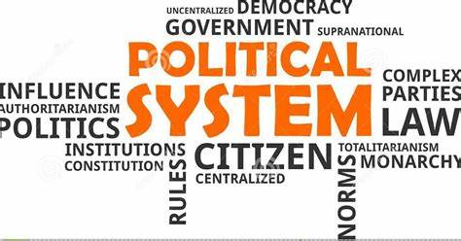
Chapter
Morgan identifies Four organizational metaphors:
03
2- Political system
How change is tackled
The political metaphor views organizations as arenas in which different groups compete for power and influence. In this type of organization, employees are encouraged to form alliances and coalitions to achieve their goals, and there is a constant struggle for control. The political metaphor is useful for organizations that operate in highly competitive environments, such as politics or the media.

Slide 17

Chapter
Morgan identifies Four organizational metaphors:
03
2- Political system
Who is responsible
Those with Power
Guiding Principles
There will be winners and losers. Change requires new coalitions and new negotiations.

Slide 18
Chapter
Morgan identifies Four organizational metaphors:
03
2- Political system
The key beliefs are:
• You can’t stay out of organizational politics: you’re already in it.
• Building support for your approach is essential if you want to make
anything happen.
• You need to know who is powerful, and who they are close to.

Slide 19
Chapter
Morgan identifies Four organizational metaphors:
03
2- Political system
The key beliefs are:
• There is an important political map that overrides the published
organizational structure.
• Coalitions between individuals are more important than work teams.
• The most important decisions in an organization concern the allocation of scarce resources, that is: who gets what, and these are reached through bargaining, negotiating and vying for position.

Slide 20
Chapter
Morgan identifies Four organizational metaphors:
03
2- Political system How change is tackled
This leads to the following assumptions about organizational change:
• The change will not work unless it’s supported by a powerful
person.
• The wider the support for this change, the better.
• It is important to understand the political map, and to understand
who will be winners and losers as a result of this change.
• Positive strategies include creating new coalitions and renegotiating
issues.

Slide 21
Chapter
03
Morgan identifies Four organizational metaphors:
3- Organisms
How change is tackled
There is first a research phase where data is gathered on the relevant issue (customer feedback, employee survey etc). Next, the data is presented to those responsible for making changes. There is discussion about what the data means, and then what needs to be done.
A solution is collaboratively designed and moved towards,
with maximum participation. Training and support are given to those who need to make significant changes.

Slide 22
Chapter
03
Morgan identifies Four organizational metaphors:
3- Organisms
How change is tackled
The organism metaphor views organizations as living entities that must adapt to their environment to survive. In this type of organization, employees are encouraged to be creative and flexible, and roles are less clearly defined. This metaphor is useful for organizations that need to be adaptable to changing circumstances, such as startups or companies operating in fast-paced industries.

Slide 23
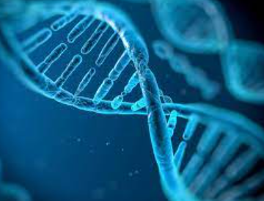
Chapter
03
Morgan identifies Four organizational metaphors:
3- Organisms
Who is responsible
Business improvement/ HR managers
Guiding Principles
There must be participation and involvement, and an awareness of the need for change. The change is collaboratively designed as a response to changes in the environment. People need to be supported through change.

Slide 24
Chapter
03
Morgan identifies Four organizational metaphors:
3- Organisms
The key beliefs are:
• There is no ‘one best way’ to design or manage an organization.
• The flow of information between different parts of the systems and its
environment is key to the organization’s success.
• It is important to maximize the fit between individual, team and
organizational needs.

Slide 25
Chapter
03
Morgan identifies Four organizational metaphors:
3- Organisms
This leads to the following assumptions about organizational change:
• Changes are made only in response to changes in the external environment
(rather than using an internal focus).
• Individuals and groups need to be psychologically aware of the need
for change in order to adapt.
• The response to a change in the environment can be designed and
worked towards.
• Participation and psychological support are necessary strategies for
success.

Slide 26
Chapter
03
Morgan identifies Four organizational metaphors:
4- Flux and transformation
How change is tackled
The initial spark of change is an emerging topic. This is a topic that is starting to appear on everyone’s agenda or is being talked about over coffee.
Someone with authority takes the initiative to create a discussion forum. The discussion is initially fairly unstructured, but well facilitated. Questions asked might be ‘Why have you come?’ ‘What is the real issue?’, ‘How would we like things to be?’ The discussion involves anyone who has the energy to be interested.

Slide 27
Chapter
03
Morgan identifies Four organizational metaphors:
4- Flux and transformation
How change is tackled
The flux and transformation metaphor sees organizations as constantly evolving and changing entities. In this type of organization, change is viewed as a natural part of the organization's life cycle, and employees are encouraged to embrace new ideas and perspectives. This metaphor is useful for organizations that are undergoing significant change or transformation, such as those undergoing a merger or restructuring.

Slide 28

Chapter
03
Morgan identifies Four organizational metaphors:
4- Flux and transformation
Who is responsible
Someone with authority to act
Guiding Principles
Change cannot be managed; it emerges. Conflict and tension give rise to change. Managers are part of the process. Their job is to highlight gaps and contradictions.

Slide 29
Chapter
03
Morgan identifies Four organizational metaphors:
4- Flux and transformation
The key beliefs are:
• Order naturally emerges out of mess.
• Organizations have a natural capacity to self-renew.
• Organizational life is not governed by the rules of cause and effect.
• Key tensions are important in the emergence of new ways of doing
things.
• The formal organizational structure (teams, hierarchies) only represents one of many dimensions of organizational life..

Slide 30
Chapter
03
Morgan identifies Four organizational metaphors:
4- Flux and transformation
This leads to the following assumptions about organizational change:
• Change cannot be managed. It emerges.
• Managers are not outside the systems they manage. They are part
of the whole environment.
• Tensions and conflicts are an important feature of emerging change.
• Managers act as enablers. They enable people to exchange views and
focus on significant differences.

Slide 31
Chapter
03
Morgan identifies Four organizational metaphors:
In conclusion, understanding the different metaphors that underpin organizational structures can be a useful tool for analyzing and interpreting the behavior of different organizations. By applying these metaphors, managers and employees can gain a deeper understanding of their organization's strengths and weaknesses and make more informed decisions about how to improve their performance. Whether your organization operates like a machine or an organism, a brain or a culture, or a political arena, understanding the underlying metaphor can help you unlock its potential and achieve greater success.

Slide 32
Agenda Organizational change
Introduction
How organizations really work;
Models and approaches to organizational change;
Summary and conclusions.

Slide 33
Chapter
Models and methods of organizational change
03
Models of organizations as open, interconnected, interdependent sub-systems sit within the organism metaphor. This model is very prevalent in the human resource world, as it support much of the thinking that drove the creation of the HR function in organizations. The organism metaphor views change as a process of adapting to changes in the environment. The focus is on designing interventions to decrease resistance to change and increase the forces for change.

Slide 34
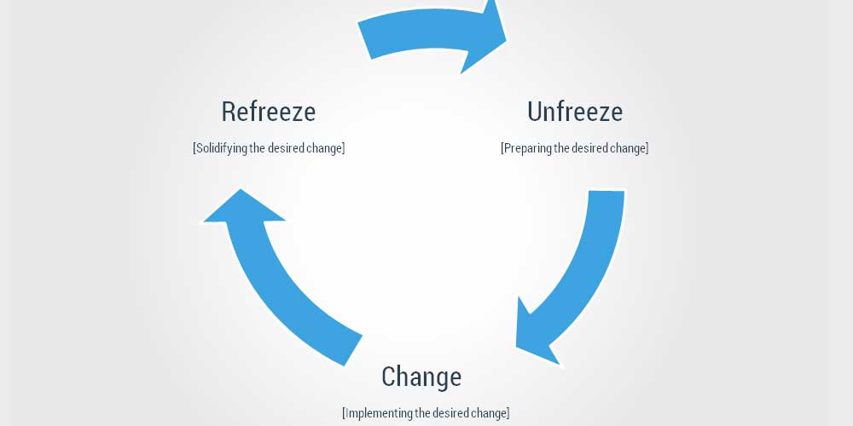
Chapter
Models and methods of organizational change
03
1- Lewin, three-steps model
Lewin’s Change Model was developed by Kurt Lewin, a German American psychologist who studied human social behaviour and group dynamics.
Lewin’s model features three stages that illustrate how people react when they’re faced with change — including changes in the way their workplace runs. The three stages are as follows:
Unfreeze: A person is in their existing state
Change: They move or change into a new state
Refreeze: They refreeze into and solidify the new state

Slide 35

Chapter
Models and methods of organizational change
03
1- Lewin, three-step model
Advantages of Lewin’s Change Management Model
1. Easy to Understand
2. Based on Psychology
3. Creates Sustainable Change
4. Puts People First

Slide 36
Chapter
Models and methods of organizational change
03
1- Lewin, three-step model
Disadvantages of Lewin’s Change Management Model
1. It May Be Too Simple for Some
2. It May Be Too Strict
3. It Can Be Seen as Combative
4. Works Best for Long-Term Projects

Slide 37

Chapter
Models and methods of organizational change
03
2- Bullock and Batten, planned change
According to Bullock and Batten (1985), a phase refers to an organizational state and a process refers to the mechanisms needed to move from one state to another.
Bullock and Batten (1985) obtained their theories from project management and they suggested utilizing four-phase model to change, namely; Exploration, Planning, Action, and integration for planned change.

Slide 38
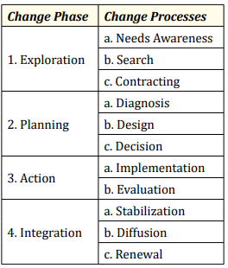

Chapter
Models and methods of organizational change
03
2- Bullock and Batten, planned change

Slide 39
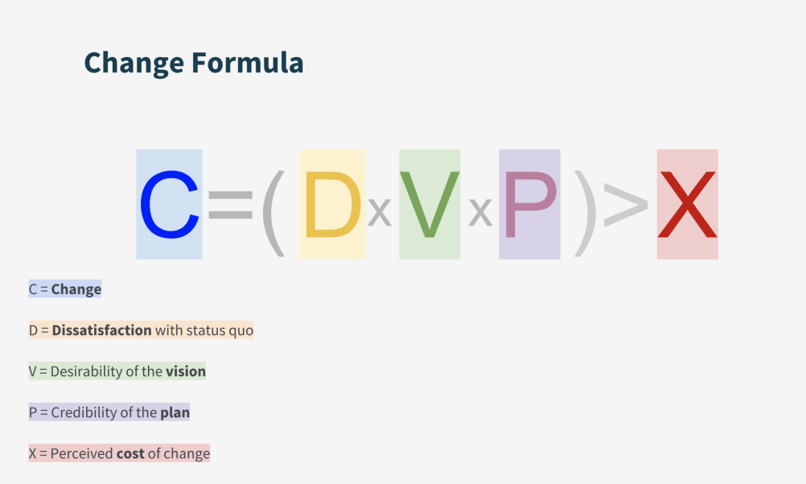
Chapter
03
Models and methods of organizational change
3- Beckhard and Harris, change formula
The change formula is simple but highly effective.
It is expressed as follows:
D x V x FS > R
Where:
D = Dissatisfaction with the status quo
V = Vision of a desired future state
FS = First Steps towards achieving the vision
R = Resistance towards change

Slide 40

Chapter
03
Models and methods of organizational change
3- Beckhard and Harris, change formula
advantages of using the Beckhard and Harris Change Formula:
Provides a structured approach
Focuses on critical factors
Helps identify potential barriers
Facilitates communication
Helps evaluate the potential success of a change initiative

Slide 41

Chapter
03
Models and methods of organizational change
3- Beckhard and Harris, change formula
disadvantages of using the Beckhard and Harris Change Formula:
Simplistic approach
Limited applicability
Lack of context
Overemphasis on early stages
Ignores feedback

Slide 42
🌍 Case Study: Organizational Change at Netflix
Background:
Netflix began in 1997 as a DVD rental service by mail. By 2010, it faced a massive technological disruption: streaming services were growing, and DVDs were becoming obsolete. To survive, Netflix had to completely transform its business model.
The Change Process:
Unfreeze (Lewin’s Model)
Netflix realized that the DVD market was dying. Management shared transparent data about declining rentals and rising competition, creating dissatisfaction with the status quo (D).
Change:
The company shifted from physical rentals to online streaming. Employees were trained in new digital systems, engineers were hired, and partnerships with studios were built. This was the first step (FS) toward the new vision (V) of becoming a global digital platform.
Refreeze:
Netflix stabilized the new model by embedding a culture of innovation—encouraging experimentation, flexibility, and continuous adaptation (Organism Metaphor).

Slide 43
Metaphors in Action:
Machine: In the beginning, Netflix operated with structured processes—warehouse operations, logistics, and inventory management.
Political System: Some executives resisted the shift to streaming. CEO Reed Hastings built coalitions to support the vision and overcame internal resistance.
Organism: As the environment changed, Netflix adapted dynamically, launching original content and AI-driven recommendations.
Flux & Transformation: Netflix today embraces constant change—each year, it experiments with new formats, technologies, and markets. Change has become part of its DNA.
Outcome:
Netflix transformed from a DVD mail service into one of the world’s most powerful entertainment platforms. The company’s adaptive culture became a global model of successful change management.

Slide 44

https://wayground.com/join?gc=07984462&source=liveDashboard
07984462

Slide 45
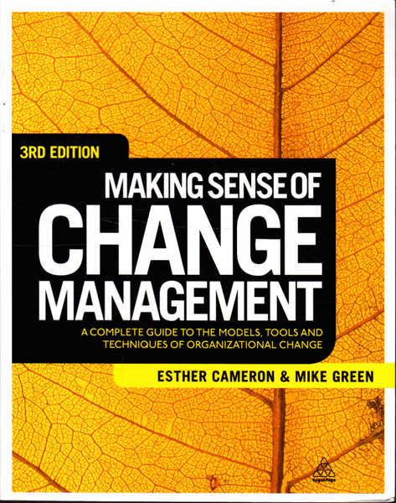
Textbook
Thank You

