Slide 1


Agile Project
Management
Prepared by Eng. Ahmed Hussein, MBA, PfMP©, PMP©, CMP APMG
PMG 622
Master of Project Management
Lecture 05

Slide 2


Different Agile Frameworks and Methodologies
Lecture 5
PMG 622
Agile Project Management
Prepared by
Eng. Ahmed Hussein, MBA, PfMP©, PMP©, CMP APMG
www.midocean.ae

Slide 3

Chapter
Learning Objectives
05
Learn a brief overview and core principles of the following Agile Frameworks and Methodologies:
  Lean Product Development
  Kanban
  Scrum
  Xtreme Programming (XP)
  Crystal
  DSDM
  FDD
www.midocean.ae

Slide 4
Chapter
There are many different Agile Frameworks
05
Lean
Agile
Scrum
ScrumBan
Kanban
Crystal
DSDM
XP
FDD
www.midocean.ae

Slide 5
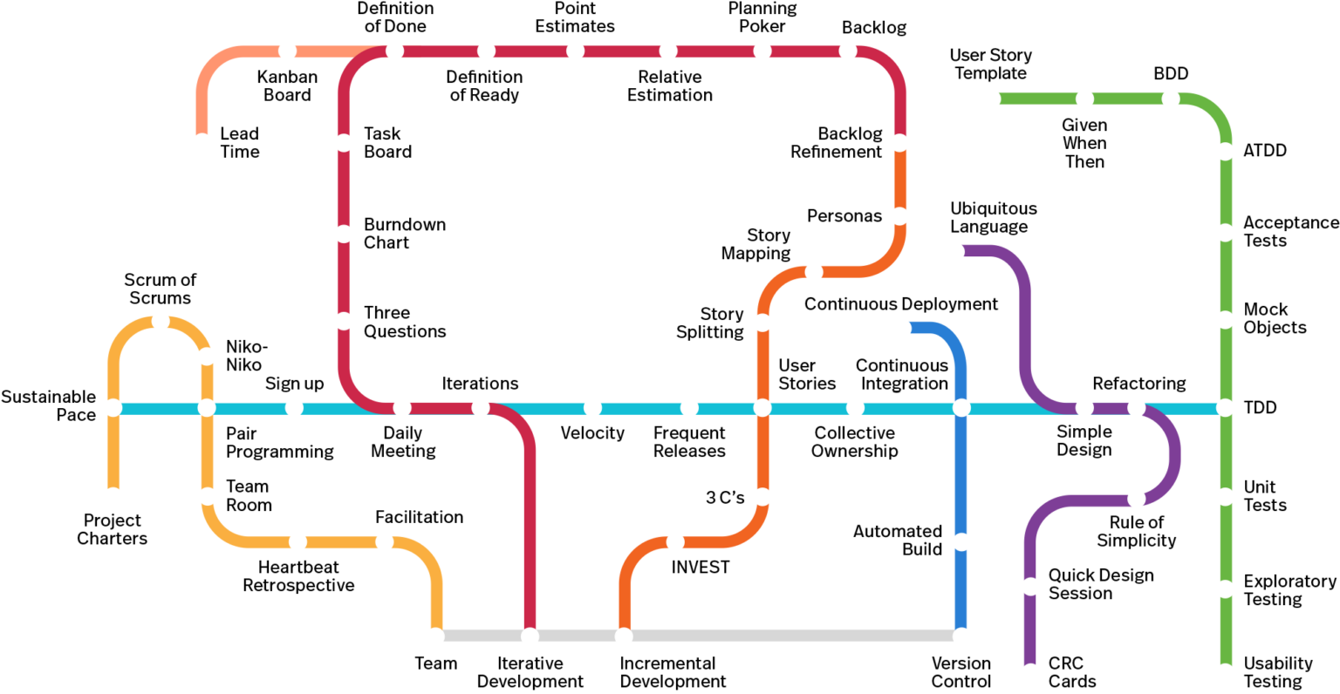
Chapter
The Agile Subway Roadmap
05
Retrieved from https://www.agilealliance.org/agile101/subway-map-to-agile-practices/
www.midocean.ae

Slide 6

Chapter
Lean Product Development
05
www.midocean.ae

Slide 7



Chapter
Lean Product Development
05
Using visual management tools
Identifying costumer defined value
Building in learning and continuous improvement
Lean product development (LPD) is a systematic approach to product development that focuses on eliminating waste in processes and delivering value to customers as quickly as possible.
It is based on the principles of lean manufacturing, started in Toyota Company
Used mainly for operations but principles can be applied to projects
Using visual management tools
Identifying costumer value
Building in learning and continuous improvement
www.midocean.ae

Slide 8
Chapter
Lean Product Development – Seven Core Concepts
05
Using visual management tools
Identifying costumer defined value
Building in learning and continuous improvement
Eliminate waste
Empower the team
Deliver fast
Optimize the whole
Build quality in
Defer decisions
Amplify learning
www.midocean.ae

Slide 9
Chapter
Lean Product Development – Seven Wastes
02
Partially done work
Extra processes
Extra features
Task switching
Waiting
Motion
Defects
www.midocean.ae

Slide 10
Chapter
Lean Product Development – Main Tools
02
Lean Tools
Value Stream Mapping
Kaizen
Kanban
Root-Cause Analysis
Bottleneck Analysis
PDCA
www.midocean.ae

Slide 11
Chapter
Kanban
05
www.midocean.ae

Slide 12

Chapter
Kanban Overview and Principles
05
Kanban is an approach for designing, managing, and improving the flow of processes in systems
Organizations can use it to visualize the flow of work and limit work in progress
Used for projects as well as continuous operations
Establishes a method for “pull” systems, or Just in Time (JIT) Work by using Kanban Boards.
Japanese word meaning “Card” “signal”
www.midocean.ae

Slide 13
Chapter
Kanban Five Principles
05
5 principles
Visualize the workflow
Limit WIP (work in progress)
Manage flow
Make process policies explicit
Improve collaboratively
www.midocean.ae

Slide 14

Chapter
Kanban Board – Pull System
02
To Do
In Progress
Done
User Story 1
User Story 2
User Story 3
User Story 4
User Story 5
www.midocean.ae

Slide 15
Kanban Boards are typically used for Iteration/ Sprint Management and Tracking (ScrumBan)
Chapter
02
Product Backlog
Iteration 1 Backlog (12)
Design (3)
Development
(2)
Testing
(2)
Done
User Story 150
User Story 100
User Story 96
User Story 94
User Story 90
User Story 80
User Story 151
User Story 101
User Story 97
User Story 95
User Story 81
User Story 152
User Story 102
User Story 82
User Story 83
www.midocean.ae

Slide 16
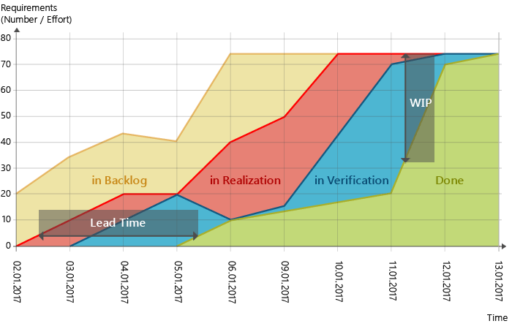
Chapter
Cumulative Flow Diagrams
05
We use lead time, WIP as metrics to track performance instead of velocity
www.midocean.ae

Slide 17
Chapter
Scrum
05
www.midocean.ae

Slide 18
Chapter
Scrum Overview and Pillars
05
Most Widely uses Agile Methodology
Goal is to deliver working products to customers on a regular basis
Time-boxed iterations (sprints) with a focus on planning, execution, and review
Focus on customer collaboration, value delivery, and continuous improvement
Transparency
Gives visibility to those responsible
Inspection
Timely checks of how the project is progressing
Adaptation
Adjusting team’s process and course correcting
www.midocean.ae

Slide 19
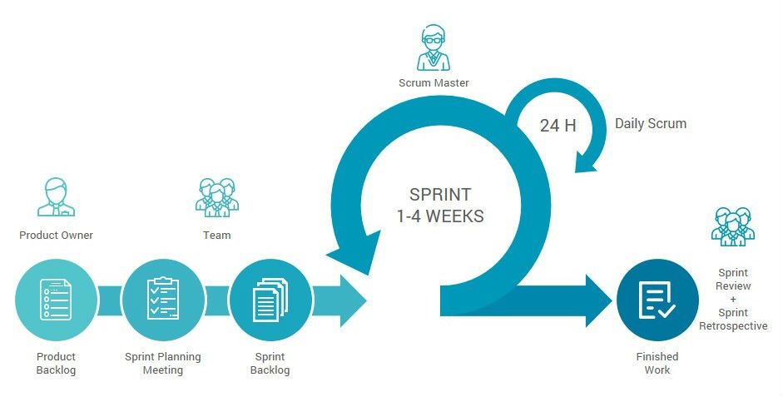
Chapter
Scrum Process
05
www.midocean.ae

Slide 20
Chapter
Scrum Ceremonies
05
Backlog Refinement
“grooming the backlog”
Everyone in the project discusses and updates items
Sprint Planning Meeting
Everyone decides what will be included in the next sprint/iteration
Product owner presents updated backlog
Group gets shared understanding
Team forecast what can be delivered
Daily Scrum
15-minute timeboxed meeting
Same time everyday
ScrumMaster is responsible
3 questions
What have I done since last daily scrum
What do I plan to do today
Are there any impediments to my progress
Sprint Review
At the end of each sprint
Sprint Retrospective
After the sprint review, before next sprint planning meeting
Includes Team, product owner, and ScrumMaster
Product owner inspects work/explains what is missing
Team holds final “inspect and adapt” activity
Find improvements for next sprint
www.midocean.ae

Slide 21
Chapter
Scrum Team Roles
05
Team
The people building the product
They are self organizing
They are cross-functional
Product Owner
Maximizes value of the product by managing the product backlog
Ensures work items in backlog are up to date
Responsible or the business and the team having a shared understanding of the project vision
ScrumMaster
Ensures scrum methodology is understood and used effective
They are a servant leader
Removes impediments to team
May also serve as an Agile Coach - Facilitating the organization's adoption of scrum on an enterprise level
www.midocean.ae

Slide 22
Chapter
Scrum Key Artifacts
05
Product Increment
Build by the team
It’s an increment of the solution
“Definition of Done” is agreed upon before the team begins working
Product Backlog
Prioritized list of all the work
May include:
Features
Functions
Requirements
Quality attributes
Sprint Backlog
Subset of items in product backlog selected as the goal for a specific sprint
It’s the team’s commitment for functionality that they will deliver
Is highly visible
Updated by the team
User Stories
fixes
www.midocean.ae

Slide 23
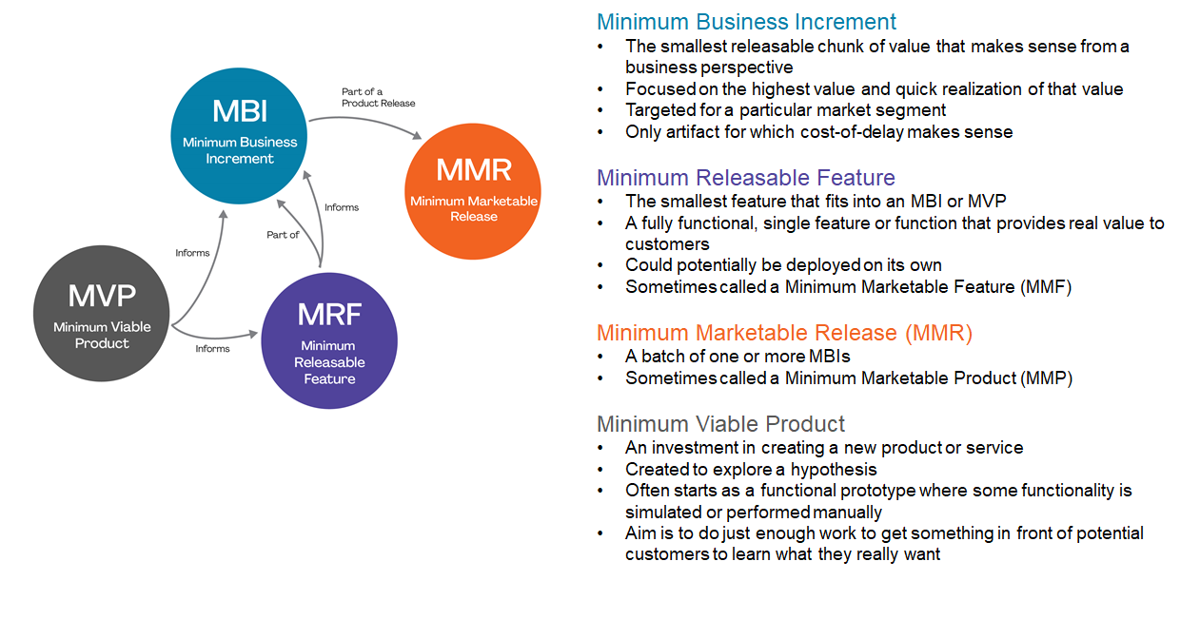
Chapter
Scrum Key Terms
05
www.midocean.ae

Slide 24


Chapter
Scrum Key Terms – Scrum of Scrums
05
Takes place on a regular basis
A representative from each team meets
The representative reports back to their teams any issues
www.midocean.ae

Slide 25
Chapter
Extreme Programming (XP)
05
www.midocean.ae

Slide 26
Chapter
XP Overview and Core Values
05
Goal is to produce High-Quality Software while also improving the team’s quality of life
Low risk, flexible, and cost-effective method
Testing software starts from the beginning and feedback used to improve the development
Simplicity
Communication
Feedback
Courage
Respect
www.midocean.ae

Slide 27
Chapter
XP – Team Roles
05
Using visual management tools
Identifying costumer defined value
Building in learning and continuous improvement
Coach
Customer
Programmers
Testers
www.midocean.ae

Slide 28
Chapter
XP – Core Practices (1/2)
05
Using visual management tools
Identifying costumer defined value
Building in learning and continuous improvement
Whole Team
Planning games
Small releases
Customer tests
Collective code ownership
Code standards
Sustainable pace
Co-Location, Generalized Specialists, Role Switching
used in Release Planning and Iteration Planning
frequent small releases for testing, and continuous integration
Customer describes test criteria, then the team builds automated tests to prove that the solution met criteria
everyone works on code to increase visibility and knowledge, identify defects early and reduce risk when a team member leaves
The team chooses a single standard for coding
Improves productivity and Optimizes delivery of long-term value
www.midocean.ae

Slide 29
Chapter
XP – Core Practices (2/2)
05
Using visual management tools
Identifying costumer defined value
Building in learning and continuous improvement
Metaphor
Continuous integration
Test-driven development
Refactoring
Simple design
Pair programming
uses metaphors to establish comparisons so that all stakeholders understand how a system should work
Automated integration testing, Ensures all code works together, and Surfaces problems early, decreasing rework
Team writes acceptance tests prior to developing the new code
Shortens the test-feedback cycle as much as possible
Improves design of existing code, increases Efficiency in coding enhances ability to apply changes and new functionality easily
developers working as a pair, one writes, the other reviews – changing roles frequently
Helps to capture issues early, save time, spread knowledge
www.midocean.ae

Slide 30
Chapter
Crystal
05
www.midocean.ae

Slide 31

Chapter
Crystal Overview
05
A software development approach that focuses on people and their interactions rather than tools and processes
Crystal goal is streamlining and optimizing processes
Lightweight and Adaptable
Consists of a family of methodologies coded by color names
Customized by criticality and team size
www.midocean.ae

Slide 32
Chapter
Example of Crystal Methods Chart
05
Criticality | Crystal Clear | Crystal Yellow | Crystal Orange | Crystal Red | Crystal Magenta
Life | L6 | L20 | L40 | L100 | L200
Essential Funds | E6 | E20 | E40 | E100 | E200
Discretionary Funds | D6 | D20 | D40 | D100 | D200
Comfort | C6 | C20 | C40 | C100 | C200
TEAM SIZE | 1-6 | 7-20 | 21-40 | 41-100 | 101-200
www.midocean.ae

Slide 33
Dynamic Systems Development Method (DSDM)
Chapter
05
www.midocean.ae

Slide 34
Chapter
DSDM Overview
05
Was an earlier agile method used to rapidly develop and deliver high quality software
Goal is to guarantee strong governance of projects during the whole project life cycle
User-Driven and thinks Change is expected at all times
Time-boxed iterations (phases) with a focus on business involvement, iterative development, and continuous testing
www.midocean.ae

Slide 35
Chapter
DSDM – Eight Principles
05
Focus on the business need
Deliver on time
Collaborate
Never compromise quality
Build incrementally from firm foundations
Develop iteratively
Communicate continuously and clearly
Demonstrate control
www.midocean.ae

Slide 36



Chapter
DSDM Process
05
Feasibility
Functional Model Iteration
Implementation
Design & Build Iteration
www.midocean.ae

Slide 37
Feature Driven Development
(FDD)
Chapter
05
www.midocean.ae

Slide 38
Chapter
FDD Overview
05
Goal to develop stable and functional products on time
Iterative and Incremental
Build by Feature
Design by Feature
Develop an Overall Model
Build a Feature List
Plan By Feature
www.midocean.ae

Slide 39
Chapter
FDD – Good Practices
05
Developing by feature
Business modeling
Feature teams
Inspections
Configuration management
Regular builds
Visibility of progress and results
Individual class (code) ownership
www.midocean.ae

Slide 40
Comparing Agile Frameworks and Methodologies
Element | Lean | Kanban | Scrum | Xp | Crystal | DSDM | FDD
Focus | Eliminating waste and delivering value to customers quickly | Visualizing and optimizing the flow of work | Delivering working software to customers on a regular basis | Producing high-quality software and improving the quality of life for the team | Lightweight and flexible, with no prescribed process | Rapidly developing and delivering high-quality software | Building features in a short, iterative, and incremental manner
Process | Iterative and incremental | Pull-based system with no fixed iterations | Time-boxed iterations (sprints) with a focus on planning, execution, and review | Time-boxed iterations (releases) with a focus on communication, feedback, and continuous improvement | Lightweight and flexible, with no prescribed process | Time-boxed iterations, focus on business involvement, iterative development, and continuous testing | Process-driven approach with a focus on domain modeling, feature development, and inspections
Principles | Focus on customer value, continuous improvement, and collaboration | Focus on continuous flow, work-in-progress limits, and visualization | Focus on customer collaboration, value delivery, and continuous improvement | Focus on communication, feedback, continuous improvement, and technical excellence | Focus on simplicity, communication, collaboration, and adaptability | Focus on customer collaboration, risk management, and continuous improvement | Focus on visibility, communication, collaboration, and quality
Others | Can be used with any agile methodology | Can be used for software development, but also other types of work | Most widely used agile methodology | The most specific agile framework regarding appropriate practices for software development | Can be used for software development, but also other types of work |  | Well-suited for software development projects with complex requirements

Slide 41
Chapter
Key Points
05
Scrum is the most widely used Agile Methodology
Some Agile methodologies as Lean, Crystal has no prescribed processes
Most methodologies started in the Software Industry, except for Lean and Kanban who came from manufacturing
You can mix tools from different methodologies together in your Agile project
www.midocean.ae

Slide 42

www.midocean.ae
Preparation for discussion panel:
Which of the Agile Frameworks and methodologies are you using or planning to use?
Why?
Chapter
05
For Discussion Panel

Slide 43
www.midocean.ae
Before next lecture:
Watch the Video
“Intro to Scrum in Under 10 Minutes”
Chapter
05
For Next Lecture

Slide 44


Thank You

