Slide 1


Health Insurance
Prepared by Dr. Hayat Farag
MHA631
Health Insurance
Introduction Lecture

Slide 2

Course Topics
Mutual Expectations
Teaching Team
Course Structure

Slide 3
Teaching Team
The course will be prepared and presented by Dr. Hayat Farag.
Education:
PhD. in Economics and Managerial Science, Alexandria University (Ongoing).
Academic Master’s degree in Business Administration, Arab Academy for Science, Technology, and Maritime Transport, Egypt.
MBA, Arab Academy for Science, Technology, and Maritime Transport, Egypt.
BSc. in Pharmaceutical Sciences, Alexandria University.
Work Experience:
Extensive experience in Pharmaceutical Industry (Health Insurance & University Hospitals).
Academic and professional experience in teaching Postgraduate Business Students.
Data Analyst (SPSS software).
Research Experience:
Speaker in the World Conference on Management, Business, and Finance (December 2023, UAE).
Speaker in the 3rd Common Good HRM, Vienna University of Economics and Business (March 2025, Online).

Slide 4
Course Topics
Introduction to Health Insurance.
Managed Health Care.
Processing Insurance Claim.
Legal and Regulatory Issues.
Overview of ICD Coding.

Slide 5
Course Topics
Overview of Current Procedural Terminology (CPT) system.
CMS Reimbursement Methodologies.
Coding for Medical Necessity.
Essential Claim Instructions.
Commercial Insurance.

Slide 6
Course Structure
Course Code : MHA631.
Credit Hours : 3 Credit hours.
Course References : Understanding Health Insurance: A guide to billing and reimbursement, Tenth Edition, by Green & Rowell.
Classes: Recorded lectures.
Discussion Class: For any questions & Interactive learning.
Self-study: Search & Reading are needed.

Slide 7
Course Structure
Course Code : MHA631.
Credit Hours : 3 Credit hours.
Course References : Understanding Health Insurance: A guide to billing and reimbursement, Tenth Edition, by Green & Rowell.
Classes: Recorded lectures.
Discussion Class: For any questions & Interactive learning.
Self-study: Search & Reading are needed.

Slide 8
To be treated with professionalism and respect.
Well-prepared lectures, with resources.
Guidance and support throughout the course.
Engaging discussion sessions.
Expectations:
What is expected from us

Slide 9
Show respect and professional manner to staff, peers and administration.
Listen to recorded lectures weekly.
Effective time management.
Active participation in discussion sessions.
Enjoy learning process.
Expectations:
What is expected from you

Slide 10
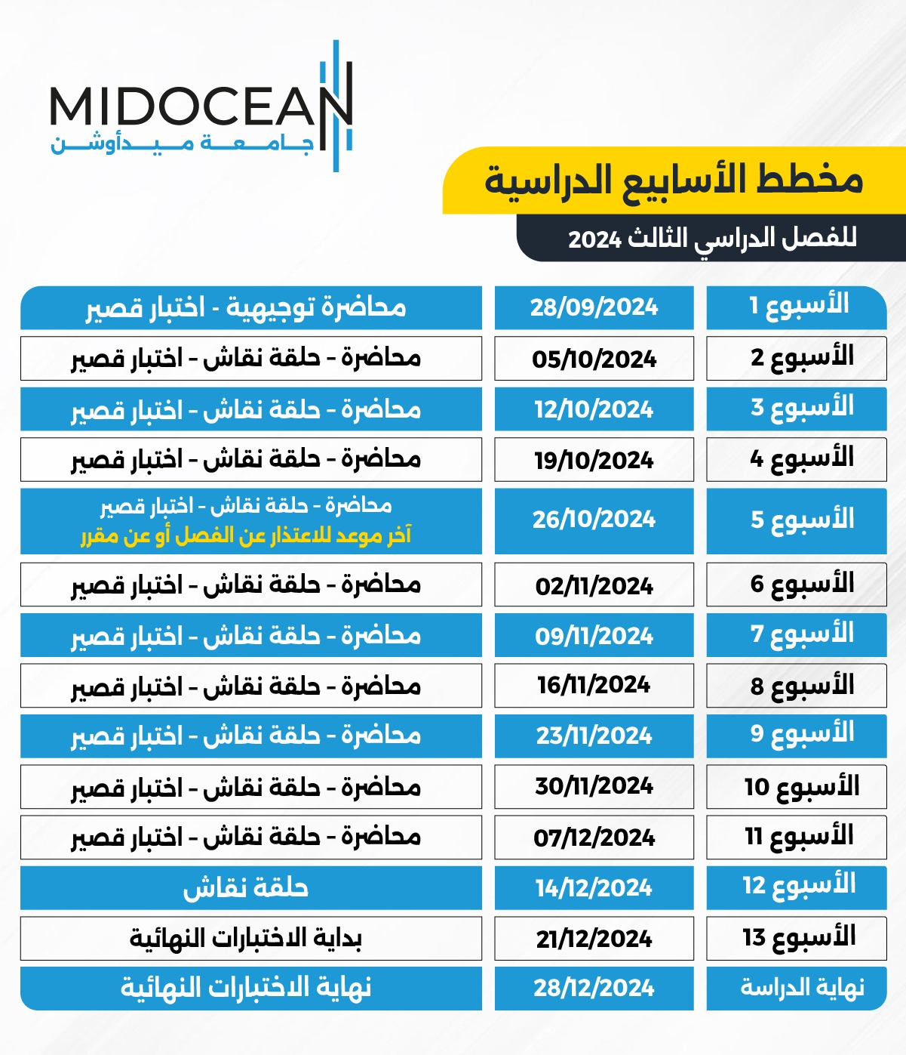
13 weeks.
Recorded lecture weekly, in addition to PPT & PDF files.
Discussion lecture (optional).
Quiz: MCQ & T/F questions.
Quiz contains 8 questions (8 marks = 80%).
Final exam contains 20 questions (20 marks = 20%).

Slide 11



Thank You

