Slide 1

E-Commerce
Prepared by Dr. Adam Yagoub
Lecture 2
MGM212
E-commerce fundamentals

Slide 2
Lecture 2
Course Outline
Lecture 1: Introduction to e-business and e-commerce.
Lecture 2: E-commerce fundamentals.
Lecture 3: E-business infrastructure.
Lecture 4: - E-environment.
Lecture 5: E-business strategy
Lecture 6: E-procurement.
Lecture 7: E-marketing.
Lecture 8: Customer relationship management.
Lecture 9: Analysis and design.
Lecture 10: Implementation and maintenance.

Slide 3
Lecture 2
Key Learning Points
Lecture Outline
1. Introduction.
2. The e-commerce environment.
- Strategic agility.
Online marketplace analysis.
3. Location of trading in the marketplace.
- The importance of multi-channel marketplace models.
- Different types of online intermediary.
- Types of intermediaries.
The importance of search engines.
4. Business models for e-commerce.
- Revenue models.
- Online publisher and intermediary revenue models.
5. Focus on auction business models.

Slide 4
Lecture 2
Lecture Outcomes
After completing this chapter the reader should be able to:
1. Complete an online marketplace analysis to assess competitor, customer, and intermediary use of the Internet as part of strategy
Development.
2. Identify the main business and marketplace models for electronic
communications and trading.
3. Evaluate the effectiveness of business and revenue models for
online businesses.

Slide 5
Lecture 2
E-commerce fundamentals
1. Introduction:
Electronic communications are disruptive technologies that have caused major changes in industry structure, marketplace structure and business models. Consider a B2B organization. Traditionally it has sold its products through a network of distributors. With the advent of e-commerce it now has the opportunity to bypass distributors and trade directly with customers via a destination web site, and it also has the opportunity to reach customers through new B2B marketplaces. Similarly, for B2C organizations such as an e-retail destination site there is the opportunity to market its products through online intermediaries such as search engines, price comparison sites, social networks, blogs and other publisher sites.

Slide 6
Lecture 2
E-commerce fundamentals
Organizations that monitor, understand and respond appropriately to changes in their online marketplace have the greatest opportunities to use digital technologies to compete effectively. Understanding the online elements of an organization’s environment as illustrated in Figure 2.1 is a key part of situation analysis for e-business strategy development. There is also the need for a process to continually monitor the environment which is often referred to as environmental scanning.

Slide 7
Lecture 2
E-commerce fundamentals
Knowledge of the opportunities and threats presented by these marketplace changes is essential to those involved in defining business, marketing and information systems strategy.

Slide 8
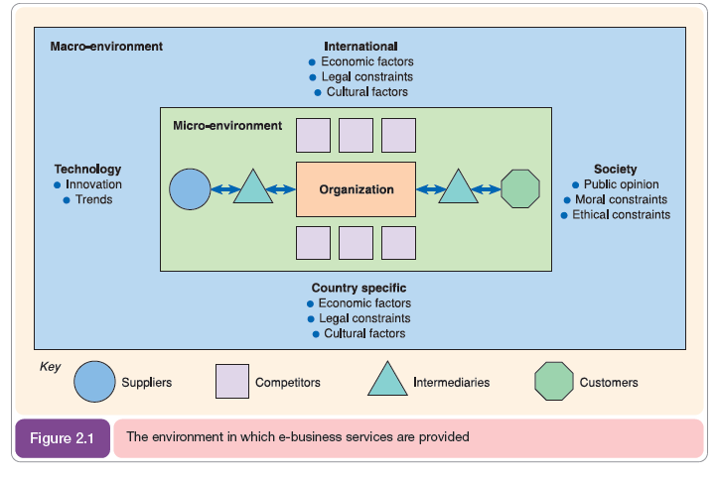
Lecture 2
E-commerce fundamentals

Slide 9
Lecture 2
E-commerce fundamentals
2. The e-commerce environment:
All organizations operate within an environment that influences the way in which they conduct business. Strategy development should be strongly influenced by considering the environment the business operates in, as illustrated in Figure 2.1. To inform e-commerce strategy, the most significant influences are those of the immediate marketplace of the micro-environment that is shaped by the needs of customers and how services are provided to them through competitors and intermediaries and via upstream suppliers.

Slide 10
Lecture 2
E-commerce fundamentals
Wider influences are provided by local and international economic conditions and legislation together with whatever business practices are acceptable to society. Finally, technological innovations are vital in providing opportunities to provide superior services to competitors or through changing the shape of the marketplace.

Slide 11
Lecture 2
E-commerce fundamentals
- Strategic agility
The capacity to respond to these environmental opportunities and threats is commonly referred to as strategic agility. Strategic agility is a concept strongly associated with knowledge management theory and is based on developing a sound process for reviewing marketplace opportunities and threats and then selecting the appropriate strategy options.

Slide 12
Lecture 2
E-commerce fundamentals
- Online marketplace analysis
Analysis of the online marketplace or ‘marketspace’ is a key part of developing a long-term e-business plan or creating a shorter-term digital marketing campaign. Completing a marketplace analysis helps to define the main types of online presence that are part of a ‘click ecosystem’ which describes the consumer behavior (Chapter 9) or flow of online visitors between search engines, media sites and other intermediaries to an organization and its competitors. Prospects and customers in an online marketplace will naturally turn to search engines to find products, services, brands and entertainment.

Slide 13
Lecture 2
E-commerce fundamentals
Search engines act as a distribution system which connects searchers to different intermediary sites for different phrases, so the flow of visits between sites must be understood by the marketer in their sector.
To help understand and summarize the online linkages between online businesses and traffic flows it is worthwhile to produce an online marketplace map as shown in Figure 2.3. This shows the relative importance of different online intermediaries in the marketplace and the flow of clicks between your different customer segments, your company site(s) and different competitors via the intermediaries.

Slide 14
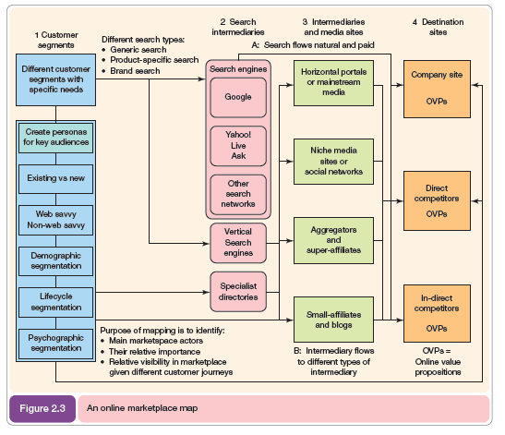
Lecture 2
E-commerce fundamentals
The main elements of the online marketplace map presented in Figure 2.3 are:
1. Customer segments.
The marketplace analysis should identify and summarize different target segments for an online business in order to then understand their online media consumption, buyer behavior and the type of content and experiences they will be looking for from intermediaries and your web site.
2. Search intermediaries.
These are the main search engines in each country. Typically they are Google, Yahoo!, Microsoft Live Search and Ask, but others are important in some markets such as China (Baidu), Russia (Yandex) and South Korea (Naver).

Slide 15
Lecture 2
E-commerce fundamentals
3. Intermediaries and media sites.
Media sites and other intermediaries such as aggregators and affiliates are often successful in attracting visitors via search or direct since they are mainstream brands.
4. Destination sites
These are the sites that the marketer is trying to generate visitors to, whether these are transactional sites, like retailers, financial services or travel companies or manufacturers or brands.

Slide 16
Lecture 2
E-commerce fundamentals
3. Location of trading in the marketplace:
While traditional marketplaces have a physical location, an Internet-based market has no physical presence – it is a virtual marketplace. Rayport and Sviokla used this distinction to coin a new term: electronic marketplace. This has implications for the way in which the relationships between the different actors in the marketplace occur.
The new electronic marketspace has many alternative virtual locations where an organization needs to position itself to communicate and sell to its customers.

Slide 17
Lecture 2
E-commerce fundamentals
- The importance of multi-channel marketplace models
it needs to be stressed that in many categories, purchasers use a combination of channels. As consumers follow their customer journeys as they select products and interact with brands, they do not use the Internet in isolation – they consume other media such as print, TV, direct mail and outdoor.

Slide 18
Lecture 2
E-commerce fundamentals
These media are still very important for marketers to communicate with customers who still spend the majority of their waking hours in the real world rather than the virtual world. It follows that an effective approach to using the Internet is as part of a multi-channel marketing strategy. This defines how different marketing channels should integrate and support each other in terms of their proposition development and communications based on their relative merits for the customer and the company.

Slide 19
Lecture 2
E-commerce fundamentals
- Different types of online intermediary
As we showed through Figure 2.3, identifying different types of online intermediary as potential partners to promote an e-business is a key part of marketplace analysis. In this section, we take a more in-depth look at the different types of intermediaries and the business and revenue models they adopt.

Slide 20
Lecture 2
E-commerce fundamentals
Sarkar et al. identified many different types of new intermediaries (mainly from a B2C perspective) which they refer to using the dated term ‘cybermediaries’. Hagel and Rayport use ‘infomediary’ specifically to refer to sale of customer information. See Box 2.2 for further information on this concept and the related concept of the metamediary.

Slide 21
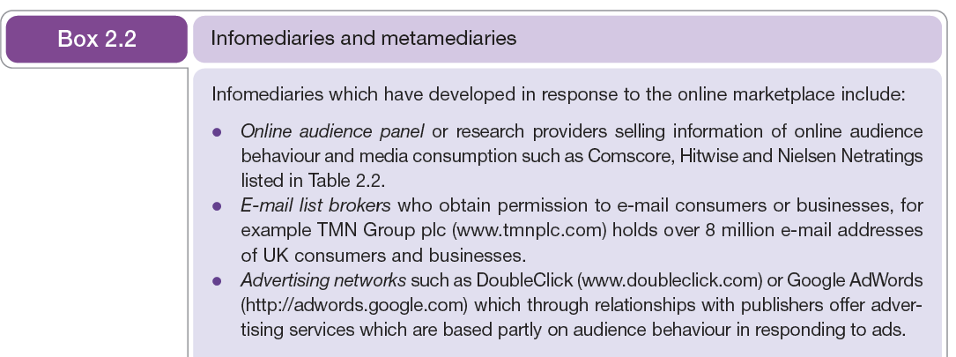
Lecture 2
E-commerce fundamentals

Slide 22
Lecture 2
E-commerce fundamentals
Some of the main new intermediaries identified by Sarkar et al. were:
- Directories (such as Yahoo!, Excite).
- Search engines (AltaVista, Infoseek).
- Malls (BarclaySquare, Buckingham Gate).
- Virtual resellers (own-inventory and sell-direct, e.g. Amazon, CDNow).
- Financial intermediaries (offering digital cash and cheque payment services, such as Digicash).
- Forums, fan clubs and user groups (referred to collectively as ‘virtual communities’).
- Evaluators (sites which perform review or comparison of services)

Slide 23
Lecture 2
E-commerce fundamentals
- Types of intermediaries
Intermediaries vary in scope and the services they offer, so naturally terms have evolved to describe the different types. The main types of intermediary you will identify as part of an online marketplace analysis are shown in Table 2.5. It is useful, in particular for marketers, to understand these terms since they act as a checklist for how their companies can be represented on the different types of intermediaries.

Slide 24
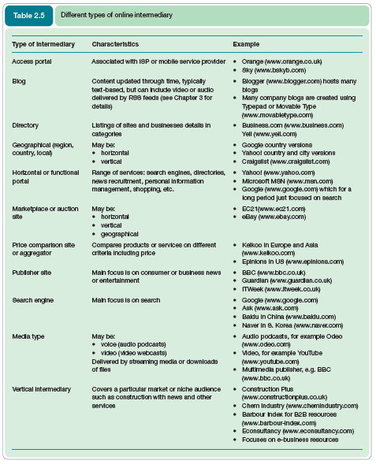

Slide 25
Lecture 2
E-commerce fundamentals
- The importance of search engines
Search engines are a key type of intermediary for organizations marketing their services online, since today they are the primary method of finding information about a company and its products. Research shows that over 90 per cent of web users state that they use search engines to find information online.

Slide 26
Lecture 2
E-commerce fundamentals
For marketplace analysis it is useful for companies to assess demand for products and brand preferences in different countries using tools such as the Google Keyword Tool (Figure 2.12) which shows the volume of searches by consumers related to clothes in the UK in a one-month period. CPC is the cost per click charged to advertisers. Google uses this tool to encourage advertisers to use its AdWords advertising service.

Slide 27
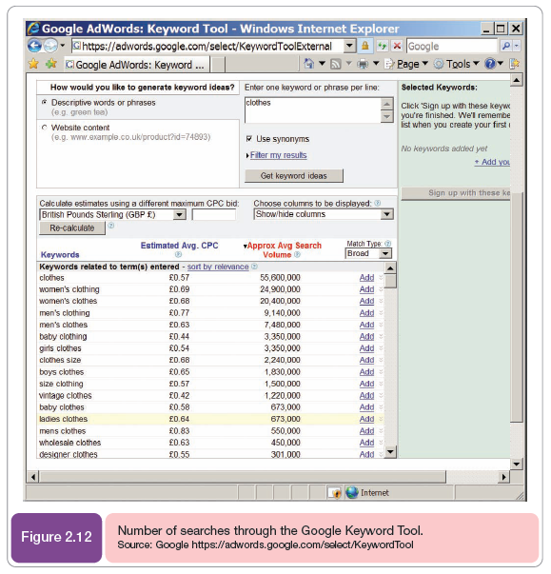
Lecture 2
E-commerce fundamentals

Slide 28
Lecture 2
E-commerce fundamentals
4. Business models for e-commerce:
A review of the different online business models made available through e-commerce is of relevance to existing companies, but in particular, start-up companies and online intermediaries. Venkatram points out that existing businesses need to use the Internet to build on current business models, while at the same time experimenting with new business models. New business models may be important to gain a competitive advantage over existing competitors, while at the same time heading off similar business models created by new entrants. More commonly, they may simply offer a different revenue stream through advertising or charging for services in a new way.

Slide 29
Lecture 2
E-commerce fundamentals
The business model for e-commerce requires consideration of a company and its position in which relate to structure of the micro environment shown in Figure 2.1. Investors will require eight key elements of the business model to be defined which will summarize the organization’s e-business strategy:

Slide 30
Lecture 2
E-commerce fundamentals
1. Value proposition. Which products and or services will the company offer? This is supplemented by the added value defined using the online value proposition .
2. Market or audience. Which audience will the company serve and target with its communications? For example, business-to-business, business-to-consumer or not-for-profit? Within these categories are there particular audience segments that will be targeted. The scope of geographical markets such as countries, regions or towns need to be defined.

Slide 31
Lecture 2
E-commerce fundamentals
3. Revenue models and cost base. What are the specific revenue models that will generate different income streams? What are the main costs of the business forming its budget? How are these forecast to change through time?
4. Competitive environment. Who are the direct and indirect competitors for the service and which range of business models do they possess?
5. Value chain and marketplace positioning. How is the company and its services positioned in the value chain between customers and suppliers and in comparison with direct and indirect competitors?

Slide 32
Lecture 2
E-commerce fundamentals
6. Representation in the physical and virtual world. What is its relative representation in the physical and virtual world, e.g. high-street presence, online only, intermediary, mixture?
7. Organizational structure. How will the organization be internally structured to create, deliver and promote its service.
8. Management. What experience in similar markets and companies do the managers have? What is their profile which can be helpful to attract publicity?

Slide 33
Lecture 2
E-commerce fundamentals
- Revenue models
Revenue models specifically describe different techniques for generation of income. For existing companies, revenue models have mainly been based upon the income from sales of products or services. This may be either for selling direct from the manufacturer or supplier of the service or through an intermediary that will take a cut of the selling price. Both of these revenue models are, of course, still crucial in online trading. There may, however, be options for other methods of generating revenue; perhaps a manufacturer may be able to sell advertising space or sell digital services that were not previously possible.

Slide 34
Lecture 2
E-commerce fundamentals
- Online publisher and intermediary revenue models
For a publisher, there are many options for generating revenue online based around advertising and fees for usage of the online service. These options, particularly the first four in the list below, can also be reviewed by other types of business such as price comparison sites, aggregators, social networks and destination sites which can also carry advertising to supplement revenue. The main types of online revenue model are:

Slide 35
Lecture 2
E-commerce fundamentals
1. CPM display advertising on site. CPM stands for ‘cost per thousand’ where M denotes ‘mille’. This is the traditional method by which site owners charge a fee for advertising.
2. CPC advertising on site (pay-per-click text ads). CPC stands for ‘cost per click’.
3. Sponsorship of site sections or content types (typically fixed fee for a period). A company can pay to advertise a site channel or section.
4. Affiliate revenue (CPA, but could be CPC).

Slide 36
Lecture 2
E-commerce fundamentals
5. Transaction fee revenue. A company receives a fee for facilitating a transaction.
6. Subscription access to content or services. A range of documents can be accessed from a publisher for a period of a month or typically a year.
7. Pay-per-view access to documents. Here payment occurs for single access to a document, video or music clip which can be downloaded.
8. Subscriber data access for e-mail marketing. The data a site owner has about its customers are also potentially valuable since it can send different forms of e-mail to its customers if they have given their permission that they are happy to receive e-mail from either the publisher or third parties.

Slide 37
Lecture 2
E-commerce fundamentals
5. Focus on Auction business models:
Auctions involve determination of the basis for product or service exchange between a buyer and seller according to particular trading rules that help select the best match between the buyer and seller from a number of participants. Klein identifies different roles for auction:

Slide 38
Lecture 2
E-commerce fundamentals
1. Price discovery – an example of price discovery is in the traditional consumer auction involving bidding for antiques. Antiques do not have standardized prices, but the auction can help establish a realistic market price through a gathering of buyers.
2. Efficient allocation mechanism – the sale of items that are difficult to distribute through traditional channels falls into this category. Examples include ‘damaged inventory’ that has a limited shelf life or is only available at a particular time such as aircraft flight or theatre tickets.

Slide 39
Lecture 2
E-commerce fundamentals
3. Distribution mechanism – as a means of attracting particular audiences.
4. Coordination mechanism – here the auction is used to coordinate the sale of a product to a number of interested parties; an example is the broadband spectrum licenses for 3G telecoms in the UK.

Slide 40

Lecture 2
E-commerce fundamentals
References:
E-Business and E-Commerce Management : strategy, implementation and practice, fourth edition.
By: dave chaffey.
Chapter 2

