Slide 1



Project Business
Analysis
PMG 461 – MGM 461
Lecture 7
Business Modeling
Prepared by
Eng. Ahmed Hussein, MBA, PfMP©, PMP©, CMP APMG

Slide 2
In Previous Lectures
Business Analysts elicit requirements from stakeholders using various qualitative and quantitative techniques.
Business analyst captures Different stakeholders views in Business Activity Models
Business analysts contribute to identifying and engaging stakeholders.
Requirements are engineered through elicitation, analysis, documentation, validation, and requirements management.
It is important to plan for business analysis plan and work plan before starting the analysis
7 – 2

Slide 3

Lecture
What we will cover
07
Business Models Overview
Scope Models
Process Models
Rule Models
Data Models
7 – 3

Slide 4


Business Models Overview
Lecture
07
7 – 4

Slide 5
Lecture
Definition of a Model
07
A model is a visual representation of information that operates under a set of rules to efficiently arrange and convey a lot of information in a concise manner.
Business analysis model is a structured representation of information.
Models can be in the form of diagrams, tables, or structured text.
Created with a variety of tools from formal modeling software to whiteboards or artistic software.
There are many business analysis models serving different purposes.
7 – 5

Slide 6
Lecture
Purpose of Models
07
Provide context to better understand information.
Facilitate analysis of information through visualization and summarization.
Help convey information clearly.
Help find gaps or missing information.
To identify irrelevant information.
7 – 6

Slide 7
Lecture
Categories of Models (1 / 3)
07
Scope Models
Models that structure and organize the features, functions, and boundaries
Examples:
Goal and Business objectives model
Ecosystem map
Context diagrams
Feature Model
Organization Charts
Use Case Diagram
Fishbone Diagram
SWOT Diagram
Process Models
Models that describe business processes and ways in which stakeholders interact with those processes.
Examples:
Process Flow
Use Case
User Story
7 – 7

Slide 8
Lecture
Categories of Models (2 / 3)
07
Rule Models
Models of concepts and behaviors that define or constrain aspects of a business in order to enforce established business policies
Examples:
Business rules catalog
Decision Tree
Decision Table.
Data Models
Models that document the data used in a process or system and its lifecycle
Examples:
Entity relationship diagram
Data flow diagram
Data dictionary
State table
State diagram
7 – 8

Slide 9
Lecture
Categories of Models (3 / 3)
07
Interface Models
Models that assist in understanding specific systems and their relationships within a solution
Examples:
Report table
System interface table
User Interface flow
Wireframes
Display-Action-Response
7 – 9

Slide 10
Lecture
07
Business Modeling is performed within Requirements Analysis and Documentation.
Business Models are validated in Requirements Validation.
Requirement Elicitation
Requirements Analysis
Requirements validation
Requirements Documentation
Requirements Management
7 – 10

Slide 11
Lecture
Selection of Models
07
There may be multiple valid model choices.
We can use more than one type of Model.
Models should be prioritized based on applicability.
Several factors to consider when choosing which model to use.
Methodology
Characteristics
Timing
Categories of Models
Level of Abstraction
Traditional or Agile
nature, scope, and compelxity of project
early phases or late phases of requirements management
level of details needed
better to cover more than one category or even all in some projects.
7 – 11

Slide 12
Lecture
Examples
07
Agile project → user stories rather than use cases
Analytics project → data models, data dictionary, and data tables
System migration project → ecosystem map or context diagram, data dictionary, and business rules catalog.
7 – 12

Slide 13
Lecture
Examples
07
Early in a project (High-level Analysis) → ecosystem map, context diagram, and data dictionary
Later in a project (Detailed level Analysis) → state models, decision models, and user interface models
7 – 13

Slide 14
Scope Models
Lecture
07
7 – 14

Slide 15
Lecture
Ecosystem Map
07
A diagram that shows all relevant systems, relationships between them, and any data objects passed between them.
Made up of boxes representing the systems and lines depicting the relationships, labels identify data objects.
Shows all in scope systems that passes or consumes data.
Used to understand all systems that are affected by the in-scope systems and shows interface requirements.
Systems
Data objects
7 – 15

Slide 16
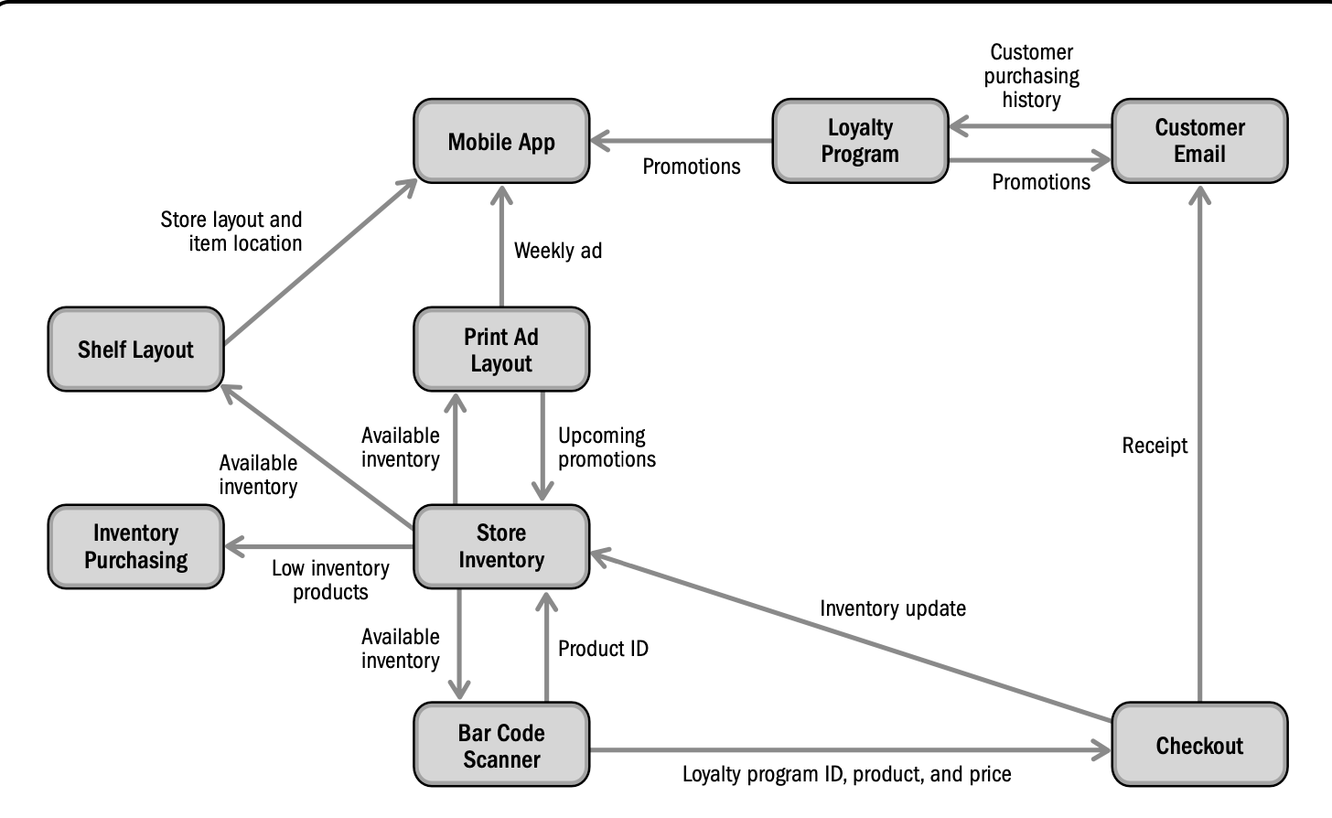
Lecture
Ecosystem Map Sample
07
7 – 16

Slide 17

Lecture
Context Diagrams
07
Shows all direct and human interfaces to systems within a solution.
System is represented as a circle in the middle, interfaces as boxes. Human actors as people shapes or boxes, lines to show actual interface and data passed.
Called LEVEL 0 of a data flow diagram which digs deeper in details.
Used early in a project to specify the scope and interfaces.
Shows external touch points between the system and the other systems or people,
Helpful in determining where an interface is needed.
Easy to build and understand the as-is and to-be systems.
System
Interfaces
People
Interface
7 – 17

Slide 18
Context Diagram Sample
Online Ordering Application
Lecture
07
Supplier
Delivery
Order
Customer Order
Online Ordering App
Customer
Store
Order
Receipt
Reports
Sales Manager
7 – 18

Slide 19
Lecture
Use Case Diagram
07
Shows all of the in-scope use cases for a system.
Use case is represented by an oval, actors as stick figures, lines for actor-system interaction, and human interfaces to systems within a solution.
Used to summarize the scope of a solution, highlighting main features.
Shows stakeholders who directly interact with the system, and interfaces needed.
Indicates out of scope to manage stakeholder expectations.
Helpful in planning and tracking progress in building a solution as it summarizes scope of features.
it does not show requirements, but helps to organize requirements in a requirements document.
Use Case
Actors
Actor-System Interaction
7 – 19

Slide 20
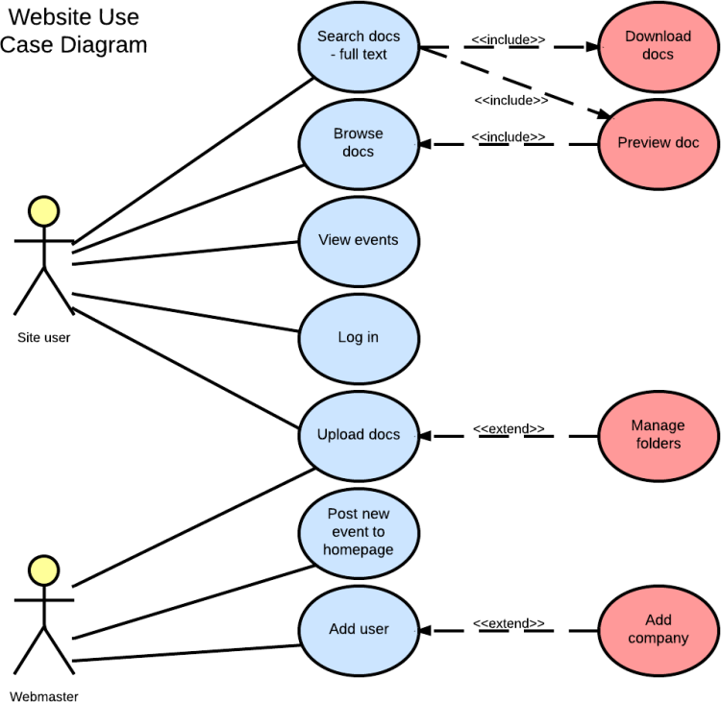
Lecture
Use Case Diagram Sample
07
7 – 20

Slide 21
Process Models
Lecture
07
7 – 21

Slide 22
Lecture
Process Flow Diagram
07
Also called, process maps, process flow charts, process diagrams, or swimlane diagrams
Describes steps that people or system make.
Steps are represented as boxes, decision logic as diamond, arrows represent order of flow, swimlanes groups steps performed by a person or group.
Used to model both As-Is and To-Be processes.
Valuable in most types of projects whenever there are people performing tasks.
Helps in facilitating conversations with stakeholders during elicitation
Used to identify missing features or requirements
Shows flow of work to provide context and order.
Steps
Decision
Order of Flow
7 – 22

Slide 23
Process Flow Diagram Sample
Develop project charter
Lecture
07
Review Business Case
Meet with Sponsor
Develop Project Charter
Project Manager
Start
Approve Charter
Swimlanes
Project Sponsor
No
Yes
File Charter Document
Project Officer
End
7 – 23

Slide 24
Lecture
Use Cases
07
Describe a set of scenarios, and is a set of activities, actions, and reactions that take the primary actor from initiation to completion of the goal.
Are text based, usually presented in a tabular format.
Represent functional requirements of a system and cannot be used for non-functional requirements (as how fast the product should work).
Used in complex interactions, and in elicitation sessions to discover and describe interactions
Helpful in creating tests.
Common Fields
Name
Description
Actors
Benefit
Trigger
Flow or steps
7 – 24

Slide 25
Lecture
Use Cases Sample
07
ID | Name | Description | Actors | Benefits | Trigger | Flow
A01 | Find Recipe Items | A daily email with the featured recipe is sent to customers who have opted-in to the program. The customer opens the Recipe Box application directly on their iOS or Android device. The customer can choose a past recipe or use the current one. With a recipe chosen, the customer chooses a store or uses a store already indicated a "My Store." A map of the store is displayed with an overlay showing the locations of the items for the recipe. | User | Customer visits store to make purchases related to the recipe which are high-margin cooking items. | Customer clicks on link in email on mobile device or directly opens application | 1. System shows short description of the daily recipe 2. Customer selects current recipe or chooses a past recipe 3. Customer chooses to use their local store ("My Store") 4. System displays map of the store with the recipe items overlaid as icons 5. Customers can select icons to see item aisle and shelf location
7 – 25

Slide 26
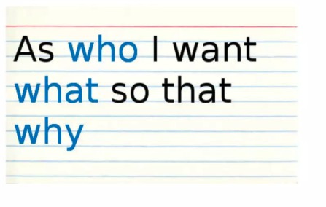
Lecture
User Stories
07
A statement written from the point of view of the user, and describes the functionality needed in a solution.
Typically used in Agile methodology.
Follows the format of:
As a <Actor>, I want to be able to <function>, so that I can <business reason>.
Acceptance criteria for each user story is included.
Big user stories (called Epics) are broken down into user stories.
Focus on user, easy for stakeholders to engage with.
Epics and user stories form functional grouping of requirements.
User stories are prioritized and can be traced to releases.
7 – 26

Slide 27
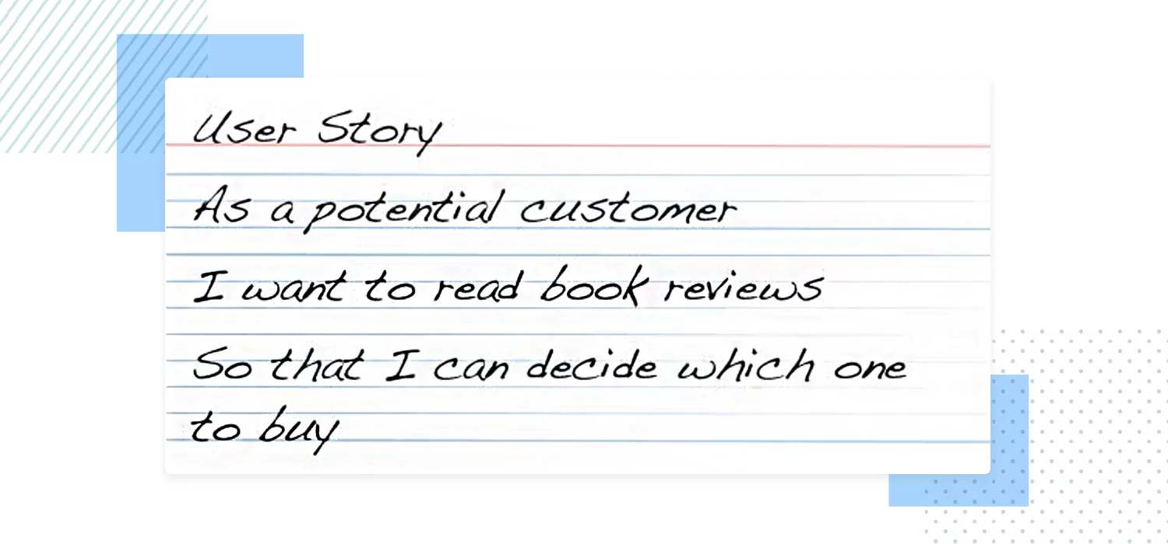
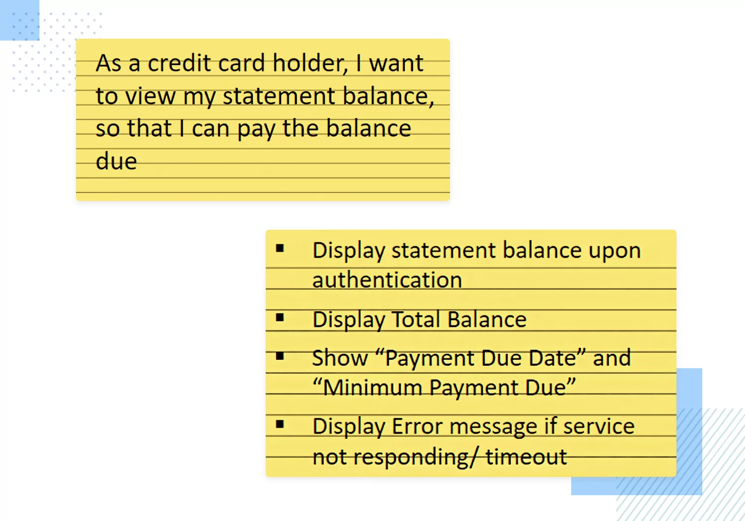
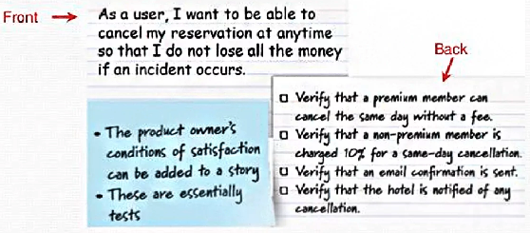
Lecture
User Stories Sample
07
7 – 27

Slide 28
Rule Models
Lecture
07
7 – 28

Slide 29
Lecture
Business Rules Catalogue
07
A table of business rules and related attributes.
Business rules are not processes, but apply across processes, and describe rules, policies, and constraints.
Rules need to be correct, verifiable, and consistent.
ID | Title | Description | Type | Reference
BR01 | Recipe email opt-in | Recipe emails will only be sent to customers who have opted-in and have a valid e-mail address | Constraint | See corporate email policy
7 – 29

Slide 30
Lecture
Decision Trees
07
Represent a series of decisions and their outcomes in a tree of decision points where each branch represent the outcomes of a decision.
Decision points are represented as diamond, outcomes are shown in boxes.
Decision trees work best with binary choices (yes or no).
Inventory Available
Place Order
Yes
Yes
Store within range
No
Select Recipe
Notify user
Notify user
No
7 – 30

Slide 31
Lecture
Decision Tables
07
Represent a series of decisions and their outcomes.
Use a tabular format where upper row represents decision points and the other rows represent outcomes.
Used to model complex decision logic
Help to identify ways to reduce complex logic and ensure all possible combinations are considered.
Decision Table | Rule 1 | Rule 2 | Rule 3 | Rule 4
Condition: Stores within preference Range | N | Y | Y | Y
Condition: Inventory available | - | Y | N | N
Outcome: Notify User | X | - | - | -
Outcome: Notify User of Lack of Inventory | - | X | - | -
7 – 31

Slide 32
Data Models
Lecture
07
7 – 32

Slide 33
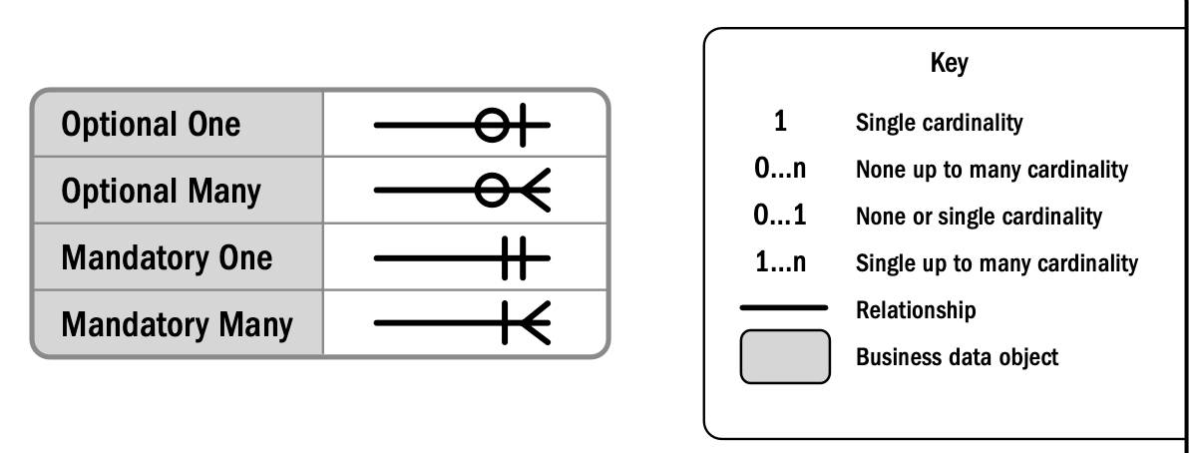
Lecture
Entity Relationship Diagrams
07
Entity Relationship diagrams (ERD), also called business data Diagrams, shows business data objects or pieces of information in a project and the relationship between them.
Business data objects represent people, places, things and concepts.
Business data objects are shown as boxed, relationships as line, and cardinality as labels on lines.
Used in projects that has data management components.
Attributes are specified in a data dictionary.
Business Data object
Relationship
7 – 33

Slide 34
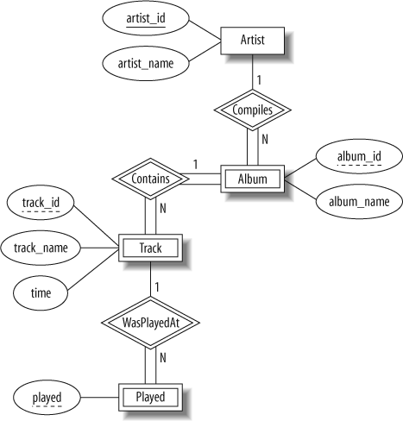
Lecture
Entity Relationship Diagram Sample
07
7 – 34

Slide 35
Lecture
Data Flow Diagrams
07
Illustrates relationships between systems, actors, and the data that is exchanged over one or more processes.
Can be used after Entity Relationship Diagrams, process flows, and ecosystem maps.
Data stores (parallel lines) show where information is conceptually stored, process steps (circles) indicate functions using the data, and entities (boxes) create or consume data.
Used to describe movement of data between actors, systems.
Identify data inputs and outputs of processes.
DFD do not specify timing or sequence.
Data Store
Process Steps
Entities
7 – 35

Slide 36
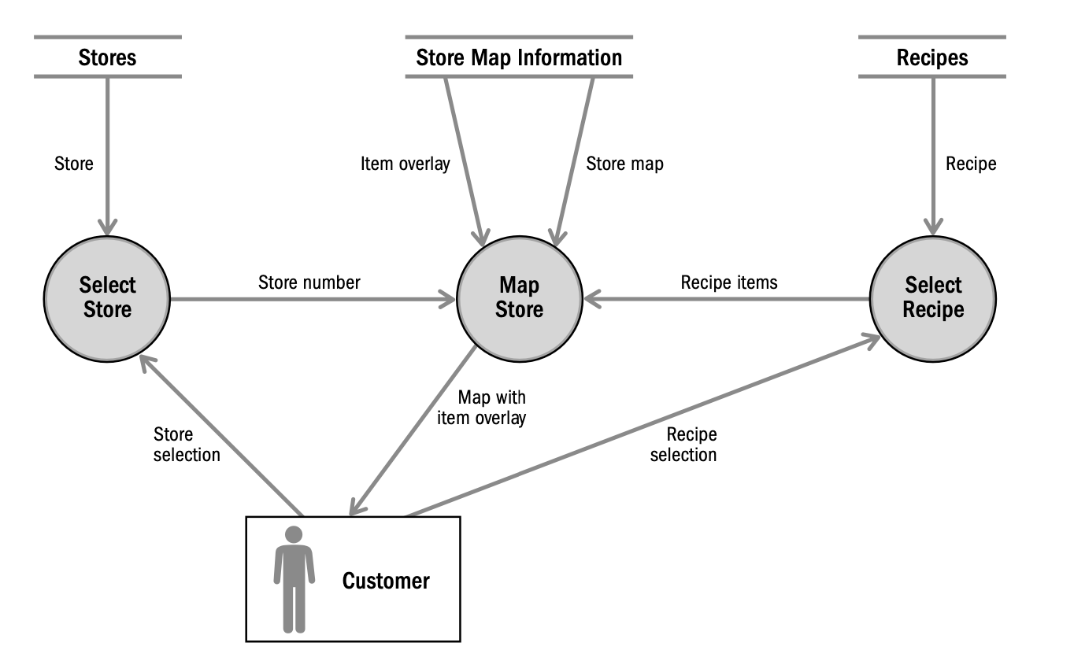
Lecture
Data Flow Diagram Sample
07
7 – 36

Slide 37
Lecture
Data Dictionary
07
A tabular format that shows data fields and attributes of these fields.
ID | Business Data object | Field Name | Description | Unique Value | Data Type | Length | Valid values
R01 | Recipe | Recipe Text | Recipe in formatted layout | Yes | Alphanumeric | <200 characters | Structured Text
7 – 37

Slide 38
Lecture
Key Points
07
Models are a visual representation of information and efficiently arrange and convey a lot of information in a concise manner.
Typically in a project, more than model is used, depending on need, methodology, characteristics, timing, and level of detail.
Models are categorized as scope, process, data, rules, and interface models.
Models are done in requirements analysis and documentation, and validated in requirements validation.
Business analysts should know various types of models and be able to apply them
7 – 38

Slide 39

For Discussion Panel:
Questions:
Which tools have you used and in which types of projects?
How do these tools helped you in defining and analyzing requirements?
Lecture
07
For Discussion Panel and Next Lecture
6 – 39

Slide 40



Thank You

