Slide 1


Design Thinking
Prepared by Dr. Aya Mohamed
ENT 621
Master of Entrepreneurship
Lecture 6

Slide 2

In The Previous Lecture: Design Thinking
Topics
v
The Holistic approach of Design thinking
Key principles and mindset of design thinking
FOUNDATION BUILDING FOR DESIGN THINKING PROJECT
STEEP analysis
Case Study
Holistic
Foundation
STEEP

Slide 3
In This Lecture: Design Thinking
Topics
v
4 Ways to Get Started with Design Thinking
The power of Empathy
The Power of Observation
The power of User Interviewing
The Empathy Map
Empathy
Observation
Interviewing

Slide 4

4 Ways to Get Started with Design Thinking
Gather Insights by Practicing Empathy, Observation, and Interviewing
create solutions that actually work for people
Getting to know your customers is the first step toward creating products and services they want and need. Don’t assume you know what someone thinks or feels. Gathering information about your target consumer is a critical piece of the design thinking approach. Build your interview skills

Slide 5
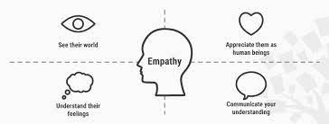
4 Ways to Get Started with Design Thinking
Gather Insights by Practicing Empathy, Observation, and Interviewing

Slide 6
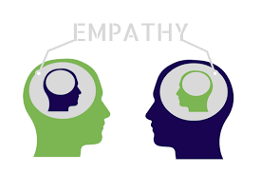
The Power of Empathy
Empathy is our ability to see the world through other people's eyes — to see what they see, feel what they feel and experience things as they do. Of course, none of us can fully experience things the way someone else does, but we can attempt to get as close to this as possible. We achieve this empathic state as we put aside our own preconceived ideas about the world and choose to understand the ideas, thoughts and needs of others instead.
Empathy is a “deep understanding of the problems and realities of the people you are designing for.”

Slide 7
The Power of Empathy
Empathy is our ability to see the world through other people's eyes — to see what they see, feel what they feel and experience things as they do. Of course, none of us can fully experience things the way someone else does, but we can attempt to get as close to this as possible. We achieve this empathic state as we put aside our own preconceived ideas about the world and choose to understand the ideas, thoughts and needs of others instead.
Empathy is a “deep understanding of the problems and realities of the people you are designing for.”
Empathy helps you:
Appreciate people's emotional and physical needs.
Gain insight into the way people see, understand and interact with the world around them.
Realize how lives are impacted within the contexts being investigated.
Find out what people mean rather than just what they say — empathic research is inherently subjective and is concerned with motivations and thoughts, rather than facts.

Slide 8
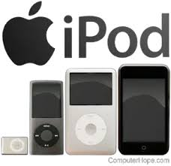
The Power of Empathy
Empathy is simply crucial to a human-centered design process such as design thinking as it helps you set aside your own assumptions about the world to gain insight into your users and their needs instead.
Empathy is Crucial to Business Success
“People ignore design that ignores people.”
— Frank Chimero, author of The Shape of Design

Slide 9
The Power of Empathy
Empathy is simply crucial to a human-centered design process such as design thinking as it helps you set aside your own assumptions about the world to gain insight into your users and their needs instead.
Empathy is Crucial to Business Success
One clear example of this is the iPod. Many MP3 players came and went throughout the late 1990s, and didn’t create much of an impact. Then, along came the iPod in 2001. It not only provided a technological solution, but also delivered a completely desirable and viable experience. This meant Apple took the lead in the market and continued to hold it for many years to come, generating huge profits along the way.
“People ignore design that ignores people.”
— Frank Chimero, author of The Shape of Design

Slide 10
The Power of Observation
Observation: A way to understand your customers is to immerse yourself into their world and perspectives. Observing users in their world gives you the opportunity to empathize with their experience, understand their context, uncover hidden needs and hear their honest and unfettered feedback.
Observation also requires taking on a beginner’s mindset. What does that mean?
Think about how 5-year-olds explore. They ask lots of “why” questions, they make no predetermined notions as to how something works, and they are truly fascinated by what they see. A successful observation looks upon the customer’s world the same way.

Slide 11
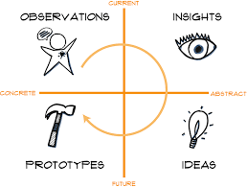
The Power of Observation

Slide 12
The Power of Observation
Tips on gaining a beginner’s mindset, shared by Stanford D.School:
Don’t judge. Simply engage with users without the influence of value judgements on their actions.
Question everything. Question even things you think you understand. Question users on how they perceive their world. Follow up a “why” with another “why.”
Be truly curious. Try to observe from a different perspective.
Find patterns. Try to find common threads that weave a similar story.
Listen. Let everything sink in and soak up the scene. Really listen to what is being said to you or during your observation. Don’t get distracted about thinking of what you will say next when someone is talking.

Slide 13
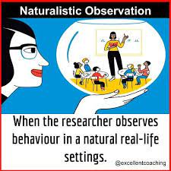
The Power of Observation
Methods for Observing Your Customers
1. Natural Environment
Go out to where your customers are, whether it is a retail shop or a dealership. This is where you can gain a lot of insight in a short time. Sit and watch how interactions happen. Feel free to approach customers and ask them questions about their experience.

Slide 14
The Power of Observation
Methods for Observing Your Customers
1. Natural Environment
Go out to where your customers are, whether it is a retail shop or a dealership. This is where you can gain a lot of insight in a short time. Sit and watch how interactions happen. Feel free to approach customers and ask them questions about their experience.
Some questions you can ask yourself are:
How are users interacting with my product in a store?
What type of questions are they asking?
Who are they with?
The natural environment provides a lot of great opportunities for the observer. Don’t just stop at one, however. Try to locate a wide variety of locations where your customers shop.

Slide 15
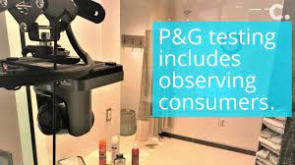
The Power of Observation
Methods for Observing Your Customers
2. Observation Lab
Another popular method is to create an environment to see how your customers engage with and use your products.
At the Procter & Gamble Mason Business Center in Ohio, P&G set up a lab that takes customer discovery to a whole new level.
At the oral health science “Insight Suite,” a two-way mirror lets the company watch customers use products in a bathroom and kitchen.
.

Slide 16
The Power of Observation
Methods for Observing Your Customers
2. Observation Lab
Another popular method is to create an environment to see how your customers engage with and use your products.
At the Procter & Gamble Mason Business Center in Ohio, P&G set up a lab that takes customer discovery to a whole new level.
At the oral health science “Insight Suite,” a two-way mirror lets the company watch customers use products in a bathroom and kitchen.
Researchers can then note how users interact with the products and what they use them for. Building a lab provides a different type of insight compared to the natural environment. Since users knows they are being observed, it may create skewed results. However, it is still a valuable way to see how your customers engage with your products
.

Slide 17
The Power of Observation
Methods for Observing Your Customers
3. “Day in the Life” Home Observation
This one piggybacks off of observing the customer in a natural environment. Recruit customers who you can spend a day with and see how they engage with your product in a natural way.
Let’s say you wanted to observe how a landscape crew uses their equipment. Reach out to some landscaping companies and see if you can tag along for the day. Observe how they schedule work in the morning, how a trailer get stocked with the equipment, how employees use the equipment out in the field, etc.

Slide 18
The Power of Observation
Additional Observation Tips
If possible, observe in groups. Two eyes are better than one, and you can discuss the experience as a team once it is completed. If you can’t observe as a team, share your observations with a team later.
Get to know the people you are observing, not just as customers but as people. Ask open questions on how they live and work.

Slide 19
The Power of Observation
Additional Observation Tips
If possible, observe in groups. Two eyes are better than one, and you can discuss the experience as a team once it is completed. If you can’t observe as a team, share your observations with a team later.
Get to know the people you are observing, not just as customers but as people. Ask open questions on how they live and work.
When observing, understand the context of the situation. What led to them going in and buying a product? Why did they decide to use the product that way?
And remember, the role of observation is to understand what the customer can’t – or won’t – always tell you.

Slide 20
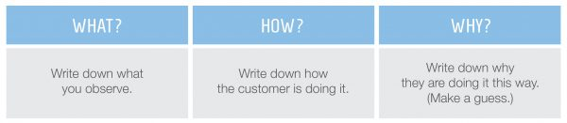
The Power of Observation
Tools for Observation Sessions
1- WHAT, HOW and WHY method:
The Stanford D.School has developed a method called What? | How? | Why? that you can use during an observation session
Using this quick tool can help formulate your insights in a tangible way for discussion with the team later. And while observation is an important and often insightful method to empathize with your customer, remember – it can also be useful for internal processes within your organization

Slide 21
The Power of Observation
Tools for Observation Sessions
2- AEIOU Observation Framework
A - Activities
E - Environments
I - Interactions
O - Objects
U – Users
For the purposes of digital product and software practices,
AEIOU is helpful for categorizing and interpreting observations gathered during user research field studies and usability testing efforts.
AEIOU quickly turns raw notes into categories that can inform research analysis to develop key insights and other findings.

Slide 22
The Power of Observation
Tools for Observation Sessions
2- AEIOU Observation Framework
Activities: What actions and behaviors are people taking to reach goals?
Environments: What is the overall setting in which the activities are taking place? How are people behaving in the environment?
Interactions: What are the basic interactions occurring for people to reach goals? What effect do people have on activities and environment?
Objects: What are all the details that form the environment? How do objects relate to people, activities and interactions?
Users: Who are the people being observed? What are their personalities like? How do they engage with other people to reach goals?

Slide 23
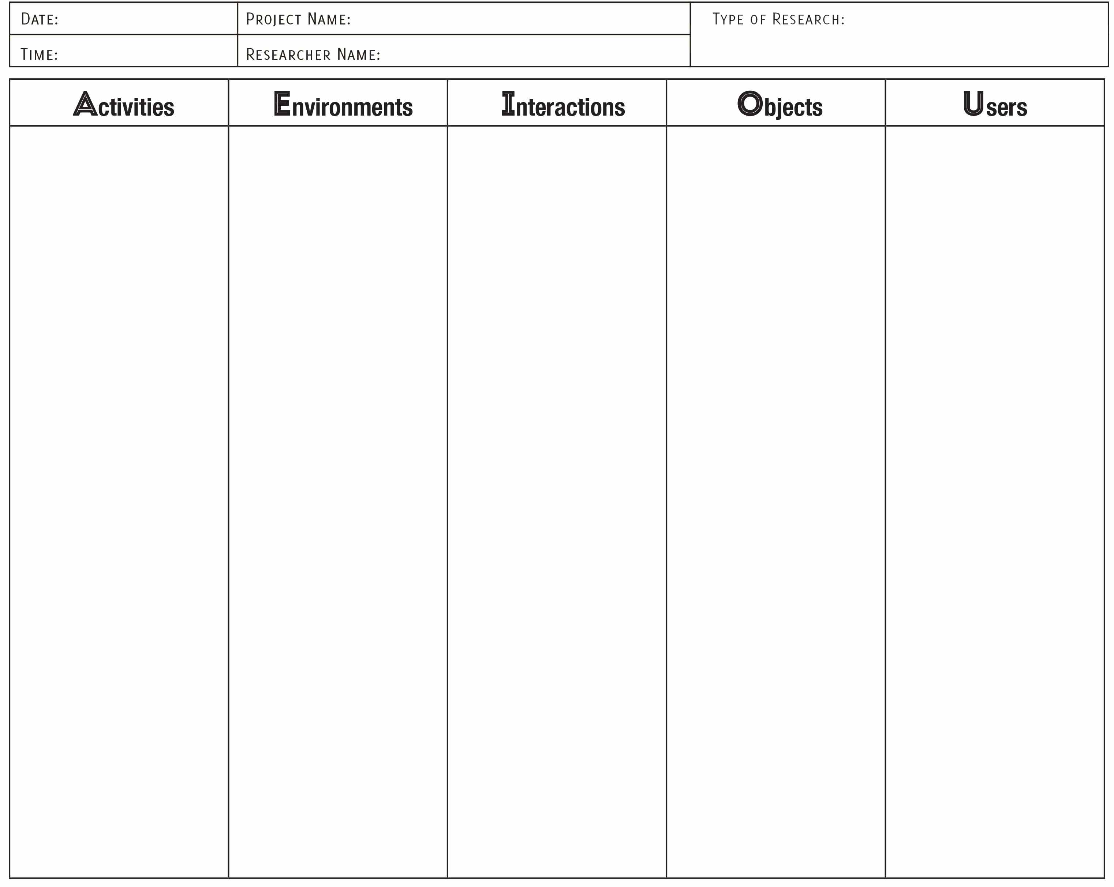

The Power of Observation
Tools for Observation Sessions
2- AEIOU Observation Framework

Slide 24
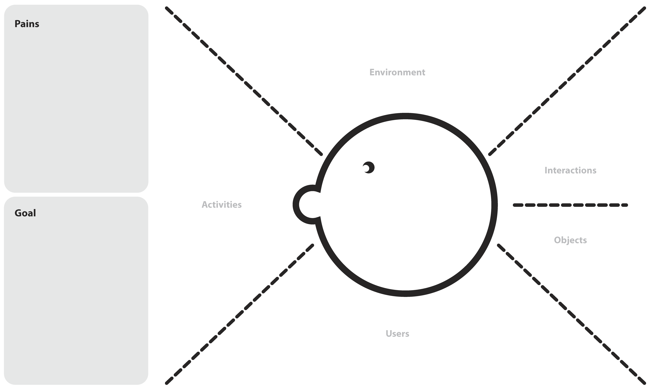
The Power of Observation
Tools for Observation Sessions
2- AEIOU Observation Framework

Slide 25

The Power of Interviewing
You need to go out and meet your users if you want to properly understand and design for them, and user interviews are a great way to achieve this. They enable you to extract information about the user experience and usability of your product or service, and will also help you ideate for further solutions.

Slide 26
The Power of Interviewing
You need to go out and meet your users if you want to properly understand and design for them, and user interviews are a great way to achieve this. They enable you to extract information about the user experience and usability of your product or service, and will also help you ideate for further solutions.
User interviews are guided interviews where a researcher asks existing or potential users questions to gain an understanding of their preferences, thoughts and feelings. User interviews can be used to examine the user experience and usability of a product or service, as well as flesh out demographic or ethnographic data for input into user personas.

Slide 27
The Power of Interviewing
The ideal user interview involves two UX researchers and one user. The first UX researcher asks questions and guides the interviewee through the interview, and the second researcher takes notes.
If you’ve ever tried to ask questions, listen to responses and take notes all at the same time, you’ll know how hard it is to do all three! There’s a good chance the interview will be derailed and become hard to manage.
If a second researcher is, however, unavailable and you have to go it alone, make sure to video or audio record the interview to ensure you don’t lose any information.

Slide 28
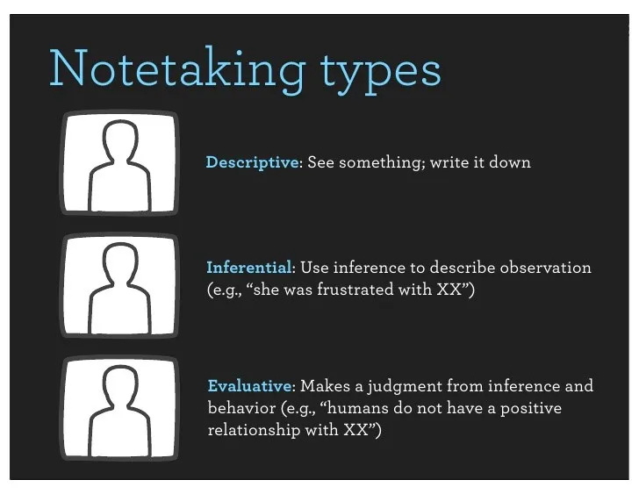
The Power of Interviewing
It’s important to have a second researcher when you conduct user interviews as they can then be the one to take notes.
There are three types of notes you can take; however, it is descriptive notes that are most important and relevant to user interviews

Slide 29
The Power of Interviewing
Typical topics covered within user interviews include:
The background of the user (ethnographic data, for example)
The use of related technology
How the user uses the product
The user’s main objectives and motivations to use the product
The user’s pain points with the product
However, please don’t feel limited to these topics alone! If there’s something you need to know, and can find the answers by asking your users, make sure to include a few questions about it (as long as it’s not offensive or threatening of course!).

Slide 30
The Power of Interviewing
contextual interview :This is an interview that is conducted after (or during) a user observation—it’s an interview “in context” with usage. You’ll find these are very common in usability testing, the assessment of products and even in information visualization.
When should you conduct user interview?

Slide 31
The Power of Interviewing
contextual interview :This is an interview that is conducted after (or during) a user observation—it’s an interview “in context” with usage. You’ll find these are very common in usability testing, the assessment of products and even in information visualization.
When should you conduct user interview?
At the beginning of a project, even before you’ve defined a clear concept. The information you collect during these initial user interviews will help you get a better understanding of your potential users, their wants and needs and what kind of solution you should aim for.
During the early stages of product development. Once you have an early prototype, you can conduct usability tests with your users to gain valuable feedback before the product gets properly implemented and mass produced.
After the product has been put to market. Just because your product has been shipped, it doesn’t mean the user interviews have to stop!

Slide 32
The Power of Interviewing
Prepare for User Interviews
Set a Goal for Your Interviews-----------form a concise, concrete goal for your user interviews—one that’s related to a specific aspect of your users’ behaviors or motivations is ideal. You should ask product stakeholders what they want to learn and base your goal on one of their realistic aspirations. Remember, don’t go too broad otherwise your interviews will generate too much irrelevant material.
Keep your design needs in mind at all times!

Slide 33
The Power of Interviewing
Prepare for User Interviews
Set a Goal for Your Interviews-----------form a concise, concrete goal for your user interviews—one that’s related to a specific aspect of your users’ behaviors or motivations is ideal. You should ask product stakeholders what they want to learn and base your goal on one of their realistic aspirations. Remember, don’t go too broad otherwise your interviews will generate too much irrelevant material.
Keep your design needs in mind at all times!
2. Recruit the Right Participants-----------recruit a representative sample of users for your interviews, so you should start with your user personas and try to find interview participants that match them. If you have multiple user personas, now is the time to decide whether you want to focus on one particular group of users or several.
3. pick a location that’s convenient and comfortable for both your participants and your team.

Slide 34
The Power of Interviewing
Interview Questions
Keep leading questions to a minimum—focus on open-ended questions and leave out the closed-ended questions wherever possible.
Prepare more questions than you think you’ll need. Make sure you include questions that allow you to approach the same issue from different angles yet also bear in mind the interviewee should be the person who talks for the majority of the interview (not you).
Anticipate different responses and create follow-up based questions based on your research goals.

Slide 35
The Power of Interviewing
Interview Questions
Keep leading questions to a minimum—focus on open-ended questions and leave out the closed-ended questions wherever possible.
Prepare more questions than you think you’ll need. Make sure you include questions that allow you to approach the same issue from different angles yet also bear in mind the interviewee should be the person who talks for the majority of the interview (not you).
Anticipate different responses and create follow-up based questions based on your research goals.
Don’t forget your questions are a guide, not a script. If you find your interviewee says something particularly interesting in an interview and there are no relevant questions to explore that idea… explore it anyway.

Slide 36
The Power of Interviewing
The Drawbacks of User Interviews
There’s a difference between what humans say and what they actually do. This is why the 5 whys method is so crucial and can help you get more accurate insights.
Human memory is flawed and we can often struggle to recall details as clearly as we would like.
Participants often leave out small details because they deem them insignificant. Make sure you repeat how important such details are for the purpose of your project and keep asking them “Why” to uncover more details about what they did and why.

Slide 37
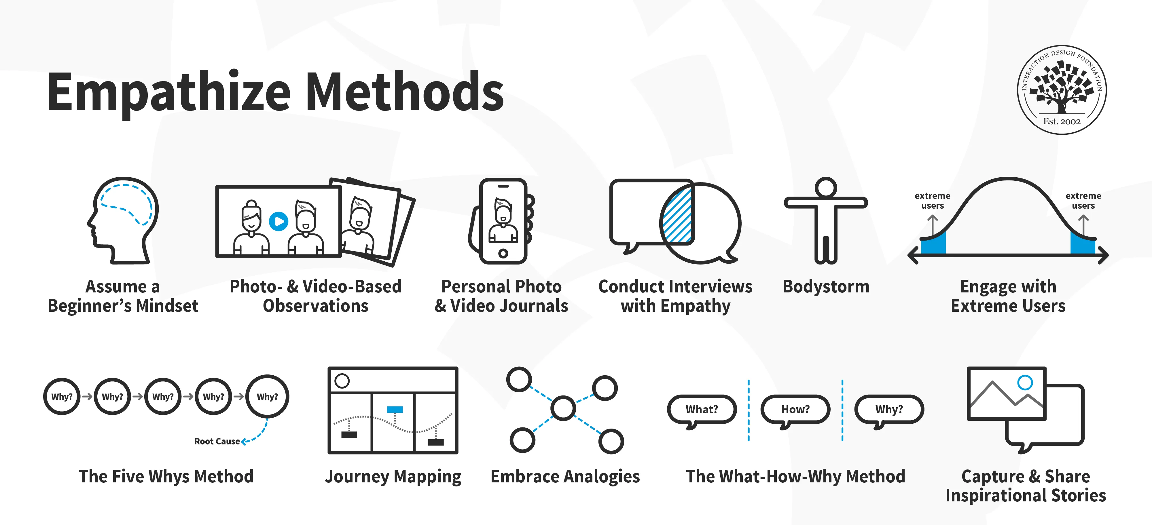

Slide 38
Conclusion:
Empathy is the cornerstone of any successful design project.
The extent to which you understand and empathise with your users ultimately determines the outcome of your design. Will it be user-friendly–an apt solution to the user’s problem? Or will it miss the mark because you never fully grasped where your users are coming from?
As a designer, it’s crucial to adopt a Design Thinking mindset. This means building empathy at every opportunity; getting to know your users, experiencing their pain points as if they were your own, and using this empathy to make smart design decisions

Slide 39
In This Lecture: Design Thinking
Wrap Up
v
4 Ways to Get Started with Design Thinking
The power of Empathy
The Power of Observation
The power of User Interviewing
Empathy
Observation
Interviewing

Slide 40





Thank You
Thank You

