Slide 1

Project Risk &Supply Chain Risk
Prepared by Dr. Dalia Hosni
Lecture 1
PMG 663
Project Risk &Supply Chain Risk

Slide 2


Chapter
01
Project Risk &Supply Chain Risk
What Is a Project?
What Is a Risk?
Types of Project Risk
Supply chain management
Risk in Supply chain
Supply Chain Risk Management (SCRM)

Slide 3
Chapter
01
What Is a Project?
A Project : A temporary efforts that has a defined goal and definitive start and stop point
      A time-scoped/time-boxed activity
      Has a beginning, middle and an end
      Creates a unique product, service or result
      A ‘progressive elaboration’

Slide 4
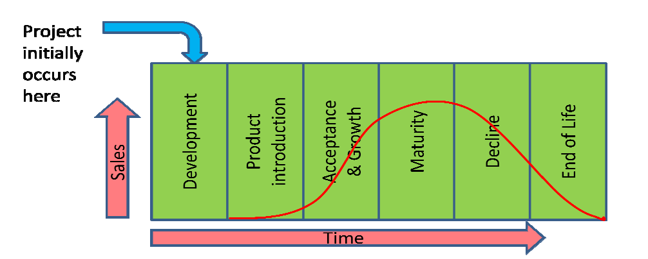
Chapter
01
  The Project Life Cycle
The Product is what is created as a result of executing a project . When is talk about project management what we are talking about is the work that is being done in the project to produce and deliver the product of the project.
Defining the Product Life Cycle

Slide 5
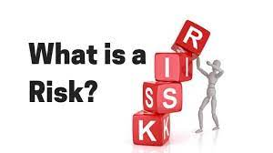
Chapter
01
Risk
Risk
An unplanned or uncertain event that can impact a project

Slide 6
Chapter
01
Risk
Risk
A risk is any uncertain event or condition that might affect your project. Not all risks are negative. Some events (like finding an easier way to do an activity) or conditions (like lower prices for certain materials) can help your project. When this happens, we call it an opportunity; but it’s still handled just like a risk.

Slide 7
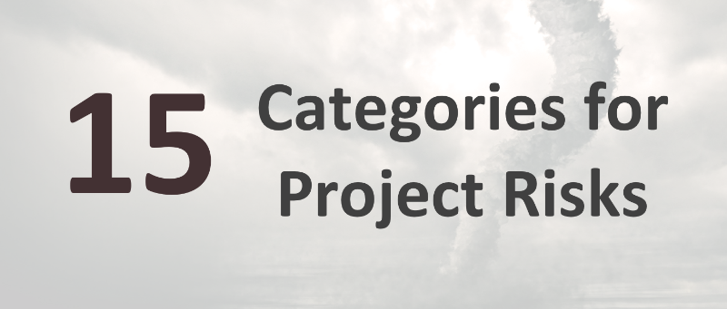
Chapter
01
Types of Project Risk
Beyond the basics of what “risk” means, project managers should also know the different types of risks they may encounter. Depending on the project type, the factors that should be considered will differ.
So, let’s jump straight in and look at these categories for project risks..

Slide 8
Chapter
01
Types of Project Risk
1- Political:
Most projects will be affected by organizational politics, but you should also be aware of the possibilities of impact from local or national politics (or even international politics, if that’s appropriate for your project).
A change in government will affect policy decisions and potentially funding, especially for projects with an element of public sector work or those working with government bodies.

Slide 9
Chapter
01
Types of Project Risk
2- Economic
The economy has a huge impact on businesses, and that filters down to have an impact on certain projects.
3- Technological: Technology is moving on at a rapid speed, and it’s possible that technological changes could make your project more or less viable over a period of time. This should be built into your approach to managing volatile projects. There are also risks relating to using new technology for the first time, or in an immature way.

Slide 10
Chapter
01
Types of Project Risk
4- Legal:
Your Legal team or advisors should be connected to changes in the law and regulations affecting your industry. These may have implications for projects that should be considered. A risk resulting from legal changes that may mean your project is no longer viable.
5- Market:
Some industries have a more stable marketplace than others, and you’ll know your own market well. Risks relating to your position in the market, the demand for your goods and services and the rise of new competitors can all affect your project.

Slide 11
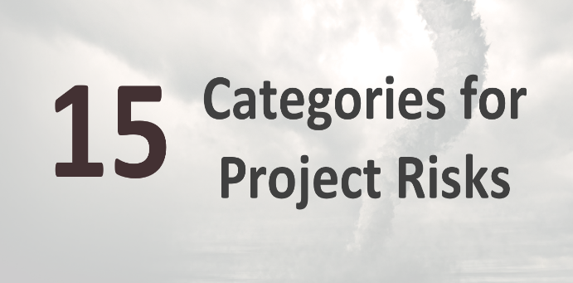
Chapter
01
Types of Project Risk
6- Supply Chain: Internal External
Rarely these days will you do a project that has no reliance on anyone else. Whether that’s the manufacturer of a critical part for your product, or a vendor supplying you with cloud-based software, our organizations are more linked together than ever before.
This creates risk, because when one part of the supply chain fails, the downstream implications can be significant. A supplier going bankrupt could put your project back months. Bad weather on the other side of the world could lead to crucial electrical components failing to make it your manufacturing plant on time.
Supply chain risk can also be internal, as your project team will rely on other departments to provide subject matter expertise to the project. If the people or services you need from your own staff are delayed, this can also affect the success of your project.

Slide 12
Chapter
01
Types of Project Risk
7- Organizational
This type of risk relates to changes in the organizational structure. This might apply if you have a change of leadership, which might in turn lead to a change in strategic direction. It’s crucial to make sure project teams are aware of these risks and then what to do if they happen, because something like this could quickly make a project unviable
8- Operations
These risks relate to impacts on how your business is run. That could be anything from risk that would impact the ability to keep a critical process running in the factory through to making sure the project goes ahead without impacting your customer services.

Slide 13
Chapter
01
Types of Project Risk
9- Environmental:
Environmental risks range from those that could expose your organization to fines or even legislative action, such as illegal dumping, through to ensuring that your internal environmental policies are adhered to.
Risks in this category are likely to be heavily tied to your position on corporate and social responsibility, and can also affect reputational risk, for example if your business is seen to be polluting.
10- Financial
Financial risks on projects relate to funding cycles, access to funding and making sure that the cash flow is available to pay invoices on time. It’s prudent to consider financial risks to projects because if there are problems in this area, projects could stall, putting all prior investment at risk of being wasted.

Slide 14
Chapter
01
Types of Project Risk
11- Resources:
Specifically, non-people resources. This kind of risk relates to whether you can get access to the equipment, materials and other resources required to deliver the project in a timely fashion. Risks around delivery of equipment or the inability to source specialist materials would fall into this category.
12- Staffing:
Alongside non-people resources, you also have to consider staffing risks. These are things like the right people not being available at the right time due to other projects overrunning, or lack of expertise within your business. It would also extend to the risk of staff sickness, and poorly timed vacations.

Slide 15
Chapter
01
Types of Project Risk
13- Scheduling :
Risks in this category affect the project timeline. A common risk here is that a task turns out to be more complicated than expected, and so it takes longer. This would add delay to the schedule if the task is on the critical path.
14- Reputation:
focusing on the public face of your business, think about the impact on investors and on your own staff.
15- Other
It’s useful to have an ‘other’ category!

Slide 16
Chapter
01
Types of Project Risk
Organizational
Operations
Environmental
Supply chain
Market
Legal
Political
Economic
Technological
Financial
Resources
Staffing
Scheduling
Reputation
Other

Slide 17
Chapter
01
Types of Project Risk
There are several types of risks that occur frequently, regardless of the specifics of the project. These common types of risk include:
Cost: The risk of events that impact the budget, especially those that cause the project to be completed over budget. Errors in cost estimation commonly generate risk in addition to external factors.
Schedule: The risk of unplanned scheduling conflicts, such as events that cause the project to be delayed. Scope creep is a common reason for scheduling issues and project delays.
Performance: The risk of events that cause the project to produce results that are inconsistent with the project specifications.

Slide 18
قيمة للعميل
قيمة للعميل
EVOLUTION OF MANAGEMENT FOCUS
تطور اهتمام الإدارة
1990-2000
Customer Value
1991
- - - - - -
- - - - - -
1991
- - - - - -
- - - - - -
1980s
Quality
1990
- - - - - -
- - - - - -
1990
- - - - - -
- - - - - -
1981
- - - - - -
- - - - - -
1981
- - - - - -
- - - - - -
1980
- - - - - -
- - - - - -
1970s
Strategy
1980
- - - - - -
- - - - - -
1970s
Strategy
الجودة
1971
- - - - - -
- - - - - -
الجودة
1971
- - - - - -
- - - - - -
1960s
Marketing
1970
- - - - - -
- - - - - -
1970
- - - - - -
- - - - - -
1961
- - - - - -
- - - - - -
الاستراتيجية
1950s
Production
1960
- - - - - -
- - - - - -
1951
- - - - - -
- - - - - -
التسويق
1950
- - - - - -
- - - - - -
الإنتاج

Slide 19
Chapter
01
Supply chain management
Introduction
Recently, managing risk has become a crucial challenge for supply chain managers owing to several factors, such as growing global competition, rising cost pressures, increasing customer expectations, and ever-increasing complexity
Due to the increasing complexity and interrelation of modern supply chains, the type and nature of uncertain developments and the impact of an action have become difficult, or even impossible, to predict
Risks and uncertainties frequently interrupt the operational efficiency of the supply chain and hence adversely impact a firm’s profits

Slide 20
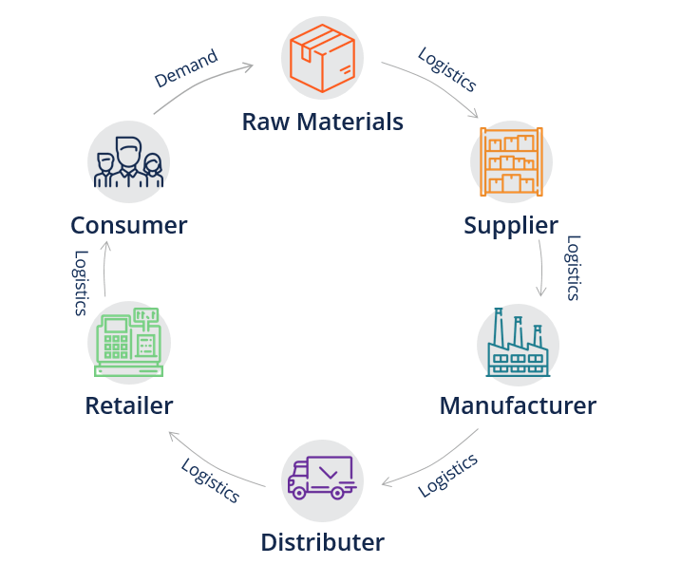
Chapter
01
Supply chain management
First appearing in 1982 :and used to describe connecting logistics with other functions.
The term was also used by Houlihan (1985, 1988) to describe the connections between logistics and internal functions and external
organizations
A supply chain consists of all activities associated with the flow and transformation of goods from raw materials to end users

Slide 21
Chapter
01
Supply chain management
What is a Supply Chain?
A supply chain is an entire system of producing and delivering a product or service, from the very beginning stage of sourcing the raw materials to the final delivery of the product or service to end-users.
The supply chain lays out all aspects of the production process, including the activities involved at each stage, information that is being communicated, natural resources that are transformed into useful materials, human resources, and other components that go into the finished product or service.

Slide 22




Chapter
01
Supply chain management
- A supply chain consists of
Supplier
Manufacturer
Distributor
Retailer
Customer
Upstream
Downstream
- aims to Match Supply and Demand, profitably for products and services
SUPPLY SIDE
DEMAND SIDE
- achieves
+
+
+
+
+
=
The right
Product
The right
Price
The right
Store
The right
Quantity
The right
Customer
The right
Time
Higher
Profits

Slide 23
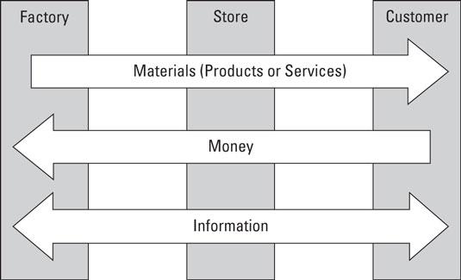
Chapter
01
Supply chain management

Slide 24
Chapter
01
Risk in the supply chain
Supply chain management is responsible for the movement of materials all the way from initial suppliers through to final customers. Supply chain risk appears as any event that might affect this movement and disrupt the planned flow of materials.
There are risks in the supply chain when unexpected events might disrupt the flow of materials on their journey from initial suppliers through to final customers.

Slide 25
Chapter
01
Risk in the supply chain
There are risks in the supply chain when unexpected events might disrupt the flow of materials on their journey from initial suppliers through to final customers.
These risks might prevent deliveries, cause delays, damage goods or somehow affect smooth operations. But these initial effects are only a beginning, and the consequences are generally much broader. A late delivery of raw materials might halt production; it might raise costs by forcing a move to alternative transport, materials or operations; it might raise stocks of work in progress; it might make partners reconsider their trading relationships. An interruption to the supply chain can have widespread effects,

Slide 26
Chapter
01
Supply Chain Risk Management (SCRM)
SCRM can be described as the intersection of supply chain management and risk management
A supply chain consists of all activities associated with the flow and transformation of goods from raw materials to end users.
a supply chain is a network of facilities and distribution options that performs the function of procurement of materials, transformation of these materials into intermediate and finished products, and the distribution of these finished products to customers.

Slide 27
Chapter
01
Supply Chain Risk Management (SCRM)
Supply chain risk management (SCRM) is the process of taking strategic steps
To identify
To assess
To mitigate
_ the risk in the end-to-end supply chain

Slide 28
Chapter
01
Risk Management
Ritchie and Brindley (2007) pointed out three dimensions of risk as follows:
Likelihood/probability of the occurrence of particular events/outcomes;
Consequences/severity of the occurrence of particular events;
Causal pathways leading to these events (detection).
      Risk = Likelihood X Severity X Detection

Slide 29
Chapter
01
What is risk management?
Risk Management in project is the identification, analysis and treatment of potential impacts to the project based on an assessment of likelihood and consequence

Slide 30
Chapter
01
Why is project risk management important?
?
Risk management is a very important part of project management because it can exponentially increase the chances of a project's successful outcome. By developing and sticking to the project risk management plan, you are getting benefits such as:
        Assists you in avoiding major disasters.
        Increases your revenue by lowering your costs
        Ensures successful project completion
        Gives you a competitive advantage
        Increases a sense of accountability and responsibility
        Assists you in discovering new possibilities

Slide 31
Chapter
01
Why is project risk management important?
?
        Risk management is inseparable from the cost, schedule and quality of the project. Consequently, it has to be a key component of the project management process.

Slide 32
Chapter
01
Definition of Supply Chain Risk Management
SCRM has been defined in a number of ways
    SCRM as the management of supply chain risk through coordination or collaboration among supply chain partners so as to ensure profitability and continuity.
    SCRM “The implementation of strategies to manage both everyday and exceptional risks along the supply chain based on continuous risk assessment with the objective of reducing vulnerability and ensuring continuity”.
Supply chain risk management refers to the process by which businesses take strategic steps to identify, assess, and mitigate risks within their end-to-end supply chain. There are both internal and external risks that can disrupt your supply chain, so it’s helpful to understand the difference between the two.

Slide 33
Chapter
01
External Supply Chain Risks
As the name implies, these global supply chain risks come from outside of your organization. Unfortunately, that means that they are harder to predict and typically require more resources to overcome. Some of the top external supply chain risks include:
      Demand Risks: Demand risks occur when you miscalculate product demand and are often the product of a lack of insight into year-over-year purchasing trends or unpredictable demand.
      Supply Risks: Supply risks occur when the raw materials your business relies on aren’t delivered on time or at all, thereby causing disruption to the flow of product, material, and/or parts.
      Environmental Risks: Environmental risk in the supply chain is the direct result of social-economic, political, governmental, or environmental issues that affect the timing of any aspect of the supply chain.
      Business Risks: Business risks occur whenever unexpected changes take place with one of the entities you depend on to keep your supply chain running smoothly — for example, the purchase or sale of a supplier company.

Slide 34
Chapter
01
Internal Supply Chain Risks
Manufacturing Risks: Manufacturing risks refer to the possibility that a key component or step of your workflow could be disrupted, causing operations to go off schedule.
Business Risks: Business risks are a product of disruptions to standard personnel, management, reporting, and other essential business processes.
Planning and Control Risks: Planning and control risks are caused by inaccurate forecasting and assessments and poorly planned production and management.
Mitigation and Contingency Risks: Mitigation and contingency risks can occur if your business doesn’t have a contingency plan for supply chain disruptions.

