Slide 1



Marketing Management
Marketing Management
MGM612
Prepared by
Dr. Magdy Al-haj
  Lecture - 7-
New-Product Development Strategy

Slide 2


New-Product Development Strategy
Lecture -7
Marketing Management
MGM612

Slide 3


Chapter
7
Learn outcomes
After studying this chapter, you should be able to:
Explain how companies find and develop new-product ideas
List and define the steps in the new-product development process and the major considerations in managing this process
Describe the stages of the product life cycle
Describe how marketing strategies change during the product’s life cycle
Discuss two additional product and services issues: socially responsible product decisions and international product and services marketing

Slide 4
Chapter Outline
New-Product Development Strategy
New-Product Development Process
Managing New-Product Development
Product Life-Cycle Strategies
Additional Product and Service Considerations

Slide 5

Chapter
New-Product Development Strategy
7
A firm can obtain new products through:
Acquisition
New product development

Slide 6
New-Product Development Strategy
Acquisition refers to the buying of a whole company, a patent, or a license to produce someone else’s product.
New product development refers to original products, product improvements, product modifications, and new brands developed from the firm’s own research and development.

Slide 7

Chapter
New-Product Development Strategy
7
Reasons for new product failure
Overestimation of market size
Poor design
Incorrect positioning
Wrong timing
Priced too high
Ineffective promotion
Management influence
High development costs
Competition

Slide 8
Chapter
New-Product Development Strategy
7
Steps of New-Product Development Strategy
Idea generation
Idea screening
Concept development and testing
Marketing strategy development
Business analysis
Product development
Test marketing
Commercialization

Slide 9
Chapter
New-Product Development Process
7
Idea Generation
New idea generation is the systematic search for new product ideas.
To create a large number of ideas
Sources of new-product ideas
  Internal sources refer to the company’s own formal research and development, management and staff, and entrepreneurial programs.
  External sources refer to sources outside the company such as customers, competitors, distributors, suppliers, and outside design firms.

Slide 10
Chapter
New-Product Development Process
7
Idea Screening
Idea screening refers to reviewing new-product ideas in order to drop poor ones as soon as possible.
idea screening is the stage in the new product development process which follows idea (or concept) generation. It often involves use of scoring models, checklists, or personal judgments and is based on information from experience and market research

Slide 11
Chapter
New-Product Development Process
7
Concept Development and Testing:
Concept Development and Testing:
Product idea is an idea for a possible product that the company can see itself offering to the market.
Product concept is a detailed version of the idea stated in meaningful consumer terms.
Product image is the way consumers perceive an actual or potential product.
Concept testing refers to testing new-product concepts with groups of target consumers. To find out how attractive each concept is to customers, and choose the best one.

Slide 12
Chapter
New-Product Development Process
7
Marketing Strategy Development
Marketing strategy development refers to the initial marketing strategy for introducing the product to the market.
Marketing strategy statement
Part 1:
  Description of the target market
  The planning product positioning; sales, market share, and profit goals
Part 2:
  Price distribution and budget
Part 3:
  Long-term sales, profit goals, and marketing mix strategy

Slide 13
Chapter
New-Product Development Process
7
Business Analysis
Business Analysis
Business analysis involves a review of the sales, costs, and profit projections to find out whether they satisfy the company’s objectives.

Slide 14
Chapter
New-Product Development Process
7
Product Development
Product Development
Product development involves the creation and testing of one or more physical versions by the R&D or engineering departments. - Requires an increase in investment

Slide 15
R&D Engineering is a leading provider of manufacturing equipment, testing equipment and tools

Slide 16
Chapter
New-Product Development Process
7
Test Marketing
Test marketing is the stage at which the product and marketing program are introduced into more realistic marketing settings.
Test marketing provides the marketer with experience in testing the product and entire marketing program before full introduction.

Slide 17
When firms test market: New product with large investment; Uncertainty about product or marketing program
When firms may not test market: Simple line extension; Copy of competitor product; Low costs; Management confidence

Slide 18
New-Product Development Process
Test Marketing
Approaches to test marketing
  Standard test markets
  Controlled test markets
  Simulated test markets

Slide 19
Chapter
New-Product Development Process
7
Test Marketing
Standard test markets
  Small representative markets where the firm conducts a full marketing campaign
  Uses store audits, consumer and distributor surveys, and other measures to gauge product performance
  Results are used to
    Forecast national sales and profits
    Discover product problems
    Fine-tune the marketing program

Slide 20
Chapter
New-Product Development Process
7
Test Marketing
Challenges of standard test markets
  Cost
  Time
  Competitors can monitor the test as well
  Competitor interference
  Competitors gain access to the new product before introduction

Slide 21
Chapter
New-Product Development Process
7
Test Marketing
Controlled test markets
  Panels of stores that have agreed to carry new products for a fee
  Less expensive than standard test markets
  Faster than standard test markets
  Competitors gain access to the new product

Slide 22
Chapter
New-Product Development Process
7
Test Marketing
Simulated test markets
  Events where the firm will create a shopping environment and note how many consumers buy the new product and competing products
  Provides measure of trial and the effectiveness of promotion
  Researchers can interview consumers

Slide 23
Chapter
New-Product Development Process
7
Test Marketing
Simulated test markets
Advantages of simulated test markets
  Less expensive than other test methods
  Faster
  Restricts access by competitors
Disadvantages of simulated test markets
  Not considered as reliable and accurate due to the controlled setting

Slide 24
Chapter
New-Product Development Process
7
Commercialization
Commercialization
Commercialization is the introduction of the new product into the market
  When to launch
  Where to launch
  Planned market rollout (the widespread public introduction of a new product )

Slide 25
Managing New-Product Development
New-Product Development Strategies
Customer-centered new product development
Team-based new product development
Systematic new product development

Slide 26
Chapter
Managing New-Product Development
7
New-Product Development Strategies
Customer-centered new-product development
focuses on finding new ways to solve customer problems and create more customer satisfying experiences
  Begins and ends with solving customer problems
  The most successful new products are ones that are differentiated

Slide 27
Chapter
Managing New-Product Development
7
New-Product Development Strategies
Team-based new-product development is a development approach where company departments work closely together in cross-functional teams, overlapping in the product-development process to save time and increase effectiveness.
  increase tension and confusion
  is faster and more flexible

Slide 28
Chapter
Managing New-Product Development
7
New-Product Development Strategies
Systematic new product development
is an innovative development approach that collects, reviews, evaluates, and manages new product ideas.
  Creates an innovation-oriented culture
  Yields a large number of new-product ideas

Slide 29
Product Life-Cycle Strategies
Product life-cycle (PLC) is the course that a product’s sales and profits take over its lifetime:
  Product development
  Introduction
  Growth
  Maturity
  Decline

Slide 30
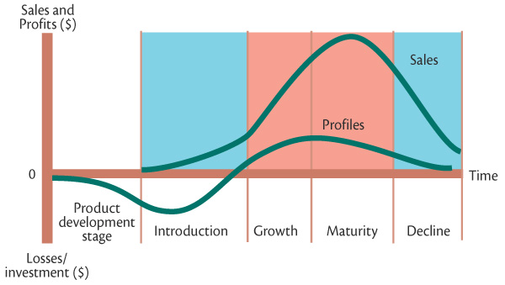
Chapter
Product Life-Cycle Strategies
7
Sales and profits over the product’s life from inception to decline

Slide 31
Chapter
7
Product Life-Cycle Strategies
Product life-cycle (PLC) can describe a product class, a product form, or a brand
Product classes have the longest life cycles, with sales of many product classes in the mature stage for a long time.
Product forms have the standard PLC shape: introduction, rapid growth, maturity, and decline.
Brands have changing PLCs due to competitive threats.

Slide 32
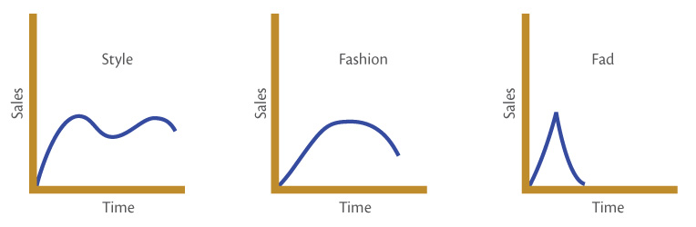
Chapter
Product Life-Cycle Strategies
7
Product life-cycle (PLC) can also be applied to styles, fashions and fads
Style is a basic and distinctive mode of expression.
Fashion is a currently accepted popular style in a given field.
Fads are temporary periods of unusually high sales driven by consumer enthusiasm and immediate product or brand popularity.

Slide 33
Chapter
Product Life-Cycle Strategies
7
Introduction stage
Introduction stage is when the new product is first launched.
  Takes time
  Slow sales growth
  Little or no profit
  High distribution and promotion expense

Slide 34
Product Life-Cycle Strategies
Chapter
7
Growth stage
Growth stage is when the new product satisfies the market.
  Sales increase
  New competitors enter the market
  Price stability or decline to increase volume
  Consumer education
  Profits increase
  Promotion and manufacturing costs gain economies of scale
  Product quality increases
  New features
  New market segments and distribution channels are entered

Slide 35
Chapter
Product Life-Cycle Strategies
7
Maturity stage
Maturity stage is a long-lasting stage of a product that has gained consumer acceptance.
  Slowdown in sales
  Many suppliers
  Substitute products
  Overcapacity leads to competition
  Increased promotion and R&D to support sales and profits.

Slide 36

Marketers consider modifying strategies at the maturity stage
Market modifying
Product modifying
Marketing mix modifying

Slide 37
Chapter
Product Life-Cycle Strategies
7
Market modifying is when a company tries to increase consumption of the current product (New users; Increase usage of existing users; New market segments)
Product modifying is changing characteristics (quality, features, or style) to attract new users and to inspire more usage.
Marketing mix modifying is when a company changes one or more of the marketing mix elements.
  Price
  Promotion
  Distribution channels

Slide 38
Chapter
7
Product Life-Cycle Strategies
Decline stage
Decline stage is when sales decline or level off for an extended time, creating a weak product.
  Maintain the product without change in the hope that competitors leave the industry
  Reposition or reformulate the product in hopes of moving back into the growth stage
  Harvest the product that means reducing various costs and hoping that sales hold up
  Drop the product by selling it to another firm or simply liquidate it at salvage value

Slide 39
Chapter
Additional Product and Service Considerations
7
Product Decisions and Social Responsibility
Public policy and regulations regarding developing and dropping products, patent protection, product quality and safety, and product warranties.
International Product and Service Marketing
  Determining what products and services to introduce in which countries
  Standardization versus customization
  Packaging and labeling
  Customs, values, laws

Slide 40


Thank You

Slide 41

01
My Best Wishes …
Dr. Ayman Hassan

