Slide 1


Information Security
Prepared by Dr. Ahmed Omar
IT373
Information Security
Lecture 0

Slide 2



Information Security
Lecture 0
IT373
Information Security
Prepared by
Dr. Ahmed Omar

Slide 3

Course Outline
Develop an understanding of information assurance as practiced in computer operating systems, software and web applications, gain familiarity with common attacking techniques such as virus, Trojan, worms and memory exploits defenses against them, develop a basic understanding of cryptography, how it has evolved, and two key encryption techniques used today(DEA, RSA).

Slide 4
Learning Outcomes
Upon completion of this course, the student will be able to:
Describe Computer security concepts.
Describe OSI security architecture.
Explain information assurance as practiced in software and web applications.
Describe cryptography and how it has evolved.
Apply two key encryption techniques used today (DEA, RSA).
Develop a basic understanding of Message Authentication (MAC)
Apply Message Integrity (Secure Hash Algorithms: SHA-1)
Apply Digital signatures (ELGamal digital signature scheme and Digital
Signature Standard)
Explain malicious software, viruses, viruses’ countermeasures, worms.
study ways of attaching a virus to a program.

Slide 5
Learning Outcomes
Upon completion of this course, the student will be able to:
explain the sources of viruses and how to countermeasure them.
List types of security policies, high- and low-level policy languages,
operational issues.
explain security feature in Linux.
apply security feature in windows.
explain the vulnerabilities in programs.
explain Buffer Overflow, Cross-site Scripting (XSS) and SQL Injection.
study cybercrime and computer crime, intellectual property (copyright).
explain the problem of intrusion (behavior and techniques).
classify intrusion detection techniques (statistical and rule-based)
explain password management.

Slide 6

Week | Topics
1 | Orientation week
2 | Foundations of Information Security & Assurance
3 | Symmetric Encryption & Standards
4 | Asymmetric Cryptography & Key Management
5 | Message Authentication & Digital Signatures
6 | Malicious Software & Countermeasures
7 | Operating System Security
8 | Application & Web Security
9 | Network Security & Protocols
10 | Intrusion Detection & Cybercrime
11 | Security Policies and Operational Issues
12 | Revision
13 | Final Exam
Course Plan

Slide 7
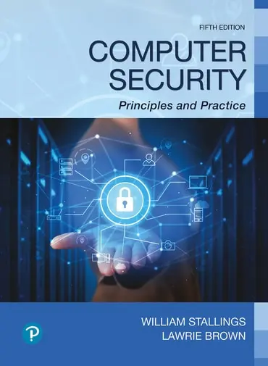
Reference
Computer Security Principles and Practice, 5th edition

Slide 8
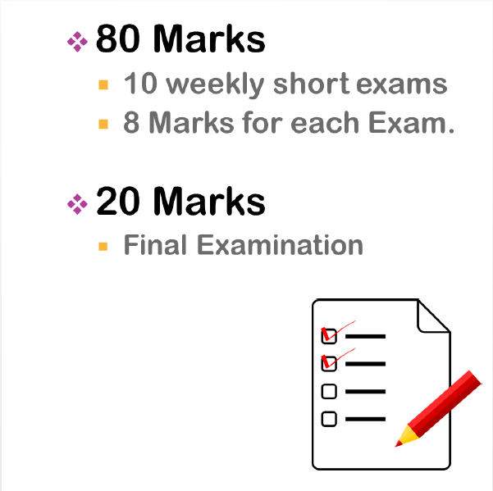
Assessment

Slide 9



Thank You

