Slide 1


Storage Technologies
IT403
Prepared by
Dr. Ahmed El-Douh
Orientation Lecture

Slide 2



Storage Technologies
Lecture 0
IT403
Storage Technologies
Prepared by
Dr. Ahmed El-Douh

Slide 3

Who Am I ?
December 2024 - Current
Lecturer, Ashur University, Baghdad, Iraq
2023 - 2024
Lecturer, October 6 University, Egypt
December 2021 - Current
Huawei Instructor in storage track
  Ph.D.: Cyber Security - 2022
  Huazhong University of Science and Technology
  School of Cyber Science and Engineering, China
  Awarded [ HUST University Outstanding Students Award 2022]
  M.D.: Big Data - 2019
  Cairo University
  Faculty of Computers and Artificial Intelligence, Egypt

Slide 4
Course Description
This course provides a comprehensive overview of various aspects of information and data storage, including the development of storage technologies, intelligent storage components, RAID technologies, common storage protocols, storage system architecture, resource tuning, data protection technologies and applications, business continuity solutions, and operation management.
www.midocean.ae

Slide 5
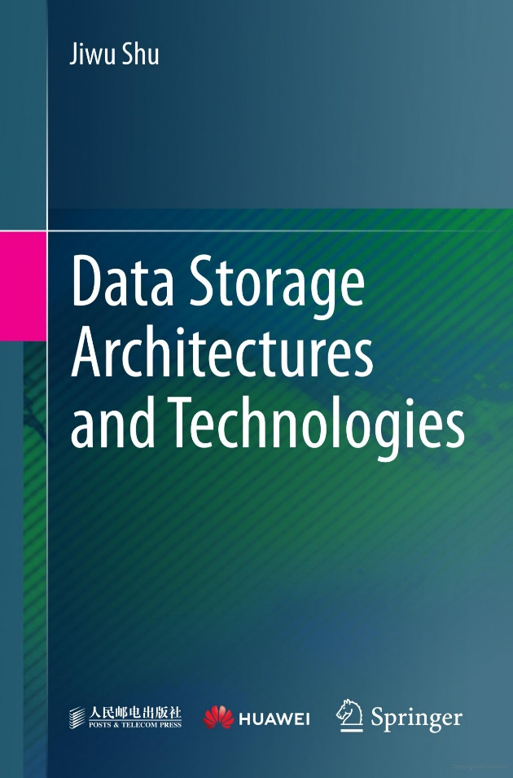
References
Textbook:
Required Textbook: Jiwu Shu, Data Storage Architectures and Technologies, 2024.
HCIA-Storage V5.0 Training Material.
Note: The main material and reference for each course will be the Lecture notes and slides that the professor prepares. Textbook and other materials are additional resources.
www.midocean.ae

Slide 6
Course Learning Outcomes
After learning the course, the students should be able to:
  Describe the information lifecycle.
  To explain the design of a data center and storage requirements.
  To discuss the various types of storage and their properties.
  To explain physical and virtualized storage.
  To explain the backup and archiving regarding recovery and business continuity.
  Describe the components of an intelligent storage system.
  Discuss Data Protection Technologies and Applications.
  Design Storage Business Continuity Solutions and Storage System Operation Management.
www.midocean.ae

Slide 7
Course Contents
Introduction to Information Storage and Management
The Evolution of Storage Technology and Architecture
Data Center Infrastructure
Key Challenges in Managing Information
Information Lifecycle
Storage System Environment
Data Protection: RAID
Storage Networking Technologies and Virtualization
www.midocean.ae

Slide 8
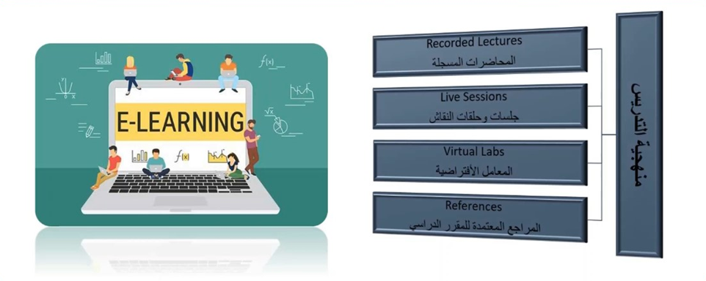
Teaching Methodology
www.midocean.ae

Slide 9
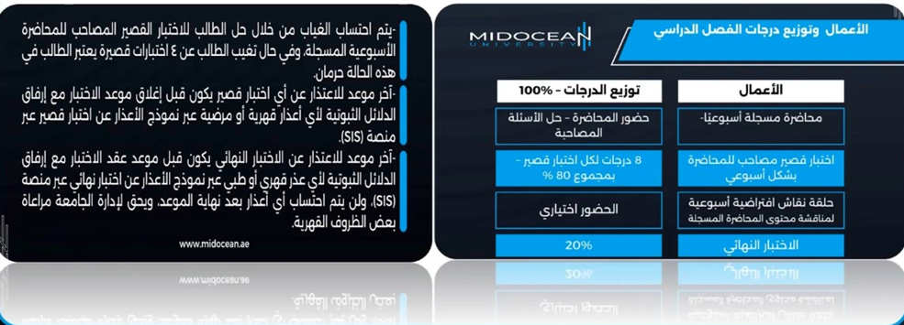
Study System
www.midocean.ae

Slide 10
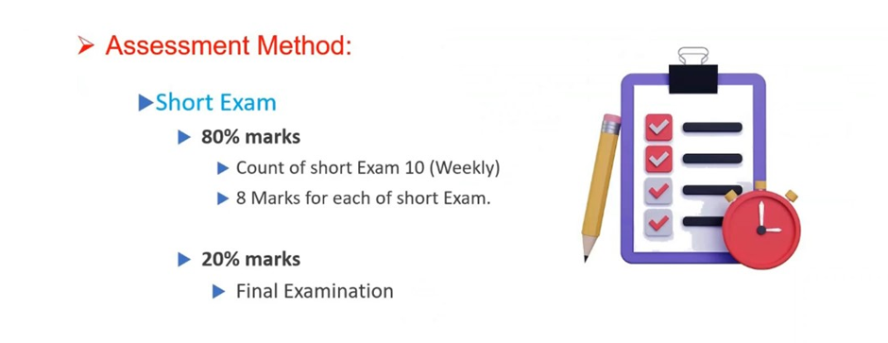
Course Information - Evaluation
www.midocean.ae

Slide 11



Thank You

