Slide 1

Risk Management
Prepared by Dr. Dalia Hosni
Lecture2
MGM 510
Risk Management

Slide 2

Lecture
02
Risk Management
Concept of Risk Management
Protect the organizations assets
Focus on all risks to an organization
Aligned with organization mission ,vision , value, and goals

Slide 3
Lecture
02
Risk Management Topics
Plan Risk Management
Identify Risks
Perform Qualitative Risk Analysis
Perform Quantitative Risk Analysis
Plan Risk Responses
Monitor and Control Risks

Slide 4
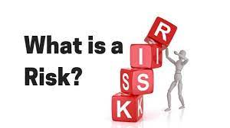
Lecture
02
Risk
Risk
An unplanned or uncertain event that can impact a project

Slide 5
Lecture
02
Risk
Risk
A risk is any uncertain event or condition that might affect your project. Not all risks are negative. Some events (like finding an easier way to do an activity) or conditions (like lower prices for certain materials) can help your project. When this happens, we call it an opportunity; but it’s still handled just like a risk.

Slide 6
Lecture
02
Risk Management
التنفيذ
المراقبة والمتابعة
الإغلاق
تخطيط
Initiating
Executing
Monitoring
&
Controlling
Planning
Closing
إعداد
Plan Risk Management
Identify Risks
Perform Qualitative Risk Analysis
Perform Quantitative Risk Analysis
Plan Risk Responses
Monitor and
Control Risks

Slide 7
Lecture
02
Risk Management
A risk management plan defines how your project’s risk management process will be executed. That includes the funds, tools and approaches that will be used to perform risk identification, assessment, mitigation and monitoring activities

Slide 8
Lecture
02
Risk Management Plan
A risk management plan usually includes:
Methodology
Risk Register
Risk Breakdown Structure
Risk Assessment Matrix
Risk Response Plan
Roles and responsibilities
Funding
Timing

Slide 9
Chapter
02
Risk Management Plan
Methodology: Define the tools and approaches that will be used to perform risk management activities such as risk assessment, risk analysis and risk mitigation strategies.

Slide 10
Lecture
02
Risk Management Plan
Risk Register: A risk register is a chart where you can document all the risk identification information of your project.

Slide 11
Lecture
02
Risk Management Plan
Risk Breakdown Structure: It’s a chart that allows you to identify risk categories and the hierarchical structure of project risks.

Slide 12
Lecture
02
Risk Management Plan
Risk Assessment Matrix: A risk assessment matrix allows you to analyze the likelihood and the impact of project risks so you can prioritize them.

Slide 13
Lecture
02
Risk Management Plan
Risk Response Plan: A risk response plan is a project management document that explains the risk mitigation strategies that will be employed to manage your project risks.

Slide 14
Lecture
02
Risk Management Plan
Roles and responsibilities: The risk management team members have responsibilities as risk owners. They need to monitor project risks and supervise their risk response actions.

Slide 15
Lecture
02
Risk Management Plan
Funding: Have a section where you identify the funds required to perform your risk management activities.

Slide 16
Lecture
02
Risk Management Plan
Timing: Include a section to define the schedule for the risk management activities.

Slide 17
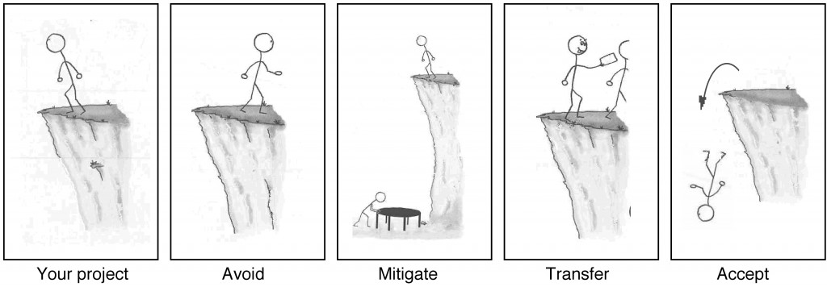
Lecture
02
Risk Management Planning
        If your project requires that you stand on the edge of a cliff, then there’s a risk that you could fall. If it’s very windy out or if the ground is slippery and uneven, then falling is more likely

Slide 18
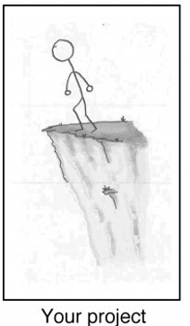
Lecture
02
Risk Management Planning?
When you’re planning your project, risks are still uncertain: they haven’t happened yet. But eventually, some of the risks that you plan for do happen, and that’s when you have to deal with them. There are four basic ways to handle a risk.

Slide 19
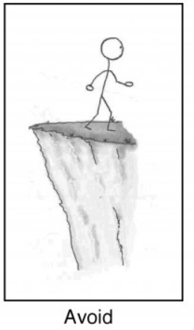
Lecture
02
Risk Management Planning?
Avoid: The best thing you can do with a risk is avoid it. If you can prevent it from happening, it definitely won’t hurt your project.

Slide 20
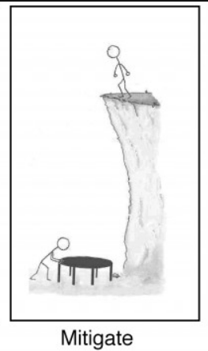
Lecture
02
Risk Management Planning?
Mitigate: If you can’t avoid the risk, you can mitigate it. This means taking some sort of action that will cause it to do as little damage to your project as possible.

Slide 21
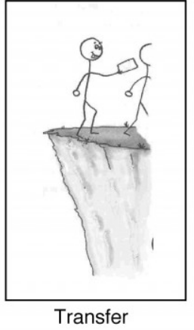
Lecture
02
Risk Management Planning?
3.Transfer: One effective way to deal with a risk is to pay someone else to accept it for you. The most common way to do this is to buy insurance.

Slide 22
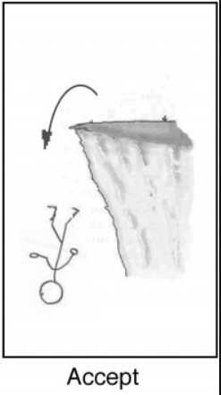
Lecture
02
Risk Management Planning?
Accept: When you can’t avoid, mitigate, or transfer a risk, then you have to accept it. But even when you accept a risk, at least you’ve looked at the alternatives and you know what will happen if it occurs. If you can’t avoid the risk, and there’s nothing you can do to reduce its impact, then accepting it is your only choice.

Slide 23
Lecture
02
Risk Management Planning?
By the time a risk actually occurs on your project, it’s too late to do anything about it. That’s why you need to plan for risks from the beginning and keep coming back to do more planning throughout the project.

Slide 24
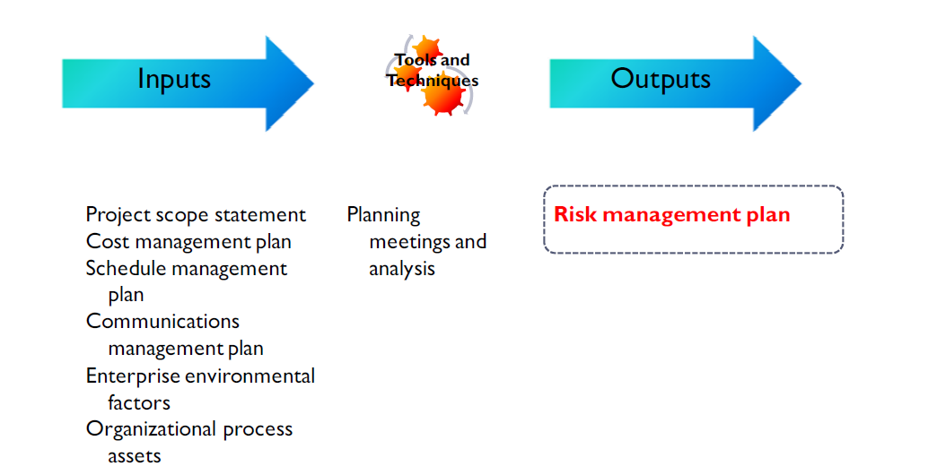
Lecture
02
Plan Risk Management
Notes
This process defines how you will conduct risk management activities for a project. It includes the
process of defining and providing sufficient resources and time to perform risk management activities.
Planning for risk management begins when the project is originally conceived and should be completed early in the Planning process group.

Slide 25
Lecture
02
The Risk Management Plan
Components Include:
Methodology
Roles and responsibilities
Budgeting
Timing
Risk categories
Definitions of probability and impact
Stakeholder tolerances
Reporting formats
Tracking
Which Define:
How you will do risk management
Who will do what
What risk. Will cost
When we do risk.
Example internal, external
Will it happen and how severe the
risk may be
Risk tolerant or risk averse
What goes into the report
Audit of risk process

Slide 26
Lecture
02
The Risk Management Plan
The output of the Plan Risk Management process is the creation and completion of the Risk
Management Plan. The major categories in a risk management plan include:
      Risk management methodology
      roles and responsibilities
      Budgeting
      Timing
      Risk Categories
      Definitions of probability and impact
      Probability and impact matrix
      Revised stakeholder’s tolerances
      Reporting Formats
      Tracking

Slide 27
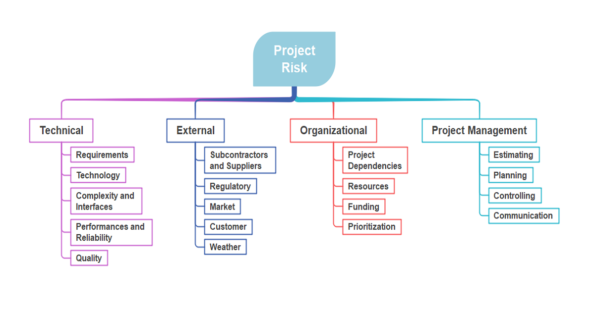
Lecture
02
Risk Breakdown Structure
The risk categories in a project management plan can be graphically represented with a tool that is similar to the work breakdown structure (WBS) called a Risk Breakdown Structure (RBS).
The RBS enables you to see all project risks grouped by basic themes and the specific risk areas occurring in relation to each theme
.

Slide 28
Lecture
02
What is Risk Identification?
Risk identification is the process of identifying and assessing threats to an organization, its operations, and its workforce. For example, risk identification may include assessing IT security threats such as malware and ransomware, accidents, natural disasters, and other potentially harmful events that could disrupt business operations. Companies that develop robust risk management plans are likely to find they’re able to minimize the impact of threats, when and if they should occur.

Slide 29
Lecture
02
Risk Identification Process Steps
There are five core steps within the risk identification and management process. These steps include risk identification, risk analysis, risk evaluation, risk treatment, and risk monitoring.
Risk Identification: The purpose of risk identification is to reveal what, where, when, why, and how something could affect a company’s ability to operate. For example, a business located in central California might include “the possibility of wildfire” as an event that could disrupt business operations.

Slide 30
Lecture
02
Risk Identification Process Steps
Risk Analysis: This step involves establishing the probability that a risk event might occur and the potential outcome of each event. Using the California wildfire example, safety managers might assess how much rainfall has occurred in the past 12 months and the extent of damage the company could face should a fire occur.

Slide 31
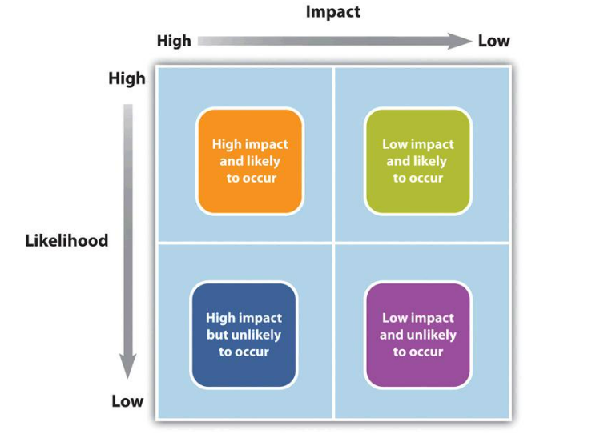
Lecture
02
Risk Identification Process Steps
Risk Evaluation: Risk evaluation compares the magnitude of each risk and ranks them according to prominence and consequence. For example, the effects of a possible wildfire may be weighed against the effects of a possible mudslide. Whichever event is determined to have a higher probability of happening and causing damage, it would rank higher.
تأثير كبير محتمل الحدوث
تأثير منخفض محتمل الحدوث
تأثير كبير ولكن غير محتمل الحدوث
تأثير منخفض ولكن غير محتمل الحدوث

Slide 32
Lecture
02
Risk Identification Process Steps
Risk Treatment: Risk treatment is also referred to as Risk Response Planning. In this step, risk mitigation strategies, preventative care, and contingency plans are created based on the assessed value of each risk. Using the wildfire example, risk managers may choose to house additional network servers offsite, so business operations could still resume if an onsite server is damaged. The risk manager may also develop evacuation plans for employees.
Risk Monitoring: Risk management is a non-stop process that adapts and changes over time. Repeating and continually monitoring the processes can help assure maximum coverage of known and unknown risks.

Slide 33
Lecture
02
identify risk
This Process is used to determine which risks may affect the project, and can include the following resources when performing risk identification activities:
      Project Manager
      Project Team
      Risk Team
      Stakeholders
      Customers
      Subject matter experts

