Slide 1


Slide 2


Slide 3
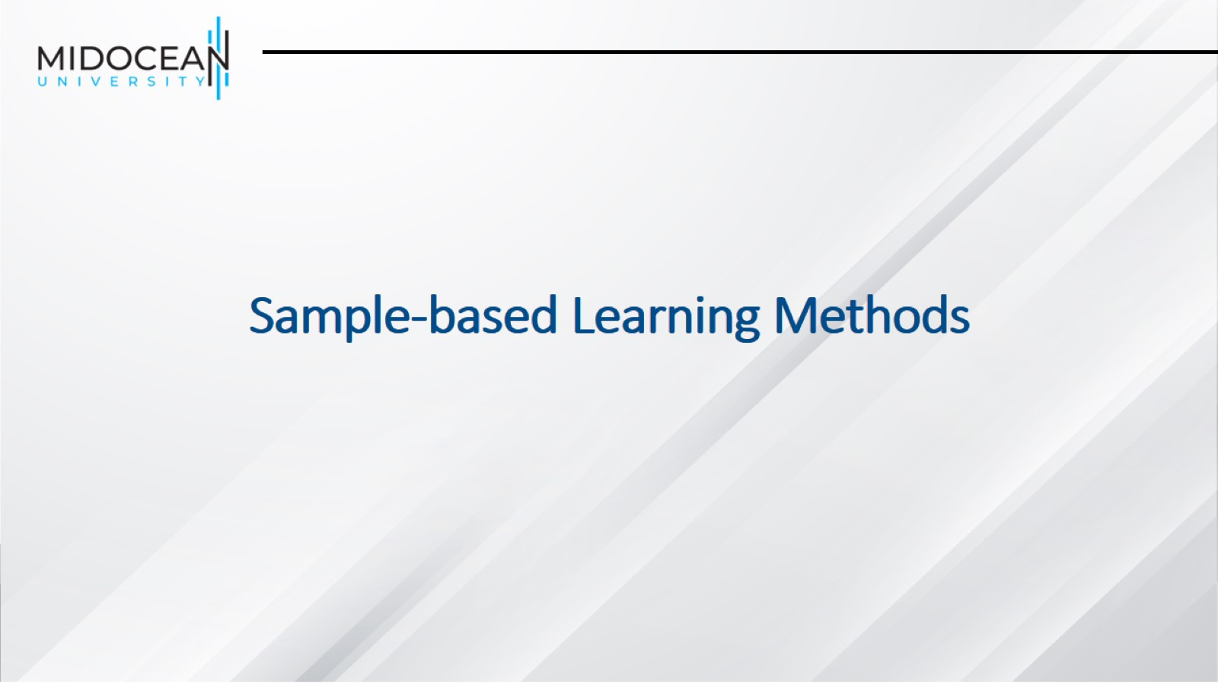
Sample-based Learning Methods

Slide 4
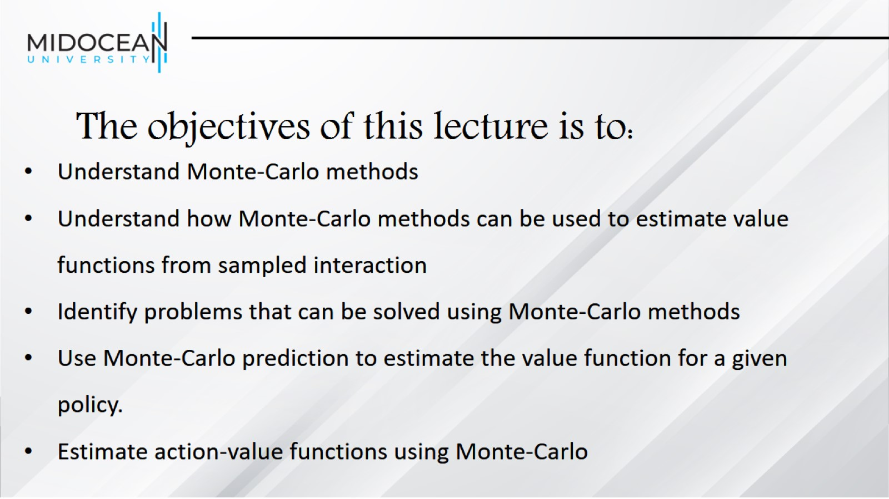
The objectives of this lecture is to:

Slide 5
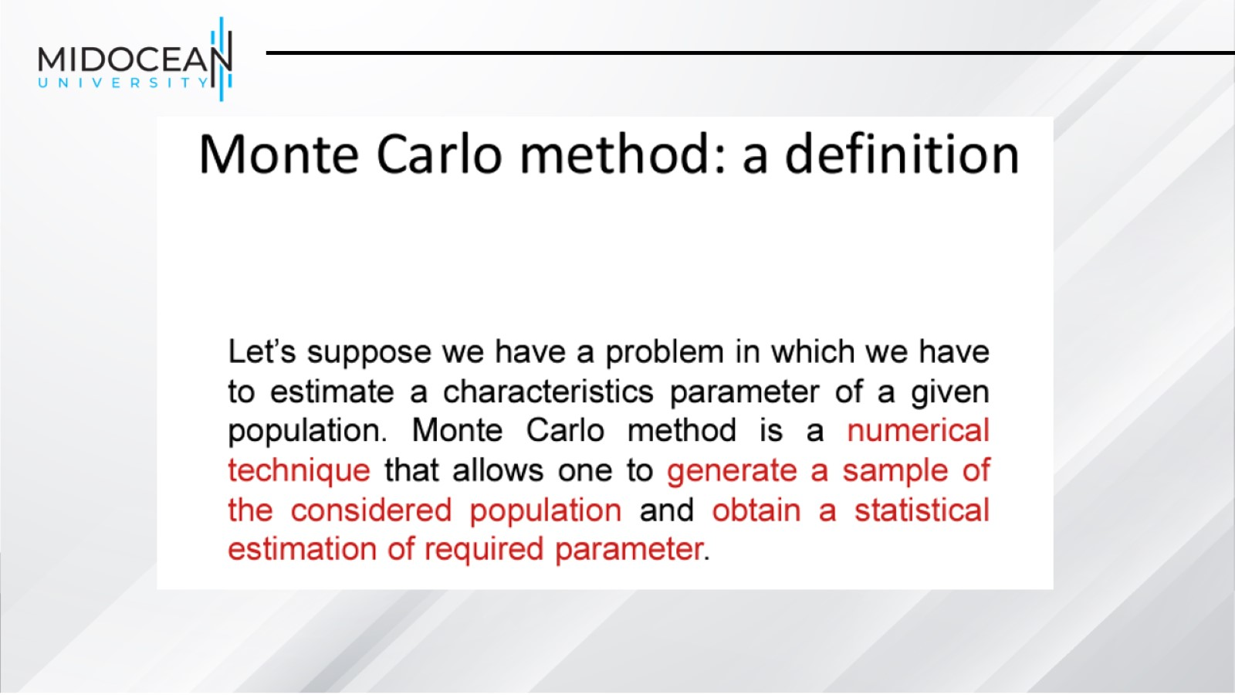

Slide 6
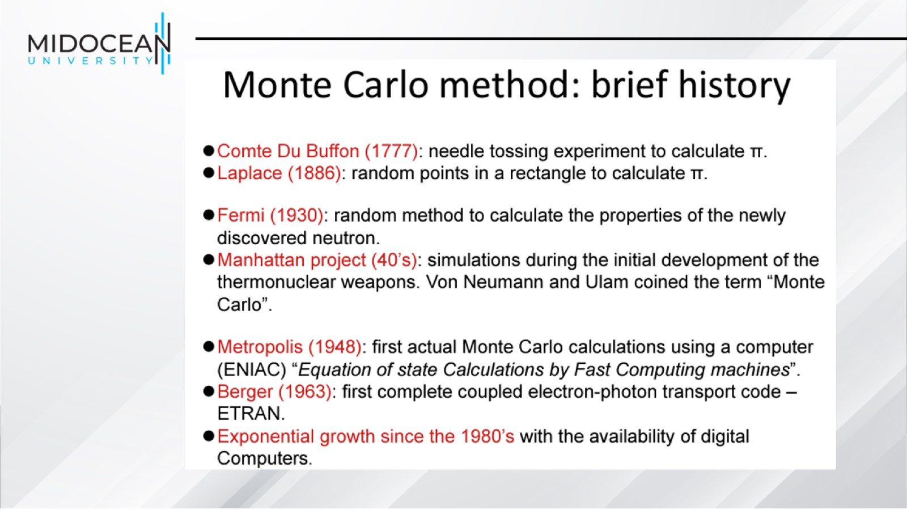

Slide 7
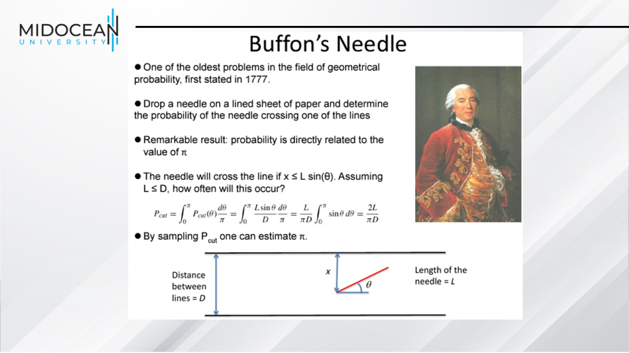

Slide 8
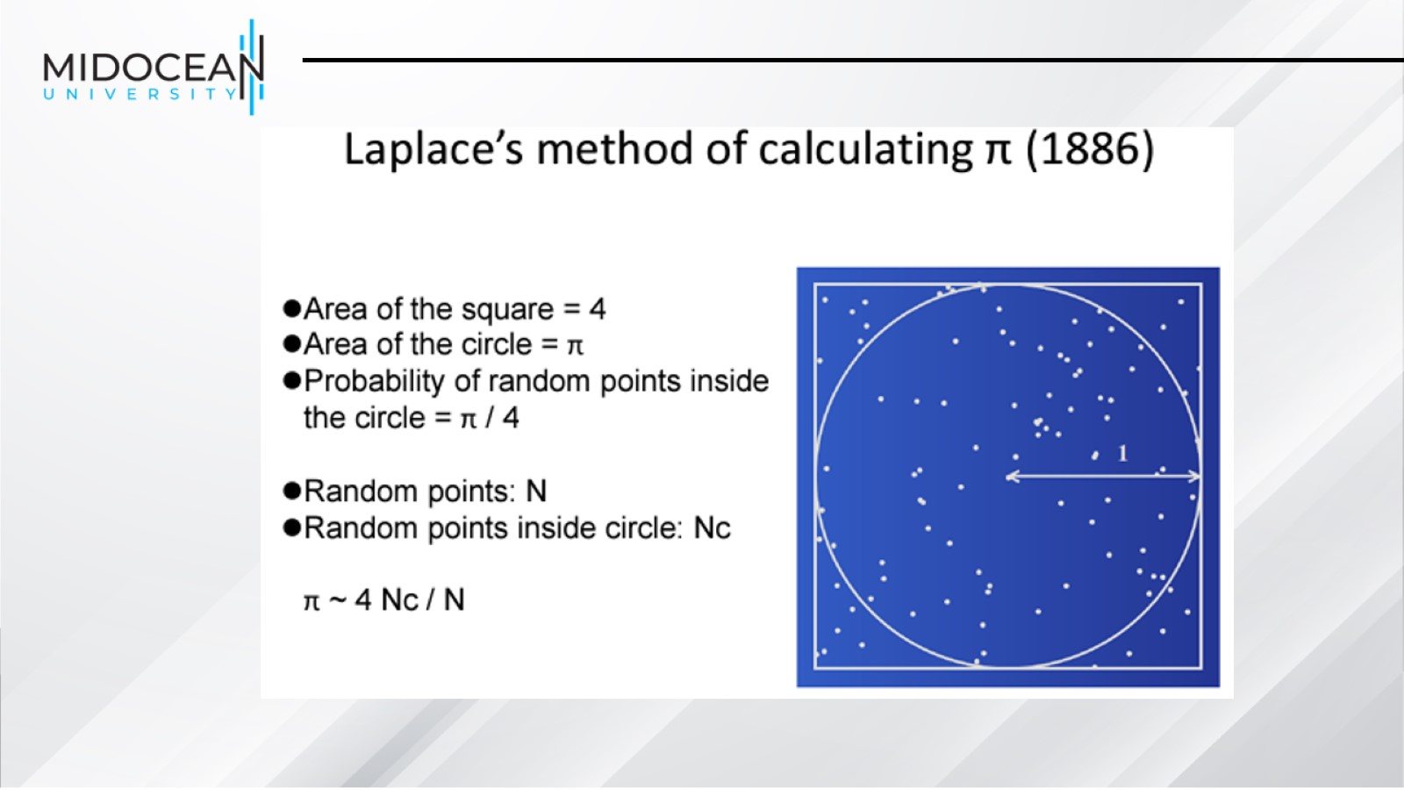

Slide 9


Slide 10
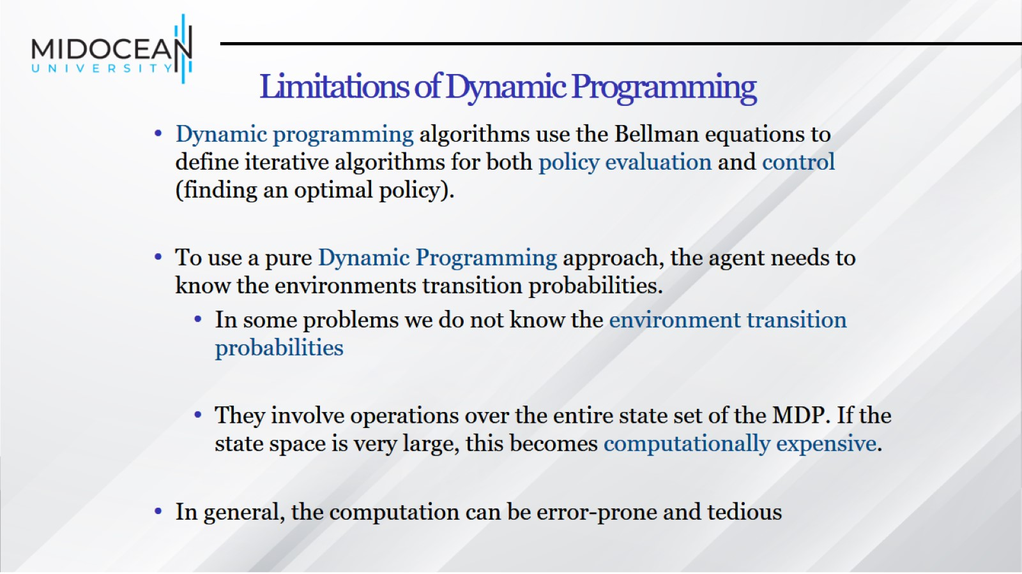
Limitations of Dynamic Programming

Slide 11
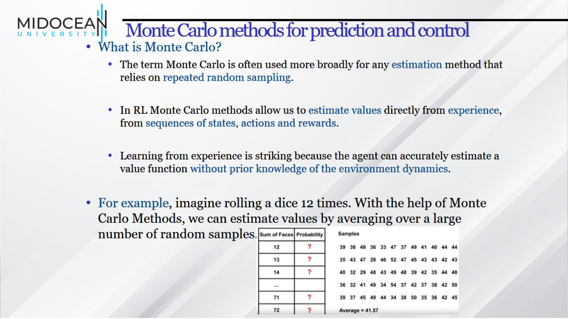
Monte Carlo methods for prediction and control

Slide 12
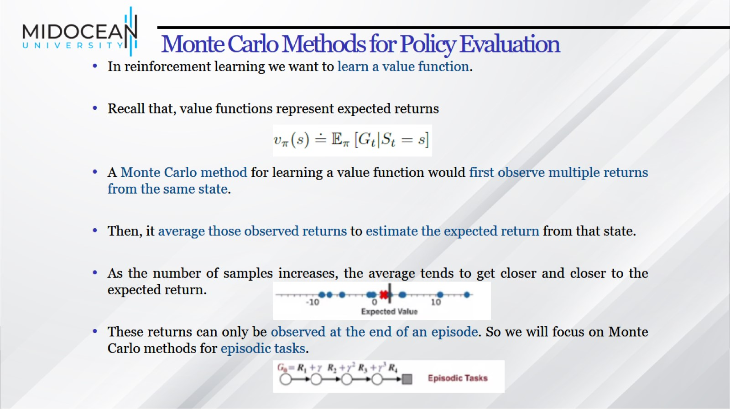
Monte Carlo Methods for Policy Evaluation

Slide 13
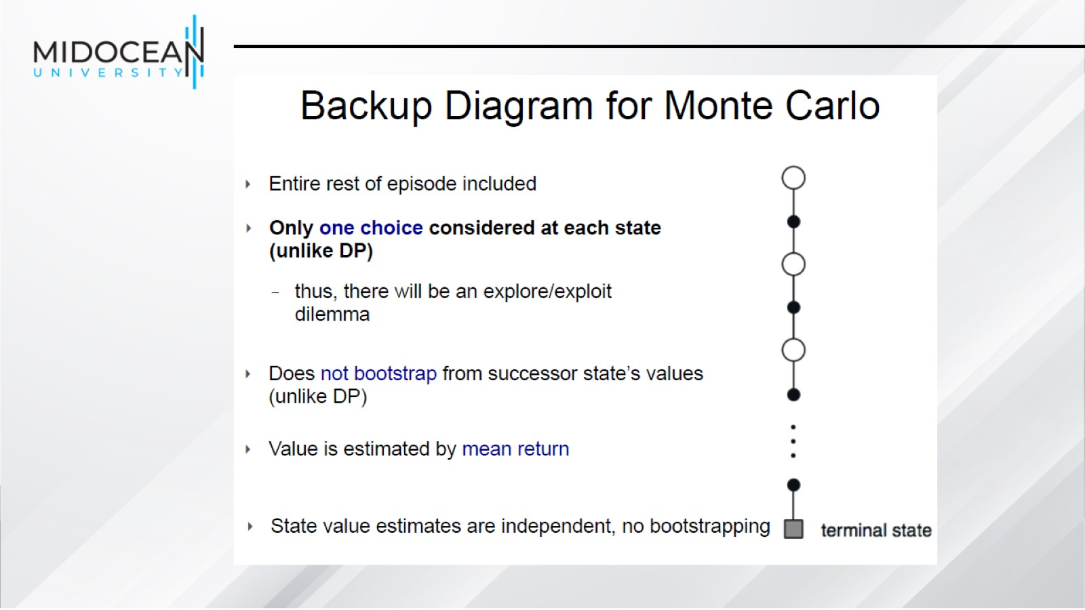

Slide 14
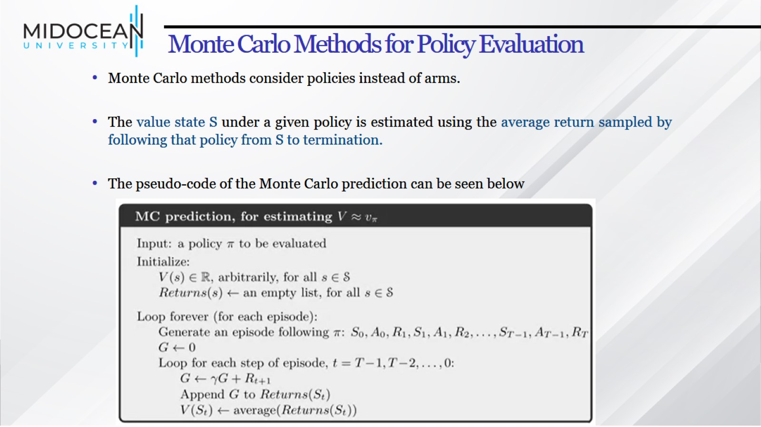
Monte Carlo Methods for Policy Evaluation

Slide 15
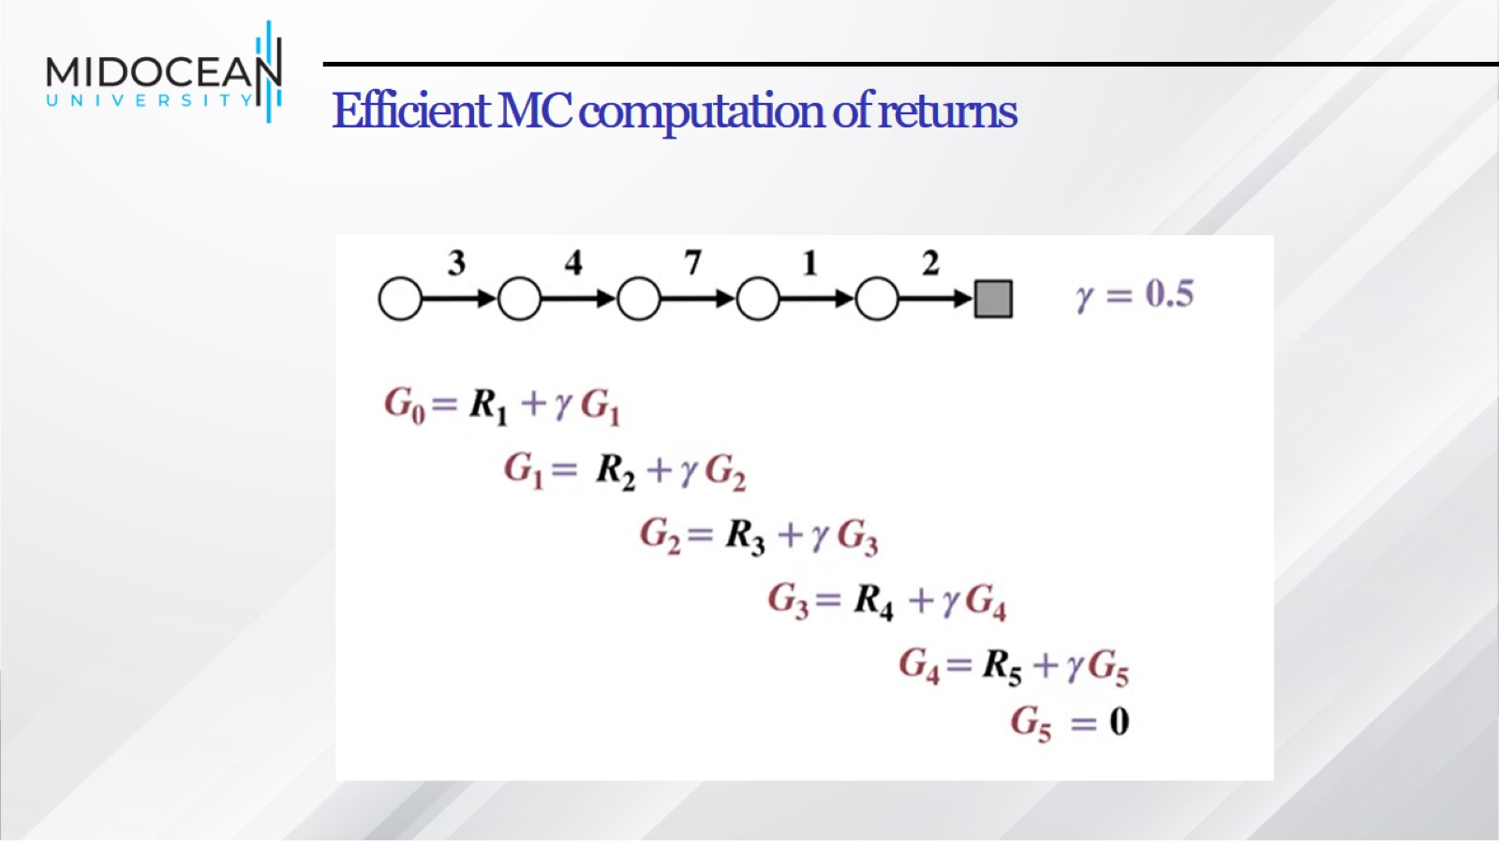
Efficient MC computation of returns

Slide 16
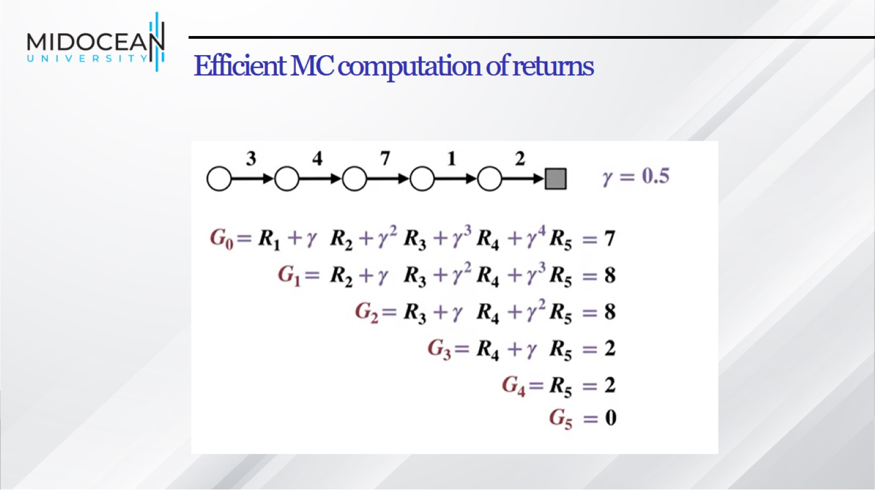
Efficient MC computation of returns

Slide 17
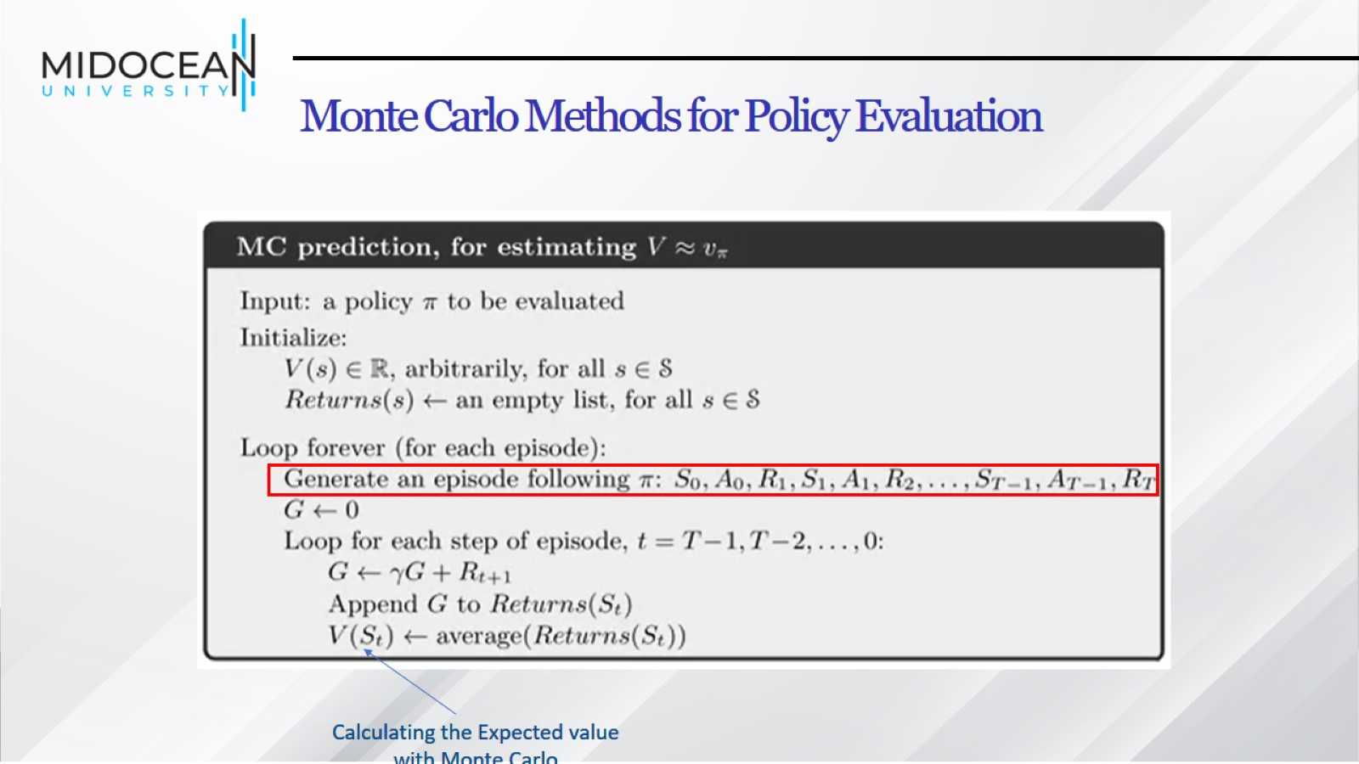
Monte Carlo Methods for Policy Evaluation

Slide 18
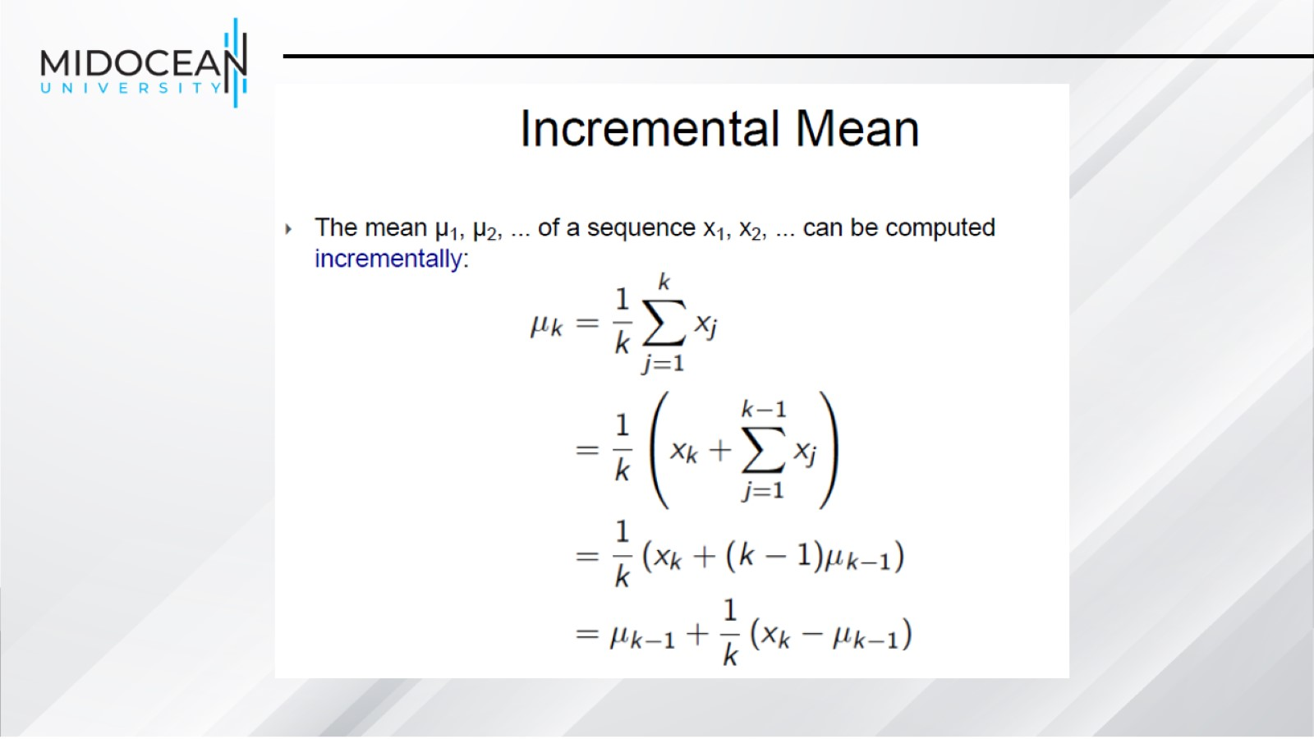

Slide 19
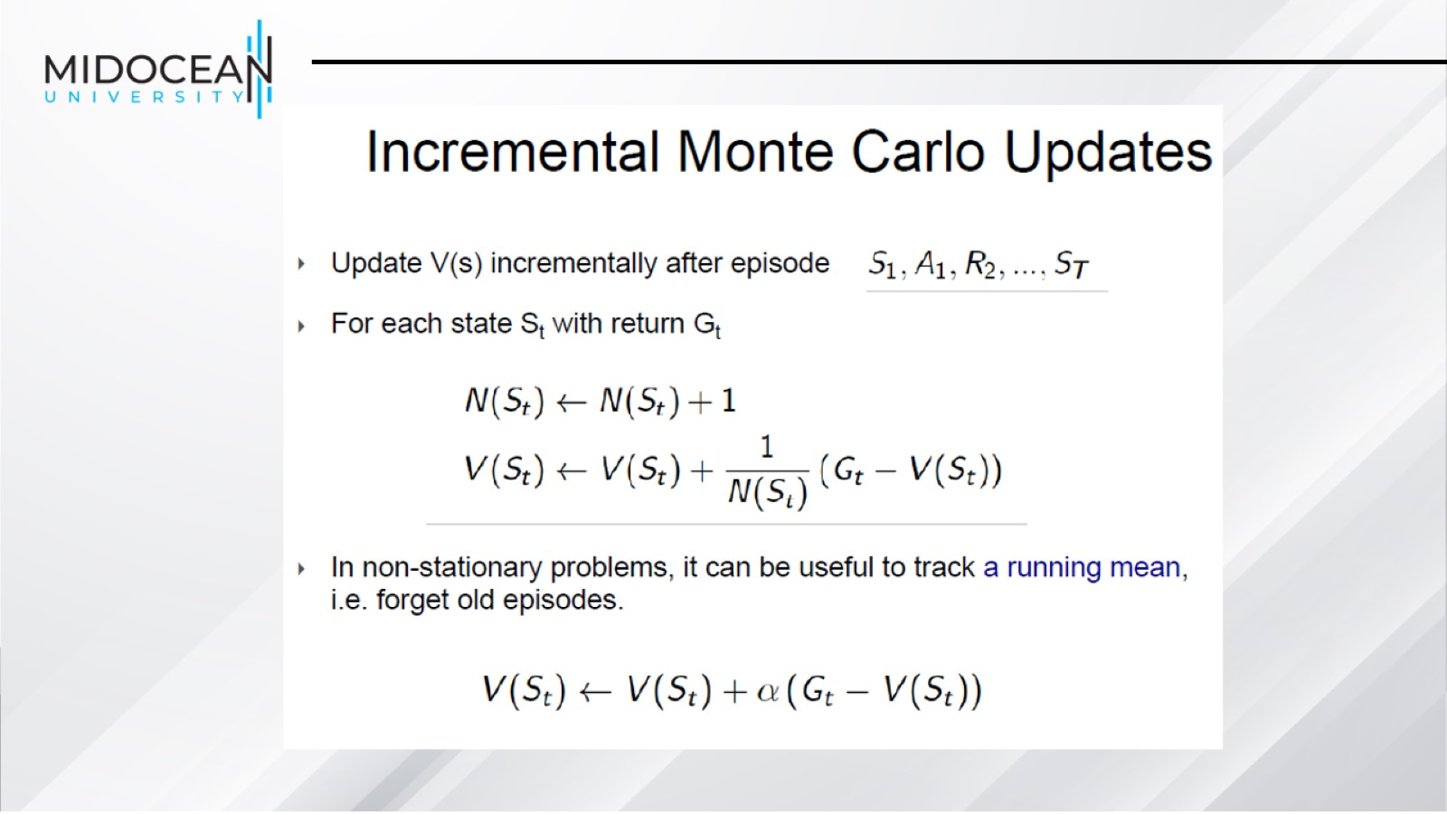

Slide 20
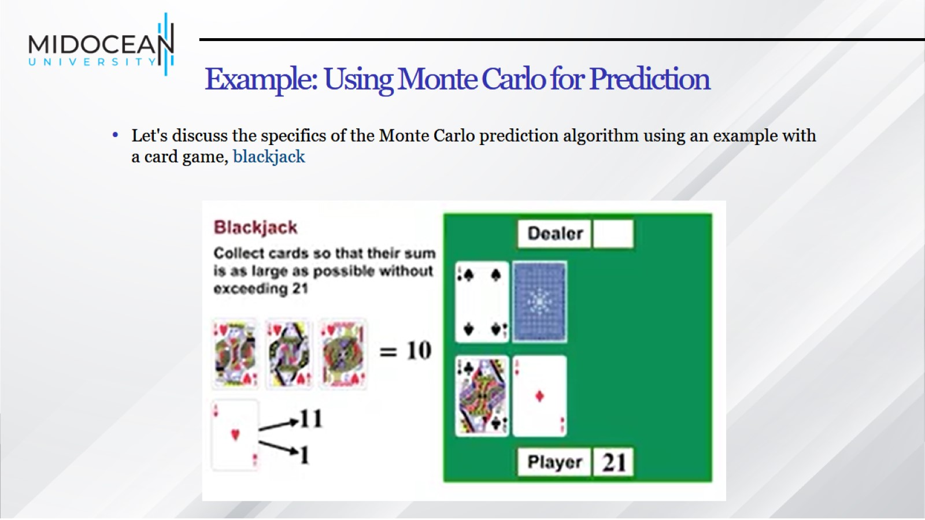
Example: Using Monte Carlo for Prediction

Slide 21
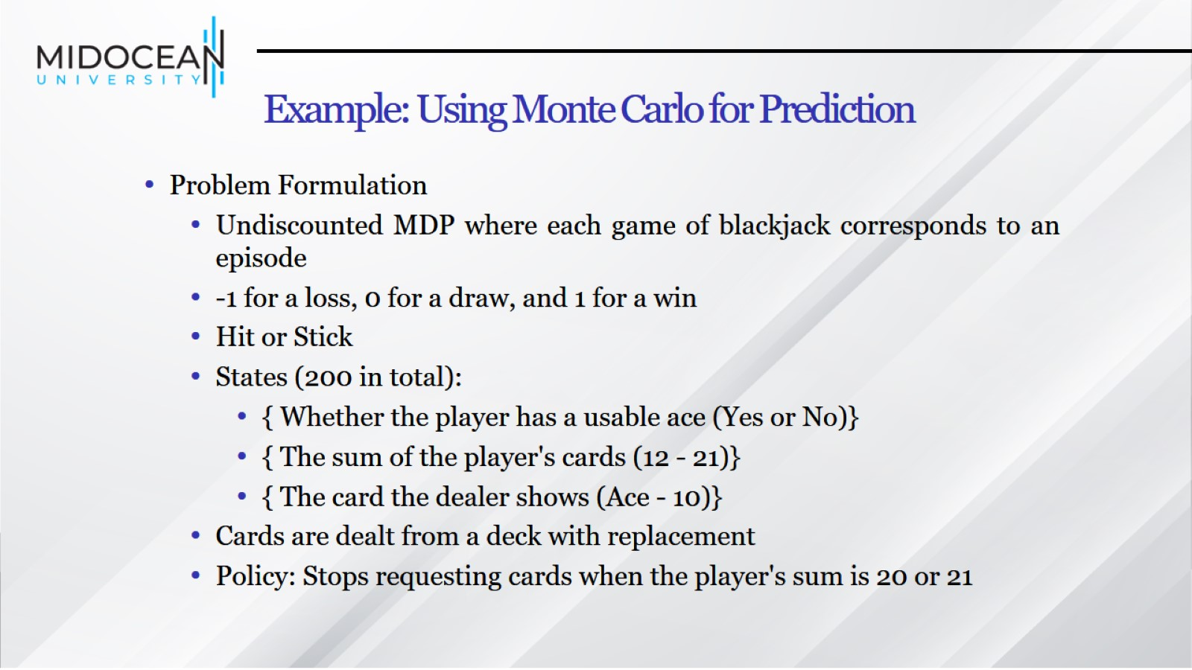
Example: Using Monte Carlo for Prediction

Slide 22
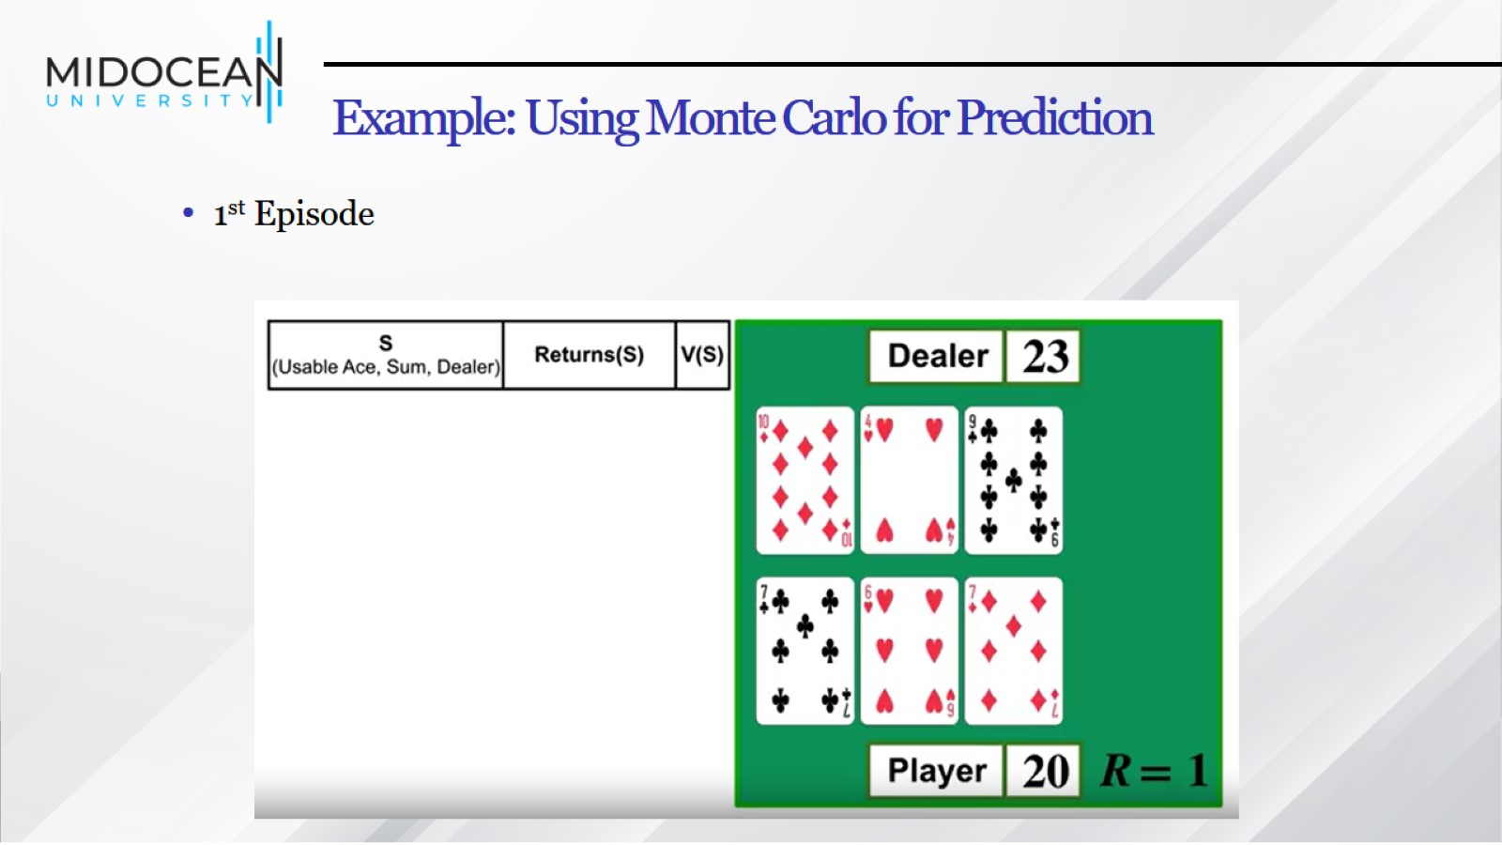
Example: Using Monte Carlo for Prediction

Slide 23
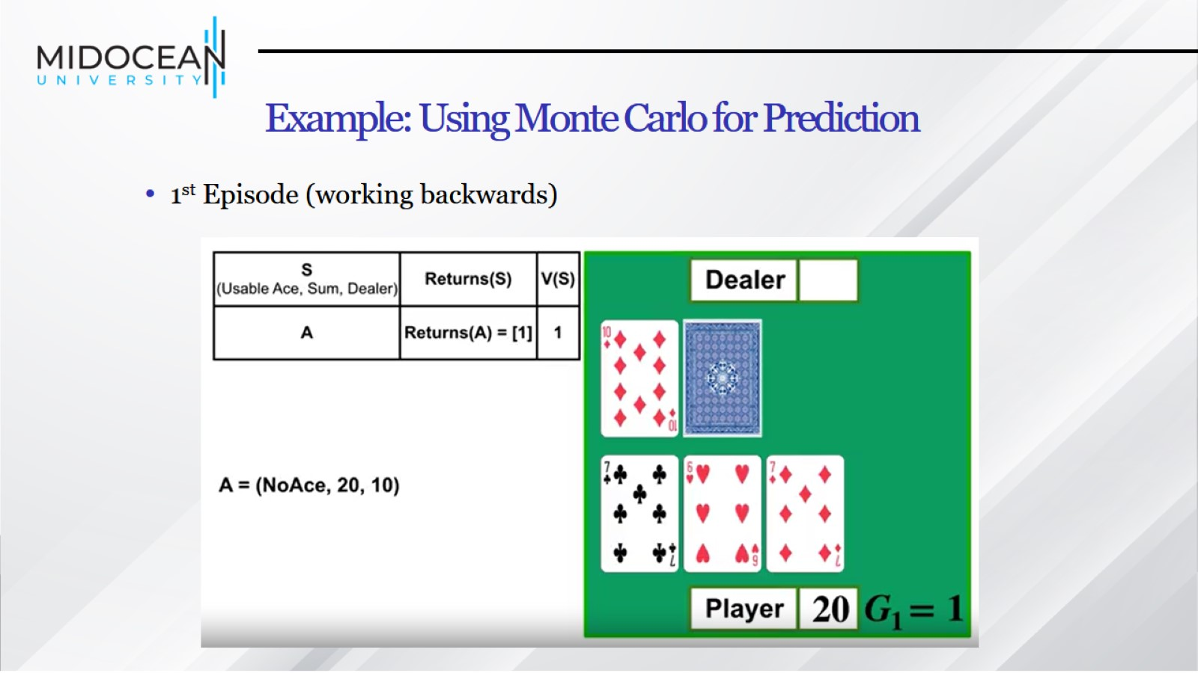
Example: Using Monte Carlo for Prediction

Slide 24
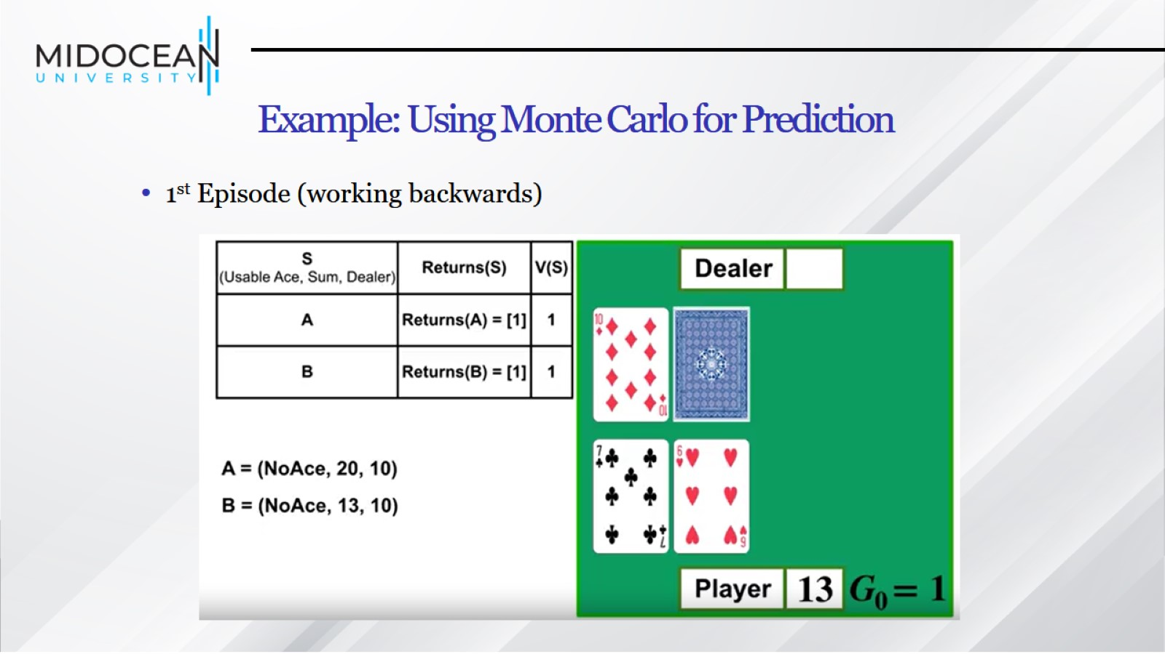
Example: Using Monte Carlo for Prediction

Slide 25
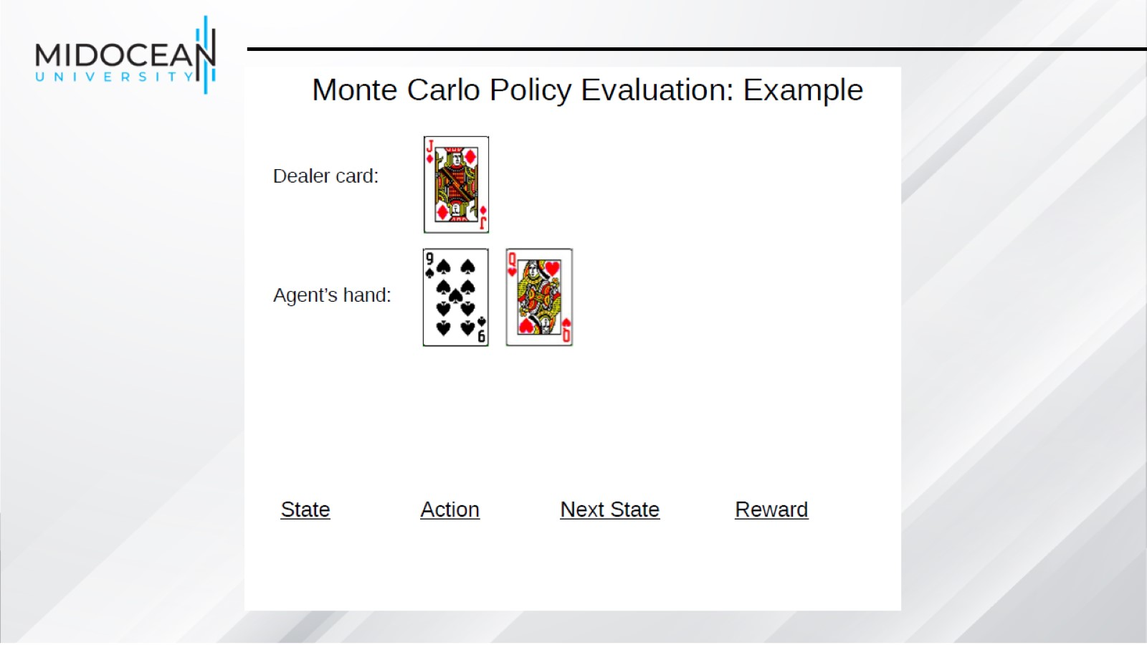

Slide 26
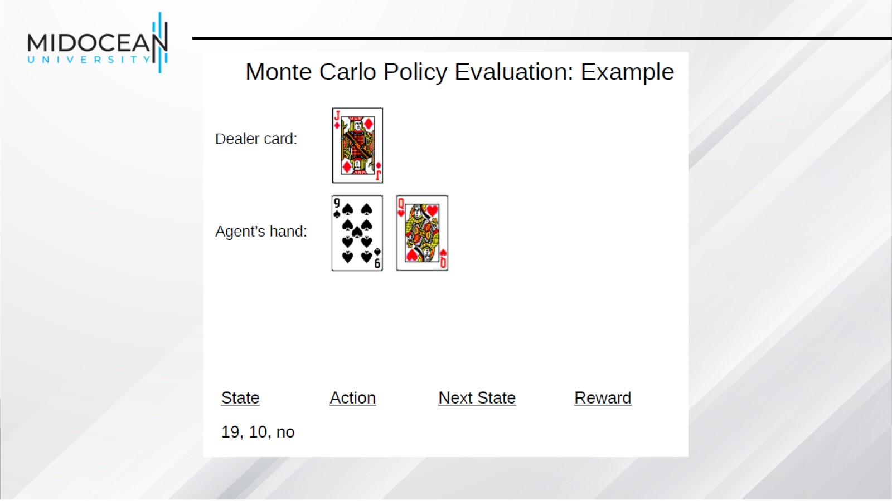

Slide 27
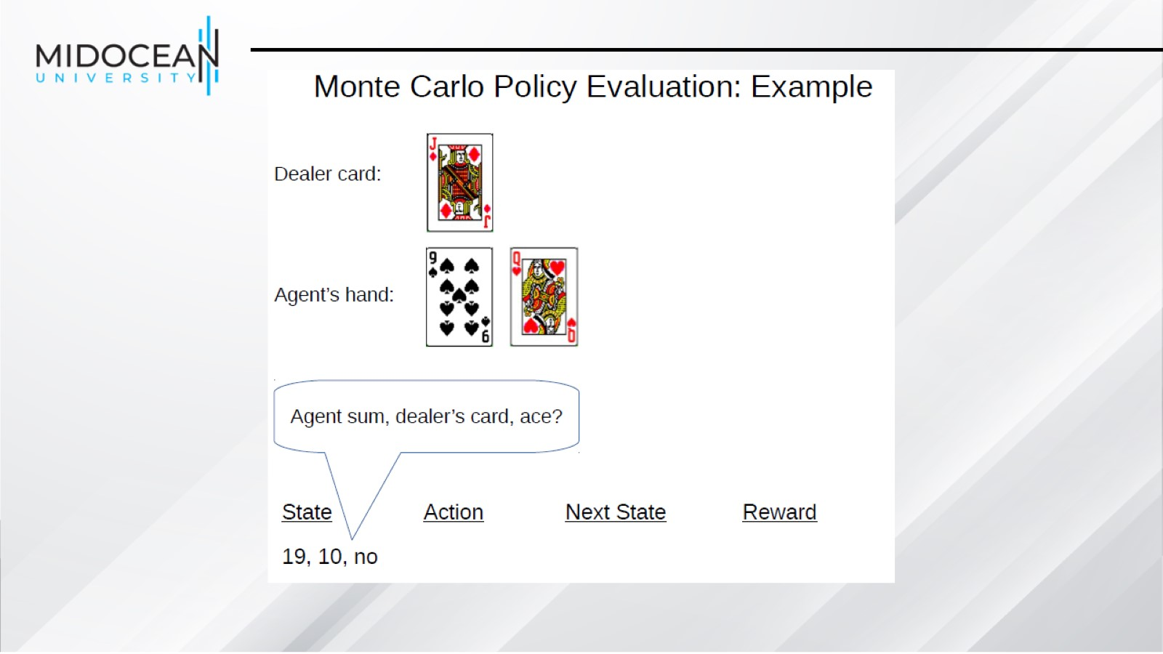

Slide 28
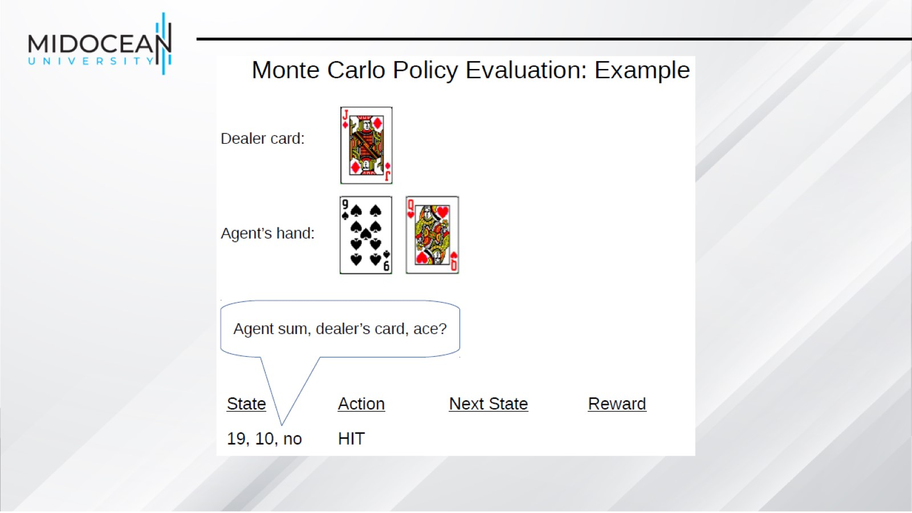

Slide 29
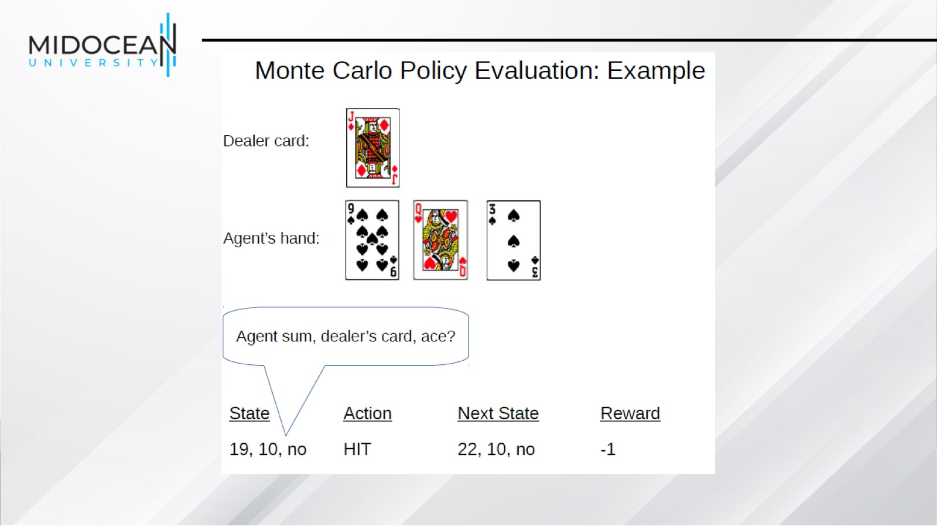

Slide 30
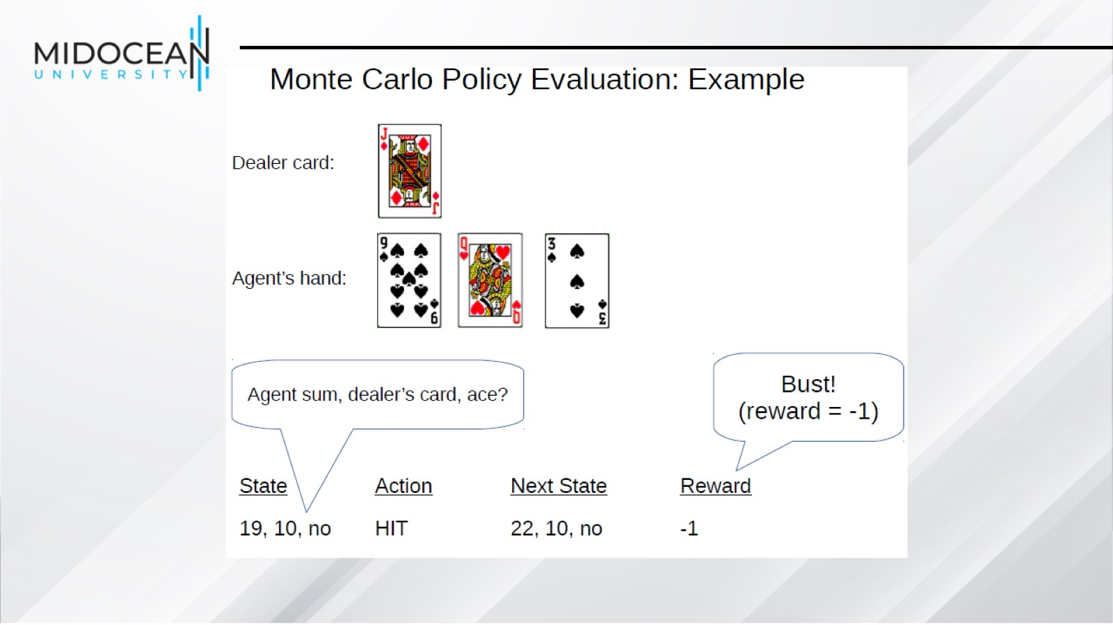

Slide 31
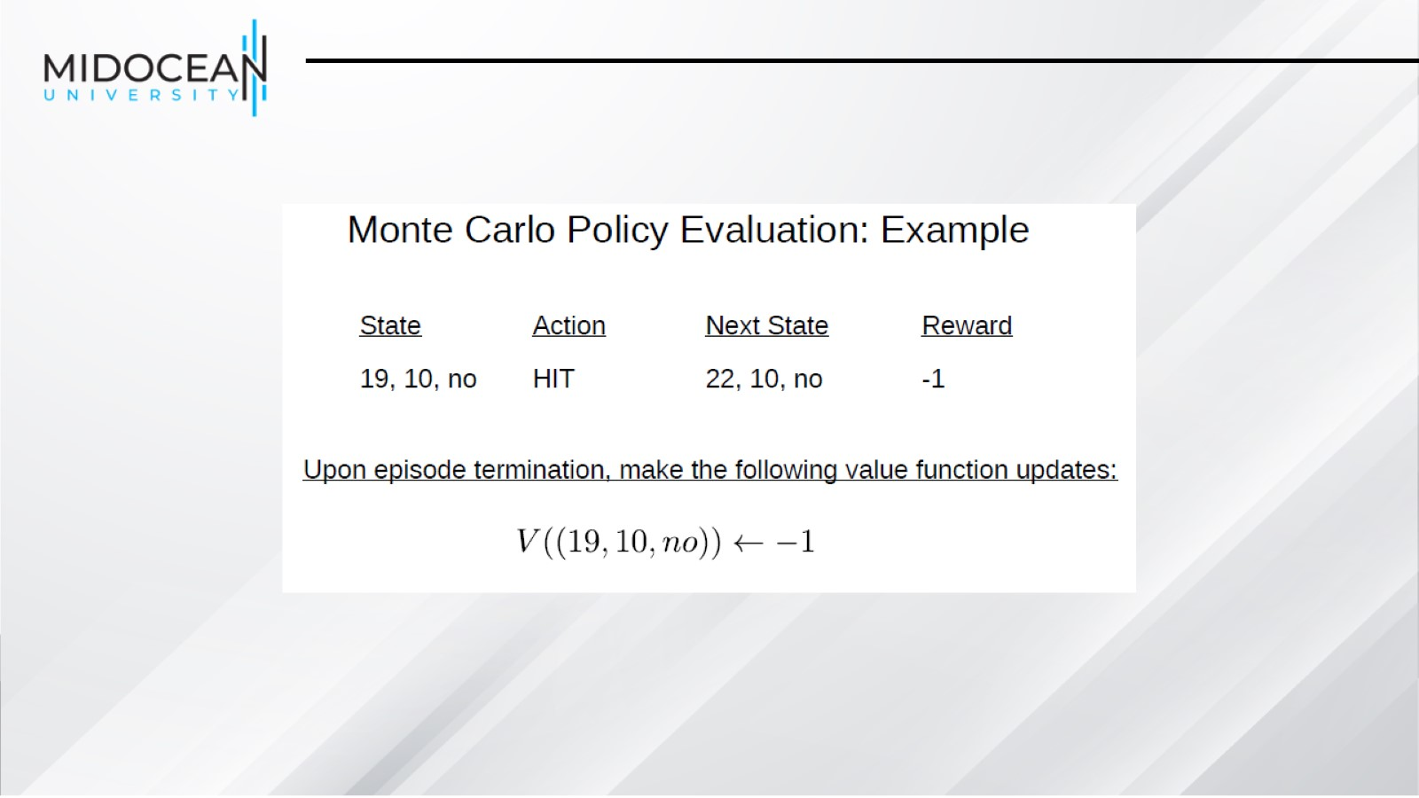

Slide 32
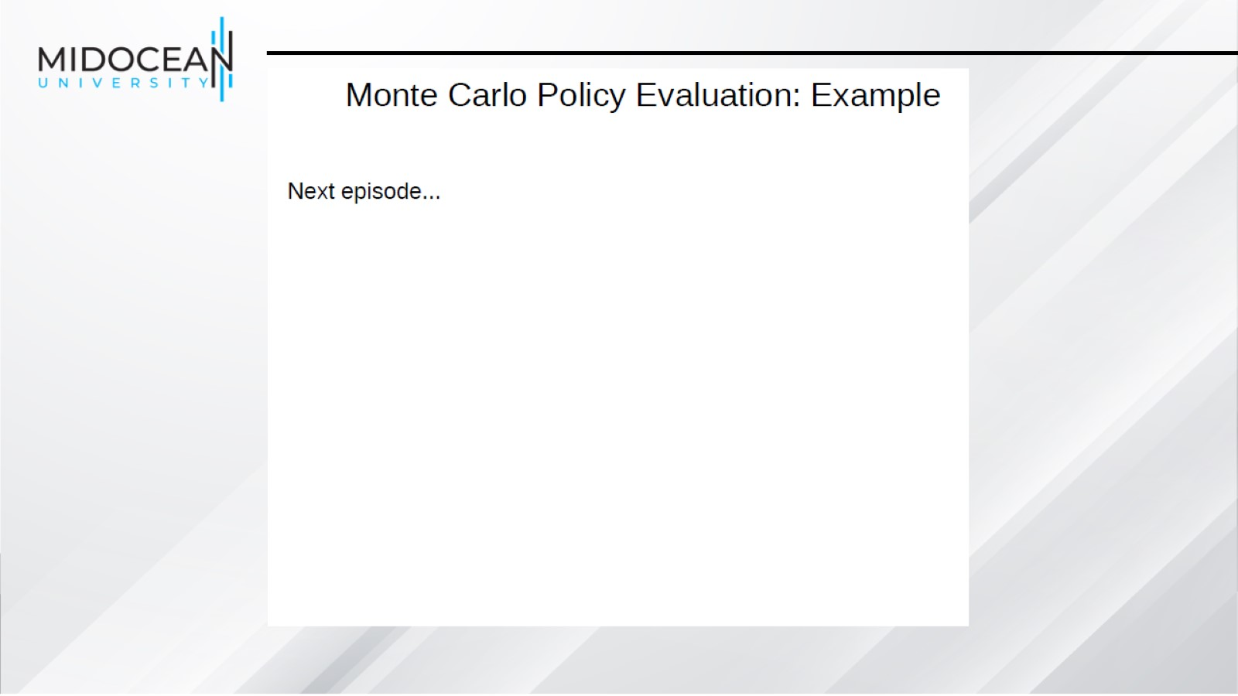

Slide 33
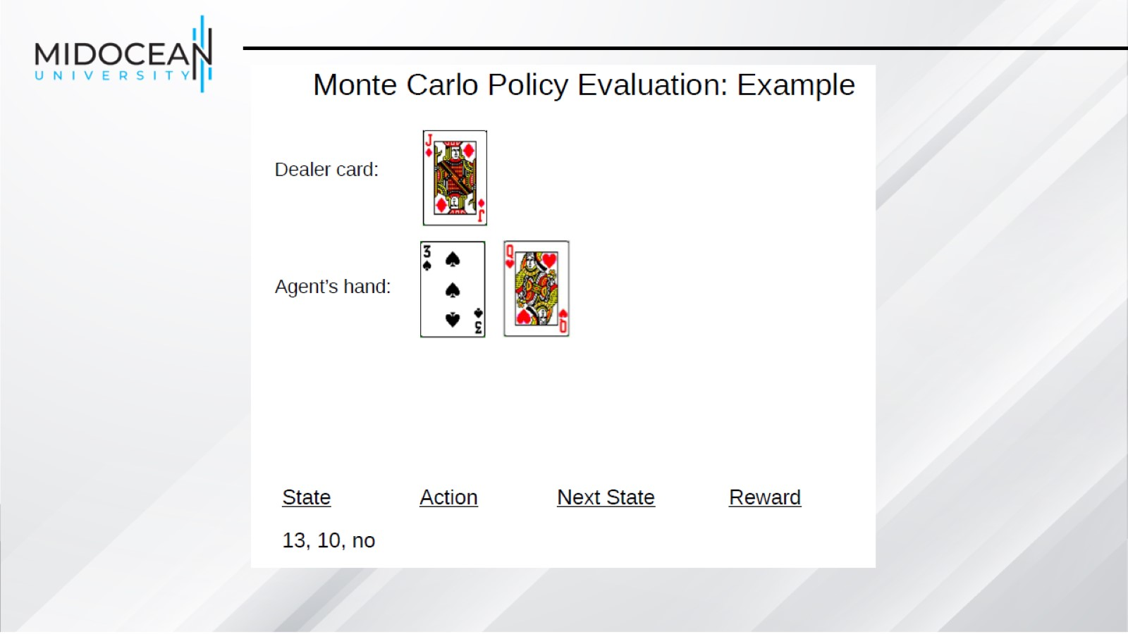

Slide 34
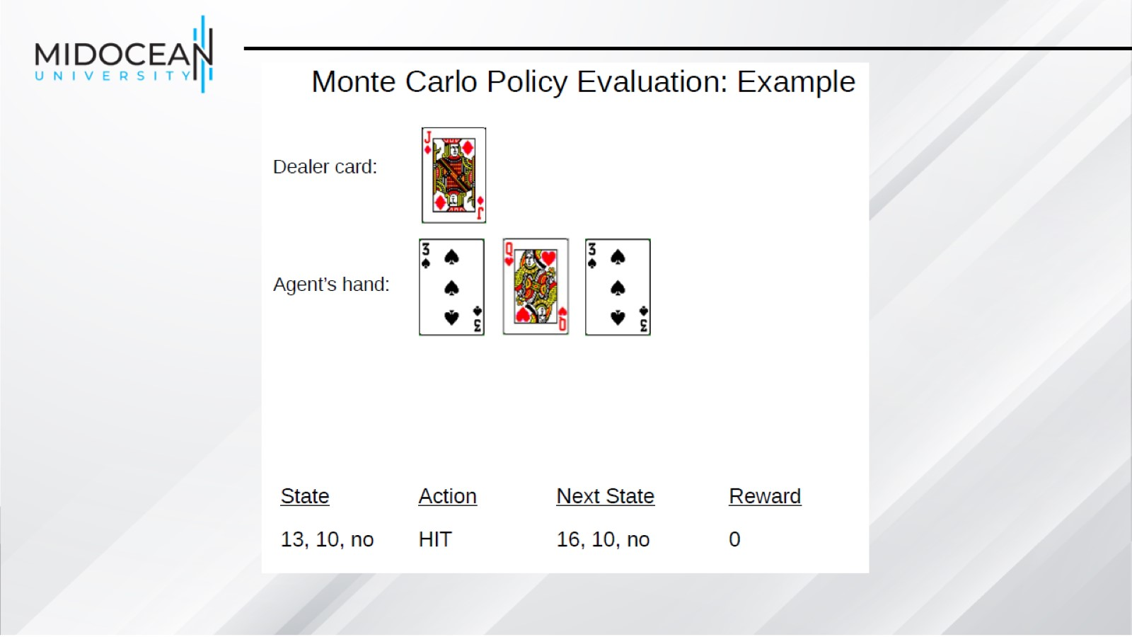

Slide 35
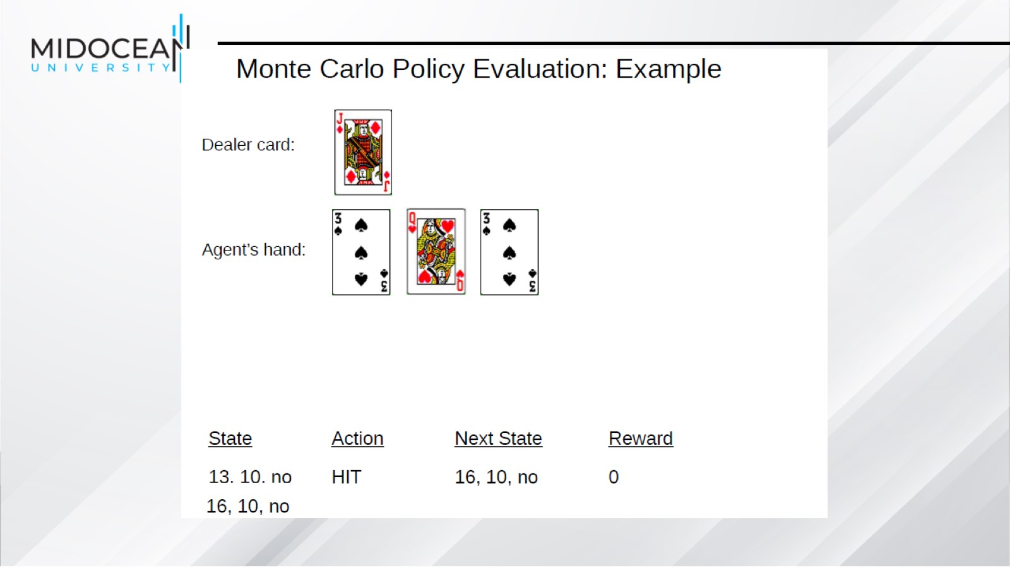

Slide 36
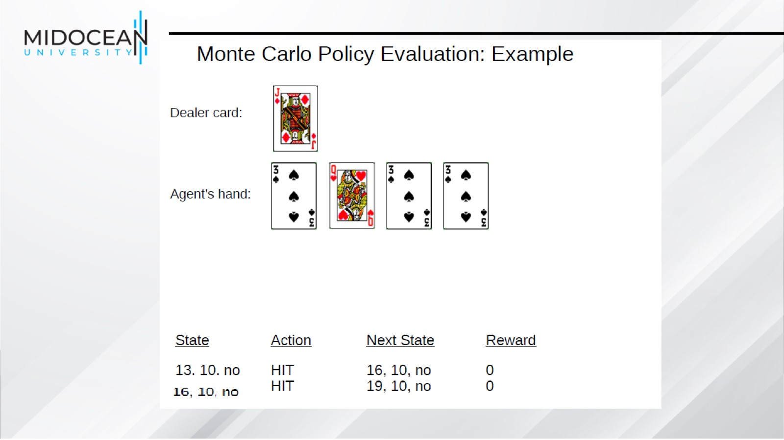

Slide 37
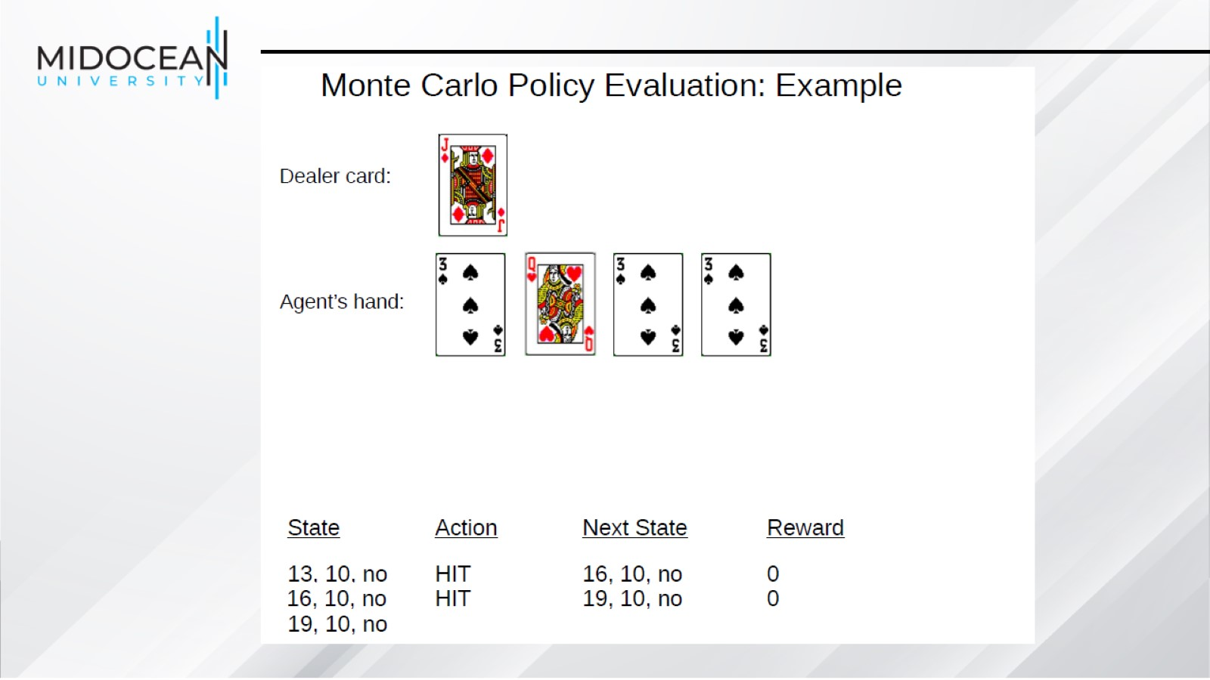

Slide 38
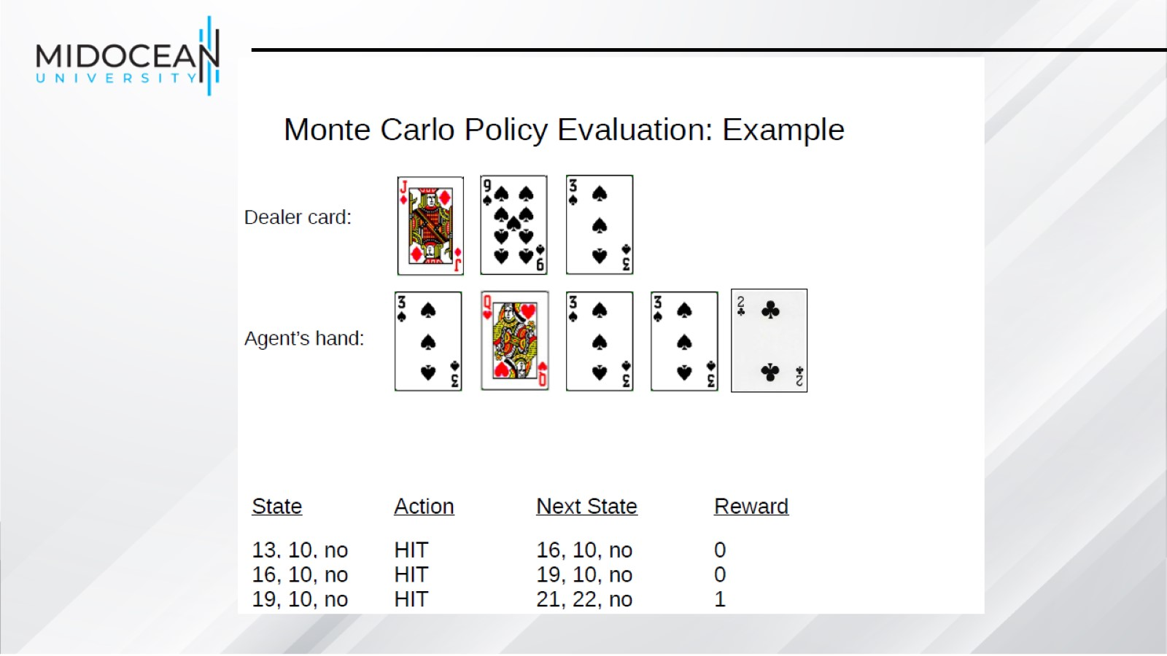

Slide 39
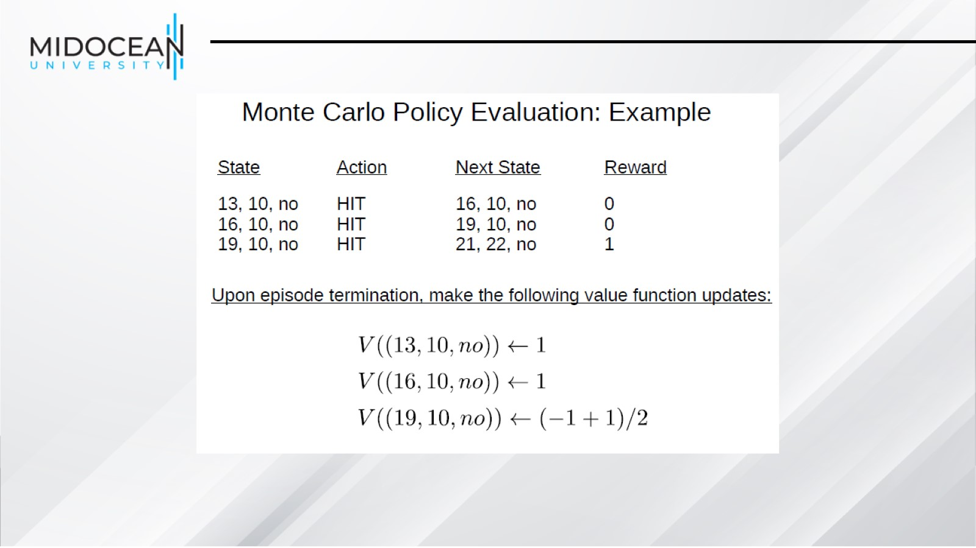

Slide 40
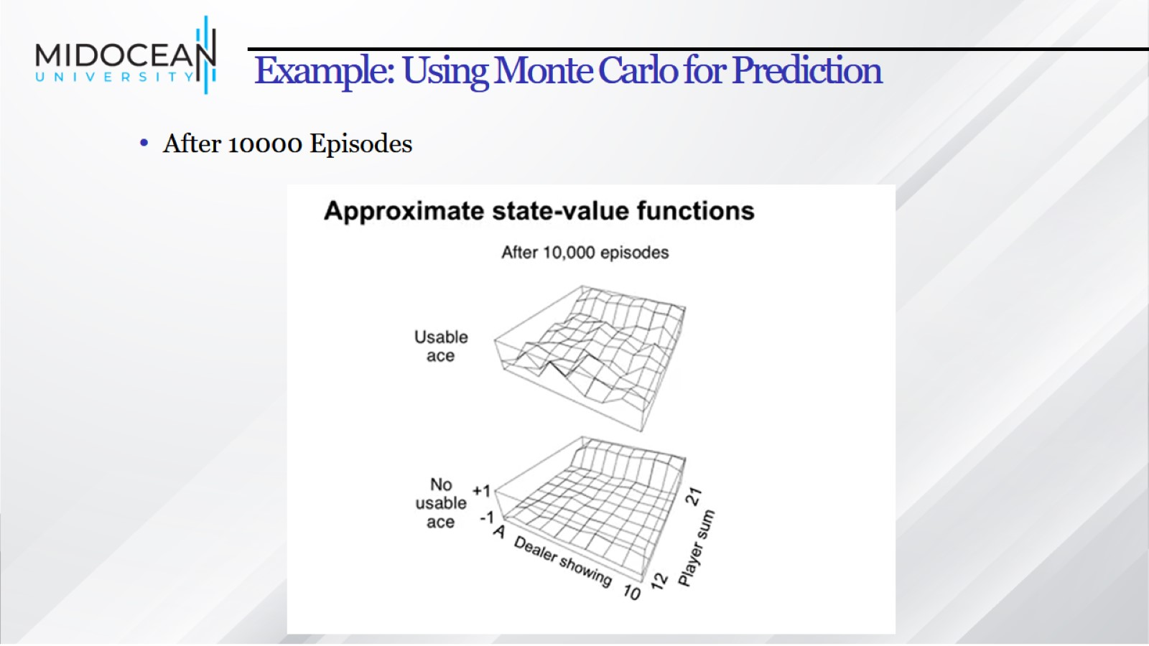
Example: Using Monte Carlo for Prediction

Slide 41
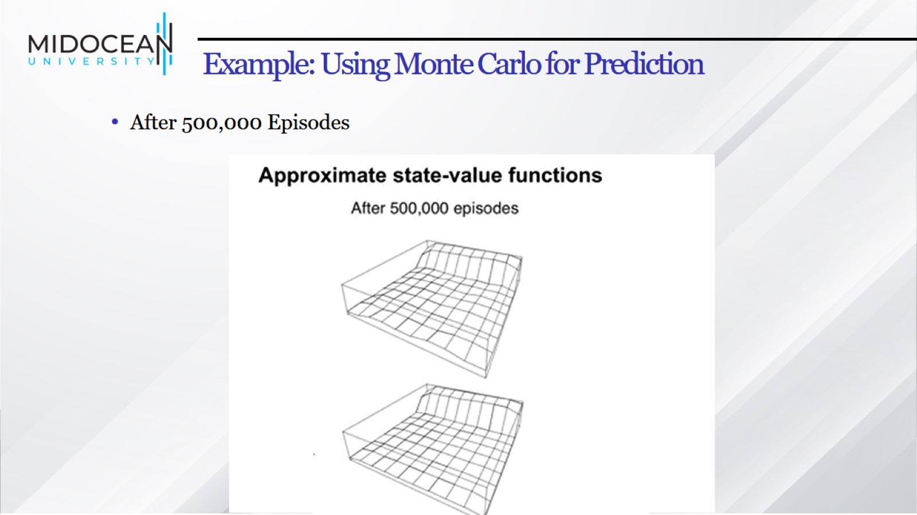
Example: Using Monte Carlo for Prediction

Slide 42
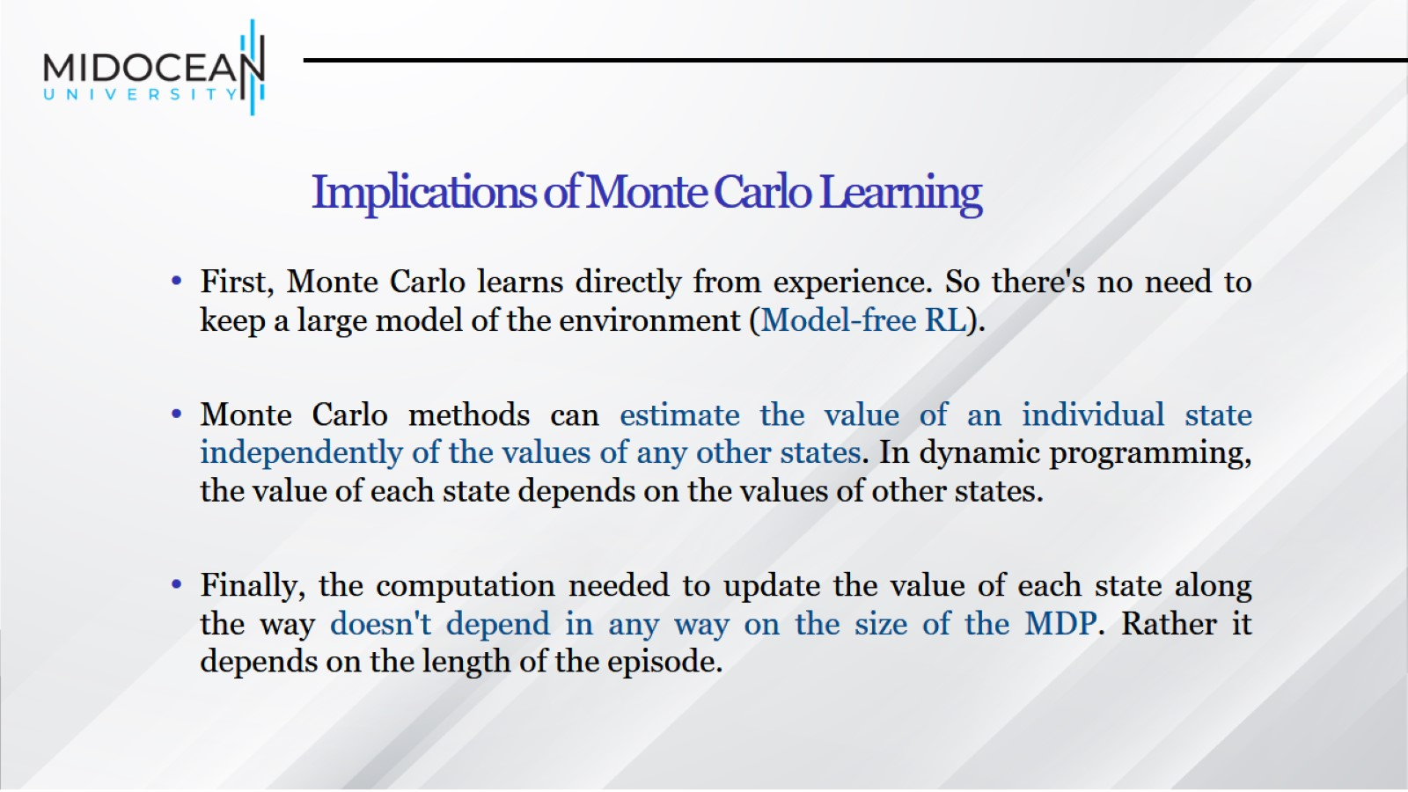
Implications of Monte Carlo Learning

Slide 43
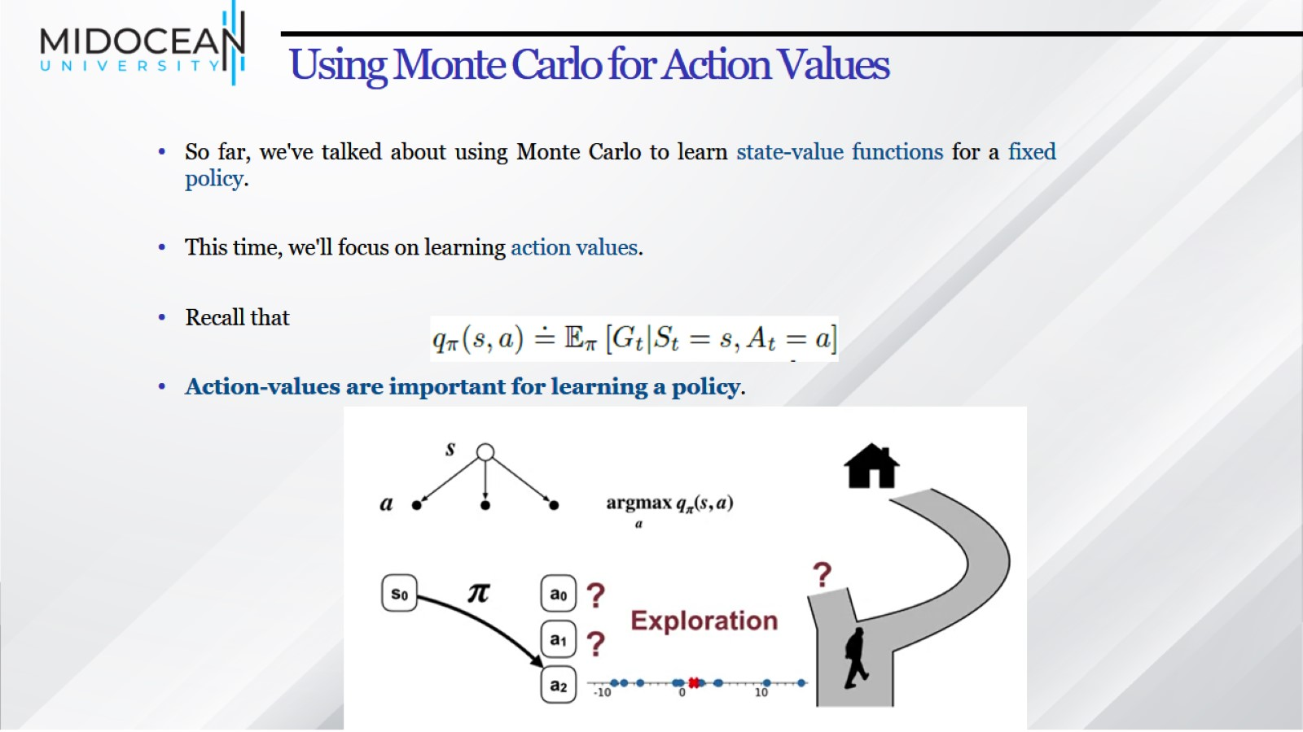
Using Monte Carlo for Action Values

Slide 44
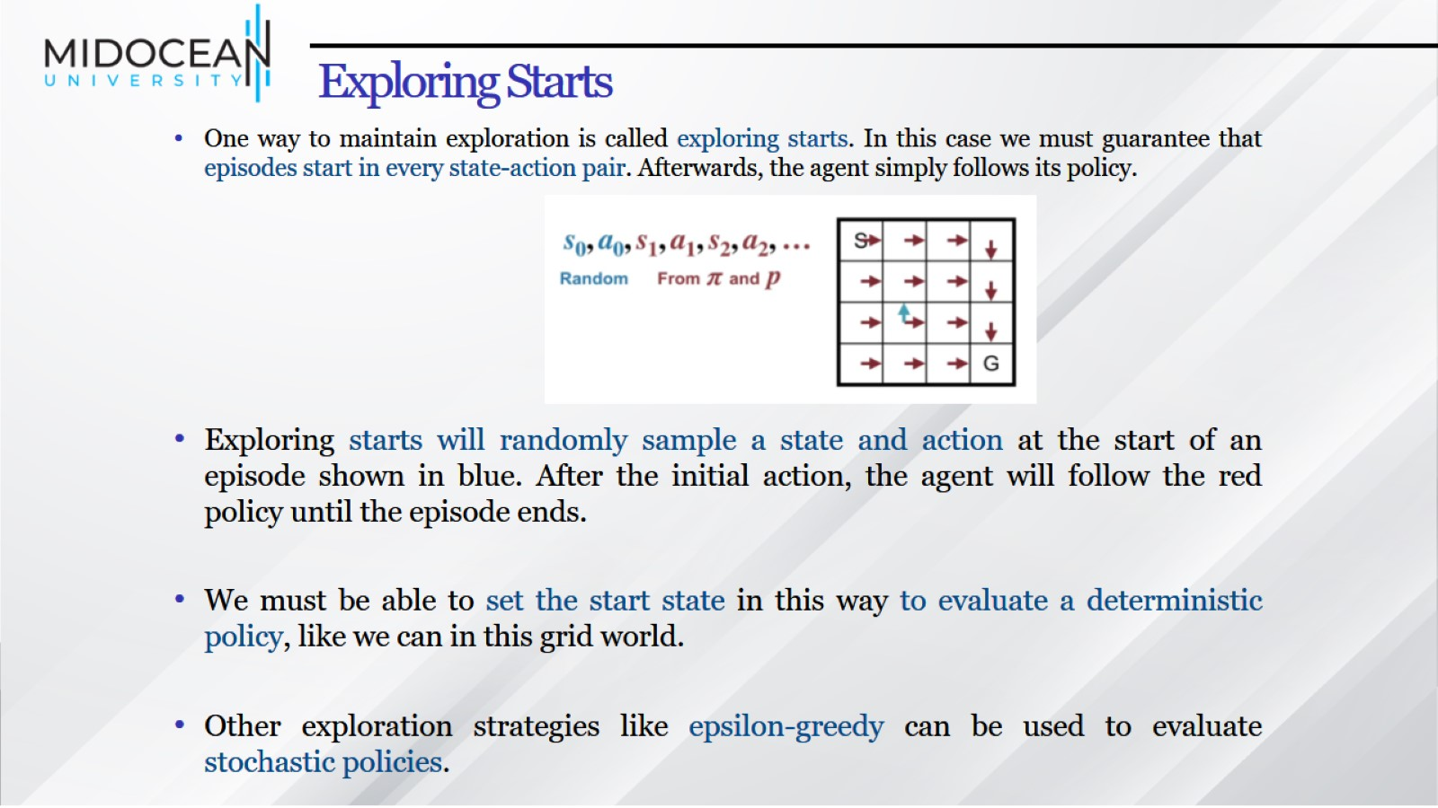
Exploring Starts

Slide 45
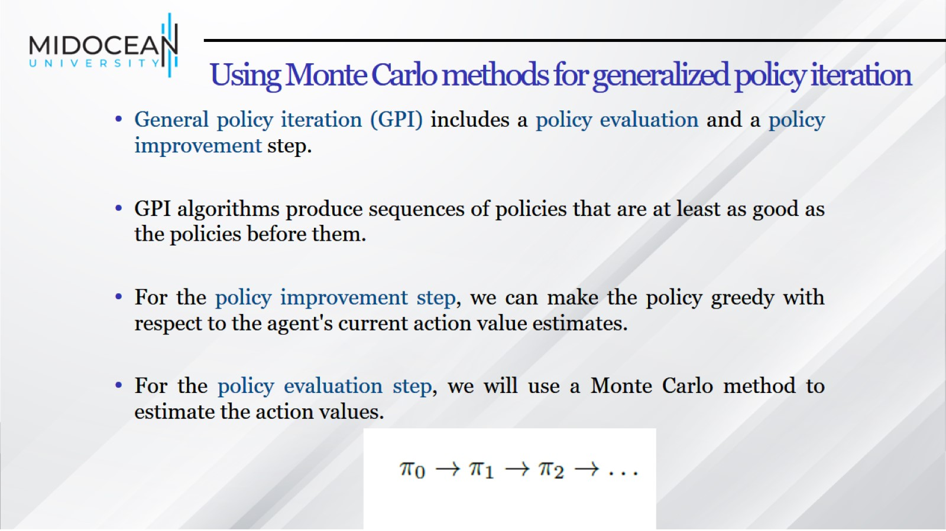
Using Monte Carlo methods for generalized policy iteration

Slide 46
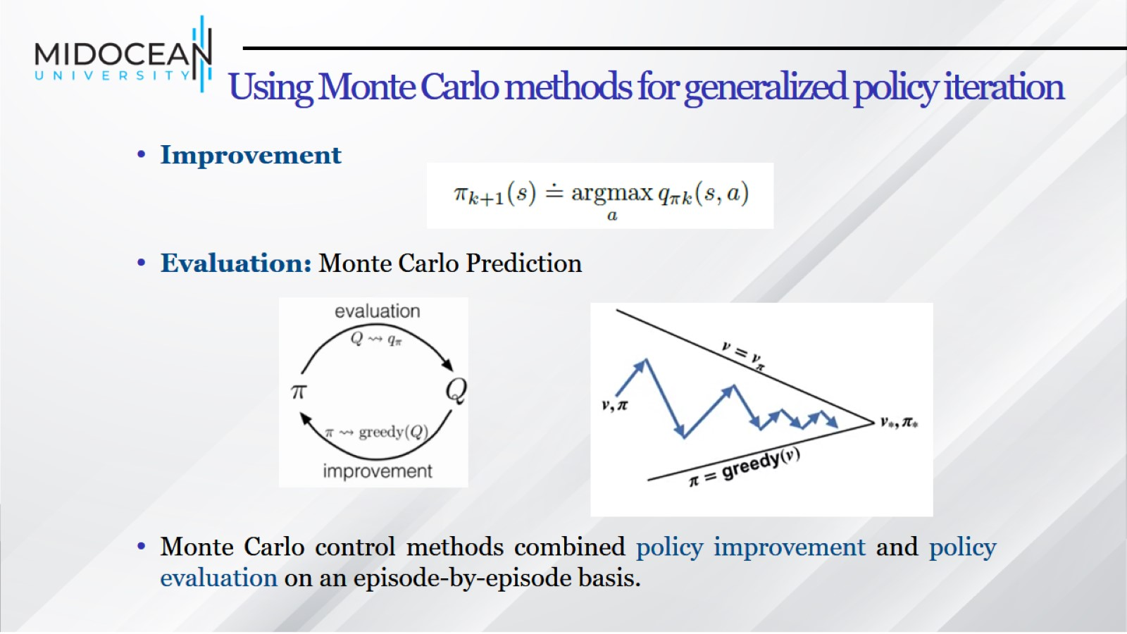
Using Monte Carlo methods for generalized policy iteration

Slide 47
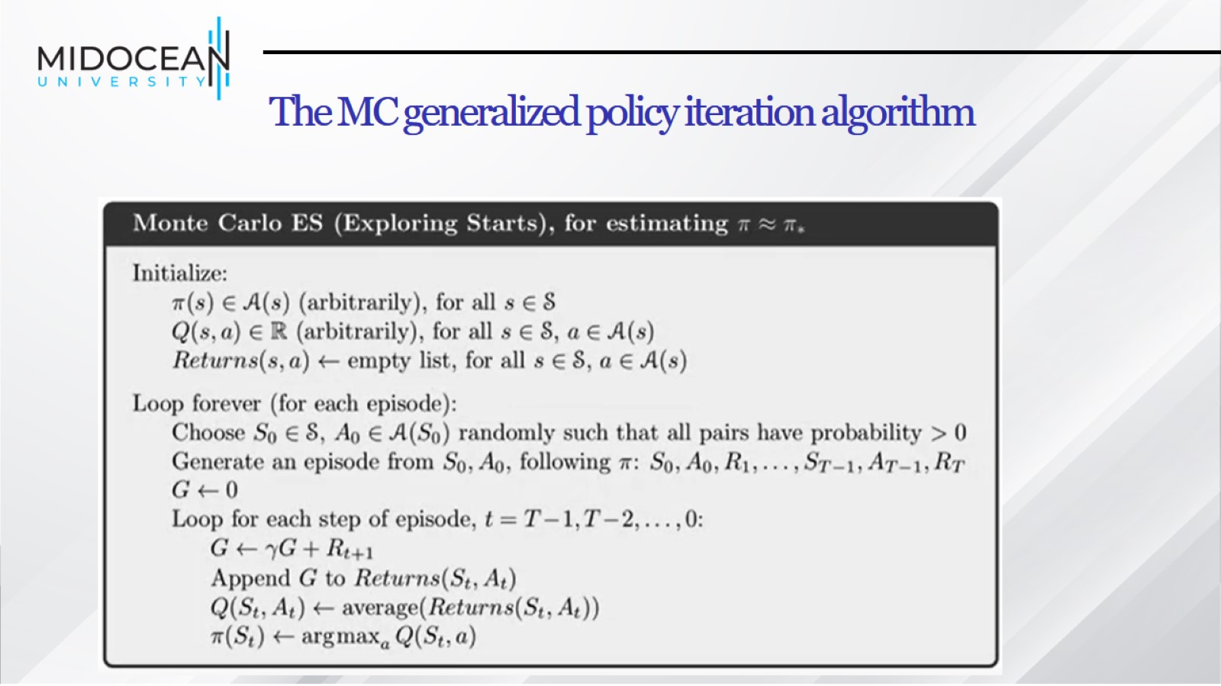
The MC generalized policy iteration algorithm

Slide 48
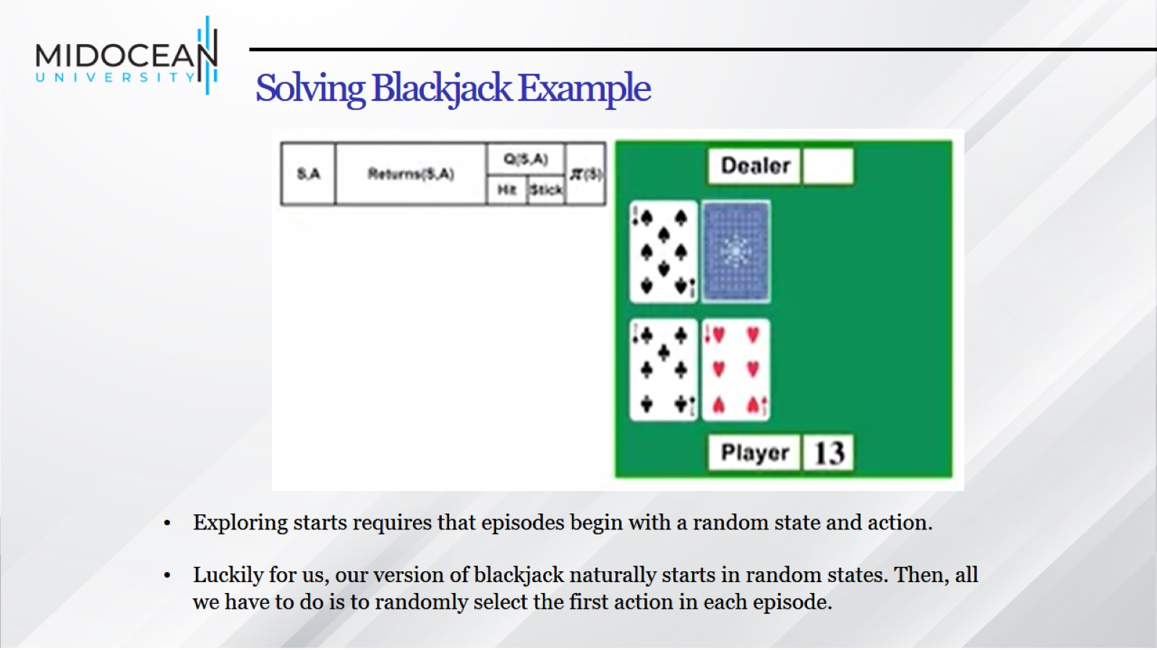
Solving Blackjack Example

Slide 49
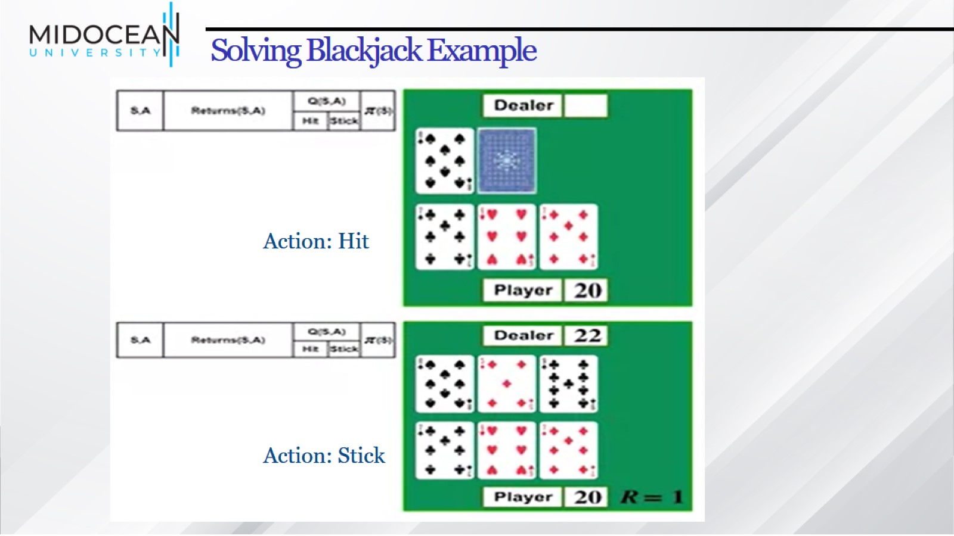
Solving Blackjack Example

Slide 50
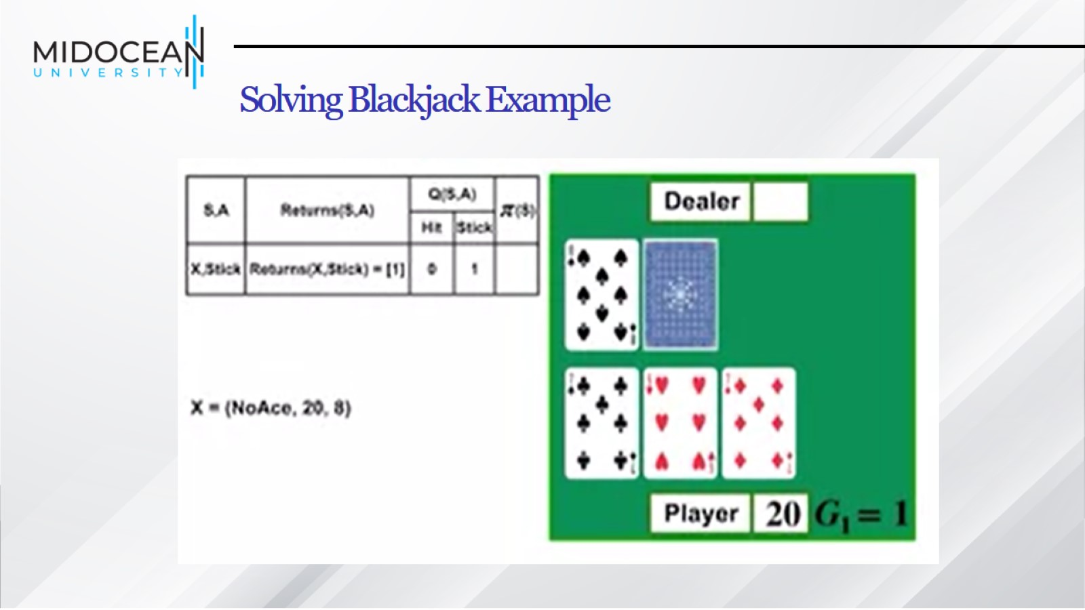
Solving Blackjack Example

Slide 51

Solving Blackjack Example

Slide 52
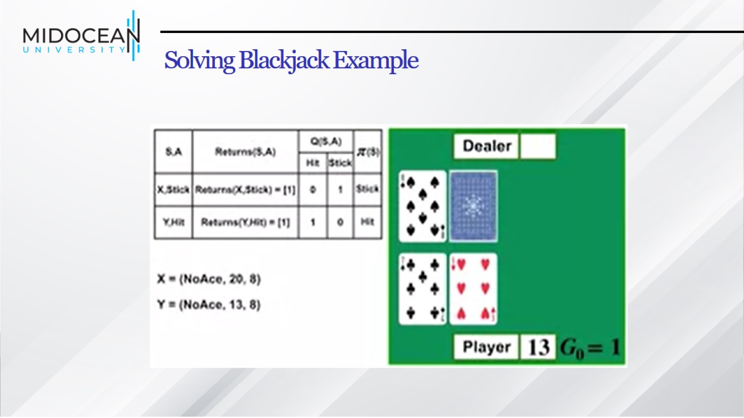
Solving Blackjack Example

Slide 53
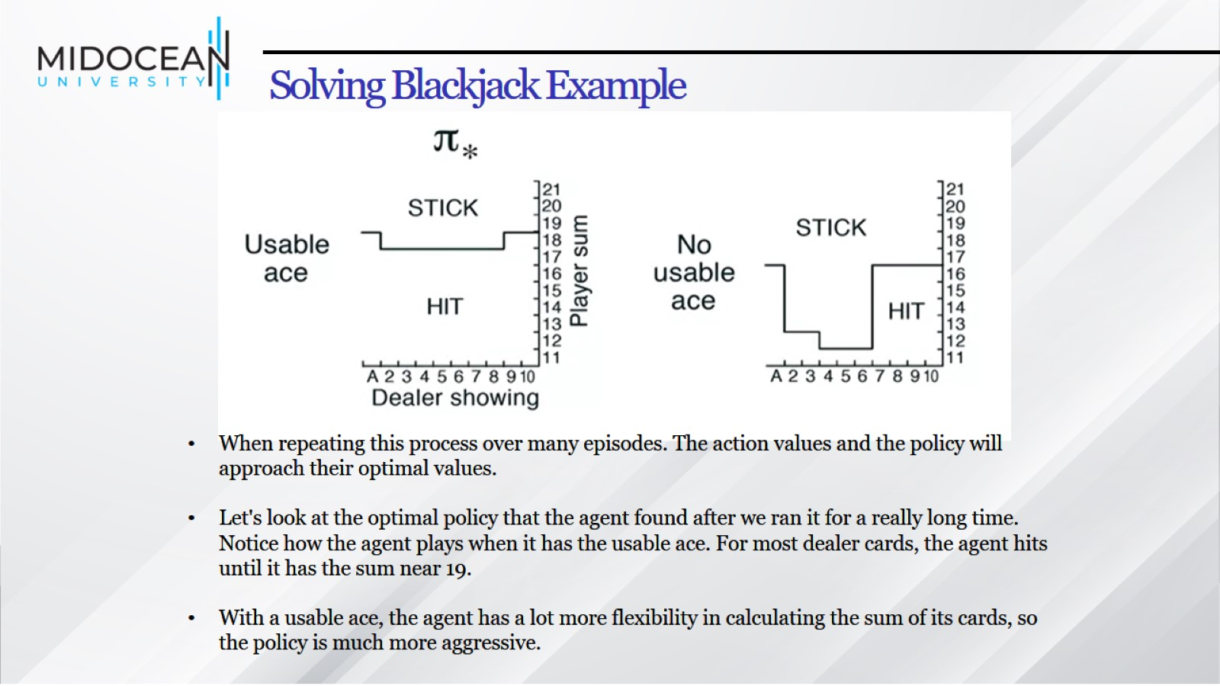
Solving Blackjack Example

Slide 54


