Slide 1


Slide 2


Slide 3
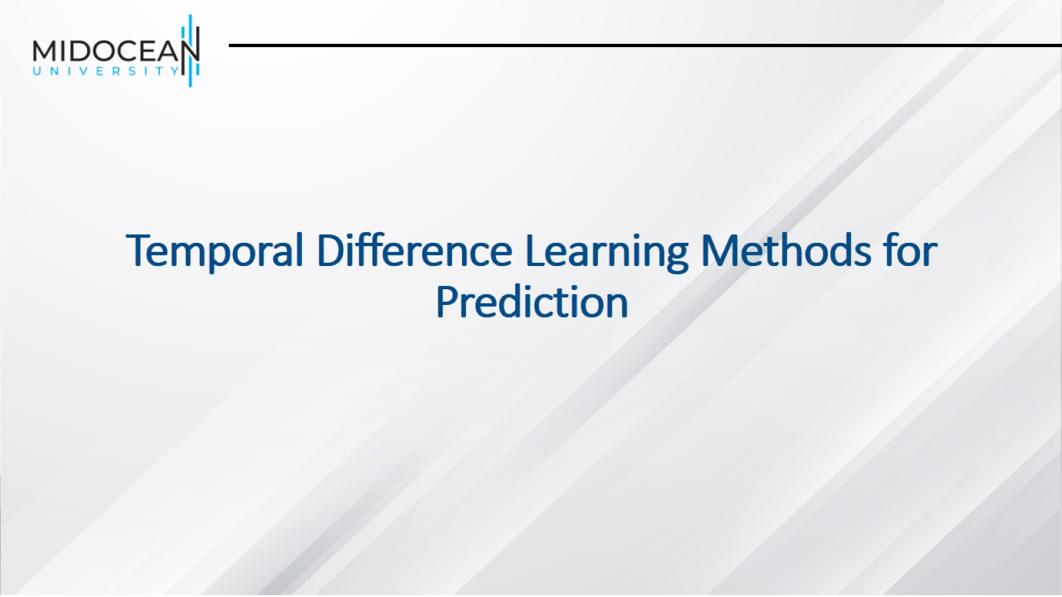
Temporal Difference Learning Methods for Prediction

Slide 4
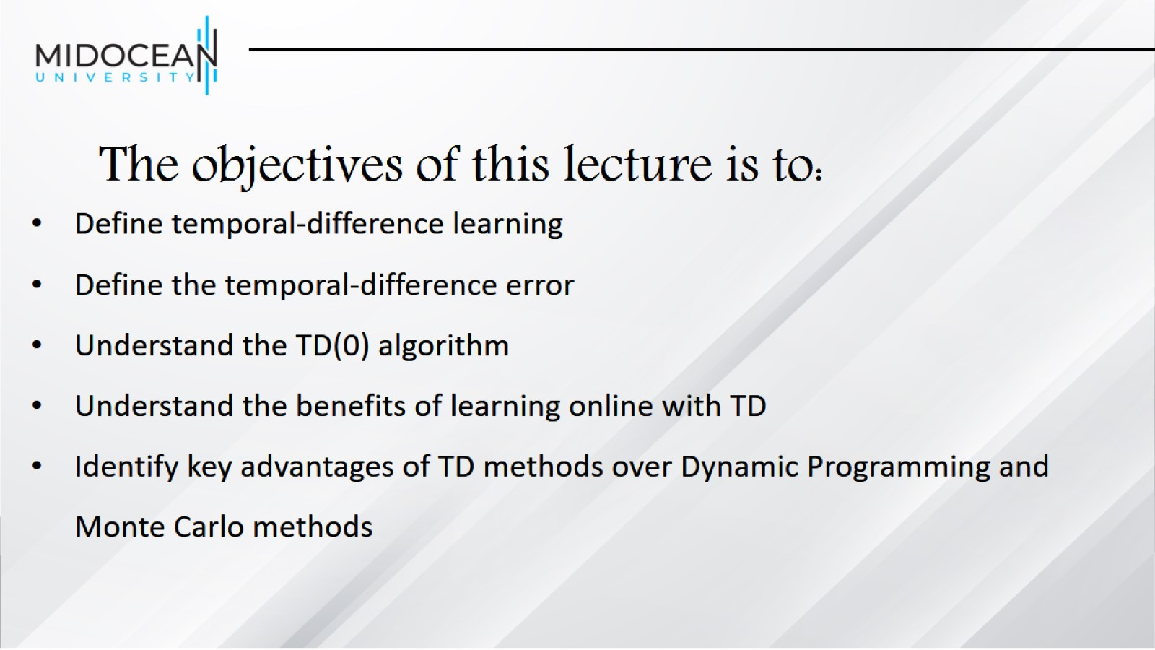
The objectives of this lecture is to:

Slide 5
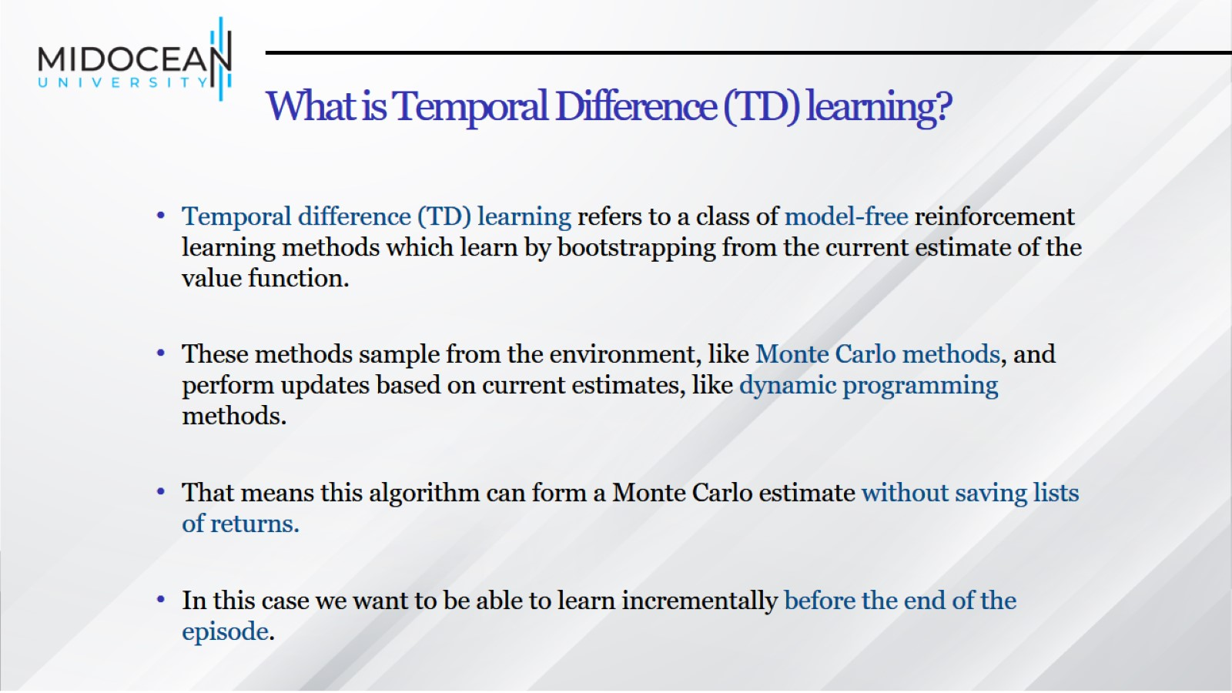
What is Temporal Difference (TD) learning?

Slide 6
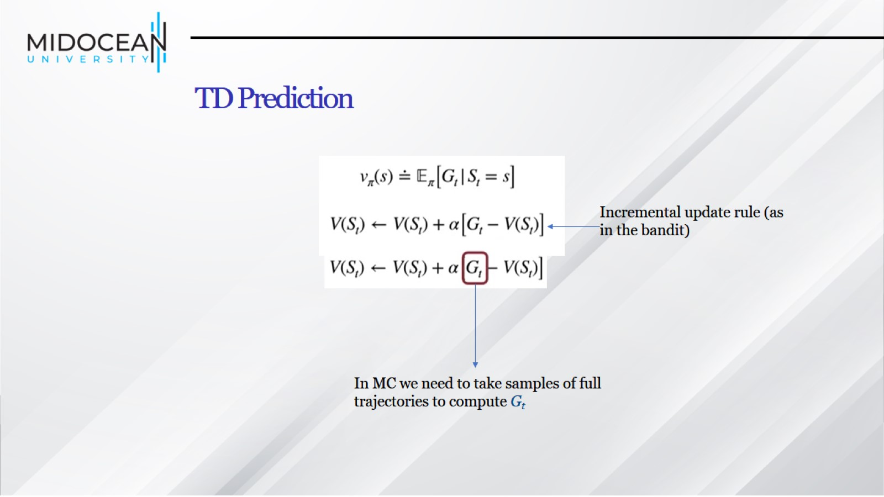
TD Prediction

Slide 7
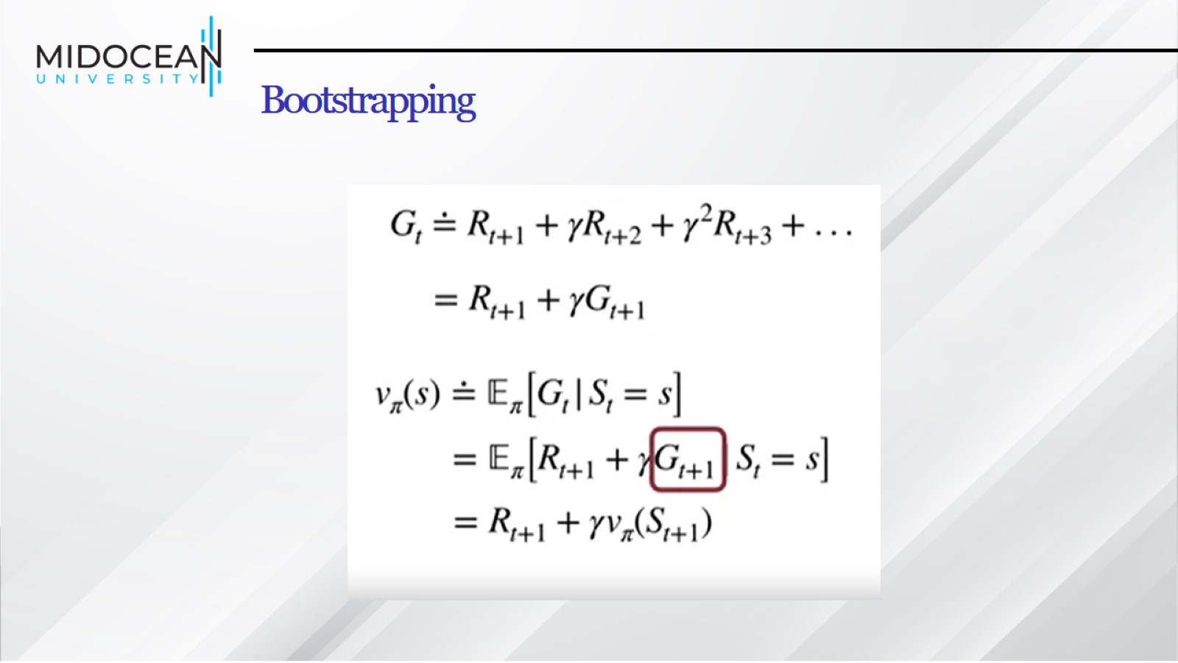
Bootstrapping

Slide 8
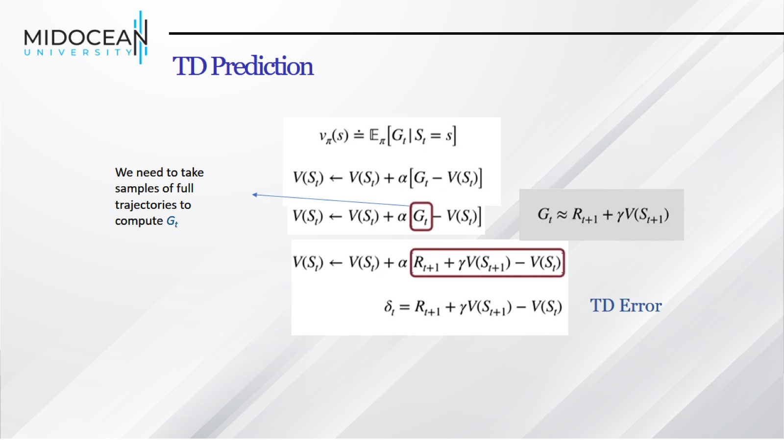
TD Prediction

Slide 9
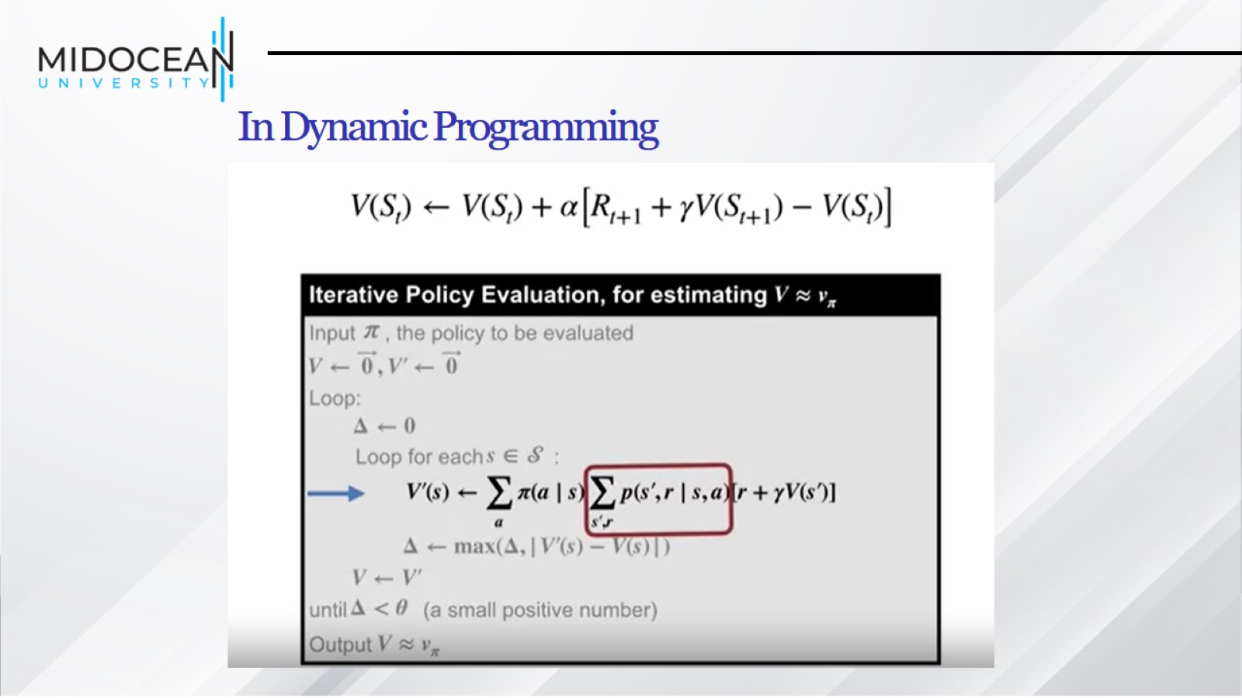
In Dynamic Programming

Slide 10
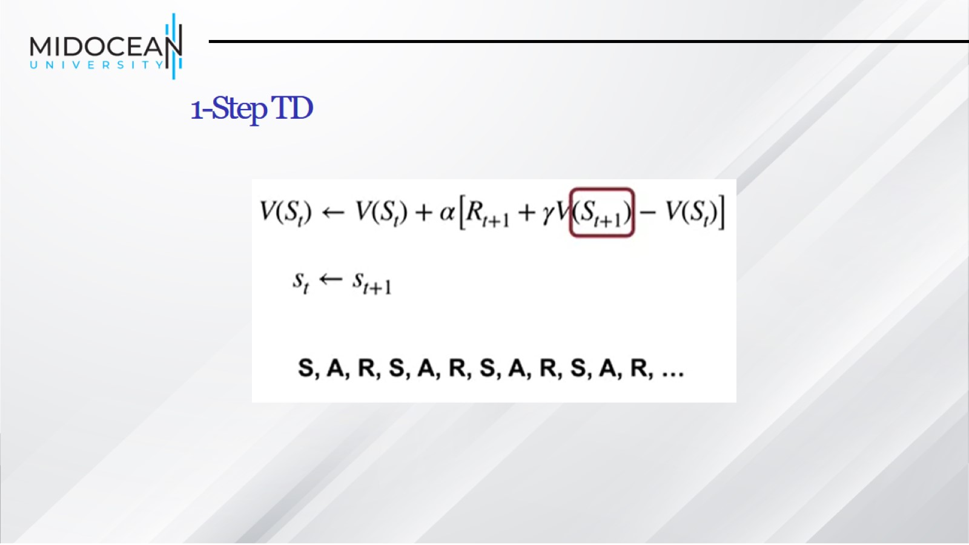
1-Step TD

Slide 11
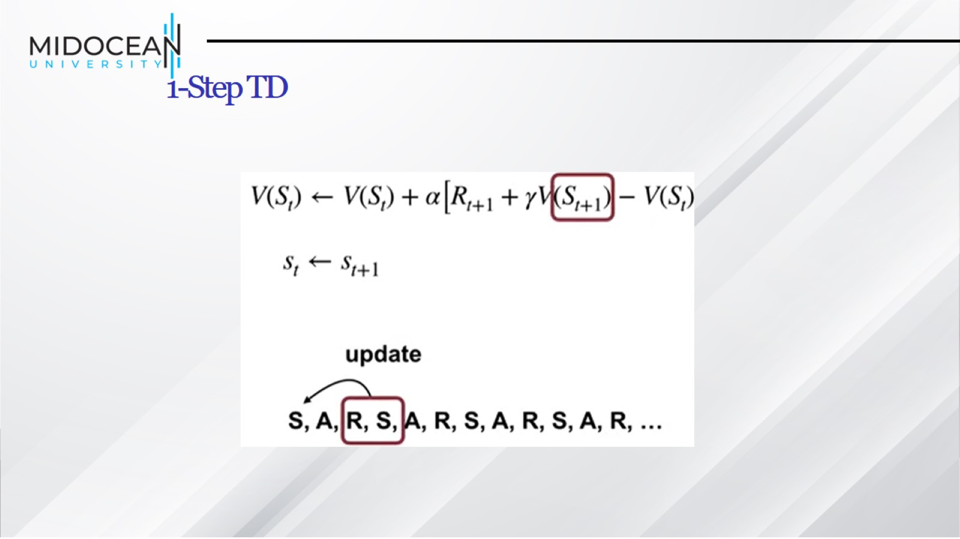
1-Step TD

Slide 12
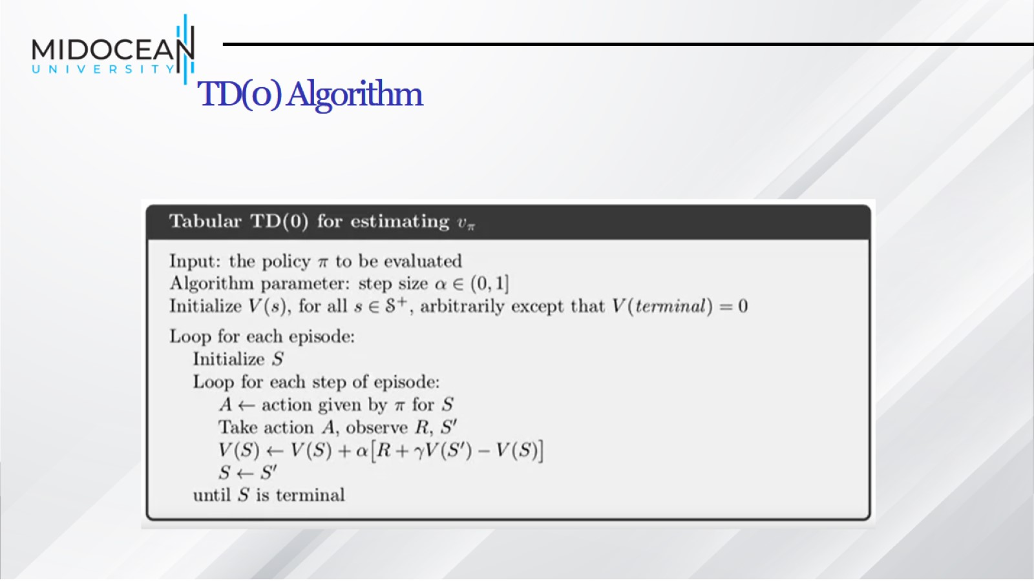
TD(0) Algorithm

Slide 13
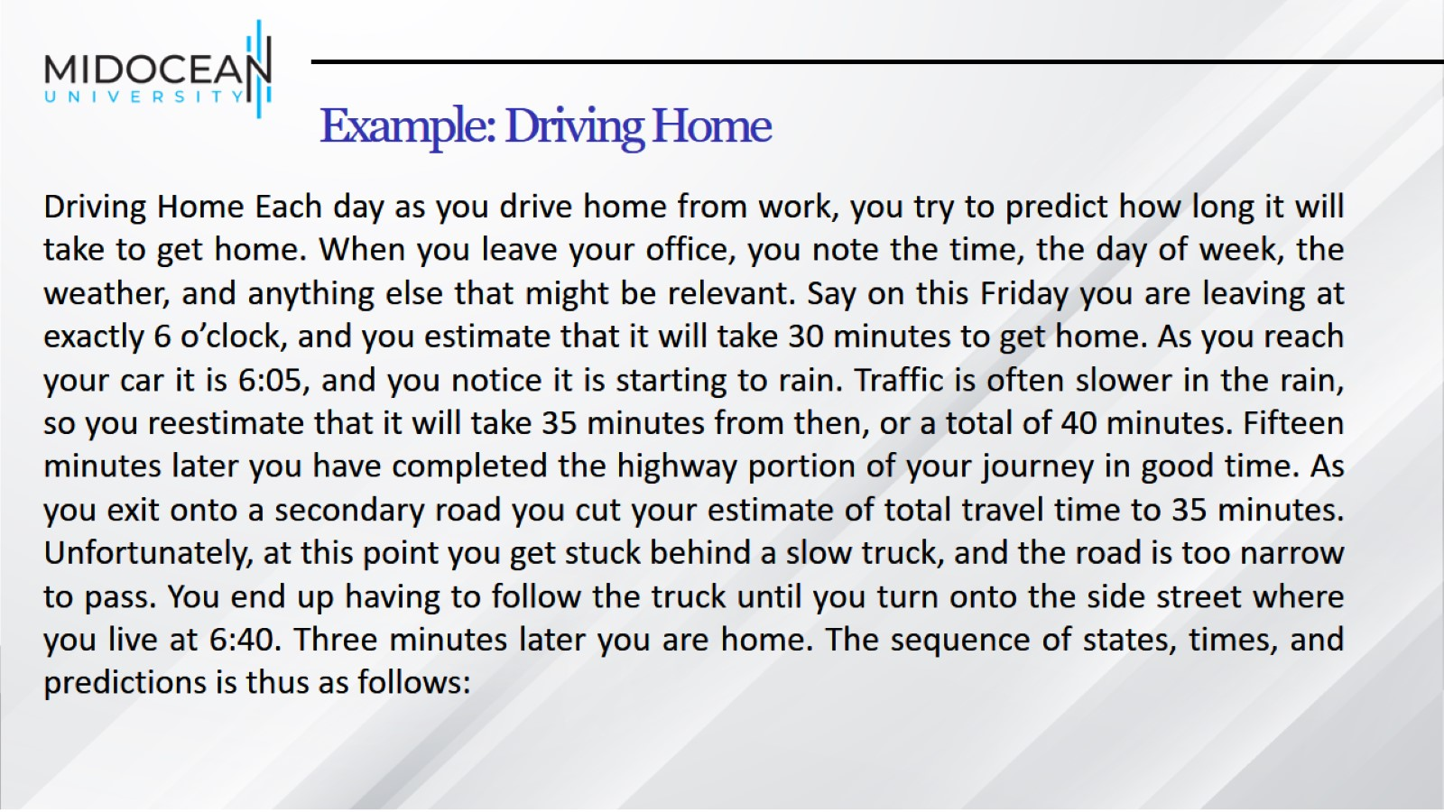
Example: Driving Home

Slide 14
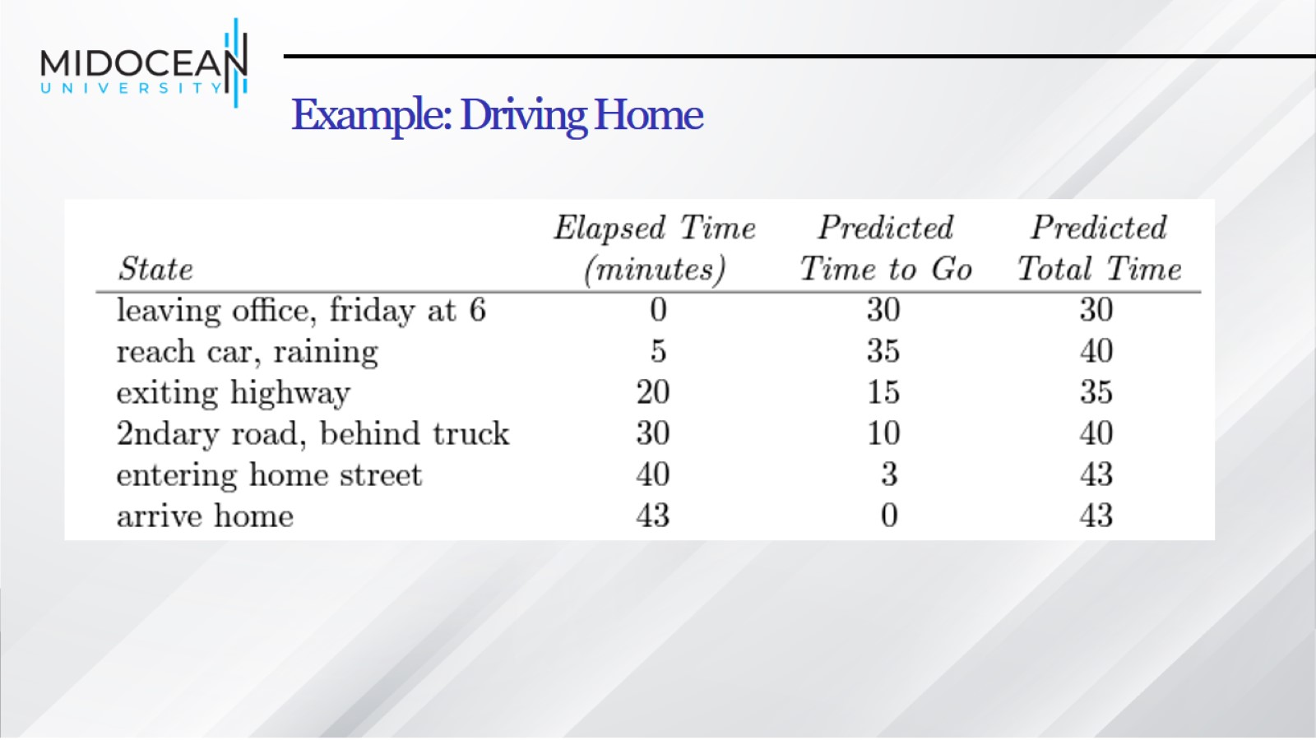
Example: Driving Home

Slide 15

Example: Driving Home

Slide 16
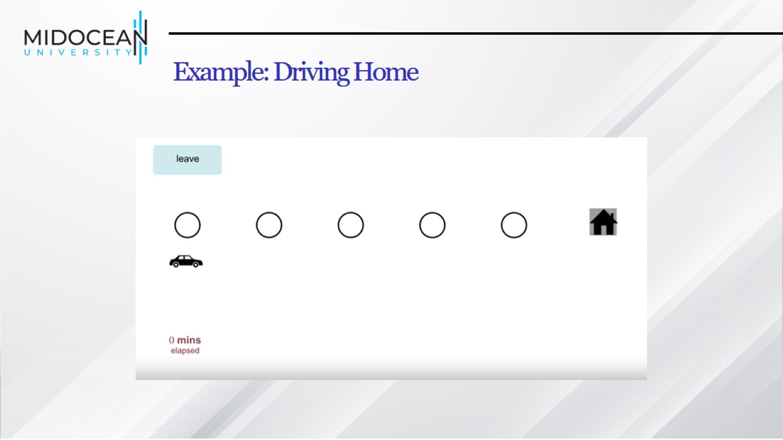
Example: Driving Home

Slide 17
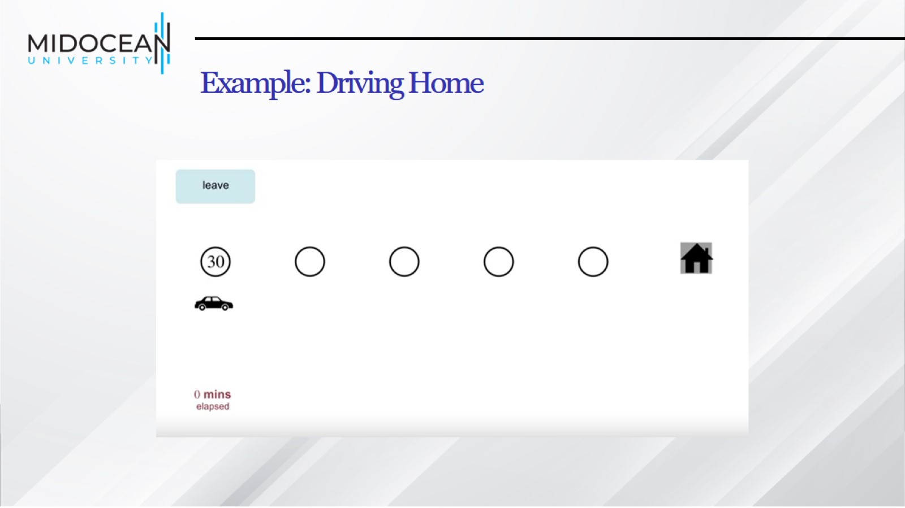
Example: Driving Home

Slide 18
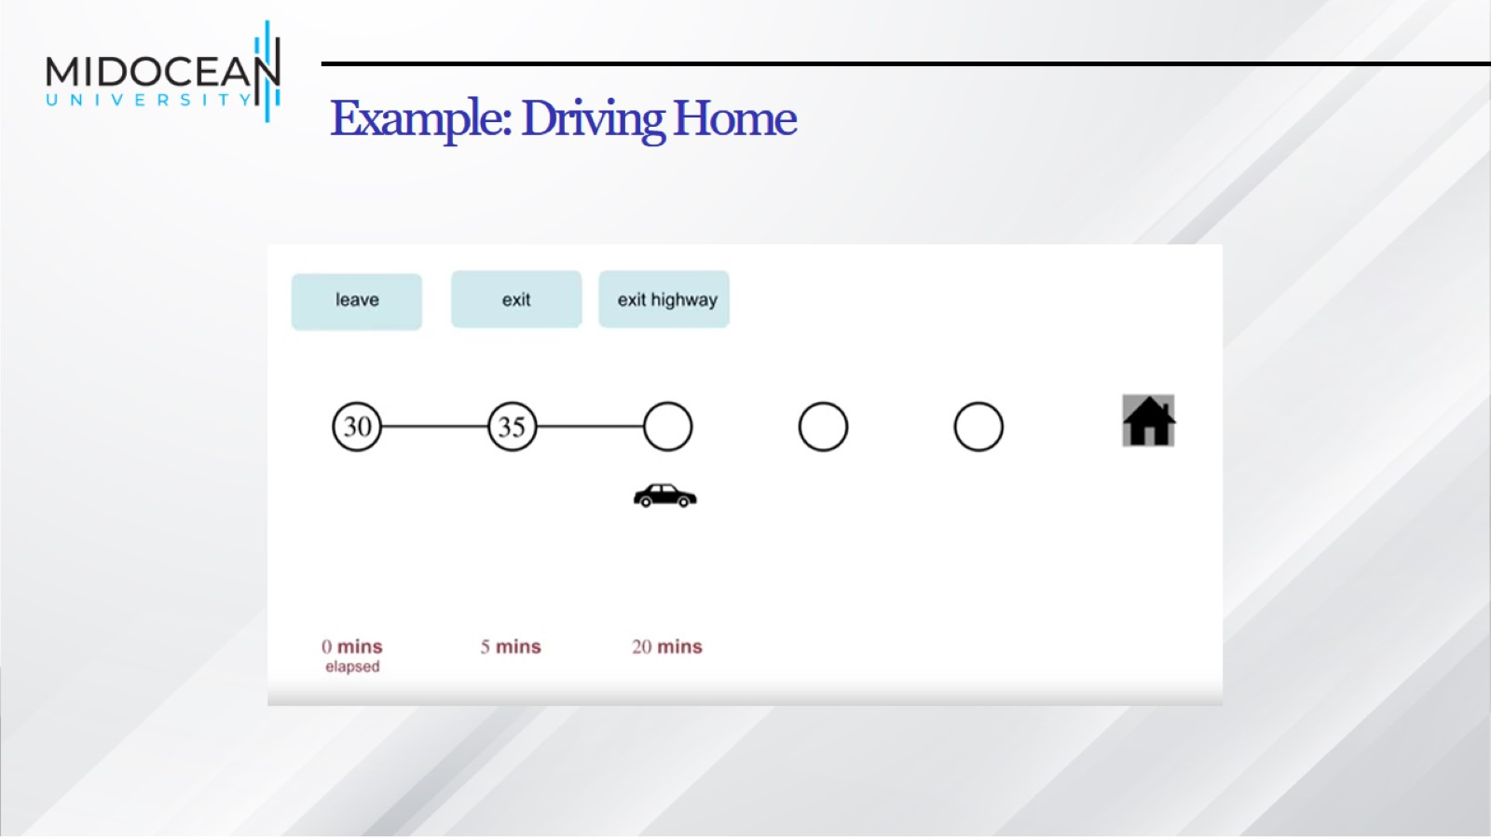
Example: Driving Home

Slide 19
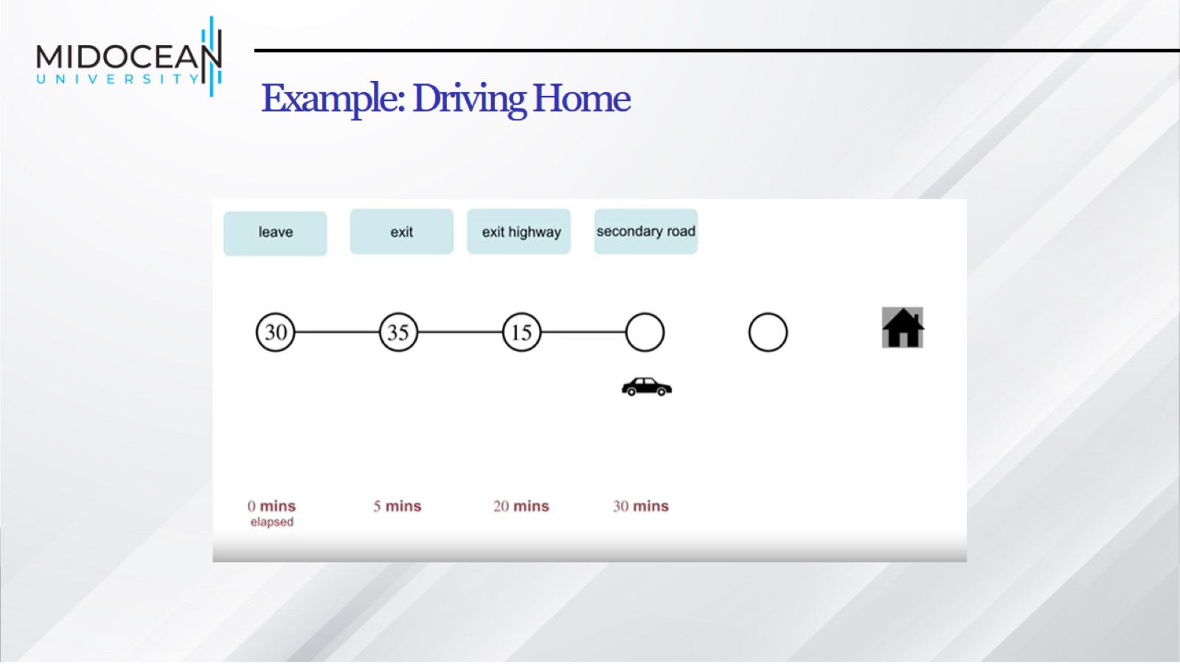
Example: Driving Home

Slide 20
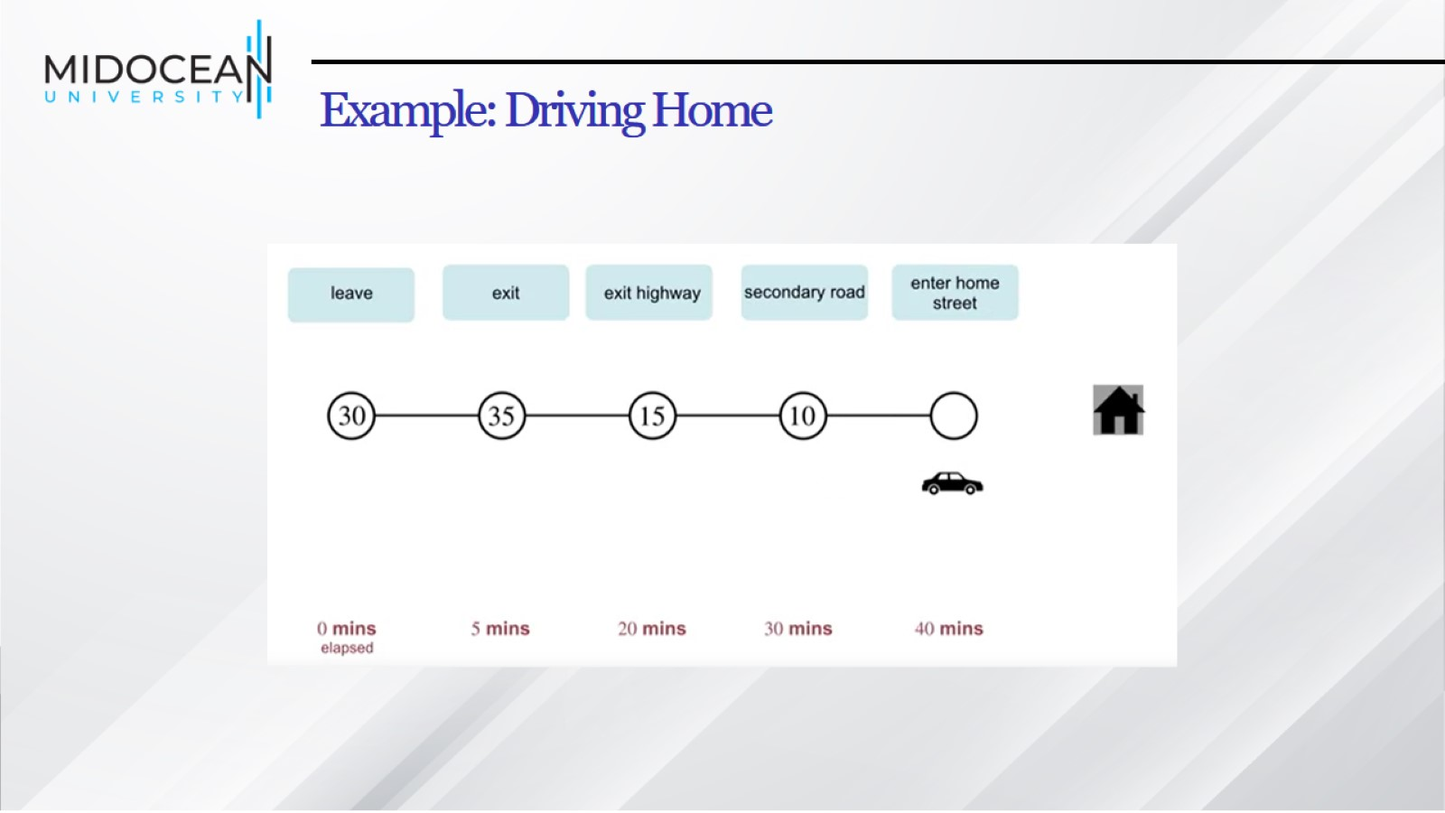
Example: Driving Home

Slide 21
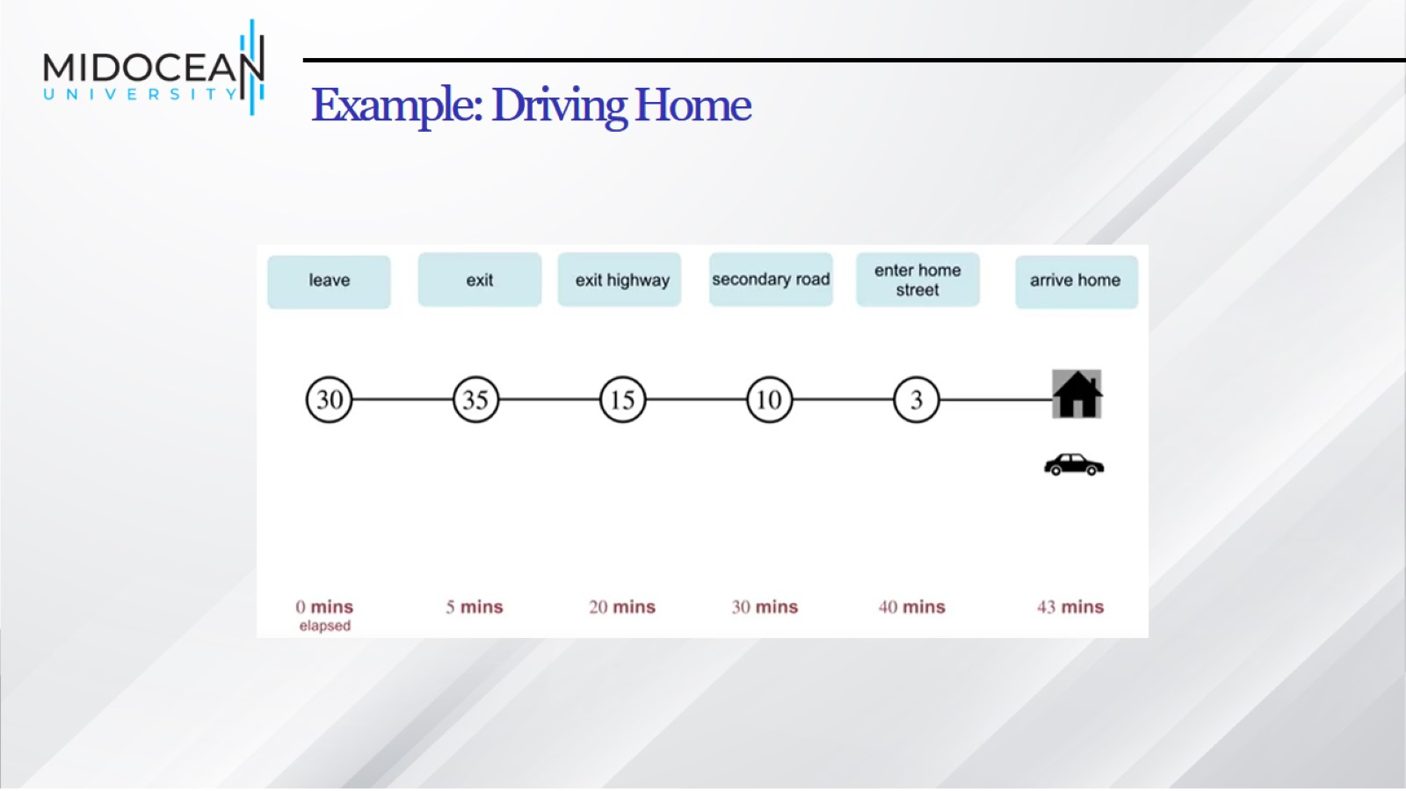
Example: Driving Home

Slide 22
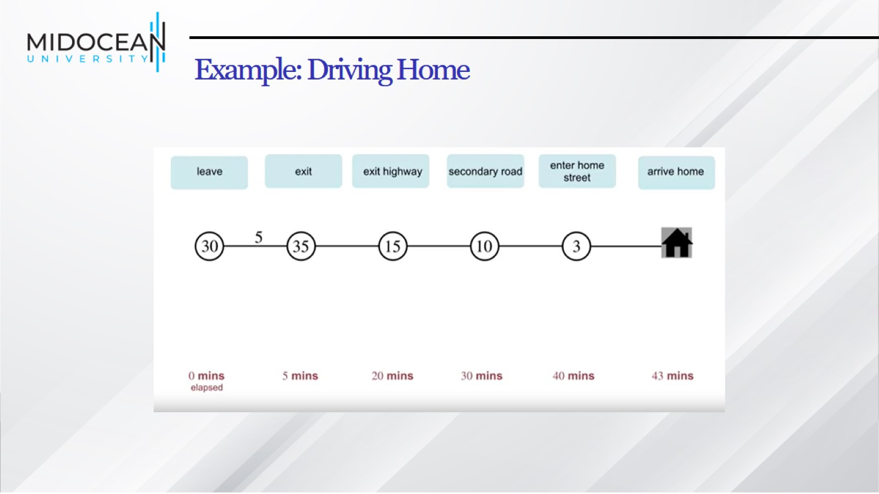
Example: Driving Home

Slide 23
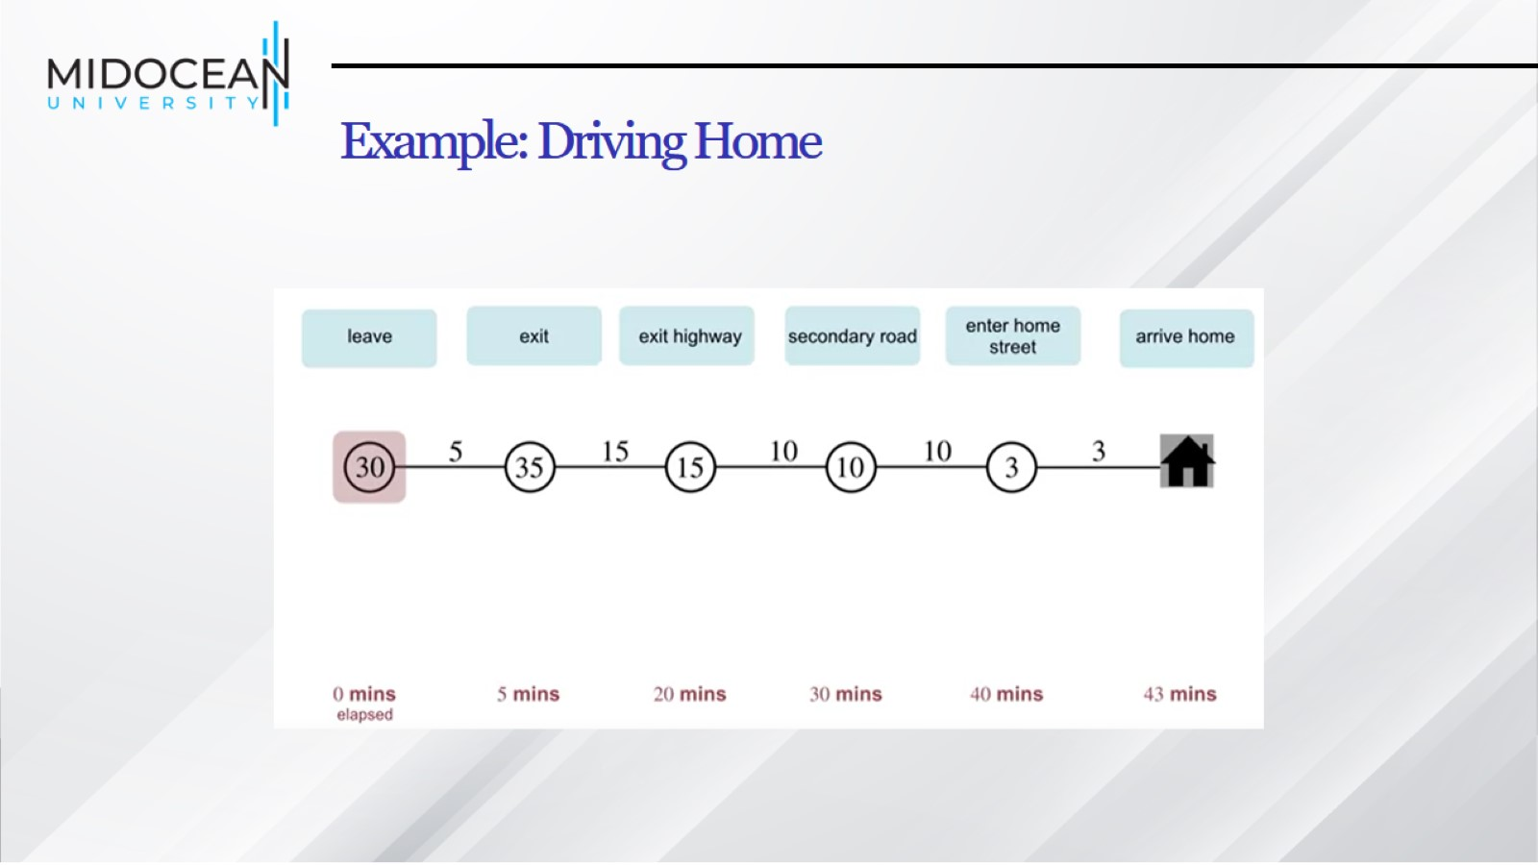
Example: Driving Home

Slide 24
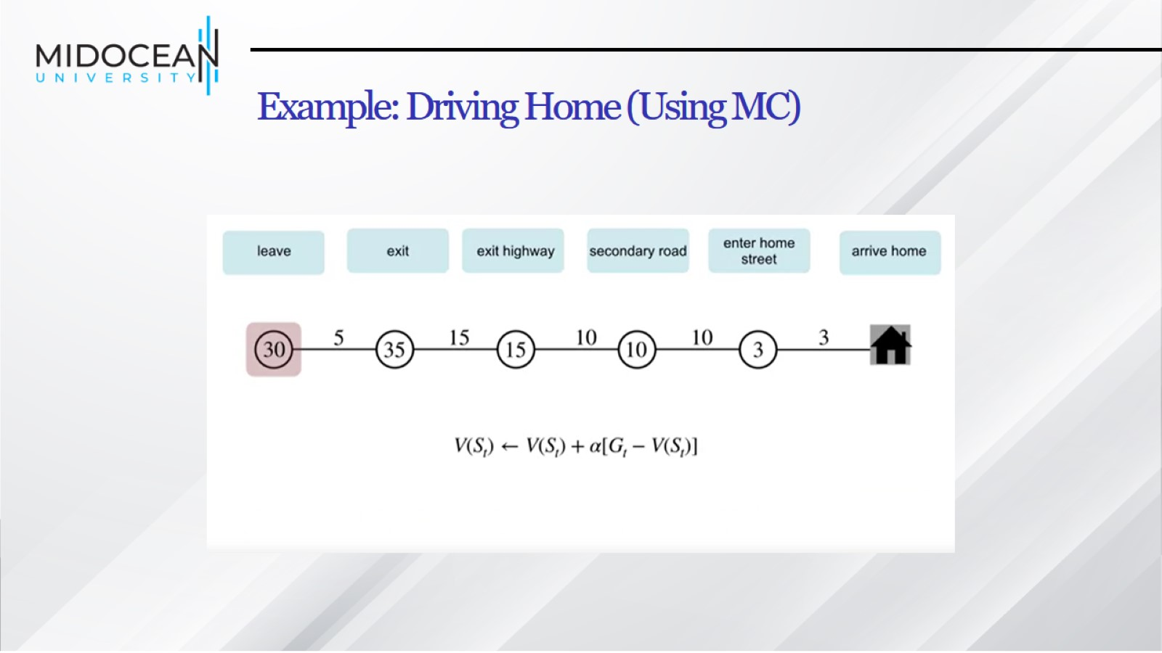
Example: Driving Home (Using MC)

Slide 25
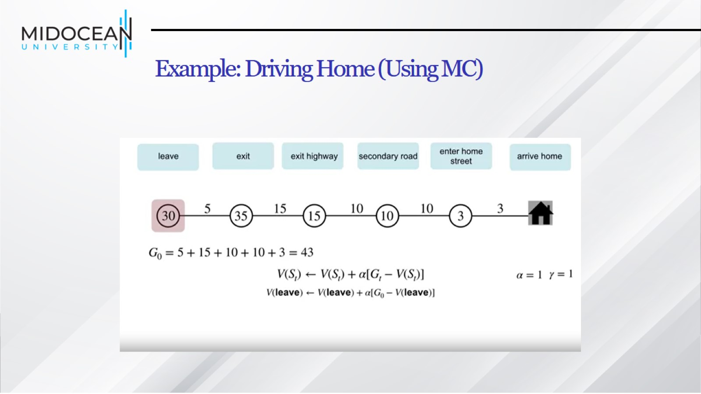
Example: Driving Home (Using MC)

Slide 26
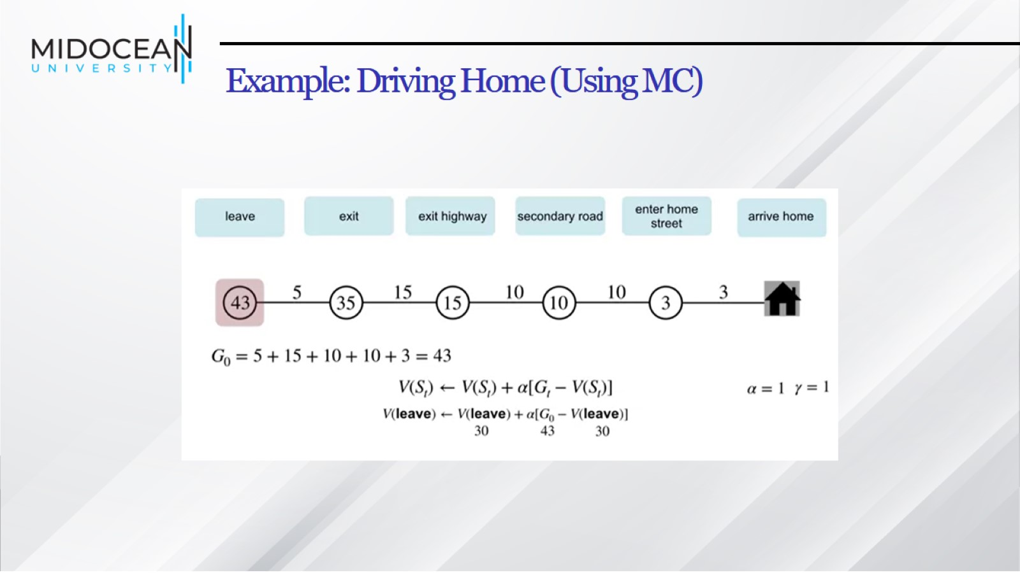
Example: Driving Home (Using MC)

Slide 27
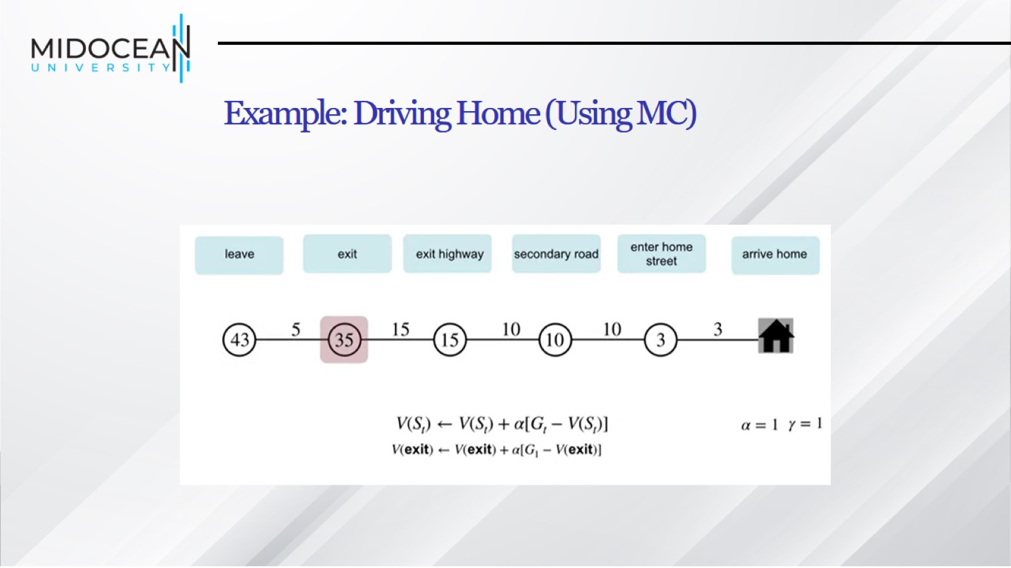
Example: Driving Home (Using MC)

Slide 28
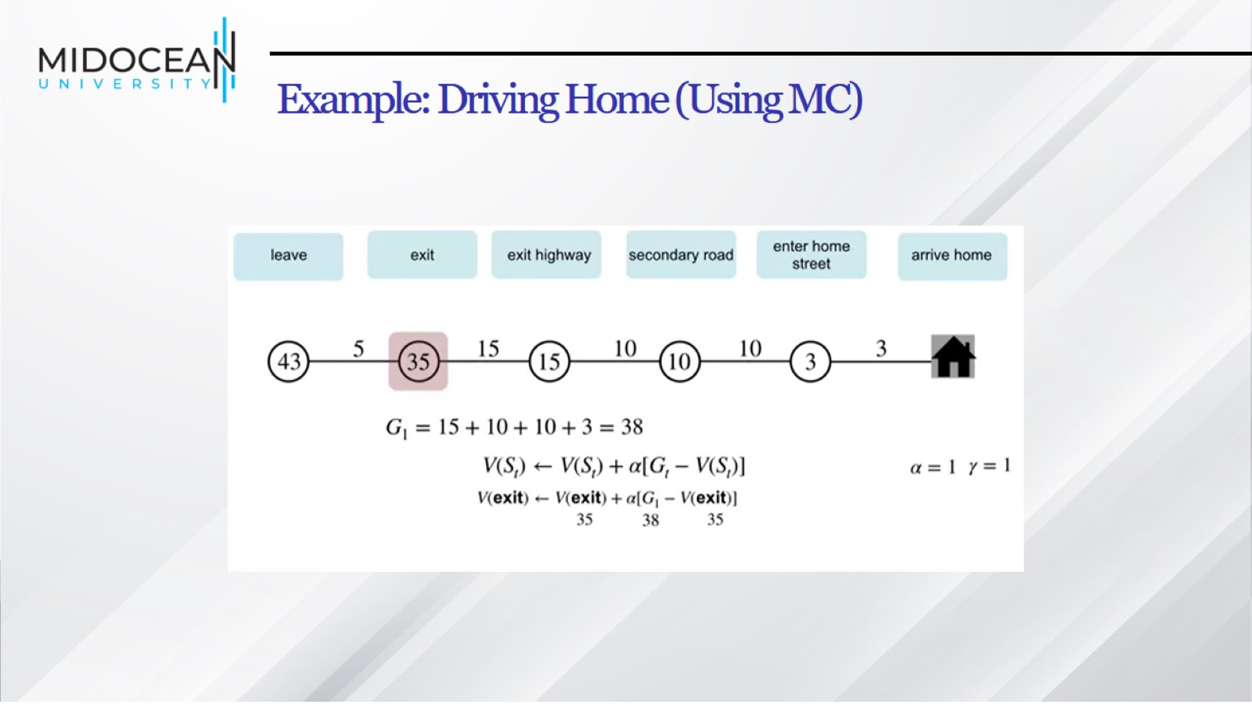
Example: Driving Home (Using MC)

Slide 29
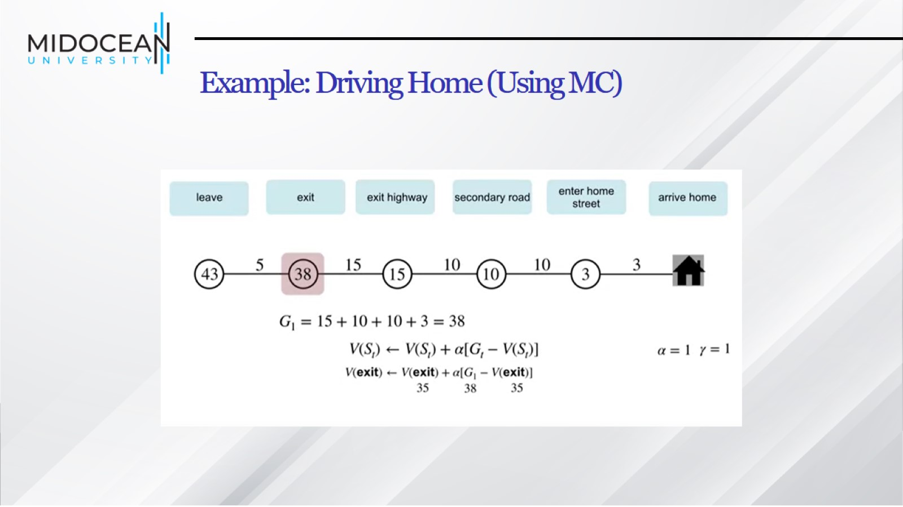
Example: Driving Home (Using MC)

Slide 30
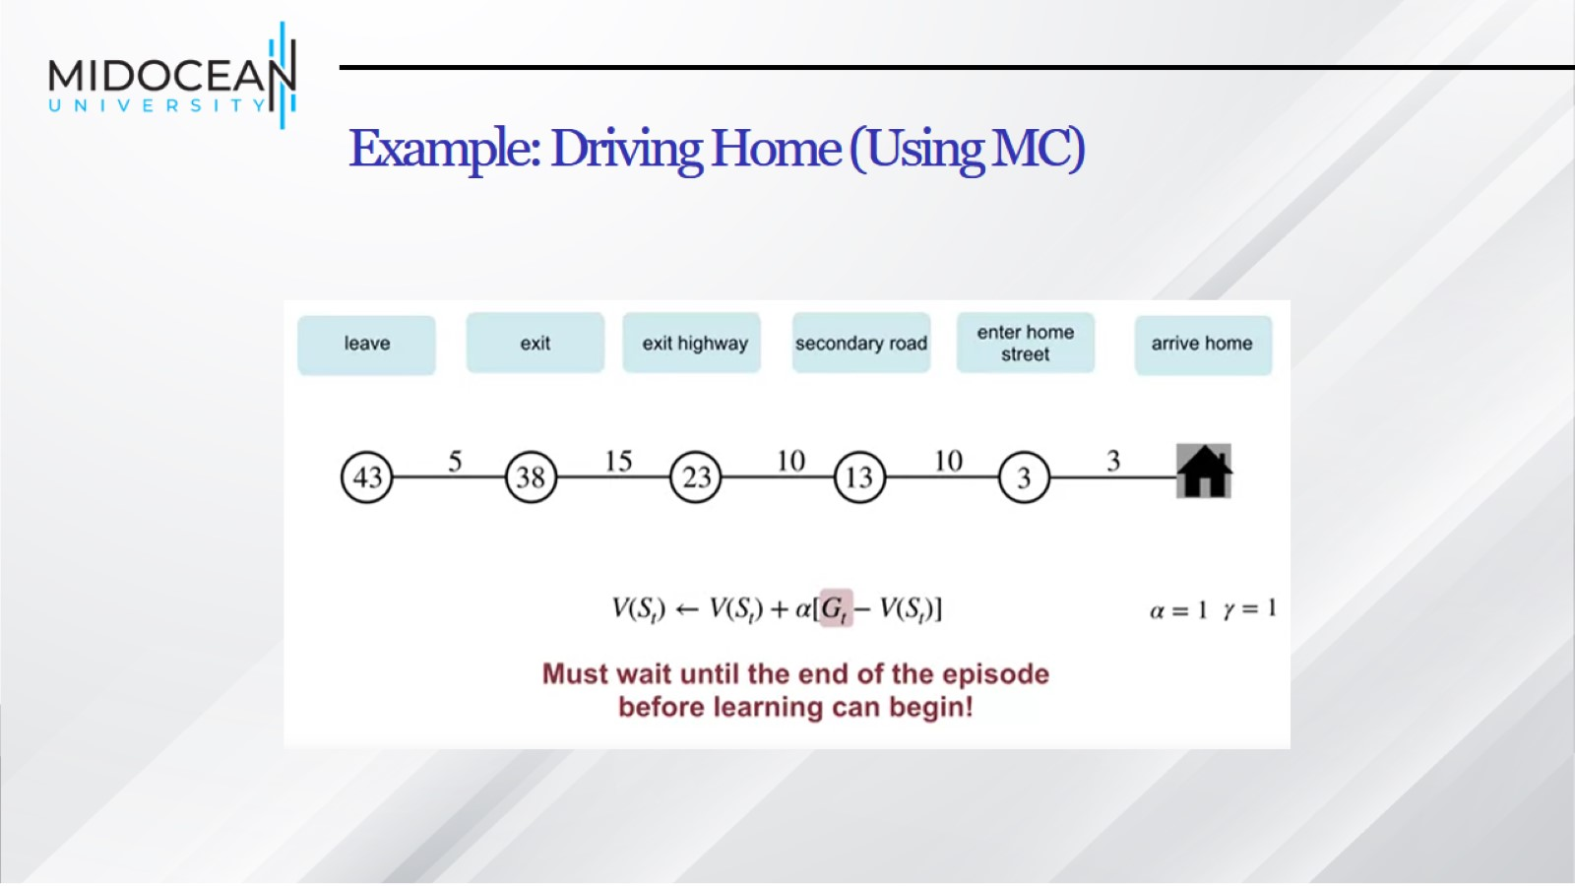
Example: Driving Home (Using MC)

Slide 31
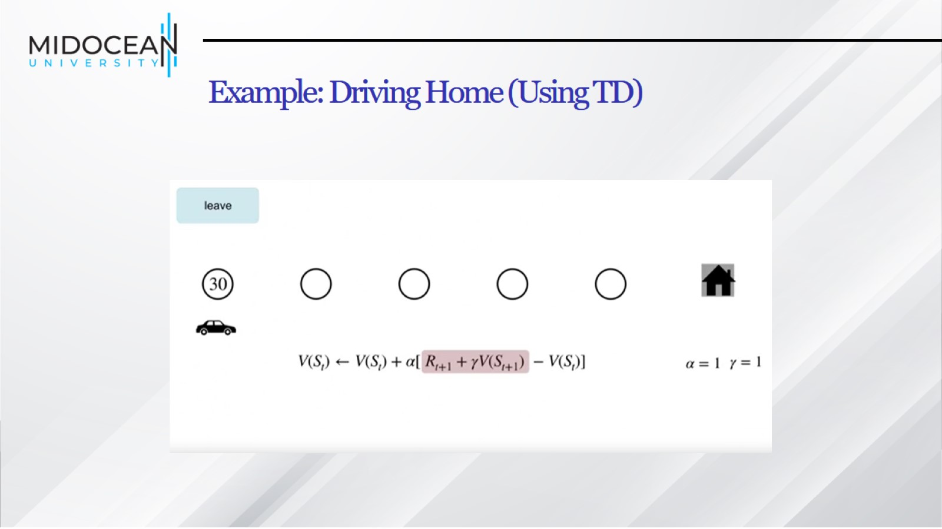
Example: Driving Home (Using TD)

Slide 32
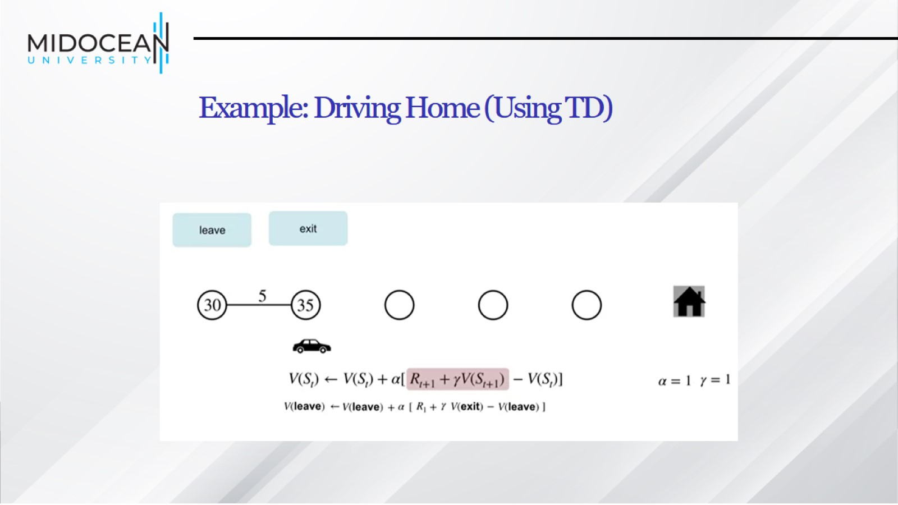
Example: Driving Home (Using TD)

Slide 33
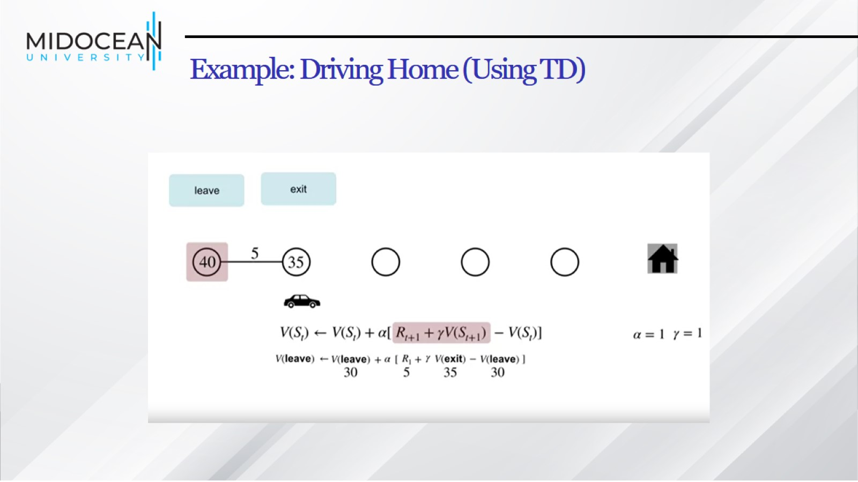
Example: Driving Home (Using TD)

Slide 34
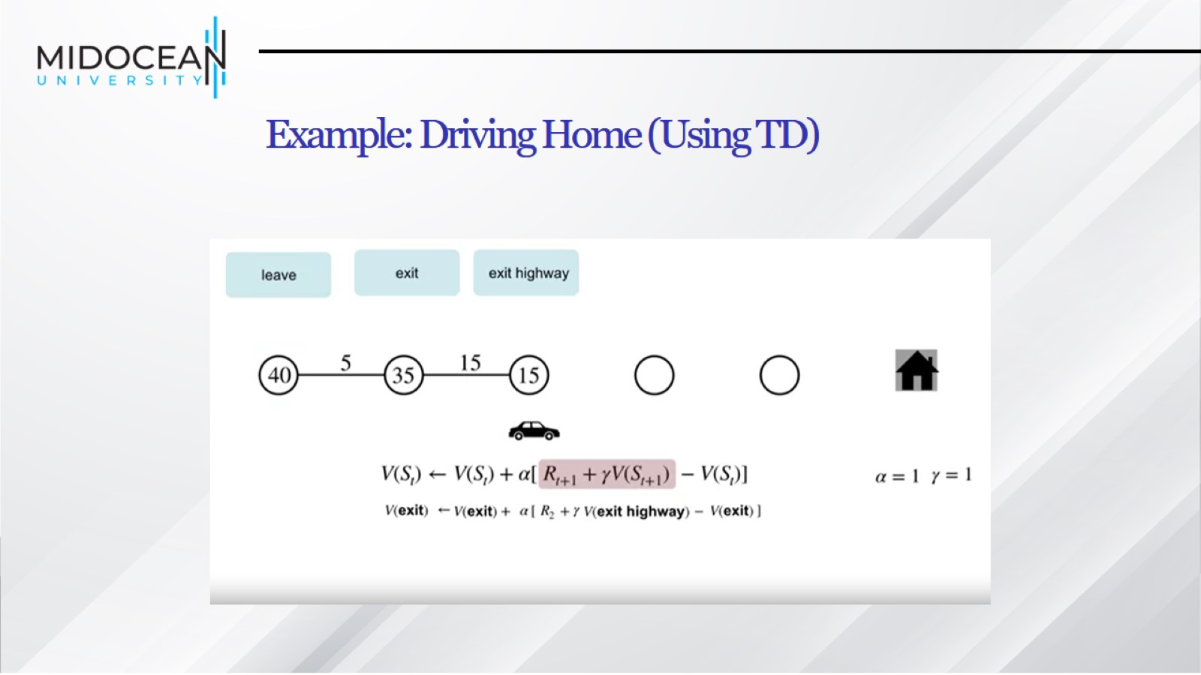
Example: Driving Home (Using TD)

Slide 35
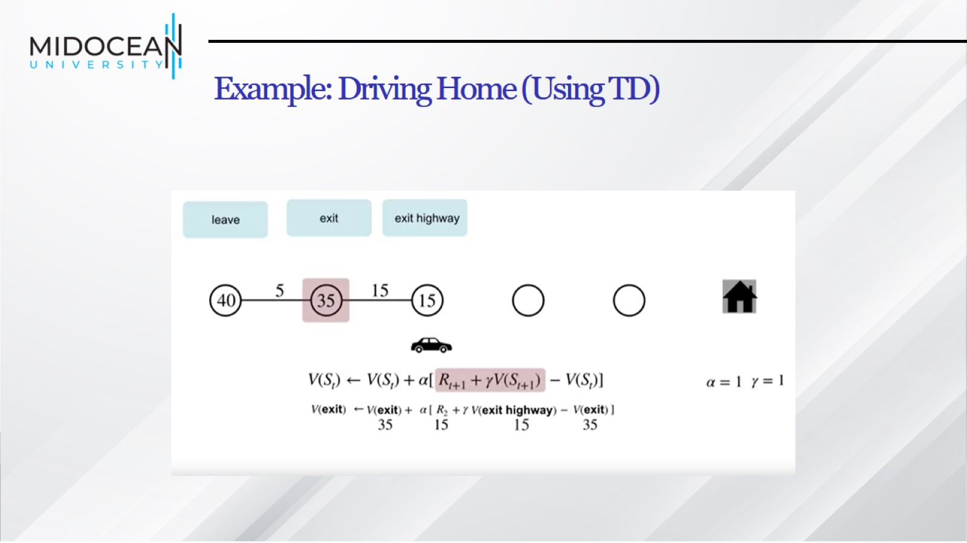
Example: Driving Home (Using TD)

Slide 36
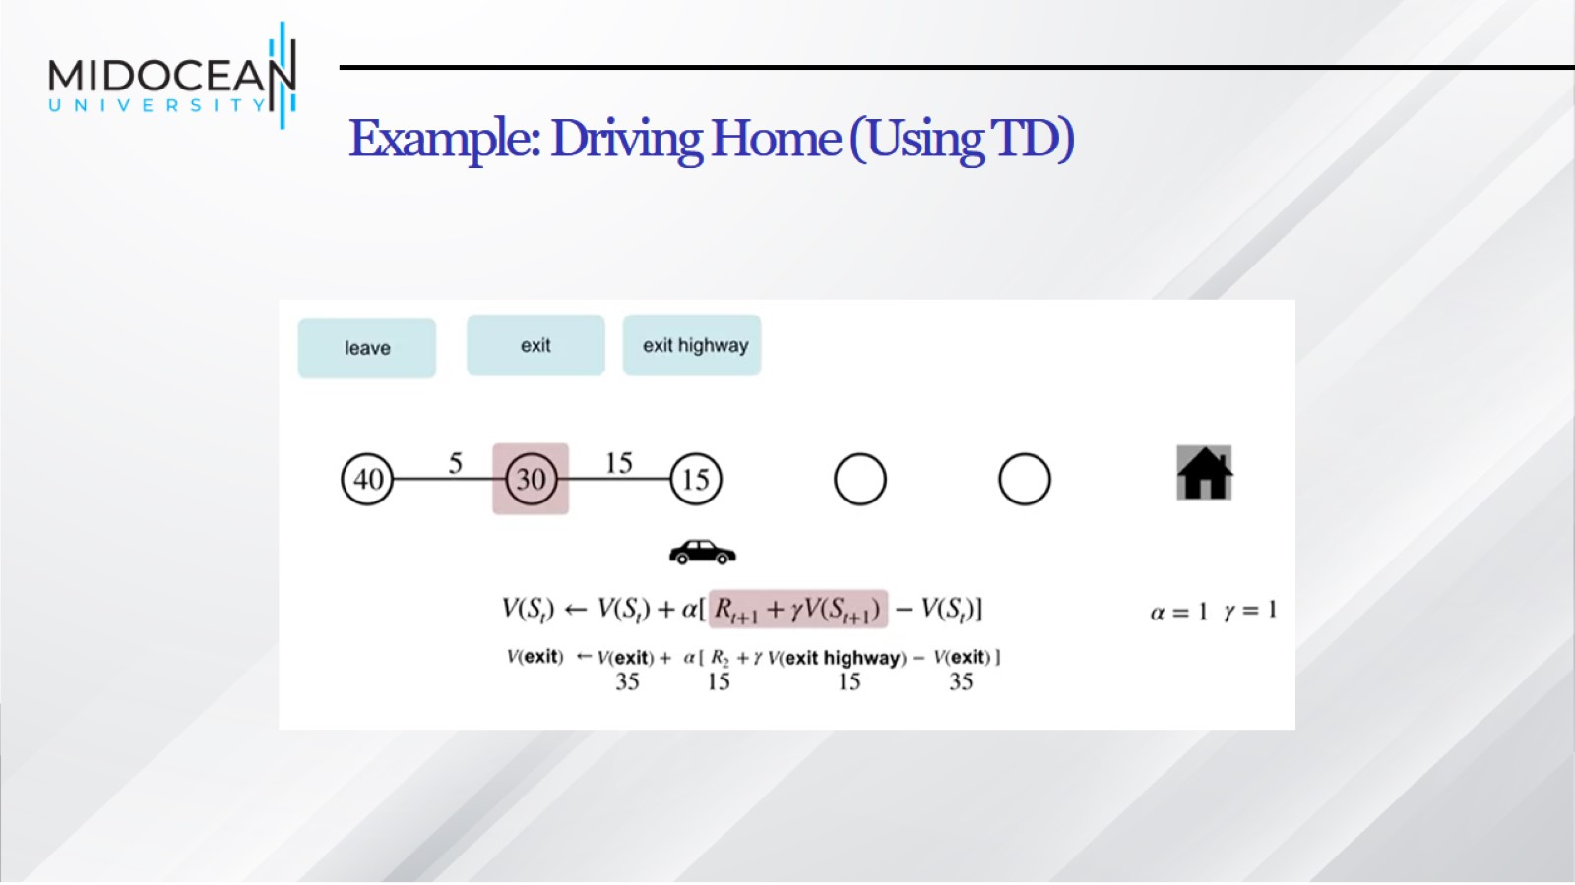
Example: Driving Home (Using TD)

Slide 37
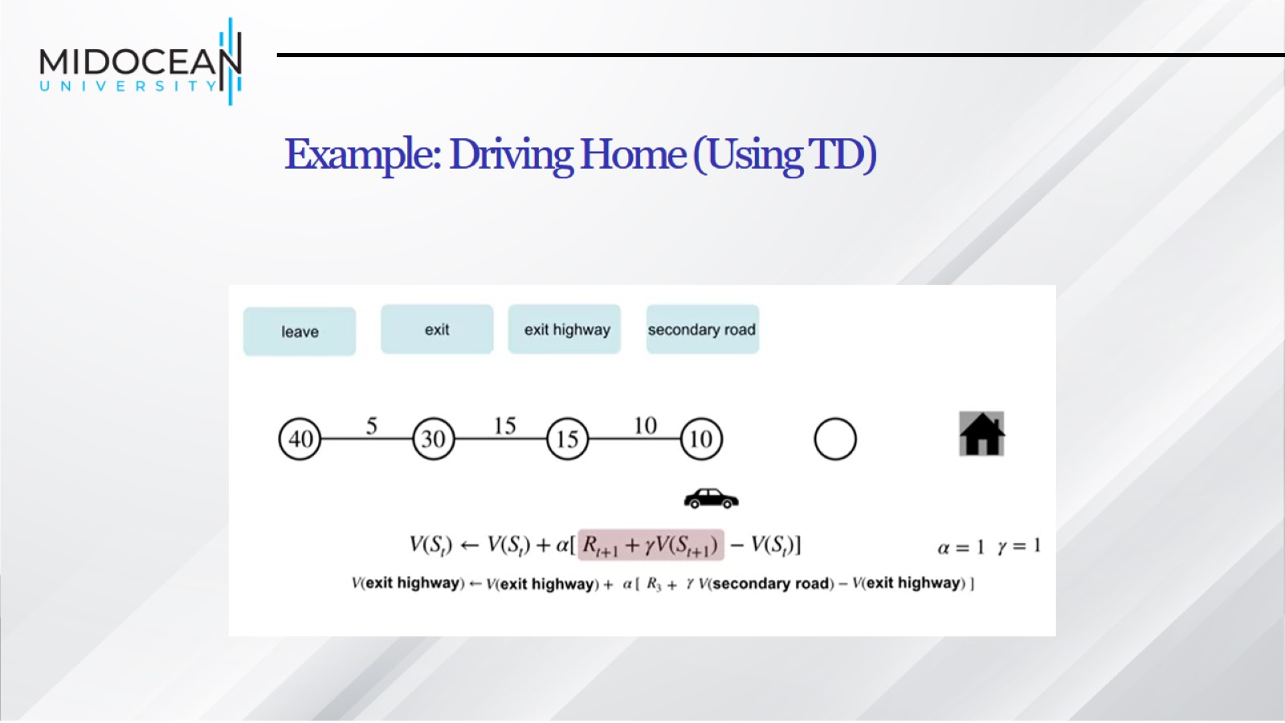
Example: Driving Home (Using TD)

Slide 38
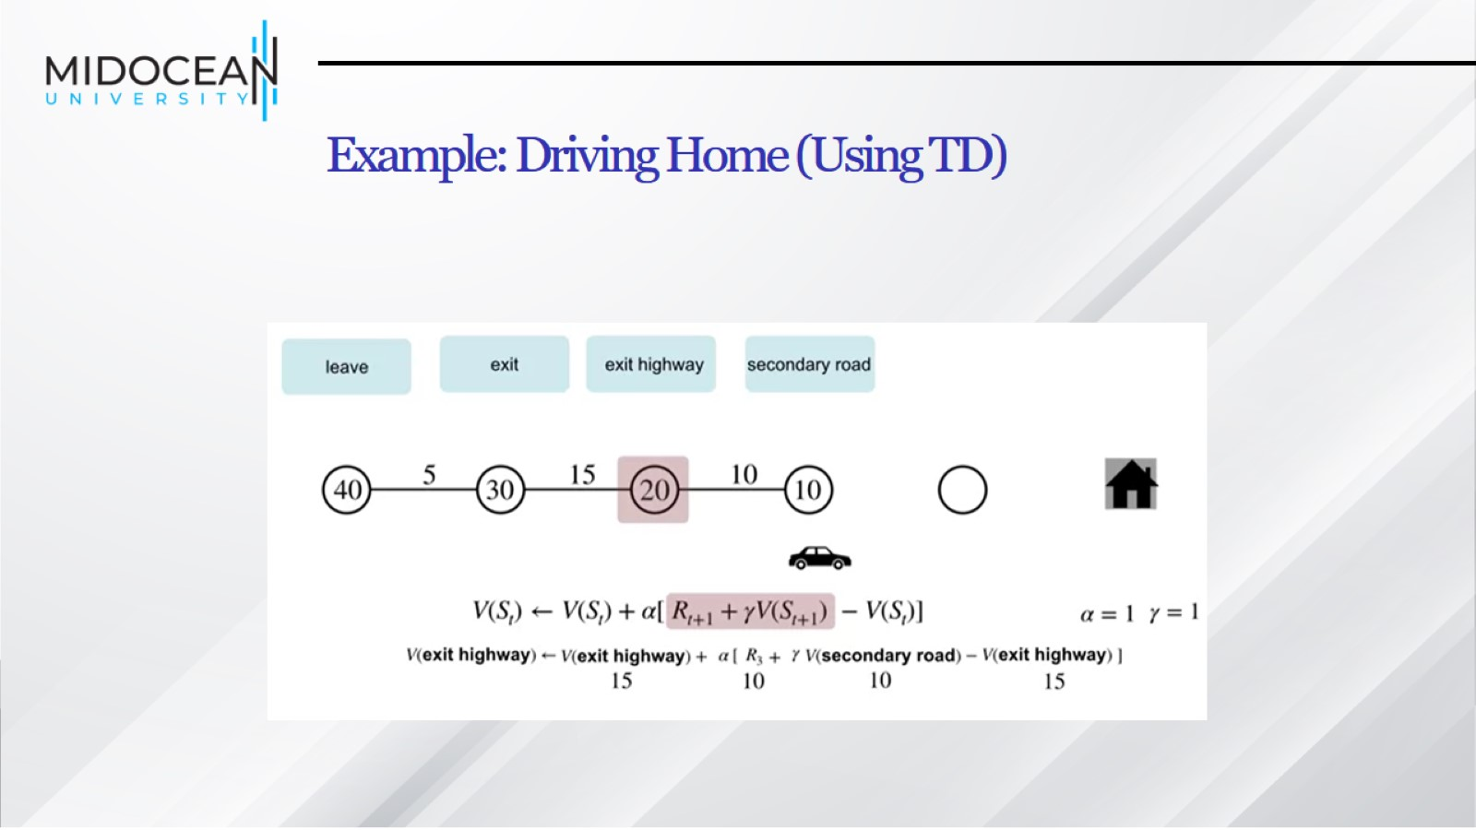
Example: Driving Home (Using TD)

Slide 39
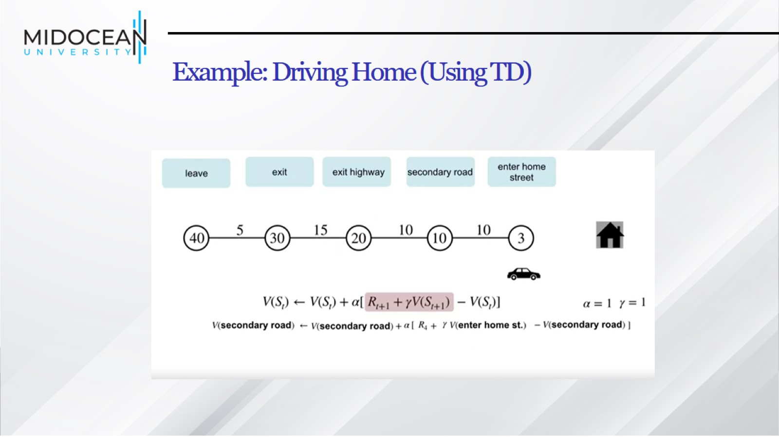
Example: Driving Home (Using TD)

Slide 40
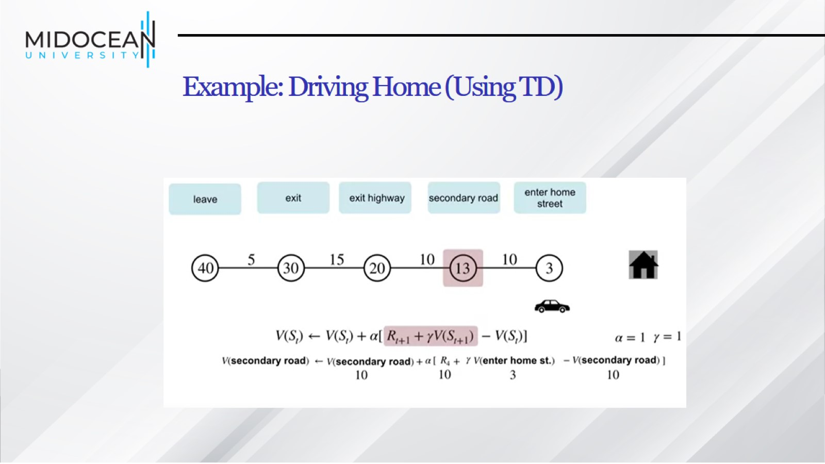
Example: Driving Home (Using TD)

Slide 41
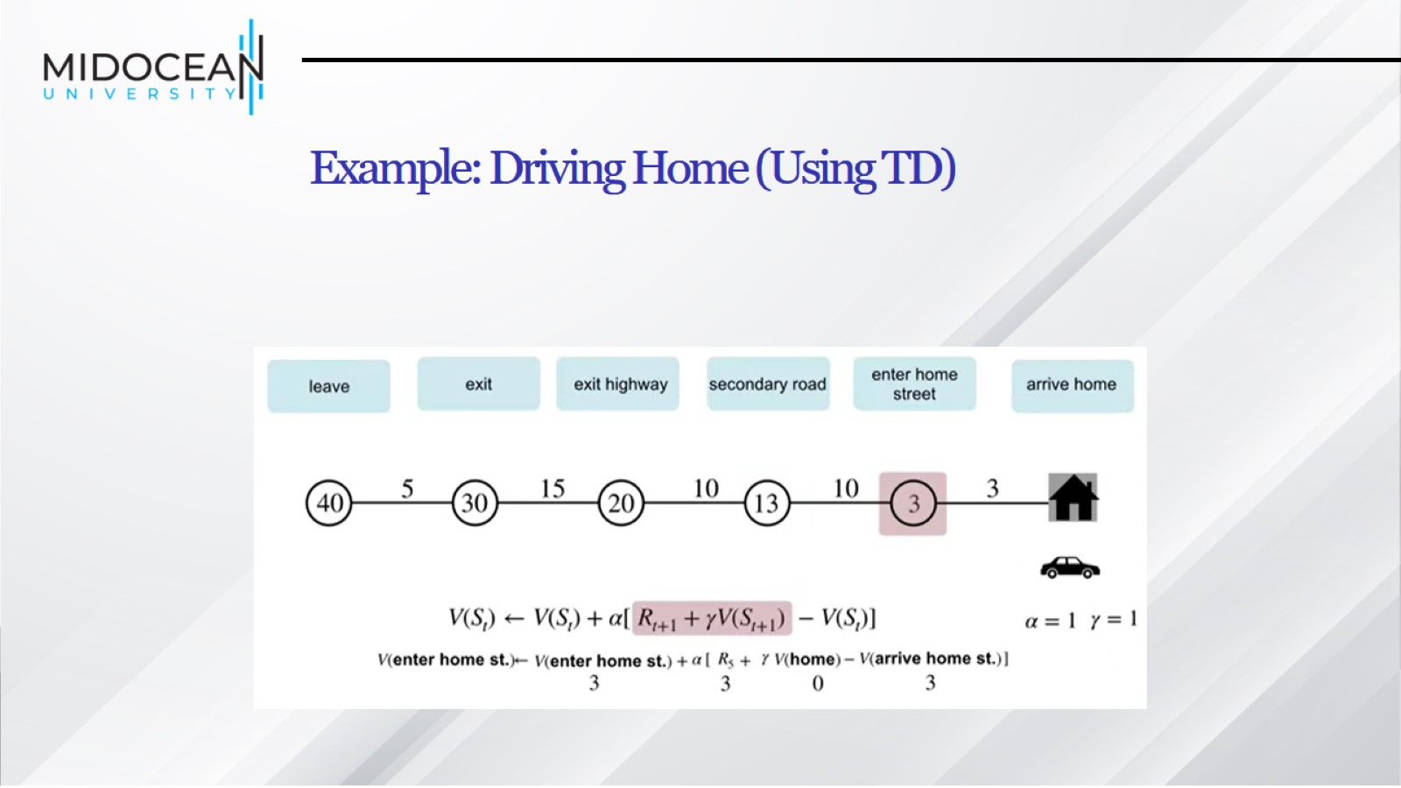
Example: Driving Home (Using TD)

Slide 42
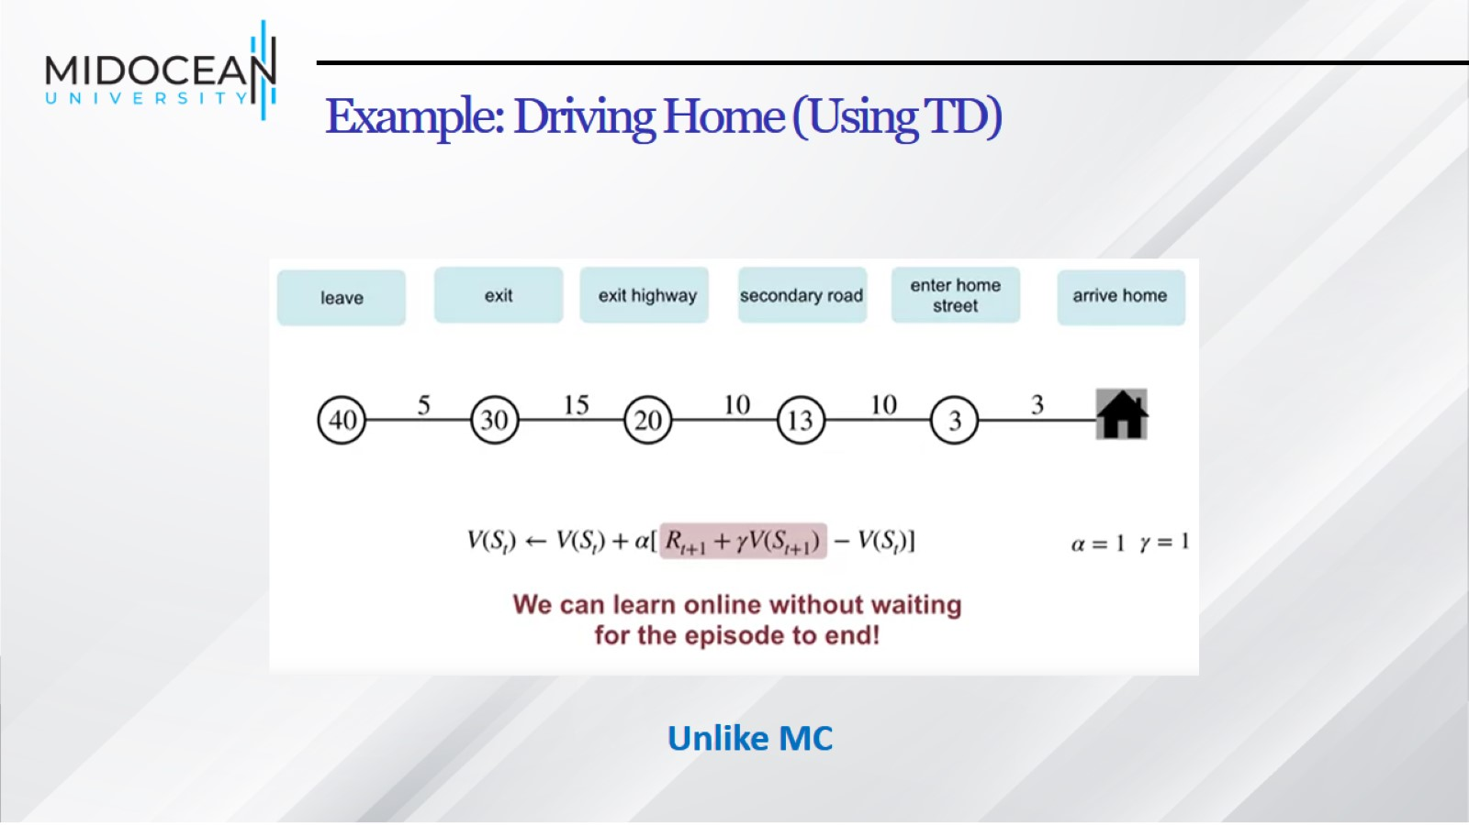
Example: Driving Home (Using TD)

Slide 43
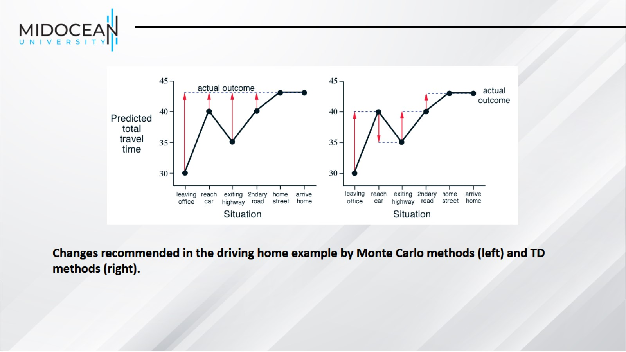

Slide 44
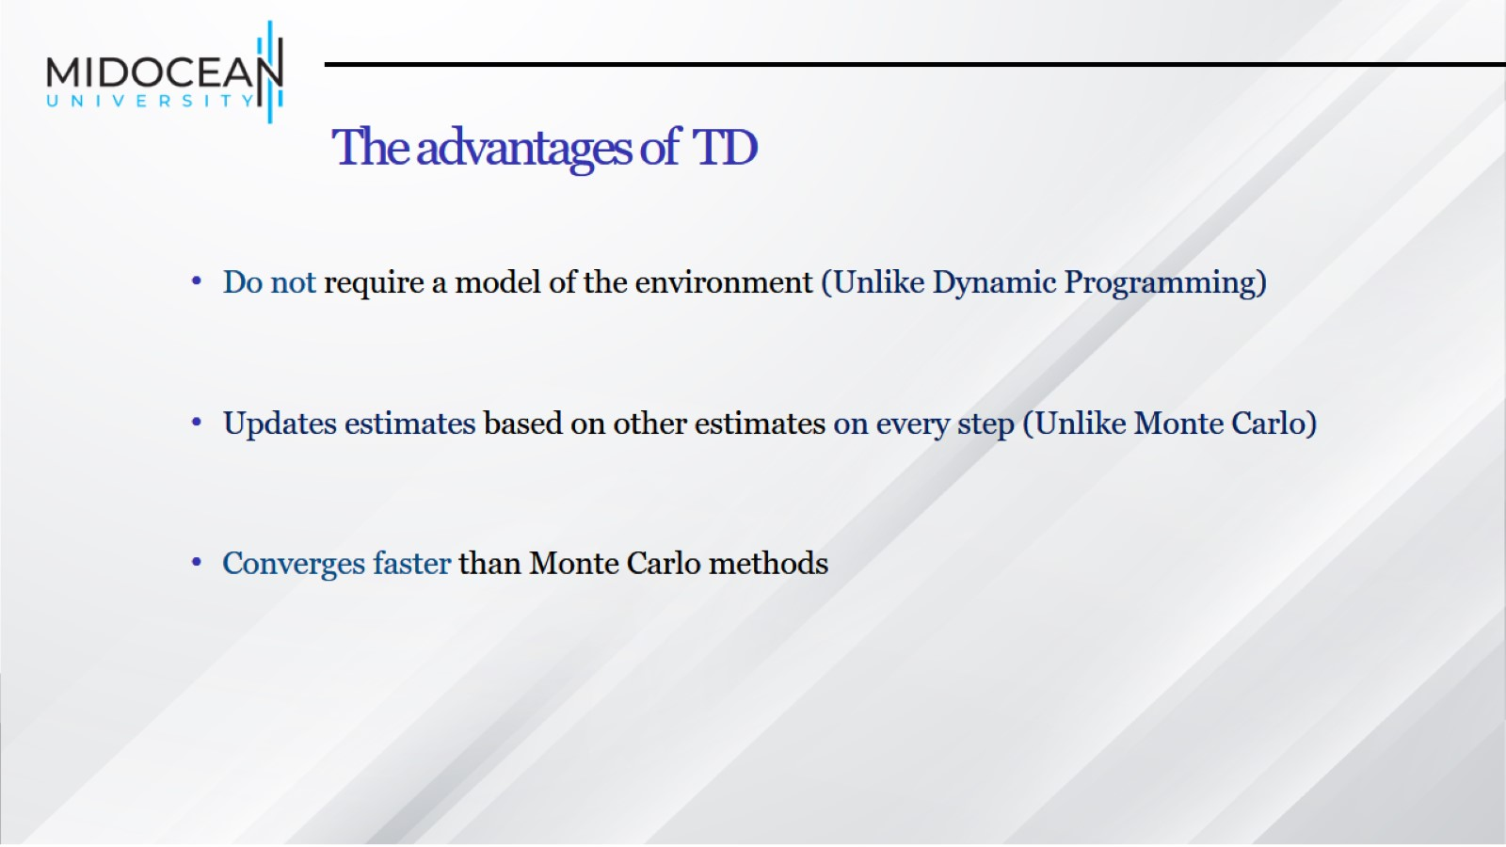
The advantages of TD

Slide 45
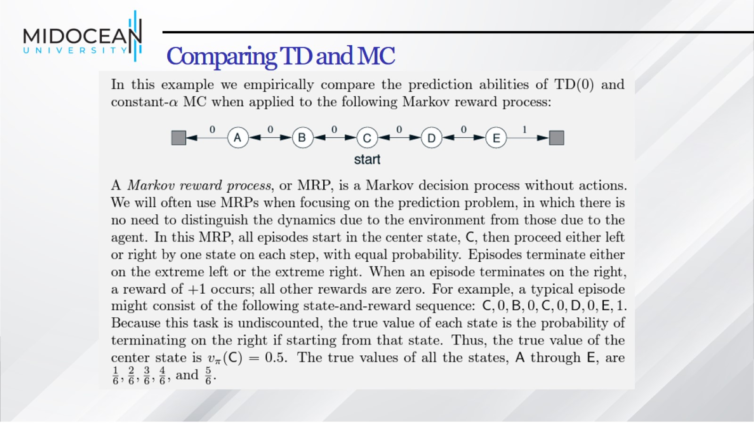
Comparing TD and MC

Slide 46
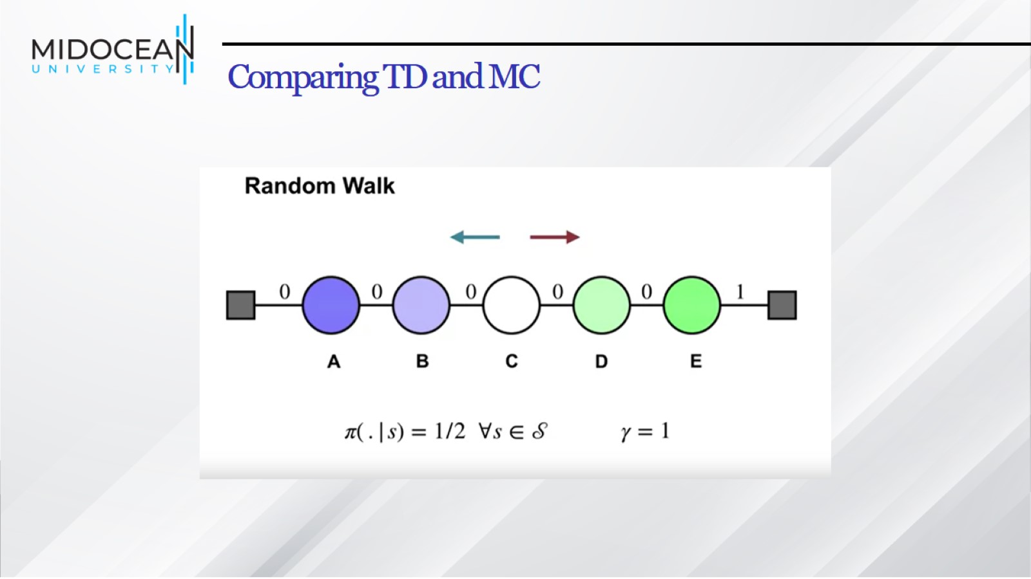
Comparing TD and MC

Slide 47
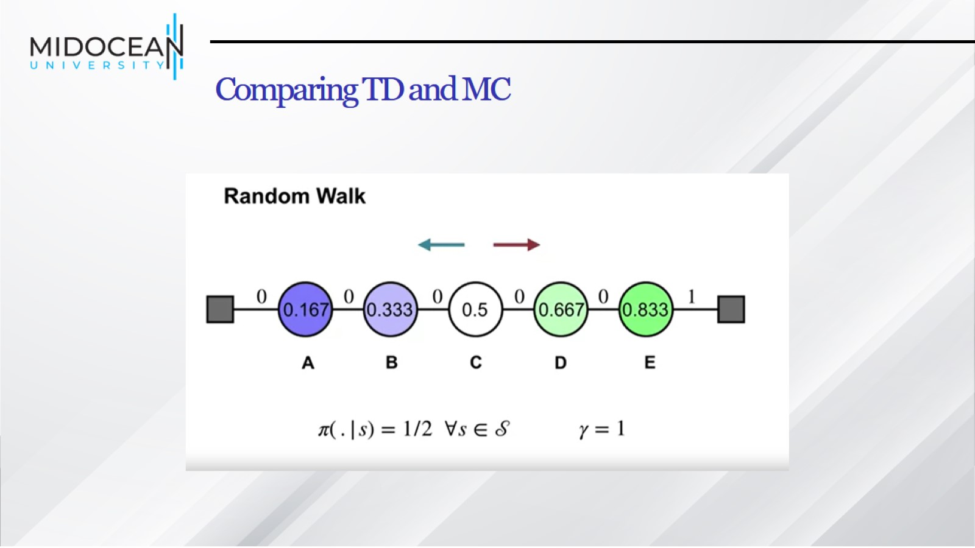
Comparing TD and MC

Slide 48
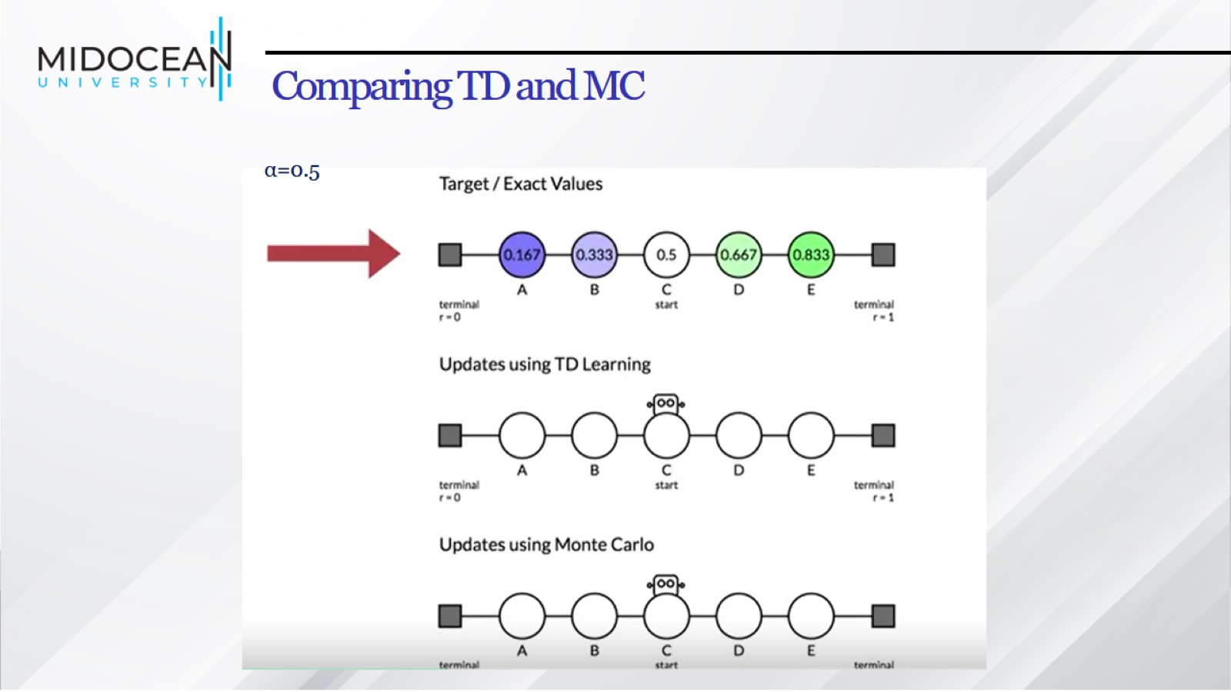
Comparing TD and MC

Slide 49
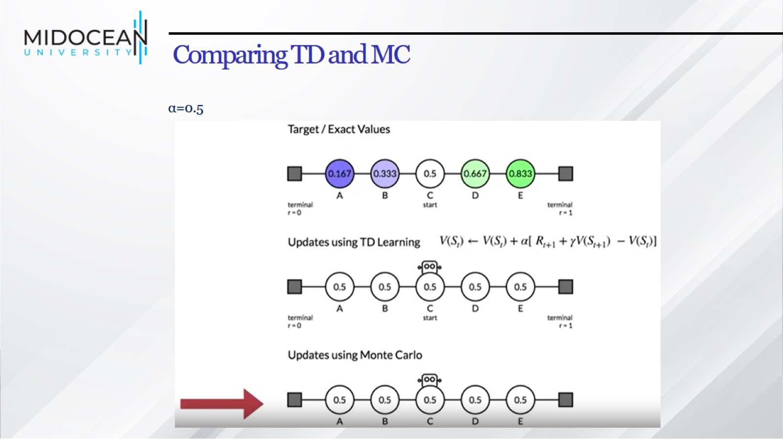
Comparing TD and MC

Slide 50
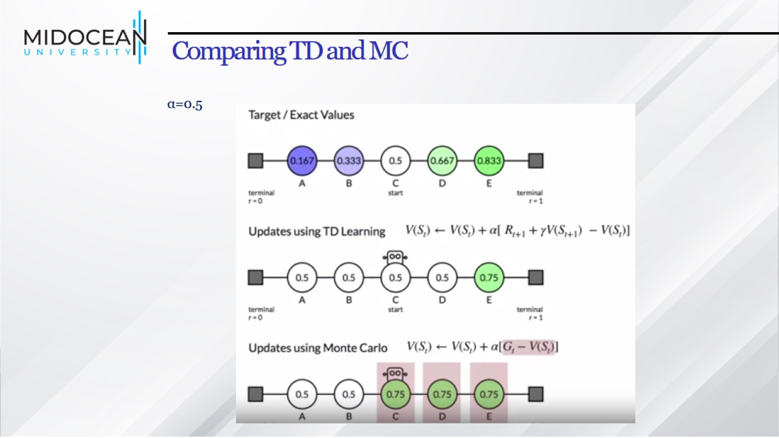
Comparing TD and MC

Slide 51
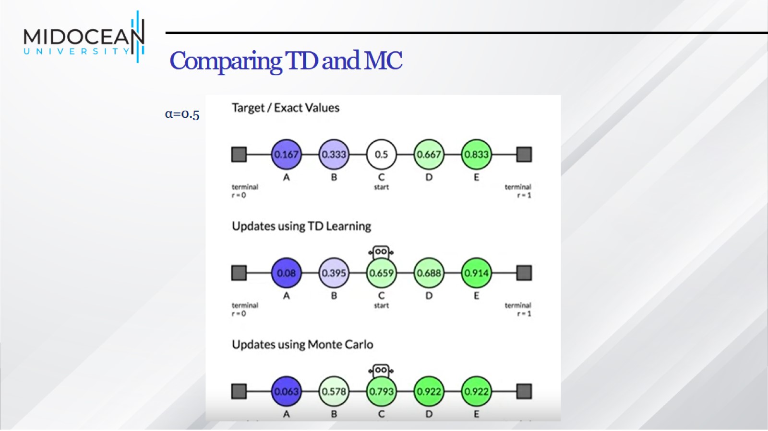
Comparing TD and MC

Slide 52
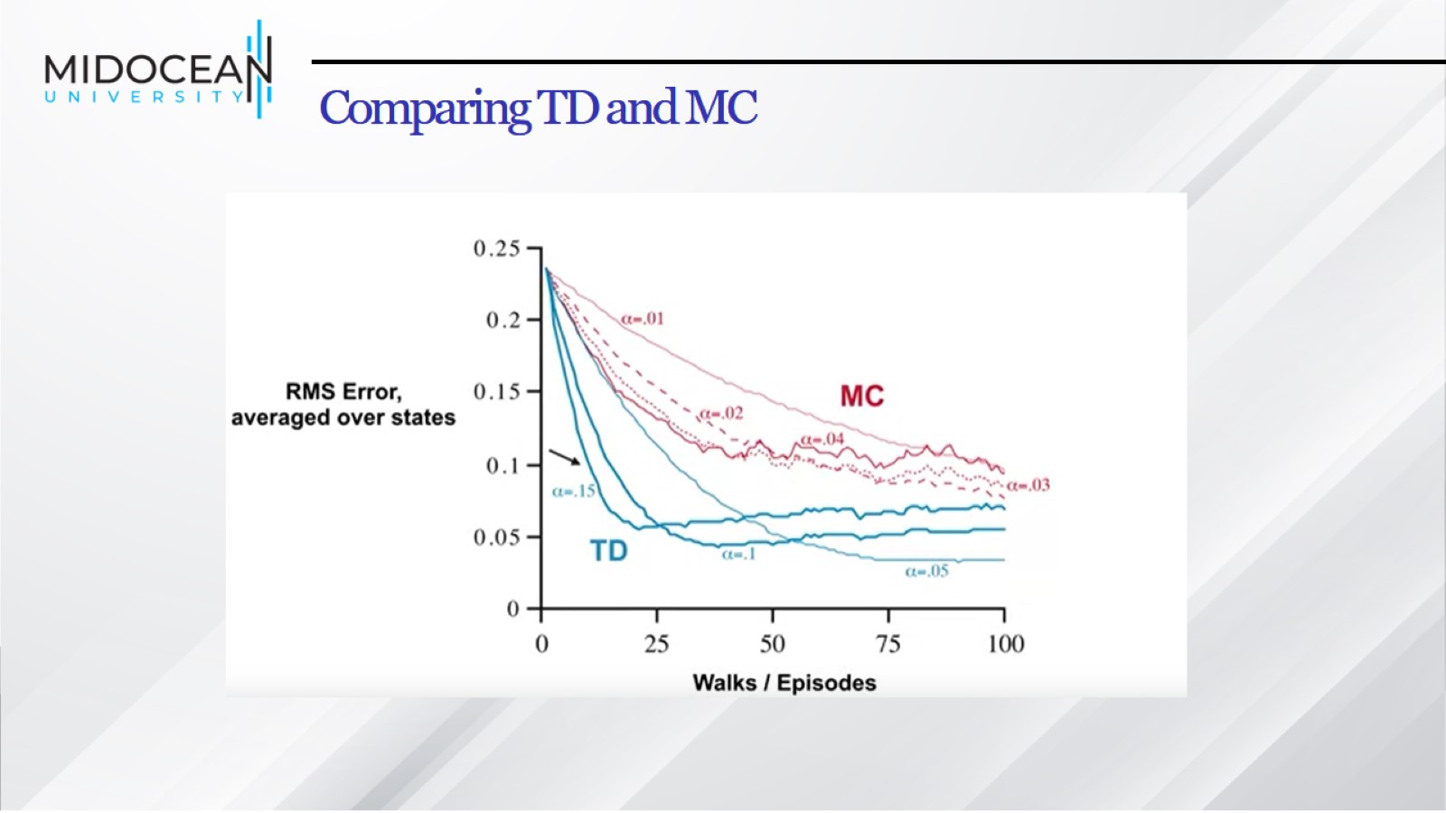
Comparing TD and MC

Slide 53
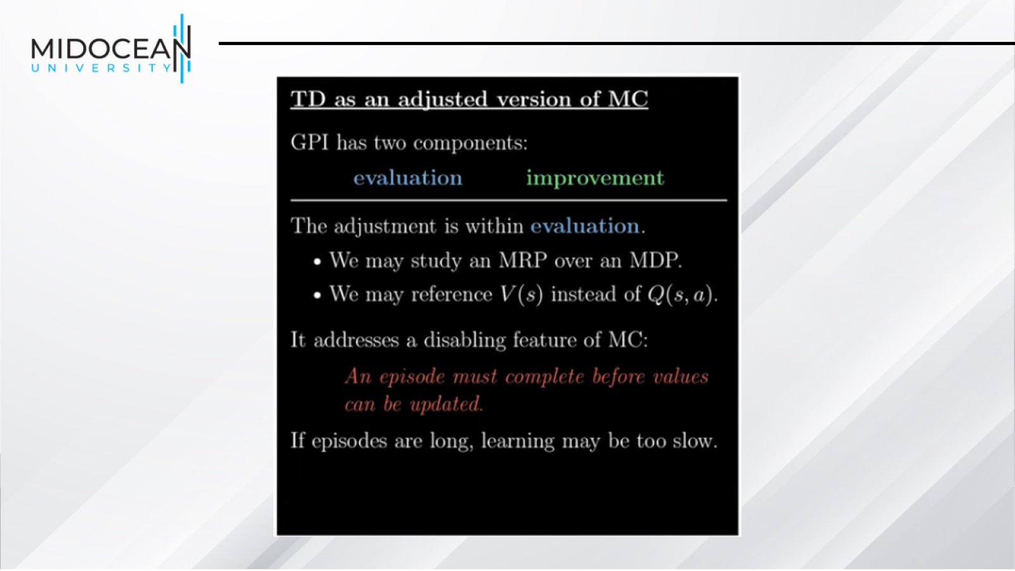

Slide 54


Slide 55


Slide 56


Slide 57


Slide 58


Slide 59


Slide 60


Slide 61


Slide 62


Slide 63


Slide 64


Slide 65


Slide 66


Slide 67

Solved Example

Slide 68


Slide 69


Slide 70


Slide 71


Slide 72


Slide 73

Summary

Slide 74


