Slide 1
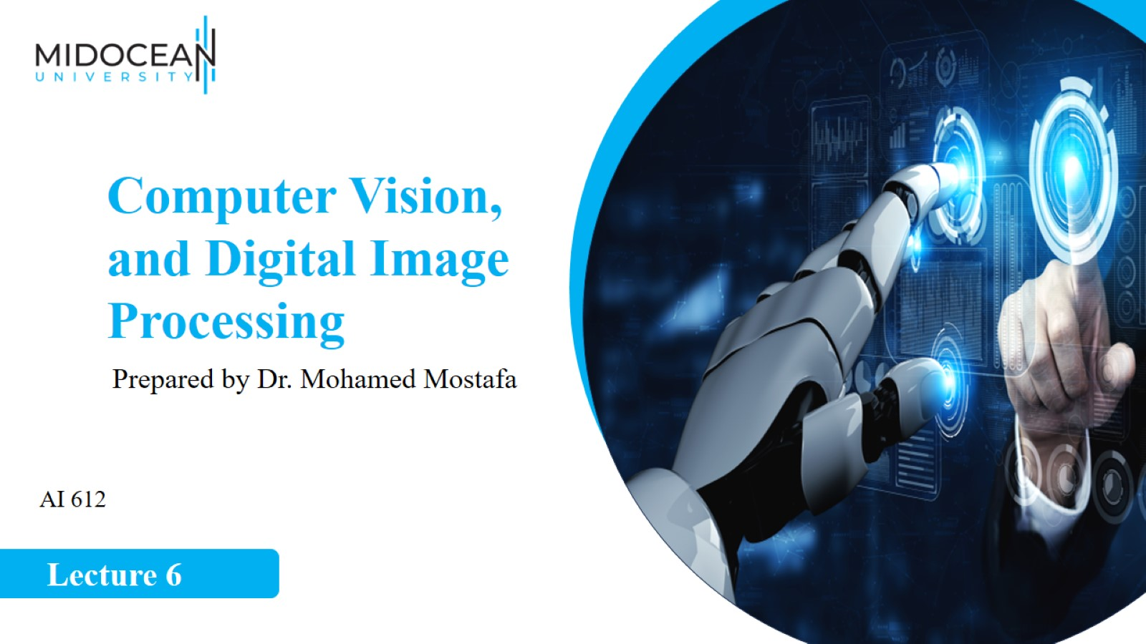

Slide 2
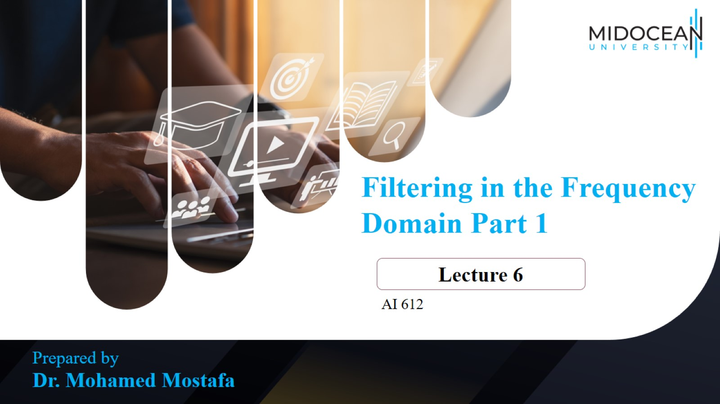

Slide 3
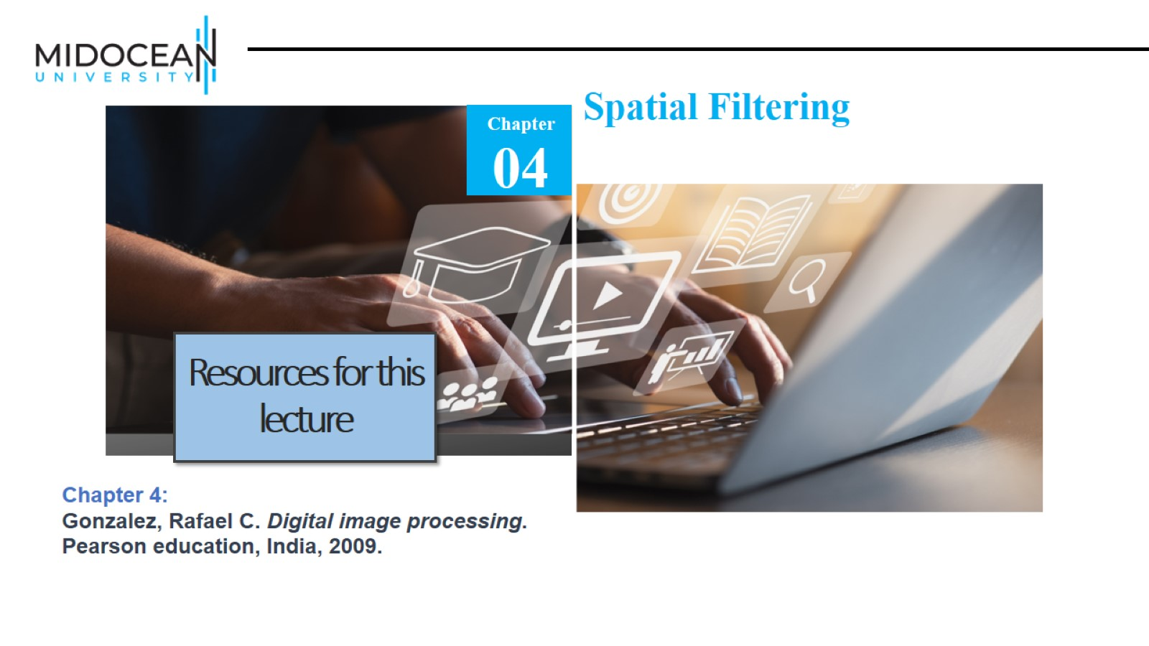

Slide 4
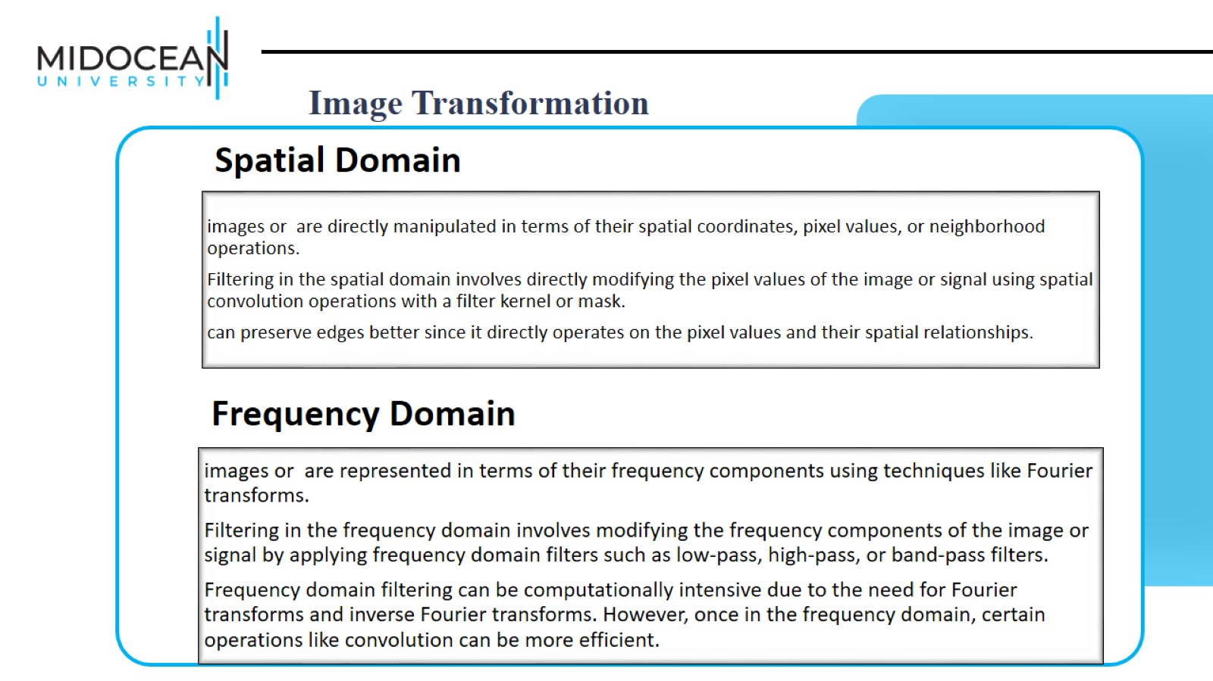

Slide 5
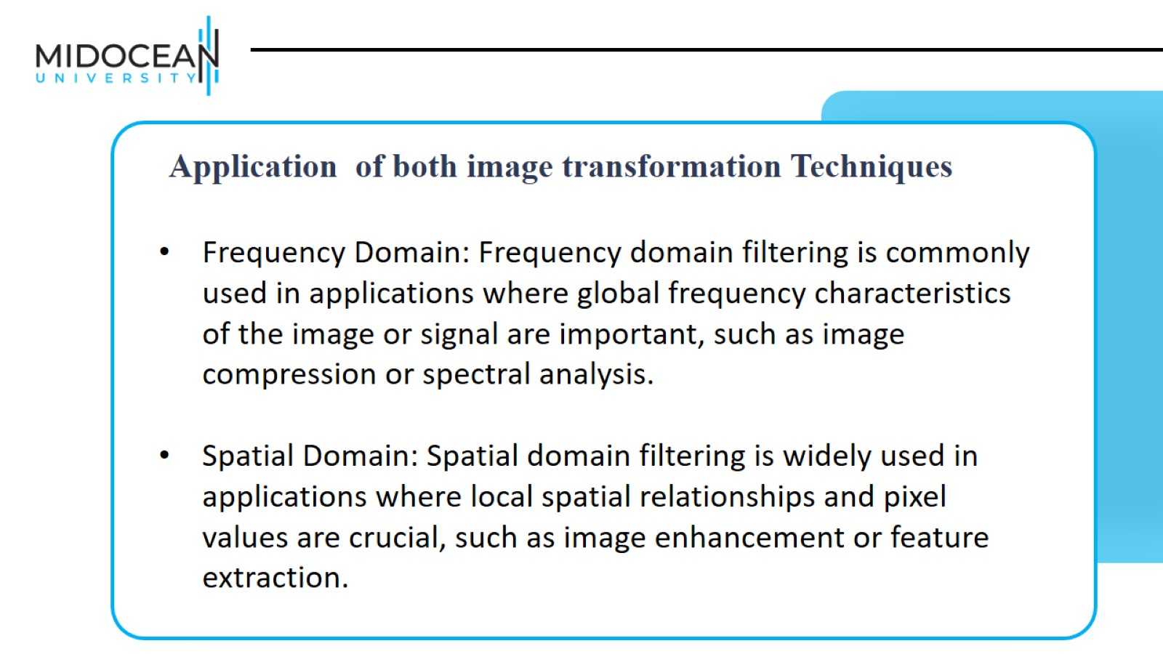

Slide 6
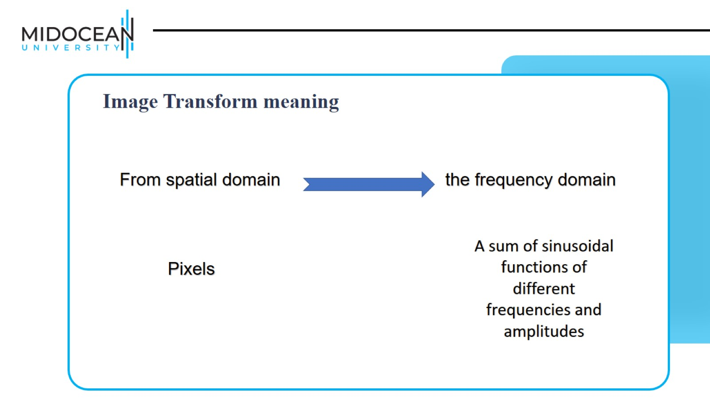

Slide 7
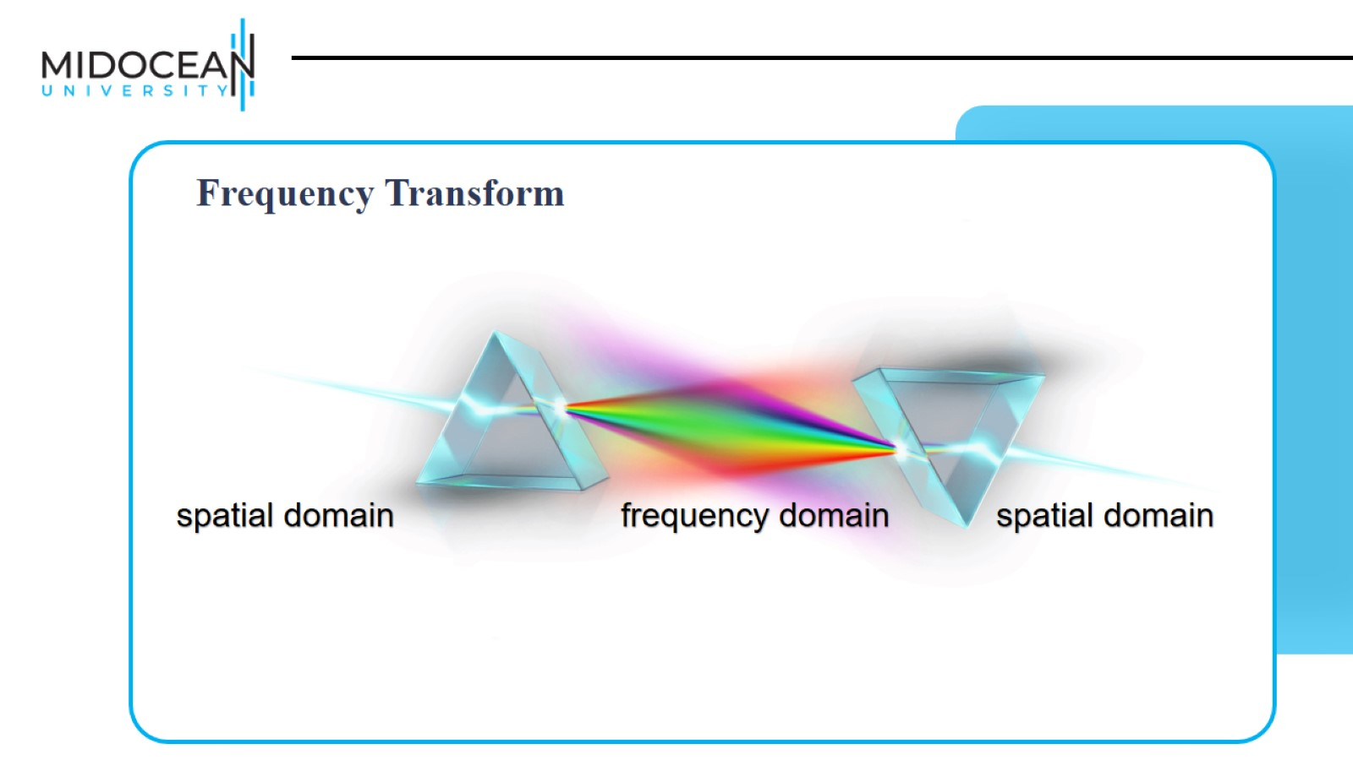

Slide 8
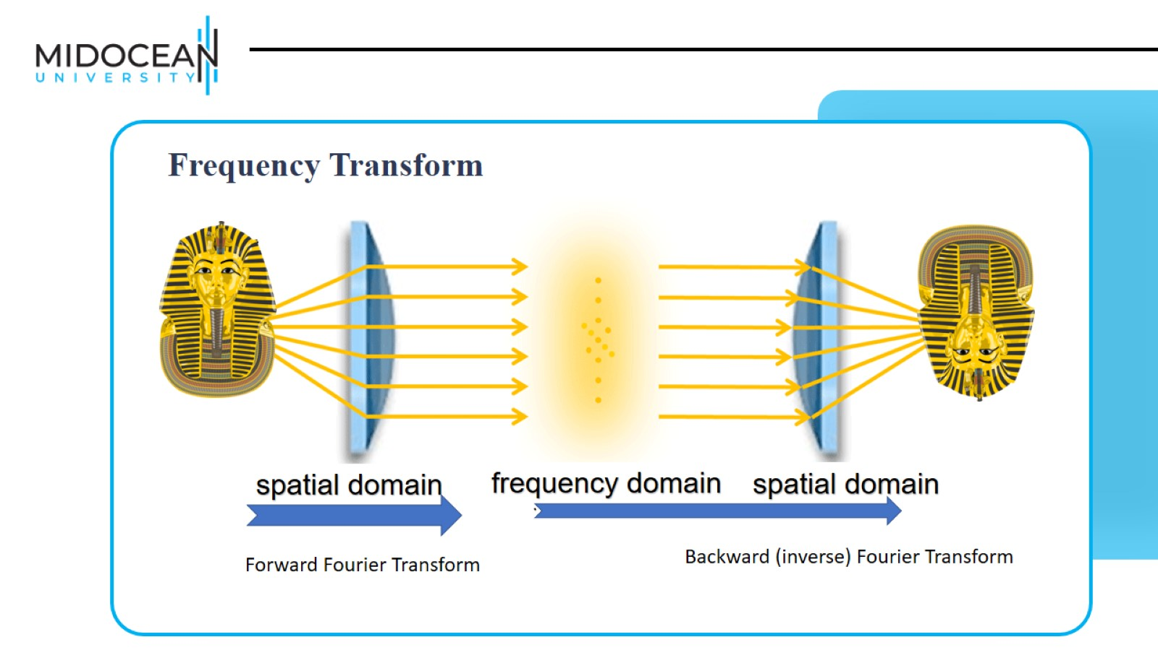

Slide 9
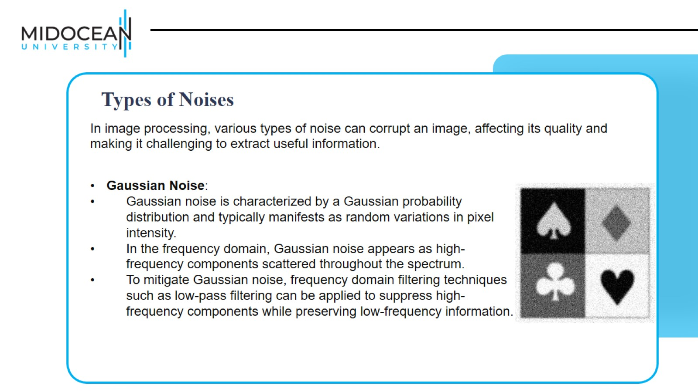

Slide 10
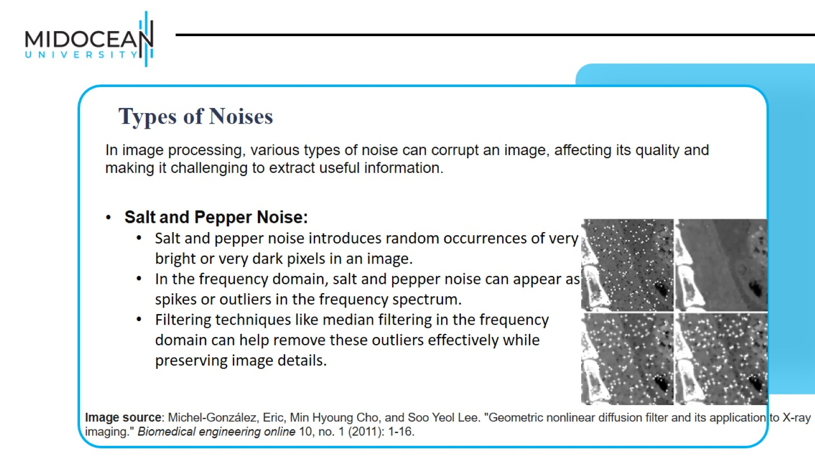

Slide 11
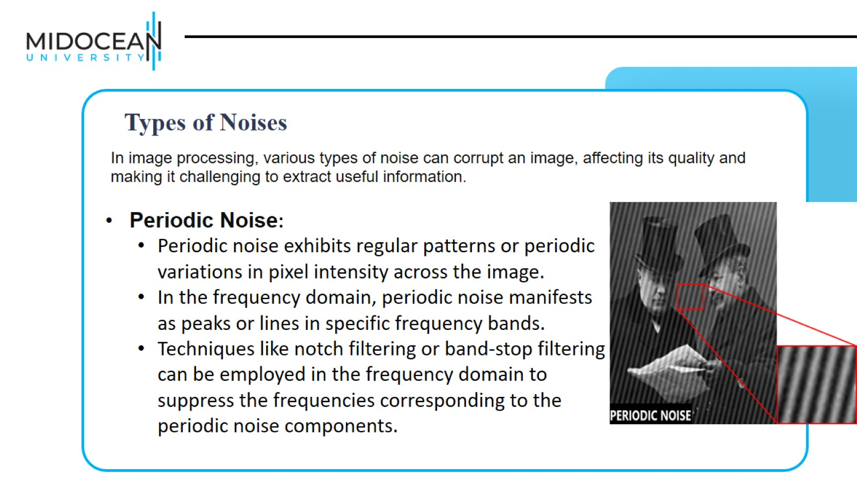

Slide 12
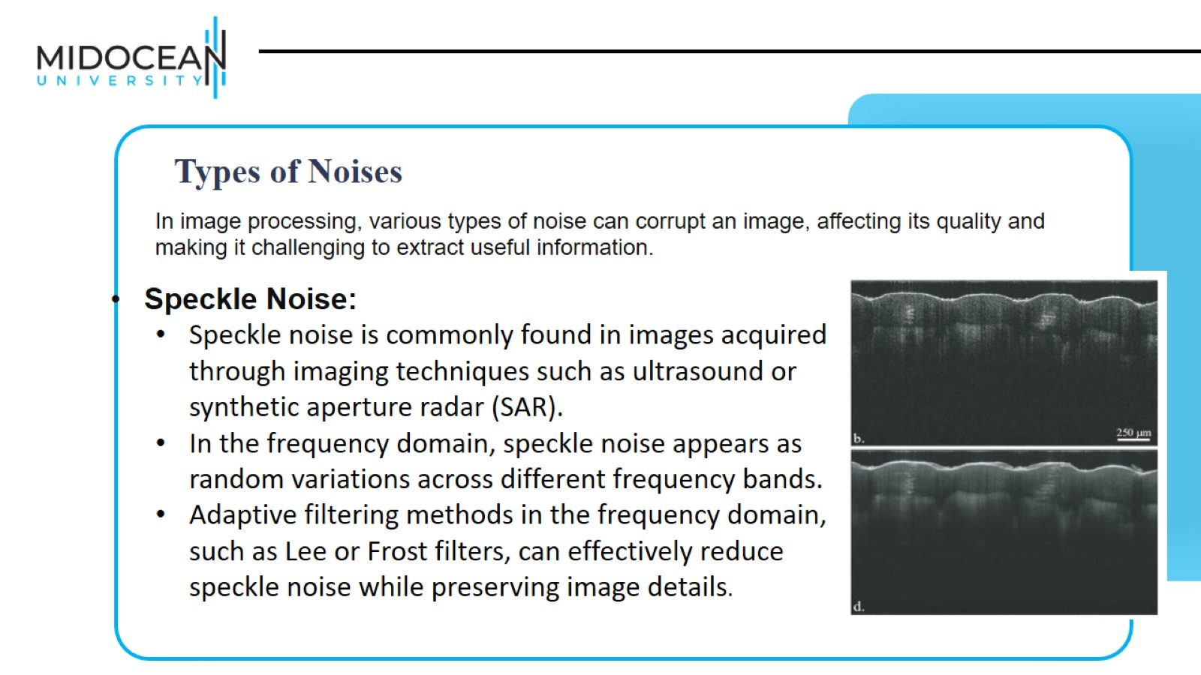

Slide 13
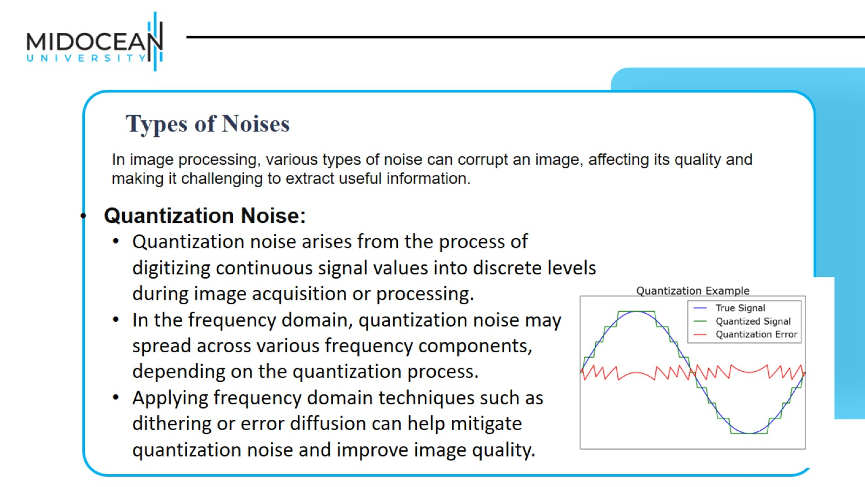

Slide 14
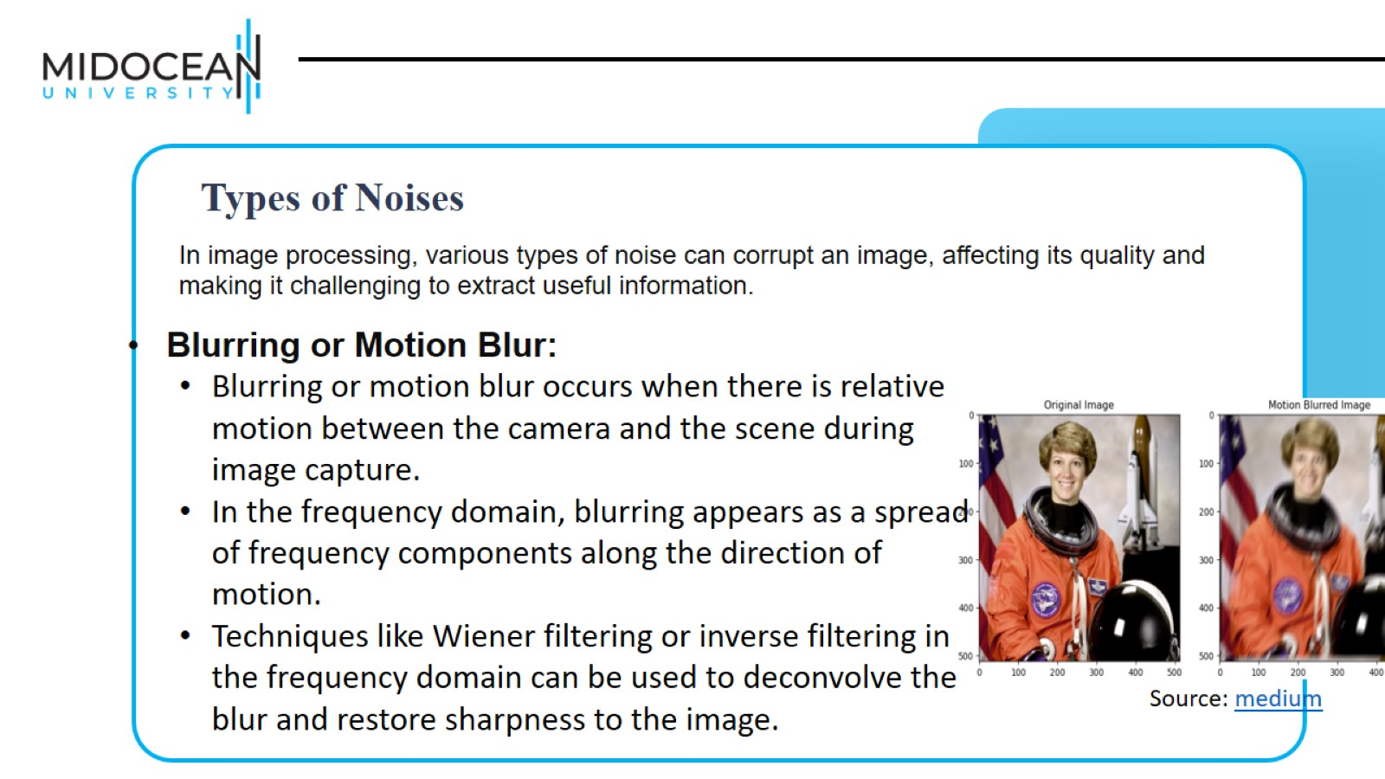

Slide 15
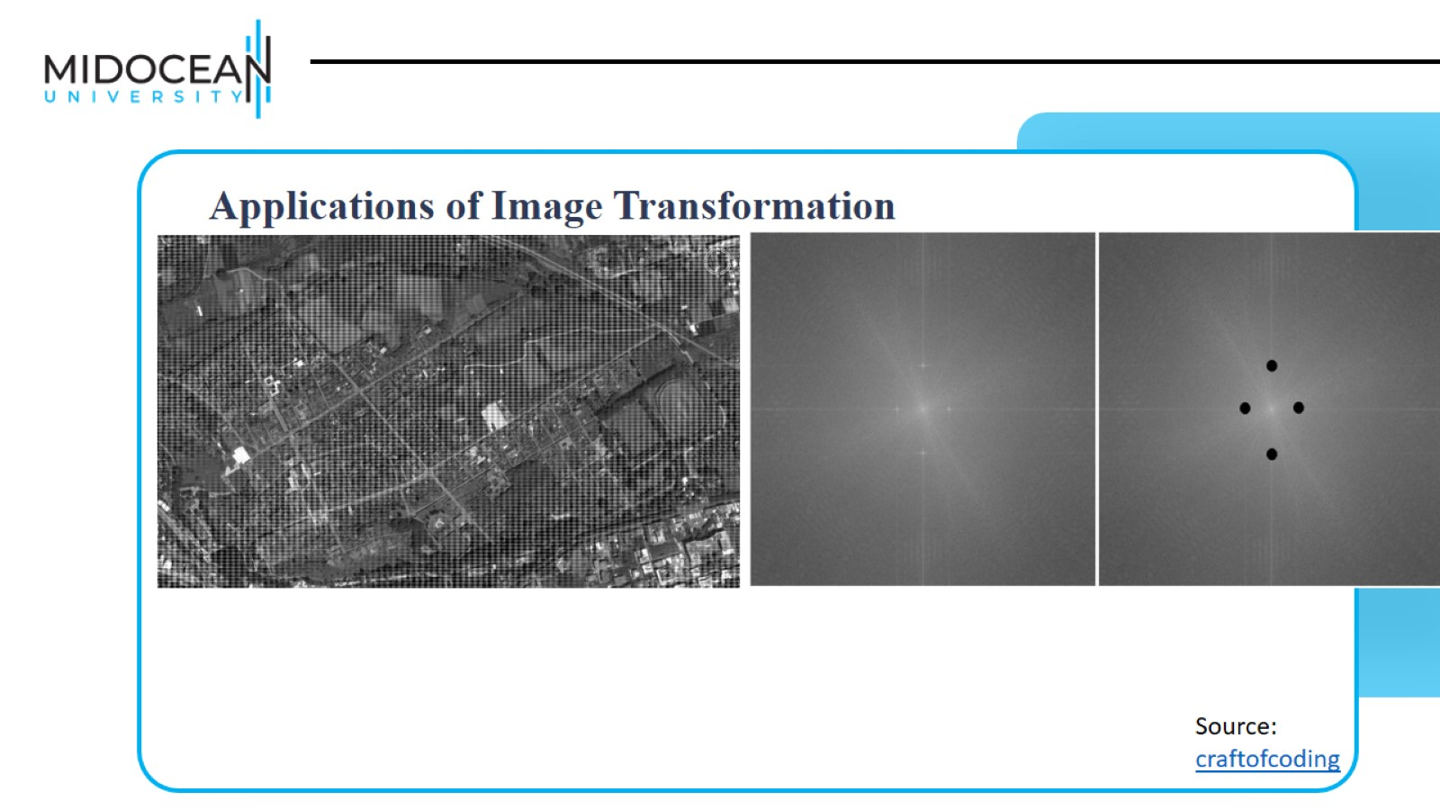

Slide 16
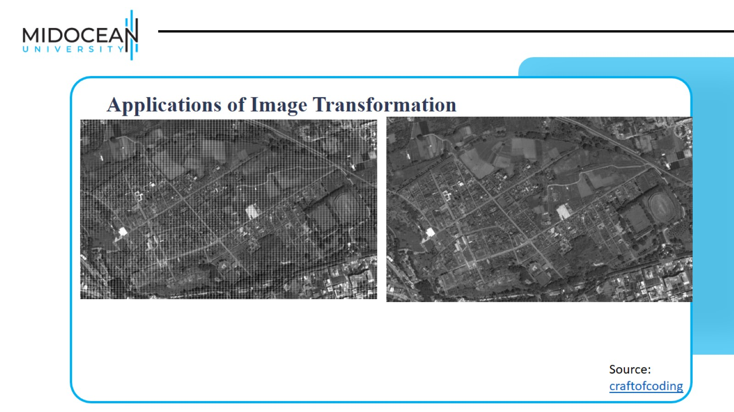

Slide 17
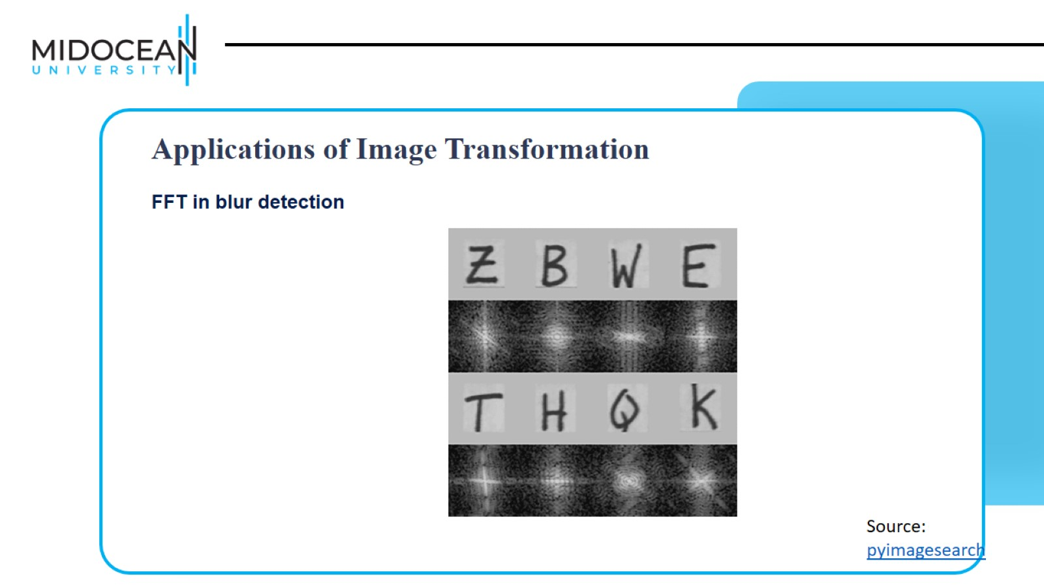

Slide 18
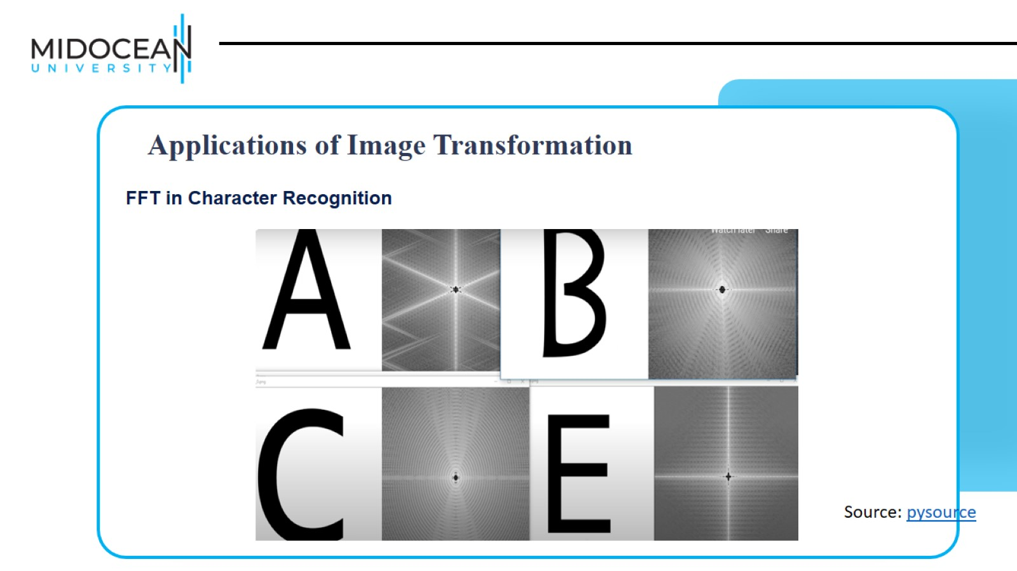

Slide 19
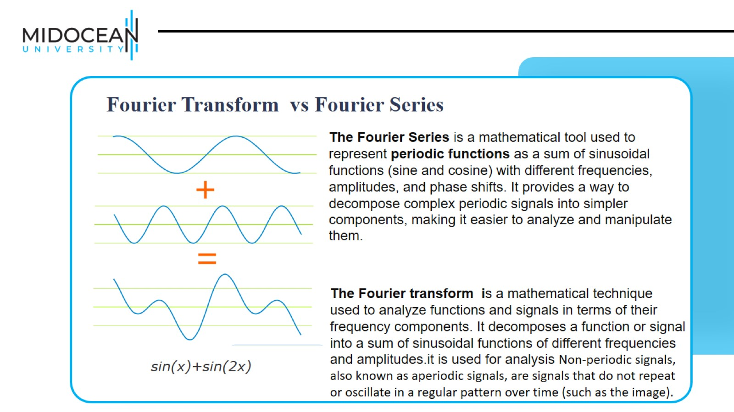

Slide 20
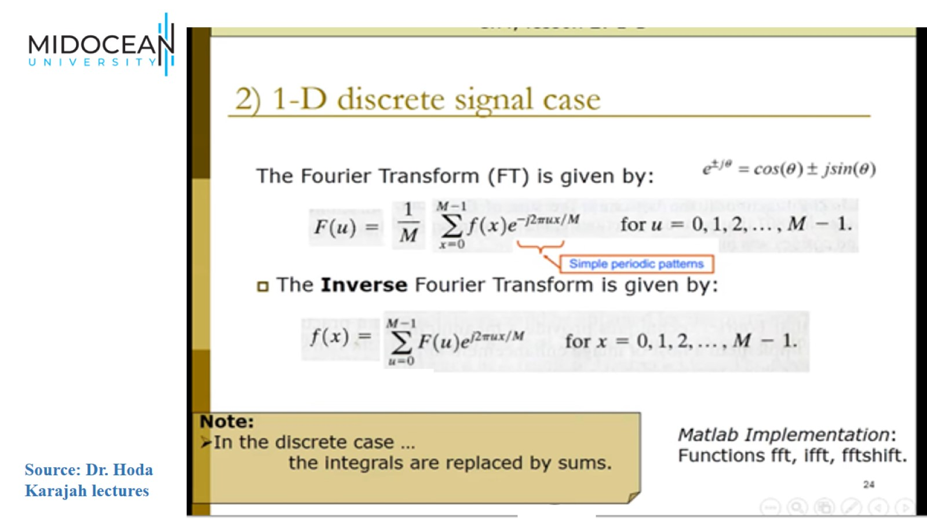

Slide 21
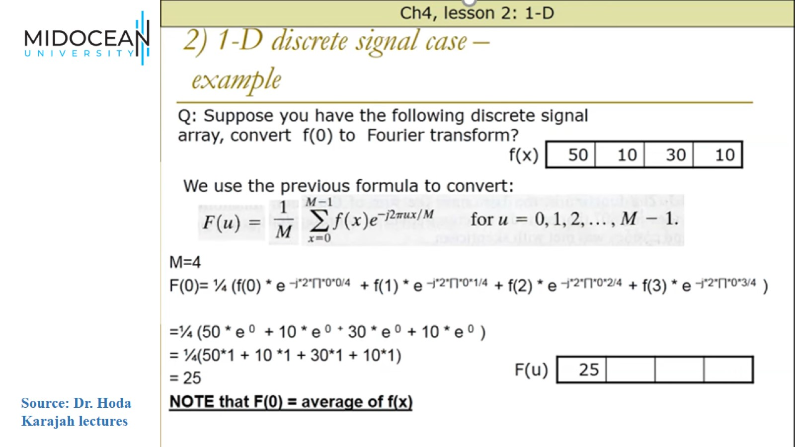

Slide 22
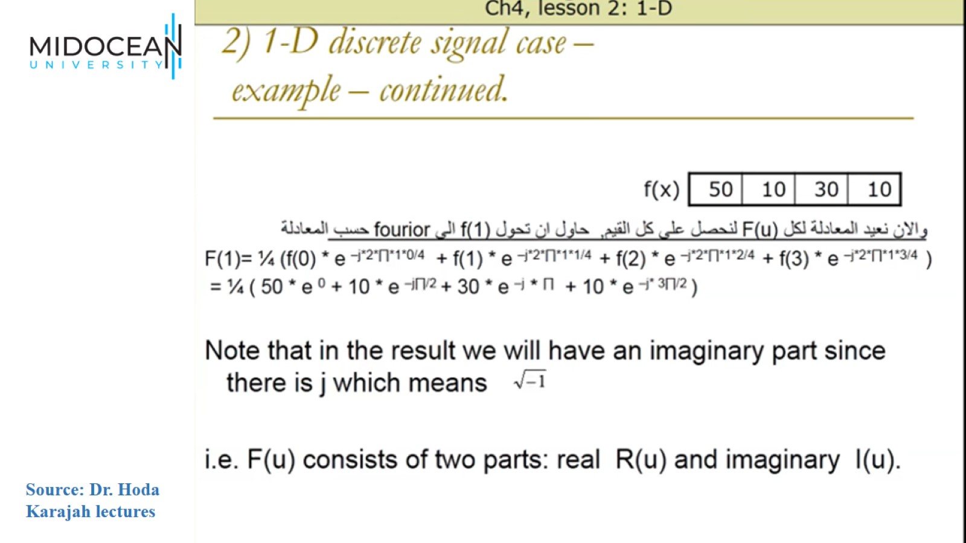

Slide 23
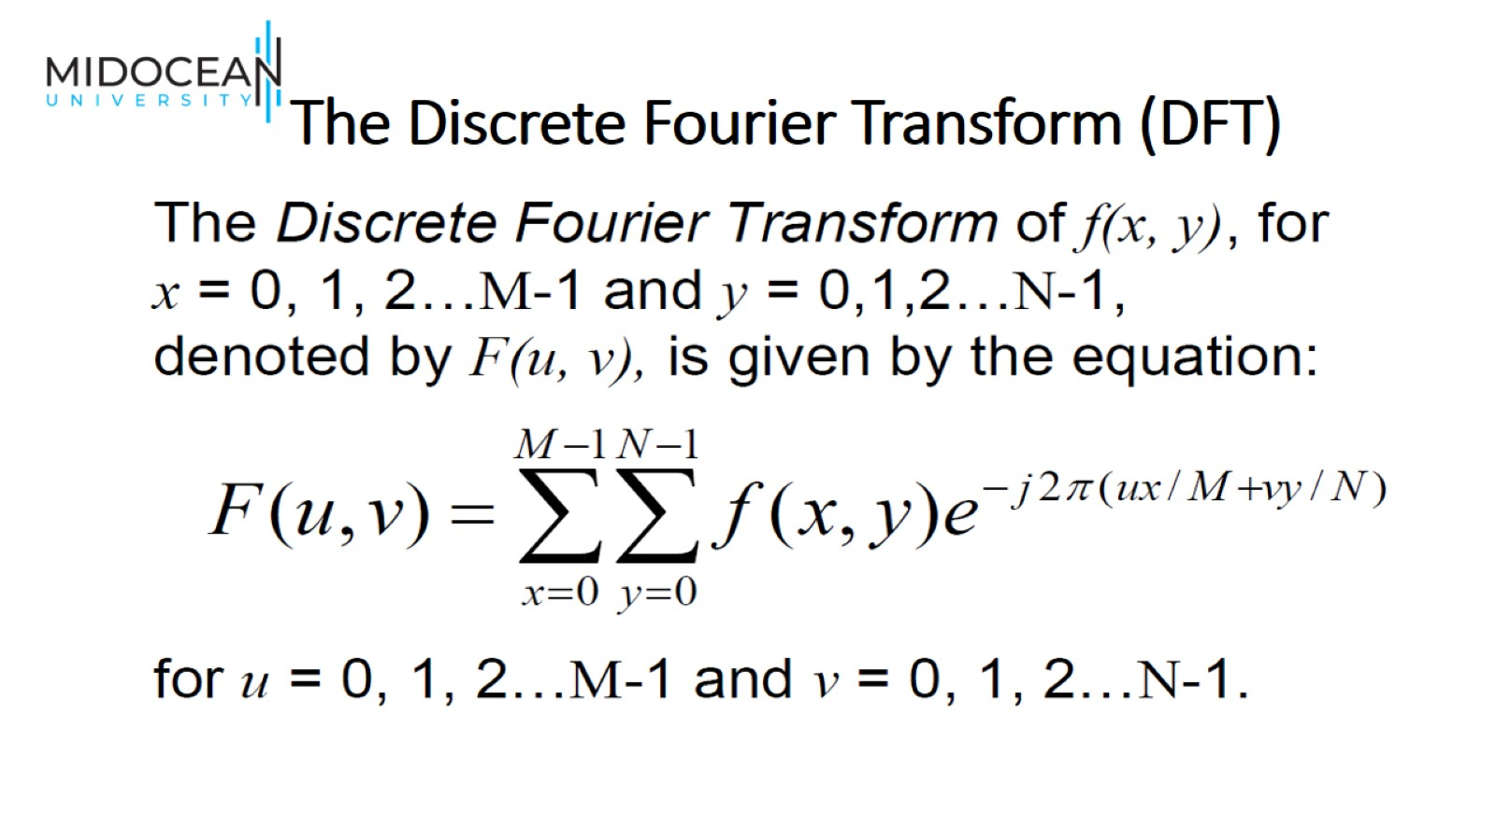
The Discrete Fourier Transform (DFT)

Slide 24
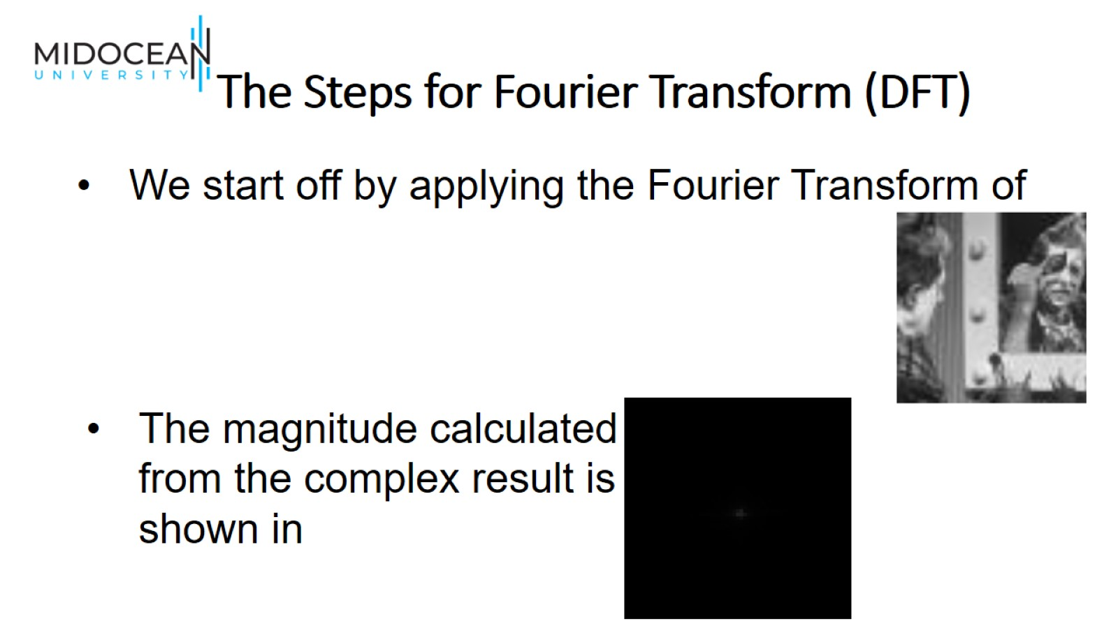
The Steps for Fourier Transform (DFT)

Slide 25
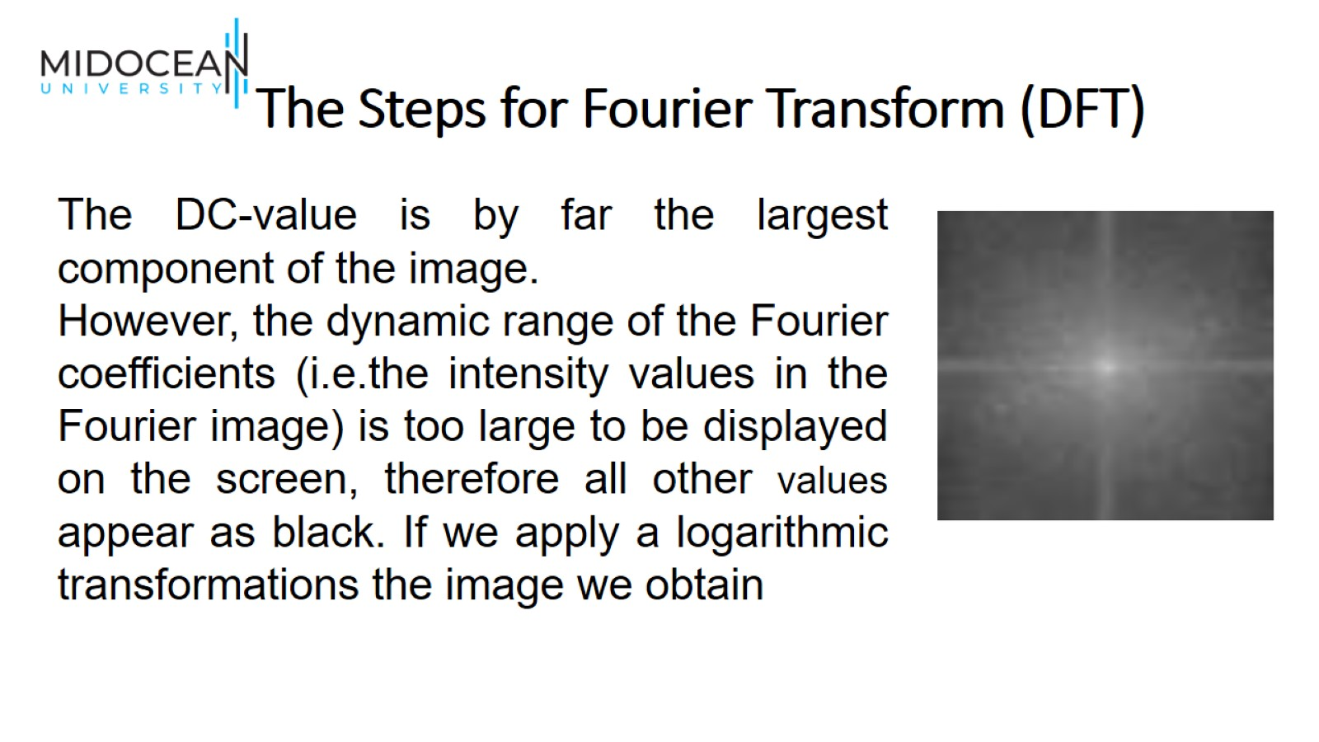
The Steps for Fourier Transform (DFT)

Slide 26
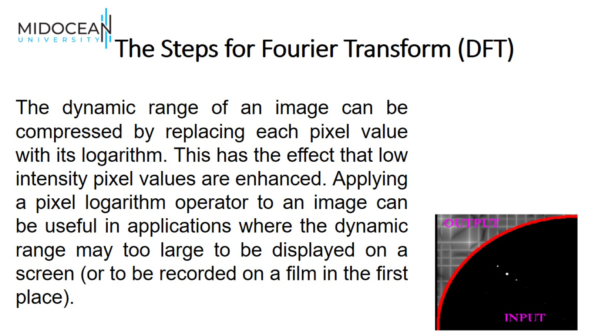
The Steps for Fourier Transform (DFT)

Slide 27
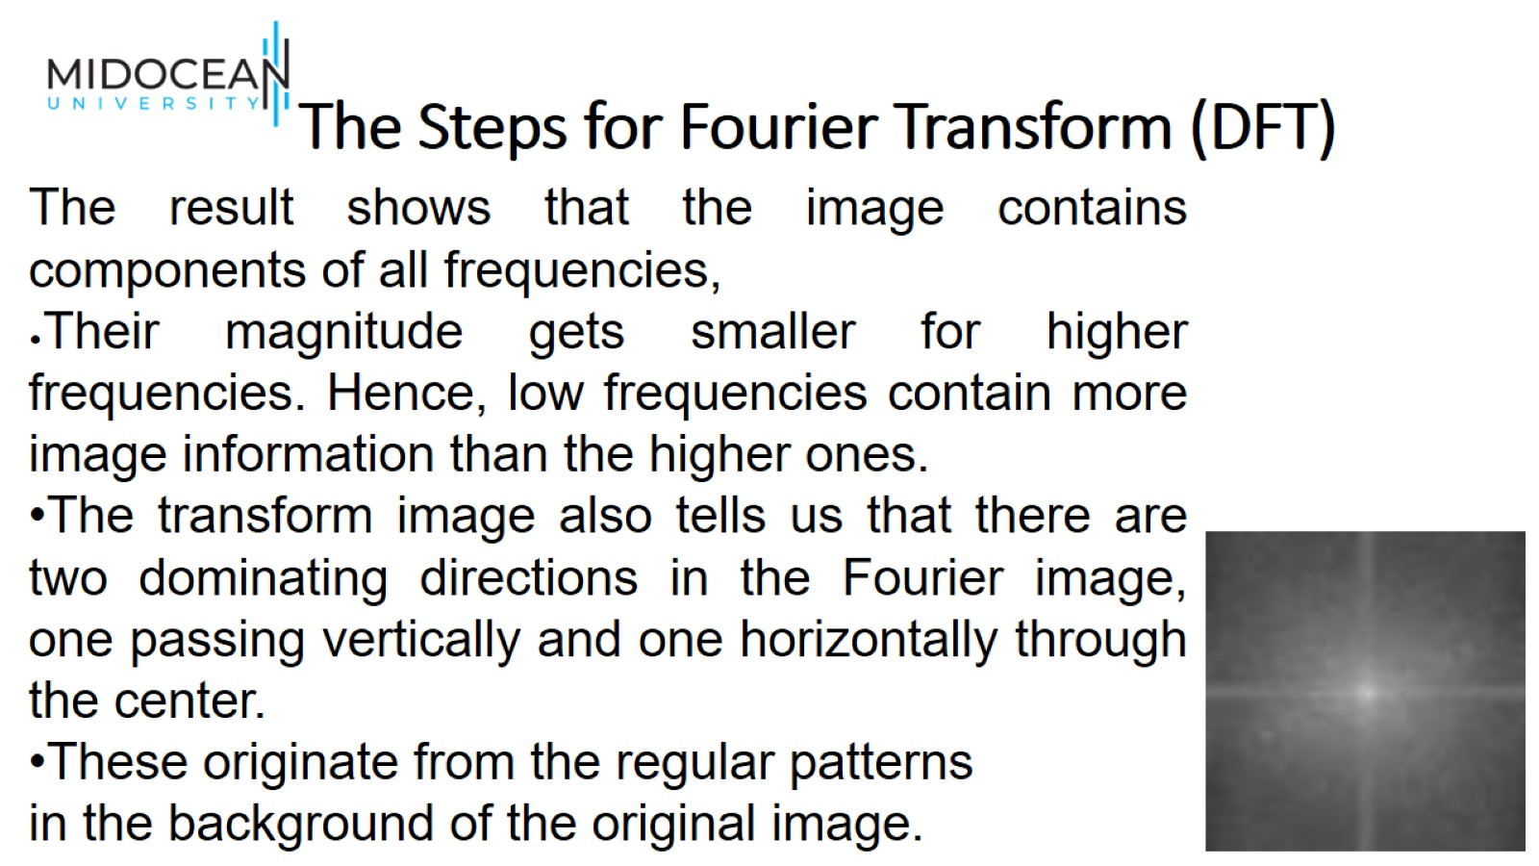
The Steps for Fourier Transform (DFT)

Slide 28
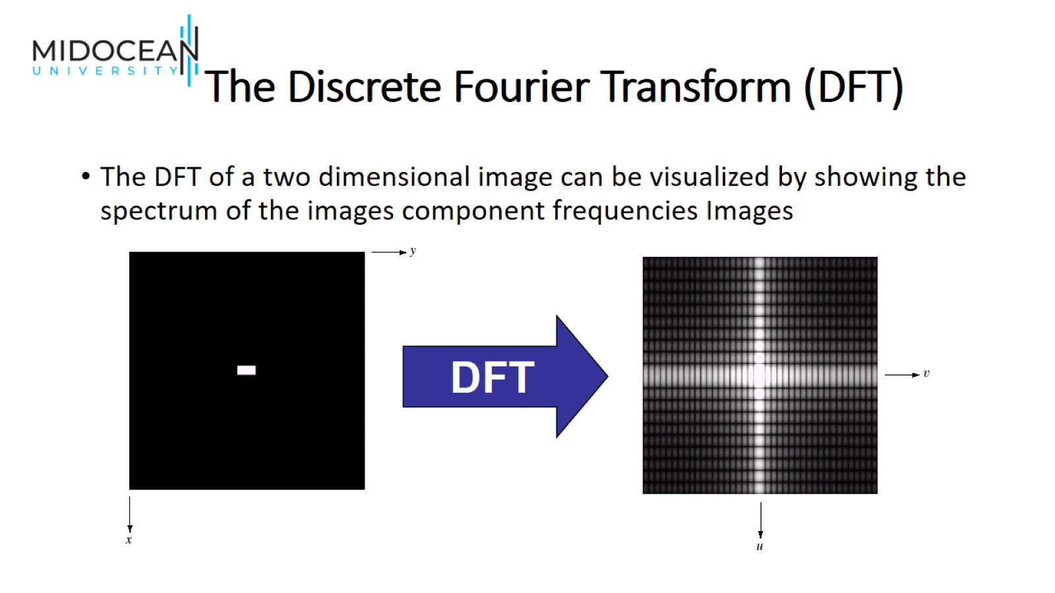
The Discrete Fourier Transform (DFT)

Slide 29
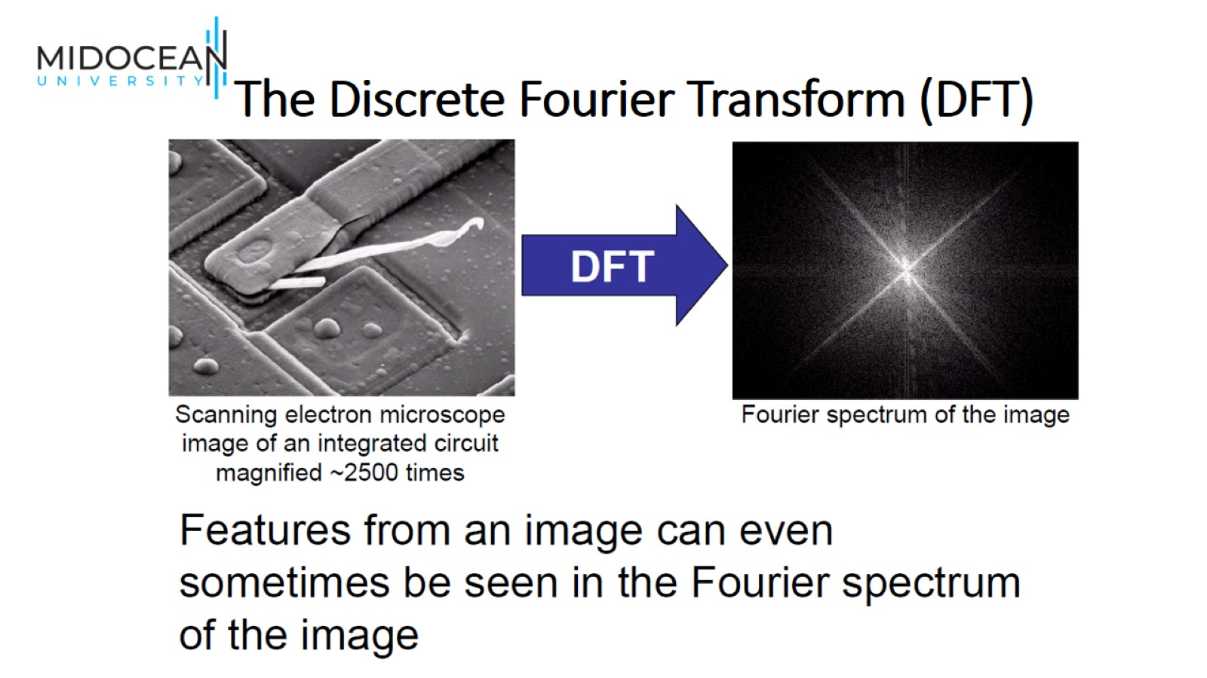
The Discrete Fourier Transform (DFT)

Slide 30
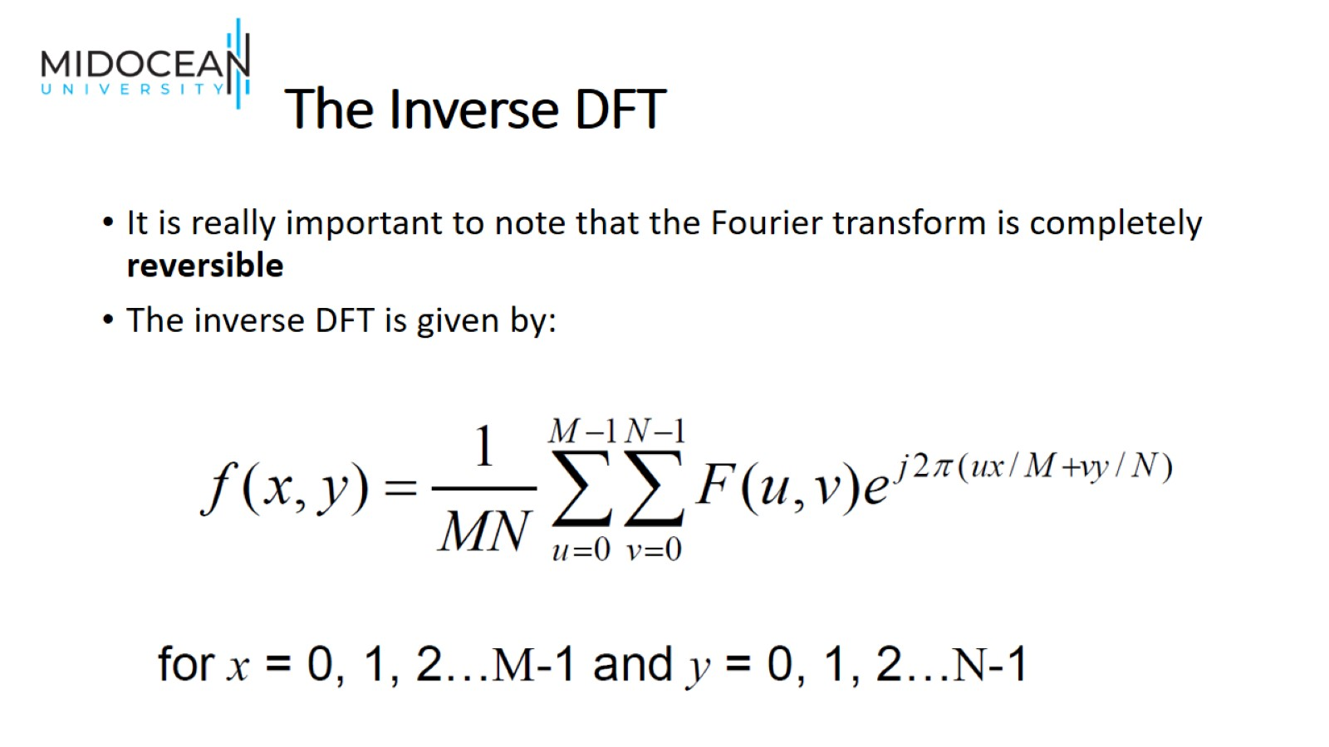
The Inverse DFT

Slide 31
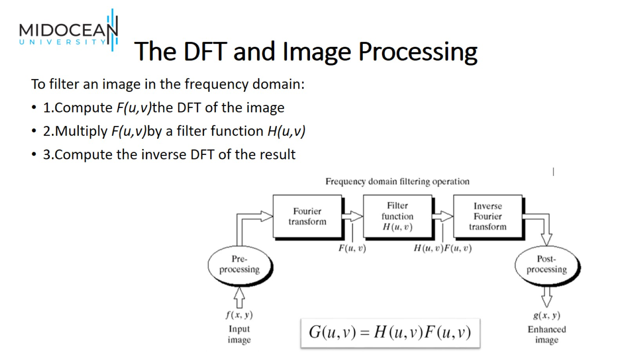
The DFT and Image Processing

Slide 32
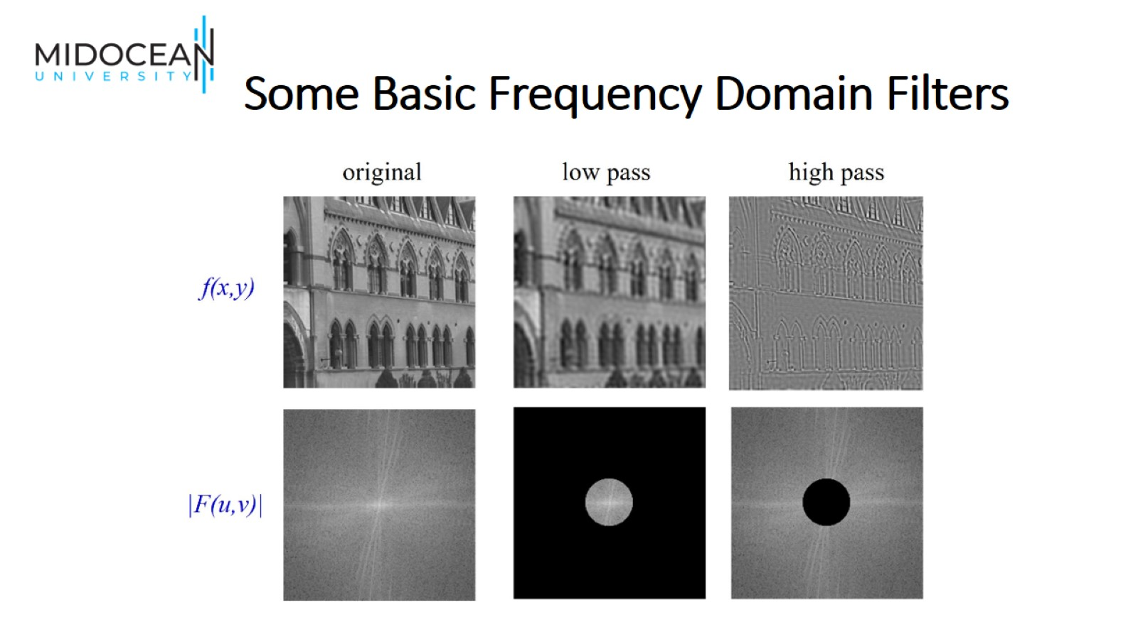
Some Basic Frequency Domain Filters

Slide 33
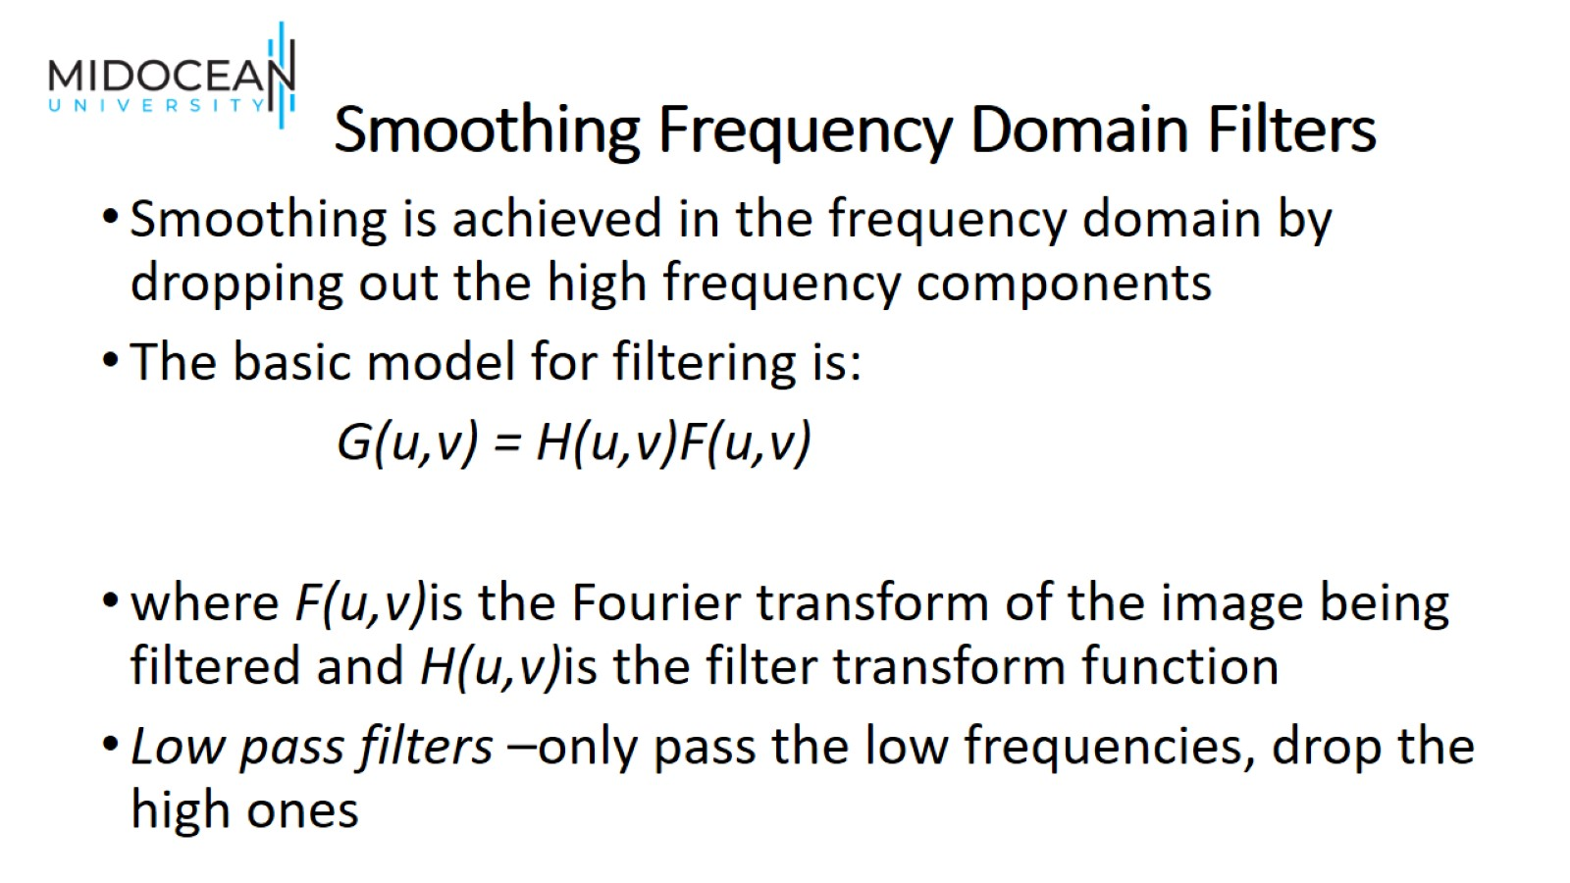
Smoothing Frequency Domain Filters

Slide 34
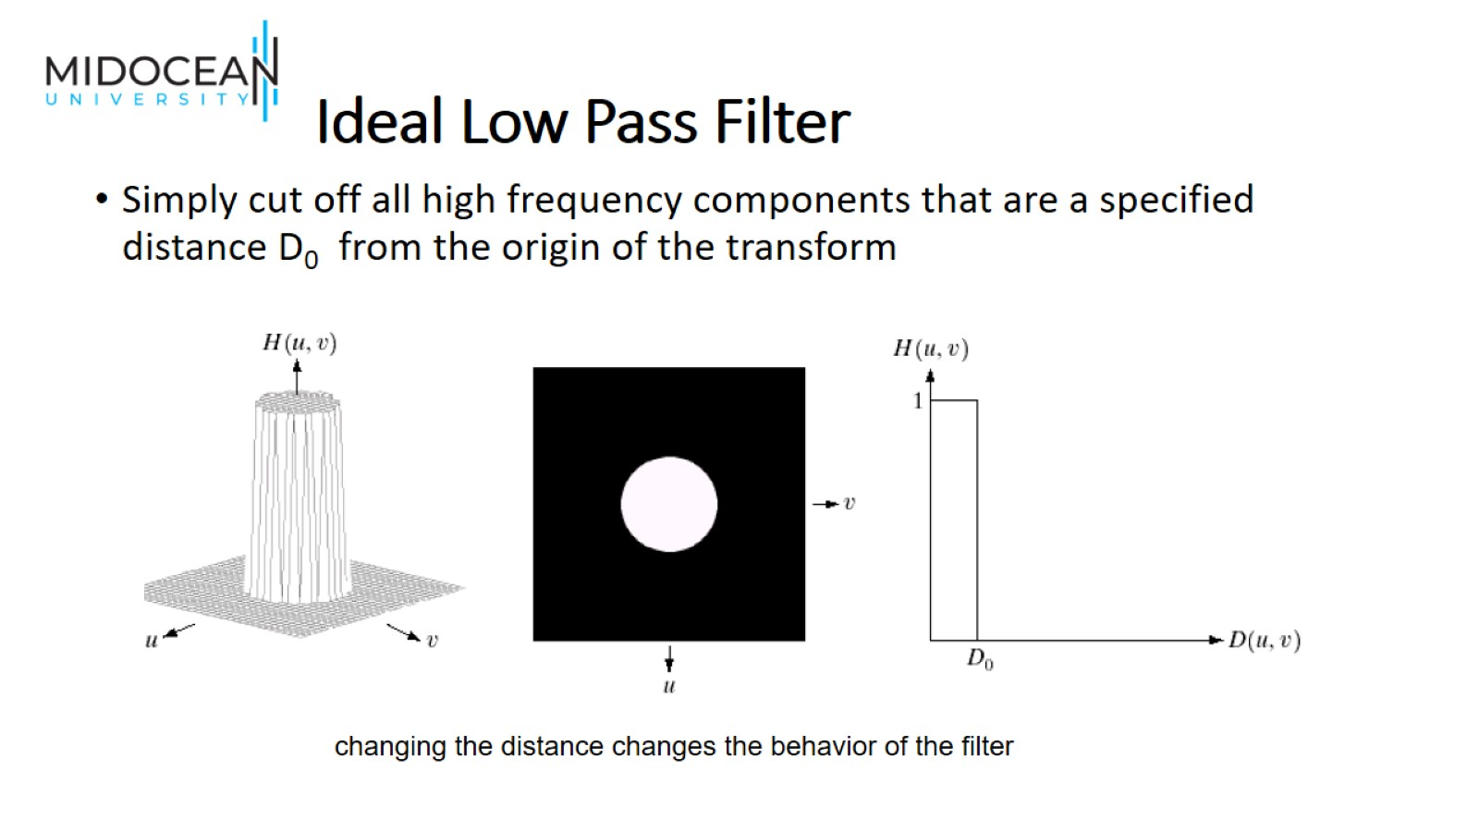
Ideal Low Pass Filter

Slide 35
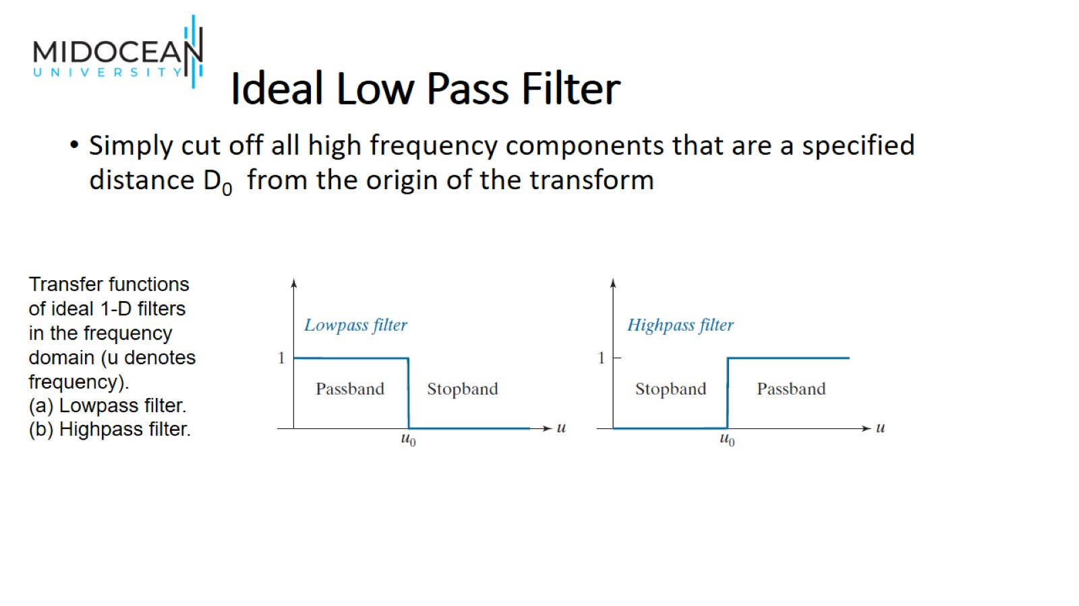
Ideal Low Pass Filter

Slide 36
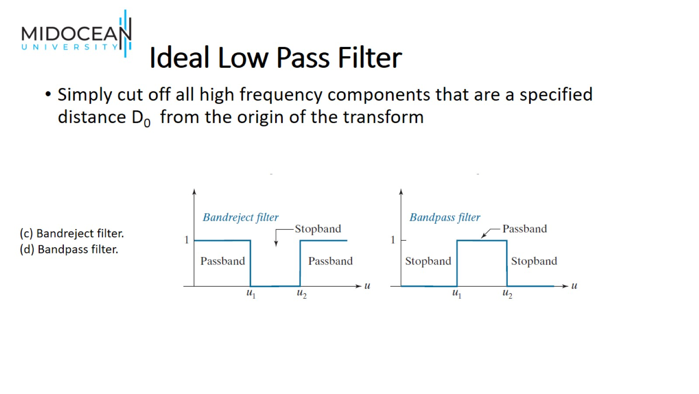
Ideal Low Pass Filter

Slide 37
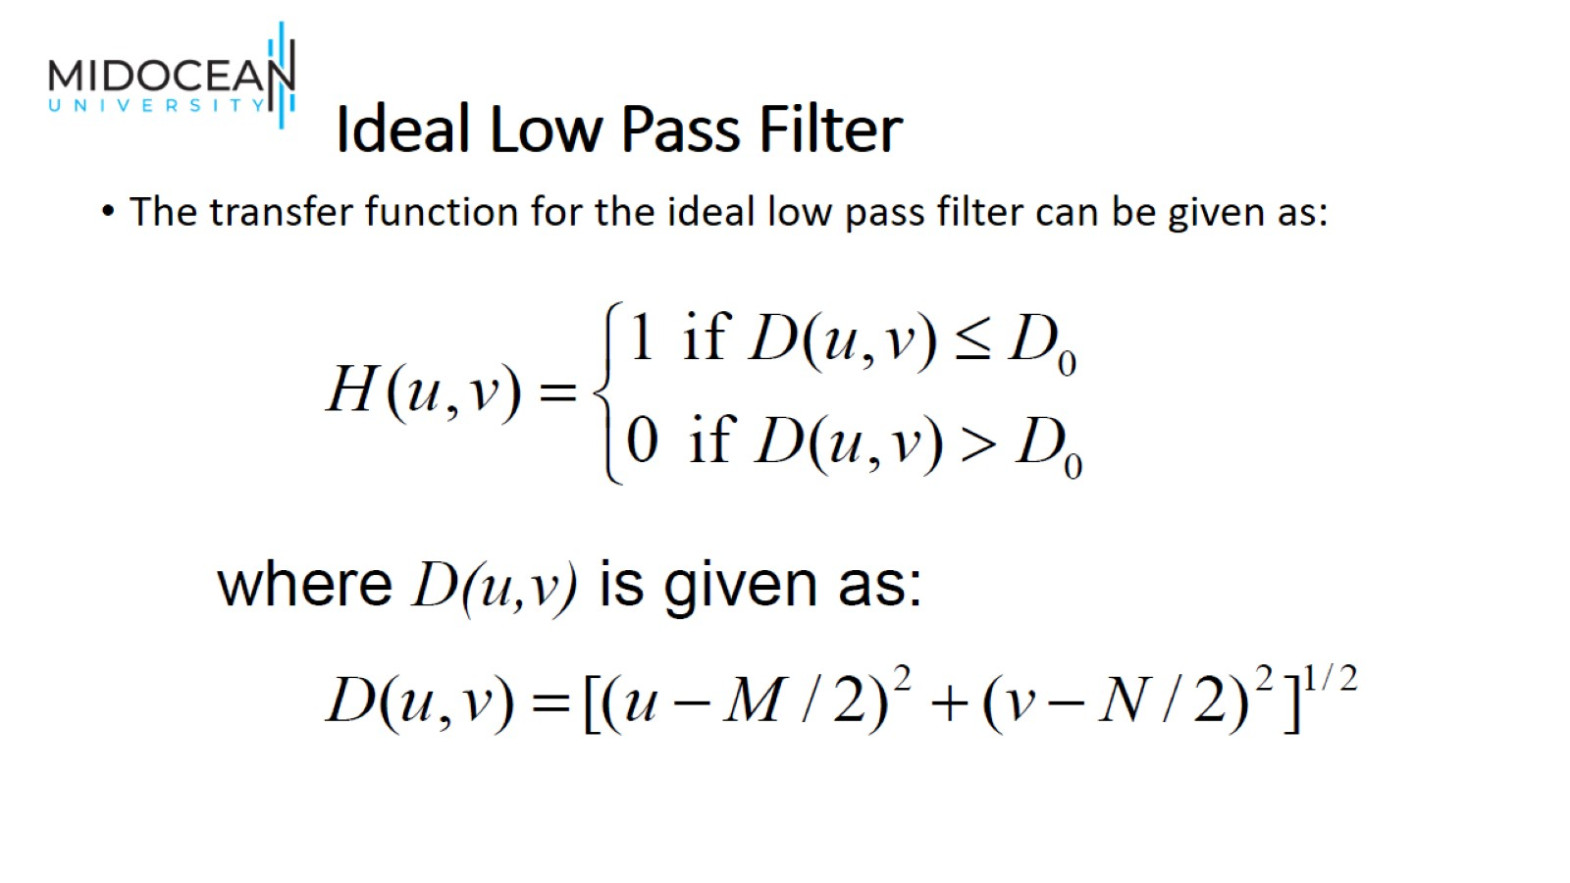
Ideal Low Pass Filter

Slide 38
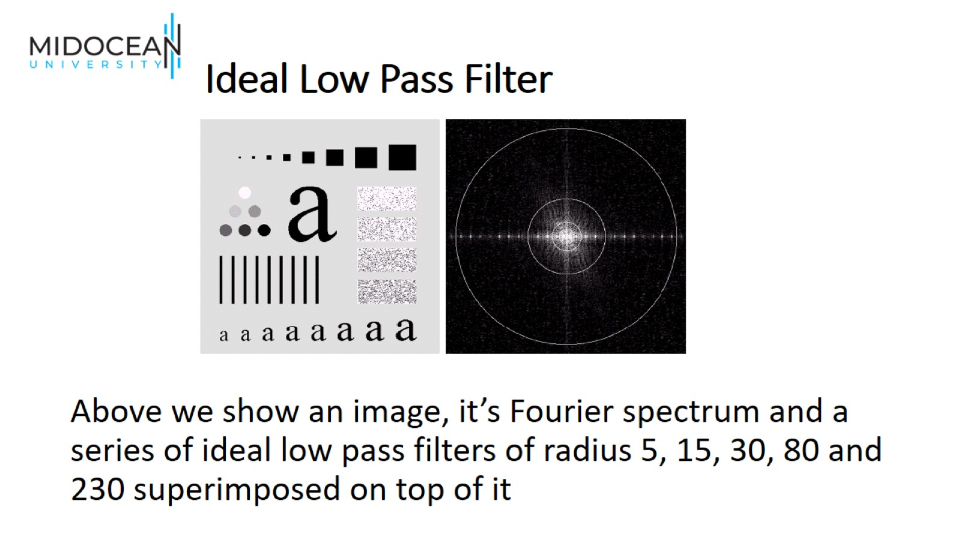
Ideal Low Pass Filter

Slide 39
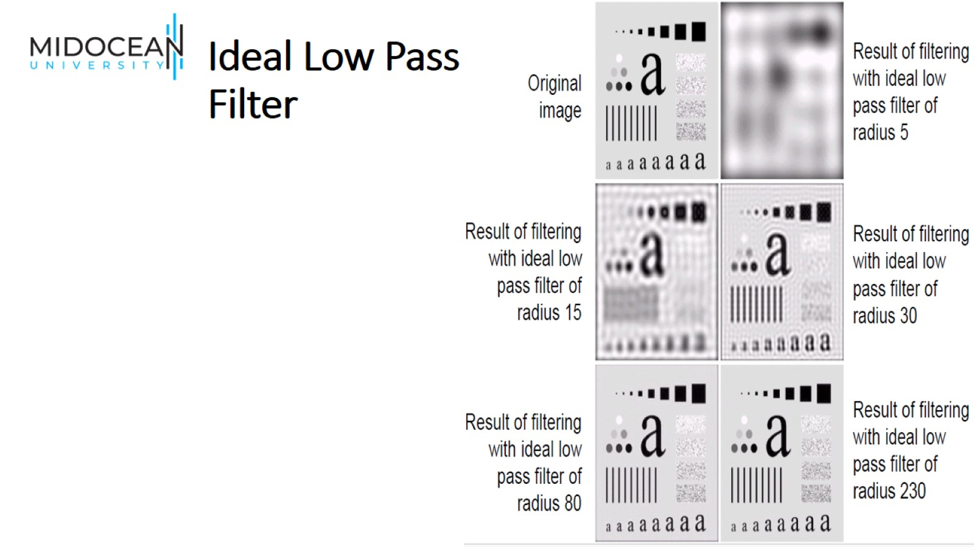
Ideal Low Pass Filter

Slide 40
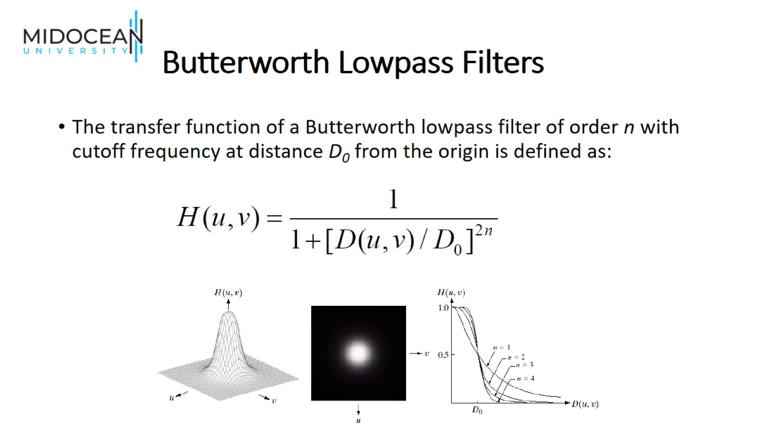
Butterworth Lowpass Filters

Slide 41
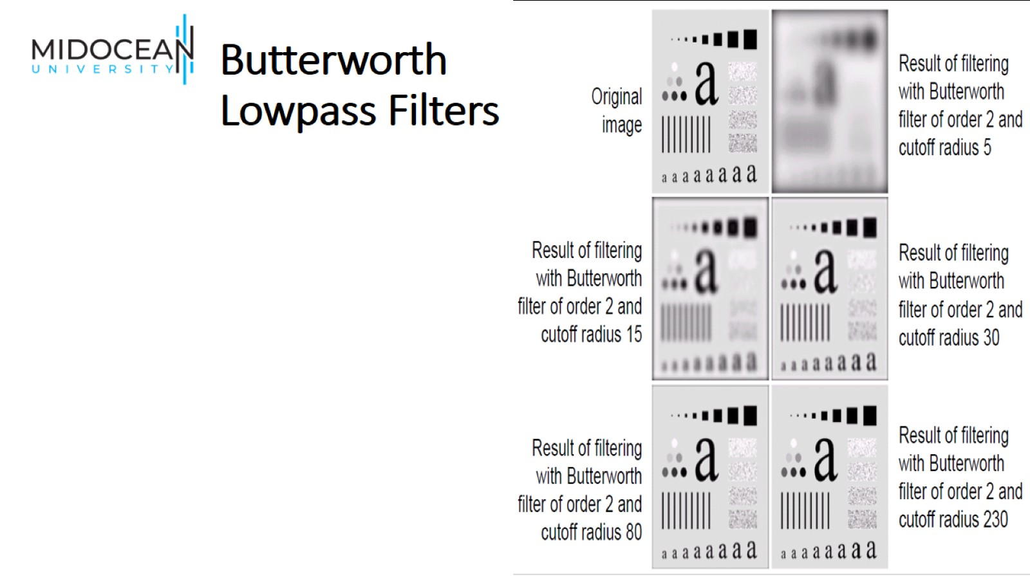
Butterworth Lowpass Filters

Slide 42
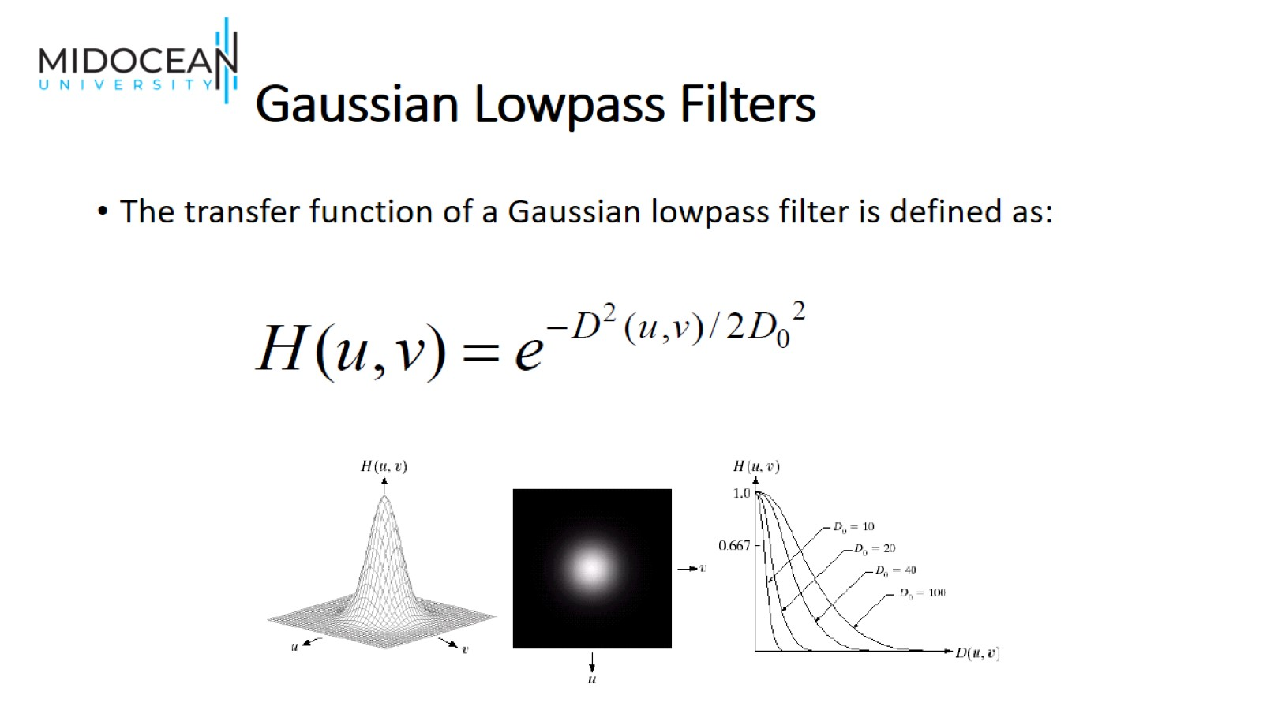
Gaussian Lowpass Filters

Slide 43
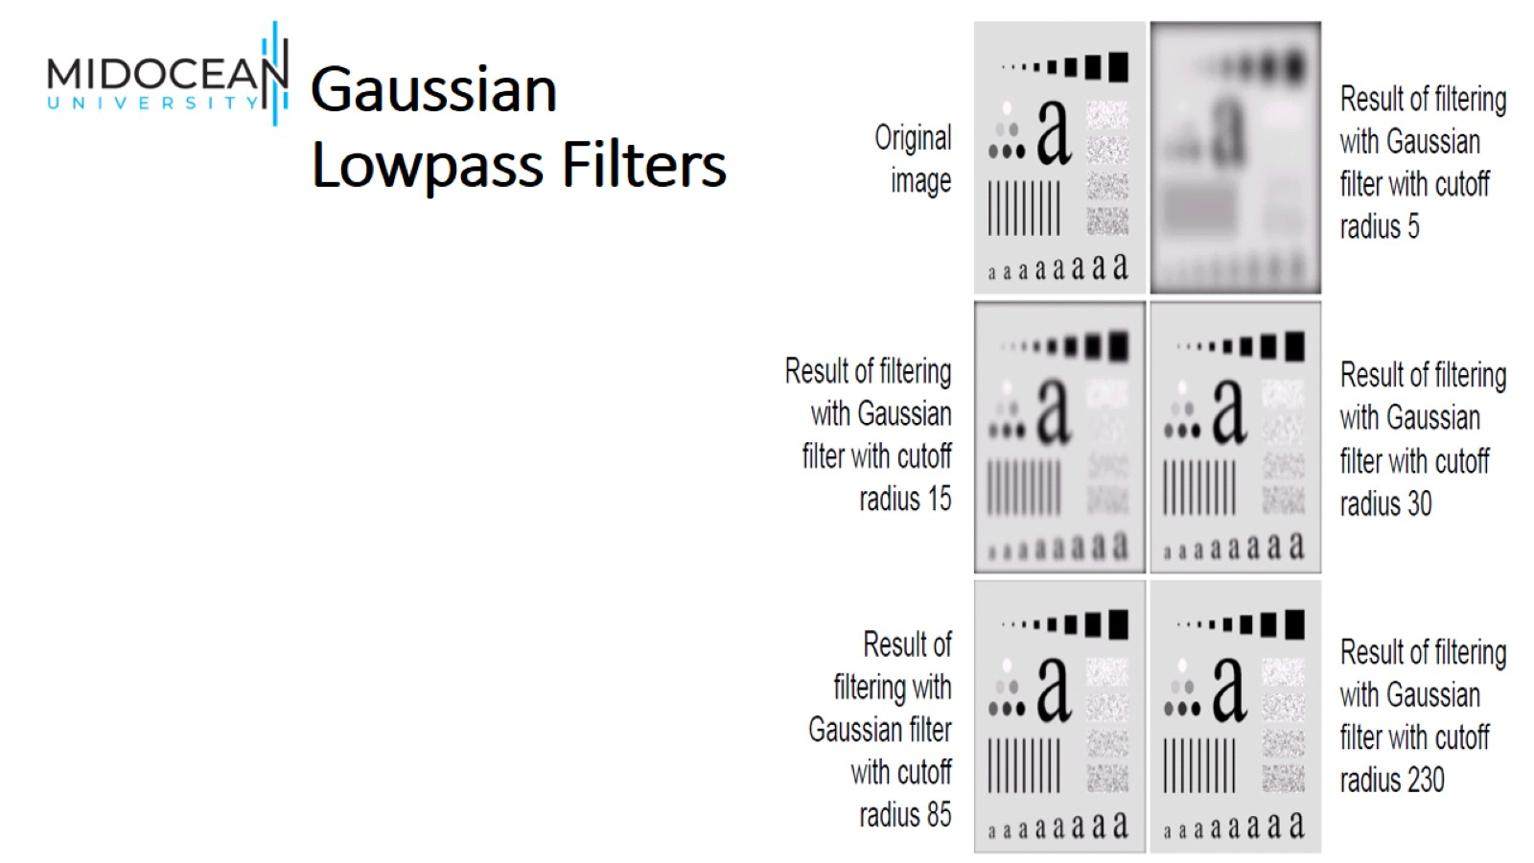
Gaussian Lowpass Filters

Slide 44
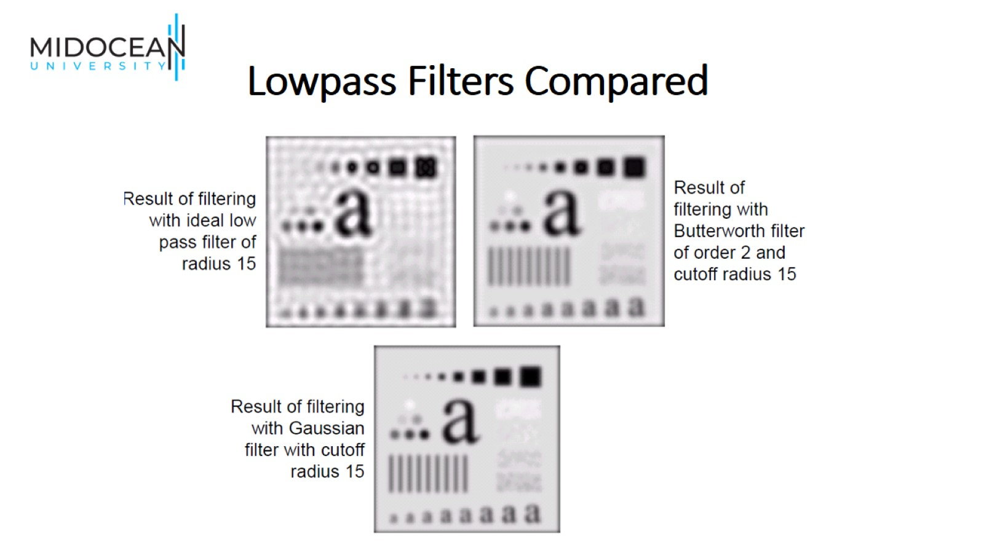
Lowpass Filters Compared

Slide 45
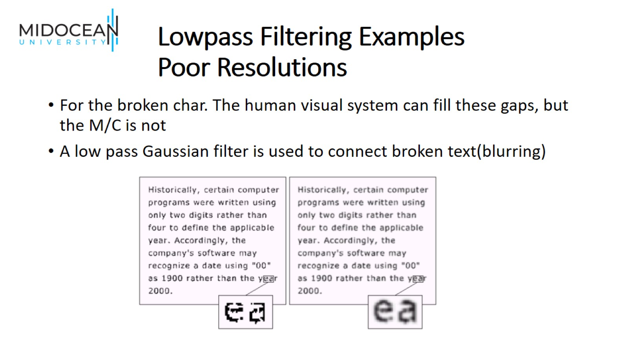
Lowpass Filtering Examples
Poor Resolutions

Slide 46
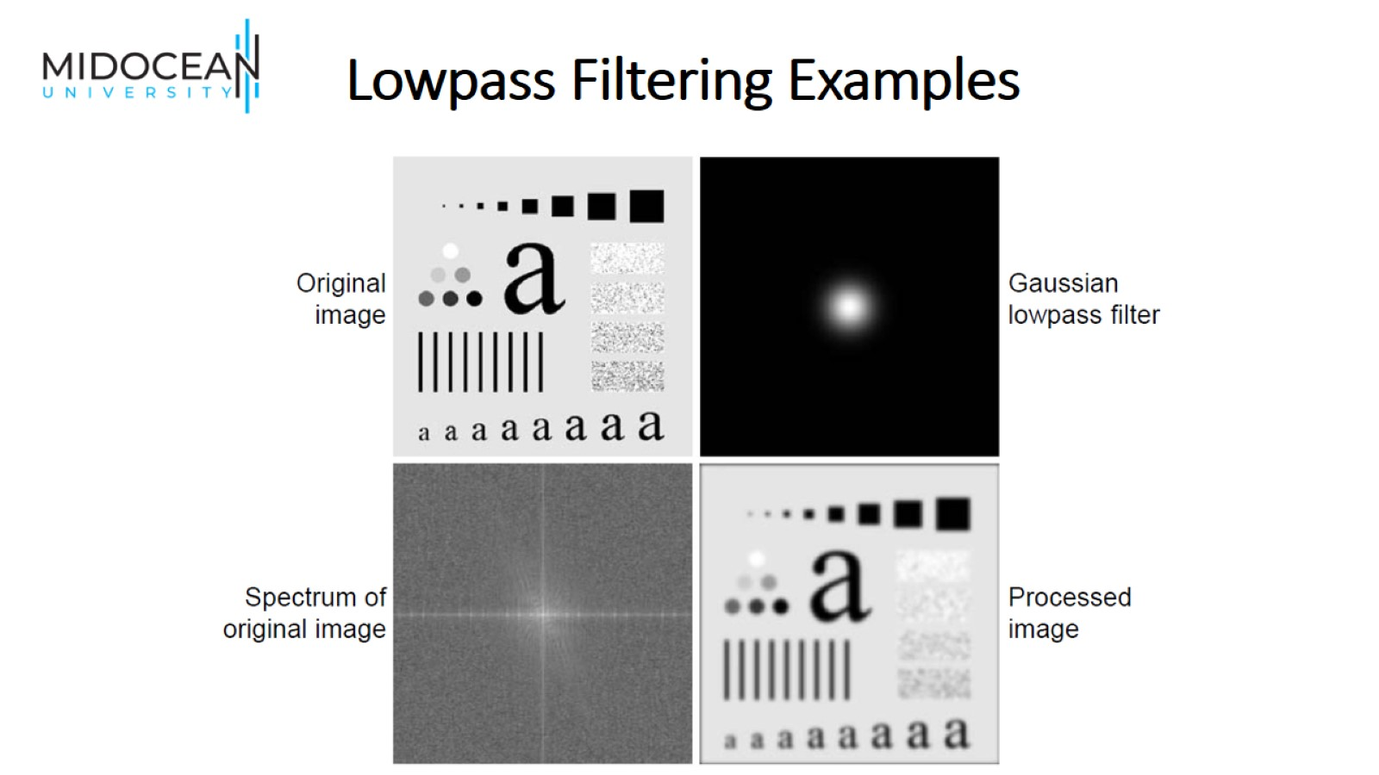
Lowpass Filtering Examples

Slide 47
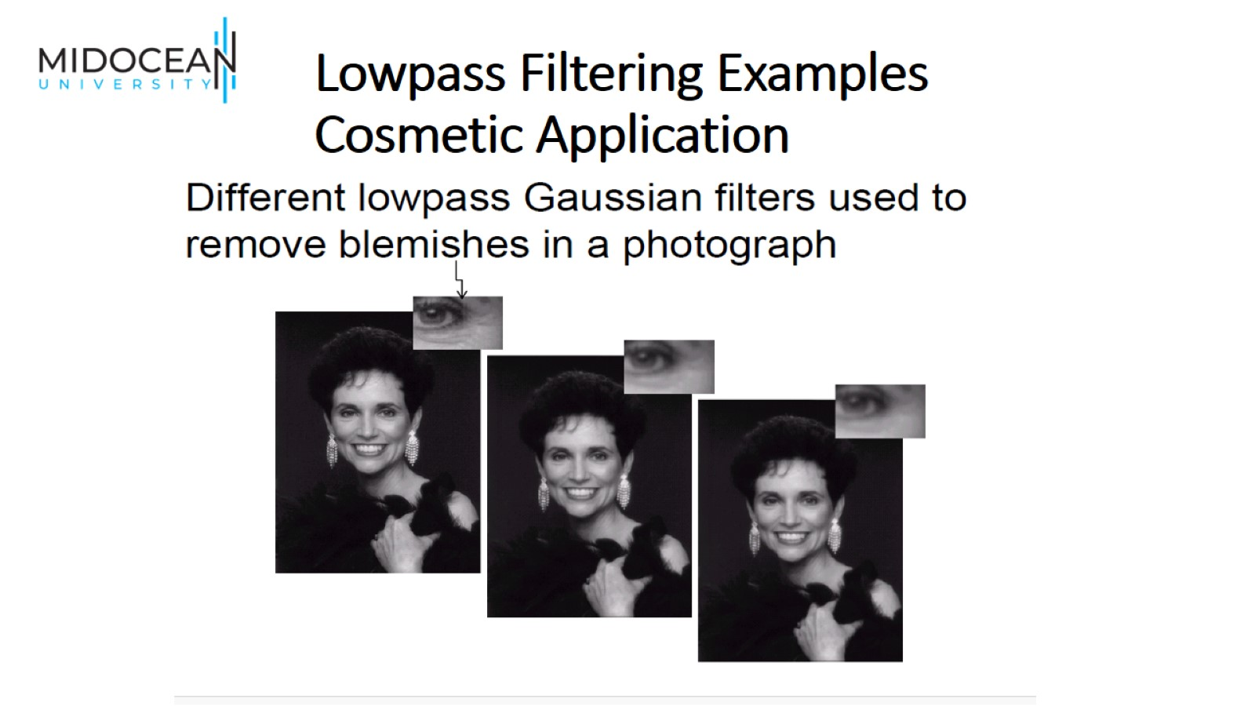
Lowpass Filtering Examples
Cosmetic Application

Slide 48


