Slide 1

Mathematics 1
Dr. Israa Lewaa
Orientation show
MAT112
First Trimaster 2023

Slide 2



Welcome
Welcome Back!
First Trimaster 2023
Mathematics, Dr. Israa Lewaa

Slide 3
Who Am I?
Dr. Israa Lewaa
  Lecturer in Statistics and Mathematics
    Ph.D from Faculty of Economics and Political Science, Cairo University, Statistics Department.
    Thesis: “Statistical data integration Using A latent Class Model”.
    M.Sc from Faculty of Economics and Political Science, Cairo University, Statistics Department.
    B.Sc from Faculty of Economics and Political Science, Cairo University, Statistics Department.
Mathematics, Dr. Israa Lewaa

Slide 4



Who Am I?
  How to reach me
    By email at israa@esu.ac.ae
    ( please include “Mathematics 1” in subject line)
  Office hours
  Discussion Time (Tuesday at 7:00 PM to 8:00 PM) every week
https://scholar.google.com.my/citations?user=3rS1w7UAAAAJ&hl=en
https://www.scopus.com/authid/detail.uri?authorId=57222739185
https://orcid.org/0000-0002-3471-9609
Mathematics, Dr. Israa Lewaa

Slide 5
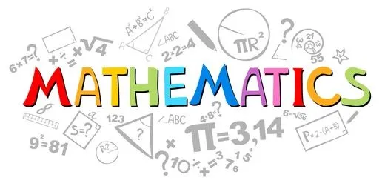
The course that will be taught
Mathematics 1
Mathematics, Dr. Israa Lewaa

Slide 6
Primary Goal of This Course
This course aims to:
  Provide students with concepts of
Function,
Continuity and limits,
Derivatives,
Integration,
Calculus by Python,
  and other Mathematical topics.
Mathematics, Dr. Israa Lewaa

Slide 7
Learning Resources:
Credit Hours:
3 credit hours.
  Required Textbook:
Introductory Mathematical Analysis/ Ernest Haeussler, Richard Paul and Richard Wood.
Doing Math with Python: Use Programming to Explore Algebra, Statistics, Calculus, and More!/ Amit Saha.
  Essential References:
Mathematics and Its Logics/Geoffrey Hellman, University of Minnesota
Mathematics, Dr. Israa Lewaa

Slide 8
What This Course is About
  The course will help students to
  Understand different types of functions and how to graph it ,
Compute limits, derivatives, and definite & indefinite integrals of algebraic, logarithmic and exponential functions,
Analyze functions and their graphs as informed by limits and derivatives, and
Solve applied problems using differentiation and integration.
Determine the continuity and differentiability of a function at a point and on a set;
Use the derivative of a function to determine the properties of the graph of the function and use the graph of a function to estimate its derivative;
Use appropriate modern technology to explore calculus concepts.
Mathematics, Dr. Israa Lewaa

Slide 9
Units of Course Contents
  Lecture Structure:
Module | Course Unit | No.of. Weeks | Contact Hours
1 | Lecture_1_Functions and Graphs | 1st | 3
2 | Lecture_2_Exponential Functions | 2nd | 3
3 | Lecture_3_Limits and Continuity | 3 | 3
4 | Lecture_4_Convergence Tests and Tylor Series | 4 | 3
5 | Lecture_5_Differentiation | 5 | 3
6 | Lecture_6_Additional Differentiation Topics | 6 | 3
7 | Lecture_7_Integration | 7 | 3
8 | Lecture_8_Methods and Applications of Integration | 8 | 3
9 | Lecture_9_Multivariable Calculus | 9 | 3
10 | Lecture_10_Calculus by Python | 10 | 3
Mathematics, Dr. Israa Lewaa

Slide 10
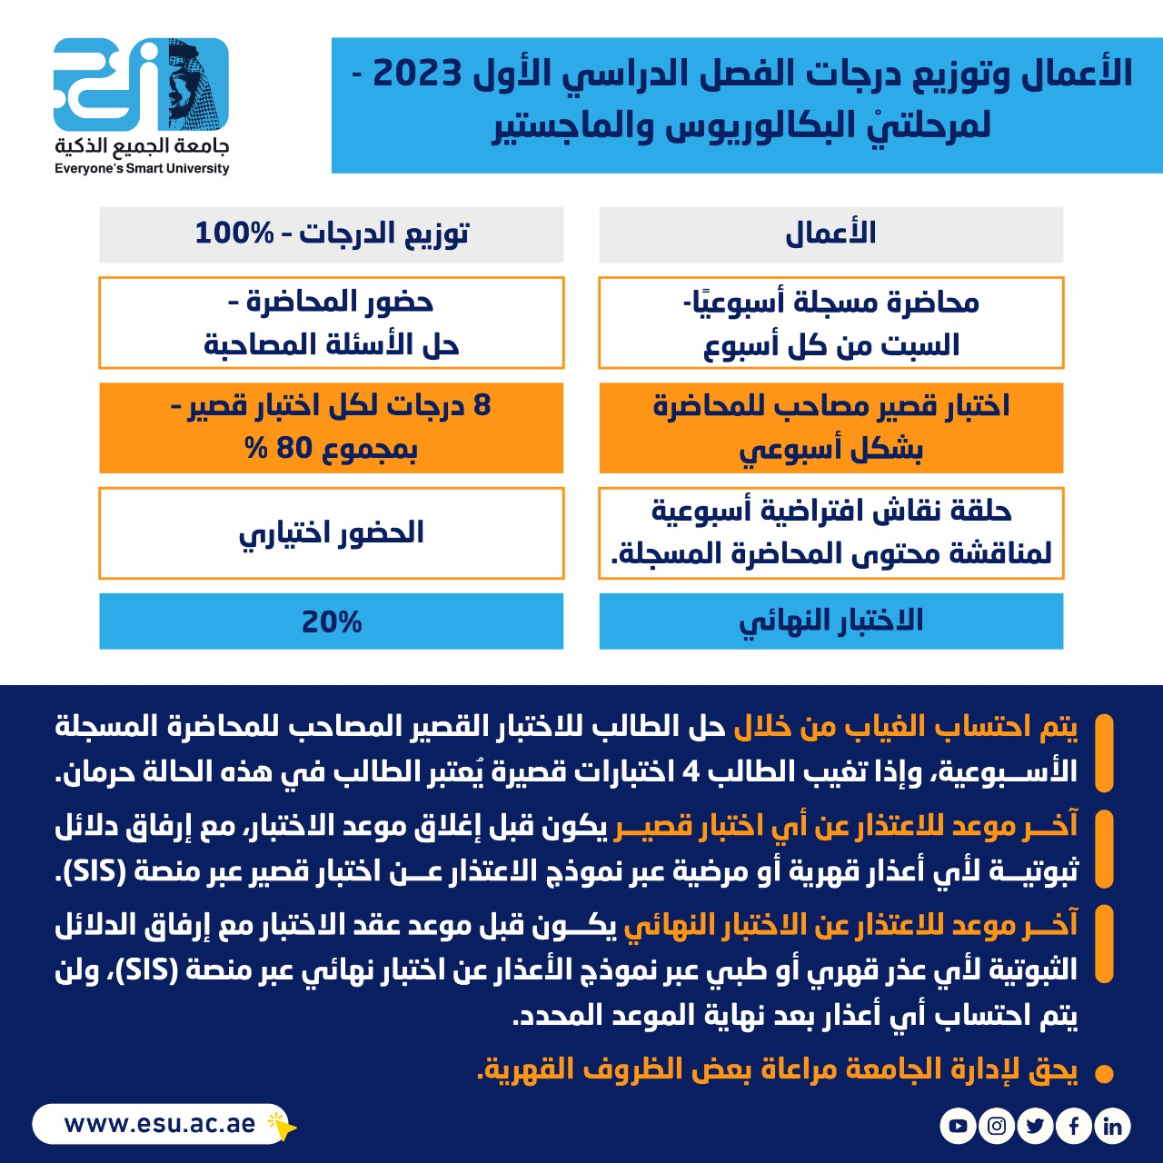
Course Information
  Assessment Method:
اعمال الفصل الدراسي
الأول 2023
Mathematics, Dr. Israa Lewaa

Slide 11
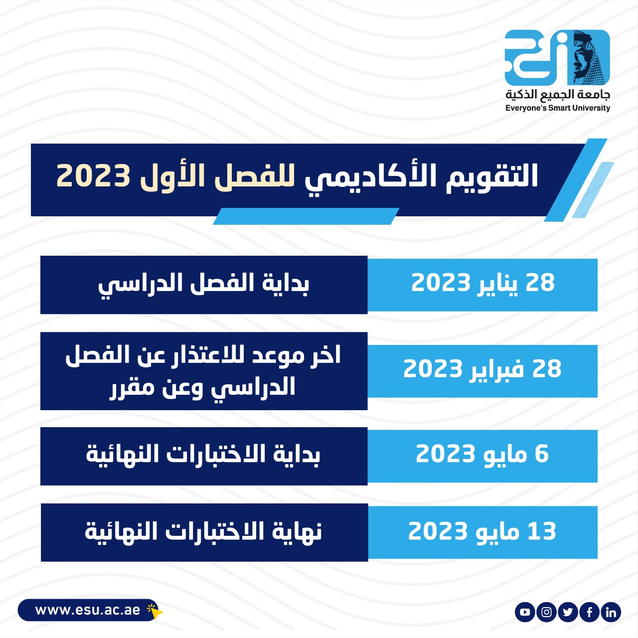
Academic Calendar
First Trimaster 2023 Academic
Calendar
Everyone's smart university
Mathematics, Dr. Israa Lewaa

Slide 12
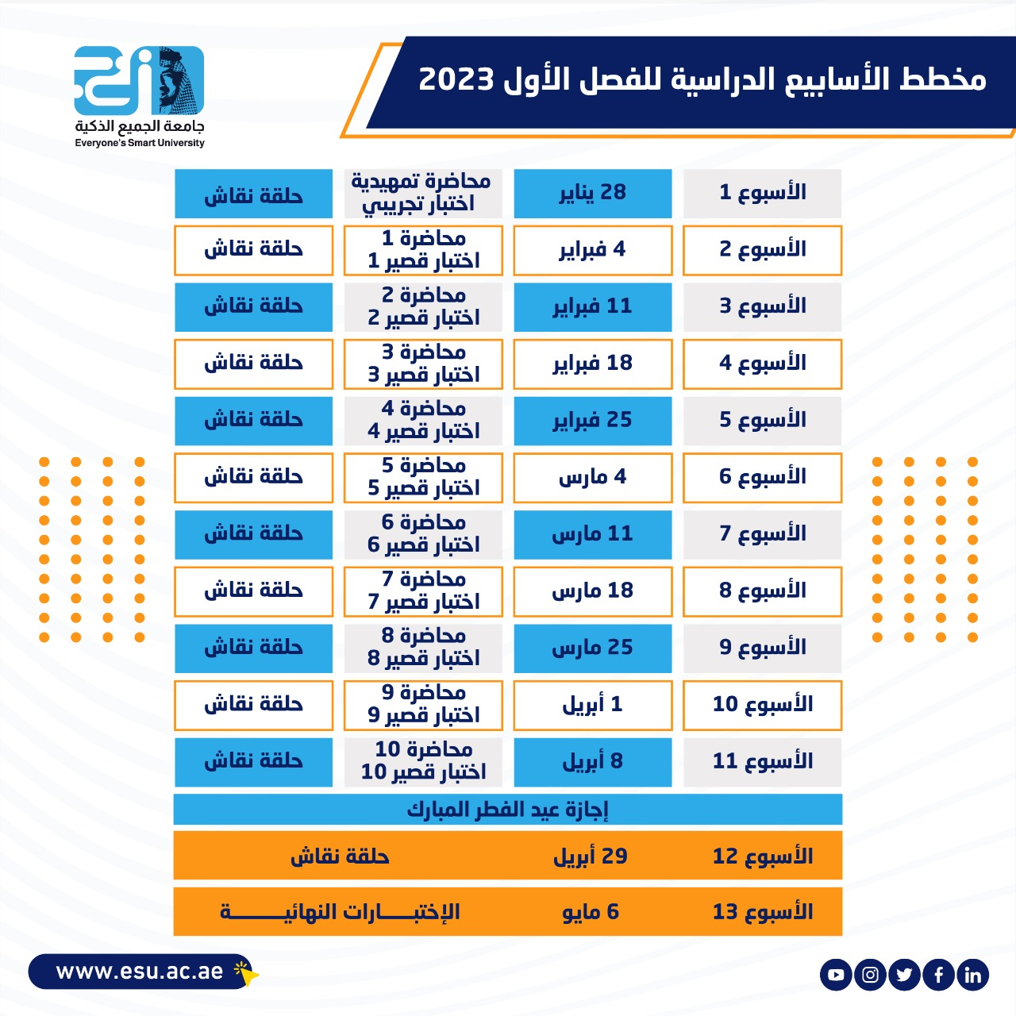
Academic Calendar
مخطط الأسابيع الدراسية
Mathematics, Dr. Israa Lewaa

Slide 13
Academic Calendar
عبر برنامج ZOOM
سيتم تثبيت رابط حلقة النقاش على صفحة المقرر
حلقة النقاش يوم الثلاثاء من كل أسبوع من الساعة 7 إلى الساعة 8
Mathematics, Dr. Israa Lewaa

Slide 14
Academic Calendar
-- اللغة الأساسية في المحاضرات هي:
اللغة الإنجليزية
-- الاختبارات باللغة الإنجليزية مع وجود
ترجمة للسؤال.
Mathematics, Dr. Israa Lewaa

Slide 15


