Slide 1

Writing in Organizations
Prepared by Dr. Adam Yagoub
Lecture 9
MGM 202
Writing Successful Proposals

Slide 2
Lecture 1
Lecture 9
Key Learning Points
Lecture Outline
Lecture 1: Getting Started: Writing and Your Career.
Lecture 2: The Writing Process and Collaboration at Work.
Lecture 3: Writing Routine Business Correspondence.
Lecture 4: Writing Letters: Some Basics for Communicating with Audiences Worldwide.
Lecture 5: How to Get a Job: Searches, Dossiers, Portfolios, Résumés, Letters, and Interviews.
Lecture 6: Designing Successful Documents, Visuals, and Websites.
Lecture 7: Writing Instructions and Procedures.
Lecture 8: Writing Effective Short Reports.
Lecture 9: Writing Proposals.
Lecture 10: Writing Careful Long Reports.

Slide 3

Lecture 1
Lecture 9
Key Learning Points
Lecture Outline
1- Writing Successful Proposals.
2- Internal Proposals.
3- Sales Proposals.
4- Short Reports and Proposals: Some Final Words.

Slide 4
Lecture 9
Writing Successful Proposals
1- Writing Successful Proposals:
A proposal is a detailed plan of action submitted to a reader or group of readers for approval. The readers are usually in a position of authority—supervisors, managers, department heads, company buyers, boards of private foundations, elected officials, military or civic leaders—to endorse or reject the plan. Your proposal must convince these readers that your plan will help them improve their business, save them money, enhance their image, improve customer satisfaction, make the environment safer, or all of these.

Slide 5
Lecture 9
Writing Successful Proposals
Proposals are written for many purposes and many different audiences. You can write an internal proposal, for example, to your boss, seeking authorization to hire staff, change a procedure, or purchase a new piece of equipment. Or you can write a sales proposal to potential customers, offering a product or a service (such as providing training with new, special firefighting gear or selling an office manager a line of ergonomically designed furniture).

Slide 6
Lecture 9
Writing Successful Proposals
Depending on the job, proposals can vary greatly in size and in scope. A formal proposal can be a very long and complex document running into hundreds of pages. A proposal to your employer, however, about redesigning the company website could easily be conveyed in a few pages, the length of a short report. To propose doing a small job for a prospective client—for example, redecorating a waiting room in an accountant’s office—a letter with information on costs, materials, and a timetable might suffice.

Slide 7
Lecture 9
Writing Successful Proposals
- Proposals Are Persuasive Plans
Proposals, whether large or small, must be highly persuasive to succeed. Without your audience’s approval, your plan will never go into effect, however accurate and important you think it is. Your enthusiasm is not enough to persuade readers; you have to supply hard evidence. Your proposals must convince readers that your plan is relevant, practical, based upon careful research, and designed to benefit the reader and his or her company.

Slide 8
Lecture 9
Writing Successful Proposals
- Proposals Frequently Are Collaborative Efforts
Like many other examples of business and technical writing, proposals often are the product of teamwork. Even a short in-house proposal is often researched and put together by more than one individual in the company or agency, as Figure 8.8 illustrates.
Many times, individual employees will pull together information from their separate areas (such as graphics and design, finance, marketing, technology, transportation, and even legal) and put it into a proposal that each member of the team then reads and revises until the team agrees that the document is ready to be released.

Slide 9
Lecture 9
Writing Successful Proposals
- Guidelines for Writing a Successful Proposal
The following guidelines will help you to persuade your audience to approve your plan. Refer to these guidelines both before and while you formulate your plan.
1. Approach writing a proposal as a problem-solving activity.
2. Regard your audience as skeptical.
3. Research your proposal topic thoroughly.

Slide 10
Lecture 9
Writing Successful Proposals
4. Scout out what your competitors are doing.
5. Prove that your proposal is workable.
6. Be sure your proposal is financially realistic.
7. Package your proposal attractively.

Slide 11
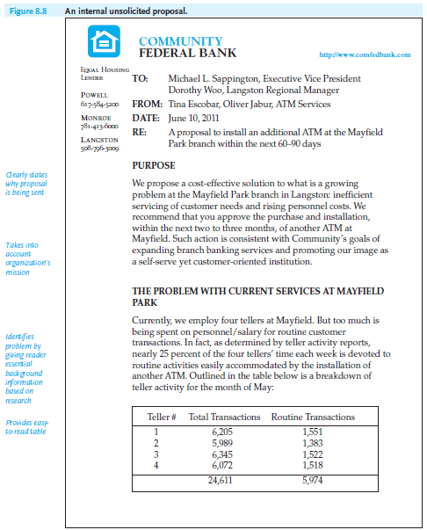
Lecture 9
Writing Successful Proposals
2- Internal Proposals:
The primary purpose of an internal proposal, such as the one shown in Figure 8.8, is to offer a realistic and constructive plan to help your company run its business more efficiently and economically.

Slide 12
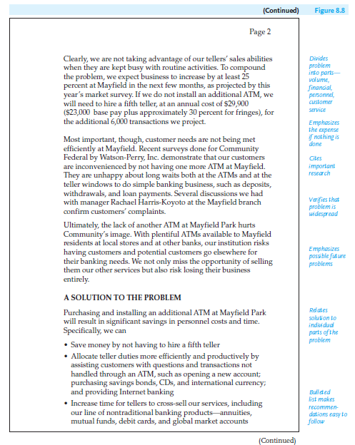
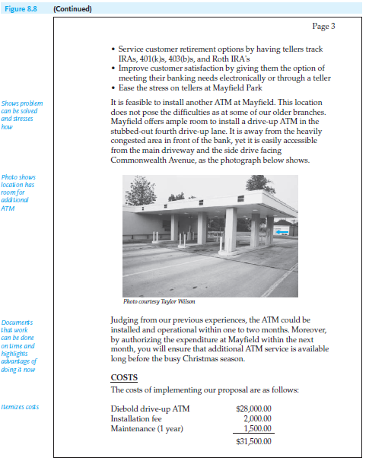
Lecture 9
Writing Successful Proposals

Slide 13
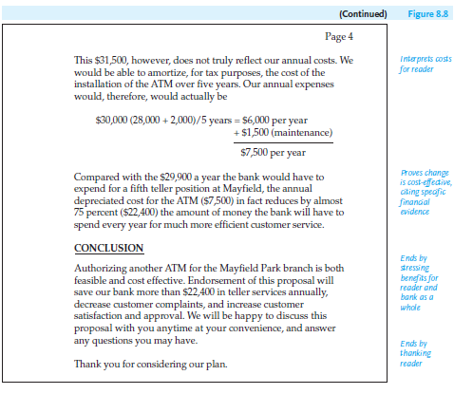
Lecture 9
Writing Successful Proposals

Slide 14
Lecture 9
Writing Successful Proposals
On your job you may discover a better way of doing something or a more efficient way to correct a problem. You believe that your proposed change will save your employer time, money, or further trouble.
Regardless of who identifies the problem, your proposal, generally speaking, will be an informal, in-house message. A brief (one to three-page) memo, as in Figure 8.8, or even a shorter e-mail, should be appropriate.

Slide 15
Lecture 9
Writing Successful Proposals
- Some Common Topics for Internal Proposals
An internal proposal can be written about a variety of topics, including the following:
■ purchasing new or more advanced equipment to replace obsolete or inefficient computers, appliances, vehicles, and the like, or upgrading equipment technology
■ obtaining document security software and offering training sessions to show employees how to use it
■ recruiting new employees or retraining current ones on a new technique or process

Slide 16
Lecture 9
Writing Successful Proposals
■ eliminating a dangerous condition or reducing an environmental risk to prevent accidents—for employees, customers, or the community at large
■ cutting costs—for services, transportation, advertising, etc.
■ improving technology/communication within or between departments of a company or agency
■ expanding work space or making it greener, more private, ergonomically beneficial to employees, or more inviting to customers

Slide 17
Lecture 9
Writing Successful Proposals
- Following the Proper Chain of Command
Writing an internal proposal requires you to be sensitive to office politics. It may be wise first to meet with your boss to see if she or he has already identified the problem or has specific suggestions on how to solve it. If given the go-ahead, then you and your team can provide your boss with a draft and ask for revisions or feedback.

Slide 18
Lecture 9
Writing Successful Proposals
- Ethically Identifying and Resolving Readers’ Problems
When you prepare an internal proposal, do not lose sight of the ethical obligations you have and the ways to meet them. Here are three important guidelines:
1. Consider the implications of your plan company-wide. The change you propose (transfers, new schedules or technology, new hires) may have sweeping and potentially disruptive implications in another division of your company.

Slide 19
Lecture 9
Writing Successful Proposals
2. Keep in mind what impact your change may have for co-workers from cultural traditions other than your own. In addition to speaking with your boss, it would be wise, maybe even mandatory, to consult your human resources director.
3. Never submit an internal proposal that offers an idea that you think will work but relies on someone else to supply the specific details on how and when it will work.

Slide 20
Lecture 9
Writing Successful Proposals
- Organizing Internal Proposals
A short internal proposal can follow a relatively straightforward plan of organization, from identifying the problem to solving it. Internal proposals usually contain four parts, as shown in Figure 8.8: purpose, problem, solution, and conclusion. Refer to this figure as you read the following discussion.

Slide 21
Lecture 9
Writing Successful Proposals
A - The Purpose
Begin your proposal with a brief statement of why you are writing to your supervisor: “I propose that . . .” State right away why you think a specific change is necessary now. Then, succinctly define the problem and emphasize that your plan, if approved by the reader, will solve that problem.
B - The Problem
Prove that a problem exists. Document its importance for your boss and your company; as a matter of fact, the more you show, with concrete evidence, how the problem affects the boss’s work (and area of supervision), the more likely you are to persuade him or her to act.

Slide 22
Lecture 9
Writing Successful Proposals
- Here are some guidelines for documenting a problem.
■ Avoid vague (and unsupported) generalizations.
■ Provide quantifiable details about the problem.
■ Indicate how many employees (or work hours) are involved or how many customers are inconvenienced or endangered by a procedure or condition.
■ Verify how widespread a problem is or how frequently it occurs by citing specific occasions.
■ Relate the problem to an organization’s image, corporate mission, or influence (where appropriate).

Slide 23
Lecture 9
Writing Successful Proposals
C - The Solution or Plan
In this section describe how you will make the change you propose and want approved, and then demonstrate the likelihood of its success. Your reader will again expect to find factual evidence. Be specific. Supply details that answer the following questions: (1) Is the plan workable, is it feasible—can it be accomplished here in our office, plant, or region? (2) Is it cost-effective—will it really save us money in the long run and not lead to even greater expenses?

Slide 24
Lecture 9
Writing Successful Proposals
To get the reader to say “Yes” to these questions, provide the factual evidence you have gathered as a result of your research. For example, if you propose that your firm buy a new piece of equipment, do the necessary homework to locate the most efficient and cost-effective model available.

Slide 25
Lecture 9
Writing Successful Proposals
■ Supply the dealer’s name, the costs, installation time, types of necessary service and training contracts, and warranties.
■ Describe how your firm could use the equipment to obtain better or quicker results in the future.
■ Document specific tasks the new equipment can perform more efficiently and economically than the models or types you use now

Slide 26
Lecture 9
Writing Successful Proposals
D - The Conclusion
Your conclusion should be short—a paragraph or two at the most. Remind readers that (a) the problem is ongoing and serious, (b) the reason for change is justified and will benefit your organization, and (c) action needs to be taken and by a specified time. Re-emphasize the most important advantages.

Slide 27
Lecture 9
Writing Successful Proposals
3- Sales Proposals:
A sales proposal is the most common type of proposal. Its purpose is to sell your company’s products or services for a set fee. The firm or organization you want to sell your product or services to will issue a request for proposals or bids specifying exactly what it wants done and when, and it will expect you to stay within a clearly defined budget. A short sales proposal is a marketing tool that includes a sales pitch as well as a detailed description of the work you propose to do. Figure 8.9 contains a sales proposal in response to a company’s request.

Slide 28
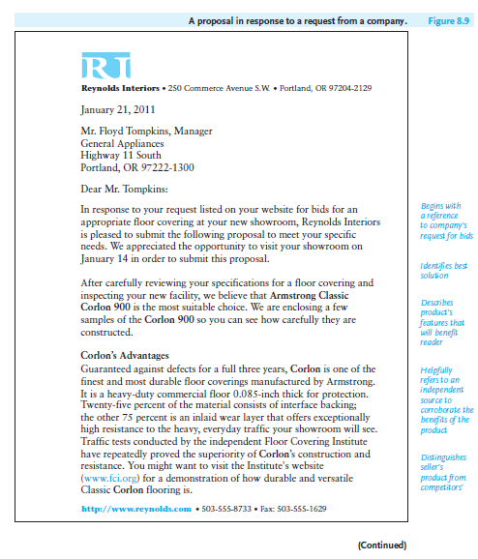
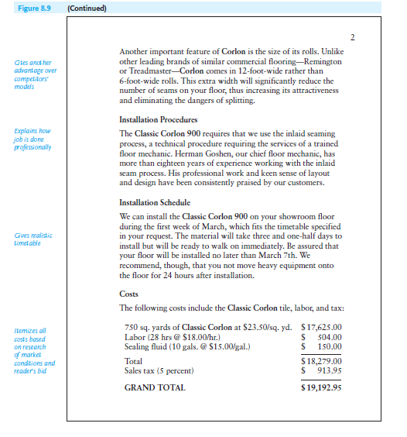
Lecture 9
Writing Successful Proposals

Slide 29
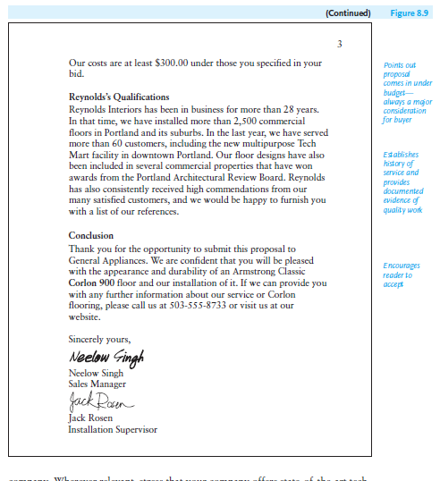
Lecture 9
Writing Successful Proposals

Slide 30
Lecture 9
Writing Successful Proposals
- Knowing Your Audience and Meeting Its Needs
Your audience will usually be one or more executives who have the power to approve or reject a proposal. Unlike readers of an internal proposal, your audience for a sales proposal may be even more skeptical since they may not know you or your work. You can increase your chances of success by trying to anticipate their questions such as:

Slide 31
Lecture 9
Writing Successful Proposals
■ Does the writer’s firm understand our problem?
■ Can the writer’s firm deliver the services it promises?
■ Can the job be completed on time?
■ Is the budget reasonable and realistic (neither inflated nor too low)?
■ What assurances does the writer offer that the job will be done exactly as proposed?
■ What are the qualifications the writer’s firm has to get the job done?
■ How has the writer demonstrated his or her trustworthiness?

Slide 32
Lecture 9
Writing Successful Proposals
- Organizing Sales Proposals
Most sales proposals include the following elements: introduction, description of the proposed product or service, timetable, costs, qualifications of your company, and conclusion.

Slide 33
Lecture 9
Writing Successful Proposals
A - Introduction
The introduction to your sales proposal can be a single paragraph in a short sales proposal or several pages in a more complex one. Basically, your introduction should persuasively prepare readers for everything that follows in your proposal. The introduction itself may contain the following sections, which sometimes may be combined.
1. Statement of purpose and subject of proposal.
2. Background of the problem you propose to solve.

Slide 34
Lecture 9
Writing Successful Proposals
B - Description of the Proposed Product or Service
This section is the heart of your proposal. Before spending their money, customers will demand hard, factual evidence of what you claim can and should be done. Here are some points that your proposal should cover.
1. Carefully show potential customers that your product or service is right for them.
2. Describe your work in suitable detail.
3. Stress any special features, maintenance advantages, warranties, or service benefits.

Slide 35
Lecture 9
Writing Successful Proposals
C - Timetable
A carefully planned timetable assures readers that you know your job and that you can accomplish it in the deadline set forth in the call for proposals or bids. Your dates should match any listed in a company’s proposal request. Provide specific dates to indicate
■ when the work will begin
■ how the work will be divided into phases or stages
■ when you will be finished
■ whether any follow-up visits or services are involved

Slide 36
Lecture 9
Writing Successful Proposals
D - Costs
Make your budget accurate, complete, and convincing. But give customers more than merely the bottom-line cost. Show exactly what readers are getting for their money so that they can determine if everything they need is included. Itemize costs for
■ specific services
■ equipment and materials
■ labor (by the hour or by the job)
■ transportation
■ travel
■ training

Slide 37
Lecture 9
Writing Successful Proposals
E - Qualifications of Your Company
Emphasize your company’s accomplishments and expertise in providing similar services and/or equipment. Mention the names of a few local firms for whom you have worked that would be able to recommend you and cite any awards or commendations.

Slide 38
Lecture 9
Writing Successful Proposals
F - Conclusion of Proposal
This is the “call to action” section of your sales proposal. Encourage your reader to approve your plan by stressing major benefits of your plan. Offer to answer any questions the reader may have. Some proposals end by asking readers to sign and return a copy of the proposal indicating their acceptance.

Slide 39
Lecture 9
Writing Successful Proposals
4- Short Reports and Proposals: Some Final Words:
To prepare successful short reports and winning proposals, always remember your reader’s needs, document your information, and write objectively, persuasively, and ethically.

Slide 40

Lecture 9
Writing Successful Proposals
References:
Successful Writing at Work, Concise Third Edition,
By: Philip C. Kolin
University of Southern Mississippi
Chapter 8

