Slide 1


Project Monitoring
Lecture 3
PMG 333
Estimating Project Times
and Costs
Prepared by
Dr. Mohammed Mustafa

Slide 2


Learning objectives
Understand estimating project times and costs are the foundation for project planning and control.
Describe guidelines for estimating time, costs, and resources.
Describe the methods, uses, and advantages and disadvantages of top-down and bottom-up estimating methods.
Distinguish different kinds of costs associated with a project.
Suggest a scheme for developing an estimating database for future projects.
Understand the challenge of estimating mega projects and describe steps that lead to better informed decisions.
Define a “white elephant” in project management and provide examples.

Slide 3
Lecture
Outlines
03
Factors Influencing the Quality of Estimates
Estimating Guidelines for Times, Costs, and Resources
Top-Down versus Bottom-Up Estimating
Methods for Estimating Project Times and Costs
Level of Detail
Types of Costs
Refining Estimates
Creating a Database for Estimating
Mega Projects: A Special Case
www.midocean.ae

Slide 4
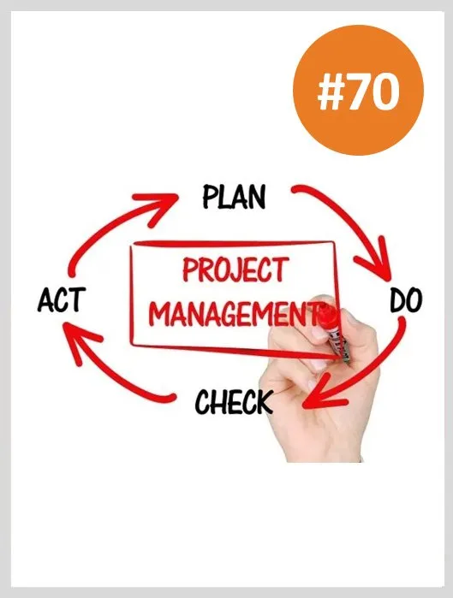
Factors Influencing the Quality of Estimates
A typical statement in the field is the desire to “have a 95 percent probability of meeting time and cost estimates.”
Past experience is a good starting point for developing time and cost estimates.
But past experience estimates must almost always be refined by other considerations to reach the 95 percent probability level.
Factors related to the uniqueness of the project will have a strong influence on the accuracy of estimates.
Project, people, and external factors all need to be considered to improve quality of estimates for project times and costs.

Slide 5
(1) Planning Horizon
The quality of the estimate depends on the planning horizon; estimates of current events are close to 100 percent accurate but are reduced for more distant events.
For example, cost estimates for a party you are organizing this weekend should be much more accurate than the estimates for a party that will take place in six months.
The accuracy of time and cost estimates should improve as you move from the conceptual phase to the point where individual work packages are defined.
Long-duration projects increase the uncertainty in estimates.

Slide 6
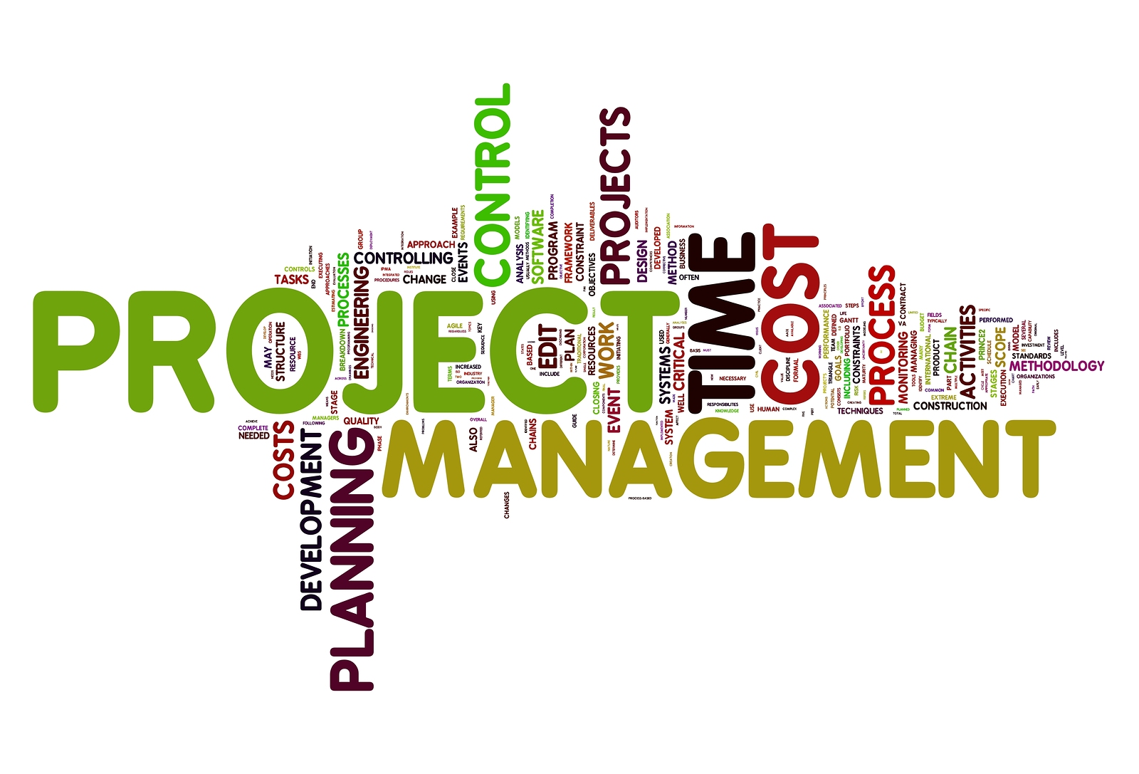
(2) Project complexity
Time to implement new technology has a habit of expanding in an increasing, nonlinear fashion.
Sometimes poorly written scope specifications for new technology result in errors in estimating times and costs.

Slide 7


(3) People
The people factor can influence the quality of time and cost estimates.
For example, accuracy of estimates depends on the skills of the people making the estimates.
How familiar are they with the task they are estimating?

Slide 8
(4) Project structure and organization
Which project structure is chosen to manage the project will influence time and cost estimates.
One of the major advantages of a dedicated project team discussed earlier is the speed gained from concentrated focus and localized project decisions.
This speed comes at an additional cost of tying up personnel full time.
Conversely, projects operating in a matrix environment may reduce costs by more efficiently sharing personnel across projects but may take longer to complete since attention is divided and coordination demands are higher.

Slide 9
(5) Padding estimates
In some cases people are inclined to pad estimates.
For example, if you are asked how long it takes you to drive to the airport, you might give an average time of 30 minutes, assuming a 50/50 chance of getting there in 30 minutes.
If you are asked the fastest you could possibly get there, you might reduce the driving time to 20 minutes.
Finally, if you are asked how long the drive would take if you absolutely had to be there to meet with the president, it is likely you would increase the estimate to say 50 minutes to ensure not being late.

Slide 10
(5) Padding estimates – Cont..
In work situations where you are asked for time and cost estimates, most of us are inclined to add a little padding to increase the probability and reduce the risk of being late.
If everyone at all levels of the project adds a little padding to reduce risk, the project duration and cost are seriously overstated.
This phenomenon causes some managers or owners to call for a 10–15 percent cut in time and/or cost for the project.
Of course the next time the game is played, the person estimating cost and/or time will pad the estimate to 20 percent or more.
Clearly such games defeat chances for realistic estimates, which is what is needed to be competitive.

Slide 11

(6) Organization culture
Organization culture can significantly influence project estimates.
In some organizations padding estimates is tolerated and even privately encouraged.
Other organizations place a premium on accuracy and strongly discourage estimating gamesmanship.
Organizations vary in the importance they attach to estimates. The prevailing belief in some organizations is that detailed estimating takes too much time and is not worth the effort or that it’s impossible to predict the future.
Other organizations subscribe to the belief that accurate estimates are the bedrock of effective project management.
Organization culture shapes every dimension of project management; estimating is not immune to this influence.

Slide 12

(7) Other factors
Finally, nonproject factors can impact time and cost estimates.
For example, equipment down-time can alter time estimates. National holidays, vacations, and legal limits can influence project estimates.
Project priority can influence resource assignment and impact time and cost.
Project estimating is a complex process. The quality of time and cost estimates can be improved when these variables are considered in making the estimates.

Slide 13
(7) Other factors – Cont..
Estimates of time and cost together allow the manager to develop a time-phased budget, which is imperative for project control.
Before discussing macro and micro estimating methods for times and costs, a review of estimating guidelines will remind us of some of the important “rules of the game” that can improve estimating.

Slide 14
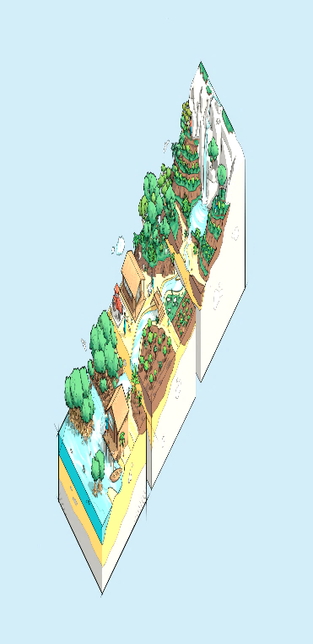
Estimating Guidelines for Times, Costs, and Resources
Managers recognize time, cost, and resource estimates must be accurate if project planning, scheduling, and controlling are to be effective.
However, there is substantial evidence suggesting poor estimates are a major contributor to projects that have failed.
Therefore, every effort should be made to see that initial estimates are as accurate as possible since the choice of no estimates leaves a great deal to luck and is not palatable to serious project managers.
Even though a project has never been done before, a manager can follow seven guidelines to develop useful work package estimates.

Slide 15

(1) Responsibility
At the work package level, estimates should be made by the person(s) most familiar with the task.
Draw on their expertise! Except for supertechnical tasks, those responsible for getting the job done on schedule and within budget are usually first-line supervisors or technicians who are experienced and familiar with the type of work involved.
These people will not have some preconceived, imposed duration for a deliverable in mind.
They will give an estimate based on experience and best judgment.

Slide 16
(1) Responsibility – Cont..
A secondary benefit of using those responsible is the hope they will “buy in” to seeing that the estimate materializes when they implement the work package. If those involved are not consulted, it will be difficult to hold them responsible for failure to achieve the estimated time.
Finally, drawing on the expertise of team members who will be responsible helps to build communication channels early.

Slide 17

(2) Use several people to estimate
It is well known that a cost or time estimate usually has a better chance of being reasonable and realistic when several people with relevant experience and/or knowledge of the task are used (sometimes called “crowdsourcing”).
True, people bring different biases based on their experience.
But discussion of the individual differences in their estimate leads to consensus and tends to eliminate extreme estimate errors.

Slide 18

(3) Normal conditions
When task time, cost, and resource estimates are determined, they are based on certain assumptions.
Estimates should be based on normal conditions, efficient methods, and a normal level of resources.
Normal conditions are sometimes difficult to discern, but it is necessary to have a consensus in the organization as to what normal conditions mean in this project.
If the normal workday is eight hours, the time estimate should be based on an eight-hour day.
Similarly, if the normal workday is two shifts, the time estimate should be based on a two-shift workday.

Slide 19
(3) Normal conditions – Cont..
Any time estimate should reflect efficient methods for the resources normally available.
The time estimate should represent the normal level of resources—people or equipment.
For example, if three programmers are available for coding or two road graders are available for road construction, time and cost estimates should be based on these normal levels of resources unless it is anticipated the project will change what is currently viewed as “normal.”
In addition, possible conflicts in demand for resources on parallel or concurrent activities should not be considered at this stage.
The need for adding resources will be examined when resource scheduling is discussed in a later chapter.

Slide 20
(4) Time units
Specific time units to use should be selected early in the development phase of the project network.
All task time estimates need consistent time units.
Estimates of time must consider whether normal time is represented by calendar days, workdays, workweeks, person days, single shift, hours, minutes, etc.
In practice the use of workdays is the dominant choice for expressing task duration.
However, in projects such as a heart transplant operation, minutes probably would be more appropriate as a time unit.

Slide 21
(4) Time units – Cont..
One such project that used minutes as the time unit was the movement of patients from an old hospital to an elegant new one across town.
Since there were several life-endangering moves, minutes were used to ensure patient safety so proper emergency life-support systems would be available if needed.
The point is, network analysis requires a standard unit of time.
When computer programs allow more than one option, some notation should be made of any variance from the standard unit of time.
If the standard unit of time is a five-day workweek and the estimated activity duration is in calendar days, it must be converted to the normal workweek.

Slide 22
(5) Independence
Estimators should treat each task as independent of other tasks that might be integrated by the WBS.
Use of first-line managers usually results in considering tasks independently; this is good.
Top managers are prone to aggregate many tasks into one time estimate and then deductively make the individual task time estimates add to the total.
If tasks are in a chain and performed by the same group or department, it is best not to ask for all the time estimates in the sequence at once to avoid the tendency for a planner or a supervisor to look at the whole path and try to adjust individual task times in the sequence to meet an arbitrary imposed schedule or some rough “guesstimate” of the total time for the whole path or segment of the project.
This tendency does not reflect the uncertainties of individual activities and generally results in optimistic task time estimates.

Slide 23
(6) Contingencies
Work package estimates should not include allowances for contingencies.
The estimate should assume normal or average conditions even though every work package will not materialize as planned.
For this reason top management needs to create an extra fund for contingencies that can be used to cover unforeseen events.

Slide 24
(7) Adding risk assessment to the estimate helps to avoid surprises to stakeholders
It is obvious some tasks carry more time and cost risks than others.
For example, a new technology usually carries more time and cost risks than a proven process.
Simply identifying the degree of risk lets stakeholders consider alternative methods and alter process decisions.
A simple breakdown by optimistic, most likely, and pessimistic for task time could provide valuable information regarding time and cost.

Slide 25
Top-Down versus Bottom-Up Estimating
Top-down estimates: usually are derived from someone who uses experience and/ or information to determine the project duration and total cost.
However, these estimates are sometimes made by top managers who have very little knowledge of the component activities used to complete the project.
For example, a mayor of a major city making a speech noted that a new law building would be constructed at a cost of $23 million and would be ready for occupancy in two and one-half years.
Although the mayor probably asked for an estimate from someone, the estimate could have come from a luncheon meeting with a local contractor who wrote an estimate (guesstimate) on a napkin.
This is an extreme example, but in a relative sense this scenario is frequently played out in practice.

Slide 26
bottom-up estimates: that establish low-cost, efficient methods.
This process can take place after the project has been defined in detail.
Good sense suggests project estimates should come from the people most knowledgeable about the estimate needed.
The use of several people with relevant experience with the task can improve the time and cost estimate.
The bottom-up approach at the work package level can serve as a check on cost elements in the WBS by rolling up the work packages and associated cost accounts to major deliverables.
Similarly, resource requirements can be checked.
Later, the time, resource, and cost estimates from the work packages can be consolidated into time-phased networks, resource schedules, and budgets that are used for control.
The bottom-up approach also provides the customer with an opportunity to compare the low-cost, efficient method approach with any imposed restrictions.

Slide 27
Methods for Estimating Project Times and Costs
Top-Down Approaches for Estimating Project Times and Costs
At the strategic level top-down estimating methods are used to evaluate the project proposal.
Sometimes much of the information needed to derive accurate time and cost estimates is not available in the initial phase of the project—for example, design is not finalized.
In these situations top-down estimates are used until the tasks in the WBS are clearly defined.
(1) Consensus Methods
This method simply uses the pooled experience of senior and/or middle managers to estimate the total project duration and cost.
This typically involves a meeting where experts discuss, argue, and ultimately reach a decision as to their best guess estimate.
Firms seeking greater rigor will use the Delphi Method to make these macro estimates.

Slide 28
(2) Ratio Methods
Top-down methods (sometimes called parametric) usually use ratios, or surrogates, to estimate project times or costs.
Top-down approaches are often used in the concept or “need” phase of a project to get an initial duration and cost estimate for the project.
For example, contractors frequently use number of square feet to estimate the cost and time to build a house; that is, a house of 2,700 square feet might cost $160 per square foot (2,700 feet × $160 per foot equals $432,000).
Likewise, knowing the square feet and dollars per square foot, experience suggests it should take approximately 100 days to complete.
Two other common examples of top-down cost estimates are the cost for a new plant estimated by capacity size, or a software product estimated by features and complexity.

Slide 29
(3) Apportion Methods
This method is an extension to the ratio method.
Apportionment is used when projects closely follow past projects in features and costs.
Given good historical data, estimates can be made quickly with little effort and reasonable accuracy.
This method is very common in projects that are relatively standard but have some small variation or customization

Slide 30
(4) Learning Curves
Some projects require that the same task, group of tasks, or product be repeated several times.
Managers know intuitively that the time to perform a task improves with repetition.
This phenomenon is especially true of tasks that are labor intensive.
In these circumstances the pattern of improvement phenomenon can be used to predict the reduction in time to perform the task.
From empirical evidence across all industries, the pattern of this improvement has been quantified in the learning curve (also known as improvement curve, experience curve, and industrial progress curve), which is described by the following relationship:
Each time the output quantity doubles, the unit labor hours are reduced at a constant rate.

Slide 31
Bottom-Up Approaches for Estimating Project Times and Costs
(1) Template Methods
If the project is similar to past projects, the costs from past projects can be used as a starting point for the new project.
Differences in the new project can be noted and past times and costs adjusted to reflect these differences.
For example, a ship repair drydock firm has a set of standard repair projects (i.e., templates for overhaul, electrical, mechanical) that are used as starting points for estimating the cost and duration of any new project.
Differences from the appropriate standardized project are noted (for times, costs, and resources) and changes are made.
This approach enables the firm to develop a potential schedule, estimate costs, and develop a budget in a very short time span.
Development of such templates in a database can quickly reduce estimate errors.

Slide 32

(2) Parametric Procedures Applied to Specific Tasks
Just as parametric techniques such as cost per square foot can be the source of topdown estimates, the same technique can be applied to specific tasks.
For example, as part of an MS Office conversion project, 36 different computer workstations needed to be converted.
Based on past conversion projects, the project manager determined that on average one person could convert three workstations per day.
Therefore the task of converting the 36 workstations would take three technicians four days [(36/3)/3].
Similarly, to estimate the wallpapering allowance on a house remodel, the contractor figured a cost of $5 per square yard of wallpaper and $2 per yard to install it, for a total cost of $7.
By measuring the length and height of all the walls she was able to calculate the total area in square yards and multiply it by $7.

Slide 33
(3) Range Estimating
When do you use range estimating? Range estimating works best when work packages have significant uncertainty associated with the time or cost to complete.
If the work package is routine and carries little uncertainty, using a person most familiar with the work package is usually the best approach.
She is likely to know best how to estimate work packages durations and costs.
However, when work packages have significant uncertainty associated with the time or cost to complete, it is a prudent policy to require three time estimates—low, average, and high (borrowed from PERT methodology that uses probability distributions).
The low to high give a range within which the average estimate will fall.
Determining the low and high estimates for the activity is influenced by factors such as complexity, technology, newness, familiarity.

Slide 34
Range Estimating – Cont..
How do you get the estimates? Since range estimating works best for work packages that have significant uncertainty, having a group determine the low, average, and high cost or duration gives best results.
Group estimating tends to refine extremes by bringing more
evaluative judgments to the estimate and potential risks.
The judgment of others in a group helps to moderate extreme perceived risks associated with a time or cost estimate.
Involving others in making activity estimates gains buy-in and credibility to the estimate.

Slide 35

Range Estimating Template

Slide 36
A Hybrid: Phase Estimating
This approach begins with a top-down estimate for the project and then refines estimates for phases of the project as it is implemented.
Some projects by their nature cannot be rigorously defined because of the uncertainty of design or the final product.
Although rare, such projects do exist.
These projects are often found in aerospace projects,
IT projects, new technology projects, and construction projects where design is incomplete.
In these projects, phase or life-cycle estimating is frequently used.

Slide 37
Phase Estimating over Project Life Cycle

Slide 38
Types of Costs
Assuming work packages are defined, detailed cost estimates can be made.
Here are typical kinds of costs found in a project:
  1. Direct costs
    a. Labor
    b. Materials
    c. Equipment
    d. Other
  2. Direct project overhead costs
  3. General and administrative (G&A) overhead costs

Slide 39
Types of Costing – Cont..
Direct Costs
These costs are clearly chargeable to a specific work package.
Direct costs can be influenced by the project manager, project team, and individuals implementing the work package.
These costs represent real cash outflows and must be paid as the project progresses; therefore, direct costs are usually separated from overhead costs.
Lowerlevel project rollups frequently include only direct costs.

Slide 40
Types of Costing – Cont..
Direct Project Overhead Costs
Direct overhead rates more closely pinpoint which resources of the organization are being used in the project.
Direct project overhead costs can be tied to project deliverables or work packages.
Examples include the salary of the project manager and temporary rental space for the project team.
Although overhead is not an immediate outof-pocket expense, it is real and must be covered in the long run if the firm is to remain viable.
These rates are usually a ratio of the dollar value of the resources used—e.g., direct labor, materials, equipment.

Slide 41
Types of Costing – Cont..
For example, a direct labor burden rate of 20 percent would add a direct overhead charge of 20 percent to the direct labor cost estimate.
A direct charge rate of 50 percent for materials would carry an additional 50 percent charge to the material cost estimate.
Selective direct overhead charges provide a more accurate project (job or work package) cost, rather than using a blanket overhead rate for the whole project.

Slide 42
General and Administrative (G&A) Overhead Costs
These represent organization costs that are not directly linked to a specific project.
These costs are carried for the duration of the project.
Examples include organization costs across all products and projects such as advertising, accounting, and senior management above the project level.
Allocation of G&A costs varies from organization to organization.
However, G&A costs are usually allocated as a percent of total direct cost, or a percent of the total of a specific direct cost such as labor, materials, or equipment.

Slide 43
Refining Estimates
Experience tells us that for many projects the total estimates do not materialize and the actual costs and schedule of some projects significantly exceed original work package–based estimates.
In order to compensate for the problem of actual cost and schedule exceeding estimates, some project managers adjust total costs by some multiplier (i.e., total estimated costs × 1.20).
The practice of adjusting original estimates by 20 percent or even 100 percent begs the question of why, after investing so much time and energy on detailed estimates, the numbers could be so far off.
There are a number of reasons for this, most of which can be traced to the estimating process and the inherent uncertainty of predicting the future.
Some of these reasons are discussed below.

Slide 44
(1) Interaction costs are hidden in estimates:
According to the guidelines, each task estimate is supposed to be done independently.
However, tasks are rarely completed in a vacuum.
Work on one task is dependent upon prior tasks, and the hand-offs between tasks require time and attention.
For example, people working on prototype development need to interact with design engineers after the design is completed, whether to simply ask clarifying questions or to make adjustments in the original design.
Similarly, the time necessary to coordinate activities is typically not reflected in independent estimates.
Coordination is reflected in meetings and briefings as well as time necessary to resolve disconnects between tasks.
Time, and therefore cost, devoted to managing interactions rises exponentially as the number of people and different disciplines involved increases on a project.

Slide 45
(2) Normal conditions do not apply:
Estimates are supposed to be based on normal conditions.
While this is a good starting point, it rarely holds true in real life.
This is especially true when it comes to the availability of resources.
Resource shortages, whether in the form of people, equipment, or materials, can extend original estimates.
For example, under normal conditions four bulldozers are typically used to clear a certain site size in five days, but the availability of only three bulldozers would extend the task duration to eight days.
Similarly, the decision to outsource certain tasks can increase costs as well as extend task durations since time is added to acclimating outsiders to the particulars of the project and the culture of the organization.

Slide 46

(3) Things go wrong on projects:
Design flaws are revealed after the fact, extreme weather conditions occur, accidents happen, and so forth.
Although you shouldn’t plan for these risks to happen when estimating a particular task, the likelihood and impact of such events need to be considered.
(4) Changes in project scope and plans:
As one gets further and further into the project, a manager obtains a better understanding of what needs to be done to accomplish the project.
This may lead to major changes in project plans and costs.
Likewise, if the project is a commercial project, changes often have to be made midstream to respond to new demands by the customer and/or competition.
Unstable project scopes are a major source of cost overruns.
While every effort should be made up front to nail down the project scope, it is becoming increasingly difficult to do so in our rapidly changing world.

Slide 47
(5) Overly optimistic:
There is solid research indicating that there is a tendency in people to overestimate how quickly they can get things done and underestimate how long it will take them to complete tasks.
(6) Strategic misrepresentation:
There is growing evidence that some project promoters underestimate the costs of projects and overestimate project benefits in order to win approval.
This appears to be particularly true for large-scale public works projects which have a notorious habit of coming in way over budget.

Slide 48
Creating a Database for Estimating
The best way to improve estimates is to collect and archive data on past project estimates and actuals.
Saving historical data—estimates and actuals—provides a knowledge base for improving project time and cost estimating.
Creating an estimating database is a “best practice” among leading project management organizations.
Some organizations have large estimating departments of professional estimators— e.g., Boeing, IBM—that have developed large time and cost databases.
Others collect these data through the project office.
This database approach allows the project estimator to select a specific work package item from the database for inclusion.
The estimator then makes any necessary adjustments concerning the materials, labor, and equipment.

Slide 49
Estimating Database Templates

Slide 50




Thank You

