Slide 1




Digital Analytics
MKT631
Lecture 7
Prepared by
Dr. Karim Ahmed
www.midocean.ae

Slide 2
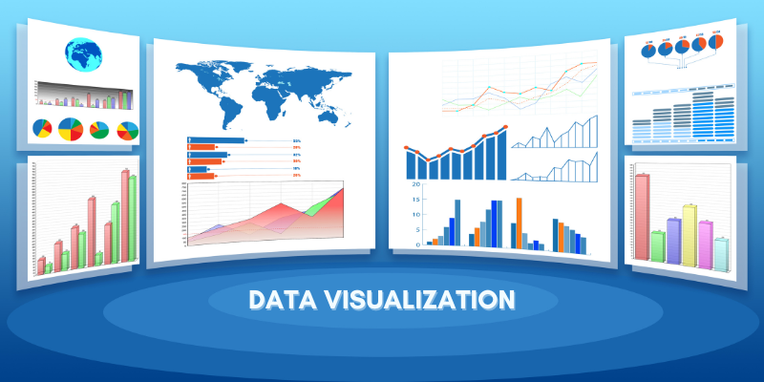
Analytics and Dataviz Tools
www.midocean.ae

Slide 3

Chapter
Content
07
Introduction
Key Categories of Digital Analysis Tools
Evaluation of Digital Analysis Tools
www.midocean.ae

Slide 4
Chapter
Introduction
07
Tools play an important part in the analyst’s work. They aid in data collection, cleanse data of errors, and allow for sophisticated analysis techniques. They can scale insights across companies large and small. In a very real sense, the analyst is enabled by the tools they use. The market for digital analysis tools is expanding quickly and changing constantly. The growing need for analytics solutions, rampant acquisition activity, and the low cost of tool design have produced a fast-moving field that features established companies and entrepreneurial startups. A quick web search reveals page after page of “Top 10 Analytics Tools” lists, showing the best resources selected from what must number in the thousands, if not tens of thousands, of tools.
www.midocean.ae

Slide 5
Chapter
Key Categories of Digital Analysis Tools
07
In the vastness of the digital marketing analytics tool market, analysts will find a few critical categories that are particularly important. Tools in these categories are required to unlock insights that are unique to consumers’ online behavior.
Social Listening
Content Analysis
Search Trends
Website Analytics
A/B Testing
www.midocean.ae

Slide 6
Chapter
Key Categories of Digital Analysis Tools
07
Social Listening
Social listening tools connect to various social media networks to extract consumer data. These tools provide direct access to content consumers create and allow marketers to learn about interests, actions (e.g., likes, favorites, etc.), and thoughts in consumers’ words.
https://www.brandwatch.com/
https://www.hootsuite.com/
www.midocean.ae

Slide 7
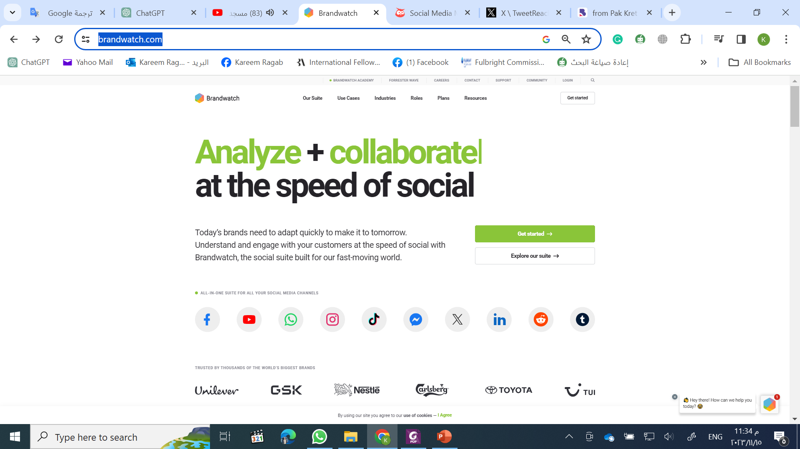
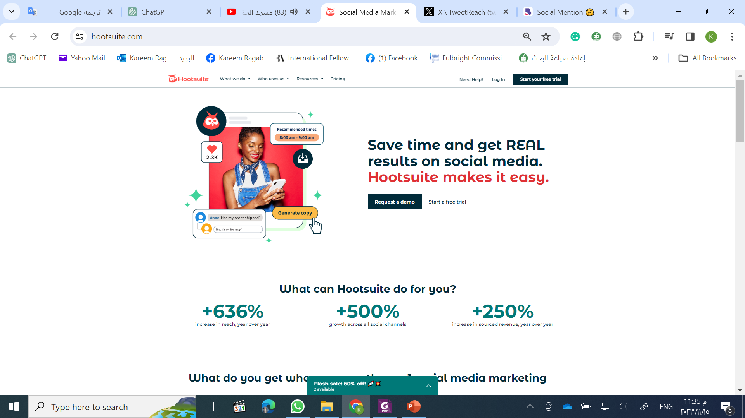
Chapter
Key Categories of Digital Analysis Tools
07
www.midocean.ae

Slide 8
Chapter
Key Categories of Digital Analysis Tools
07
Social Listening
These tools connect to multiple platforms at the same time. In addition, analysts can use several free tools to gain insight into how consumers interact with a brand on social networks. Tools that include BrandMentions’ free real-time social tracking tool, SocialMention (brandmentions.com/socialmention), collect publicly available information about a brand across social media posts, website blogs, news, videos, articles, and other content and are particularly valuable tools when conducting SOV analysis. Also, social media networks often provide detailed analytics about who’s interacting with content through native social listening tools, including Facebook’s analysis tools.
www.midocean.ae

Slide 9
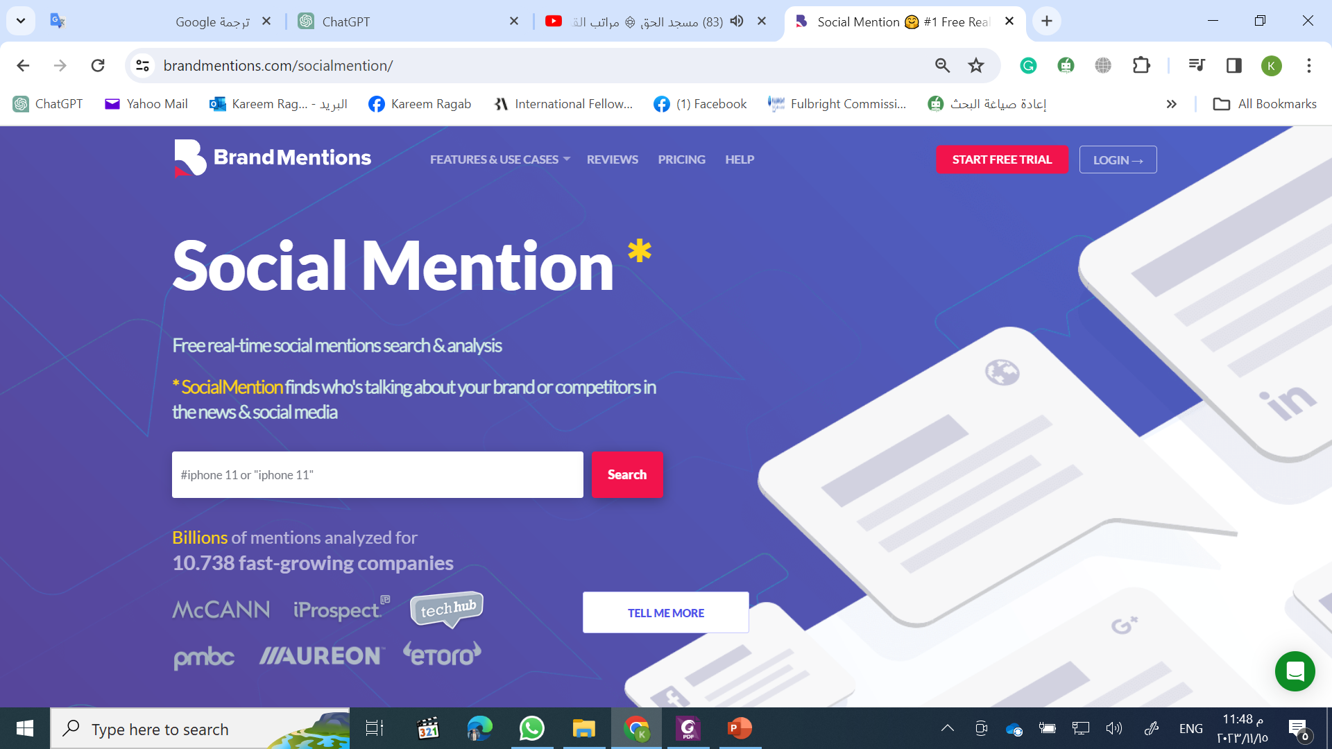
Chapter
Key Categories of Digital Analysis Tools
07
www.midocean.ae

Slide 10
Chapter
Key Categories of Digital Analysis Tools
07
Content analysis
Content analysis tools help analysts use collected data in meaningful ways by studying digital text, photos, audio and visual formats of communication. These tools can reveal otherwise unrecognizable patterns in data. Term relevance (i.e., the relative number of times a term is used in a body of text data) and consumer sentiment (i.e., the tone of consumer mentions of a company, brand, or product typically categorized as “positive,” “neutral” and “negative”) are two of the more popular and useful types of content analysis.
www.midocean.ae

Slide 11
Chapter
Key Categories of Digital Analysis Tools
07
Content analysis
Many free tools, including the R package Quanteda, provide quantitative text analysis by analyzing keywords, representing text visually, applying sentiment analysis frameworks, and more. Commercial tools, such as Linguistic Inquiry and Word Count (LIWC), interpret text to reveal thoughts, attitudes, feelings, personality, and motivations of the author. Another tool, BuzzSumo (buzzsumo.com), provides insights into the types of content that resonate with specific audience groups and can be a valuable tool for targeting content and competitive analysis.
www.midocean.ae

Slide 12
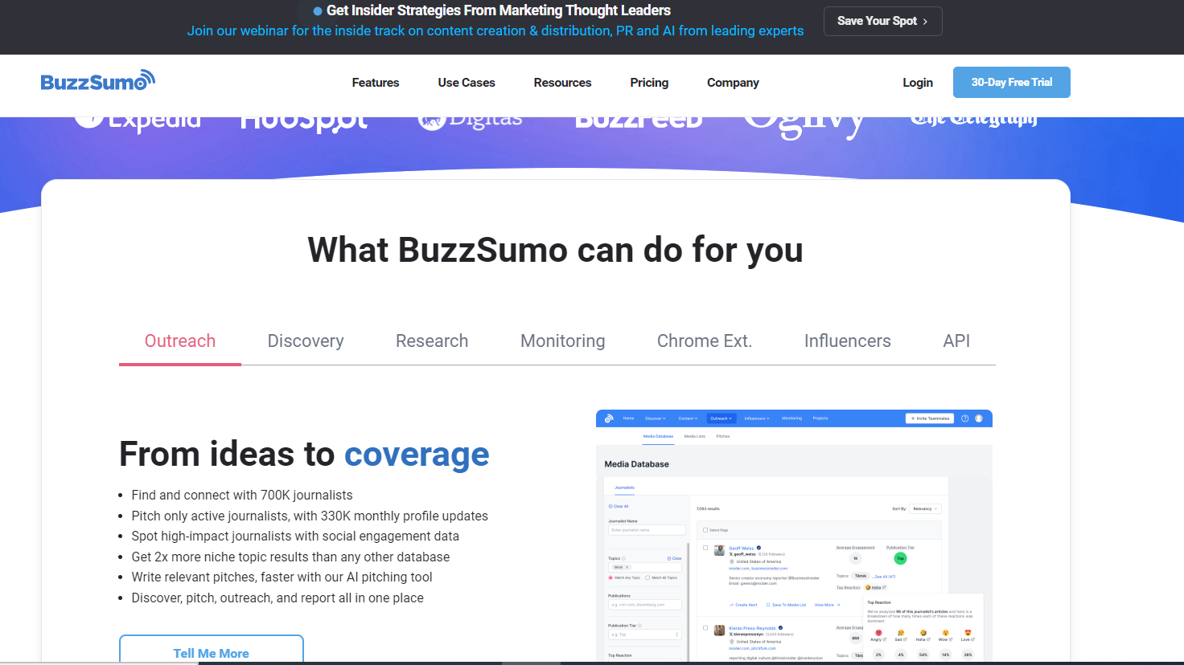
Chapter
Key Categories of Digital Analysis Tools
07
www.midocean.ae

Slide 13
Chapter
Key Categories of Digital Analysis Tools
07
Search trends
Internet search trend data reveals the issues that are on consumers’ minds. Search analysis tools aggregate and visualize that data to show analysts the popularity of specific topics, which can offer insights on demand for new products, consumer response to marketing campaigns, and brand awareness.
www.midocean.ae

Slide 14
Chapter
Key Categories of Digital Analysis Tools
07
Search trends
Google Trends (trends.google.com) provides free access to indexed search volume from Google.com, Google Images, Google Shopping, and YouTube. Using Google Trends, analysts can collect data about topic and search term interest over time (ranging from the last hour to 2004) at various geographic levels (ranging from worldwide to a specific city) and download the data into raw files for further analysis. Google Trends is a particularly valuable tool when conducting SOS analysis. Bing and Yahoo offer services similar to Google Trends to analyze search behavior on their properties.
www.midocean.ae

Slide 15
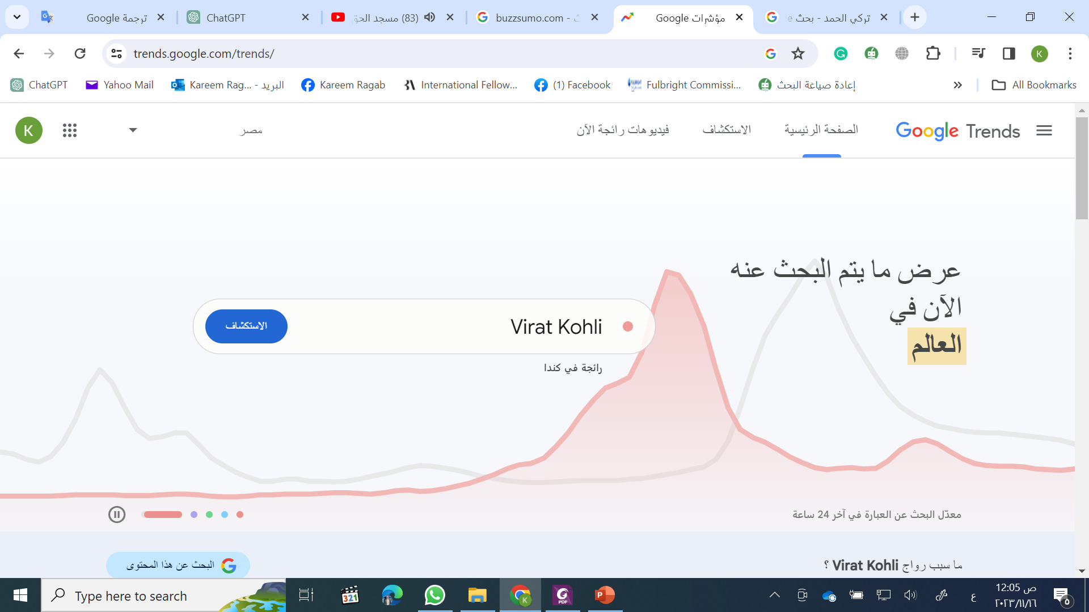
Chapter
Key Categories of Digital Analysis Tools
07
www.midocean.ae

Slide 16
Chapter
Key Categories of Digital Analysis Tools
07
Search trends
Several other free tools – including Searchvolume.io (searchvolume.io) and a search analysis tool found on The New York Times website (nytimes.com/search) – offer simple keyword research through online interfaces, while commercial services like Moz (moz.com) analyze search volume, report metrics and suggest actions.
www.midocean.ae

Slide 17
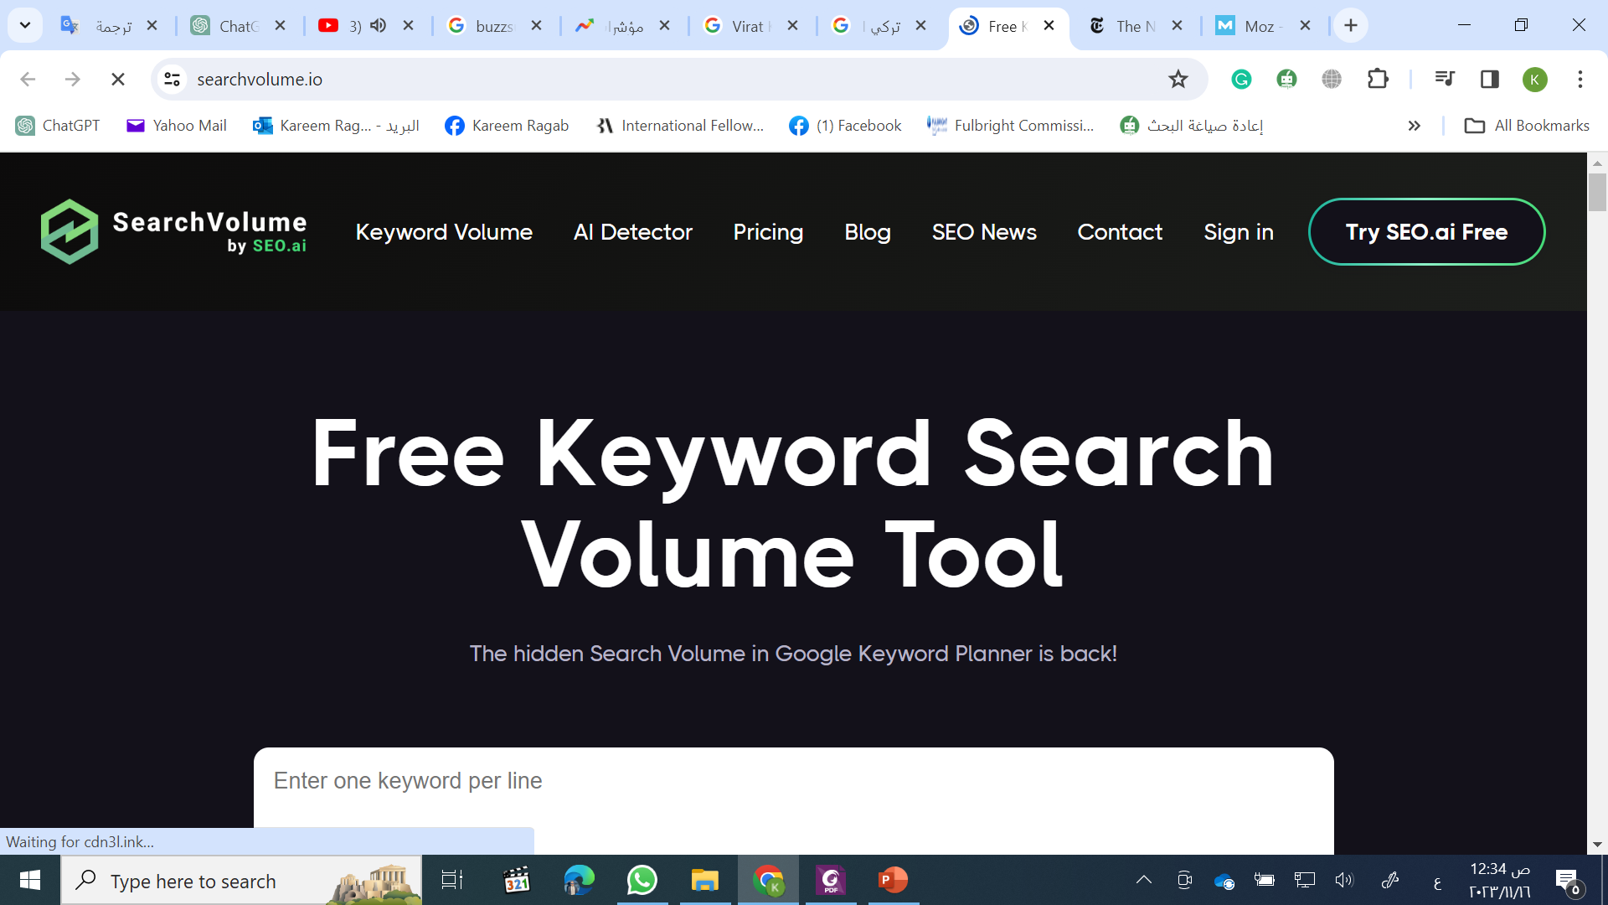
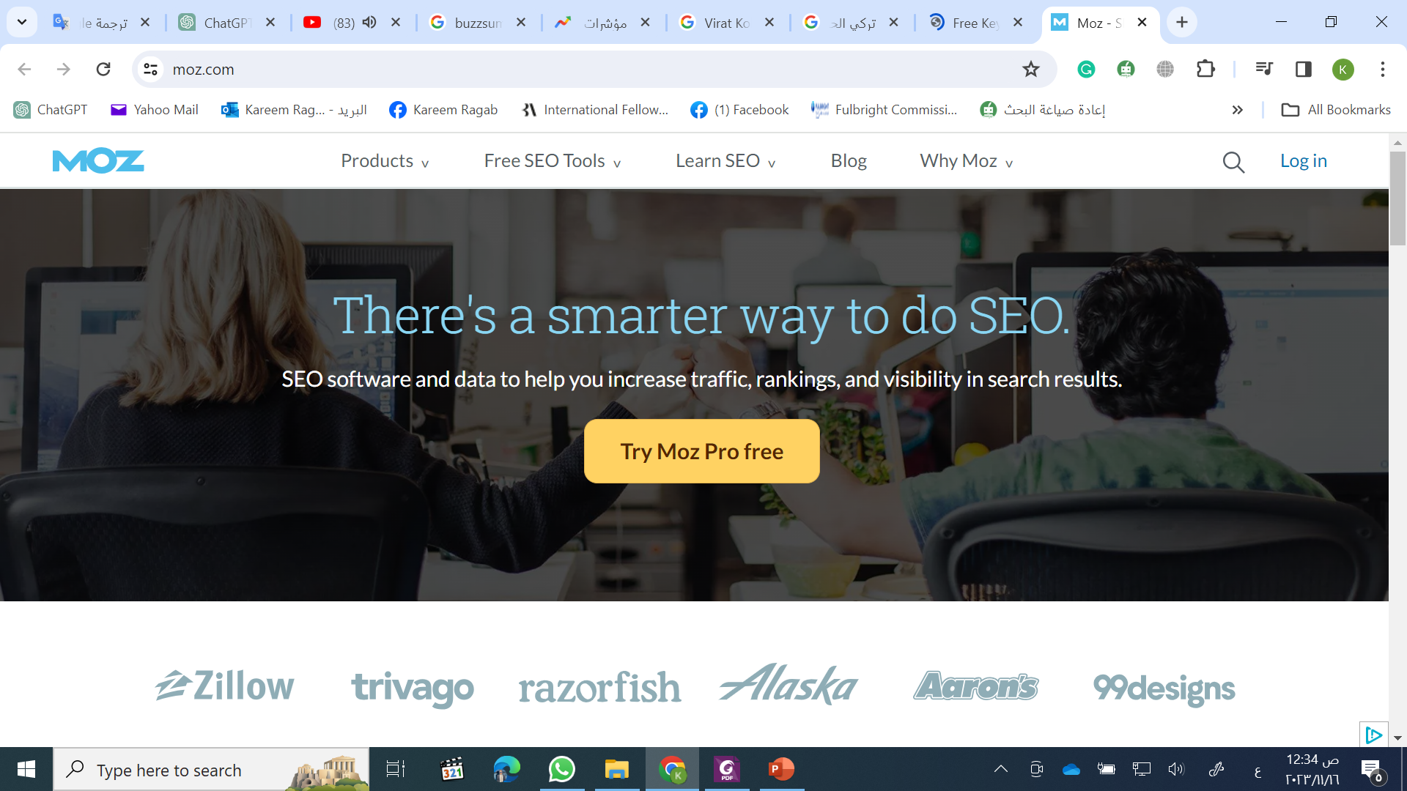
Chapter
Key Categories of Digital Analysis Tools
07
www.midocean.ae

Slide 18
Chapter
Key Categories of Digital Analysis Tools
07
Website analytics
Website analytics tools provide information about visitors to a website, including the number of visitors and how they behave on the site. These tools let the analyst gauge traffic and the popularity of content on the site, which is useful for market research. Say the analyst wants to improve a website’s design. Clickstream analysis – tracking how visitors interact with the site – can reveal which content visitors believe is most valuable. Metrics, including the number of times people visited the site (“visits”), the specific pages people view (“unique page views”), and the percentage of people who left the site from the first page they visited (“bounce rate”) offer valuable insights.
www.midocean.ae

Slide 19
Chapter
Key Categories of Digital Analysis Tools
07
Website analytics
Large, powerful, paid tools, such as Adobe Analytics and Google Analytics 360, can handle this challenge (along with a thousand other challenges) for you. But many lighter-weight tools can perform expert clickstream analysis and visualization at a fraction of the cost of premium platforms. For example, Google’s free version of Google Analytics provides many of the capabilities found in the premium tool, including clickstream analysis. The disadvantage of these lighter-weight tools is they can handle less data and have more restrictions than premium website analytics tools.
www.midocean.ae

Slide 20
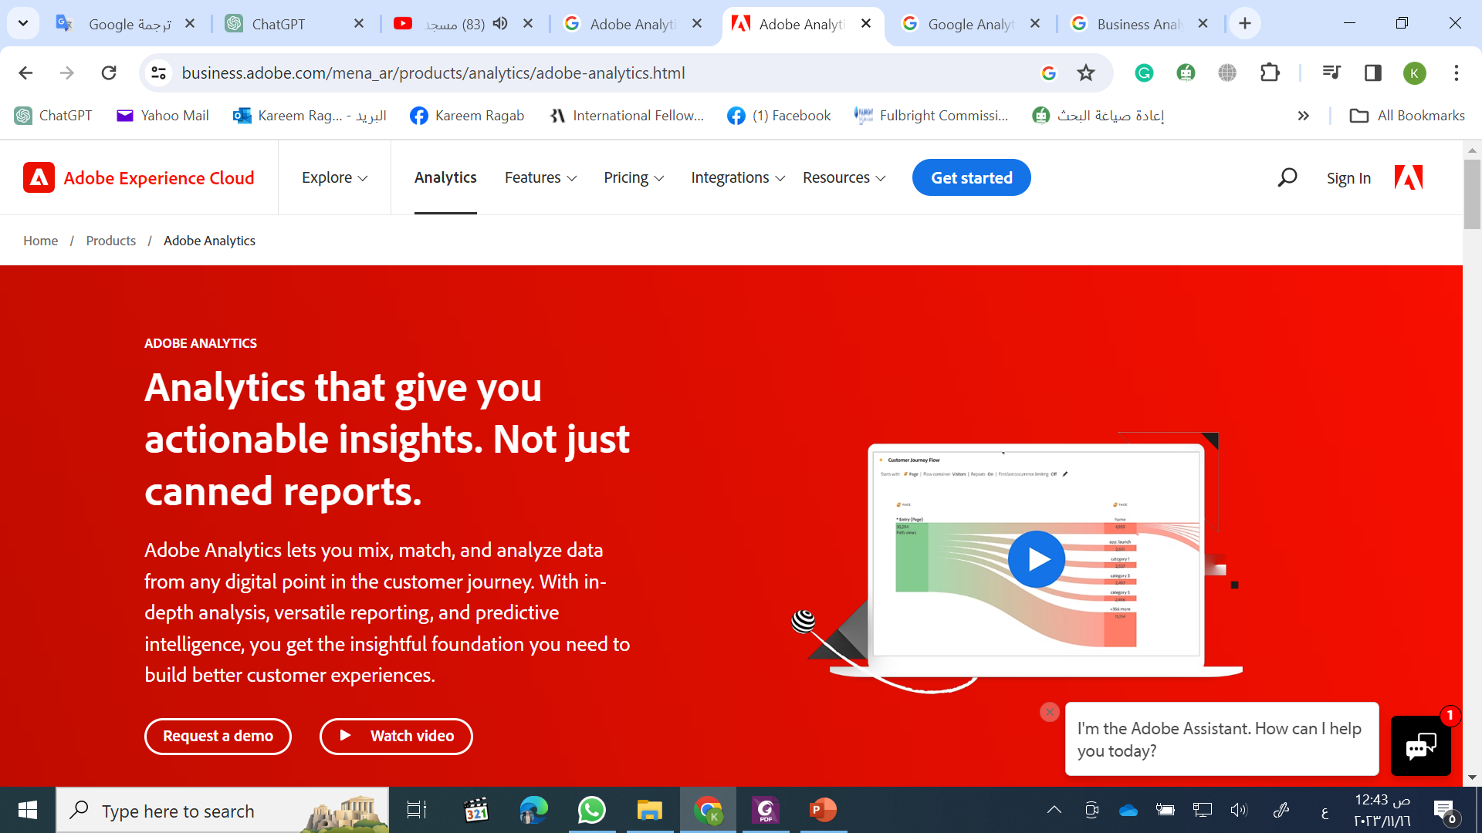
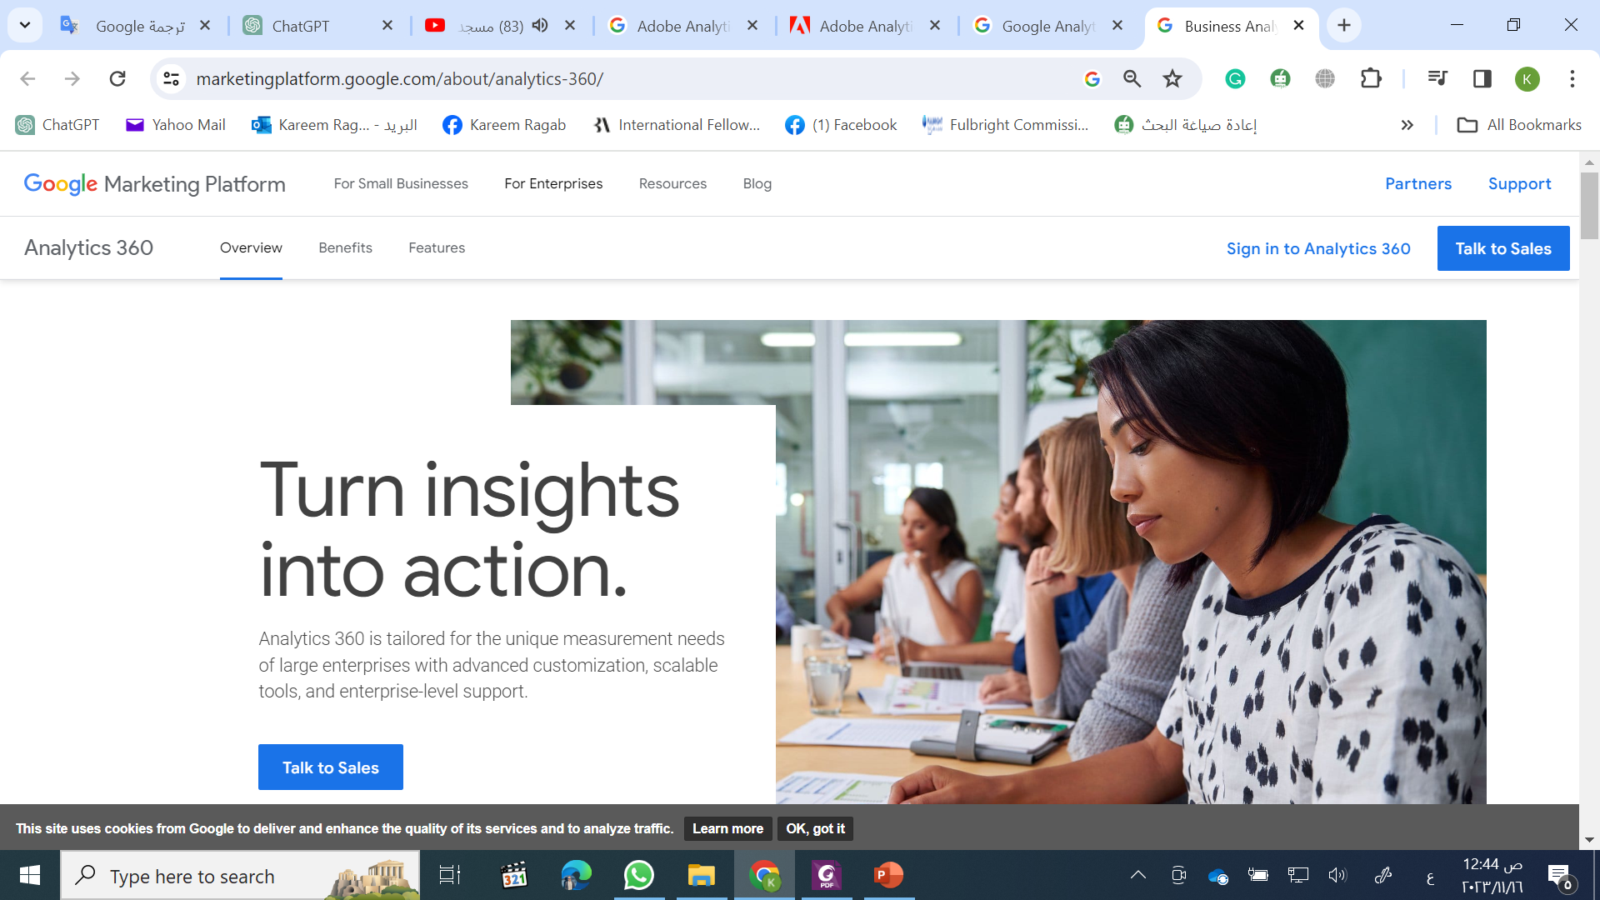
Chapter
Key Categories of Digital Analysis Tools
07
www.midocean.ae

Slide 21
Chapter
Key Categories of Digital Analysis Tools
07
A/B testing
A/B testing, also known as “conversion rate optimization” (CRO), is another important category of analysis for the analyst. A/B testing measures the effectiveness of ads, website design, and other forms of digital content by producing two versions of the item being tested, presenting those versions to consumers, and tracking engagement rates. In doing so, A/B testing helps the analyst determine which version is more effective overall and for specific consumer segments.
www.midocean.ae

Slide 22
Chapter
Key Categories of Digital Analysis Tools
07
A/B testing
Online A/B testing is efficient and effective due to the scale of the internet. A tool, such as Optimizely (optimizely.com), and Visual Website Optimizer (vwo.com), offer a full set of deep capabilities. In addition, the free and paid versions of most website analytics tools offer A/B test and optimization modules.
www.midocean.ae

Slide 23
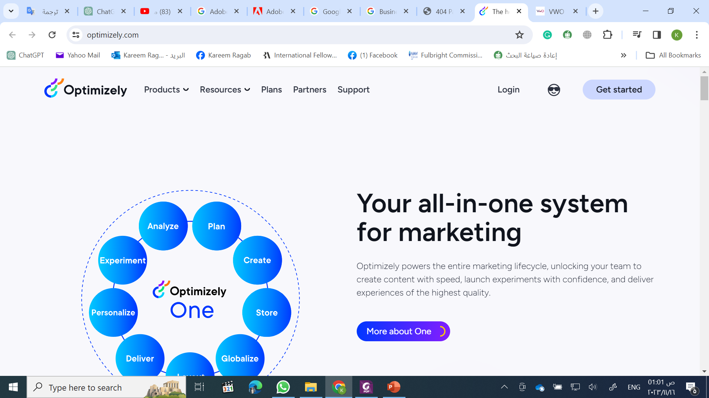
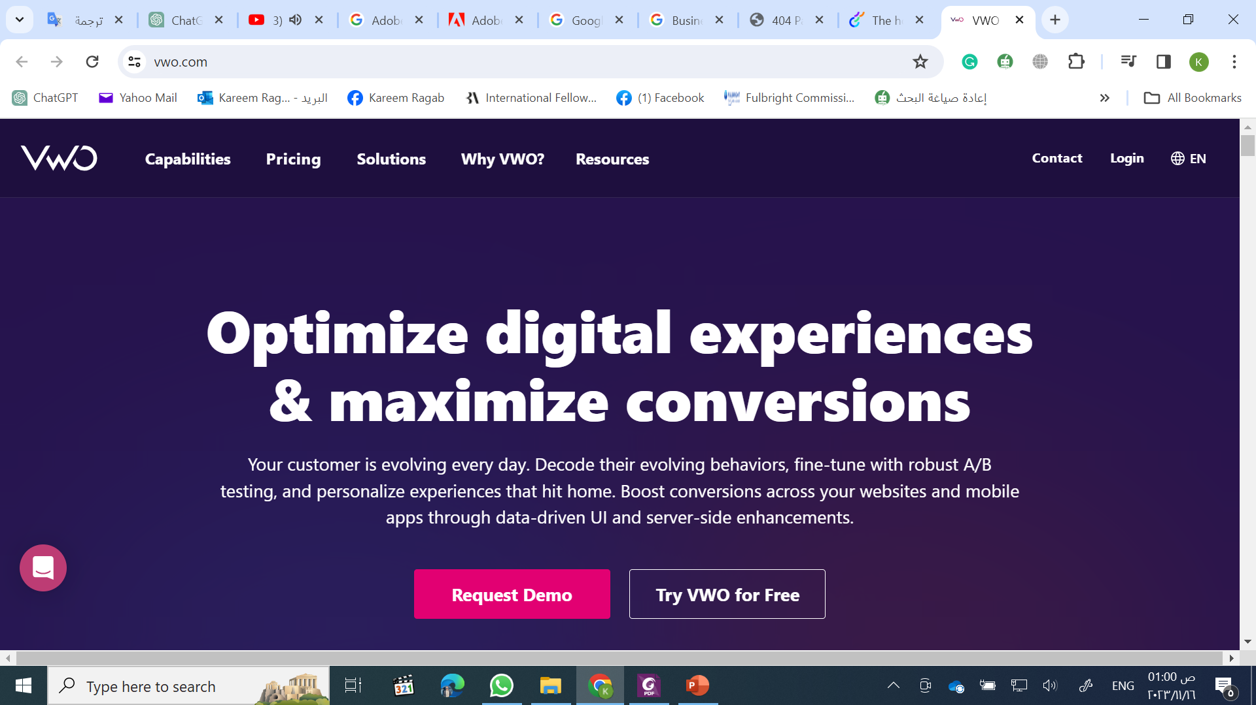
Chapter
Key Categories of Digital Analysis Tools
07
A/B testing
www.midocean.ae

Slide 24
Chapter
Evaluation of Digital Analysis Tools
07
While some tools found in these categories have enjoyed long tenures, many more lasted much less time or changed names and/or directions because of mergers and acquisitions in the digital analytics industry. For example, Klout was once the gold standard for measuring social influence but shuttered in 2018 following the influx of simpler and more methodologically sound online tools. Because the digital analysis tool market shifts so rapidly, it’s more important for us to characterize and segment this market than it is to stay on top of the newest and “hottest” tools. I like to do this by thinking about tools in terms of two variables that can be posed as questions: (1) How much can I do with this tool (i.e., data flexibility)?; and (2) How easy is it for me to use the tool (i.e., ease of use)?
www.midocean.ae

Slide 25
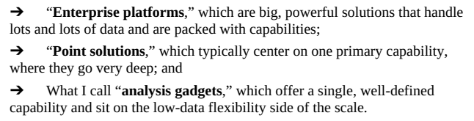
Chapter
Evaluation of Digital Analysis Tools
07
Evaluation Criteria 1: Data Flexibility
When we look at the first question, we see clear demarcation in the tool marketplace. In fact, three distinct categories of tools emerge:
www.midocean.ae

Slide 26
Chapter
Evaluation of Digital Analysis Tools
07
Enterprise Platforms (High Data Flexibility)
The brand names behind today’s enterprise platforms are easily recognizable. These tools come from some of the most well-known names in marketing analytics. Companies, such as comScore, Adobe, IBM, and Google offer premium tools that feature in-depth analysis and visualization capabilities. In fact, these tools give analysts as many capabilities as they could possibly want. The downside to enterprise platforms is their large price tags.
www.midocean.ae

Slide 27
Chapter
Evaluation of Digital Analysis Tools
07
Enterprise Platforms (High Data Flexibility)
It can be a huge benefit if an analyst works for an organization that has an enterprise platform. The analyst will have access to a significant amount of information and – as advertisers that can invest in enterprise platforms typically operate large, complex business models – the ability to handle inputs from a variety of data sources. Benefits aside, not every business has the wherewithal or the need to invest up to six figures a year in an enterprise platform solution.
www.midocean.ae

Slide 28
Chapter
Evaluation of Digital Analysis Tools
07
Enterprise Platforms (High Data Flexibility)
A number of popular free tools – including R and Python – are included in the enterprise platform solution category as they offer a broad set of capabilities, placing them high on the data flexibility scale. R and Python are open-source tools, with thousands of people contributing to their design by creating help files, building new capabilities, and offering their experience to the user community. Unlike the premium solutions found in this category, however, these free tools lack the slickly packaged and fully integrated feel of premium solutions. This makes them more difficult to navigate and means they may not fit well in every business situation. Still, analysts should become familiar with R and/or Python.
www.midocean.ae

Slide 29
Chapter
Evaluation of Digital Analysis Tools
07
Point Solutions (Medium Data Flexibility)
Point solutions offer more affordable, but less robust, solutions to analytics problems. If analysts have a single objective or challenge to crack, a point solution can be a viable option. For all analysis and visualization challenges analysts face, they’ll find myriad companies that offer valuable solutions.
www.midocean.ae

Slide 30
Chapter
Evaluation of Digital Analysis Tools
07
Point Solutions (Medium Data Flexibility)
Examples of point solutions include online survey platforms such as iPerceptions (iperceptions.com), SurveyMonkey (surveymonkey.com), ForeSee Results (foresee.com), and Google’s Consumer Surveys (surveys.google.com) – that offer insights through “voice of the consumer” data. These tools allow analysts to design surveys, collect responses from consumers as they browse the internet (typically, so they can get access to premium content), and analyze results through visualization modules.
www.midocean.ae

Slide 31
Chapter
Evaluation of Digital Analysis Tools
07
Point Solutions (Medium Data Flexibility)
Promising results in as little as three days – compared to months for traditional surveys – online survey tools can provide consumer insights that help drive important business decisions. Their scope is limited to digital surveys, but they do that job exceptionally well with a deep set of capabilities.
www.midocean.ae

Slide 32
Chapter
Evaluation of Digital Analysis Tools
07
Analysis Gadgets (Low Data Flexibility)
All challenges don’t require the depth of capabilities featured in enterprise platforms and point solutions. Low- and no-cost options that we call analysis gadgets are widely available and fit a wide variety of analytics needs. The analysis gadget market is an exciting, undulating collection of quick-to market tools born from the minds of experimenting analysts and coders, and community-based open-source solutions. The one characteristic that unites them under the banner of analysis gadgets is that they’re extremely lightweight, and the amount of data they can handle pales in comparison to that absorbed by point solutions and enterprise platforms.
www.midocean.ae

Slide 33
Chapter
Evaluation of Digital Analysis Tools
07
Analysis Gadgets (Low Data Flexibility)
These analysis gadgets are available online and usually don’t need users to download anything onto their desktops. Some of these tools require users to register and sign in with email subscriptions, while others require nothing. Some analysis gadgets include a request for voluntary contributions to help defray associated hosting or technology licensing costs while others are free.
www.midocean.ae

Slide 34
Chapter
Evaluation of Digital Analysis Tools
07
Analysis Gadgets (Low Data Flexibility)
An example of an analysis gadget with low data flexibility is "TagCrowd" (tagcrowd.com). TagCrowd is a web-based tool that allows users to create word clouds from text input. TagCrowd visualizes the frequency of words in a given text by representing them in a word cloud. Users can customize the appearance of the word cloud, such as excluding common words or setting word frequency thresholds.
TagCrowd, like other Analysis Gadgets, is lightweight and straightforward. It serves as a quick and accessible solution for users who need a simple visualization of word frequency in a given text but don't require the advanced features and capabilities found in more complex tools.
www.midocean.ae

Slide 35
Chapter
Evaluation of Digital Analysis Tools
07
Evaluation Criteria 2: Ease of Use
When we address the second question, “How easy is it for me to use that tool?” the market begins to separate into groups of tools we should use for the majority of our analytics challenges and those tools we should discard. The answer to the question of ease of use, of course, is a personal one. A tool that comes naturally to you might not be easy for another analyst. In addition, an analyst’s skills will certainly improve, and with training, a tool that’s difficult to use today may become easier tomorrow. As a result, how an analyst evaluates tools through this lens should be thought of as a uniquely personal snapshot in time.
www.midocean.ae

Slide 36
Chapter
Evaluation of Digital Analysis Tools
07
Evaluation Criteria 2: Ease of Use
Regardless of the temporal and shifting nature of these evaluation criteria, putting together the two questions we’ve discussed allows for a very useful framework with which to view the data analysis and visualization tool market. To illustrate the usefulness of this approach, We can show the free tools available to the public in the market today through the following figure. Four quadrants emerge in this framework. Which quadrant a tool resides in will become important to the role it plays in our practice.
www.midocean.ae

Slide 37
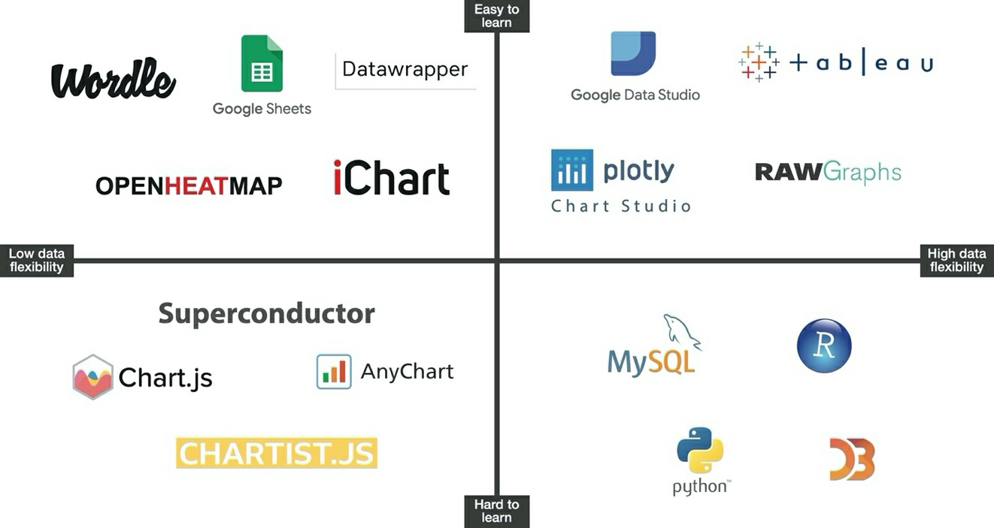
Chapter
Evaluation of Digital Analysis Tools
07
www.midocean.ae

Slide 38
Chapter
Evaluation of Digital Analysis Tools
07
Upper Left Quadrant: Tools to Collect
Tools in the upper left quadrant have limited capabilities but are easy to use. They perform one-off jobs or specific tasks quickly and efficiently. Analysts should keep these analysis gadgets in their toolboxes. In fact, the more easy-to-use tools analysts can master – and, given the inherently low level of complexity, “mastering” tools in this quadrant is often not a challenge – the broader and more flexible their skills will be.
www.midocean.ae

Slide 39
Chapter
Evaluation of Digital Analysis Tools
07
Upper Left Quadrant: Tools to Collect
www.midocean.ae

Slide 40
Chapter
Evaluation of Digital Analysis Tools
07
Upper Left Quadrant: Tools to Collect
The recommendation is to get hands-on with these tools. When analysts find a tool that comes naturally, they should make it their go-to, with the assurance they won’t need to keep up on certifications or training. After all, the benefit of an easy-to-use analysis gadget is akin to learning how to ride a bike: it doesn’t matter how long it’s been since you’ve done it – you can pop right on and hit the road.
www.midocean.ae

Slide 41
Chapter
Evaluation of Digital Analysis Tools
07
Upper Right Quadrant: Your Go-to Tool(s)
On the other side of that ledger, in the upper right quadrant, are powerful and easy-to-use tools. It makes sense for an analyst to settle on one (or possibly two) here and use it as the foundation for data analysis and visualization. The tool(s) analysts choose from this quadrant will do just about everything they need easily and efficiently. This should become an analyst’s go-to tool for the majority of data analysis and visualization tasks.
www.midocean.ae

Slide 42
Chapter
Evaluation of Digital Analysis Tools
07
Upper Right Quadrant: Your Go-to Tool(s)
www.midocean.ae

Slide 43
Chapter
Evaluation of Digital Analysis Tools
07
Upper Right Quadrant: Your Go-to Tool(s)
We may place Tableau in this quadrant. It’s intuitive, proven, and powerful. In fact, Tableau has, in many ways, become table stakes for most data analysts in their role as Data Designers. You can use the tools in your upper right quadrant to complete about 75 percent of your visualization tasks.
www.midocean.ae

Slide 44
Chapter
Evaluation of Digital Analysis Tools
07
Lower Right Quadrant: Your Secret Power Tool(s)
In the lower right quadrant, we find tremendously powerful tools that have deep capabilities and potential. The downside is that these tools are a tad awkward. Learning them will take a bit more effort and practice. Mastering them can require significant time. Indeed, their power comes with the price of being challenging to use.
www.midocean.ae

Slide 45
Chapter
Evaluation of Digital Analysis Tools
07
Lower Right Quadrant: Your Secret Power Tool(s)
www.midocean.ae

Slide 46
Chapter
Evaluation of Digital Analysis Tools
07
Lower Right Quadrant: Your Secret Power Tool(s)
Analysts shouldn’t avoid these tools, however. In fact, using a tool from this quadrant is extremely important. The explosive creation of data gives analysts opportunities to collect, analyze, and visualize data like never before. Realizing these opportunities often requires tools powerful enough to move through large amounts of data. To do that, a little more sophistication (which often materializes in the form of a sophisticated tool) is required. One of the tools in the lower right quadrant is R. Of course, several other tools in the “High data flexibility/Hard to use” quadrant can serve many purposes as well as R can and even surpass some of the things it can do. But R has become the tool of choice.
www.midocean.ae

Slide 47
Chapter
Evaluation of Digital Analysis Tools
07
Lower Right Quadrant: Your Secret Power Tool(s)
The time required to master tools in the lower right quadrant and their overlapping capabilities make it impractical to learn them all. A better approach is to focus on a single tool in this quadrant. Analysts should master that tool to complete the sophisticated, data-dense tasks that their go-to tool in the upper right quadrant struggles with.
www.midocean.ae

Slide 48
Chapter
Evaluation of Digital Analysis Tools
07
Lower Left Quadrant: Tools to Avoid
Analysts should avoid any tool that’s hard to use and doesn’t have strong capabilities. Given the plethora of credible, capable tools that can fit in the other quadrants, there’s no reason to waste time on difficult tools.
www.midocean.ae

Slide 49
Chapter
Evaluation of Digital Analysis Tools
07
Lower Left Quadrant: Tools to Avoid
www.midocean.ae

Slide 50
Chapter
Evaluation of Digital Analysis Tools
07
This approach to evaluating data analysis and visualization tools gives analysts a helpful way to think about the tool marketplace. As the marketplace evolves, so must this evaluation. Think of the quadrant exercise as a view into where the analyst is at the time of the evaluation. Adding new tools to the framework is key. Analysts should shift tools from the “High data flexibility/Hard to use” quadrant to the “High data flexibility/Easy to use” quadrant as their skills progress. Most importantly, analysts should revisit their evaluations periodically to ensure they’re using data analysis and visualization tools efficiently.
www.midocean.ae

Slide 51
In this lecture, we discussed:
Introduction
Key Categories of Digital Analysis Tools
Evaluation of Digital Analysis Tools
www.midocean.ae

Slide 52


Thank You

