Slide 1

Operating and Financial Leverage
Lecture 6
Introduction to Finance
Prepared by
Dr. Mohamed Hamouda
www.midocean.ae

Slide 2


Operating and Financial Leverage

Slide 3
After studying you should be able to:
Define operating and financial leverage and identify causes of both.
Calculate a firm’s operating break-even (quantity) point and break-even (sales) point .
Define, calculate, and interpret a firm's degree of operating, financial, and total leverage.
Understand EBIT-EPS break-even, or indifference, analysis, and construct and interpret an EBIT-EPS chart.
Define, discuss, and quantify “total firm risk” and its two components, “business risk” and “financial risk.”
Understand what is involved in determining the appropriate amount of financial leverage for a firm.

Slide 4
Operating and Financial Leverage
Operating Leverage
Financial Leverage
Total Leverage
Cash-Flow Ability to Service Debt
Other Methods of Analysis
Combination of Methods

Slide 5
Leverage: Breakeven Analysis
Breakeven analysis is used to indicate the level of operations necessary to cover all costs and to evaluate the profitability associated with various levels of sales; also called cost-volume-profit analysis.
The operating breakeven point is the level of sales necessary to cover all operating costs; the point at which EBIT = $0.
  The first step in finding the operating breakeven point is to divide the cost of goods sold and operating expenses into fixed and variable operating costs.
  Fixed costs are costs that the firm must pay in a given period regardless of the sales volume achieved during that period.
  Variable costs vary directly with sales volume.

Slide 6
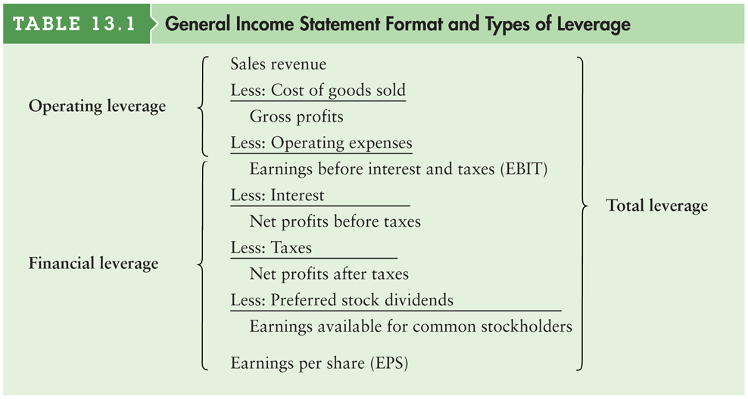
Table 13.1 General Income Statement Format and Types of Leverage

Slide 7
Operating Leverage
Operating Leverage -- The use of fixed operating costs by the firm.
  One potential “effect” caused by the presence of operating leverage is that a change in the volume of sales results in a “more than proportional” change in operating profit (or loss).

Slide 8
Impact of Operating Leverage on Profits
Firm F is the most “sensitive” firm -- for it, a 50% increase in sales leads to a 400% increase in EBIT.
Our example reveals that it is a mistake to assume that the firm with the largest absolute or relative amount of fixed costs automatically shows the most dramatic effects of operating leverage.
Later, we will come up with an easy way to spot the firm that is most sensitive to the presence of operating leverage.

Slide 9
Break-Even Analysis
Break-Even Analysis -- A technique for studying the relationship among fixed costs, variable costs, sales volume, and profits. Also called cost/volume/profit (C/V/P) analysis.
  When studying operating leverage, “profits” refers to operating profits before taxes (i.e., EBIT) and excludes debt interest and dividend payments.

Slide 10
Break-Even Chart
Total Revenues
Profits
250
Total Costs
175
REVENUES AND COSTS
($ thousands)
100
Fixed Costs
Losses
Variable Costs
50
0 1,000 2,000 3,000 4,000 5,000 6,000 7,000
QUANTITY PRODUCED AND SOLD

Slide 11
Degree of Operating Leverage (DOL)
Degree of Operating Leverage -- The percentage change in a firm’s operating profit (EBIT) resulting from a 1 percent change in output (sales).
  DOL at Q units of output
  (or sales)
Percentage change in
operating profit (EBIT)
=
Percentage change in
output (or sales)

Slide 12
Financial Leverage
Financial Leverage -- The use of fixed financing costs by the firm. The British expression is gearing.
  Financial leverage is acquired by choice.
  Used as a means of increasing the return to common shareholders.

Slide 13
EBIT-EPS Break-Even, or Indifference, Analysis
EBIT-EPS Break-Even Analysis -- Analysis of the effect of financing alternatives on earnings per share. The break-even point is the EBIT level where EPS is the same for two (or more) alternatives.
  Calculate EPS for a given level of EBIT at a given financing structure.
EPS
(EBIT - I) (1 - t) - Pref. Div.
=
# of Common Shares

Slide 14
What About Risk?
Debt
6
5
Lower risk. Only a small
probability that EPS will
be less if the debt
alternative is chosen.
4
Common
3
Probability of Occurrence
(for the probability distribution)
Earnings per Share ($)
2
1
0
0 100 200 300 400 500 600 700
EBIT ($ thousands)

Slide 15
What About Risk?
Debt
6
5
Higher risk. A much larger
probability that EPS will
be less if the debt
alternative is chosen.
4
Probability of Occurrence
(for the probability distribution)
Common
Earnings per Share ($)
3
2
1
0
0 100 200 300 400 500 600 700
EBIT ($ thousands)

Slide 16
Degree of Financial Leverage (DFL)
Degree of Financial Leverage -- The percentage change in a firm’s earnings per share (EPS) resulting from a 1 percent change in operating profit.
  DFL at EBIT of X dollars
Percentage change in
earnings per share (EPS)
=
Percentage change in
operating profit (EBIT)

Slide 17
Financial Risk
Financial Risk -- The added variability in earnings per share (EPS) -- plus the risk of possible insolvency -- that is induced by the use of financial leverage.
  Debt increases the probability of cash insolvency over an all-equity-financed firm. For example, our example firm must have EBIT of at least $100,000 to cover the interest payment.
  Debt also increased the variability in EPS as the DFL increased from 1.00 to 1.25.

Slide 18
What is an Appropriate
Amount of Financial Leverage?
Debt Capacity -- The maximum amount of debt (and other fixed-charge financing) that a firm can adequately service.
  Firms must first analyze their expected future cash flows.
  The greater and more stable the expected future cash flows, the greater the debt capacity.
  Fixed charges include: debt principal and interest payments, lease payments, and preferred stock dividends.

Slide 19
Coverage Ratios
Interest Coverage
EBIT
Interest expenses
Income Statement
Ratios
Coverage Ratios
A ratio value equal to 1
indicates that earnings
are just sufficient to
cover interest charges.
Indicates a firm’s ability to cover interest charges.

Slide 20
Coverage Ratios
Debt-service Coverage
EBIT
{ Interest expenses + [Principal payments / (1-t) ] }
Income Statement
Ratios
Coverage Ratios
Allows us to examine the
ability of the firm to meet
all of its debt payments.
Failure to make principal
payments is also default.
Indicates a firm’s ability to cover interest expenses and principal payments.

Slide 21
Coverage Example
Make an examination of the coverage ratios for Basket Wonders when EBIT=$500,000. Compare the equity and the debt financing alternatives.
Assume that:
  Interest expenses remain at $100,000
  Principal payments of $100,000 are made yearly for 10 years

Slide 22
Summary of the Coverage Ratio Discussion
The debt-service coverage ratio accounts for required annual principal payments.
A single ratio value cannot be interpreted identically for all firms as some firms have greater debt capacity.
Annual financial lease payments should be added to both the numerator and denominator of the debt-service coverage ratio as financial leases are similar to debt.

Slide 23
Other Methods of Analysis
Capital Structure -- The mix (or proportion) of a firm’s permanent long-term financing represented by debt, preferred stock, and common stock equity.
  Often, firms are compared to peer institutions in the same industry.
  Large deviations from norms must be justified.
  For example, an industry’s median debt-to-net-worth ratio might be used as a benchmark for financial leverage comparisons.

Slide 24
Other Methods of Analysis
Surveying Investment Analysts and Lenders
Firms may gain insight into the financial markets’ evaluation of their firm by talking with:
  Investment bankers
  Institutional investors
  Investment analysts
  Lenders

Slide 25
Other Methods of Analysis
Security Ratings
Firms must consider the impact of any financing decision on the firm’s security rating(s).

Slide 26
Matter of Fact
Leverage Around the World
  A recent study of the use of long-term debt in 42 countries found that firms in Argentina used more long-term debt than firms in any other country.
  Relative to their assets, firms in Argentina used almost 60% more long-term debt than did U.S. companies.

Slide 27
Matter of Fact
Leverage Around the World
  Indian firms were heavy users of long-term debt as well. At the other end of the spectrum, companies from Italy, Greece, and Poland used very little long-term debt. In those countries, firms used only about 40% as much long-term debt as did their U.S. counterparts.

Slide 28
Personal Finance Example
Shanta and Ravi Shandra wish to assess the impact of additional long-term borrowing on their degree of financial leverage (DFL). The Shandras currently have $4,200 available after meeting all of their monthly living (operating) expenses, before making monthly loan payments.

Slide 29
Personal Finance Example
They currently have monthly loan payment obligations of $1,700 and are considering the purchase of a new car, which would result in a $500 per month increase (to $2,200) in their total monthly loan payments. Because a large portion of Ravi’s monthly income represents commissions, the Shandras feel that the $4,200 per month currently available for making loan payments could vary by 20% above or below that amount.

Slide 30
The End

