Slide 1

Financial Risk Management
Prepared by Dr. Walaa Mohamed
Lecture 6
PMG 633
Credit Risk

Slide 2
Lecture 7
Key Learning Points
Market risk measurement & Management
Credit risk:
One of a bank’s core risks is the possibility that borrowers will not repay their loans on time, or at all.
Lenders distinguish between retail and commercial borrowers and tailor products to meet each group’s unique financial needs.
Loan products can be characterized by maturity, repayment method, loan use, the different types of security the borrower needs to provide the lender (collateral), or the restrictions the borrower must agree to in order to obtain the loan (covenants).
There is a wide variety of credit products, and similar products can be used to meet both retail and commercial borrowing needs.

Slide 3
Market risk measurement & Management
4.1. Types of Market Risk: The Five Risk Classes
To better understand the five different types of market risk, this section describes each risk type.
1. Foreign exchange risk is the potential for loss due to an adverse change in foreign exchange rates, and applies to all exchange rate–related products whose positions are valued in a currency that differs from the bank’s reporting currency.

Slide 4
2. Interest rate risk is the potential loss due to adverse changes in interest rates. Note that the value of fixed income instruments will change if either the creditworthiness of the borrower changes or the risk-free interest rate changes. The potential change to the creditworthiness of the borrower is the credit risk associated with the loan. The potential change to the interest rate is the market risk associated with the loan.

Slide 5
Equity risk is the potential loss due to an adverse change in the price of stocks and applies to all instruments that use equity prices as part of their valuation—for example, derivative products such as futures contracts.
4. Commodity risk is the potential loss from an adverse change in commodity prices. This applies to all commodity positions and any derivative commodity positions such as futures contracts.

Slide 6
4.2. Value-at-Risk
To measure market risk in their portfolios, banks commonly use a concept termed Value-at-risk (VaR). VaR provides a qualified answer to the question, “How much could we lose in the next day (or week, month, year)?” Formally, VaR is defined as the predicted loss at a specific confidence level (e.g., 95%) over a given period of time (e.g., 1 day). Note that VaR does not provide the worst-case loss, but instead uses a confidence level, generally 95% or higher.

Slide 7
With a 99% confidence level, for example, VaR estimates the loss level such that 99% of the time (e.g., in 99 trading days out of 100), the actual loss level will be less than that number. VaR makes no prediction about what the loss could be on the worst day. If a 95% confidence level were used, then VaR is estimating the 6th worst daily loss in a 100-day horizon, but does not provide any additional information about how much worse the five worst daily losses will be.

Slide 8
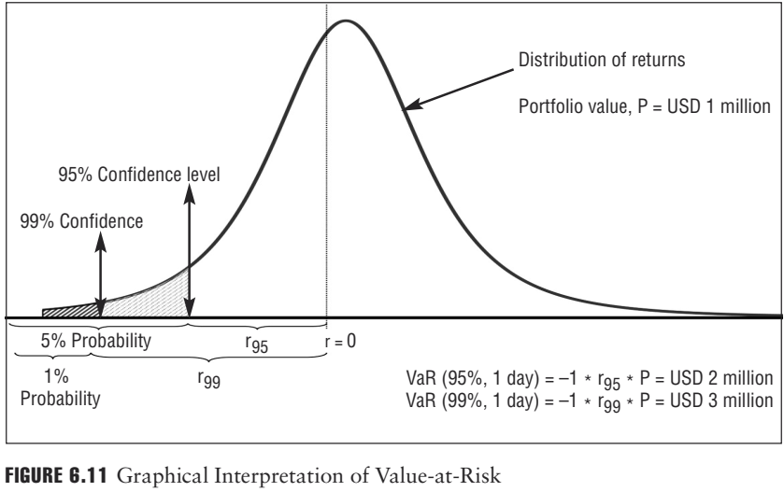
For Bank G, the figure above offers graphical interpretation of its VaR. The line labeled 95% confidence level is at USD –2 million. The shaded area under the curve to the left of the line is 5%, indicating that there is a 5% chance losses could be greater than USD 2 million, and so, the 1-day 95% VaR is USD 2 million. Further to the left, at USD –3 million, there is a line labeled 99% confidence level. The area under the curve left of that line is 1% and indicates that there is a 1% chance that losses could exceed USD 3 million. Therefore, the 1-day 99% VaR is USD 3 million.

Slide 9
VaR calculations make assumptions about the likely movements of market values in the future. One way to do this is to look at how market values moved in the past, and to assume that they will move that way in the future. If a company’s stock price has moved up and down by significant amounts in the past, one might assume that it will continue to do so in the future. Similarly, if a company’s stock price rarely moves above USD 100, although sometimes it falls as low as USD 70, again one could assume that its price will remain in that range in the future.
Clearly, if historical data is to be used as a guide to future price movements, then the time period that is used when collecting data on price movements is important. If the period used is too short, the data may not capture a wide range of possible price movements. Similarly, if data is used from a time when economic conditions were stable and benign, they may not be much use in predicting how prices will move under more difficult economic conditions.

Slide 10
EXAMPLE
A bank calculates that its 1-day 95% VaR is USD 100 million. The head of market risk tells the chief risk officer that the bank stands to lose no more than USD 100 million 95 days out of every 100. The chief risk officer decides that is too much risk for the bank to be taking so she tells the head of market risk to sell volatile positions and buy bonds and stocks that have shown price stability in the past. After the head of market risk has done this, the bank’s VaR is reduced to USD 60 million.

Slide 11
Summary
VaR is a very general concept that attempts to provide a concise snapshot of the current market risk profile of the bank’s portfolio. VaR has broad applications in risk management, including market, credit, and operational risk. VaR as a concept has some shortcomings that are important to emphasize:
■VaR is measured with estimation error. That is, the estimated return distribution is derived from a quantitative model that typically makes simplifying assumptions and is therefore not a precise statement of the range of possible outcomes.
■VaR does not give any information about the severity of loss by which it is exceeded. That is, if the loss amount does exceed the VaR value, VaR does not provide any information about how much greater the loss might be. Risk managers will typically consider a range of confidence levels to understand better the range of possible losses and alter- native risk measures such as expected shortfall.
■Most importantly, VaR does not describe the worst-case loss but the worst case for a specified confidence level. This is a point to be emphasized and remembered.

Slide 12
4.3. Expected Shortfall
Given the limitations of VaR, regulators and financial organizations are putting more emphasis on another risk measure, expected shortfall (ES), to more fully estimate risk in the tail of the return distribution. ES is also referred to as conditional VaR (CVaR) or Expected Tail Loss (ETL). For a given time period and confidence level, ES is the average loss that could occur in excess of the loss calculated by VaR over the same time period and using the same confidence level.
By construction, ES will always be a larger number than its corresponding VaR because it is estimating the average loss in the extreme tail of the distribution beyond the VaR loss value. Like VaR, ES is NOT the worst case loss, which for many portfolios cannot be estimated. Because it requires even greater information about the extreme tail of the return distribution, ES is more difficult than VaR to calculate and has greater estimation error.

Slide 13
By construction, ES will always be a larger number than its corresponding VaR because it is estimating the average loss in the extreme tail of the distribution beyond the VaR loss value. Like VaR, ES is NOT the worst case loss, which for many portfolios cannot be estimated. Because it requires even greater information about the extreme tail of the return distribution, ES is more difficult than VaR to calculate and has greater estimation error.

Slide 14
4.4. Stress Testing and Scenario Analysis
Although a 99% VaR measure may capture a wide range of all possible outcomes, risk managers must pay particular attention to the remaining 1% of outcomes since these events could cause banks serious financial problems. Stress testing and scenario analysis are important tools of any risk management system that seeks to understand how a portfolio will perform in extreme cases. Given the reliance on modeling, risk measures need to be closely examined and tested against extreme events.

Slide 15
Stress testing considers instances for particular value changes, such as a rapid change in interest rates or equity indices. Scenario analysis evaluates portfolio performance in severe states of the world, either hypothetical or historical.
For example, scenarios that a risk manager may consider for an equity portfolio would be to model and use the U.S. stock market crash of 1987 or the 1997 Asian financial crisis. Other scenarios might be based on natural disasters, wars, changes in political situations—virtually anything that would have a dramatic effect on market prices.

Slide 16
4.6 Hedging and Basis Risk
Hedging
Banks and individuals hedge in order to reduce or cancel out a risk. When a bank hedges a position it currently holds in a financial instrument, the position is matched as closely as possible with an equal and opposite offsetting position in a financial instrument that tracks or mirrors the value changes in the position being hedged. Usually, hedging involves a position in a derivative that mirrors as closely as possible the value changes of the underlying asset.

Slide 17
Hedging is the opposite of speculation. In a speculative trade, the bank chooses to take a calculated risk in the expectation of a positive future return. In a hedging trade, the bank chooses to limit some of the risk exposures it has by sacrificing some, if not all, possible future returns. While hedging sounds complicated, in fact it is not. In our everyday lives, we all hedge.
Example on speculative trade
Short selling involves borrowing a security and selling it on the open market. You then purchase it later at a lower price, pocketing the difference after repaying the initial loan.
For example, let's say a stock is trading at $50 a share. You borrow 100 shares and sell them for $5,000. The price suddenly declines to $25 a share, at which point you purchase 100 shares to replace those you borrowed, netting $2,500 in the bargain.
Short selling may sound straightforward, but this kind of speculative trading involves considerable risk.

Slide 18
To summarize:
In a long equity position, the undesirable outcome is that the value of the equity decreases; to hedge, a put option should be purchased (long position in a put option) because the value of the put option increases as the value of the stock decreases.
In a short equity position, the undesirable outcome is that the value of the equity increases; to hedge, a call option should be purchased (long position in a call option) because the value of the call option increases as the value of the stock increases.

Slide 19

Introduction to Credit Risk
Credit risk analysis encompasses various components that, in combination,
offer the bank a way to measure the probability that a borrower may default on a contract—a debt, loan, or similar promise to perform—and how much value is likely to be recovered in the event of a default. Credit risk is most simply defined as the potential that a borrower, or counterparty, will fail to meet its obligations in accordance with agreed terms. Defaults the failure to repay or meet existing obligations.

Slide 20
Counterparty risk is a common reference to the risk that another party to a contract or agreement will fail to perform under the terms of the agreement. This could mean the failure to provide promised goods or services, refusal to provide promised loan facilities, or the failure to pay amounts owed.

Slide 21
Lenders:
Banks facilitate financial intermediation, the process by which one group in need of capital borrows funds from another group that has excess capital available for investment. In arranging this transfer of capital between the two groups, the bank uses deposits to finance the loan. Intermediation is critical to promoting economic development. Banks accept deposits from one group (depositors) and use those funds to provide credit products to another group (borrowers).

Slide 22
Granting credit facilities (i.e., loans) creates risk. Banks accept this risk as a regular cost of business. Essentially, banks are in the business of managing risk. Banks continually attempt to expand their ability to manage all types of risks and, in particular, have gained considerable experience with credit risk analysis. Banks routinely evaluate their experiences and incorporate the lessons learned into their business practice by modifying or adding policies and procedures that mitigate credit risk. Despite these efforts, recent events in the banking sector highlight how challenging credit analysis and credit risk management can be.

Slide 23
Banking is essential to both the retail and the wholesale markets. There are thousands of local, regional, and global banks that offer a variety of products and services to meet the needs of the retail market (individual customers, shops, and small and medium-sized businesses). In the wholesale market (lending to other banks, large corporate entities, and large global institutions), only the larger banks are able to offer a diverse enough product range to meet the needs of the customers. Figure 4.1 describes the two major banking sectors.

Slide 24
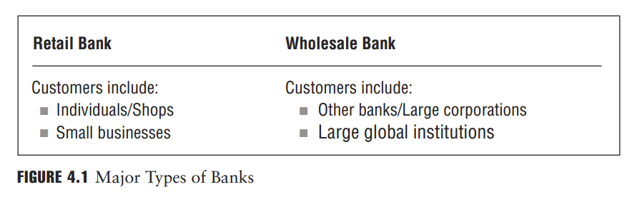

Slide 25
1. Investment Banks
Investment bank soften act as an agent or financial intermediary to companies. Although they may have their own brokerage operations, provide investment advice to their customers, and provide loans and credit to commercial customers, their core activity is to arrange equity and debt financing on behalf of their corporate customers. Investment banks typically do not accept deposits from customers or provide loans to retail customers, and they are not often directly regulated by bank regulators unless the investment bank is part of a bank that is otherwise regulated by bank regulators.

Slide 26
As mentioned in Chapter 1, in late 2008, some large U.S. investment banks, including Goldman Sachs and Morgan Stanley, converted to banks regulated by the government. The change was considered necessary in order to allow these entities to increase their capital by collecting customer deposits and also, crucially, gave them access to the Federal Reserve’s Emergency Lending Facilities. Given the severity of the global financial crisis of 2007– 2009, it would appear that the investment banking model that has existed in the United States since the mid-1930s is becoming obsolete in a globally connected and capital-intensive financial world.

Slide 27
Borrowers:
Both retail and wholesale banks differentiate between different types of borrowers based on a variety of factors, including size and financing needs. On the retail side, one broad distinction is typically drawn between individual borrowers and small business borrowers. On the wholesale side, however, the differentiation tends to be more complex.

Slide 28
1. Retail Borrowers
Retail borrowers include consumers (individuals) who borrow money to purchase homes, cars, and other goods (in many countries, consumers also borrow to finance education and similar expenses). Generally, consumers with high income, low levels of debt, and solid loan repayment records are considered less risky borrowers, but a borrower’s rating ultimately depends on a variety of criteria.

Slide 29
In today’s banking environment, retail banking has become a commodity-like business. Most banks now group their retail borrowers into relatively homogeneous risk groups based on standard criteria. This process allows banks to analyze repayment and default characteristics based on standardized borrower characteristics. One aspect of this process is credit scoring, which allows the common characteristics of loans and borrowers to be grouped and analyzed.

Slide 30
Scoring in groups enables loans and borrowers to be dissected and analyzed to more accurately assess a portfolio’s probability of loss. Standardization and credit scoring allow the assessment process to be completed more cheaply, making relatively small loans profitable. It has also facilitated securitization, the bundling or packaging of portfolios of loans, against which debt instruments can be issued.
Credit scoring is a statistical analysis performed by lenders and financial institutions to determine the creditworthiness of a person or a small, owner-operated business. Credit scoring is used by lenders to help decide whether to extend or deny credit.

Slide 31
2. Corporate Borrowers
Corporate borrowers include companies ranging from small local companies to large global conglomerates. Each has different financing needs, and each should be analyzed on a stand-alone basis. Depending on the ease of access to capital (public markets, banks, private funding), companies may borrow capital or raise equity to finance growth and generate income. When borrowing, companies typically repay their obligations from the cash generated from the growth.

Slide 32
Companies with steady profits, low debt levels, and solid management are considered to be less risky and are offered better contractual terms for their borrowings. Corporate borrowers are frequently differentiated by their size and global reach. The main differences are listed in Figure 4.2.

Slide 33
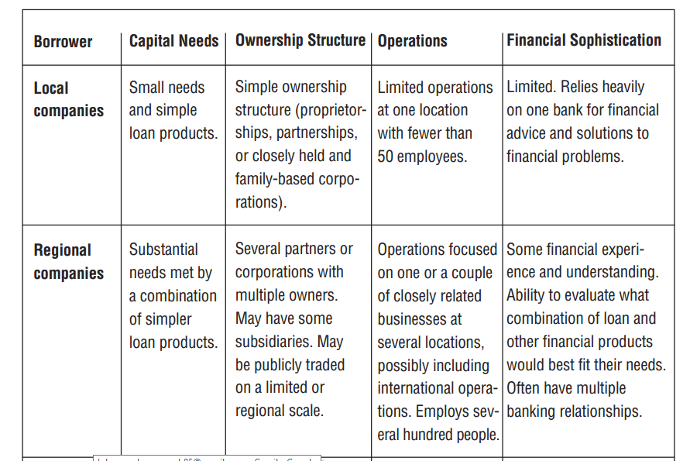

Slide 34
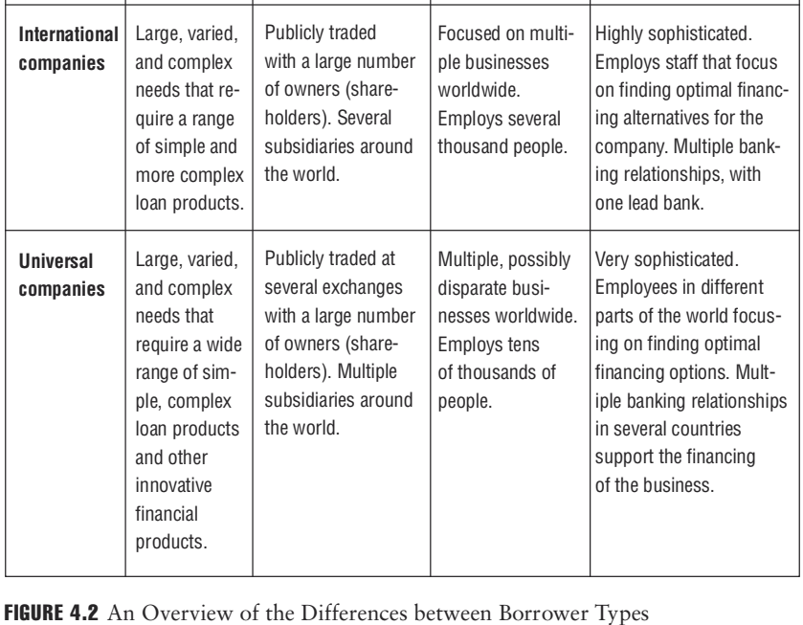

Slide 35
Local companies. These companies are generally referred to as small and medium enterprises (SMEs). SMEs are usually smaller corporate entities such as partnerships, sole proprietorships, owner-operators, mom-and-pop shops, and other small businesses. SMEs are generally privately or closely held and have a straightforward legal structure. Annual sales are generally below USD 1 million, EUR 750,000, or GBP 500,000, but business size does differ across institutions and regulatory frameworks, and SMEs in emerging markets are generally much smaller than those seen in more developed economies.

Slide 36
Regional companies. Regional companies are commercial businesses, generally larger SMEs, and include chain stores, gas stations, and restaurants, with sales between USD 1 million and 100 million (EUR 750,000 to 75 million, GBP 500,000 to 50 million). Some would fall into the definition of SMEs according to the Basel II Accord. Further, their business activities usually expose them to one or more local markets or provide general exposure within a region. The legal and ownership structure of these businesses can be more complex, with multiple owners, several subsidiaries, and locations in different legal jurisdictions.

Slide 37
International companies. International companies conduct their business across country borders but generally limit their activities to a certain region around the globe (e.g., Western Europe, the United States, and Canada). They may also be listed or publicly traded companies on a stock exchange or other similar exchange, or may be large, privately held businesses that operate in different countries. International companies can have sizable annual sales (often in the billions) and need to borrow regularly from banks or the corporate bond market to finance their activities and growth.

Slide 38
Universal companies. These companies are generally considered global conglomerates with exposures around the world. They typically manage their businesses by being constantly aware of global business considerations and pressures. Most are publicly traded on an exchange. Examples include Siemens, Mitsubishi Heavy Industries, Procter & Gamble, BP, Royal Dutch Shell, and General Electric. All are considered institutional borrowers by banks and demand unique consideration for their financing needs. Hedge funds, international banks, and global insurers are also considered universal companies and institutional borrowers.

Slide 39
3. Sovereign Borrowers
Sovereign borrowers are governments that raise capital through bonds or direct borrowing generally from the larger global banks. Amounts raised are often used for large capital investments (roads, railways) or to finance government spending. Governments often use tax revenues to repay these loans.

Slide 40
4. Public Borrowers
Public borrowers are primarily state, provincial, and local governments (municipalities) and their sub entities (e.g., water and sewage companies, air-port authorities, public hospitals, and school districts). Amounts borrowed at this level are normally used either for investments (streets, water supply) or general spending. Since most local governments have the ability to generate cash by taxing their constituencies, public loans are considered relatively low risk. Nevertheless, there have been times when strong local governments have defaulted on their loans.

Slide 41
Characteristics of Credit Products:
There is a wide variety of loan types. All were developed to meet specific business needs of different borrowers’ unique situations. This section describes basic lending facilities and their differences. To understand which type of lending facility is appropriate for a borrower, lenders must understand the details of the borrower’s financial status, especially how it relates to existing and anticipated conditions in the local, regional, or international marketplaces.

Slide 42
There are a number of ways a credit product can be classified:
Maturity
Commitment specification
Purpose
Repayment source
Collateral requirements
Covenant requirements
Repayment characteristics

Slide 43
1. Maturity
Credit needs range over different time periods, with the loans made to meet those needs generally classified by maturity. Maturity simply means the date the final payment on the loan or other financial instrument becomes due.
For instance, a loan of a maturity of one year must be repaid in full within one year.

Slide 44
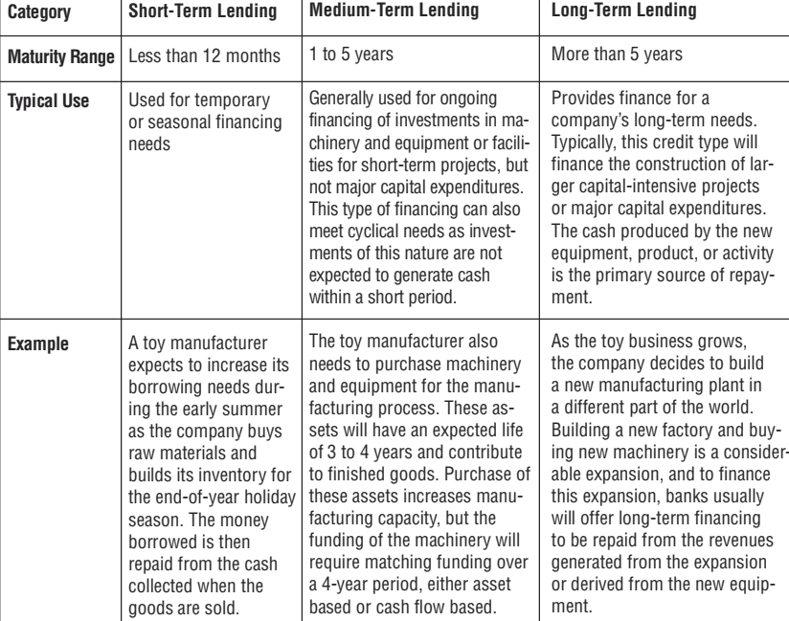

Slide 45
2. Commitment Specification
Banking facilities are further classified as committed or uncommitted. Figure 4.4 outlines the differences between standard bank facilities.
Committed facilities are characterized by formal loan agreements, usually for one year or more. Committed facilities earn a margin for the bank above its own cost of funds and include a facility fee, a commitment fee, and a fee for the amount of the loan the bank has actually extended to the borrower, whether or not the borrower uses the full amount of the loan. The amount of the loan not yet taken by the borrower is referred to as an undrawn commitment.

Slide 46
Uncommitted facilities are less formal arrangements but often include a facility letter stating that funds would be made available on demand but solely at the lender’s discretion. Uncommitted facilities provide a general framework for the terms of the lending without noting the specific contractual terms of that agreement, such as the amount of the loan or its duration, although such facilities are short term in nature (often on demand or overdrafts).
An overdraft occurs when money is withdrawn in excess of what is on the current account. In this situation the account is said to be "overdrawn".

Slide 47
There may be different contractual terms depending on when the facility is used. Uncommitted facilities are generally cheaper than committed facilities and priced on a margin above the bank’s base rate. There may also be an arrangement fee charged at each renewal of the uncommitted facility.

Slide 48
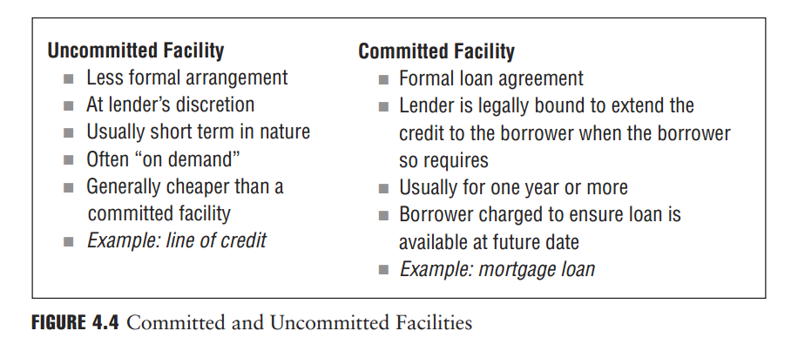
A line of credit (LOC) is an account that lets you borrow money when you need it, up to a preset borrowing limit, by writing checks or using a bank card to make purchases or cash withdrawals.

Slide 49
Banks can also generate income through compensating balances. When a bank extends a committed or an uncommitted facility, it may require the borrower to deposit certain amounts of money with the lending bank for the duration of the loan commitment. These funds are referred to as compensating balances. This arrangement provides the bank with funds to be used for other purposes, thus allowing it to earn a return on those funds in excess of the costs of the services being provided to the borrower. The borrower may also receive a credit for the compensating balance through an offset of the fee for the banking facility.

Slide 50
Compensating balances serve several functions:
They serve as collateral in case the borrower defaults.
They reduce the bank’s interest expenses. Since the deposit usually carries a very low interest rate, sometimes as low as 0%, it allows the bank to secure additional deposits effectively at a very low cost, providing the bank with cheap financing through low-cost deposits. Borrowing at a low rate while lending at a higher rate increases the bank’s potential earnings.
Compensating balances also indirectly increase the interest the borrower pays to the bank and are consequently considered as a charge to the borrower, as interest is charged for the extension of a loan.

Slide 51
3. Loan Purpose
The use of loan proceeds can vary widely and can impact a lender’s credit decision. A loan used to finance inventory, to purchase equipment used in the production process, or to address some other type of working capital need may be viewed as facilitating the normal course of business or perhaps making possible the exploitation of a perceived strategic opportunity.
Typically, there is little credit quality decline inherent in these transactions. Loans, however, can also be used to buy back stock, to finance a leveraged buyout, to pay a dividend, or to fund other shareholder-friendly activities. These loans are typically considered riskier, as they tend to benefit shareholders at the expense of creditors.

Slide 52
4. Repayment Source
Another way to distinguish between the different loan types is to consider how the borrower generates funds to repay the loan. Asset conversion loans, also known as self-liquidating loans, are loans that are repaid by converting the asset that is used to collateralize the loan into cash. The assets used for this type of loan are typically inventory and work in progress (partly completed jobs). The asset conversion loan is normally considered short-term or temporary financing with the asset later being sold on credit terms or for cash that ultimately will be used to repay the loan.

Slide 53
For example, a toy company may need to pay its employees in mid-November, but it is cash-poor because it has laid out most of its funds to produce and market toys that won’t be purchased until December.
One option the toy company might explore is to get an asset-conversion loan. It could take the loan while simultaneously agreeing to put a delivery truck up for sale. When the truck sold, the loan is paid off. If it doesn’t sell, the toy company will be in default on the loan, but the lender will have the truck as collateral.
Asset-conversion loans are short-term loans used when a company needs a quick infusion of cash because it has no liquidity.

Slide 54
Note that these loans are different from asset-based loans in that the asset used as collateral is being sold to repay the loan versus being used simply as collateral for the loan. Agricultural loans (see Section 4.5.1) are asset conversion loans. With cash flow–based loans, a bank provides funds that are repaid with the cash flow from the company’s operations. With asset-based loans, a bank extends a loan after a specific asset or a combination of assets is pledged as collateral or security (see next section on collateral) to cover the loan. Collateral for this type of loan typically includes inventory, machinery and equip-ment, leases, furniture and fixtures, or other tangible assets.

Slide 55
5. Collateral Requirements
Assets pledged by a borrower to secure a loan are called collateral(or security). Collateral is used by the bank to safeguard its capital and acts as insurance in case the borrower cannot repay the loan. In the event of default, the bank has the option of accepting the collateral as full or partial repayment of the loan’s principal, accrued interest, fees and costs, and expenses. As such, collateral plays a major role in a bank’s lending policies—it reduces the potential loss the bank can suffer when a borrower defaults.

Slide 56
Collateral can come in many forms. Cash is the most obvious and most secure form of collateral since it is already liquid. Property is the most common form of collateral, but is unpredictable because its value fluctuates with market conditions and the lender may or may not have access to it. Mortgage lending uses real estate as the collateral for the loan against the property.

Slide 57
6. Covenant Requirements
Covenants are one-way commitments or promises by the obligor to honor an obligation. The essential purpose of covenants in the financial market-place is to protect the lender by attempting to prevent events and/or processes that could result in a potential deterioration in the borrower’s financial or business condition.

Slide 58
COVENANTS
The main purposes of the covenants are:
  To ensure that the project is constructed and operated as agreed with the lenders
  To give lenders advance warning of any problems that might affect the Project Company
  To protect the lenders’ security
POSITIVE COVENANTS: such as
Construct, operate and maintain the project in accordance with the Project Contracts, applicable law, and good industry practice
Provide the agent or security trustee and lenders’ advisers with reasonable access to the project and its records
Maintain the management structure agreed with the lenders
Obtain and maintain the agreed project insurances
Supply reports (usually monthly) on the progress of construction, including achievement of milestone dates.
Provide annual budgets in advance of each operating year

Slide 59

COVENANTS
NEGATIVE COVENANTS: such as
  Undertake any business other than the project
  Merge or consolidate with any other entity
  Agree to any amendment, waiver, or change order in the Project Contracts, or any changes in the project itself (some scope may be given for de minimis amendments and waivers)
  Enter into any contracts (other than the agreed Project Contracts), subject to a de minimis exception
Incur any additional debt or issue guarantees for third parties
Enter into any hedging contracts other than the agreed hedging of interest rate or exchange rate risks
Incur any capital expenditure not agreed to by the lenders (even if it is funded by equity— this is to ensure the speciﬁcations of the project are not changed without lender consent)
Incur operating costs not provided for in the agreed annual budget (usually subject to an agreed tolerance level).
Sell, lease, or otherwise transfer any of its assets (subject to a de minimis exception)
Change its ﬁnancial year end or auditors

Slide 60
Resources:
Foundations of Financial Risk.
An Overview of Financial Risk and Risk-Based Regulation.
Richard Apostolik
Christopher Donohue
Chapter 4

