Slide 1

Types of risks
Lecture 3
Everyone’s Smart
University
PMG510
Project Risk Management

Slide 2

Timescale of risk impact

Slide 3
Timescale of risk impact
This part considers the value of classifying risks according to the timeframe for the impact of the risk.
The classification of risks as long-, medium- and short-term impact is a very useful means of analyzing the risk exposure of an organization.
These risks will be related to the strategy, tactics and operations of the organization.

Slide 4
Timescale of risk impact
In general terms, long-term risks will impact several years, perhaps up to five years, after the event occurs or the decision is taken. Long-term risks therefore relate to strategic decisions.
Medium-term risks have their impact some time after the event occurs or the decision is taken, and typically this will be about a year later.
Medium-term risks are often associated with projects or programmes of work.

Slide 5
Timescale of risk impact
Short-term risks have their impact immediately after the event occurs.
Accidents at work, traffic accidents, fire and theft are all short-term risks that have an immediate impact and immediate consequences as soon as the event has occurred.
These short-term risks cause immediate disruption to normal efficient operations and are probably the easiest types of risks to identify and manage or mitigate.

Slide 6
Timescale of risk impact
By way of example, consider the operation of a new computer software system in more detail. The organization will install the new software in anticipation of gaining efficiency and greater functionality. The decision to install new software and the choice of the software involves opportunity risks. The installation will require a project, and certain risks will be involved in that. The risks associated with the project are control risks. After the new software has been installed, it will be exposed to hazard risks. It may not deliver all of the functionality required and the software may be exposed to various risks and virus infection. These are the hazard risks associated with this new software system.

Slide 7
Timescale of risk impact
An increasingly important consideration for organizations is what will be the trigger mechanism that causes a risk to materialize.
The challenge for management is then based on recognition of the circumstances in which one or more of the significant risk events may be triggered.

Slide 8
Four types of risk
There are four types of risk:
  Compliance risks;
  Hazard risks;
  Control risks;
  Opportunity risks.

Slide 9
Four types of risk
The table below considers the risks associated with owning a car. In this case, the compliance risks relate to the legal obligations associated with owning and driving a car. The hazard risks relate to events that the owner does not want to occur. Uncertainties are the costs that are known to be involved, but these may vary. Finally, the opportunities are the benefits that car ownership offers.

Slide 10
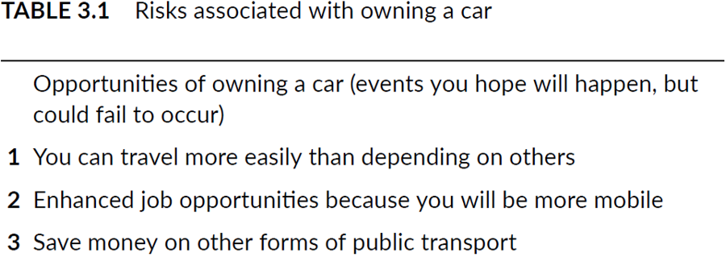
Four types of risk

Slide 11
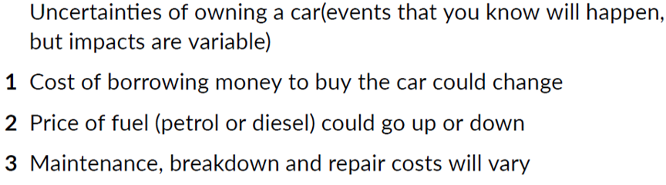
Four types of risk

Slide 12
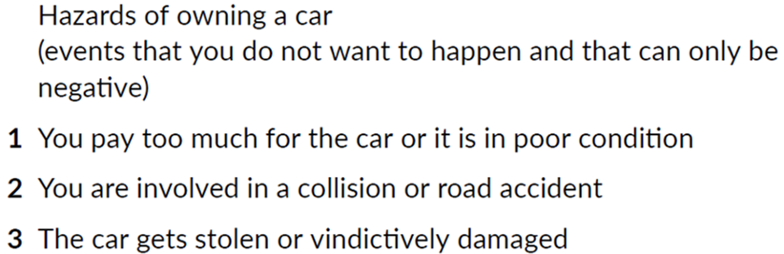
Four types of risk

Slide 13
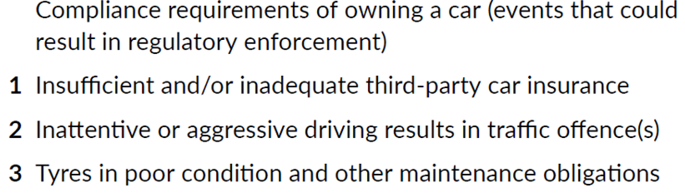
Four types of risk

Slide 14
Hazard risks
Hazard risks are the risks that can only inhibit achievement of the corporate mission. Typically, these are insurable-type risks or perils, and will include fire, storm, flood, injury and so on. The discipline of risk management has strong origins in the control and mitigation of hazard risks. Normal efficient operations may be disrupted by loss, damage, breakdown, theft and other threats associated with a wide range of dependencies.

Slide 15
Hazard risks
The table below gives examples of disruption caused by people, premises, processes and products (4Ps). These dependencies can also be sources of risk and the 4Ps can be considered to be an example of a risk classification system.

Slide 16
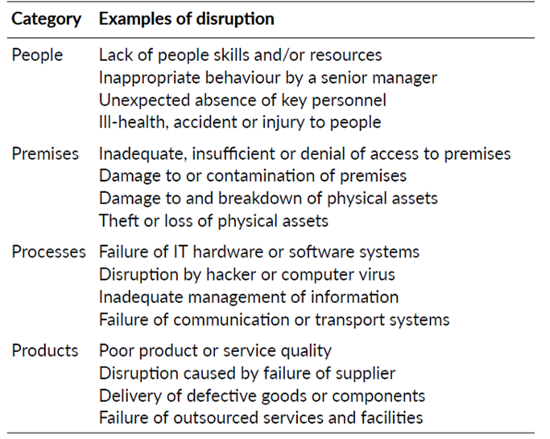
Hazard risks

Slide 17
Control risks
Control risks are risks that cause doubt about the ability to achieve the organization’s mission.

Slide 18
Opportunity risks
Opportunity risks arise because the organization is seeking to enhance the achievement of the mission, although they might inhibit the organization if the outcome is adverse.
This is the most important type of risk for the future long-term success of any organization.

Slide 19
Opportunity risks
Many organizations are willing to invest in high-risk business strategies in anticipation of a high profit or return. These organizations may be considered to have a large appetite for opportunity investment. Often, the same organization will have the opposite approach to hazard risks and have a small hazard tolerance.

Slide 20
Opportunity risks
This may be appropriate, because the attitude of the organization may be that it does not want hazard-related risks consuming the resources of the organization when it is putting so much value at risk investing in opportunities.

Slide 21
Compliance risks
For highly regulated industries, such as energy, finance, gambling and transportation, compliance issues are very important.
Because of the particular nature of compliance risks, they are often considered a separate category of risk and they are often managed or minimized differently.
Many organizations will wish to ensure full compliance with all rules and regulations and run zero risk in this category. This may be possible for compliance risks, but is almost certainly not going to be the case for hazard, control and opportunity risks.

Slide 22
Embrace opportunity risks
All organizations have some appetite for seizing opportunities and are willing to invest in them.
Opportunity risks are normally associated with the development of new or amended strategies, although opportunities can also arise from enhancing the efficiency of operations and implementing change initiatives.

Slide 23
Embrace opportunity risks
Every organization will need to decide what appetite it has for seizing new opportunities, and the level of investment that is appropriate. For example, an organization may realize that there is a requirement in the market for a new product that its expertise would allow it to develop and supply. However, if the organization does not have the resources to develop the new product, it may be unable to implement that strategy and it would be unwise for it to embark on such a potentially high-risk course of action.

Slide 24
Embrace opportunity risks
It will be for the management of the company to decide whether they have an appetite for seizing the perceived opportunity. Just because the organization has that appetite, it does not mean that it is the correct thing to do.
The board of the company should therefore be aware of the fact that, although they may have an appetite for seizing the opportunity, the organization might not have the risk capacity to support that course of action.
Consideration of whether business risks are within the control of the organization or not is an important component of successful business risk management.

Slide 25

Embrace opportunity risks

Slide 26
Manage uncertainty risks
When undertaking projects and implementing change, an organization has to accept a level of uncertainty. Uncertainty or control risks are an inevitable part of undertaking a project. A contingency fund to allow for the unexpected will need to be part of a project budget, as well as contingent time built into project schedules. When looking to develop appropriate responses to control risks, the organization must make the necessary resources available to identify the controls, implement the controls and respond to the consequences of any control risk materializing.

Slide 27
Manage uncertainty risks
Uncertainty represents a deviation from the required or expected outcome.
When an organization is undertaking a project, such as a process enhancement, the project has to be delivered on time, within budget and to specification. Also, the enhancement has to deliver the benefits that were required. Deviation from the anticipated benefits of a project represents uncertainties that can only be accepted within a certain range.

Slide 28
Manage uncertainty risks
There are dangers if the organization becomes too concerned with control management. The organization should not become obsessed with control risks, because it is sometimes suggested that over-focus on internal control and control management suppresses the entrepreneurial effort.

Slide 29
Mitigate hazard risks
Organizations need to tolerate a hazard risk exposure, accept exposure to control risks and invest in opportunity risks.
In the case of health and safety risks, it is generally accepted that organizations should be intolerant of these and should take all appropriate actions to eliminate them. In practice, this is not possible and organizations will minimize safety risks to the lowest level that is cost-effective and in compliance with the law.

Slide 30
Mitigate hazard risks
Organizations need to tolerate a hazard risk exposure, accept exposure to control risks and invest in opportunity risks.
In the case of health and safety risks, it is generally accepted that organizations should be intolerant of these and should take all appropriate actions to eliminate them. In practice, this is not possible and organizations will minimize safety risks to the lowest level that is cost-effective and in compliance with the law.

Slide 31
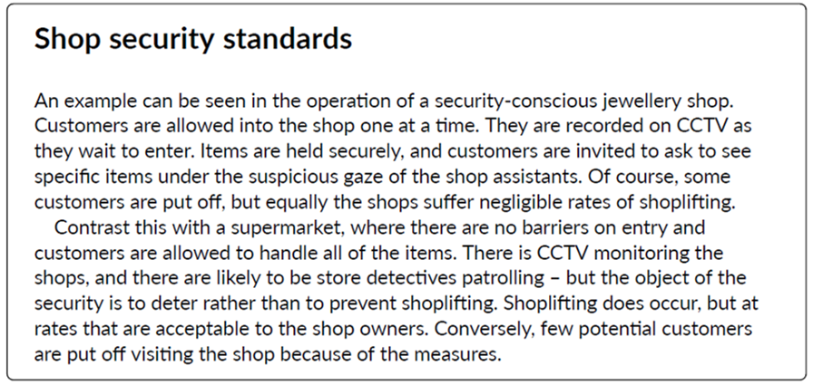
Examples

Slide 32
Examples
Refer to pages 99 & 100 in the reference book:
Read the section: (Minimize compliance risks)
Get an idea on how different organizations from diverse sectors set policies to avoid compliance risks.

