Slide 1



Introduction to Digital Media
The Digital Media Economy
DGM 711
Lecture 10
Prepared by
Dr. Shereen Kedwany

Slide 2

Reminder
Lecture 9
Power relations are now also systematically organized around digital media and the networked public sphere
There has been an increase in the number of citizens who access information and participate in political debates through digital media.
Digital divide is the difference in access to network technologies that occurs between rich countries and poor countries, which depends on the type of society Policies related to access to and transparency of information .
Several Western governments operate surveillance systems that allow them to record all phone and online interactions.
Web corporations capture users' data to improve their services or provide personalized advertising.
Individuals can choose specific strategies to resist surveillance, such as encryption or refusal of participation in the commercial web services

Slide 3

Outline
Lecture 10
I. The Digital Capitalism:.
II. Digital Media Economic Models and Actors.
III. The Startup Economy .
IV. The Sharing Economy .
V. The influencer economy .
VI. AI- Artificial Intelligence and Content Creation Economy.
V. Conclusion.

Slide 4

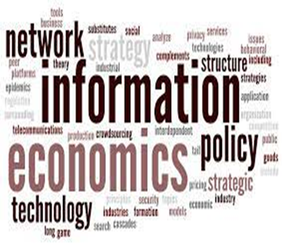
Lecture 10
I. The Digital Capitalism :
The information economy is a dynamic economic sector, dominated by new players.
Digital technologies have changed the organization of production and have contributed to transforming labor and consumption.
Yet access to the information economy is not homogeneous, and phenomena such as concentration and monopolies are at play.
Inequalities between the poorest and richest regions of the world have not disappeared.

Slide 5

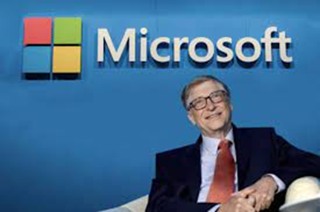
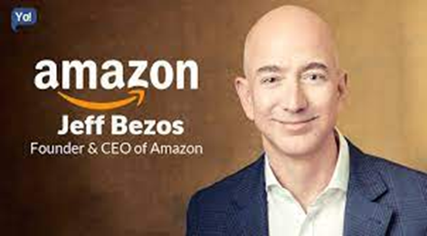
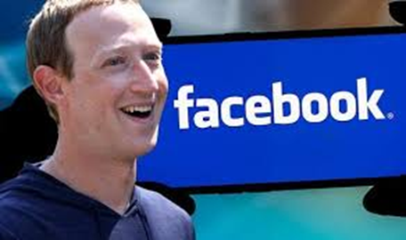
Lecture 10
I. The Digital Capitalism :
The success of companies that produce and manage digital technologies or services is immense.
The magnates of the digital economy, such as Microsoft’s Bill Gates, Amazon’s Jeff Bezos, and Facebook’s Mark Zuckerberg are among the wealthiest individuals in the world, and in some cases the value of their companies has exceeded even that of global oil corporations.

Slide 6
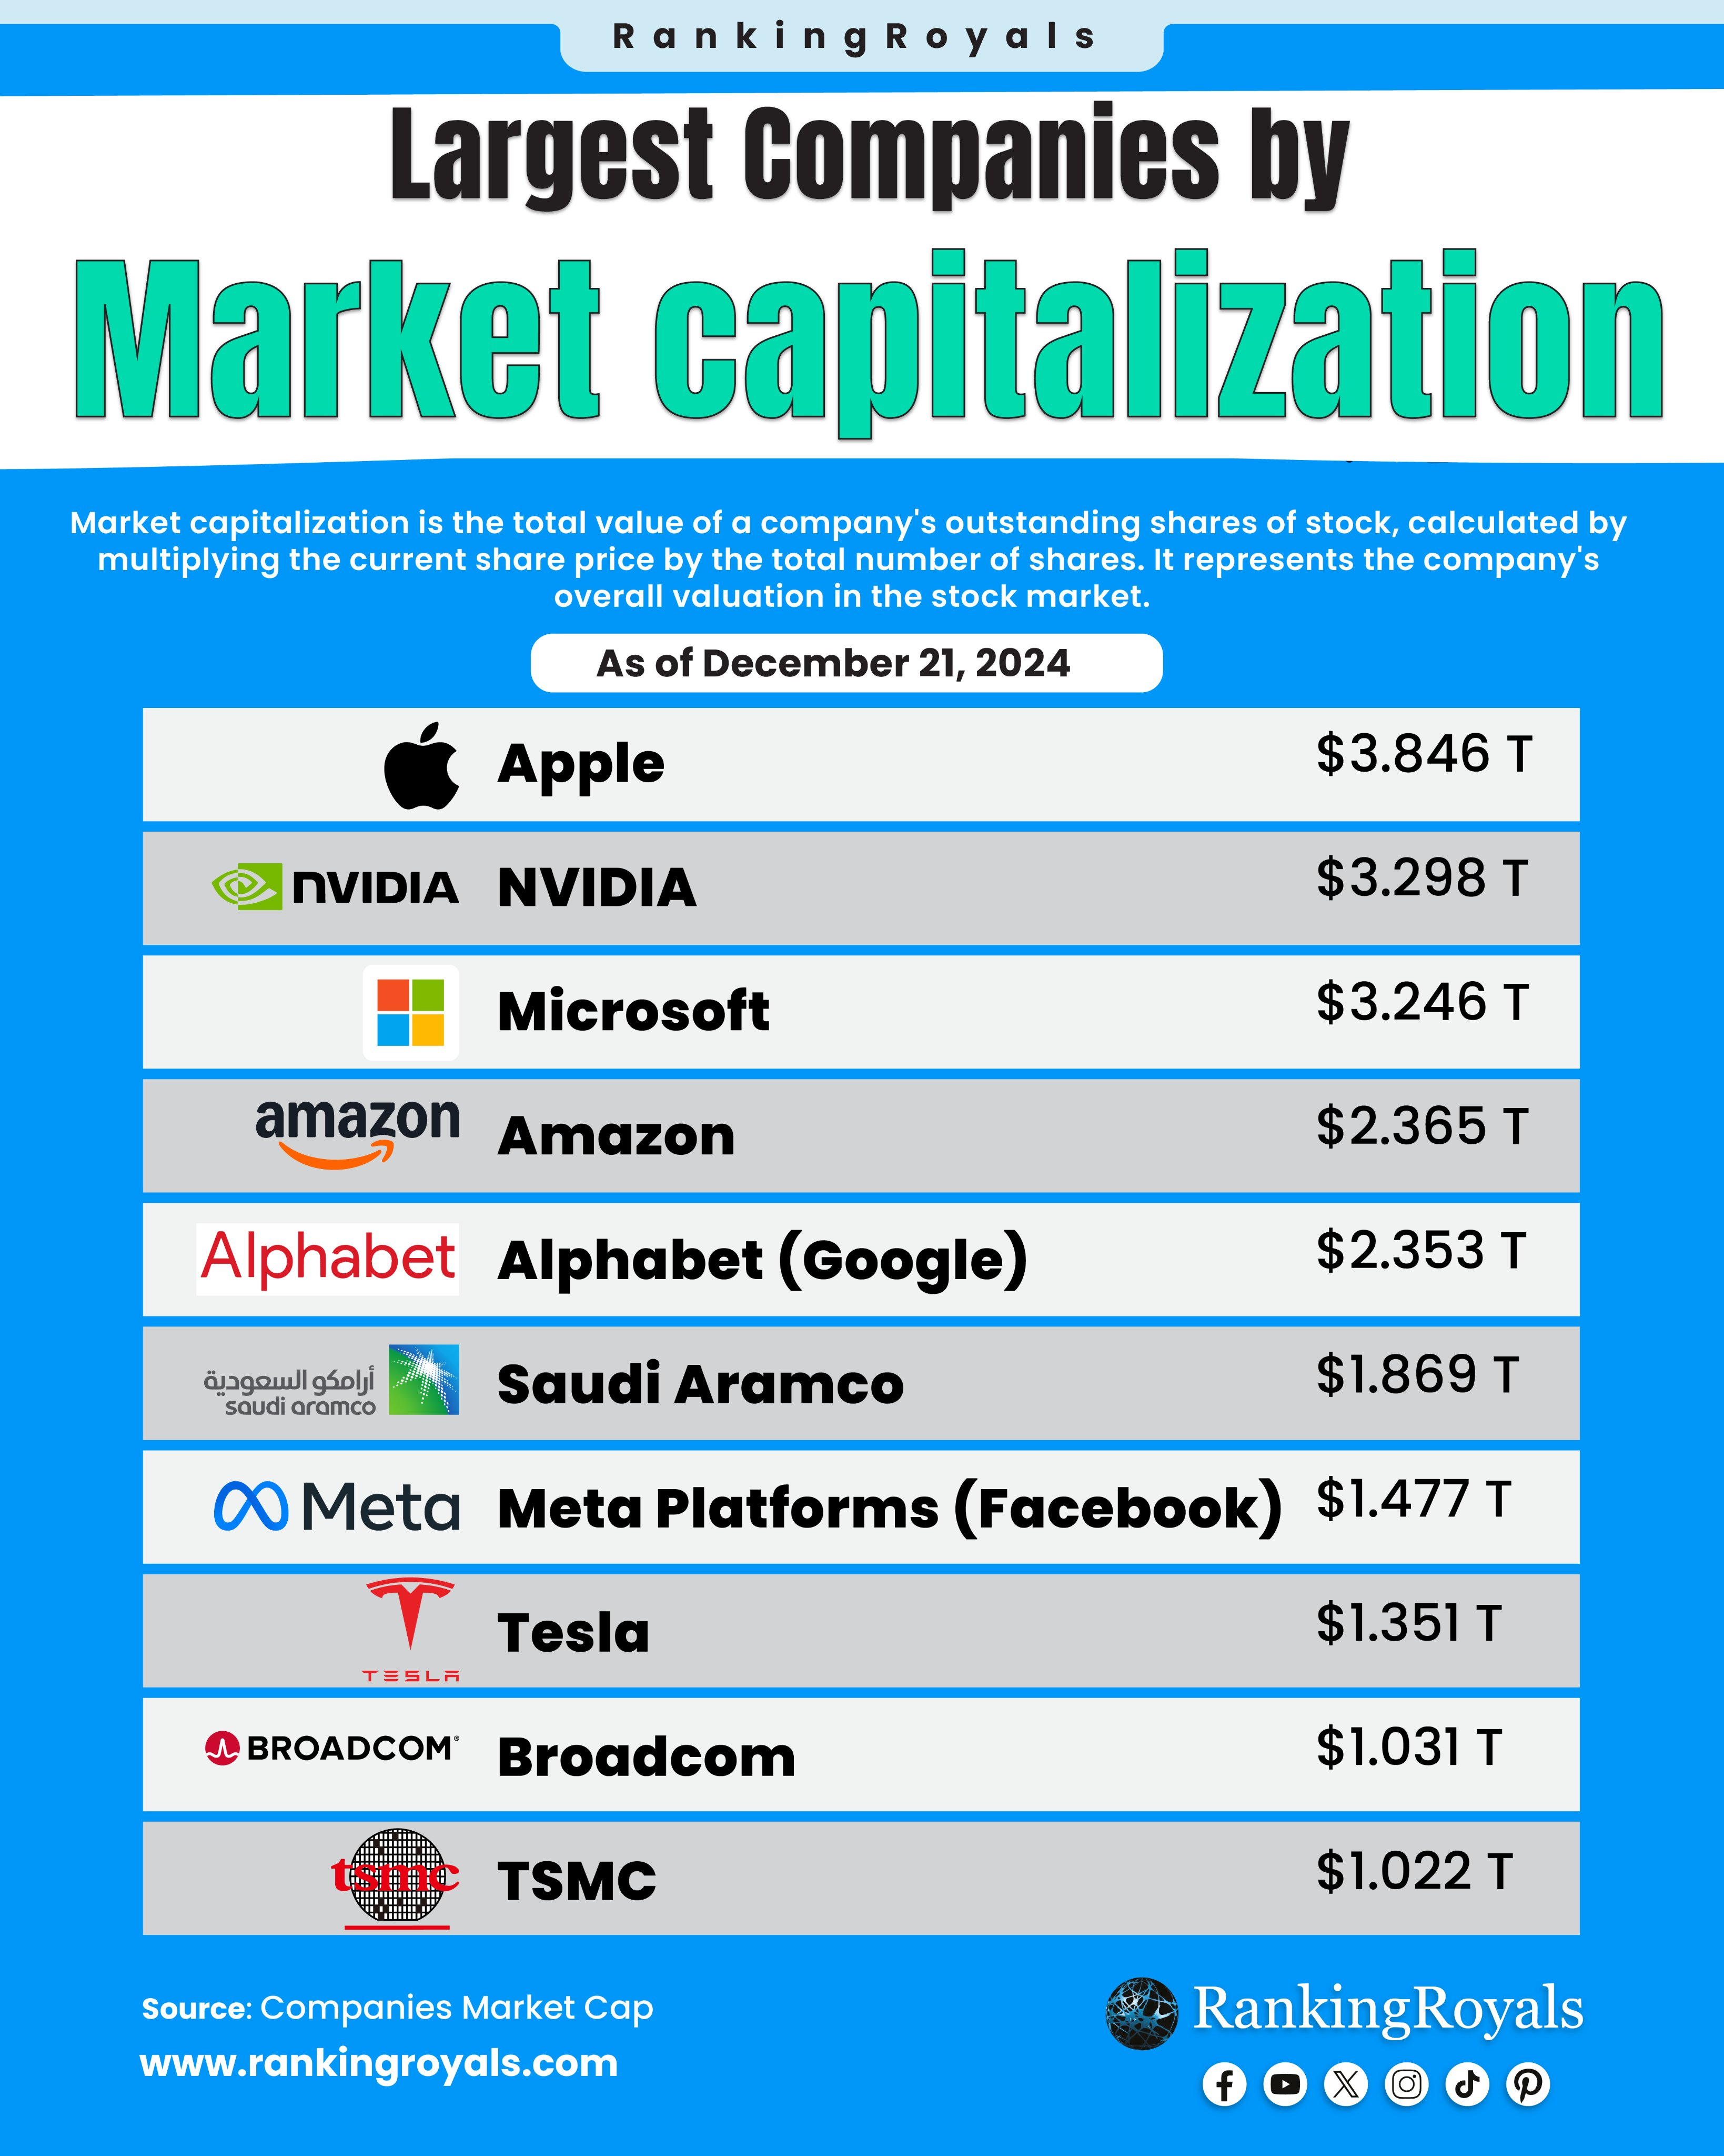





Lecture 10
I. The Digital Capitalism :
According to estimates, in early 2018 Google, Amazon, and Apple had a market value of more than $700 billion each, followed by Microsoft and Facebook at respectively about $600 and $400 billion.
Web giants are so rich as to influence the development of global capitalism through their investments.

Slide 7


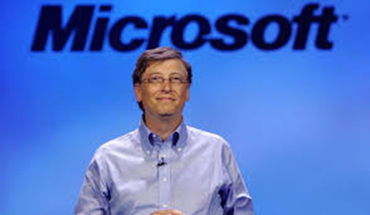
Lecture 10
I. The Digital Capitalism :
This economic power is combined with the ability to participate in the evolution of the dominant ideologies that underpin Western societies.
Bill Gates himself talked about a “frictionless capitalism” mediated by digital technologies, in which free flows of capital, information, goods, and labor are not hindered by regulations or borders.

Slide 8
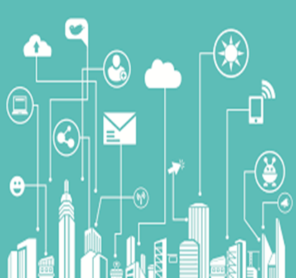
Lecture 10
I. The Digital Capitalism :
In a sense the kind of capitalism advocated by Bill Gates would be based on the fusion of technocratic and liberal ideals, and corresponds to the project of a fully capitalist information society in which barriers to free enterprise are overcome through the deregulation of labor and financial markets, the weakening of nation‐states, and the evolution of digital technologies.
The theories on the transformation toward digital capitalism represent an attempt at explaining the evolution of information societies

Slide 9

Lecture 10
I. The Digital Capitalism :
Scholars have depicted the birth of a communicative capitalism in which affective and communicative skills are the main elements of capitalist production (Dean 2005).
In this model, communication activities are commodified and their main feature is the circulation in spaces mediated by digital technologies rather than their content.
Yet the technologies developed by digital capitalism are not neutral but rather designed and adopted to tame and control human labor and extract value from it.

Slide 10
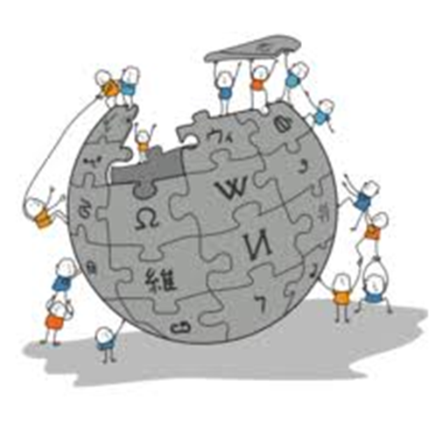
Lecture 10
I. The Digital Capitalism :
Digital capitalism evolves out of older forms of industrial capitalism and media industries.
But it has also shown it has the ability to change by co‐opting forms of alternative production.
Non‐profit institutions such as Wikipedia would thus provide a “cultural infrastructure” that represent a kind of social and cooperative production which takes place in web enterprises .

Slide 11


Lecture 10
I. The Digital Capitalism :
Countercultures are co‐opted too, as alternative technologies or organizational practices developed by hacker communities provide a source of ideas for digital capitalism .
For example, hackatons are design‐centered events traditionally used by hacker groups to collectively write a piece of software or an application.
Independent hacker media such as Internet Relay Chat (IRC), an early text‐only chat technology, have inspired commercial social media such as X(Twitter) .

Slide 12
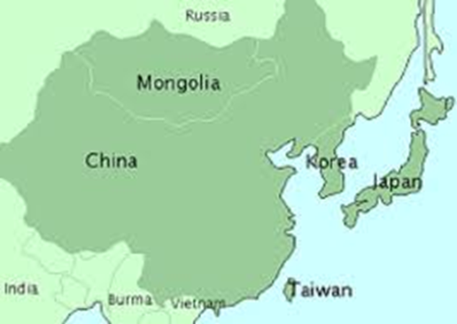

Lecture 10
II. Digital Media Economic Models and Actors :
Digital media have a great economic relevance.
Digital technologies, such as personal computers, smartphones, digital televisions, or tablets, are part of a global market for consumer products.
This market supports the economies of areas that produce hardware components, such as East Asia, and others that manage innovation and marketing processes, such as the United States .

Slide 13
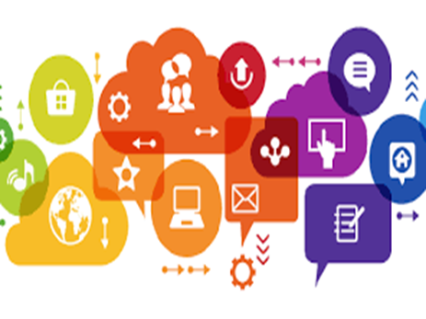
Lecture 10
II. Digital Media Economic Models and Actors :
In addition to the market in hardware, digital media have given rise to an economy that is directly based on web services, such as search engines, social media, or platforms for content distribution.
Since the mid‐1990s, mass consumer access to the internet has unleashed successive waves of investments and new business models that support these companies.
On the other hand, technological innovation based on digital technologies has introduced new possibilities and constraints for all companies that produce and exchange information.

Slide 14
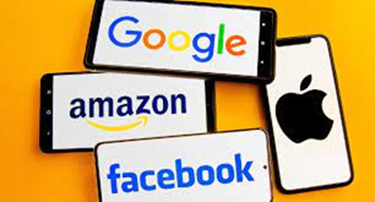
Lecture 10
II. Digital Media Economic Models and Actors :
In many case, this means a deep change in terms of models of production, commercialization, and funding.
While the wealthiest companies of the information economy, such as Google, Amazon, Apple, Facebook, and Microsoft, tend to be the most visible in the press and public discourse, digital media have a broader impact on contemporary economies.

Slide 15
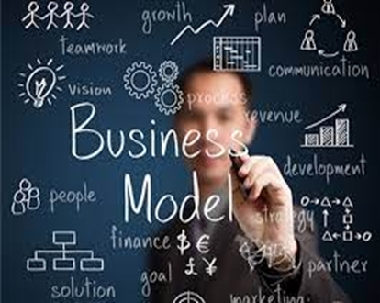

Lecture 10
II. Digital Media Economic Models and Actors :
We will analyze some of the most common business models of digital capitalism.
Some companies simply sell content distributed through digital networks.
This was the idea behind the so‐called “dot‐com” companies of the 1990s, that is that the web was a “content library” that could be accessed by a mass of customers.
In the content distribution model, customers can be charged for accessing online content.
This business model still exists in some sectors but has become less and less sustainable in others.

Slide 16



Lecture 10
II. Digital Media Economic Models and Actors :
The arrival of services such as YouTube, or social networks such as Facebook and Instagram, has given users new ways to distribute content that they produce themselves.
This is an alternative to content produced by cultural industries.

Slide 17


Lecture 10
II. Digital Media Economic Models and Actors :
Other sectors, for example television, have seen the emergence of new successful actors such as Shahid & Watch It, which sells subscriptions to a portfolio of TV content.
Companies such as Netflix have been described as working “at the intersection” of content distribution, advertising, technological evolution, and finance .
In fact, while most of their revenues are based on subscriptions, they also play a role in advertisement and in financial markets.

Slide 18
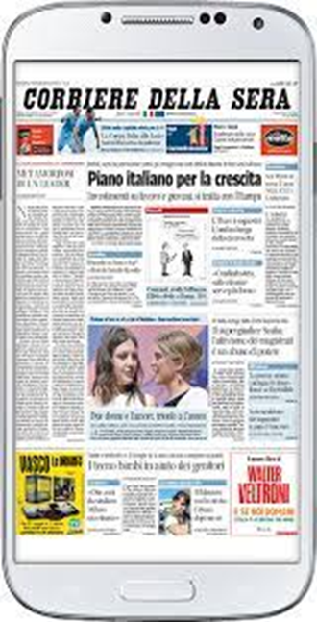
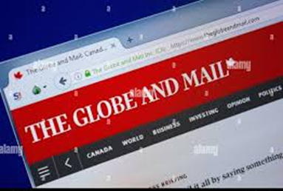
Lecture 10
II. Digital Media Economic Models and Actors :
Many newspapers, such as The Globe and Mail in Canada or the Corriere della Sera in Italy, do not charge for access to their websites via computers but are able to sell content to users of their smartphone app.
Indeed, accessing content via applications for tablets and phones adds value to the content and is perceived as worth a subscription fee.

Slide 19
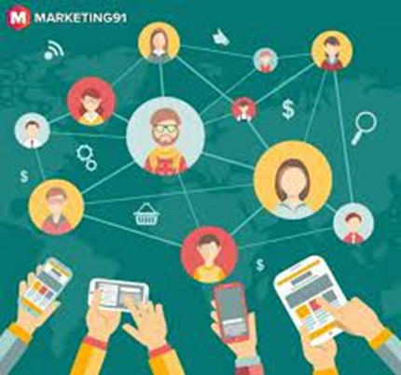
Lecture 10
II. Digital Media Economic Models and Actors :
Since the rise of the collaborative web in the early 2000s, platforms which foster user participation through their technological architecture and business models, such as wikis, and social media, have emerged.
Platforms based on user generated content facilitate user creation and sharing: WordPress makes it very easy to create and maintain a personal blog, YouTube allows video sharing, and TripAdvisor gathers reviews of hotels and restaurants.

Slide 20

Lecture 10
II. Digital Media Economic Models and Actors :
The economic model of these companies is based on user co‐creation.
TripAdvisor asks users to create the bulk of the content of its website, such as reviews and ratings, that is, votes on the quality of a service or business.

Slide 21
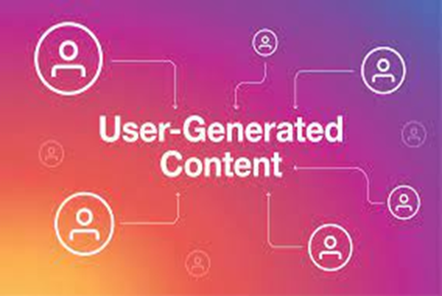

Lecture 10
II. Digital Media Economic Models and Actors :
Many services based on user‐generated content have recently adopted a hybrid model.
For example, YouTube has increasingly been “institutionalized” through the inclusion of content produced by professionals, such as music video clips or commercials.

Slide 22

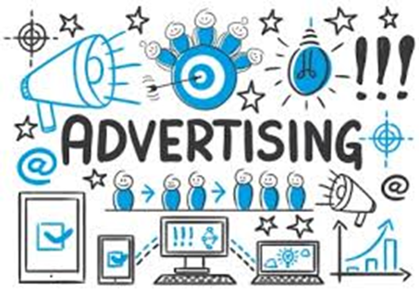
Lecture 10
II. Digital Media Economic Models and Actors :
Most services for user‐generated content are free to the user and rely on advertising as their main source of revenues.
This is the case for social media services, but also for search engines.
Both tend to generate and analyze data from user behavior and communications, and use it to provide targeted advertising.

Slide 23
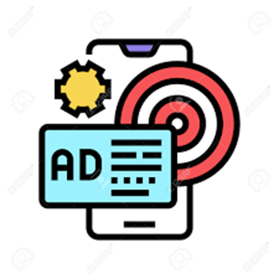
Lecture 10
II. Digital Media Economic Models and Actors :
Social media services such as Facebook follow similar patterns: they invite users to create content that will make the website enjoyable and the user experience interesting, and then sell targeted ad services to advertising agencies, based on surveillance and data analytics .
This makes online services similar to traditional broadcast media, as commercial radio and television also depend on advertising.
However, the advertising market that supports the web economy is different from older ones.

Slide 24
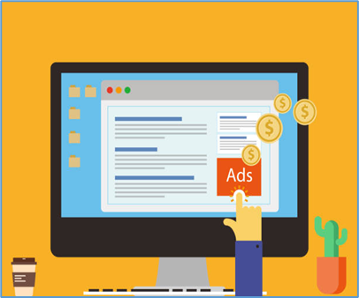
Lecture 10
II. Digital Media Economic Models and Actors :
Initially, websites were publishing ads the cost of which depended on the number of visitors to the site, just as in broadcast media.
Publishing an ad in The New York Times is more expensive than publishing it in The Toronto Star, given that the first newspaper has many more readers than the second.
Today, however, more sophisticated models have emerged.
With click‐through systems, advertisers pay a fee based on how many visitors click on an ad and actually access its content.

Slide 25

Lecture 10
II. Digital Media Economic Models and Actors :
In sum, the provision of free services made possible by the collection of massive advertising revenues represents one of the prevailing economic models of the web.
But is it a sustainable model?
So far only a few companies have managed to attract sufficient advertising revenue to underpin their market valuations .
At the same time, other partially different models are at play.

Slide 26

Lecture 10
II. Digital Media Economic Models and Actors :
LinkedIn, a social network for professionals, requires the payment of a subscription fee only to users who want to have access to its “premium” services.

Slide 27
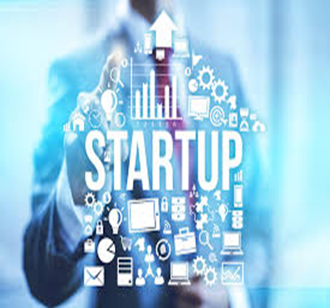
Lecture 10
III. The Startup Economy :
Major web companies such as Facebook & X(Twitter) are the result of the startup economy, i.e. an economy based on new emerging companies.
The phenomenon is closely linked to the development of Silicon Valley since the 1970s and has consolidated around a few shared characteristics.
Most startups are launched by young people and are based on a product, often digital, or on the application of a technology, such as an app.

Slide 28
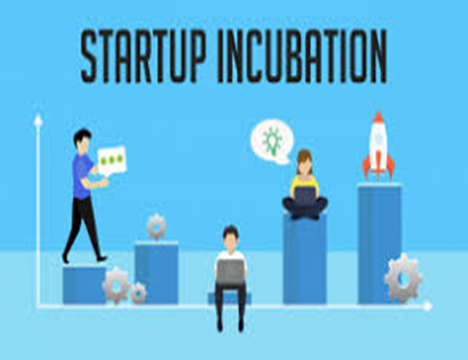
Lecture 10
III. The Startup Economy :
Many are based on a combination of ecommerce, social media, smartphones, and big data.
Startups often pass through an incubator, that is a place that provides a training program in which the company is assisted in the realization of its idea, the design of a business plan, and the preparation of a pitch – a brief narrative that presents the idea to potential investors in a concise and attractive manner.
At the end of the incubation phase, startups are ready to compete for investment.

Slide 29

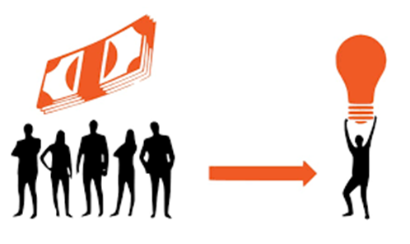
Lecture 10
III. The Startup Economy :
Some small startups make use of Kickstarter and other crowdfunding platforms to accumulate a small initial capital.
In addition to providing financial assistance, a successful crowdfunding campaign contributes to the intangible value of the startup by making it appear attractive to investors.
Instead, venture capital funds bet on high‐risk private investments, particularly in the hi‐tech sector.

Slide 30
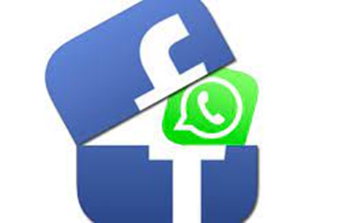

Lecture 10
III. The Startup Economy :
Usually venture capital “participates” in startups by acquiring a share of their capital, which can be sold in case of success.
Because of this logic, a startup’s success is not measured in terms of growth on the market, but on its financial evaluation.
This value can monetized in two ways:
Acquisition by a larger company (e.g. WhatsApp was acquired by Facebook for $19 billion) or on the stock exchange.

Slide 31

Lecture 10
III. The Startup Economy :
The startup system is organized around two key concepts that illustrate its position in the digital economy.
The first is “ideas are cheap,” that is, the success of a startup does not depend on the quality of its core idea but rather on its team.
This is why the incubation and training process is focused on giving a desirable cultural form to ideas, teaching teamwork, and brand building.
The challenge is not to find the best idea, but rather to handle complex forms of collaboration within a calculable risk.

Slide 32
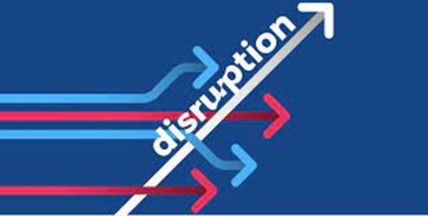


Lecture 10
III. The Startup Economy :
The second key concept is “disruption,” which suggests that the best innovations are not cumulative or incremental, but possess the ability to turn entire industries upside down .
This is the model followed by Amazon with bookstores or Uber with taxis.

Slide 33



Lecture 10
III. The Startup Economy :
In fact, truly disruptive companies are able to create new needs from scratch: no one needed Facebook before its launch.
But many startups tend to favor the replication of successful models.
We are witnessing the birth of the Uber for take‐away food, the Uber for laundry, etc.

Slide 34
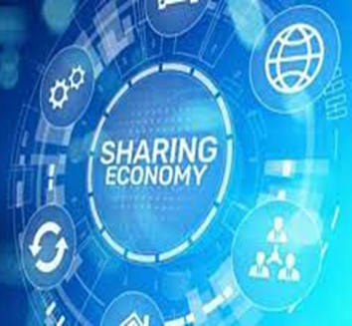
Lecture 10
IV. The Sharing Economy :
The flexible forms of production have been adapted to interact with the market economy and large multinational companies, for example through phenomena such as the so‐called sharing economy.
This expression emerged in the course of the 2010s to describe a series of platforms through which people can establish processes for the exchange of goods (such as homes or tools), services (such as car rides or senior care), or knowledge.
As a result of the technological success of social media platforms and, above all, of mobile apps, the sharing economy gained strong public visibility.

Slide 35

Lecture 10
IV. The Sharing Economy :
This form of “collaborative consumption” has been presented as a possible driver of economic development, as it generates new businesses and new forms of employment, and as a solution to the social alienation of contemporary societies, as it creates new forms of solidarity and new relational networks (Hamari et al. 2016).

Slide 36
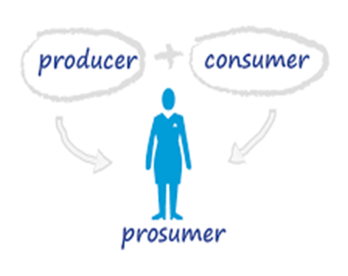
Lecture 10
IV. The Sharing Economy :
This is not an entirely new phenomenon, but rather part of a trend toward a progressive intertwining between productive and consumption activities that people undertake in their daily lives.
Since the 1980s the term prosumer, which combines the words “producer” and “consumer,” has been used to define individuals who have an active role in processes of both creation and consumption of goods .

Slide 37
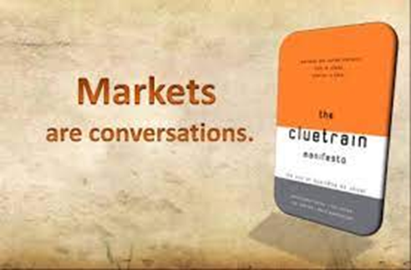

Lecture 10
IV. The Sharing Economy :
By stating that “markets are conversations,” in 2000 the authors of the Cluetrain Manifesto provided an understanding of this convergence based on the idea that the internet gives individuals the opportunity to enter into virtual markets where they can actively discuss products, for example by reviewing a book on Amazon.
Companies must take these informed customers into account and stimulate and participate in their conversations .

Slide 38
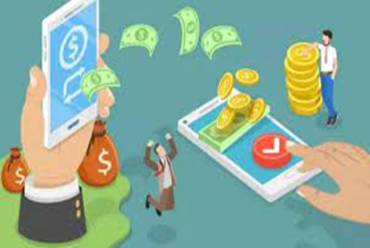
Lecture 10
IV. The Sharing Economy :
A more radical approach to this transformation refers to the prosumer as the individual who, while consuming or socializing through commercial web platforms, produces free information that companies can use and appropriate.
Interacting with friends on Facebook or reviewing hotels visited during a vacation on TripAdvisor can be seen a form of unpaid work, since Facebook and Trip Advisor’s value and revenues depend on the wealth of this user‐generated content .
This model has been criticized as exploitative .

Slide 39
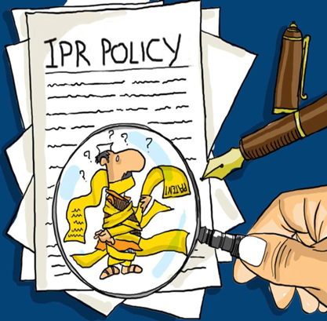
Lecture 10
IV. The Sharing Economy :
For example, in many cases the intellectual property rights policies used by these companies do not protect the creators who contribute to collaboratively producing content through their platforms.
By agreeing to the copyright clauses they accept when signing up to an online service, users give away many rights to the information they create.
In this way, web companies are legitimized to extract revenues from production processes they promote and manage.

Slide 40

Lecture 10
V. The influencer economy :
The influencers are independent Content creators play an increasingly important role as entrepreneurs.
The influencer economy is a growing novel economic phenomenon that has emerged in the era of the digital economy.
It refers to “the economic model in which online influencers attract large followers through various social media platforms and subsequently convert this traffic into purchasing power, thereby achieving monetization and generating revenue by directing consumer behavior, shaping trends, and promoting products to their audiences.”.

Slide 41
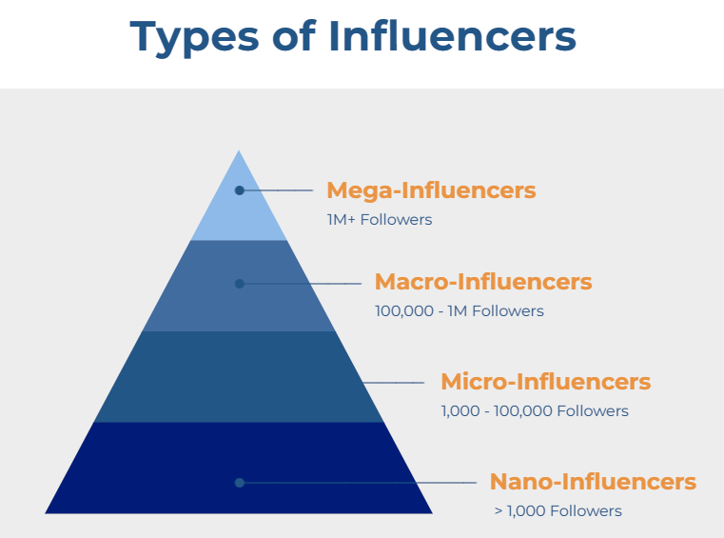
Lecture 10
V. The influencer economy :
The number of followers is an indicator of influencers popularity and profit potential.
Mega influencers—over one million followers, typically celebrities, expensive, more attractive to brands for sponsorships.
Macro influencers—100,000 to one million followers, typically content creators, expensive.
Micro influencers—small following, typically viewed as specialized and affordable.
Nano influencers—very small, perhaps local and inexperienced following, affordable.

Slide 42

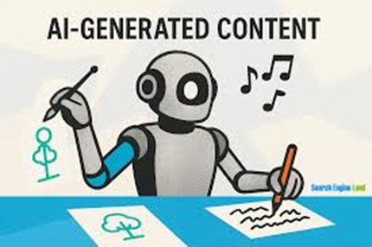
Lecture 10
VI. AI- Artificial Intelligence and Content Creation Economy:
Generative Artificial Intelligence (AI) have emerged as a transformative force in the content creation economy.
AI-generated content is auto-generated in minutes based on prompts (or instructions) that humans provide, generating high-quality content including images, text, video, animation, audio and copyright-free music.
Several digital platforms dedicated to AI-generated content have emerged, including Midjourney, Gemini, Canva, Suno and ElevenLabs.
By lowering technical barriers to content production, Generative AI has enabled broader participation in content creation and creative industries.
It enables creators to compete with established professionals, and benefit from of AI-generated content, reducing production costs.

Slide 43

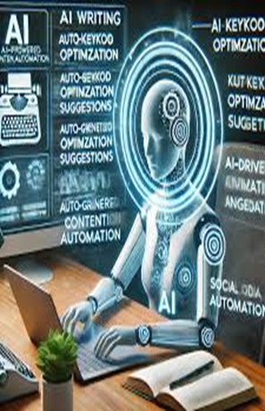
VI. AI- Artificial Intelligence and Content Creation Economy:
Lecture 10
Generative AI is changing the way media & marketing institutions work in. It offers a new set of tools to enhance their creative process and open new avenues. From content generation, to inspiration, and even editing.
AI empowers them to generate unique content quickly and efficiently, helping them save time, money, and effort in their creative process.
AI-powered tools can assist with writing and editing tasks, such as generating ideas and headlines, summarizing content, translation, checking for grammar, rewriting in different styles for social media or newsletters, writing video scripts and editing, and even produce voiceovers.
The more high-quality content can produce, the more monetization opportunities media & marketing institutions can capitalize on.

Slide 44

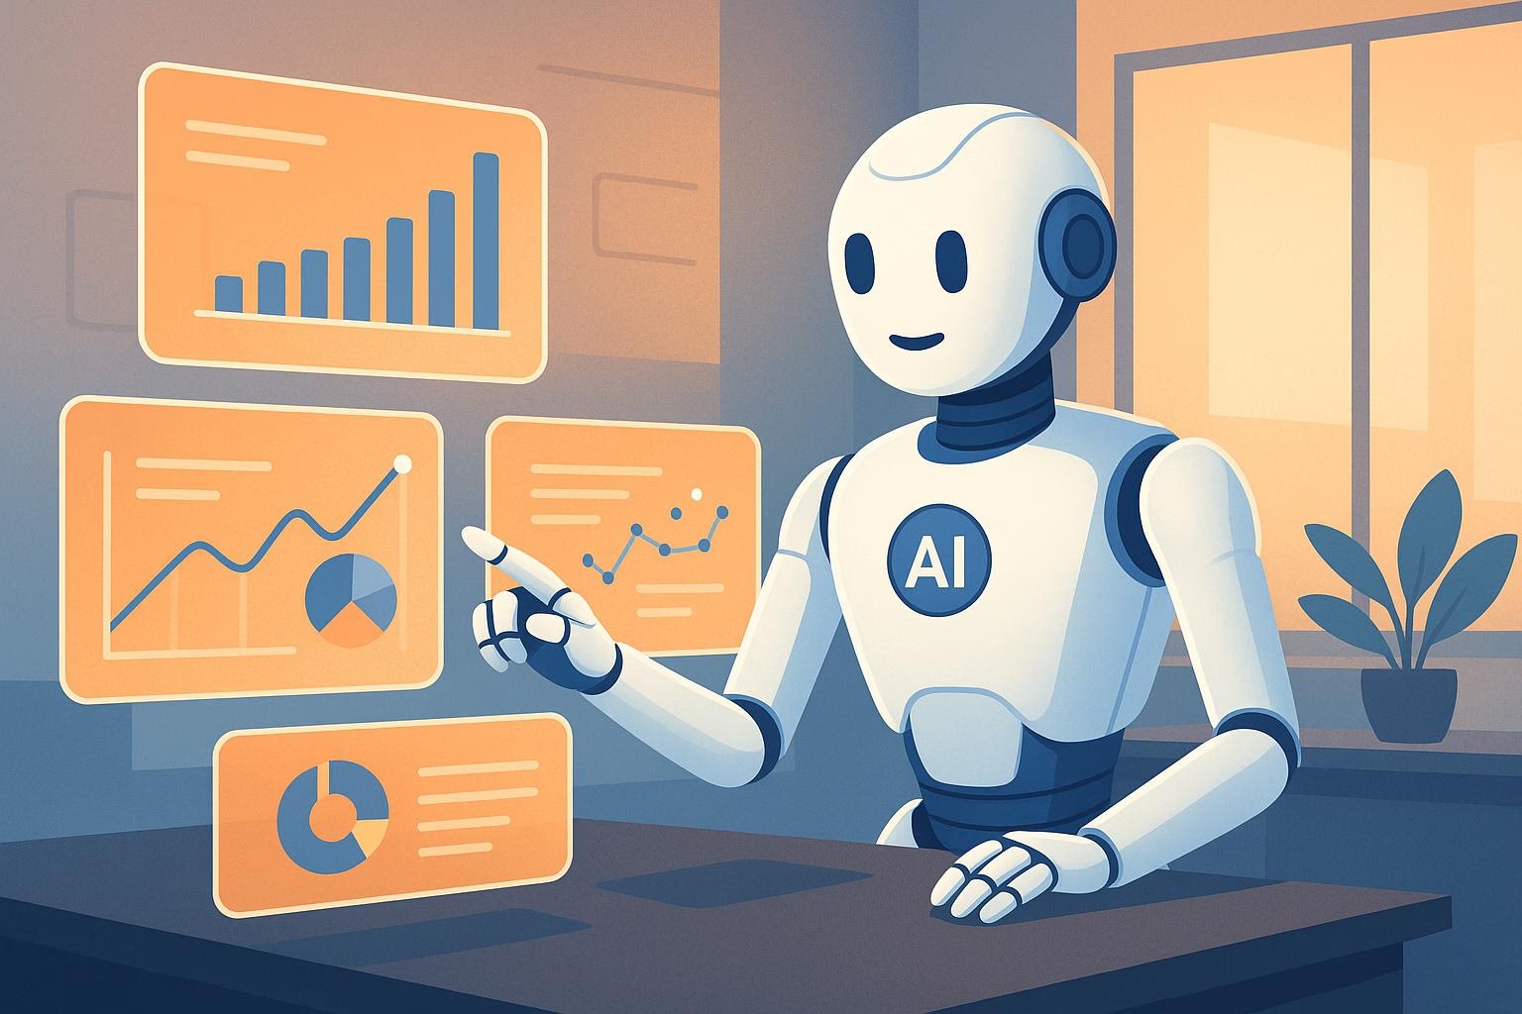
Lecture 10
VI. AI- Artificial Intelligence and Content Creation Economy:
Moreover, AI-driven analytics tools like CrowdTangle, Socialbakers and HypeAuditor can analyze audience behavior, engagement patterns, and trending topics to provide actionable insights that help creators understand their audiences and deliver content that is more likely to resonate with them, leading to increased engagement and revenue.
AI is also transforming content curation, the process of collecting content from various sources to present to a specific audience. AI can analyze vast amounts of content to identify the most relevant and valuable pieces for a particular audience.
For example, a news website use AI to curate articles that are most likely to be of interest to their readers, based on reading history and social media activity.
However, it's important to note that while AI can assist with content creation, it cannot replace the creativity of human content creators.

Slide 45


Conclusion
Lecture 10
The information economy is a dynamic economic sector, dominated by new players.
Microsoft’s Bill Gates, Amazon’s Jeff Bezos, and Facebook’s Mark Zuckerberg are among the wealthiest individuals in the world.
They influence the development of global capitalism through their investments.
The global market supports the economies of areas that produce hardware components, such as East Asia , and others that manage innovation and marketing processes, such as the United States .
Some web companies simply sell content distributed through digital networks.
Most services for user‐generated content are free to the user and rely on advertising .
Startup economy is based on new emerging companies often pass through an incubator.
Prosumer, which combines the words “producer” and “consumer,” has been used to define individuals who have an active role in processes of both creation and consumption of goods .

Slide 46


Thank You

