Slide 1

Project Management Technologies
Prepared by Lecturer Waseem Tabbaa
Chapter 7
PMG 312
S3 - Developing project scope
Ch. 7 - Developing the WBS

Slide 2

Chapter
07
Introduction
Section III: Developing project scope
Chapter 7 Developing the work breakdown structure........................ 89
Introduction ...................................................................................................... 89
Standards organizations ............................................................................ 90
Product-oriented WBS................................................................................ 91
Defining project work units............................................................................ 92
Work package dictionary variables .......................................................... 93
Role and structure of the project WBS.......................................................... 94
Requirements “ibilities” ............................................................................. 95
WBS design rules of thumb....................................................................... 98
WBS decomposition mechanics ..................................................................... 99
Sample WBS.................................................................................................... 102
WBS numbering scheme............................................................................... 102
WBS structure model comparison............................................................... 103
Standardized templates............................................................................ 105
WBS dictionary............................................................................................... 105
Other WBS views ........................................................................................... 107
Project templates ............................................................................................ 108
Project scope baseline.....................................................................................110
WBS design exercise .......................................................................................111
Summary......................................................................................................... 112
References ........................................................................................................116

Slide 3
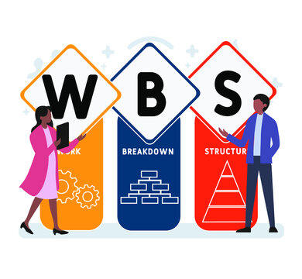
Chapter
07
Developing the work breakdown structure

Slide 4
Chapter
07
Standards organizations
The U.S. Department of Defense (DoD) and PMI organizations are two of the most recognized WBS thought and standards leaders for this topic.
The following shows the two comparative definitions:
  DoD. A work breakdown structure is a product-oriented family tree composed of hardware, software, services, data and facilities . . . [it] displays and defines the products(s) to be developed and/or produced and relates the elements of work to be accomplished to each other and to the end product(s). (DoD 2005)
  PMI. A deliverable-oriented hierarchical decomposition of the work to be executed by the project team to accomplish the project objectives and create the required deliverables. It organizes and defines the total scope of the project. (PMI 2001)
The DoD model has extensive definition of terms focusing on tangible products and standardized templates, while the PMI description softens that view to a more general “deliverable,” which could be interpreted to be any project objective.
“you cannot control what
you have not planned.”

Slide 5
Chapter
07
Product-oriented WBS
A WBS essentially divides overall project scope requirements into a tree structure of work units that are created by decomposing the project scope statement into smaller and smaller segments until all work and required deliverables are defined.
A sample three-level, nine-segment tree structure of an auto design project is illustrated in Figure 7.1.
The top one or two decomposition levels of a WBS identify a high level view of the project’s logical requirement, with little regard for the technical work required to achieve those goals (i.e., note the main auto components).
As the lower levels are defined, these logical groupings are further decomposed into work units required to produce that segment of the overall project.
The goal of this scoping exercise is to identify all of the work required to execute the entire project. In other words, if it is not shown in the WBS, it is not considered to be included in the project scope.
One of the reasons this project artifact is considered one of the most valuable (if not the most valuable) documents that the project team can produce is its broad applicability.
This process helps one to ensure that project requirements are properly translated into understandable work units and this definition later helps in status tracking.
These two roles represent a core project management activity that assists in dealing with one of the major management gaps in many projects.
Unless sufficient scope definition is synchronized from both the initial vision and later-defined execution views, there is little hope that the final output will be accurate (Richardson 2010).
The formal project-planning phase commences with various definitional activities designed to identify the required deliverables and work required.
Because of this core scope definitional role, the WBS drives many of the subsequent technical and management activities (PMI 2008, 117).

Slide 6
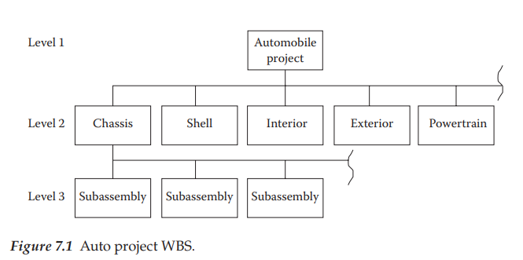
Chapter
07
Product-oriented WBS

Slide 7
Chapter
07
Defining project work units
In addition to the schematic box and hierarchy structure shown in Figure 7.1, it is also necessary to supplement this view with a companion WBS Dictionary that further defines specifics related to each work unit.
Envision a “package” of work that has been defined as part of a larger project.
These “packages” can be any type of project task such as installing piping, testing software, creating a subassembly, or producing a user guide.
For now, simply view each box as a work activity or collection of lower-level work units.
The official vocabulary term for the lowest-level work units in the tree structure is a work package (WP).
One metaphor for a WP is to view it as a box such as the one illustrated in Figure 7.2.
In this view, the focus is on the three dimensions representing time, cost, and scope (of work).
This visual metaphor will be used throughout the textbook to symbolize various aspects of project management roles.
To complete a comprehensive plan that includes more than surface level definitions, the project team must make appropriate technical decisions regarding how to organize and view the work necessary to produce the desired output.
One model view of project management is to envision the WP as a micro-building block for schedule development.
If each WP has a defined duration and cost dimension, then stacking them into some technical sequence defines both the initial direct schedule and budget for the project.
The related details of these mechanics will be explored in this section.
Because of this definitional role, the WP becomes a major ingredient in the management process.

Slide 8
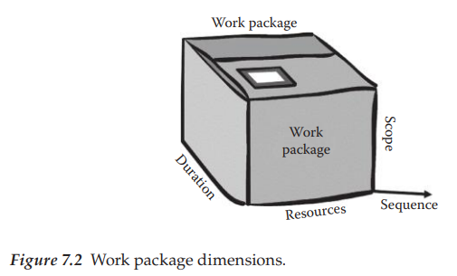
Chapter
07
Defining project work units

Slide 9
Chapter
07
Defining project work units
As the WBS boxes are defined, there is a common nomenclature for the basic elements. The following titles will be used here to identify the role of each box type:
  Top box—project goal
  First-level boxes—major subsets of the project goal
  Summary boxes—collections of lower-level boxes (e.g., subsystems and phases)
  Planning boxes—larger boxes not yet decomposed but needed to define the full project scope
  Work packages—lowest-level boxes that represent the fundamental work units of the project assigned to specific organizations teams
From a management viewpoint, the most critical WBS development item is the aggregate definition of WPs that represent the effort needed to produce the desired output.
There are many design rules of thumb regarding these units. A few to consider are listed below:
  A WP should be sized so that it can be executed in approximately 80 hours or 2 weeks’ duration.
  A WP should be allocated to a single organizational segment wherever possible and that organization has formally approved its definition of work.
  Each WP should have a “performing organization” owner with an assigned manager.
  There must be some formal process to collect actual costs and measure work accomplished either at the WP level or at some level above this as the project manager approves.

Slide 10
Chapter
07
Work package dictionary variables
Effective project WP definition requires many related items of information to fully assess the content of the work and integrate it into the rest of the project.
Conceptually, it is desirable to capture this information into a single data repository that is officially called a WBS Dictionary (PMI 2008).
Such a repository may not actually be visible by that name in real world projects, but the type of data described below will need to exist somewhere in project records.
To estimate and track project activities, it is necessary to define the following types of parameters for each WBS box:
  ID reference—this is a WBS box code used to identify where the work unit fits into the overall structure (e.g., the WBS chart of accounts).
  Work effort estimated for each skill group (e.g., hours and skills of each skill type).
  Estimated duration for the task given the planned labor resource allocation.
  Material requirements and other cost associated with each work unit.
  Name of individual responsible for managing the activity.
  Organizational unit assigned to do the work (e.g., performing organization).
  Defined constraints (e.g., activity must be finished by . . .).
  Key assumptions made in the course of the planning activity.
  Predecessors—linkages of this activity to other project work units.
  Risk level for the activity—more work will be needed on this aspect later. For now, we will simply indicate the perceived risk level (e.g., H, M, or L).

Slide 11
Chapter
07
Work package dictionary variables
  Work description—this may be a reference link to another location where more detailed information is kept; sometimes called statement of work.
  General comments—free-form statements that help describe the technical aspects of the work required.
In addition to these core definitional items, it is also necessary for the PM to have some control over work estimates for each box.
One method of doing this is to delegate final work unit estimate approval to the PM.
This check and balance prohibits the performing organizational group from excessively padding estimates to minimize overruns in their activities.
Completion of data dictionary work unit detail produces sufficient technical information to create a first cut schedule and budget for the project.
However, take note of the term first cut.
This implies that there are more iterations required as new information arises, including that from key stakeholders who feel the plan is too long, too much, or not enough in some area.
It is always difficult to say that any activity is the most significant one to support effective project management and work control processes, but there is heavy evidence from industry researchers that indicates failure to properly create a work view similar to the WBS will negatively plague the project throughout its life cycle.

Slide 12
Chapter
07
Role and structure of the project WBS
As the project definition moves from the high-level vision-oriented what definition of requirements downward toward the technical how, there is a need to translate this into something more akin to a structured technical work definition.
This translation process is reflected in the WBS box structure and embedded in the box definitions is both a requirements and a corresponding work relationship.
A related value of this approach is that it serves as a good communication tool between the user’s plain language requirement statement and the technical work required to produce those requirements.
Both technical and nontechnical groups are able to understand what the tree structure represents and for that reason, it provides a communications bridge to confirm that the stated requirements are being recognized by the defined project work units.

Slide 13
Chapter
07
Requirements “ibilities”
On the surface, the process of defining requirements sounds pretty simple: identify what the customer wants and then proceed to translate that into technical goals that will guide the design process.
Beyond the basic mechanics of developing project work units, there are several other scope-related issues that are not obvious in this process.
We will describe these as the following nine ibilities and one more general design attribute:
  Traceability
  Affordability
  Feasibility
  Usability
  Producibility
  Maintainability
  Operability
  Scalability
  Sustainability
  Simplicity

Slide 14
Chapter
07
Requirements “ibilities”
The parameters in this list are important definitional drivers in the planning and design aspects of the project.
Each ibility represents a deliverable attribute that is likely not well defined in the original requirements, but quantification that is needed for guiding the design.
These items represent supplementary definition to the defined product or process goal. Each of the ibilities should be quantified as part of the overall specification elaboration to ensure that the best design choices are made. In many situations, the design question becomes one of trade-offs between time, cost, scope, and quality.
Examples of these trade-offs are listed below:
  Cost of development versus future maintenance cost
  Quicker development versus more custom fit
  Ease of use versus lower development cost or time
  Value engineering (VE)—how to produce the product more efficiently based on ibilities priorities
  Risks associated with a particular approach
As the project moves through the scope definition life cycle and related physical design processes, each of these considerations should be formally reviewed by appropriate members of the project team.
All too often, one or more of the ibilities are ignored and the ultimate result is downstream frustration by someone in the chain of users or operational supporters.

Slide 15
Chapter
07
Requirements “ibilities”
The section below will offer a brief definition of each ibility:
ibilities | brief definition of each ibility
1. Traceability | is “defined as the ability to describe and follow the life of a requirement through the life cycle (i.e., from its origins, through its development and specification, to its subsequent deployment and use, and through periods of ongoing refinement and iteration in any of these phases)”.
2. Affordability | relates to a match of the design approach to the budget constraints. There is always pressure to cut design costs, but there must be a balance between cost and design goals.
3. Feasibility | is a term that can have many different meanings in the project environment. The most obvious of these is the technical feasibility of the selected design approach. However, often stretching to achieve some higher performance goal will go beyond existing capabilities and create additional project risk. In a similar fashion, the lack of critical skills or budget can make a project infeasible. Think of feasibility as anything that can get in the way of technical, time, or budget success, whether a technical item or otherwise.
4. Usability | involves how the process or product functions in the hands of the future user. It is making sure that the product developed, whether a physical device, software or website, is user-friendly. It is common to perform usability testing to gather user feedback on the adequacy of the design.

Slide 16
Chapter
07
Requirements “ibilities”
ibilities | brief definition of each ibility
5. Producibility | is an attribute related to how the actual item will be constructed. In many cases, there is a gap between the designer and the builder, so the key is to be sure that the building function is represented in the design process and probably even in the initial requirements process. Think of this as a “chain” of events that need to be linked together and not just thrown over the wall to the next group hoping that the previous decisions were appropriate. Each stage in the development represents special skills and complexities that need to be considered.
6. Maintainability | deals with the item in production. This relates to the level of effort to keep the device ready to perform its function. In the case of high-performance devices, there is often significant downtime for maintenance, which then means that it does not perform at all. For this reason, it is important to understand the future operational requirement. One design trade-off, in this case, is to find a way to perform the maintenance quicker or do less of it, but certainly, the best choice is not to ignore the issue.
7. Operability | involves the future user’s ability to easily and safely use the product or device. Think of this attribute as not changing the requirement but making the requirement easier and safer for the user.

Slide 17
Chapter
07
Requirements “ibilities”
ibilities | brief definition of each ibility
8. Scalability | connotes the ability of the product or process to handle higher level of activity. For example, a computer system might be capable of handling 100,000 transactions per second. How easy would it be to expand that capability and to what level?
9. Sustainability | is the least understood of the ibilities. This term goes beyond all of the other attributes in that it evaluates the ability of the process or product to existing long-term. In fact, maybe “predictability” is yet another ibility. If the project team had an accurate view of all technical and organizational futures, these goals could be better achieved. All too often, some technology is used in a design only to find in a much too short period of time that some better technology has been introduced and made the current approach obsolete. When that occurs, all of the other ibilities have also been adversely impacted.
10. Simplicity | is an overarching concept. Complexity is the natural state. The goal is to find ways to achieve a complex output as simply as possible. This is a motherhood term but is a real management and design requirement.

Slide 18
Chapter
07
Requirements “ibilities”
One of the key steps in both requirements and design reviews is to examine the ibilities list and resolve the trade-offs outlined here.
Recognize that the requirements specification process generally involves trading off aspects of one ibility for another. Seldom is the goal to maximize all of these. So, the challenge is finding the appropriate mix.
Improper choices made at this point will follow the project through its life cycle. Eventually, the future user will have less satisfaction with the result if these are not dealt with properly. Recognize that an obsolete, nonfunctioning, or hard-to-use project deliverable item decreases its ultimate value.

Slide 19
Chapter
07
WBS design rules of thumb
Regardless of the specific methodology used, the key construction principle is to capture the project requirements, organize those into a single tree structure, and then manage the project using this structure.
Although there are guidelines regarding what the top structure layers should mirror, the overriding design criterion is it should mirror the way the project is to be executed. In situations where an organization tends to do one type of project, a standard WBS structure template will likely exist.
In these cases, a common design structure will cut down on the initial planning effort.
There are several alternative design groupings for the higher layers of a WBS structure. Samples of these are as follows:
  Using standard templates created from similar recurring project types.
  Modifying the structure used from a successful similar effort.
  Defining the major physical product groups and then decomposing that structure downward (e.g., note the physical house components).
  Starting with lower-level defined work elements and aggregating them upward into a logical hierarchical structure (i.e., bottom-up design).
  Packaging the structure using the required deliverables as guidance (Schwalbe 2006, 163).
  Defining major phases at the top level and then structuring downward using one of the other schemes mentioned above.

Slide 20
Chapter
07
WBS decomposition mechanics
Regardless of the method used, the resulting structure must represent the total project work required.
In the ideal model, each box in the WBS will contain a corresponding SOW that can be used by the assigned resources to execute that incremental element and its associated deliverables.
In addition, quality and other related technical items would be documented sufficiently to support future testing and other operational aspects.
At some point in the planning process, the decision could be made to move forward into execution with the components that are defined adequately and then leave further elaboration of the remainder for later in the execution phase.
This means that some segments of the total WBS would contain work units at a higher level of definition than described thus far.
Recognize that this also means that there will be a higher potential for error in the defined planned time and cost values and possibly other “hidden” issues that were not defined.
These higher-level nondecomposed work units are called planning packages (PP).
Except for their size and level of definition, this collection of work units will have the same role in producing the subsequent project schedule and budget.
Prior to actual work being performed on a particular work unit, it should be properly decomposed. This form of plan evolution is called the rolling wave approach and is another example of progressive elaboration.

Slide 21
Chapter
07
WBS decomposition mechanics
The development of the WBS top level represents the project’s highest view. There is no right or wrong answer to this structure, but it should represent the way in which the overall project scope is best understood and managed.
The theory and concepts related to a WBS are quite easy to understand; however, a basic question remains regarding how to identify the correct structure for a specific project. The list below contains items that may help decide on the proper high-level packaging structure:
  Are there logical partitions in the project? What major phases make sense? These could be candidates for the second-level grouping.
  Are there major milestones that could represent phases?
  Are there business cycle constraints that need to be considered (e.g., tax period and scheduled down time)?
  Are there financial constraints that might dictate phases?
  What external company life cycles might impact the project?
  What development methodology is being utilized? It typically would define the basic development process.
  Are there risk areas that need to be specifically recognized (e.g., technical, organizational, political, ethical, user, and legal)?

Slide 22
Chapter
07
WBS decomposition mechanics
In addition, the list offers some basic decomposition steps to consider in evolving the structure below the top layer (adapted from Haugan 2002):
  Identify the top-level view that represents how the project will be defined within its program, phase, or project component structure.
  Identify the goals of the entire project. Consider each primary objective as a possible top-level element in the WBS hierarchy. Review the SOW and project scope documents to aid in this decision.
  Identify each phase or component needed to deliver the objectives in step one. These will become second-level elements in the structure.
  Break down each project phase into the component activities necessary to deliver the above levels. These will become third-level WBS elements.
  Continue to break down the higher-level activities into appropriate work units.

Slide 23
Chapter
07
WBS decomposition mechanics
This process should continue downward until the work units are well-defined and linked to a single organizational unit owner.
The lowest level defined work units should fit into the size definition supported by the organization but be small enough to support manageability.
If this is not feasible at this stage, the unit should be labeled a PP and handled accordingly.
The group development process should normally work from a top-down view.
Once a particular WBS high level is defined, it may be possible for a portion of that structure to be allocated to a sub-team for more segmented and detailed discussion for that portion.
This review should generally occur on a level-by-level basis through at least the major project segments.
As the process moves downward, the horizontal level of interaction across the structure often declines as the work begins to align itself into more independent units.
As the final WBS structure is completed, it is still necessary to make formal scope-oriented presentations to key organization and technical stakeholders to ensure that the overall plan is coherent.
The process of decomposition into lower levels of detail and review remains essentially the same.
Failure to resolve the scope of work issue at this stage creates multiplied negative consequences later.
Some level of the overall project design should be shared with future users and key management.
This activity is technical and marketing oriented.
Later, as the project is completed, the WBS helps in the review of the outcome status.
As new project team members arrive on the scene, a WBS and its dictionary serve an equally valuable role in providing technical and work insights into the project. This helps with team communication and provides a spirit of collaboration.

Slide 24
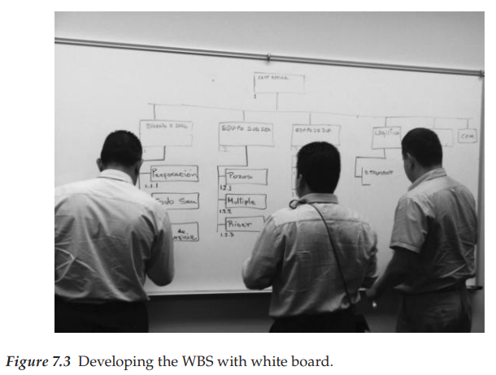
Chapter
07
WBS decomposition mechanics

Slide 25
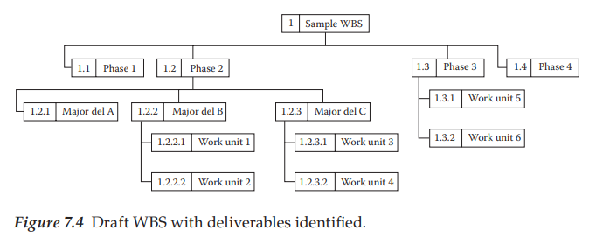
Chapter
07
Sample WBS
Figure 7.4 illustrates a sample abstract WBS, except in this case, the higher-level boxes has been labeled as a phase-oriented structure rather than physical product decomposition.
In this format, the focus is on ensuring that the defined project deliverables are covered in each phase.
This format helps to link requirements to the associated work units.
In other words, if work unit 1.2.3.1 is to produce a specified deliverable, that should be part of a future quality check upon completion of that activity.
Keep in mind that the number of levels in a WBS structure depends on the size and complexity of a project.
Another stylistic box naming consideration is to use nouns as titles, rather than verbs.
This helps focus on what is to be done and not how it will be produced.
As the scope development migrates from the higher layer, the focus of the lower WBS structure layers evolves toward the work required by an organizational unit to produce the project deliverables!

Slide 26
Chapter
07
WBS numbering scheme
There are various schemes that can be used to label the WBS boxes; however, in most of these, a decimal point-type numbering approach is used to reflect the hierarchical layers (review Figure 7.4 for this view). Mature project management organizations such as the Departments of Energy and Defense have standardized the schemes for box numbering as well as the product-level definitions for the higher levels. The key role of box numbering is to identify aggregations of work units. As an example, if the top box in the WBS structure was labeled “1,” then the boxes in the immediate layer below would be 1.1, 1.2, 1.3, and so on. Conversely, if the top layer is labeled “0,” then the layer below would be defined as 1, 2, 3, 4, and so on. Regardless of the top-level number, a decimal-type notation is used to identify the cascading layers below. Recognize that new work (boxes) will be defined through the course of a project as a result of approved CRs.
This means that it would be advisable to leave some gap in sequence numbers so that future changes and additions can be slotted into the WBS without destroying the overall number scheme. This could be accomplished by using increments of 10 in the numbering sequence. Failure to leave gaps will mean that the codes will be harder to relate to their own group. On the schematic mechanics, realize that these numbers will be used in other processes such as time, cost and schedule tracking, risk, communications, HR, contracting, and quality. This numeric coding system provides an excellent reference between the defined work and various knowledge area processes.

Slide 27
Chapter
07
WBS structure model comparison
Table 7.1 illustrates a flattened WBS. This table contains two activity lists with the same work units in both.
Note that option A divides the work by technical work area, while more of a life cycle process view is reflected in option B.
The point of this dual example is to show that the same work units can then be sequenced in more than one way with an identical related schedule for the defined effort.
Which one is right? Which one is best? If the performing organization had a strong departmental culture, option A might reflect that view best, whereas option B looks at the effort more as an organizationally coordinated group of activities evolving through life cycle phases and that may be the preferred view.
Note that the traditional method for software development is to view the preferred work process as one that moves through a defined life cycle process similar to option B. Regardless of the actual structure used, the design of the overall WBS architecture should be one of the early project team conversations.

Slide 28
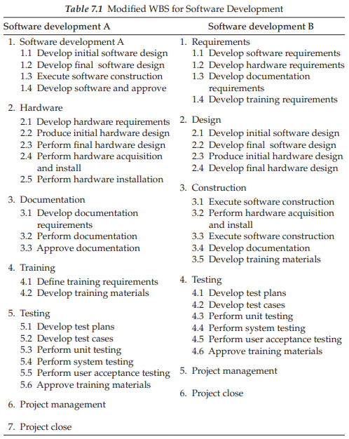
Chapter
07
WBS structure model comparison

Slide 29
Chapter
07
WBS dictionary
A companion artifact to the WBS schematic is the WBS Dictionary.
Its goal is to add further definitional content to the structure.
One way to look at a WBS is as a project scope skeleton, while the associated dictionary is the “meat on the bones.”
Together, these two artifacts provide a potentially full view of the project scope, work, and its deliverables.
Check Figure 7.5 Page 106 the illustrates sample data elements that are often included in the WBS Dictionary.
Note that each box in the WBS structure would require this type of information to support the related planning and control processes.
Please read more about “Other WBS views”
and “Project templates” Page 107 - 110

Slide 30
Chapter
07
Project scope baseline
Once the overall project scope as represented by the WBS has been approved, this view with all of its related data is baselined (frozen). The approved base point then serves as a control framework for the follow-on stages of the project. Organizations deal with such baselines in various ways.
For example, the initial scope baseline represents an overall project deliverable and work definition specification that has been formally agreed upon by the customer and the management as representing the project requirements. However, as other related planning decisions are made in areas such as procurement, risk, quality, HR, and others, the early project work definition can change somewhat.
This has the impact of changing the WBS box detail. As these decisions evolve through the formal planning phase, a final WBS scope view will be presented to the management that includes all of the planning stage decisions.
This view would represent the approved scope baseline and becomes an official control definition artifact.
Actually, recognize that the term baseline can apply to other project metrics such as time, cost, quality, technical performance, and so on. Also, as the project moves into execution and major changes occur, the project management board might decide to approve yet another set of baselines based on the newly approved and revised project definition.
This version could be titled revised baseline and this change process is called rebaselining. Less official approaches would simply label a particular version “baseline n.” From a management viewpoint, a defined baseline is used to compare actual project performance.
In most cases, the initially approved baseline will be the one used to compare project performance.
Changing the schedule every week and saying you are on schedule is similar to changing the baseline frequently and saying that you are working on the same project. Both are misleading. The iron law of control says that the project would always be comparatively measured from the original approved version, regardless of any other comparisons.

Slide 31
Chapter
07
Summary
This chapter has described how a logical project goal or vision can be translated into defined project work units.
Essentially, this involves a decomposition or elaboration of the initial verbal goal definition into increasingly detailed work units necessary to produce the defined deliverables.
The WBS can be viewed as both deliverables and associated work-oriented views of the project.
The top levels focus more on the major deliverables and components, while lower-level units describe specific work required to achieve those deliverables.
These defined work units become major elements in both the planning and control processes.
When completed, the WBS contains a collection of work entities called summary packages, planning packages (PP), control accounts, and WPs through which the project will be viewed.
Remember that the defined control accounts are used to represent the points at which work will be measured, actual resource consumption collected, and status evaluated.

Slide 32
Chapter
07
QUESTIONS
Review questions
  In starting to schedule WBS defined work units, what information would be most valuable for that effort?
  Describe some strategies for an organization to improve access to historic project information and lessons learned.
  In the new role of being in charge of organizing a rock concert fully responsible for all aspects of this experience, the first assignment was to look at the major activities for this effort. Four key activities were identified as tickets, staging, talent for the show and security. Review the first cut WBS structure and expand it into a more reasonable project scope view using question/response process outlined above.
  As the new PM of a large effort to change the work process related to customer support for a large company, develop a first cut (two-level) WBS for the work effort. This is an online-type catalog operation and there are currently many customer complaints that have been documented. For this exercise, recognize the dual role of both the customer and project team member.

Slide 33
Chapter
07
QUESTIONS
In-class question
  Define the term WBS.
  What is the SME’s role in the WBS development?
  When did the WBS concept emerge in early project management history? Why did it stand the test of time, while other ideas did not?
  What is the most frequent WBS structure for a tangible product?
  What does the term “cross-cutting” relate to? Give some examples of cross-cutting work units.
  Name at least five major management roles of the WBS in a project.
  What is the 100% rule?
  What is the difference in a WP and a control account?
  How does a PP differ from a WP?
  What does progressive elaboration mean?
  What is the basic management issue with WP size targets?
  What are some of the philosophical differences between DoD-type projects and the commercial environment?
  Describe some of the roles of the WBS box numbering scheme.
  Why is a WP represented as a three-dimensional box?
  What is the fundamental management issue between the WBS and project scope changes?
  What do ibilities relate to?
  What does flattening the WBS mean?
  What is the fundamental test of the first level of a WBS?
  What is the role of a WBS Dictionary compared to the WBS?
  Describe some of the fundamental WBS Dictionary data elements.
  What are some of the basic uses for a template?

Slide 34
Chapter
07
References
Department of Energy (DOE). 1997. Cost Codes and the Work Breakdown Structure, www.directives.doe.gov/pdfs/doe/doetext/neword/430/g4301-1chp5.pdf (accessed October 15, 2008).
DoD. July 20, 2005. Department of Defense Handbook Work Breakdown Structures for Defense Materiel Items, http://evernote.com/shard/s1/res/c7333696-398c-4f2c-ba0e-ce84e85209bc/MIL-HDBK-881A.pdf
DoD. 2011. Mil-STD-881 Revision C, Work Breakdown Structures for Defense Materiel Items, http://standardsforum.com/?p=1661
Haugan, G.T. 2002. Effective Work Breakdown Structures. Vienna, VA: Management Concepts, ISBN 1-56726-135-3.
Project Management Institute (PMI). 2001. Project Management Institute Practice Standard for Work Breakdown Structures. Newtown Square, PA: Project Management Institute.
Project Management Institute (PMI). 2008. PMBOK® Guide, 4th ed. Newtown Square, PA: Project Management Institute.
Richardson, G.L. 2010. Project Management Theory and Practice. Boca Raton, FL: CRC Press.
Schwalbe, K. 2006. Introduction to Project Management. Florence, KY: Course Technology, Cenage Technologies.

Slide 35
Chapter
07
Thank You
The End..
Thank You

