Slide 1



Influence and Negotiation Skills
Introduction to Influencing skills
Prepared by:
Dr. Bothaina Mahmoud Fouad
College of
Entrepreneurship and Innovation
Code ENT623
Lecture 2

Slide 2

Lec. 1 Overview
The main points:
To share some defining and key concepts of influencing.
To highlight some qualities and skills to influence others.
How to develop and improve your influencing skills
Case study and activities

Slide 3
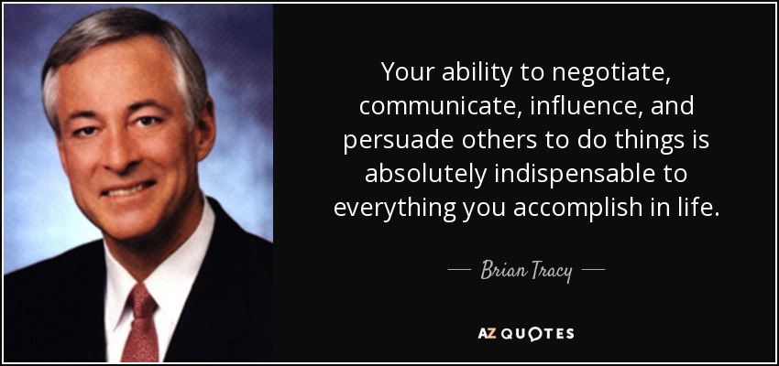
Brian Tracy is a Canadian-American motivational public speaker and self-development author

Slide 4
From where we can start ???

Slide 5
Who am I attempting to influence?
What is the situation? How much support do I need?
Why do I need this person’s support of my idea?
What tactics can I use, and how can I establish rapport?
What responses do I anticipate?
What mutual points of agreement can I use?
How can I end on a positive note no matter what the outcome is?

Slide 6
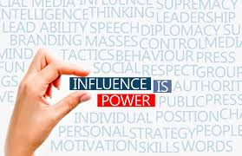
Influencing skills are your abilities to encourage and persuade others to adopt your ideas.
The skill to influence others can be beneficial for leaders to motivate people and make their teams more productive.

Slide 7
Why are Influencing Skills Important?
If you influence people you can achieve anything.
Imagine if you had the skills of persuasion to enable someone to buy, someone to vote, someone to see your perspective, someone to love, someone to care…
Through the skill of influencing others, you can change the behaviors of others to achieve your goals.

Slide 8
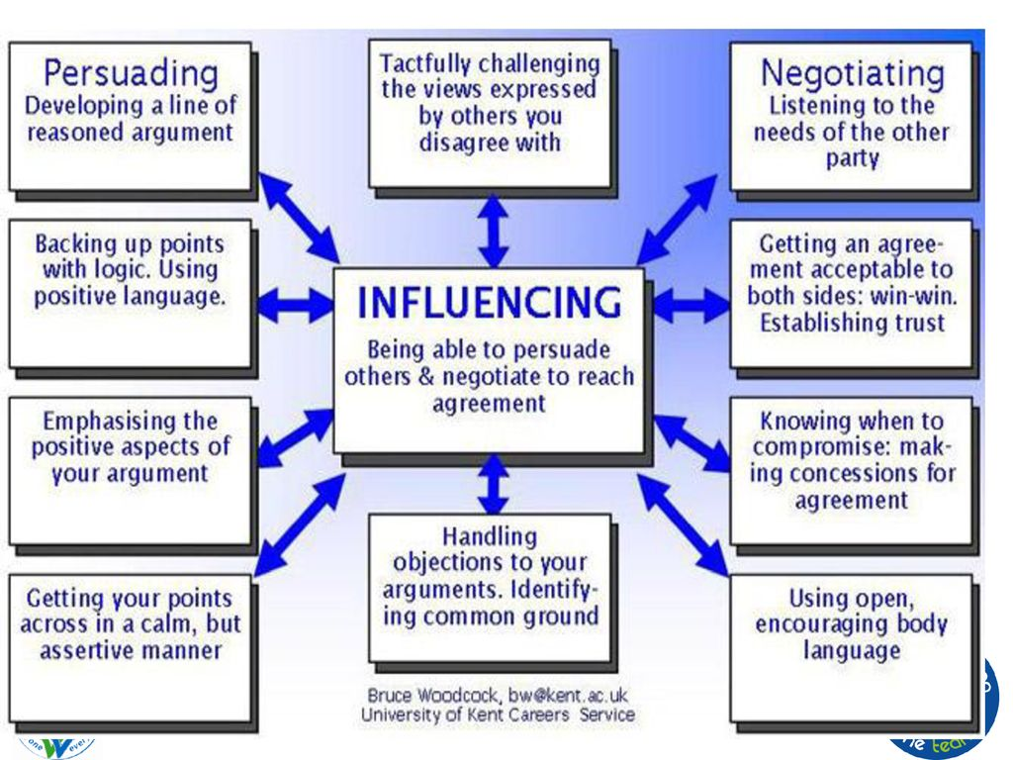

Slide 9
5 influencing Styles
Asserting – you insist that your ideas are heard and you challenge the ideas of others
Convincing – you put forward your ideas and offer logical, rational reasons to convince others of your point of view
Negotiating – you look for compromises and make concessions to reach outcomes that satisfy your greater interest
Inspiring – you advocate your position and encourage others with a sense of shared purpose and exciting possibilities
Bridging – you build relationships and connect with others through listening understanding and building coalitions

Slide 10
What factors can affect behaviour
Behaviour is affected by factors relating to the person, including: physical factors - age, health, illness, pain, influence of a substance or medication. personal and emotional factors - personality, beliefs, expectations, emotions, mental health. life experiences - family, culture, friends, life events.

Slide 11
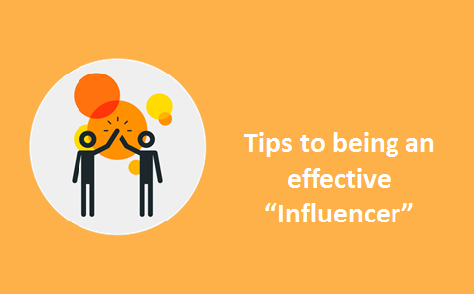

Slide 12
Tips to Influence Other People
Build trust and be consistent
build a solid rapport and a genuine concern for an individual before endeavoring to direct them towards a certain outcome. You must act with authenticity, demonstrating that you are trustworthy and that your primary goal is to help.
Be present and connect
being an active listener, you gain insight into what is driving the other person emotionally. Once you understand the emotional factors steering their thinking, you can demonstrate that you understand them, and your conversation will advance.
Ask to understand
Before you can motivate someone, you need to understand their core values and driving forces. Are they hoping to make a difference in the world, gain admiration from their peers or advance their career? What is fundamentally essential to them? What are they going through in their life?

Slide 13
Tips to Influence Other People, Con’t
Educate and encourage
The most compelling way to teach a lesson is to inspire through storytelling, and case studies. encourage others to discover the answers by themselves. The easiest way to persuade someone is by helping them persuade themselves.
Confirm suspicions and acknowledge objections
being an active listener, you gain insight into what is driving the other person emotionally. Once you understand the emotional factors steering their thinking, you can demonstrate that you understand them, and your conversation will advance.
Praise sincerely
compliment the person you are trying to persuade. Make them feel important, and show admiration.
Every person seeks out sincere praise. But be mindful of the fine line between acclaim and flattery, as fawning can turn a person off.

Slide 14
Tips to Influence Other People, Con’t
Challenge and encourage
Nothing mobilizes attention, or energizes us, better than a challenge that demands we stretch our knowledge, boosts our skills and enhance our ability to reach another level of success

Slide 15
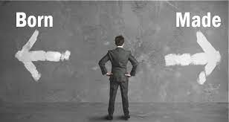
Always remember
We are not born leaders with an innate ability to persuade others. We must actively cultivate the skills, and by doing so, we can thrive.

Slide 16
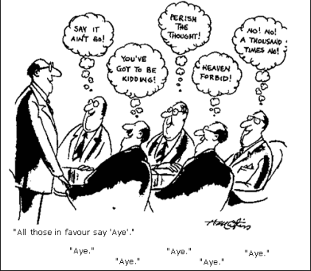
What does it mean to “Manage by Influence”?
Work influence is your ability to make a positive impact on others (actions, decisions, or points of view). Peers, employees, and leaders respect and seek out influential professionals. The receiver determines your level of influence. Real influence comes from impact, not status.

Slide 17
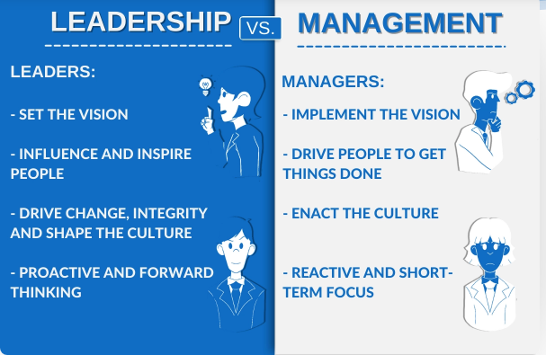
Ask yourself which is more influence than the other the manager or the leader

Slide 18
what is the difference between leader and manager to influencing others
One responsibility of a manager is controlling a group in order to accomplish a specific goal.
on the other hand
Leadership, is the ability of an individual to motivate, influence, and enable other employees to make a contribution to the success of an organization

Slide 19
The important Differences Between a Manager and a Leader
Manager | leader
Organizes is someone who generally only maintains what is already established. needs to watch the bottom line while controlling employees and workflow in the organization and preventing any chaos. | Invents or Innovates comes up with new ideas developing new techniques and strategies for the organization has immense knowledge of all the current trends, advancements, and skillsets—and has a clarity of purpose and vision
Relies on Control are required by their job description to establish control over employees | Inspires Trust is a person who pushes employees to do their best and knows how to set an appropriate pace and tempo for the rest of the group
Leans More Toward the Questions “How” and “When”: helps them make sure that plans are properly executed. | Asks the Questions “What” and “Why requires to assess and analyze failures and try to change

Slide 20

Influential people are:
    confident
    trustworthy
    positive
    focused
    goal oriented
    action oriented

Slide 21

7 key qualities are a great start to your influencing techniques
Appreciate others.
Make quality decisions.
Be clear in your message.
Engage the audience.
Give and receive feedback.
Solve Problems.
Be innovative.

Slide 22

Most Important influence Skills needed for successful Entrepreneurs
Creativity
Leadership
Communication
Problem solving
Emotional intelligence
Decision-making
Strategy
Time management

Slide 23
Most Important influence Skills needed for successful Entrepreneurs,con’t
Active listening
Self-confidence
Critical thinking
Collaboration
Ethics
Teamwork
Learning
Stress management

Slide 24
How to develop and improve your influencing skills
Soft skills are now the backbone of many job descriptions. Influencing, persuasion and communication skills cannot be overstated to advance professionally.
Human Resources and hiring managers actively pursue candidates with certain keywords indicating influence. Companies understand that these skills are a return on their investment.

Slide 25
How to develop and improve your influencing skills
Forming connections with other professionals through networking and relationship building are essential parts of improving influencing skills.
Networking allows you to get to know other people in your industry, which can open doors and provide opportunities to influence others.

Slide 26
Principles to Remember
Do:
Cultivate personal connections with colleagues so they assume positive intent when you attempt to influence them.
Make it clear to your colleagues that you value their opinions.
Take steps to develop expertise by attending conferences or taking on a leadership role in a professional organization.
https://hbr.org/2018/02/how-to-increase-your-influence-at-work

Slide 27
Principles to Remember
Don’t:
Worry that your attempts to gain sway are manipulative. You’re being strategic.
Slouch as you talk. Standing up straight with your shoulders back helps you come across as confident and commanding.
Use “I” too much. In your quest for influence, talk about how your ideas will benefit the entire organization and how “we” will see value.
https://hbr.org/2018/02/how-to-increase-your-influence-at-work

Slide 28
Think with yourself
Does every social media influencer is an entrepreneur ??

Slide 29
Social media influencers
are individuals who utilize social media platforms to build their own personal brand or influence their followers to act (including buying products, supporting a brand, or vacationing in a certain location)

Slide 30
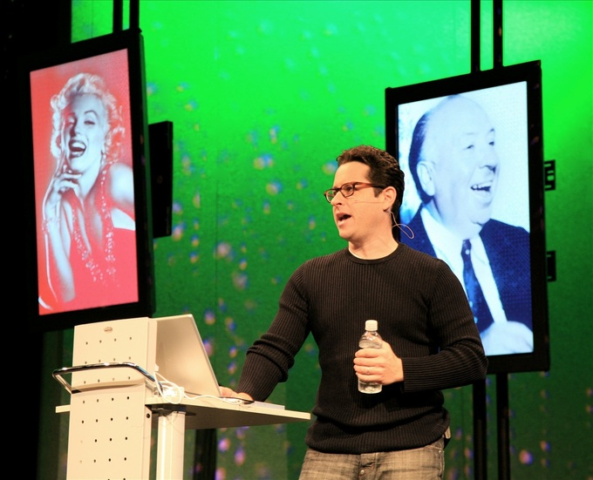
J.J. Abrams, "Apple Fanatic":
TV series creator J.J. Abrams can influence other people to buy certain products by saying how much he likes the product.

Slide 31
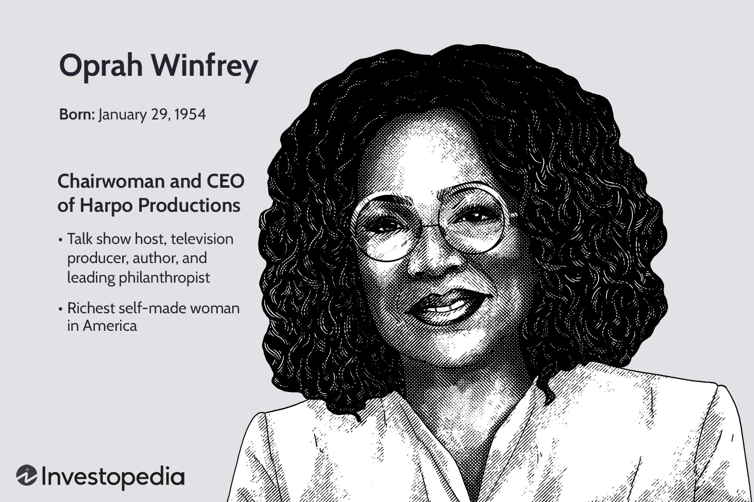
Case study
Oprah Winfrey

Slide 32
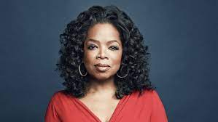
Why is Oprah Winfrey an influential person and how did she inspire others?
Oprah is known as one of the most influential and successful people in the world.
Oprah Winfrey is considered a role model to many individuals because of her tough childhood, wonderful charity work, her schools, and the true relationships with her fans.
Oprah stands out among many people on her ability to feel others' pain and help those people get through their troubling times.

Slide 33
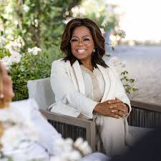
What has Oprah Winfrey done to help the world?
Oprah has long believed that education is the door to freedom, offering a chance at a brighter future. Through her private charity, she has awarded hundreds of grants to organizations that support the education and empowerment of women, children and families in the United States and around the world.

Slide 34
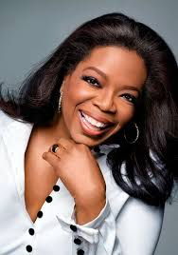
How does Oprah contribute to the economy?
The Oprah Effect was a boost in sales for companies and individuals featured by Oprah Winfrey, queen of daytime talk shows, on her TV program. Several well-known individuals with talk shows, such as Dr. Phil and health-expert Dr. Oz, received an initial boost to their careers from Oprah.

Slide 35
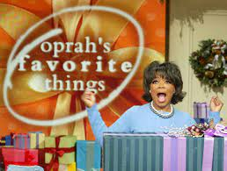
What are unique qualities of Oprah Winfrey?
Oprah's Key Behavioral Traits
Adjectives: Lively and social, caring, supportive, optimistic, ambitious, driven, focused, resilient, persistent, bold, strong, determined, confident, passionate, fast-paced and people-focused.

Slide 36
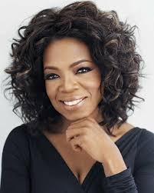
What skills made Oprah Winfrey successful?
Oprah's 5 Transferable Skills That Make Her Our Pick for President
The woman can communicate. Read any tome on leadership and a fundamental skill is the ability to effectively communicate a message. ...
She puts people first. ...
Her track record says one thing: success. ...
She's resilient. ...
She's innovative.

Slide 37
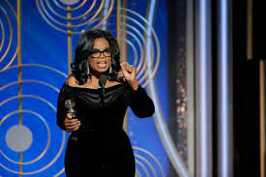
Oprah’s message
Her message and example of positivity
“live your best life”

Slide 38
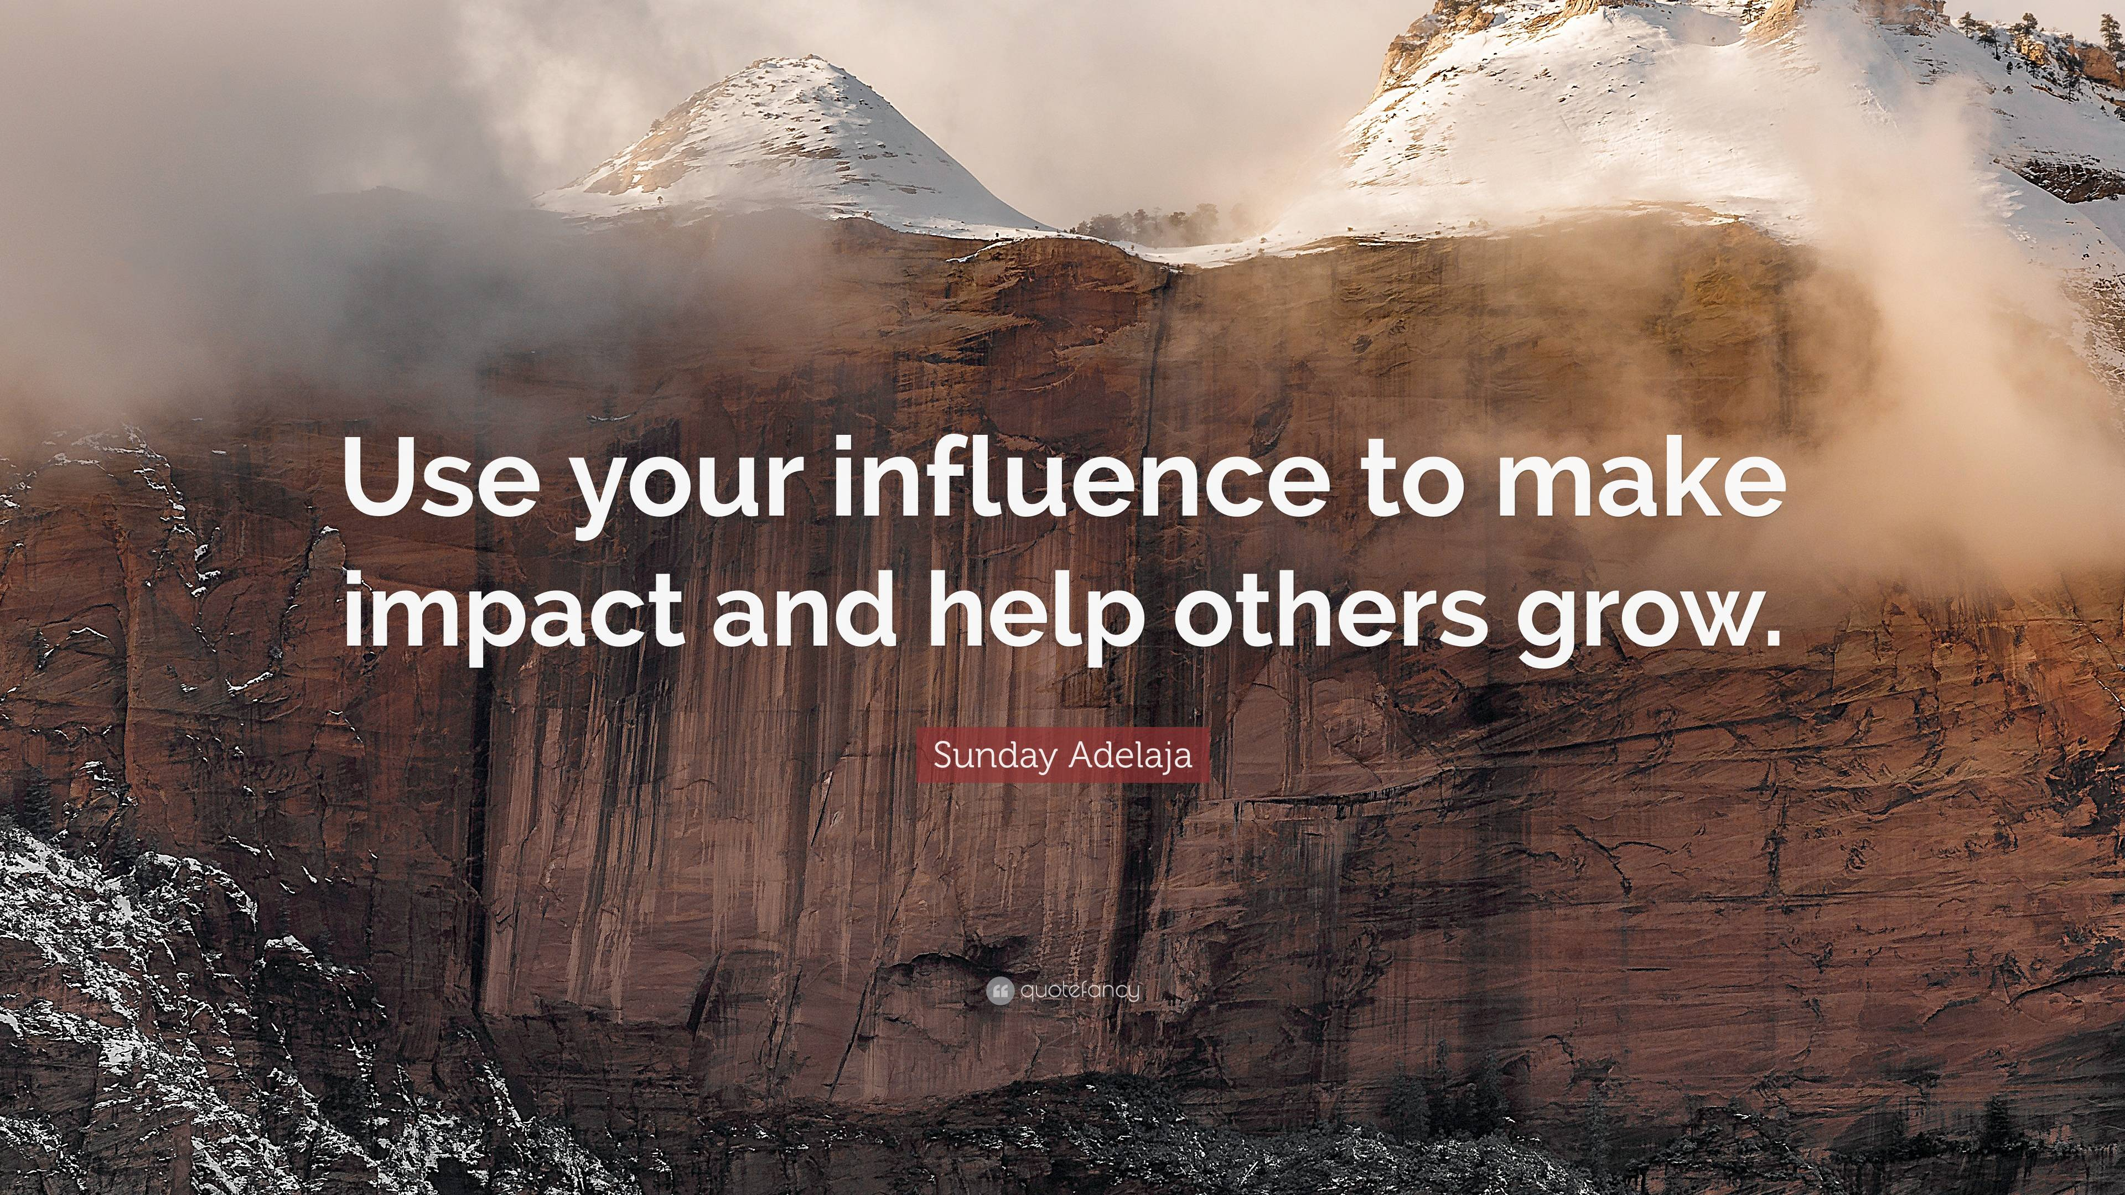
Think with yourself
Does every social media influencer is an entrepreneur ??

Slide 39
Exercise and activity
Consider a situation where you are trying to influence a situation / person
What is your natural style?
Validate which style should be used – understanding the audience and situation
Plan your approach – i.e. what you are trying to influence / what you can say or do in order to achieve your desired outcome?
In the live session we can give feedback to each other about our situation examples

Slide 40



Thank You

