Slide 1


Project Cost
Management
Prepared by
Dr. Hoda Metwally
PMG 213
Lecture 9

Slide 2


Project Cost
Management
Lecture 9
Total Quality Cost
Management and Lean
Prepared by:
Dr. Hoda Metwally
www.midocean.ae

Slide 3

What is Quality Costing?
A means of helping companies to reduce manufacturing costs by identifying excessive costs and NON-VALUE-ADDING ACTIVITIES
The total of the cost incurred by:
(a) investing in the prevention of non-conformances to requirement,
(b) appraising a product or service for conformance to requirement, and
(c) failing to meet requirements

Slide 4
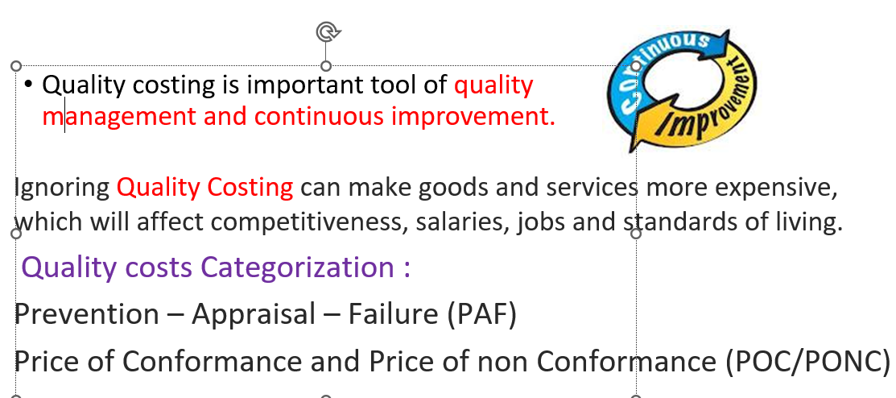

Slide 5
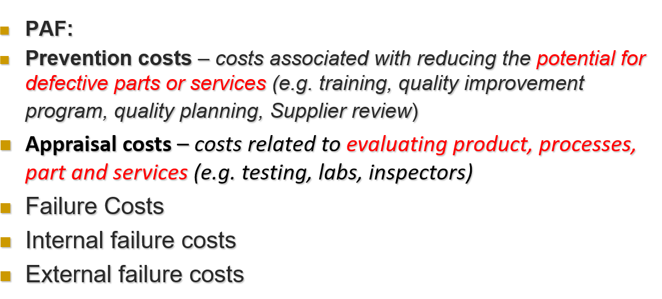

Slide 6
Internal failure – costs that results from production of defect part or service before delivery (e.g. scrap, rework)
External costs – costs that occur after delivery of defective parts or service (e.g. loss of customer, warranty, rework of return goods).

Slide 7
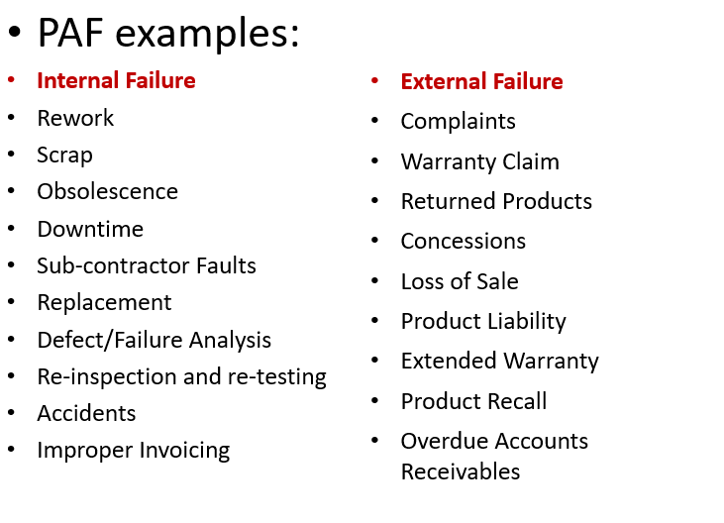

Slide 8
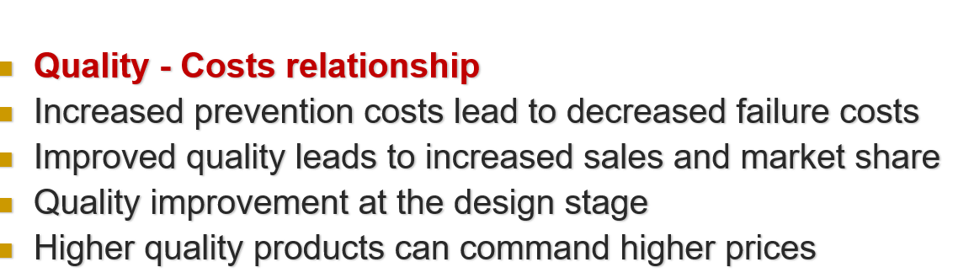

Slide 9
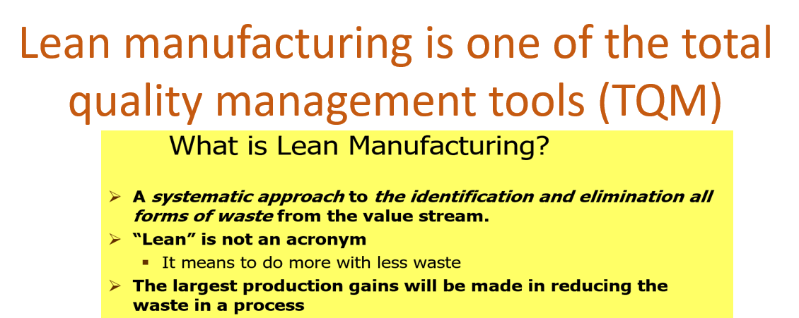

Slide 10
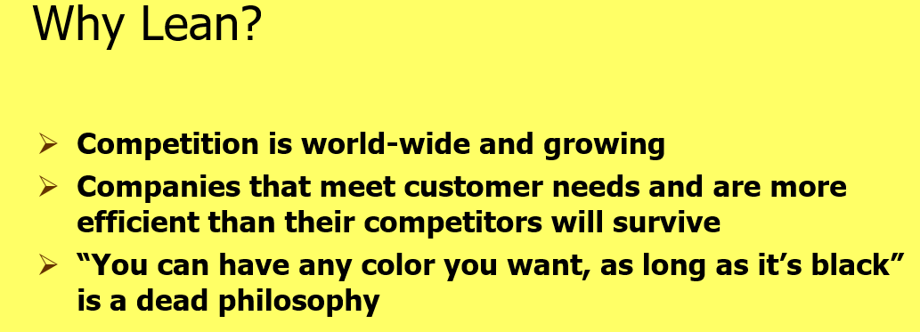

Slide 11
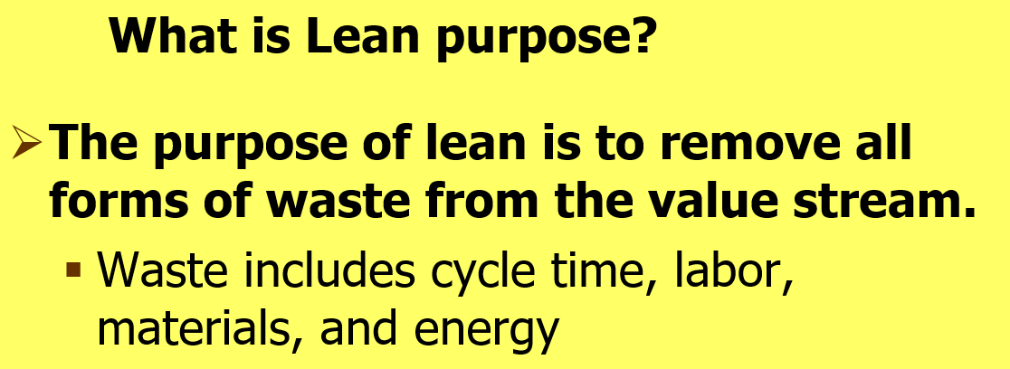

Slide 12
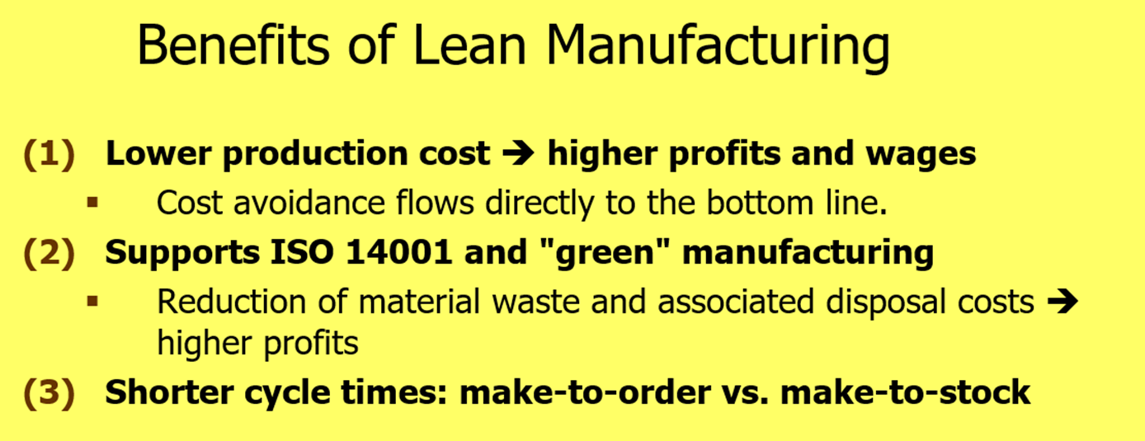

Slide 13
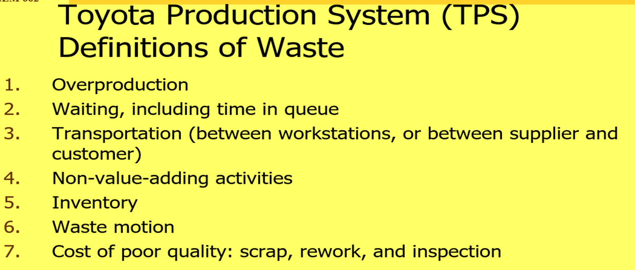

Slide 14
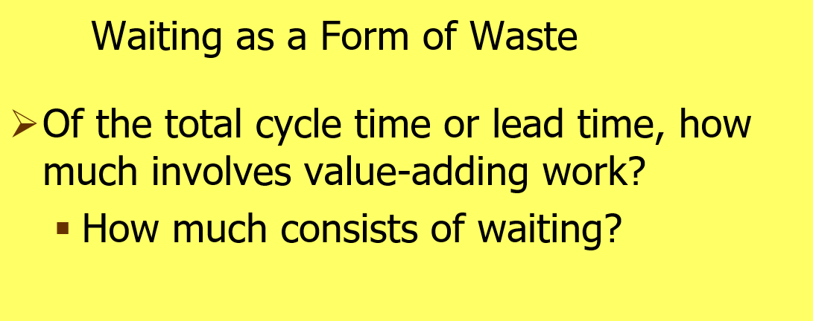

Slide 15
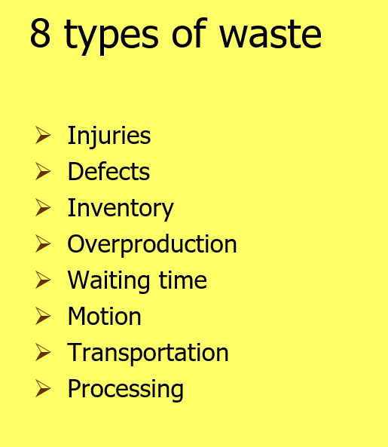

Slide 16
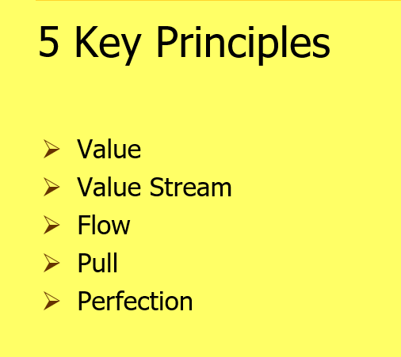

Slide 17
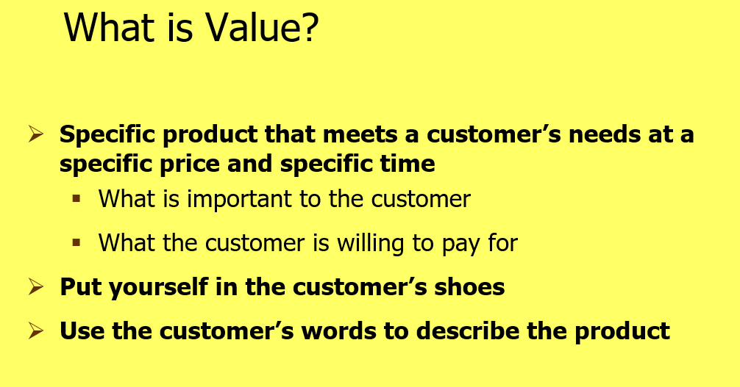

Slide 18
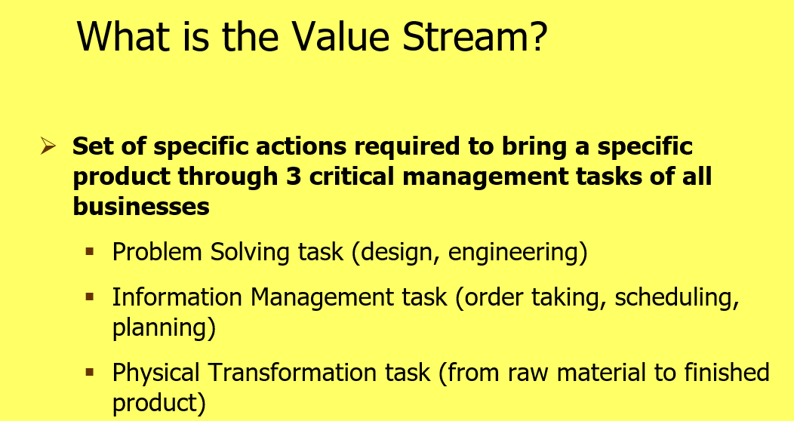

Slide 19
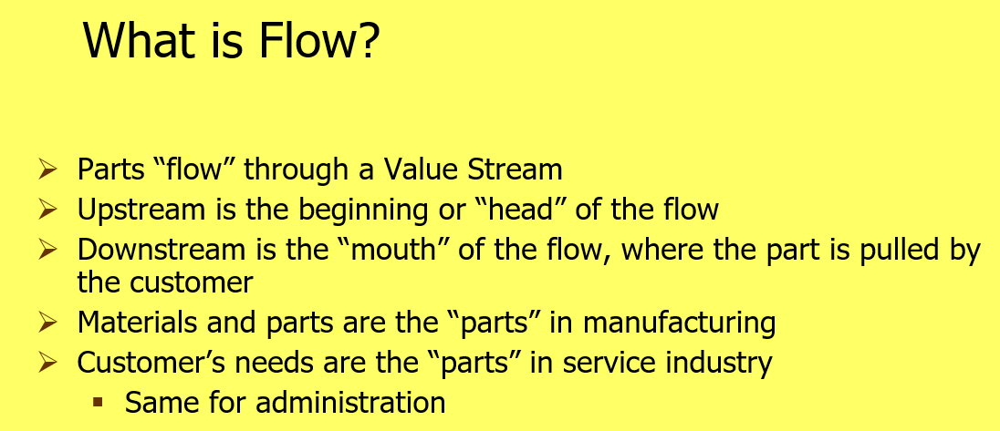

Slide 20
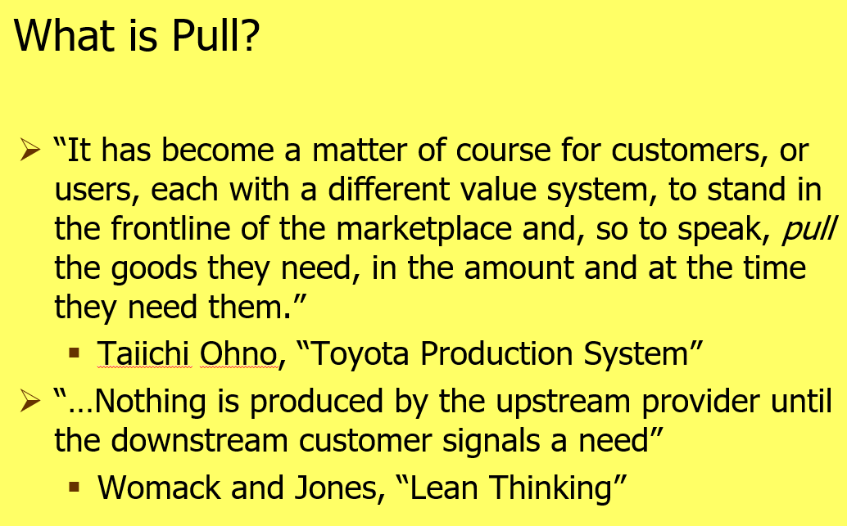

Slide 21
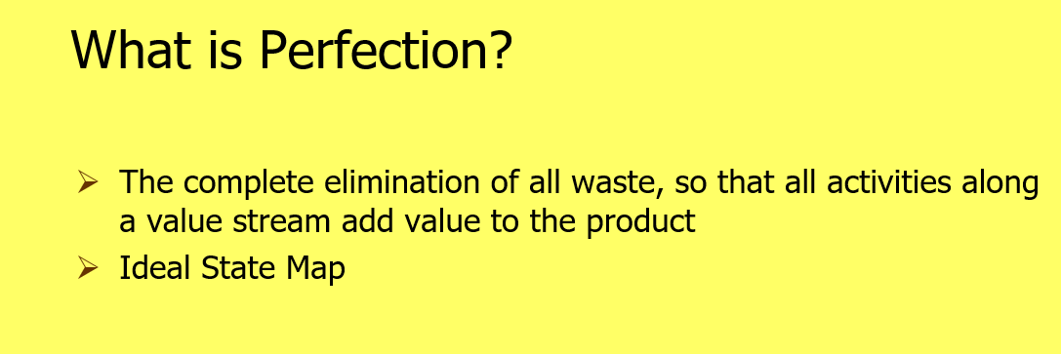

Slide 22

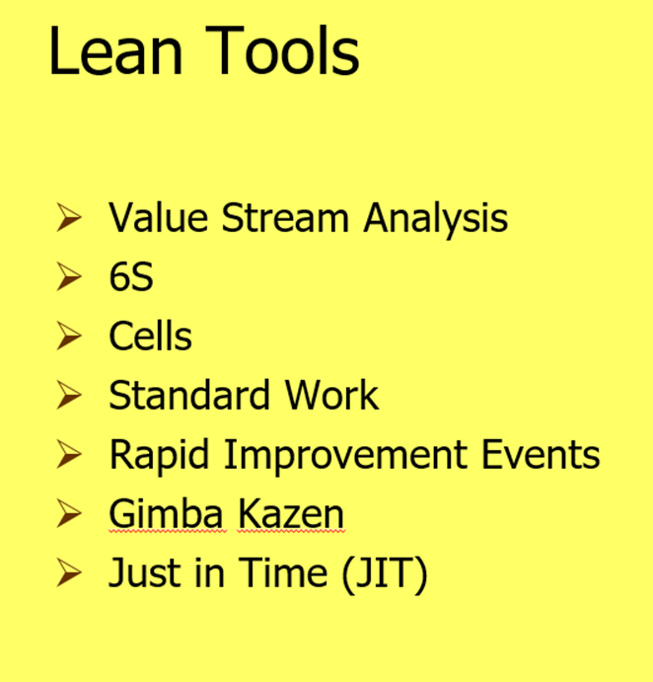

Slide 23
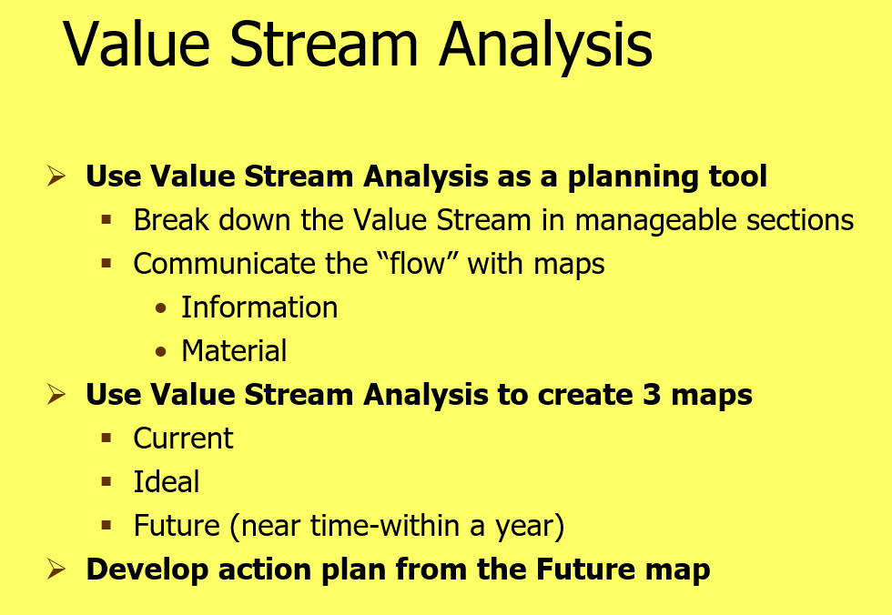

Slide 24
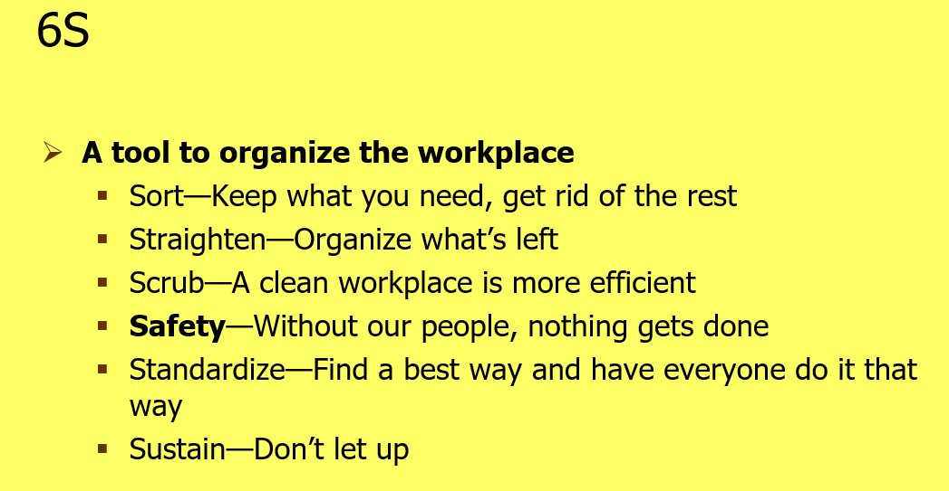

Slide 25
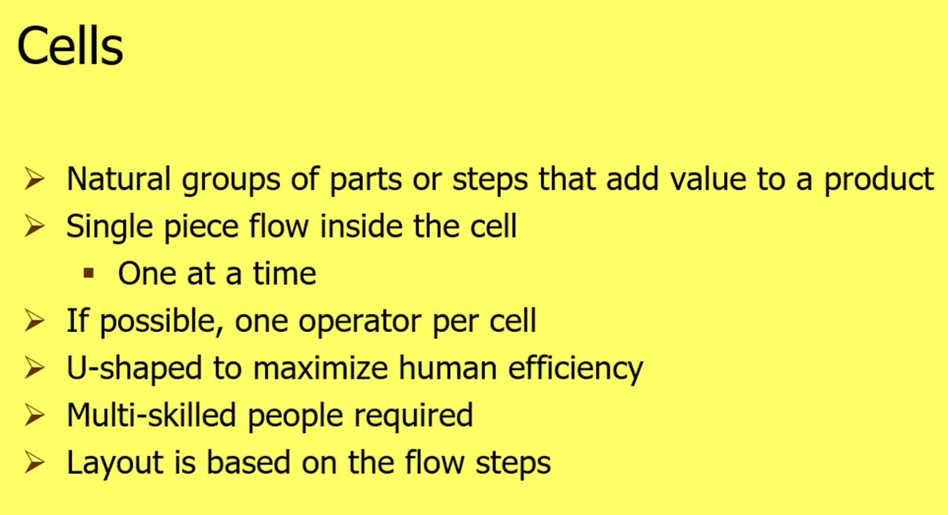

Slide 26
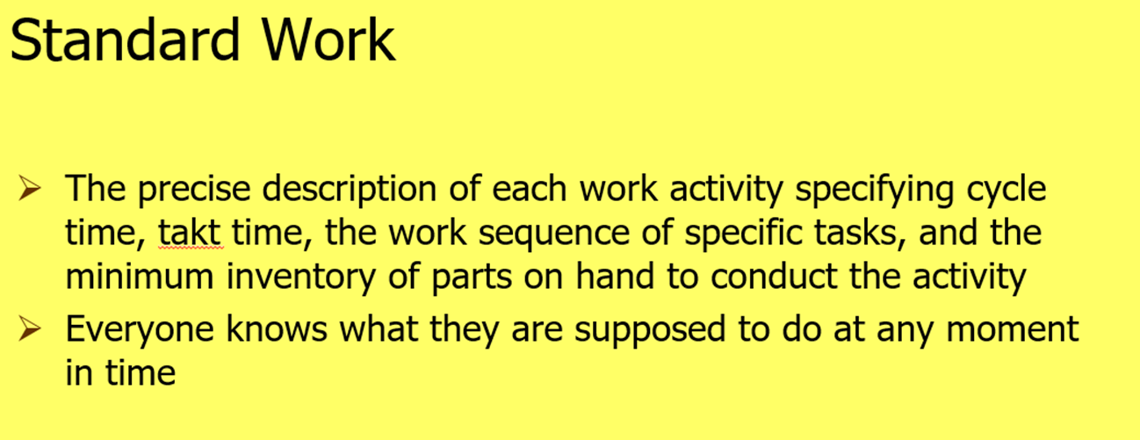

Slide 27
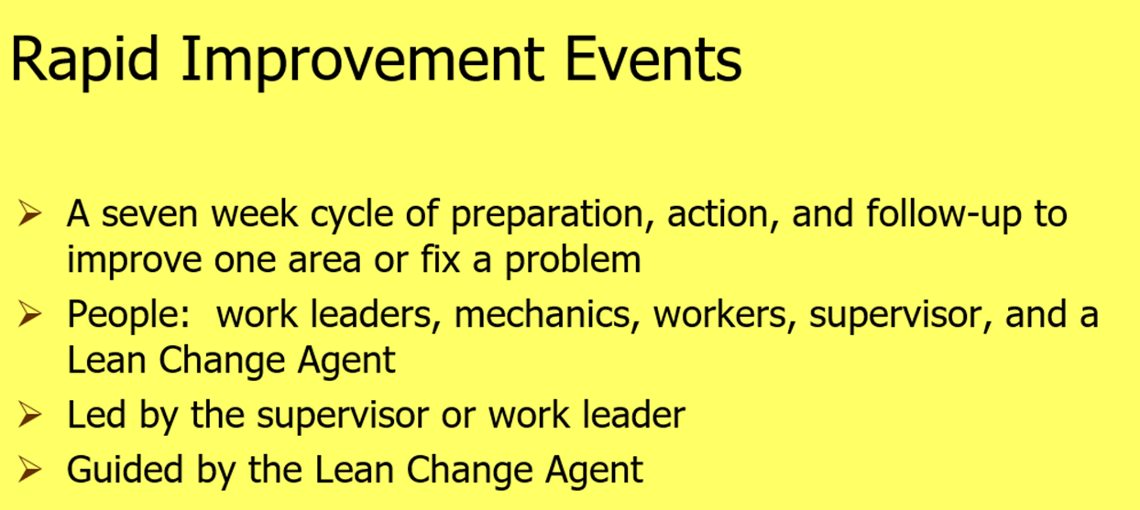

Slide 28
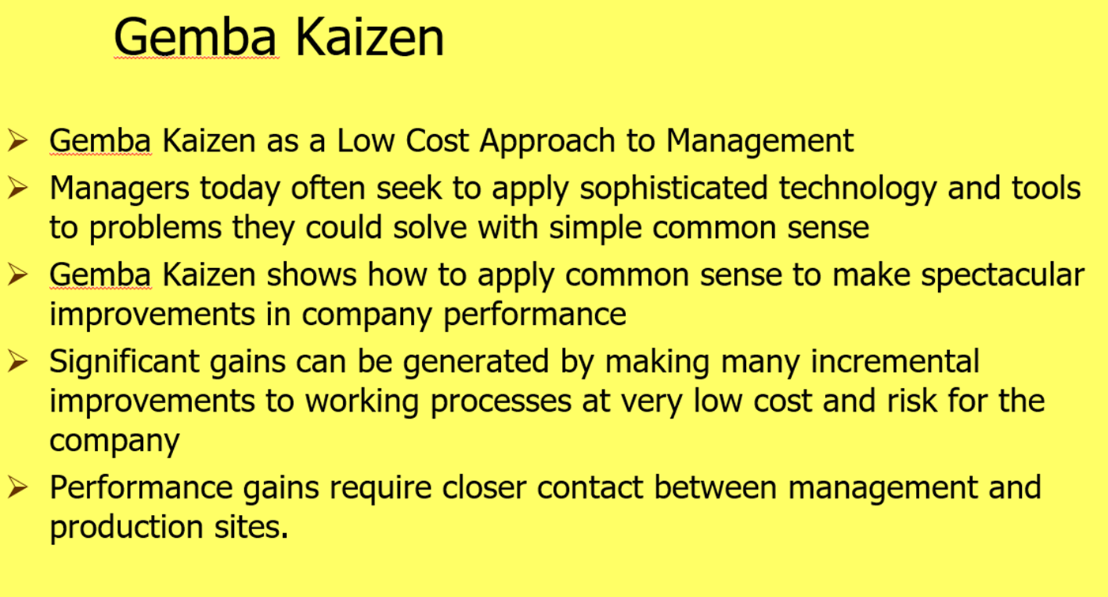

Slide 29
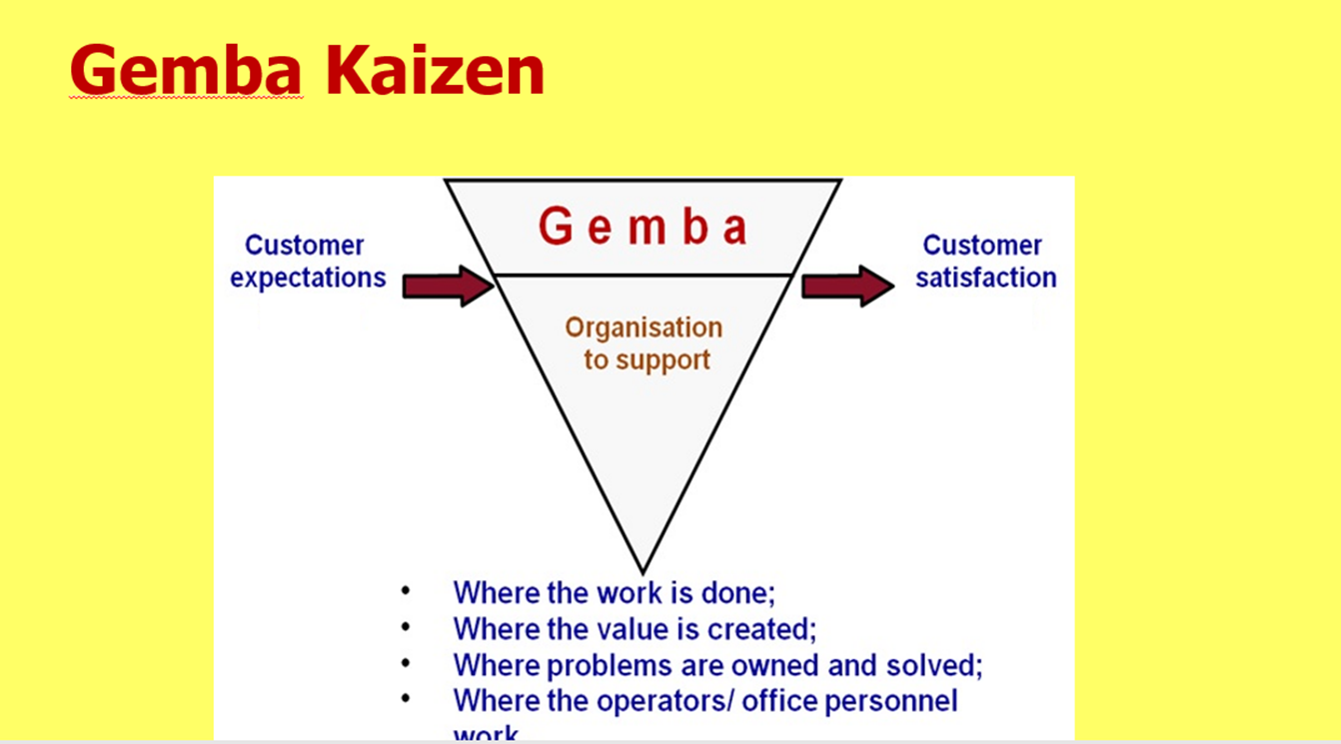

Slide 30
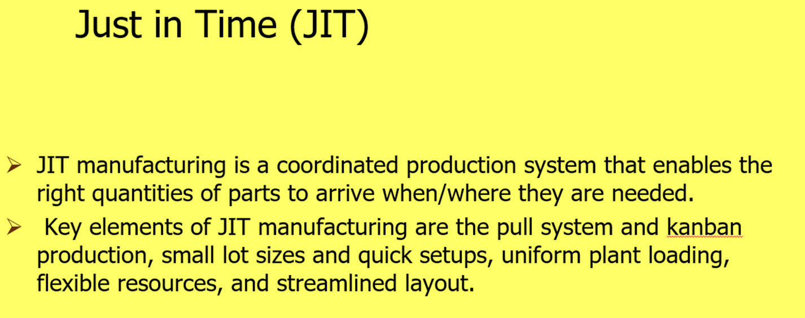

Slide 31
Summary:
Lean
Lean :A philosophy based on Toyota Production System that aimed at reducing the time from order to delivery by eliminating waste & non value adding activities, A culture of continuous improvement .
Lean Principles:
1-Provide customers with required value, quality and quantity on time
2-identify value from the customer view, map current activities

Slide 32
3-make the value flow (Value stream map), Pull from the supplier and perfect continuously
4-Sets up a waste elimination culture trying to be perfect.
It Focuses on:
-Waste elimination & non value adding activities
- improving the speed of production & its efficiency
It considers INVENTORY as a kind of waste so it adopts JIT.

Slide 33
Seven types of waste:
over-production, waiting, transportation, inappropriate processing, inventory, unnecessary motions and defects .
so, The five key principles of the lean organization are:
(1) Identify value (from the point of the customer).
(2) Measure the value stream.
(3) Pull on customer demand.
(4) Create flow.
(5) Achieve perfection
The lean production principles (3) and (4) are embedded or included in Total Quality Management theories, principles and tools .

Slide 34
Brieﬂy, lean is about controlling the resources in accordance with the customers’ needs and to reduce unnecessary waste (including the waste of time).
Lean concept : “A systematic approach to identify and eliminate waste through continuous improvement, ﬂowing the product at the pull of the customer in pursuit of perfection”

Slide 35
Methodologies and tools:
Lean principles are fundamentally customer value driven,
which makes them appropriate for many manufacturing and distribution situations.
Five basic principles of lean manufacturing are generally acknowledged:
(1) Understanding customer value. Only what the customers perceive as value is
important.
(2) Value stream analysis. Having understood the value for the customers, the next
step is to analyze the business processes to determine which ones actually add
value. If an action does not add value, it should be modiﬁed or eliminated from
the process.

Slide 36
(3) Flow. Focus on organizing a continuous ﬂow through the production or supply chain rather than moving commodities in large batches.
(4) Pull. Demand chain management prevents from producing commodities to
stock, i.e. customer demand pulls ﬁnished products through the system. No
work is carried out unless the result of it is required downstream.
(5) Perfection. The elimination of non-value-adding elements (waste) is a process of continuous improvement. “There is no end to reducing time, cost, space , mistakes, and effort”

Slide 37
The main elements contributing to the elimination of non-value-added
activities are the following:
excess production, excess processing, delays, transport,
inventory, defects and movement.
A variety of approaches are available for reducing or eliminating waste. These approaches include value stream analysis, total productive maintenance, Kaizen costing and cost analysis, engineering and change management, and document management. Tools used include Kanban cards for pull through the supply chain and the closely related JIT system for inventory reduction.

Slide 38
Effects:
There are many reasons to introduce lean techniques in an organization , as it may contribute substantially to cutting costs and providing competitive advantages.
Lean beneﬁts include reduced work-in-process, increased inventory turns, increased capacity, cycle-time reduction and improved customer satisfaction. These improvement areas include:
operational improvements (reduction of lead time, increase in productivity, reduction in work-in-process inventory, etc.),
administrative improvements (reduction in order processing errors, streamlining of customer service functions so that customers are no longer placed on hold, etc.) and strategic improvements (reduced costs, etc.).

Slide 39



Thank You

