Slide 1



Project Resources and Time Management
PMG 605
Lecture 2
Estimating Project Times and Costs
Prepared by
Dr. Eng. Abdullah Jameel Halawany

Slide 2

Lecture
Session Outline
02
Estimating Project Times and Costs
Why?
Factors Influencing the Quality of Estimates
Estimating Guidelines
Estimating Processes
Top-down
Bottom-up
Estimating Project: Preferred Approach
Level of Detail
Refining Estimates
Creating a Database for Estimating
Summary
2–2

Slide 3
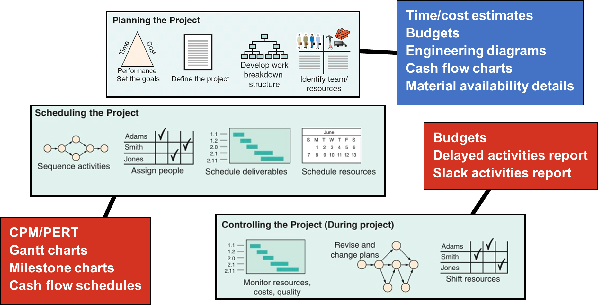
Lecture
Project Planning, Scheduling, and Controlling
02
2–3

Slide 4
Lecture
Resource of Investments
02
Manpower
(people – labors, mangers, etc.)
Machinery
(equipment)
Material
(include Money and Time)
We need at least tow of them to have a business. So, we need to estimate them before start for planning purposes.
2–4

Slide 5
Lecture
02
Why Estimating Project Times and Costs are Important?
To support good decisions.
To schedule work.
To determine how long the project should take and its cost.
To determine whether the project is worth doing.
To develop cash flow needs.
To determine how well the project is progressing.
To develop time-phased budgets and establish the project baseline.
2–5

Slide 6
Lecture
Estimating Costs Money!
02
Project stakeholders prefer accurate cost and time estimates.
They also understand the inherent uncertainty in all projects.
Inaccurate estimates lead to false expectations and consumer dissatisfaction.
Accuracy is improved with greater effort, but is it worth the time and cost?
Project estimating becomes a trade-off, balancing the benefits of better accuracy against the costs for securing increased accuracy.
2–6

Slide 7
Lecture
Factors Influencing the Quality of Estimates
02
A typical statement in the field is the desire to
“have a 95 percent probability of meeting time and cost estimates.”
Experience is a good starting point for developing time and cost estimates.
Experience estimates must almost always be refined by other considerations to reach the 95 percent probability level.
Factors related to the uniqueness of the project will have a strong influence on the accuracy of estimates.
2–7

Slide 8
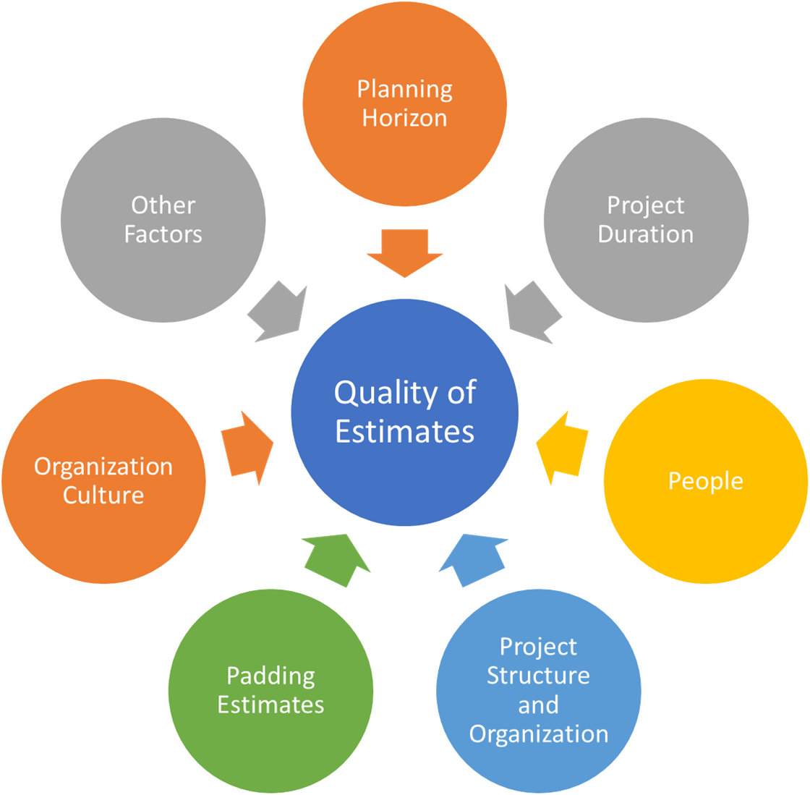
Lecture
Factors Influencing the Quality of Estimates
02
2–8

Slide 9
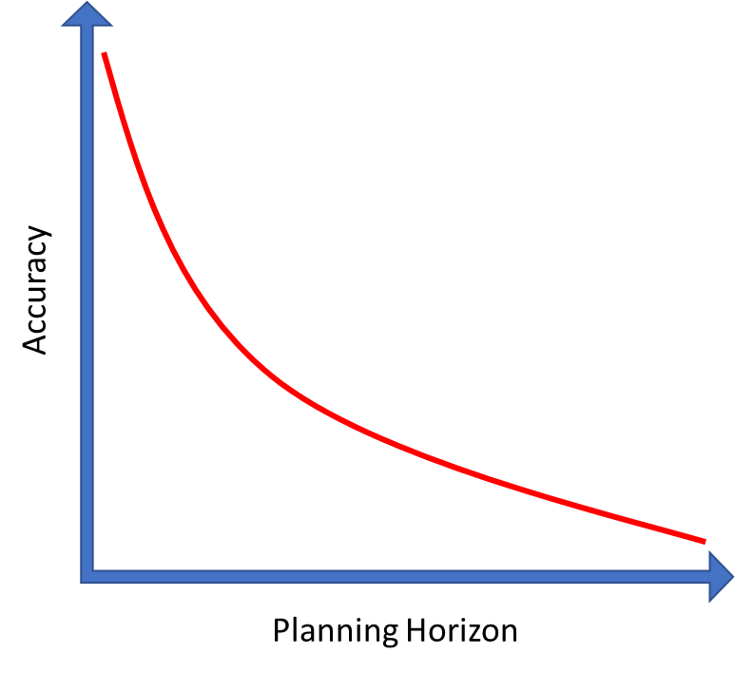
Lecture
02
Factors Influencing the Quality of Estimates
1. Planning Horizon
The quality of the estimate depends on the planning horizon
Estimates of current events are close to 100 percent accurate but are reduced for more distant events.
The accuracy of time and cost estimates should improve as you move from the conceptual phase to the point where individual work packages are defined.
2–9

Slide 10
Lecture
Factors Influencing the Quality of Estimates
02
2. Project Duration
Time to implement new technology has a habit of expanding in an increasing, nonlinear fashion.
Sometimes poorly written scope specifications for new technology result in errors in estimating times and costs.
Long-duration projects increase the uncertainty in estimates.
2–10

Slide 11
Lecture
02
Factors Influencing the Quality of Estimates
3. People
The people factor can also introduce errors in estimating times and cost.
Accuracy of estimates depends on the skills of the people making the estimates.
Matching of people skills to the task will influence productivity and learning time.
Similarly, whether members of the project team have worked together before on similar projects will influence the time it takes to coalesce into an effective team.
Sometimes factors such as staff turnover can influence estimates.
It should be noted that adding new people to a project increases time spent communicating.
2-11

Slide 12
Lecture
02
Factors Influencing the Quality of Estimates
4. Project Structure and Organization
Which project structure is chosen to manage the project will influence time and cost estimates.
One of the major advantages of a dedicated project team is the speed gained from concentrated focus and localized project decisions.
This speed comes at an additional cost of tying up personnel full time.
Conversely, projects operating in a matrix environment may reduce costs by more efficiently sharing personnel across projects but may take longer to complete since attention is divided and coordination demands are higher.
2-12

Slide 13
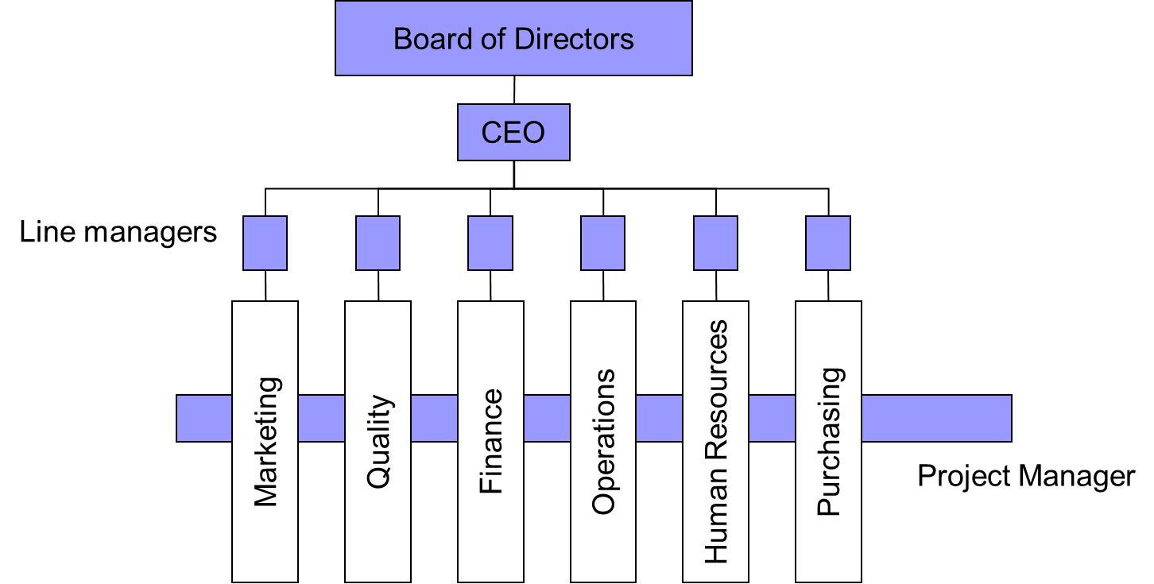
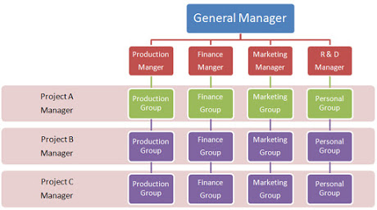
Lecture
02
Factors Influencing the Quality of Estimates
2-13

Slide 14
Lecture
Factors Influencing the Quality of Estimates
02
5. Padding Estimates
In some cases, people are inclined to pad estimates.
For example, if you are asked how long it takes you to drive to the airport, you might give an average time of 30 minutes, assuming a 50/50 chance of getting there in 30 minutes.
If you are asked the fastest you could possibly get there, you might reduce the driving time to 20 minutes.
Finally, if you are asked how long the drive would take if you absolutely had to be there to meet with the president, it is likely you would increase the estimate to say 50 minutes to ensure not being late.
2-14

Slide 15
Lecture
Factors Influencing the Quality of Estimates
02
6. Organization Culture
Organization culture shapes every dimension of project management; estimating is not immune to this influence.
In some organizations padding estimates is tolerated and even privately encouraged.
Other organizations place a premium on accuracy.
Organizations vary in the importance they attach to estimates.
In some organizations is that detailed estimating takes too much time and is not worth the effort or that it’s impossible to predict the future.
Other organizations belief that accurate estimates are the bedrock of effective project management.
2-15

Slide 16
Lecture
02
Factors Influencing the Quality of Estimates
7. Other Factors
Finally, non-project factors can impact time and cost estimates.
For example, equipment down-time can alter time estimates.
National holidays, vacations, and legal limits can influence project estimates.
Project priority can influence resource assignment and impact time and cost.
2-16

Slide 17
Lecture
02
Estimating Guidelines for Times, Costs, and Resources
Responsibility have people familiar with the tasks make the estimate
Use several people to make estimates
Base estimates on normal conditions, efficient methods, and a normal level of resources
Use consistent time units in estimating task times
Treat each task as independent, don’t aggregate.
Don’t make allowances for contingencies
Adding a risk assessment helps avoid surprises to stakeholders
2-17

Slide 18
Lecture
02
Estimating Guidelines for Times, Costs, and Resources
Responsibility.
At the work package level, estimates should be made by the person(s) most familiar with the task. Draw on their expertise! Except for super technical tasks, those responsible for getting the job done on schedule and within budget are usually first-line supervisors or technicians who are experienced and familiar with the type of work involved. These people will not have some preconceived, imposed duration for a deliverable in mind. A secondary benefit of using those responsible is the hope they will “buy in” to seeing that the estimate materializes when they implement the work package.
2-18

Slide 19
Lecture
02
Estimating Guidelines for Times, Costs, and Resources
2. Use Several People to Estimate.
It is well known that a cost or time estimate usually has a better chance of being reasonable and realistic when several people with relevant experience and/or knowledge of the task are used. True, people bring different biases based on their experience. But discussion of the individual differences in their estimate leads to consensus and tends to eliminate extreme estimate errors. This approach is similar to the Delphi estimating method, which can also be used.
2-19

Slide 20
Lecture
02
Estimating Guidelines for Times, Costs, and Resources
3. Normal Conditions.
When task time, cost, and resource estimates are determined, they are based on certain assumptions. Estimates should be based on normal conditions, efficient methods, and a normal level of resources. Normal conditions are sometimes difficult to discern, but it is necessary to have a consensus in the organization as to what normal conditions mean in this project.
2-20

Slide 21
Lecture
02
Estimating Guidelines for Times, Costs, and Resources
4. Time Units.
Specific time units to use should be selected early in the development phase of the project network. All task time estimates need consistent time units. Estimates of time must consider whether normal time is represented by calendar days, workdays, workweeks, person days, single shift, hours, minutes, etc. In practice the use of workdays is the dominant choice for expressing task duration. However, in projects such as a heart transplant operation, minutes probably would be more appropriate as a time unit.
2-21

Slide 22
Lecture
02
Estimating Guidelines for Times, Costs, and Resources
5. Independence.
Estimators should treat each task as independent of other tasks that might be integrated by the WBS.
Use of first-line managers usually results in considering tasks independently
Top managers are prone to aggregate many tasks into one time estimate
2-22

Slide 23
Lecture
02
Estimating Guidelines for Times, Costs, and Resources
6. Contingencies.
Work package estimates should not include allowances for contingencies.
The estimate should assume normal or average conditions even though every work package will not materialize as planned.
For this reason, top management needs to create an extra fund for contingencies that can be used to cover unforeseen events.
2-23

Slide 24
Lecture
02
Estimating Guidelines for Times, Costs, and Resources
7. Adding risk assessment to the estimate helps to avoid surprises to stakeholders.
It is obvious some tasks carry more time and cost risks than others.
For example, a new technology usually carries more time and cost risks than a proven process.
Simply identifying the degree of risk lets stakeholders consider alternative methods and alter process decisions.
A simple breakdown by optimistic, most likely, and pessimistic for task time could provide valuable information regarding time and cost.
2-24

Slide 25
As A Project Manager May Hear Statements Such As
Rough order of magnitude is good enough. Spending time on detailed estimating wastes money.
Time is everything; our survival depends on getting there first! Time and cost accuracy is not an issue.
The project is internal. We don’t need to worry about cost.
The project is so small. We don’t need to bother with estimates. Just do it.
We were burned once. I want a detailed estimate of every task by the people responsible.
NEVER
Skip Estimating
2-25

Slide 26
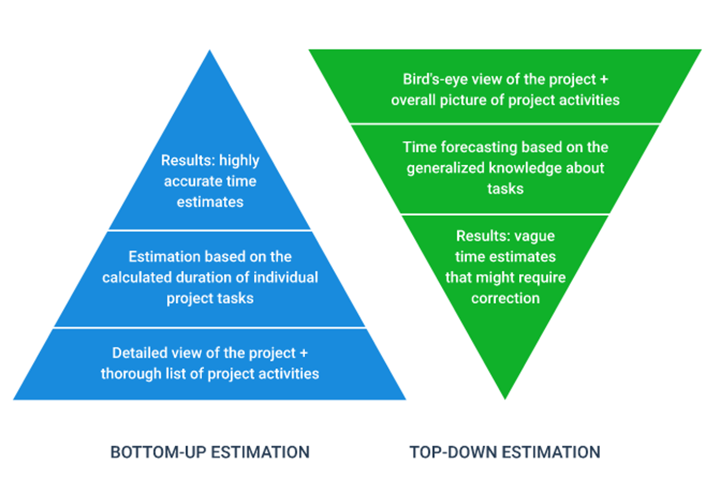
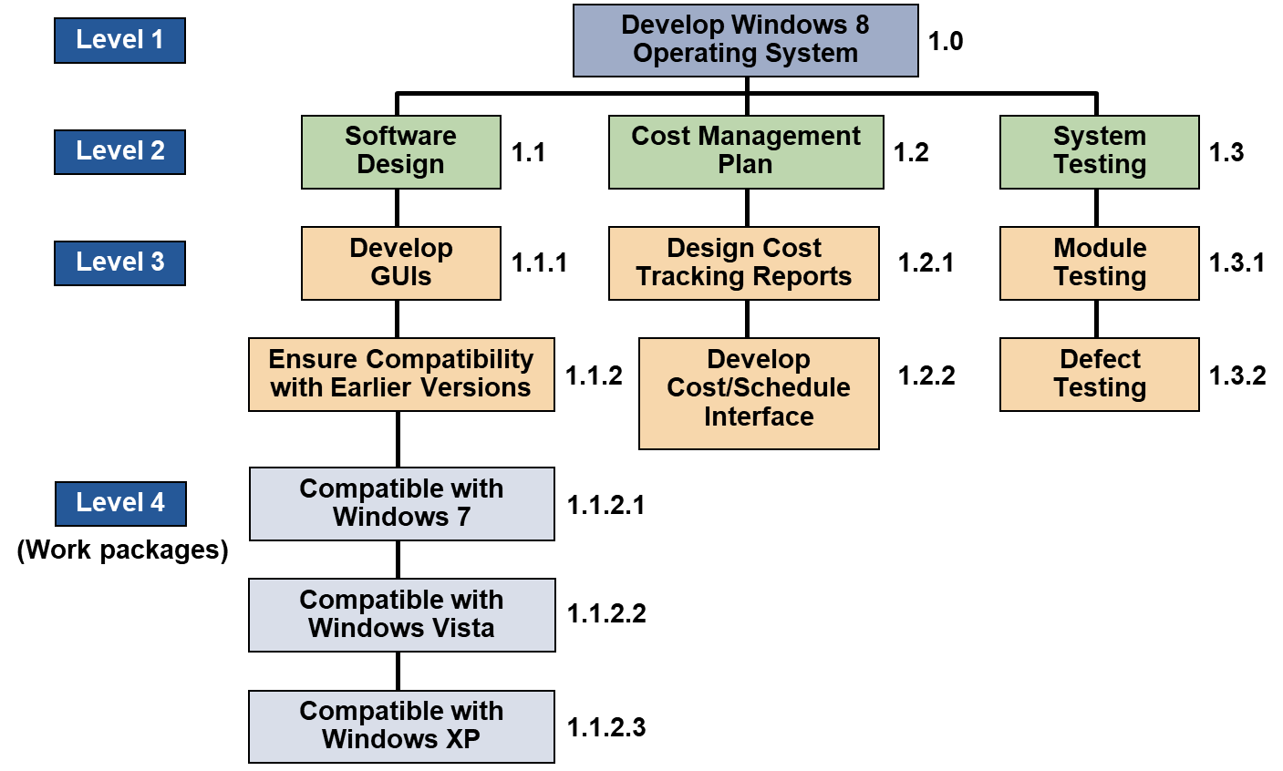
Lecture
Estimating Processes
02
2-26

Slide 27
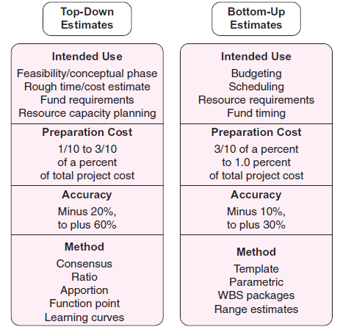
Lecture
02
Differences Between Top-down and Bottom-up Estimates
2-27

Slide 28
Lecture
Top-Down versus Bottom-Up Estimating
02
Top-Down Estimates
Are usually are derived from someone who uses experience and/or information to determine the project duration and total cost.
Used at the strategic level to evaluate the project proposal. Sometimes much of the information needed to derive accurate time and cost estimates is not available in the initial phase of the project
Bottom-Up Approach
Can serve as a check on cost elements in the WBS by rolling up the work packages and associated cost accounts to major deliverables at the work package level.
2-28

Slide 29
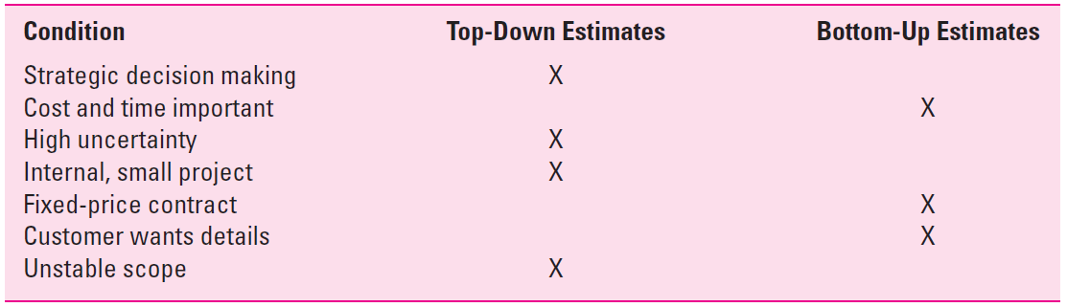
Lecture
Top-Down versus Bottom-Up Estimating
02
Conditions that suggest when one approach is preferred over another
2-29

Slide 30
Lecture
Estimating Project: Preferred Approach
02
Make Rough Top-down Estimates.
Develop The WBS/OBS.
Make Bottom-up Estimates.
Develop Schedules and Budgets.
Reconcile Differences Between Top-down and Bottom-up Estimates
2-30

Slide 31
Top-Down Approaches for Estimating Times and Costs
Consensus methods
Ratio methods
Apportion method
Function point methods for software and system projects
2-31

Slide 32
Lecture
Top-Down Approach - Consensus Methods
02
This method simply uses the pooled experience of senior and/or middle managers to estimate the total project duration and cost.
Meeting where experts discuss, argue, and ultimately reach a decision as to their best guess estimate.
Delphi Method to make these macro estimates.
Occur in the “conceptual” stage of the project.
2-32

Slide 33
Lecture
Top-Down Approach - Ratio Methods
02
Sometimes called Parametric
For example, contractors frequently use number of square feet to estimate the cost and time to build a house
Cost per square foot = $160
House of 2,700 square feet cost = 2,700 X $160 = $432,00
2-33

Slide 34
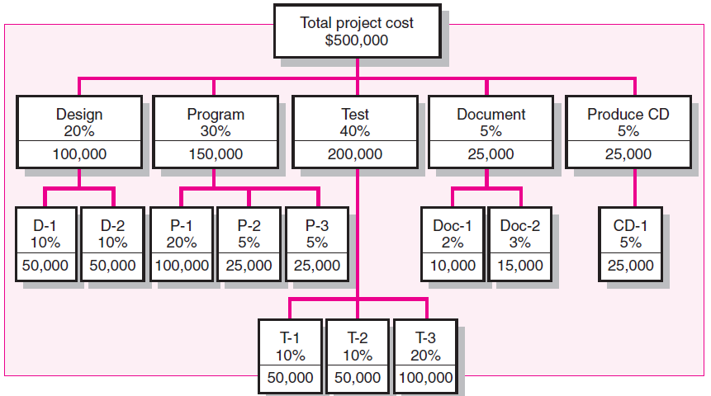
Lecture
Top-Down Approach - Apportion Methods
02
Extension to the ratio method.
Used when projects closely follow past projects in features and costs.
Given good historical data, estimates can be made quickly with little effort and reasonable accuracy.
This method is very common in projects that are relatively standard but have some small variation or customization.
Authorize pay to the contractor by completion of specific segments of project.
2-34

Slide 35
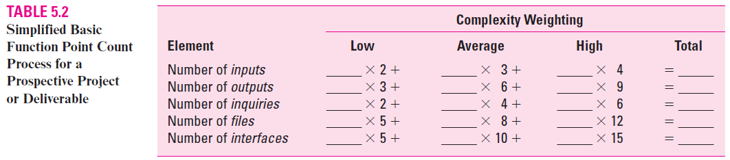
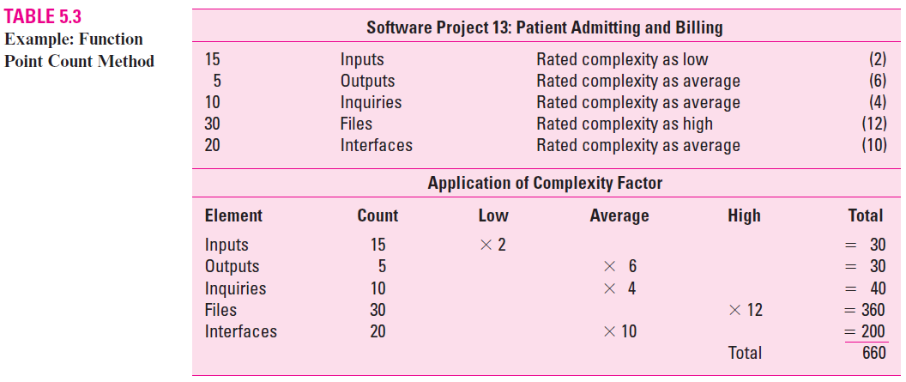
Lecture
Top-Down Approach - Function Point Methods For Software And System Projects
02
Software development projects are frequently estimated using weighted macro variables called “function points”
2-35

Slide 36
Top-Down Approach - Function Point Methods For Software And System Projects
Lecture
02
If that one-person has historically been equal to 5 function points per month, the job will require 132 person months (660/5 = 132).
Assuming you have 10 programmers who can work on this task, the duration would be (132/10) 13.2 months.
The cost is easily derived by the labor rate per month
If the monthly programmer rate is $4,000, then the estimated cost would be $528,000 (13.2X10 X 4,000).
2-36

Slide 37
Bottom-Up Approaches for Estimating Times and Costs
Template methods
Parametric procedures applied to specific tasks
Range estimates for the WBS work packages
Phase estimating: A hybrid
2-37

Slide 38
Lecture
02
Bottom-Up Approaches for Estimating Times and Costs
Template methods
  If the project is like past projects, the costs from past projects can be used as a starting point for the new project. Differences in the new project can be noted and past times and costs adjusted to reflect these differences.
Parametric procedures applied to specific tasks
Range estimates for the WBS work packages
  Significant uncertainty associated with the time or cost to complete
2-38

Slide 39
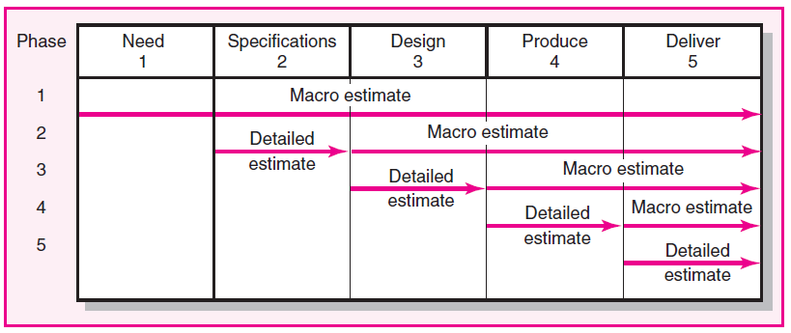
Lecture
02
Bottom-Up Approaches - Phase estimating: A hybrid
This approach begins with a top-down estimate for the project and then refines estimates for phases of the project as it is implemented.
Some projects by their nature cannot be rigorously defined because of the uncertainty of design or the final product. Although rare, such projects do exist.
2-39

Slide 40
Lecture
Level of Detail
02
Level of detail is different for different levels of management.
Level of detail in the WBS varies with the complexity of the project.
Excessive detail is costly.
  Fosters a focus on departmental outcomes
  Creates unproductive paperwork
Insufficient detail is costly.
  Lack of focus on goals
  Wasted effort on nonessential activities
2-40

Slide 41
Lecture
Refining Estimates
02
The practice of adjusting original estimates by 20 or even 100 percent.
Why, after investing so much time and energy on detailed estimates, could the numbers be so far off?
There are several reasons for this, most of which can be traced to the estimating process and the inherent uncertainty of predicting the future.
Some of these reasons are:
2-41

Slide 42
Lecture
Refining Estimates
02
Interaction costs are hidden in estimates.
According to the guidelines, each task estimate is supposed to be done independently.
However, tasks are rarely completed in a vacuum.
Work on one task is dependent upon prior tasks, and the hand-offs between tasks require time and attention.
For example, people working on prototype development need to interact with design engineers after the design is completed, whether to simply ask clarifying questions or to make adjustments in the original design.
Similarly, the time necessary to coordinate activities is typically not reflected in independent estimates.
2-42

Slide 43
Lecture
Refining Estimates
02
Normal conditions do not apply.
Estimates are supposed to be based on normal conditions.
While this is a good starting point, it rarely holds true in real life.
This is especially true when it comes to the availability of resources.
Resource shortages, whether in the form of people, equipment, or materials, can extend original estimates.
2-43

Slide 44
Lecture
Refining Estimates
02
Things go wrong on projects.
Design flaws are revealed after the fact
Extreme weather conditions occur, accidents happen, and so forth.
Although you shouldn’t plan for these risks to happen when estimating a particular task, the likelihood and impact of such events need to be considered.
2-44

Slide 45
Lecture
Refining Estimates
02
Changes in project scope and plans.
As one gets further and further into the project, a manager obtains a better understanding of what needs to be done to accomplish the project.
This may lead to major changes in project plans and costs.
Likewise, if the project is a commercial project, changes often have to be made midstream to respond to new demands by the customer and/or competition.
Unstable project scopes are a major source of cost overruns.
While every effort should be made up front to nail down the project scope, it is becoming increasingly difficult to do so in our rapidly changing world.
2-45

Slide 46
Lecture
Creating a Database for Estimating
02
The best way to improve estimates is to collect and archive data on past project estimates and actuals.
Saving historical data—estimates and actuals—provides a knowledge base for improving project time and cost estimating.
Creating an estimating database is a “best practice” among leading project management organizations.
2-46

Slide 47
Summary of Today Session
Lecture
02
Estimating Project Times and Costs
PMG 605
Project Resources and Time Management
2–47

Slide 48
Lecture
Summary of Today Session
02
Quality time and cost estimates are the bedrock of project control.
Experience is the best starting point for these estimates.
The quality of estimates is influenced by other factors such as people, technology, and downtimes.
Using top-down estimates is good for initial and strategic decision making or in situations where the costs associated with developing better estimates have little benefit.
In most cases the bottom-up approach to estimating is preferred and more reliable because it assesses each work package, rather than the whole project, section, or deliverable of a project.
Estimating time and costs for each work package facilitates development of the project schedule and a time-phased budget, which are needed to control the project as it is implemented.
2-48

Slide 49
Lecture
Summary of Today Session (cont.)
02
Using the estimating guidelines will help eliminate many common mistakes made by those unacquainted with estimating times and costs for project control.
Establishing a time and cost estimating database fits well with the learning organization philosophy.
The level of time and cost detail should follow the old saying of “no more than is necessary and sufficient.”
The main disadvantage of top-down approaches to estimating is simply that the time and cost for a specific task are not considered. Grouping many tasks into a common basket encourages errors of omission and the use of imposed times and costs.
Accurate estimates reduce uncertainty and support a discipline for effectively managing projects.
2-49

Slide 50
Resources
Project Management
The Managerial Process
Fifth Edition
By: Erik W. Larson
Oregon State University
Clifford F. Gray
Oregon State University
2–50

Slide 51



Thank You

